Slide 1
Get Started with Data Science in Microsoft Fabric
Module 14

Slide 2
The Data Science Process
Define the Problem
Get the Data
Prepare the Data
Train the Model
Generate Insights
Notes:
To train a machine learning model, the process commonly involves the following steps:
Define the problem: Together with business users and analysts, decide on what the model should predict and when it's successful.
Get the data: Find data sources and get access by storing your data in a Lakehouse.
Prepare the data: Explore the data by reading it from a Lakehouse into a notebook. Clean and transform the data based on the model's requirements.
Train the model: Choose an algorithm and hyperparameter values based on trial and error by tracking your experiments with MLflow.
Generate insights: Use model batch scoring to generate the requested predictions.
As a data scientist, most of your time is spent on preparing the data and training the model. How you prepare the data and which algorithm you choose to train a model can influence your model's success.
When experimenting, you want to keep an overview of all the different models you've trained. You want to understand how your choices influence the model's success. By tracking your experiments with MLflow in Microsoft Fabric, you're able to easily manage and deploy the models you've trained.

Slide 3
Data Science Components
Notebooks attached to Spark compute
Data Wrangler
MLFlow
Notes:
Notebooks are used to ingest and prepare data.
Data Wrangler offers some exploration and cleansing capabilities, writing all commands back to the notebook.
You can prepare and train a model by using open-source libraries available for the language of your choice. For example, if you work with Python, you can prepare the data with Pandas and Numpy, and train a model with libraries like Scikit-Learn, PyTorch, or SynapseML. When experimenting, you want to keep an overview of all the different models you've trained. You want to understand how your choices influence the model's success. By tracking your experiments with MLflow in Microsoft Fabric, you're able to easily manage and deploy the models you've trained.

Slide 4
Example Implementation
Use the Fabric notebooks for data science scenarios.
Ingest data into a Fabric lakehouse using Apache Spark.
Load existing data from the lakehouse delta tables.
Clean and transform data using Apache Spark.
Create experiments and runs to train a machine learning model.
Register and track trained models using MLflow and the Fabric UI.
Run scoring at scale and save predictions and inference results to the lakehouse.
Visualize predictions in Power BI using DirectLake.
Notes:
An example of a data science implementation in fabric is a s follows.
Use a Spark notebook to get data from a lakehouse.
Clean and transform the data using the notebook, possibly with the help fo Data Wrangler.
Create experiments and track your progress.
Save a model.
Run the notebook to predict values with a new dataset and save the data back to the lakehouse
Use Power BI to visualize results

Slide 5
Notebooks
Manipulate and visualize data
Combine visuals and explanatory text to share with others
Use your language and libraries of choice
Code snippets to speed up common tasks
Show results as table or chart
Notes:
Notebooks are the core of the data science experience. They can be used to ingest, manipulate, and visualize data.
Notebooks allow you to combine text, code, and visuals to share with others. You can pick your language, but it’s usually PySpark/Spark SQL or SparkR.
There are many built-in libraries such as seaboarn, matplotlib, and numpy to help you analyze your data
Code snippets in the notebook can help you ingest data from a table with a single click .
The results pane in the notebook can be switched between table and chart view

Slide 6
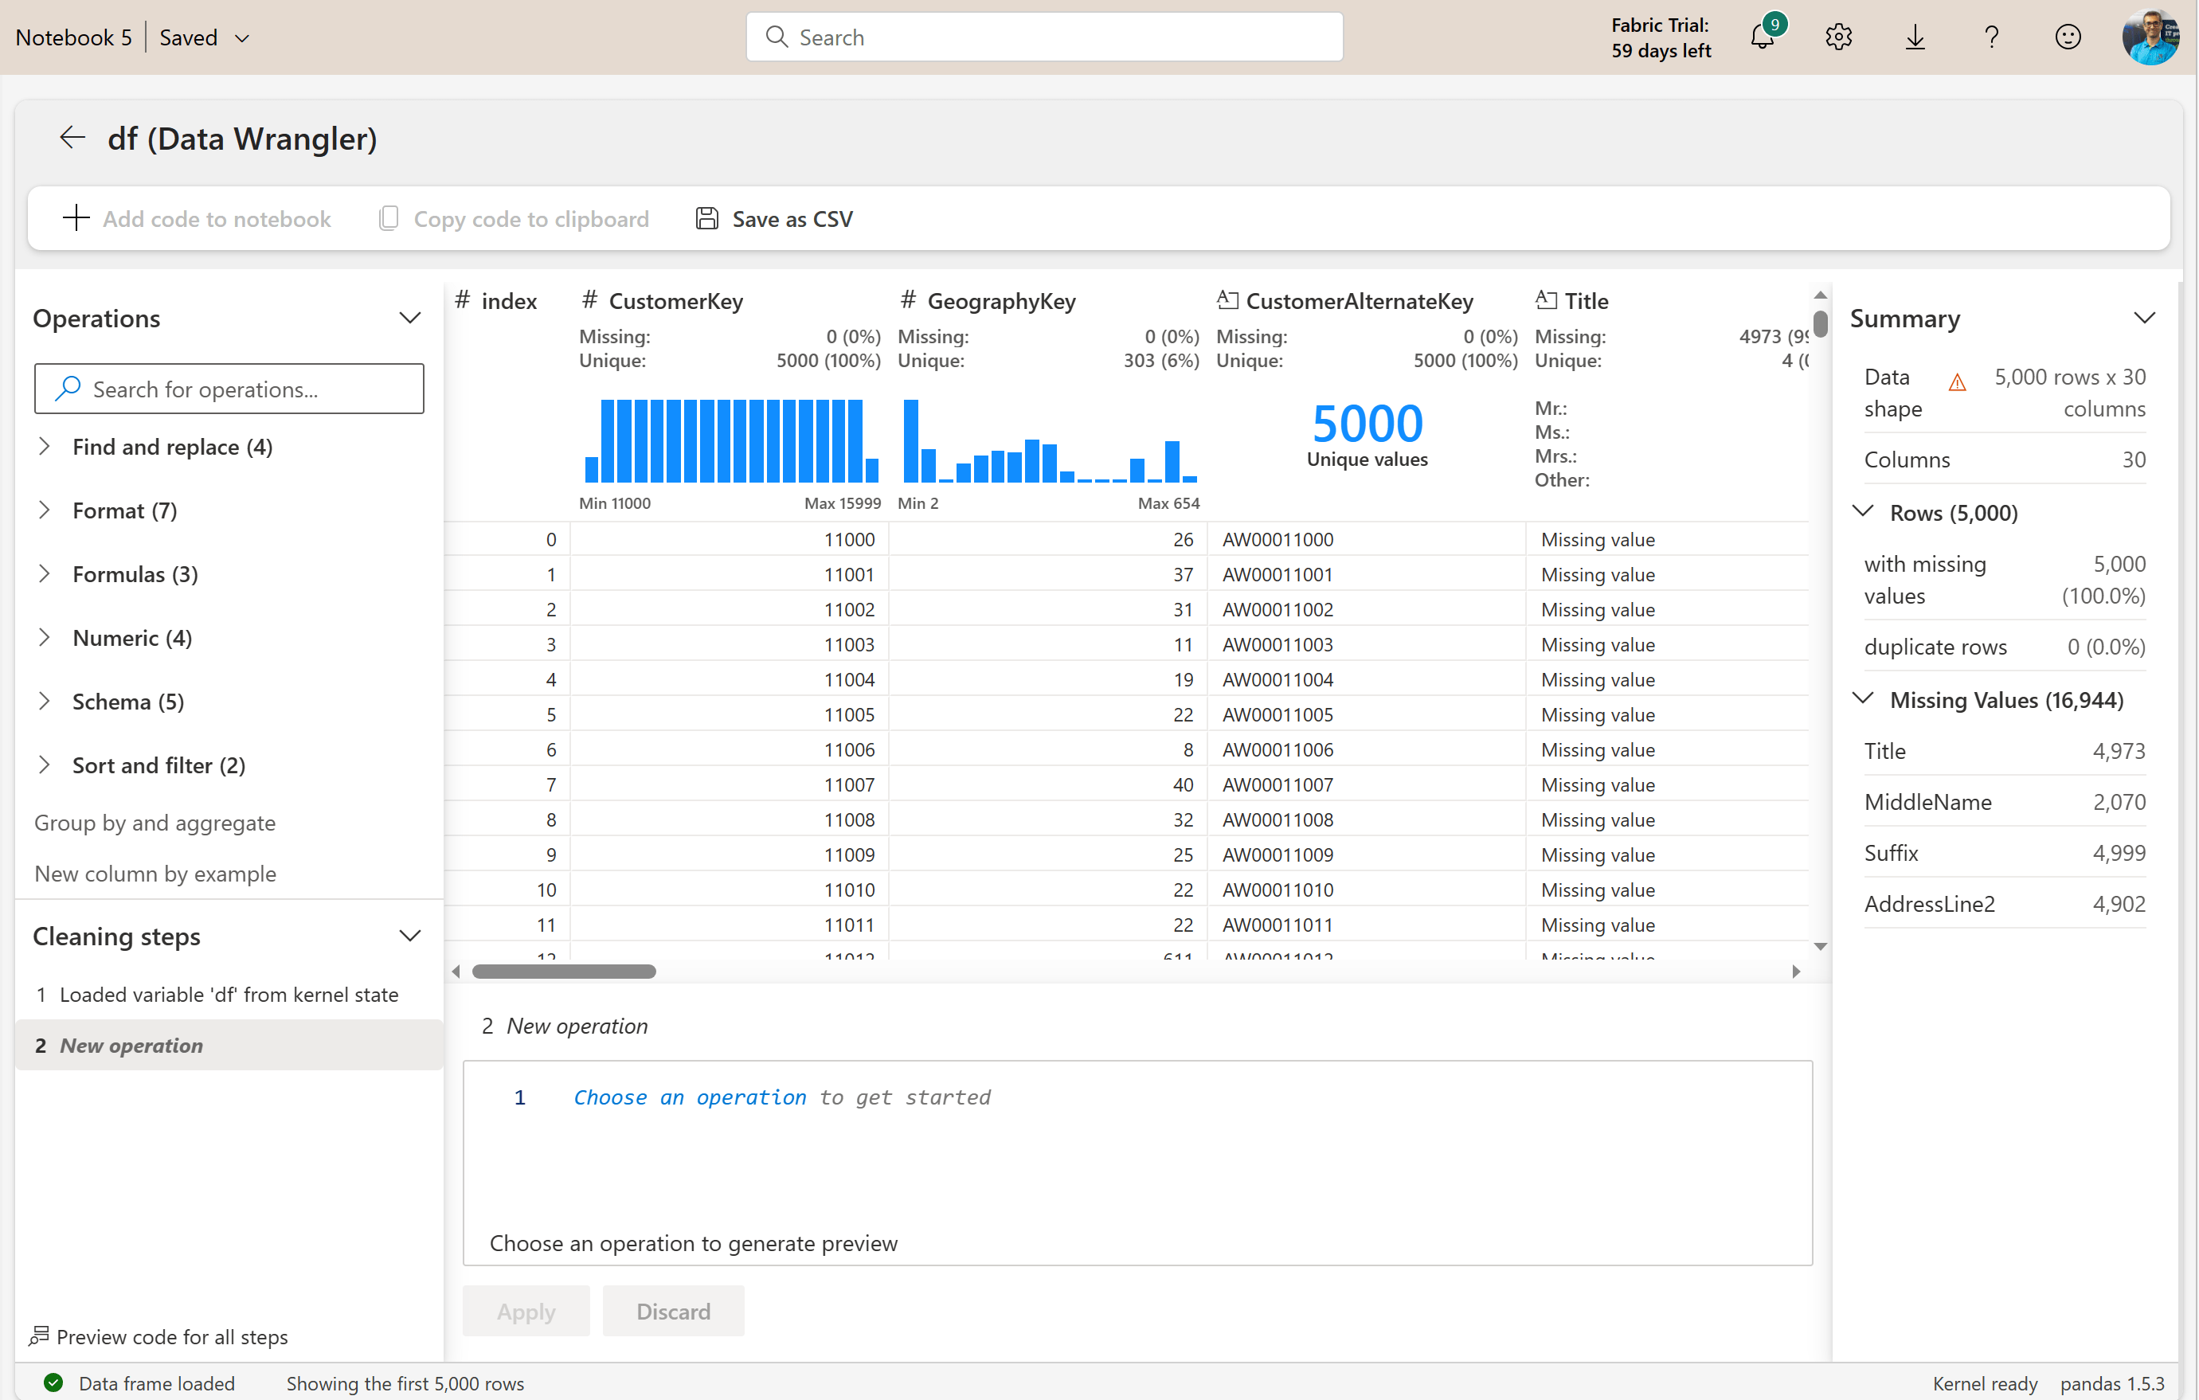
Data Wrangler
Notebook-based tool for exploratory analysis
Supports Pandas DataFrames
Summary statistics
Data cleaning
Data preview
Notes:
Data Wrangler is a notebook-based tool that provides users with an immersive experience to conduct exploratory data analysis. The feature combines a grid-like data display with dynamic summary statistics, built-in visualizations, and a library of common data-cleaning operations. Each operation can be applied in a matter of clicks, updating the data display in real time and generating code that can be saved back to the notebook as a reusable function.
Users can launch Data Wrangler directly from a Microsoft Fabric notebook to explore and transform any Pandas DataFrame. When Data Wrangler launches, it generates a descriptive overview of the displayed DataFrame in the Summary panel. This overview includes information about the DataFrame's dimensions, missing values, and more. Selecting any column in the Data Wrangler grid prompts the Summary panel to update and display descriptive statistics about that specific column. Quick insights about every column are also available in its header.
A searchable list of data-cleaning steps can be found in the Operations panel. The results of a selected operation will be previewed automatically in the Data Wrangler display grid, and the corresponding code will automatically appear in the panel below the grid. You can then choose to apply it or discard it.

Slide 7
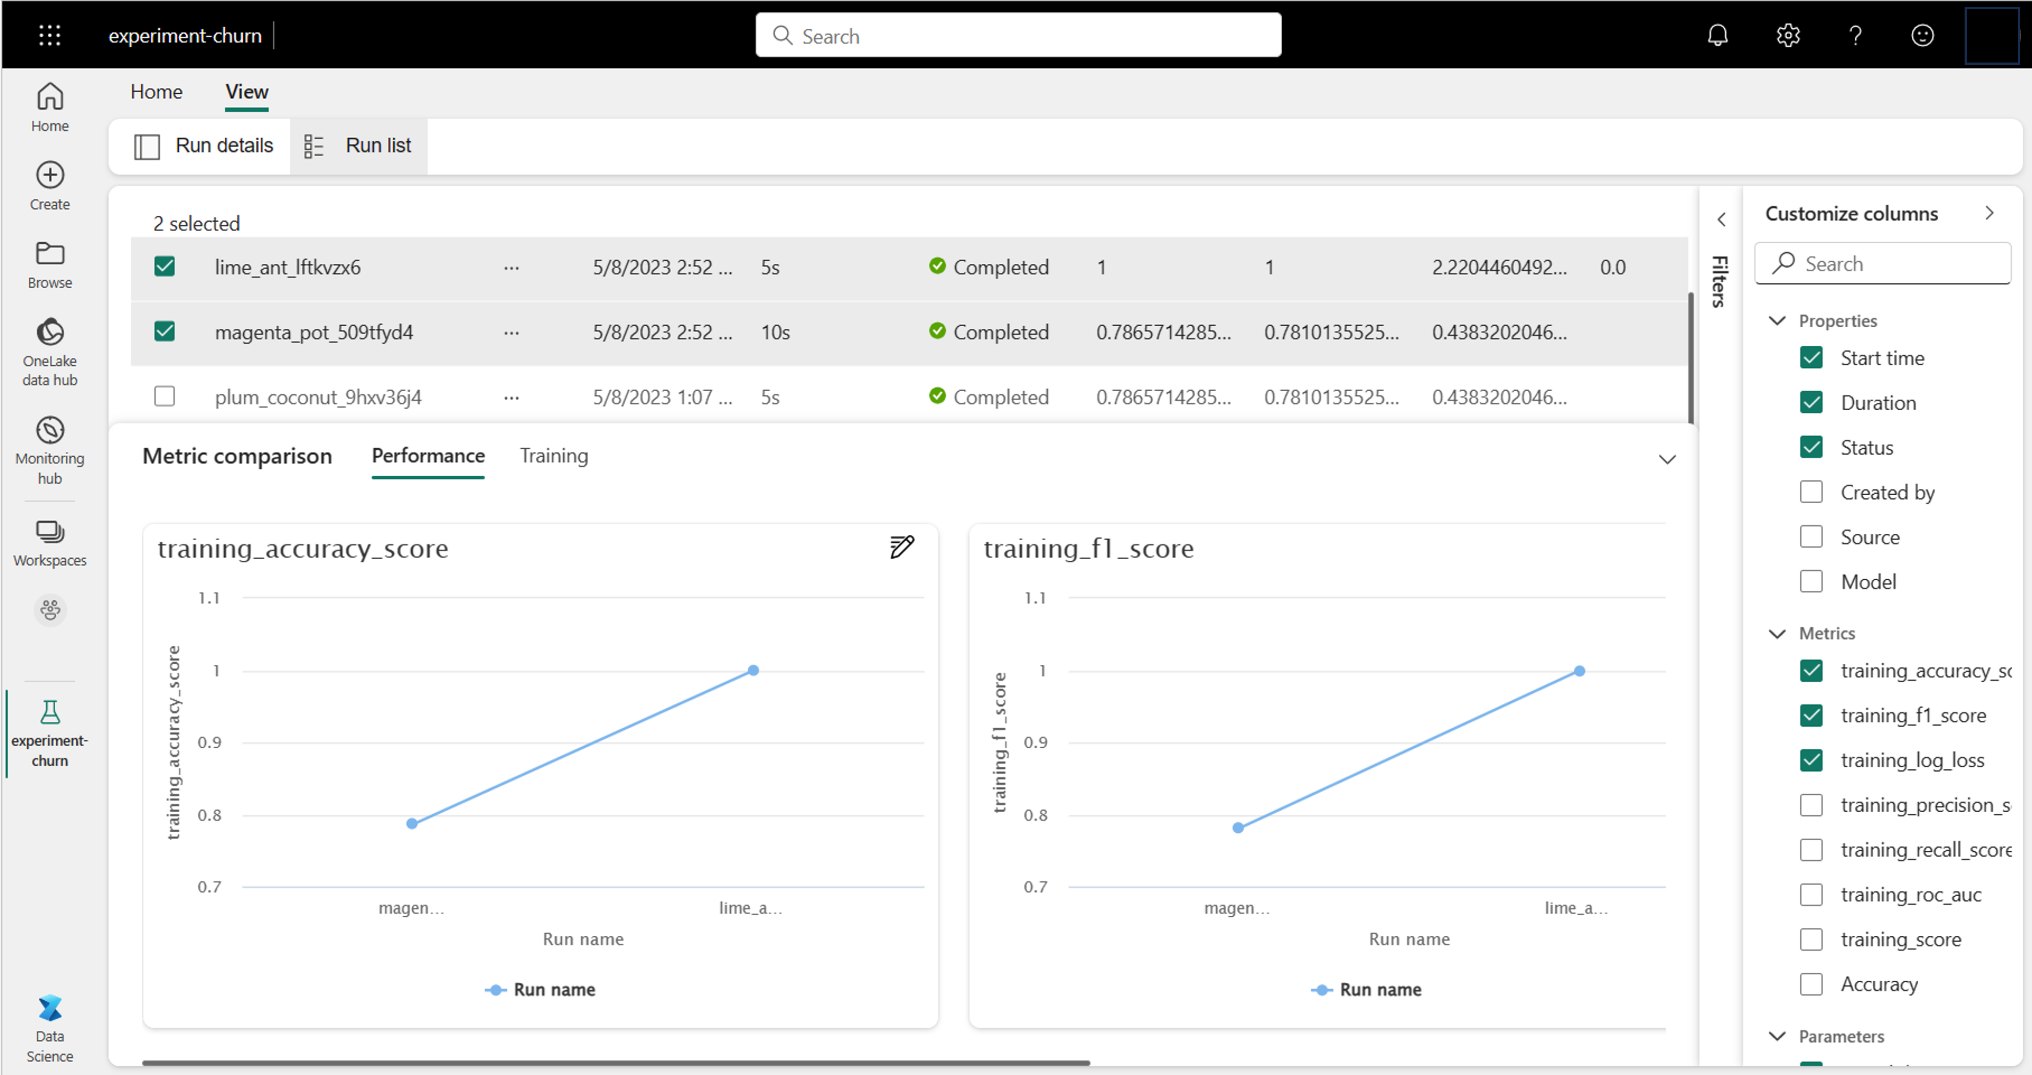
MLFLow
Track experiments
Compare model training iterations and decide which configuration resulted in the best model for your use case.
Notes:
Microsoft Fabric integrates with MLflow to easily track and log your work, enabling you to review your work at any time to decide what the best approach is to train the final model. When you track your work, your results are easily reproducible.
Whenever you train a model in a notebook that you want to track, you create an experiment in Microsoft Fabric.
An experiment can consist of multiple runs. Each run represents a task you executed in a notebook, like training a machine learning model.
For example, to train a machine learning model for sales forecasting, you can try different training datasets with the same algorithm. Each time you train a model with a different dataset, you create a new experiment run. Then, you can compare the experiment runs to determine the best performing model.
To compare experiment runs, you can track parameters, metrics, and artifacts for each run.
After you train a model, you want to use it for scoring. With scoring, you use the model on new data to generate predictions or insights. When you train and track a model with MLflow, artifacts are stored within the experiment run to represent your model and its metadata. You can save these artifacts in Microsoft Fabric as a model.
To use a model for generating predictions, you can use the PREDICT function in Microsoft Fabric. The PREDICT function is built to easily integrate with MLflow models and allows you to use the model for generating batch predictions.

Slide 8
Summary
Use Spark notebooks to ingest and prepare data
Create experiments in the UI or in a notebook
Save runs as a model

Slide 9

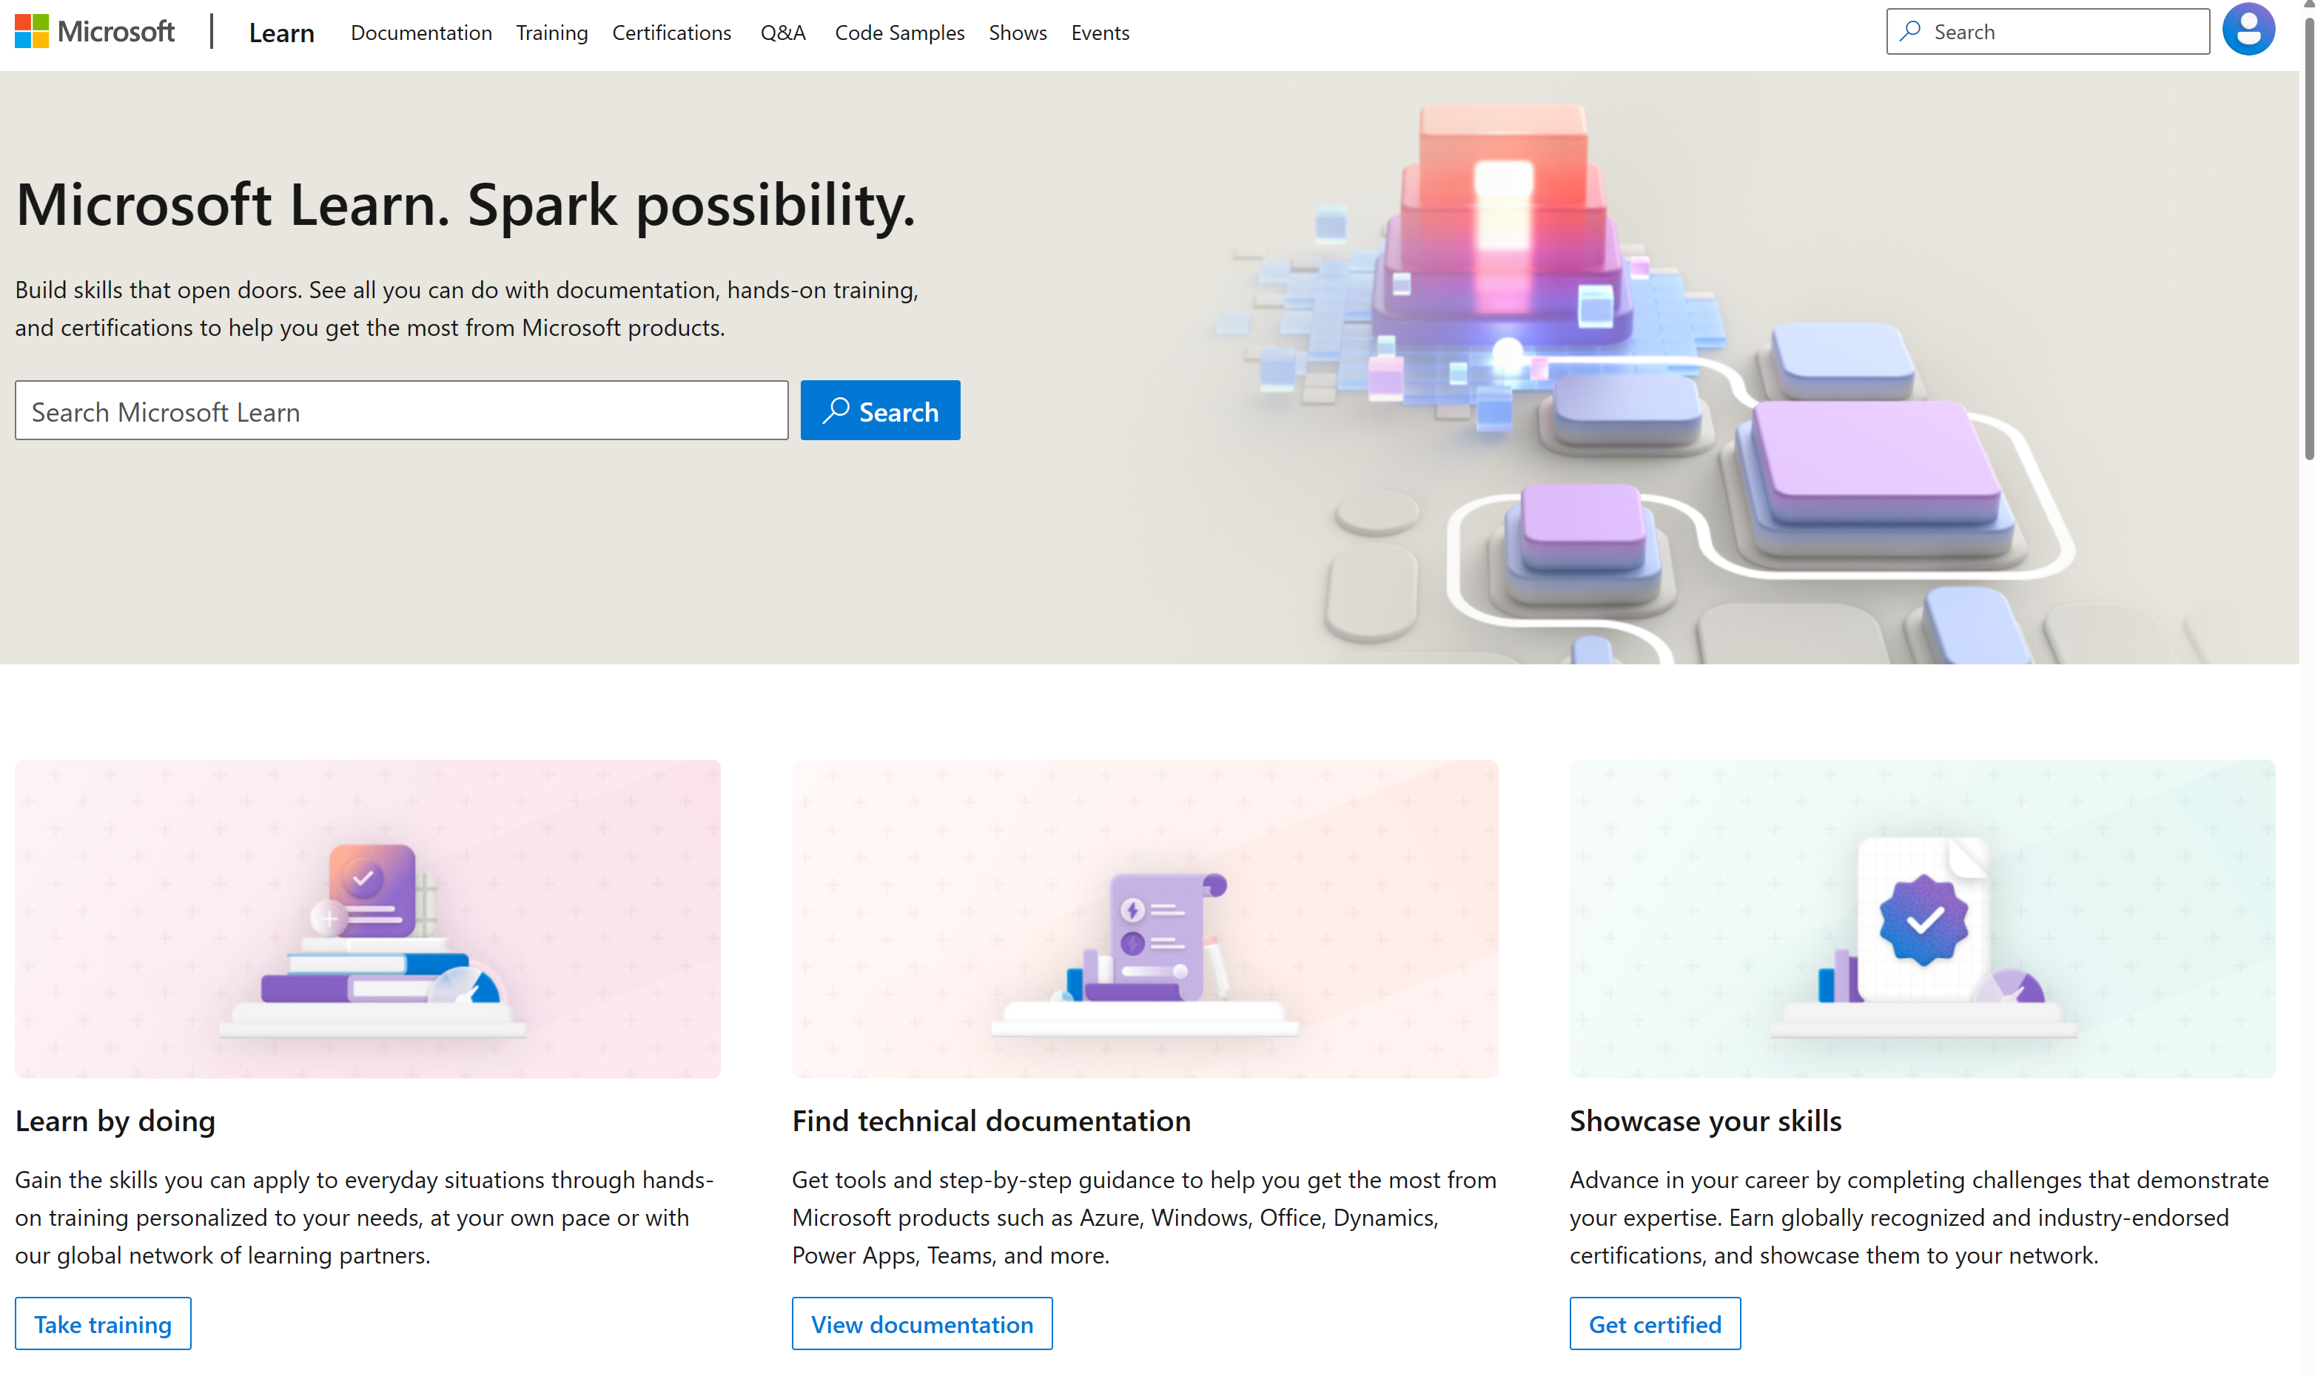
Microsoft Learn Demo
Microsoft Learn: Build skills that open doors in your career

Slide 10
Readiness and Enablement Links
The Microsoft Federal Team is here to help you accelerate customers' digital transformation. Microsoft Federal has tailored to make your organizations skilling journey successful. From the Business Decision Maker to the technical community and end-users, Microsoft provides customers with access to endless skilling resources. Below you will find links to these resources:
Get training tailored to your organization's needs: Find learning paths for specific roles in your organization, plus course recommendations based on technology, skill level, and solution area: Training | Learning Portal (microsoft.com)
Events Calendar - US Partner Community Blog – Microsoft
In addition to the above, the Microsoft Federal Team can address the needs of your non-technical community of your learners through:
Skilling Hours - Readiness and Enablement: Skilling our Federal Customers and Partners (office.com)
Microsoft Learning Portal: A closer look at Azure through training modules and gamified learning
Microsoft Learning Portal
Additional Learning Resources:
Get started with Azure – Introduction | Microsoft Azure
Microsoft Learn (path-based)
Exam-based: Select filters: Azure, D365, M365, Power Platform, and more
Microsoft Virtual Training Days – Virtual Instructor Led
Microsoft Technology Center - Work through your Account Manager
Home - Microsoft Tech Community
Microsoft Reactor | Microsoft Developer – Virtual Instructor Led

