Slide 1
Administer and Govern Microsoft Fabric
Module 15

Slide 2
Review Fabric concepts
Tenant
Capacity
Domain
Workspace
Items
Notes:
Understanding Fabric concepts is important for you as an admin, because it helps you understand how to manage the Fabric environment.
A Fabric tenant is a dedicated space for organizations to create, store, and manage Fabric items. There's often a single instance of Fabric for an organization, and it's aligned with Azure Active Directory. The Fabric tenant maps to the root of OneLake and is at the top level of the hierarchy.
Capacity is a dedicated set of resources that is available at a given time to be used. A tenant can have one or more capacities associated with it. Capacity defines the ability of a resource to perform an activity or to produce output. Different items consume different capacity at a certain time. Fabric offers capacity through the Fabric SKU and Trials.
A domain is a logical grouping of workspaces. Domains are used to organize items in a way that makes sense for your organization. You can group things together in a way that makes it easier for the right people to have access to the right workspaces. For example, you might have a domain for sales, another for marketing, and another for finance.
A workspace is a collection of items that brings together different functionality in a single tenant. It acts as a container that leverages capacity for the work that is executed, and provides controls for who can access the items in it. For example, in a sales workspace, users associated with the sales organization can create a data warehouse, run notebooks, create datasets, create reports, etc.
Fabric items are the building blocks of the Fabric platform. They're the objects that you create and manage in Fabric. There are different types of items, such as data warehouses, data pipelines, datasets, reports, and dashboards.

Slide 3
Manage Domains
Domain roles:
Fabric admin
Domain admin
Domain contributor
Notes:
In Fabric, a domain is a way of logically grouping together all the data in an organization that is relevant to a particular area or field. One of the most common uses for domains is to group data by business department, making it possible for departments to manage their data according to their specific regulations, restrictions, and needs.
To group data into domains, workspaces are associated with domains. When a workspace is associated with a domain, all the items in the workspace are also associated with the domain, and they receive a domain attribute as part of their metadata.
There are three roles involved in domains:
Fabric admin (or higher): Fabric admins can create and edit domains, specify domain admins and domain contributors, and associate workspaces with domains. Fabric admins can also see all the defined domains on the Domains page in the admin portal, and they can edit and delete domains.
Domain admin: Ideally, the domain admins of a domain are the business owners or designated experts. They should be familiar with the data in their area and the regulations and restrictions that are relevant to it.
Domain admins have access to the Domains page in the admin portal, but they can only see and edit the domains they're admins of. Domain admins can update the domain description, define/update domain contributors, and associate workspaces with the domain. They also can define and update the domain image and override tenant settings for any specific settings the tenant admin has delegated to the domain level. They can't delete the domain, change the domain name, or add/delete other domain admins.
Domain contributor: Domain contributors are workspace admins who have been authorized by the domain or Fabric admin to associate the workspaces they're the admins of to a domain, or to change the current domain association.
Domain contributors associate the workspaces they're an admin of in the settings of the workspace itself. They don’t have access to the Domains page in the admin portal.

Slide 4
Fabric Administration Tasks
Security and access control
Data governance
Customization and configuration
Monitoring and optimization
Notes:
As an admin, you may be responsible for a wide range of tasks to keep the Fabric platform running smoothly. These tasks include:
Security and access control: One of the most important aspects of Fabric administration is managing security and access control to ensure that only authorized users can access sensitive data. You can use role-based access control (RBAC) to define who can view and edit content, set up data gateways to securely connect to on-premises data sources, and use Azure Active Directory (Azure AD) to manage user access.
Data governance: Effective Fabric administration requires a solid understanding of data governance principles. You should know how to secure inbound and outbound connectivity in your tenant and how to monitor usage and performance metrics. You should also know how to apply data governance policies to ensure data within your tenant is only accessible to authorized users.
Customization and configuration: Fabric administration also involves customizing and configuring the platform to meet the needs of your organization. This could include configuring private links to secure your tenant, defining data classification policies, and adjusting the look and feel of reports and dashboards.
Monitoring and optimization: As a Fabric admin, you need to know how to monitor the performance and usage of the platform, optimize resources, and troubleshoot issues. This includes configuring monitoring and alerting settings, optimizing query performance, managing capacity and scaling, and troubleshooting data refresh and connectivity issues.
Specific tasks may vary depending on the needs of your organization and the complexity of your Fabric implementation.

Slide 5
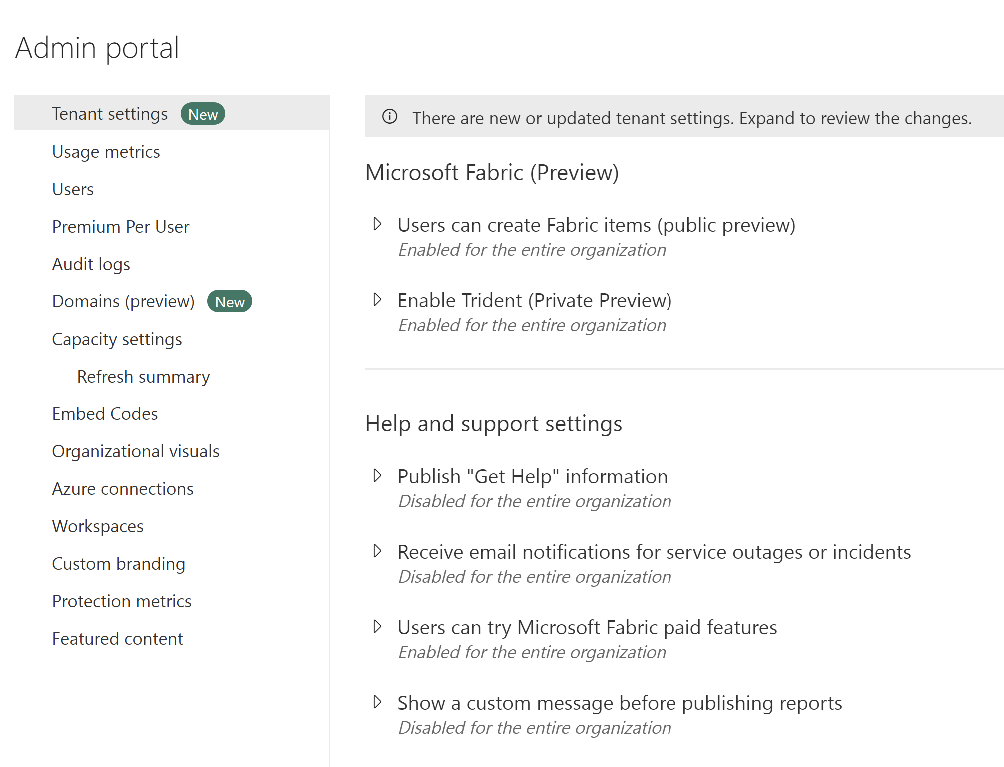
Fabric Admin Tools
Admin portal
Admin PowerShell cmdlets
Admin APIs and SDKs
Admin monitoring workspace
Notes:
Fabric admins can perform most admin tasks using one or more of the following tools: the Fabric admin portal, PowerShell cmdlets, admin APIs and SDKs, and the admin monitoring workspace.
Fabric's admin portal is a web-based portal where you can manage all aspects of the platform. In the admin portal you can centrally manage, review, and apply settings for the entire tenant or by capacity. You can also manage users, admins and groups, access audit logs, and monitor usage and performance.
Fabric provides a set of PowerShell cmdlets that you can use to automate common administrative tasks. A PowerShell cmdlet is a simple command that can be executed in PowerShell.
For example, you can use cmdlets in Fabric to systematically create and manage groups, configure data sources and gateways, and monitor usage and performance. You can also use the cmdlets to manage the Fabric admin APIs and SDKs.
An admin API and SDK are tools that allow developers to interact with a software system programmatically. An API (Application Programming Interface) is a set of protocols and tools that enable communication between different software applications. An SDK (Software Development Kit) is a set of tools and libraries that helps developers create software applications that can interact with a specific system or platform. You can use APIs and SDKs to automate common administrative tasks and integrate Fabric with other systems. You can make these requests using any HTTP client library that supports OAuth 2.0 authentication, such as Postman, or you can use PowerShell scripts to automate the process.
Fabric tenant admins will have access to the new admin monitoring workspace. You can choose to share access to the workspace or specific items within it with other users in your organization. The admin monitoring workspace includes the Feature Usage and Adoption dataset and report, which together provide insights on the usage and performance of your Fabric environment. You can use this information to identify trends and patterns, and troubleshoot issues.

Slide 6
Manage security
Assign and manage licenses
Manage items and sharing
Notes:
Microsoft Fabric security is based on Power BI security. Your role as an admin is to manage security for the Fabric environment, including managing users and groups, and managing how users interact with Fabric in terms of sharing and distribution of content. Licenses control the level of access and functionality that users have within the Fabric environment. Administrators can ensure that licensed users have the necessary access to data and analytics to perform their roles effectively, while also limiting access to sensitive data and ensuring compliance with data protection laws and regulations.
Managing licenses allows administrators to monitor and control costs by ensuring that licenses are allocated efficiently and only to users who need them. This can help to prevent unnecessary expenses and ensure that the organization is utilizing its resources effectively.
License management for Fabric is handled in the Microsoft 365 admin center.
As an admin, you can manage how users interact with Fabric in terms of sharing and distribution of content. This includes managing how users share content with others, and how they distribute content to others. You can also manage how users interact with items, such as data warehouses, data pipelines, datasets, reports, and dashboards.
Items in workspaces are best distributed through a workspace app or the workspace directly. Granting the least permissive rights is the first step is securing the data. Share the read only app for access to the reports or grant access to the workspaces for collaboration and development. Another aspect of managing and distributing items is enforcing such best practices.
You can manage sharing and distribution both internally and outside of your organization, in compliance with your organization's policies and procedures.

Slide 7
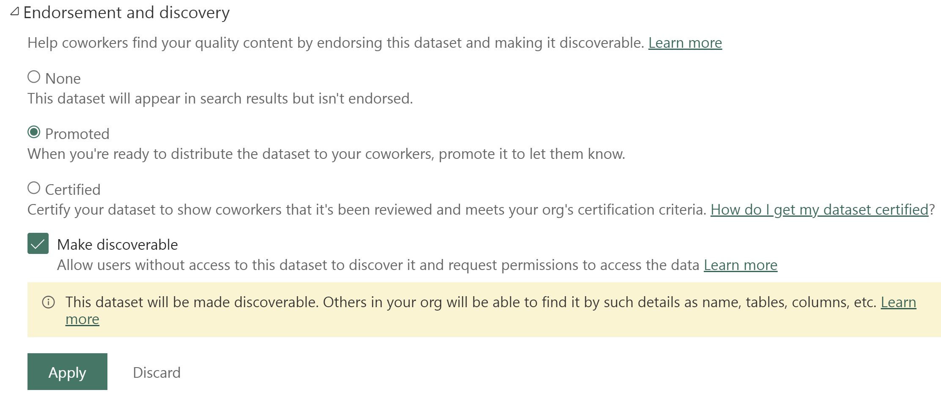
Data Governance
Endorse content
Scanner API
Data lineage
Notes:
Content endorsement is an essential governance feature that helps you establish trust in your data assets by promoting and certifying specific Fabric items as trusted and approved for use across the organization. All Fabric items can be endorsed except dashboards. Endorsed assets are identified with a badge that indicates they have been reviewed and approved. Endorsement helps your users know which assets they can trust and rely on for accurate information, and it also helps you as an admin manage the overall growth of items across your environment.
Promoted Fabric content appears with a Promoted badge in the Fabric portal. Workspace members with the contributor or admin role can promote content within a workspace. The Fabric admin can promote content across the organization.
Content certification is a more formal process that involves a review of the content by a designated reviewer. Certified Fabric content appears with a Certified badge in the Fabric portal. The certification process is managed by you, the admin, and can be customized to meet the needs of your organization.
If you aren't an admin, you need to request item certification from an admin. You can do request certification by selecting the item in the Fabric portal, and then selecting Request certification from the More menu.
Metadata scanning facilitates governance of data by enabling cataloging and reporting on all the metadata of your organization's Fabric items. The scanner API is a set of Admin REST APIs that allows you to scan Fabric items for sensitive data. Use the scanner API to scan data warehouses, data pipelines, datasets, reports, and dashboards for sensitive data. The scanner API can be used to scan both structured and unstructured data.
Data lineage is the ability to track the flow of data through Fabric. Data lineage allows you to see where data comes from, how it's transformed, and where it goes. This helps you understand the data that is available in Fabric, and how it's being used.

Slide 8
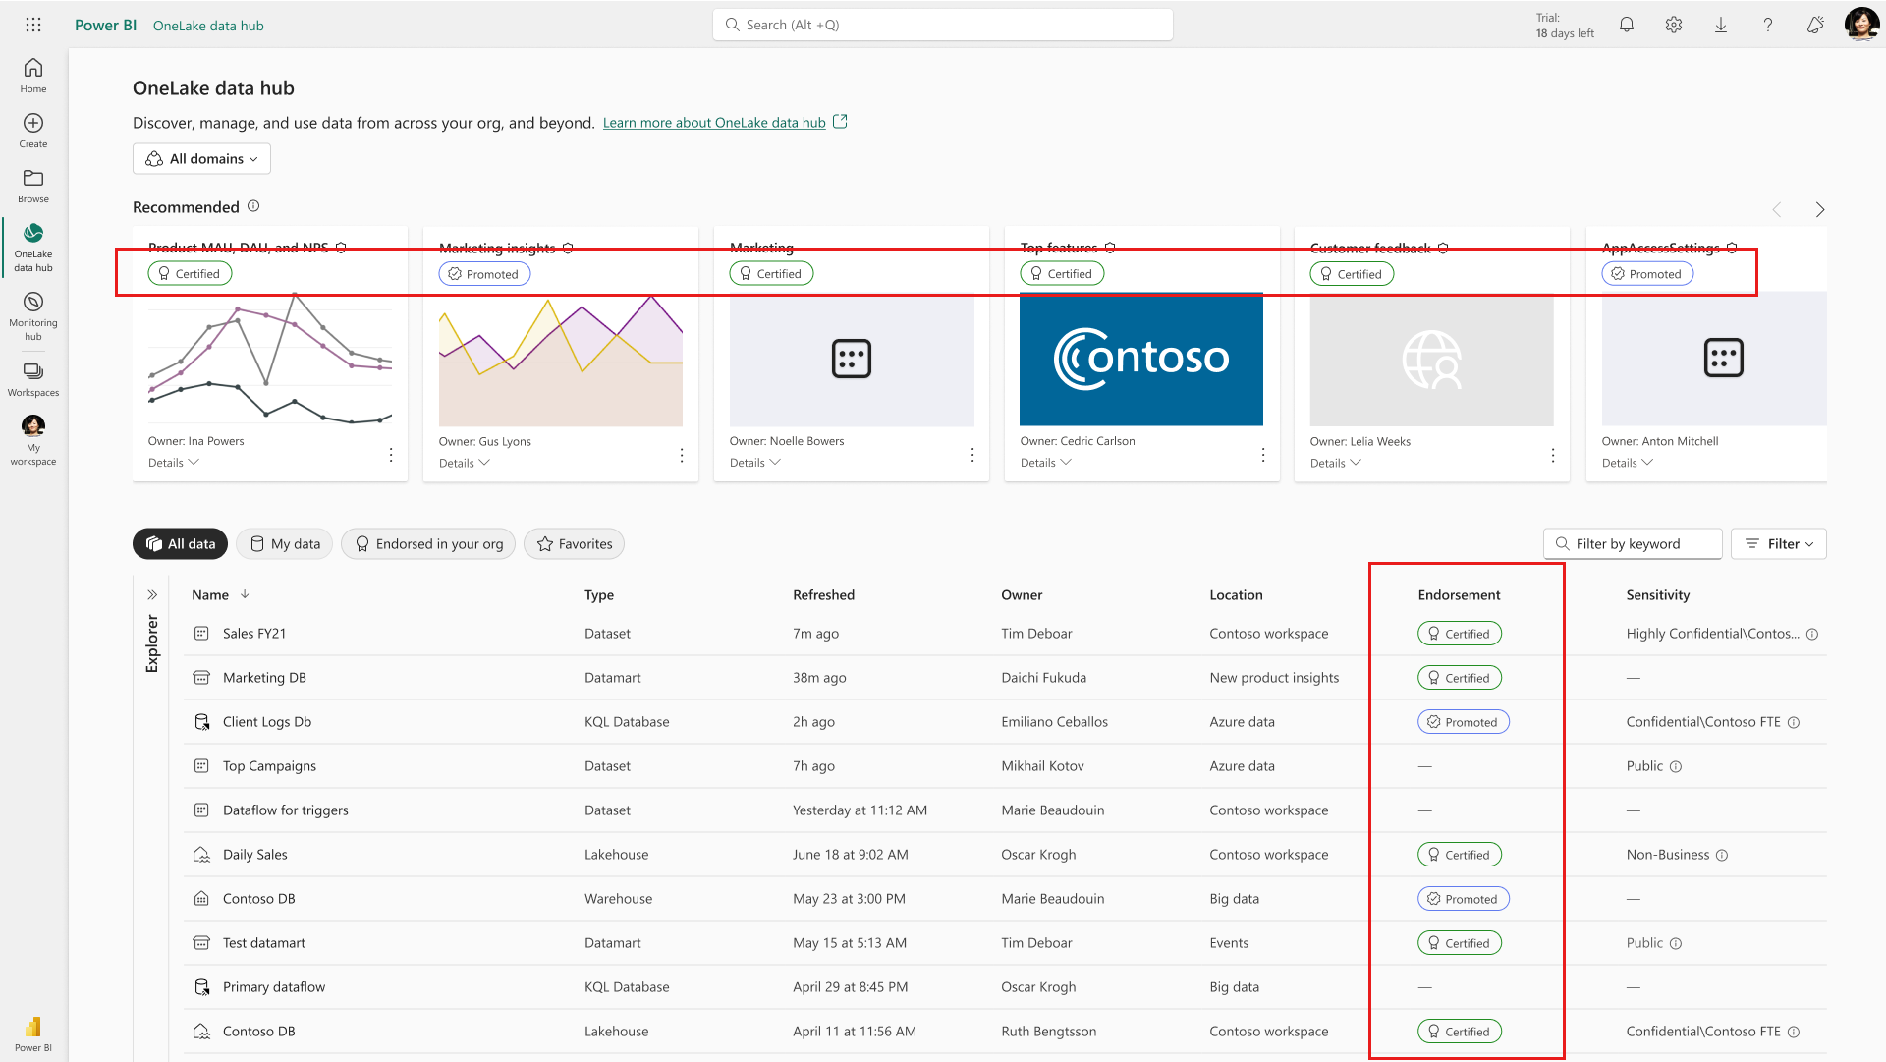
Content Certification
Means that the item meets the organization's quality standards and can be regarded as reliable, authoritative, and ready for use across the organization.
Only authorized reviewers (defined by the Fabric administrator) can certify items.

Slide 9
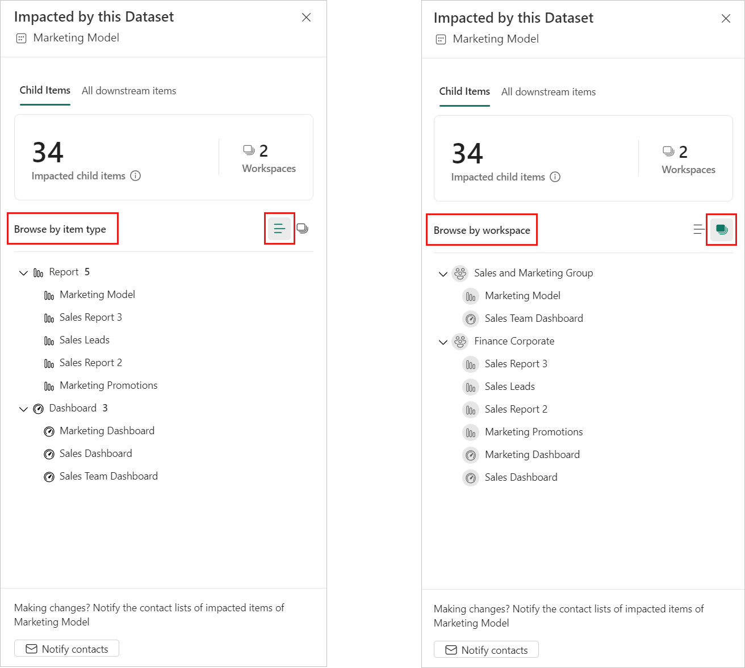
Impact analysis
Notes:
When you make changes to a Fabric item, or are considering making changes, it's important to be able to assess the potential impact of those changes on downstream items that depend on that item. Impact analysis provides you with information that can help you make this assessment.
It shows you the workspaces and Fabric items that might be affected by your change. You can choose to see only direct children, or all affected downstream items and workspaces. For data sources, you can only see direct children. To see further downstream items for data sources, use impact analysis on the direct children of the data source.
It allows you to view potentially affected items either by type or by workspace.
It provides an easy way to notify the relevant people about a change you made or are thinking about making.
For data sources, it shows you the connection string used to connect to the data source.
If you've made a change to an item or are thinking about making a change, you might want to contact the relevant users to tell them about it. When you notify contacts, an email is sent to the contact lists of all the impacted workspaces. Your name appears on the email so the contacts can find you and reply back in a new email thread.

Slide 10
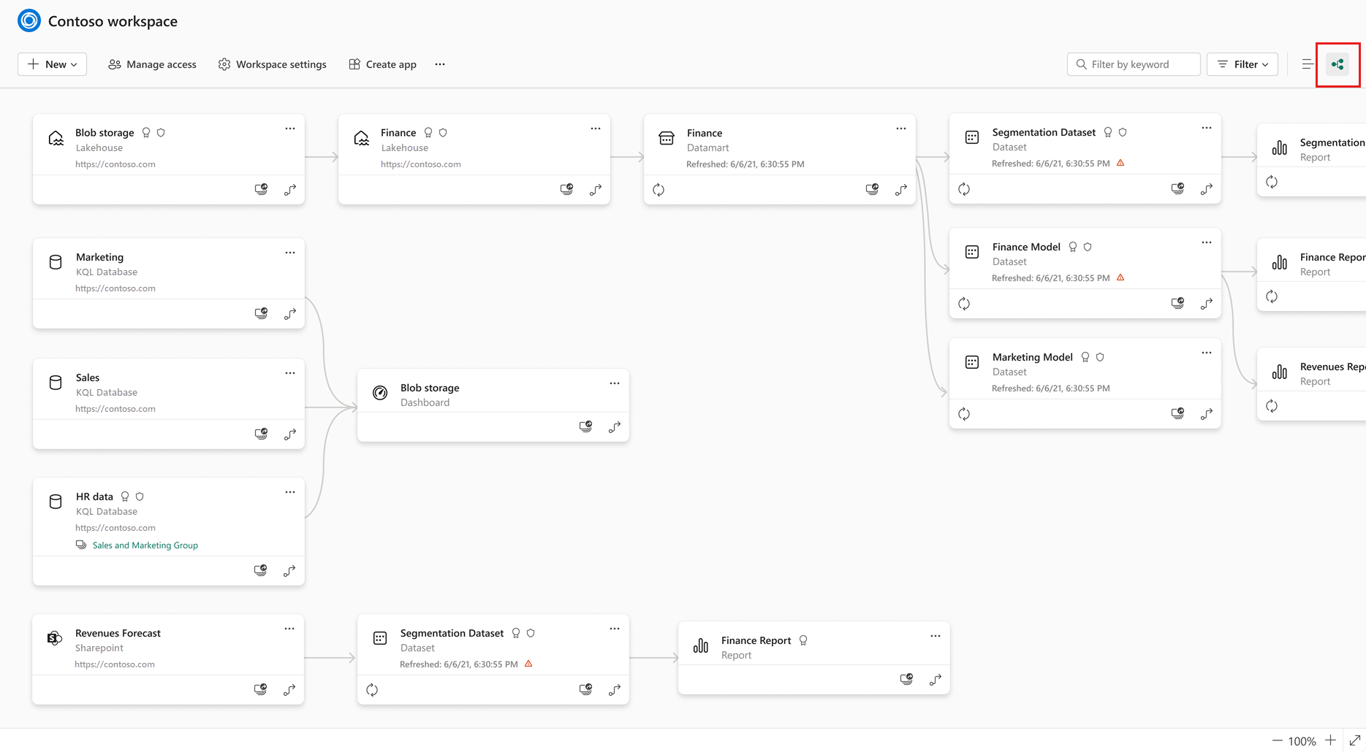
Lineage View
In lineage view, you see the lineage relationships between all the items in a workspace, as well as data sources external to the workspace one-step upstream.
Notes:
Lineage view displays:
All the items in the workspace and how they are connected to each other.
Upstream connections outside the workspace, one level up. You can tell if an item is outside the workspace because the name of the external workspace is indicated on the card, as illustrated by the HR Data KQL Database in the image above.
Downstream items in different workspaces aren't shown. To explore an item's downstream connections outside the workspace, open the item's impact analysis.

Slide 11
Summary
Domains are a new concept in Fabric used to group workspaces
Fabric administrators are responsible for security and access control, data governance, customization and configuration, and monitoring and optimization

Slide 12

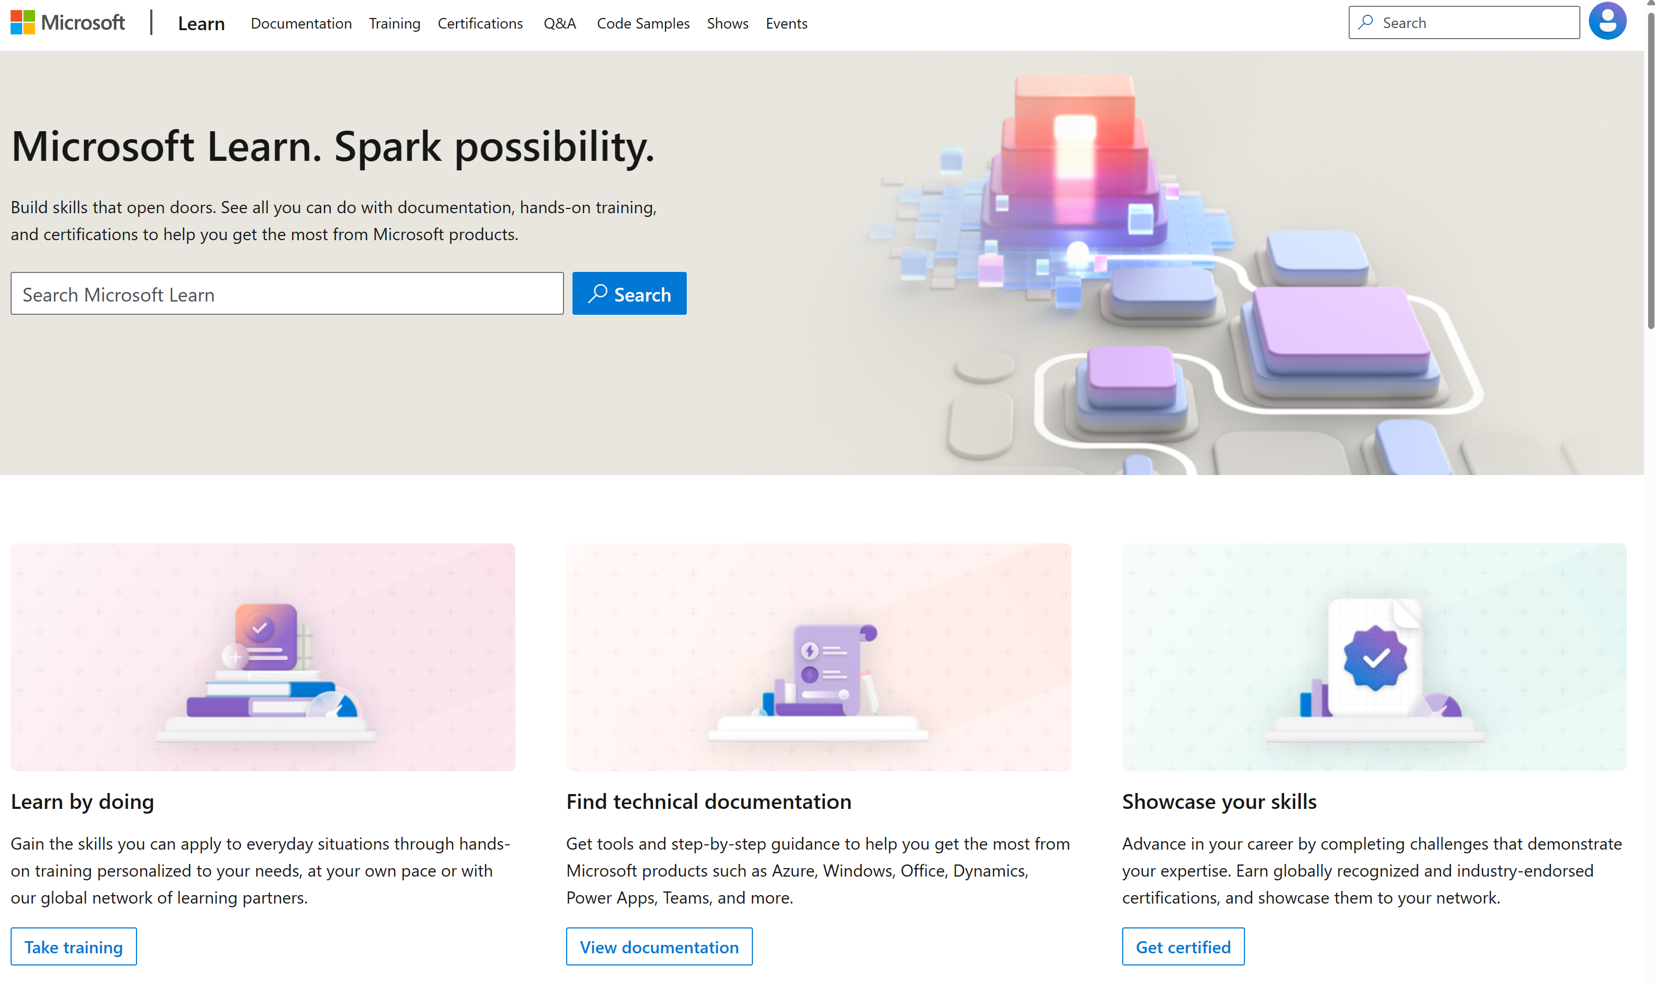
Microsoft Learn Demo
Microsoft Learn: Build skills that open doors in your career

Slide 13
Readiness and Enablement Links
The Microsoft Federal Team is here to help you accelerate customers' digital transformation. Microsoft Federal has tailored to make your organizations skilling journey successful. From the Business Decision Maker to the technical community and end-users, Microsoft provides customers with access to endless skilling resources. Below you will find links to these resources:
Get training tailored to your organization's needs: Find learning paths for specific roles in your organization, plus course recommendations based on technology, skill level, and solution area: Training | Learning Portal (microsoft.com)
Events Calendar - US Partner Community Blog – Microsoft
In addition to the above, the Microsoft Federal Team can address the needs of your non-technical community of your learners through:
Skilling Hours - Readiness and Enablement: Skilling our Federal Customers and Partners (office.com)
Microsoft Learning Portal: A closer look at Azure through training modules and gamified learning
Microsoft Learning Portal
Additional Learning Resources:
Get started with Azure – Introduction | Microsoft Azure
Microsoft Learn (path-based)
Exam-based: Select filters: Azure, D365, M365, Power Platform, and more
Microsoft Virtual Training Days – Virtual Instructor Led
Microsoft Technology Center - Work through your Account Manager
Home - Microsoft Tech Community
Microsoft Reactor | Microsoft Developer – Virtual Instructor Led

