Slide 1
OPSWAT Vietnam Center
Individual Innovation day
Nguyen Van Giang
gnguyen@opswat.com
Jul. 2014

Slide 2
Innovation Day
GEARS Go! – Android App of GEARS Manager
Purpose
Leverage GEARS CLOUD API
https://gears.opswat.com/developers/docs
Can login to any Opswat account
Two primary functions:
Have a dashboard that can list how many devices have issues
Have a details page to show each device compliant details

Slide 3
Innovation Day
GEARS Go! – Android App of GEARS Manager
Functional API Used:
API | Reason
https://gears.opswat.com/o/api/v2/account.json | Use this query to return user account details.
https://gears.opswat.com/o/api/v2/devices.json | Use this query to list devices for a given account.
https://gears.opswat.com/o/api/v2/devices/:id | Use this query to list devices by ID.

Slide 4
Innovation Day
GEARS Go! – Android App of GEARS Manager
Technology Used:
Cordova: Aplatform for uilding native mobile applications using HTML, CSS and JavaScript
Languages used: HTML, CSS, Javascript
How to build and run on Android:
Other platform, for ex: Blackberry10:
cordova emulate android
cordova emulate blackberry10

Slide 5
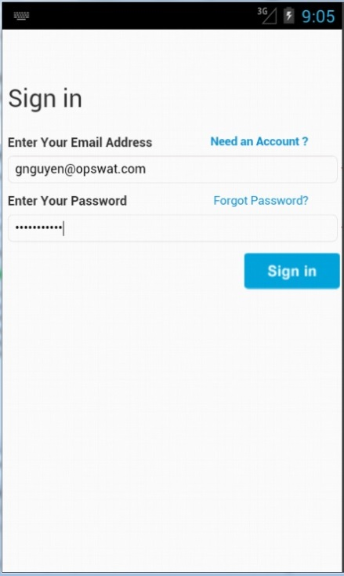
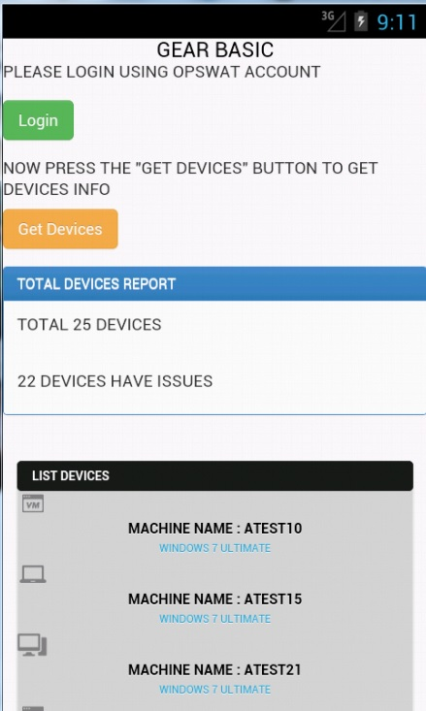
Innovation Day
GEARS Go! – Android App of GEARS Manager
Demo: login and Dashboard

Slide 6
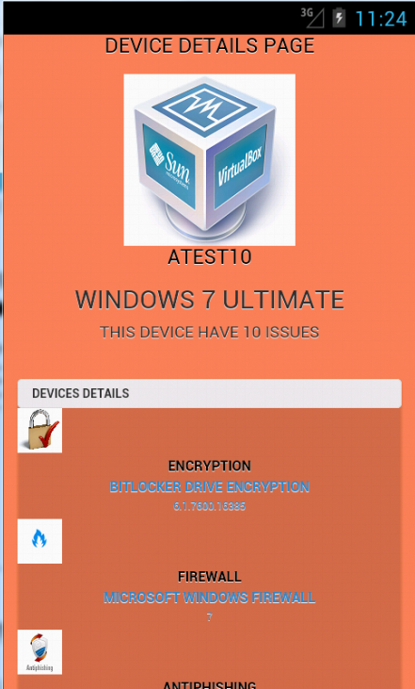
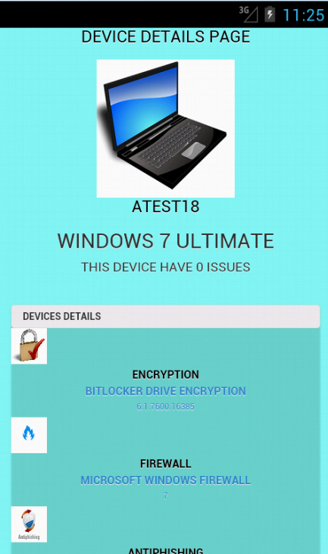
Innovation Day
GEARS Go! – Android App of GEARS Manager
Demo: devices compliant and un-compliant

Slide 7
Innovation Day
GEARS Go! – Android App of GEARS Manager
Q&A

