Slide 1



SMART INDIA HACKATHON 2026
Problem Statement ID – 26003
Problem Statement Title – AI-Based Cognitive Gaming and Memory Assistance Platform For Elderly Dementia Patients in North Eastern Region [NER]
Theme- MedTech / BioTech / HealthTech
PS Category- Software
Team ID- 162623
Team Name- COGNOVAX

Slide 2












COGNOVAX
AI-Powered Personalized Cognitive & Memory Assistance Platform
Cognitive Gaming Module
Dual-Login Architecture
Multilingual & Voice-Assisted
Interactive memory & attention games
Supports cognitive engagement Helps slow memory decline Intresting Games
Separate patient & caregiver interfaces
Role-specific experience for each user Easily Accessible
Regional North-East languages supported
Voice assistant removes literacy barriers
Increase Feasibility
Daily Routine Reminders
Caregiver Monitoring
Elderly-Friendly UI
Medicine, meal & hydration alerts Friendly walk & activity nudges Personalized reminders based on daily routines and habits
View patient activity remotely Manage multiple patients, one login Track Progress time by time
Adjustable icon sizes
low-clutter interface
Easy to use Web-Application for better experience
@SIH Idea submission
2

Slide 3
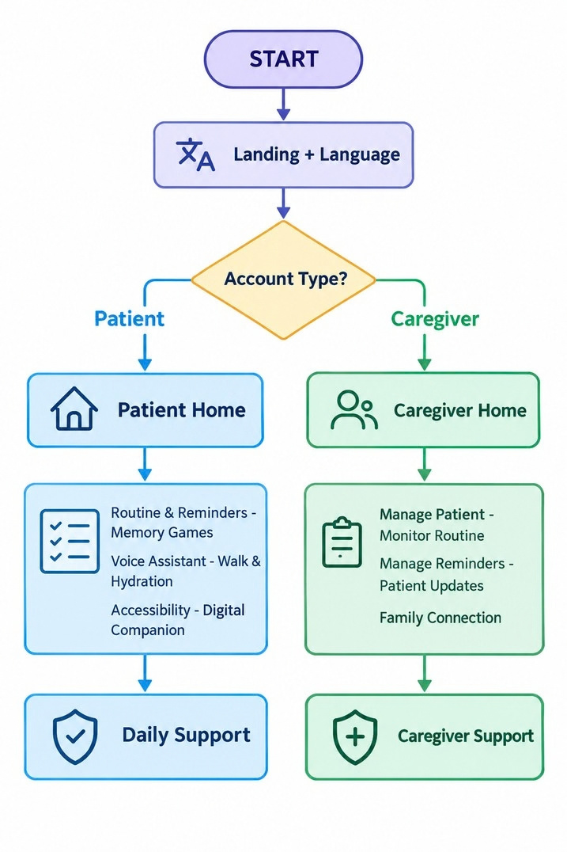


TECHNICAL APPROACH
COGNOVAX
FRONTEND
React 19.2 + Next.js 16 (App Router, Turbopack)
BACKEND
Next.js Route Handlers TypeScript + Node.js
UI / STYLING
Tailwind CSS v4
Framer Motion + Lucide
AUTH & SECURITY bcrypt hashing
Secure httpOnly session
@SIH Idea submission
3

Slide 4
FEASIBILITY AND VIABILITY
COGNOVAX
FEASIBILITY
USABILITY
Fully web-based, runs on any browser or basic smartphone.
Prototype already working core user flows built and tested, not just mockups.
Modular by design new games or features plug in without touching the core system.
No need to build new system to collect data,we’re gathering it as people use app.
Simple interface, large clear controls Accessibility: text size & high-contrast modes Voice interaction for low-friction use
Regional-language support for the NER
MITIGATION
SCALABILITY
Elderly usability
Software only approach makes it advance.
Can add more regional slide over time.
New Feature/activities can be added without rebuilding the system.
Familiy member/ caregiver help onboard elderly user,making rollut easier
→ Simple,accessibleinterface
Varying cognitive ability
→ Adaptivedifficultyperuser
Language barriers (NER)
→ Regional-languagevoicesupport
Privacy & security
→ Secureauth+sessionhandling
Over-reliance on automation
→ Caregiver given visibilityin app ,so a human is always
checking ,not just AI controlling everything
@SIH Idea submission
4

Slide 5

COGNOVAX
@SIH Idea submission
5

Slide 6
RESEARCH AND REFERENCES
COGNOVAX
1. World Health Organization.
Dementia — Key Facts (fact sheet).
https://www.who.int/news-room/fact-sheets/detail/dementia
2. JMIR Serious Games (2022). Effectiveness & safety of serious/cognitive-training games for elderly people with cognitive impairment — systematic review & meta-analysis.
https://games.jmir.org/2022/1/e34592
3. BMC Health Services Research (2024). Caregivers' experiences, challenges & needs in dementia care in India — a scoping review.
https://link.springer.com/article/10.1186/s12913-024-12146-x
4. PMC / ICMR-Forte, Indo-Sweden collaboration (2025). mHealth intervention by community workers to support family dementia caregivers —
https://pmc.ncbi.nlm.nih.gov/articles/PMC11749876/
5. JMIR Research Protocols (2022). Support: online training & support programme for dementia caregivers in India — RCT protocol.
https://www.ncbi.nlm.nih.gov/pmc/articles/PMC5941472/
6. Prototype YouTube Video Link.
https://www.youtube.com/watch?v=
@SIH Idea submission
6

