Slide 1



Intelligent Reasoning Systems
Team OptEV (Group 25) · Final presentation · 25 Oct 2026
  Ghanashyam Ramia Kasthurirangan Pandurengan (A0357701E)
  Gurneet Kaur Bhuller (A0354164E)
  Shrey Yadav (A0354457W)
  Sushant Maramkulam Shiji (A0354938M)

Slide 2





Introduction
& Context
A dynamic reasoning system that ranks candidate locations for EV charging infrastructure and sets how many chargers go at each, using observed charging pressure, existing coverage, car park capacity, accessibility and site feasibility.
Market Situation
Singapore’s 2030 EV goal
EV Demand growing
Expanding Charger Infrastructure

Slide 3




Project
Background
End-to-End transformation project
Our project aims to develop a Dynamic Intelligent EV Charging Recommendation System to help Singapore's government identify and rank the most suitable locations for new EV charging infrastructure.
Process automation
Data integration
Performance monitoring
The system evaluates HDB and public car parks, petrol stations, hawker centres and existing charging sites against observed charging pressure, existing coverage, parking capacity, accessibility and physical site constraints. It recommends both the location and the number and type of charging points, and records a reason for every site accepted, rejected or deferred.
The system integrates live government feeds — connector status, car park availability, the car park registry and planning-area boundaries — into one time-series baseline across all 55 planning areas. Spatial matching links chargers to car parks, and accumulated observations give utilisation, saturation and charging pressure. Scenarios anchored to Singapore's published deployment trajectory then project that baseline forward.
The system's dynamic feedback loop is its key feature. When a planner selects a location it appears immediately as planned capacity, held separately from observed data, and the scenario re-solves so the next recommendation reflects it. Because nothing observed is overwritten, a selection stays reversible. Growth beyond the collection window is shown through seeded future scenarios.

Slide 4
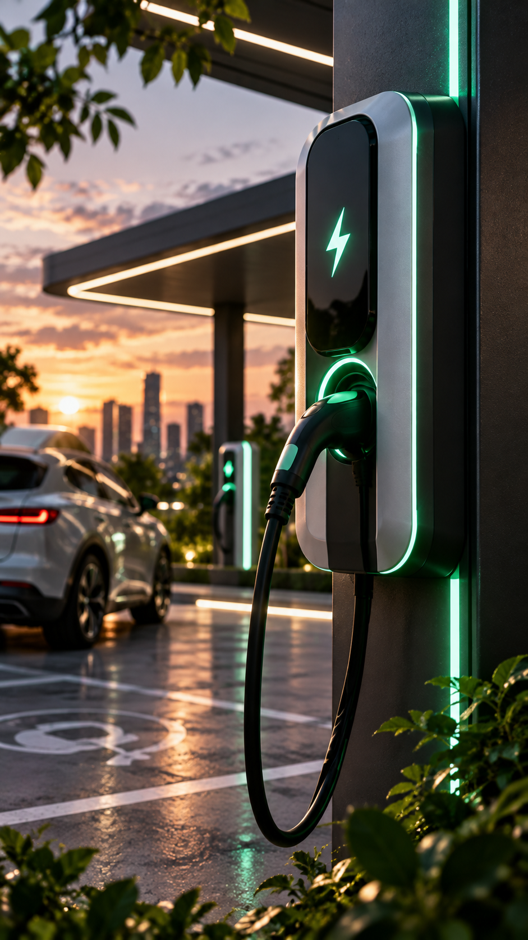

Market
Context
01
02
03
Background
Problem
Market Research
Singapore is expanding its EV ecosystem toward its 2030 electrification goals, requiring charging infrastructure to grow alongside EV adoption.
Deciding where and how many chargers to deploy requires balancing changing EV demand, existing charger coverage, accessibility, and site feasibility.
Existing EV infra planning relies heavily on demand-based analysis. Our project aims for a dynamic reasoning system that continuously re-ranks potential locations as demand and infra evolve.
Existing EV infrastructure planning relies heavily on geospatial and demand-based analysis. Our project extends this into a dynamic reasoning system that continuously re-ranks potential locations as demand and infrastructure evolve.

Slide 5
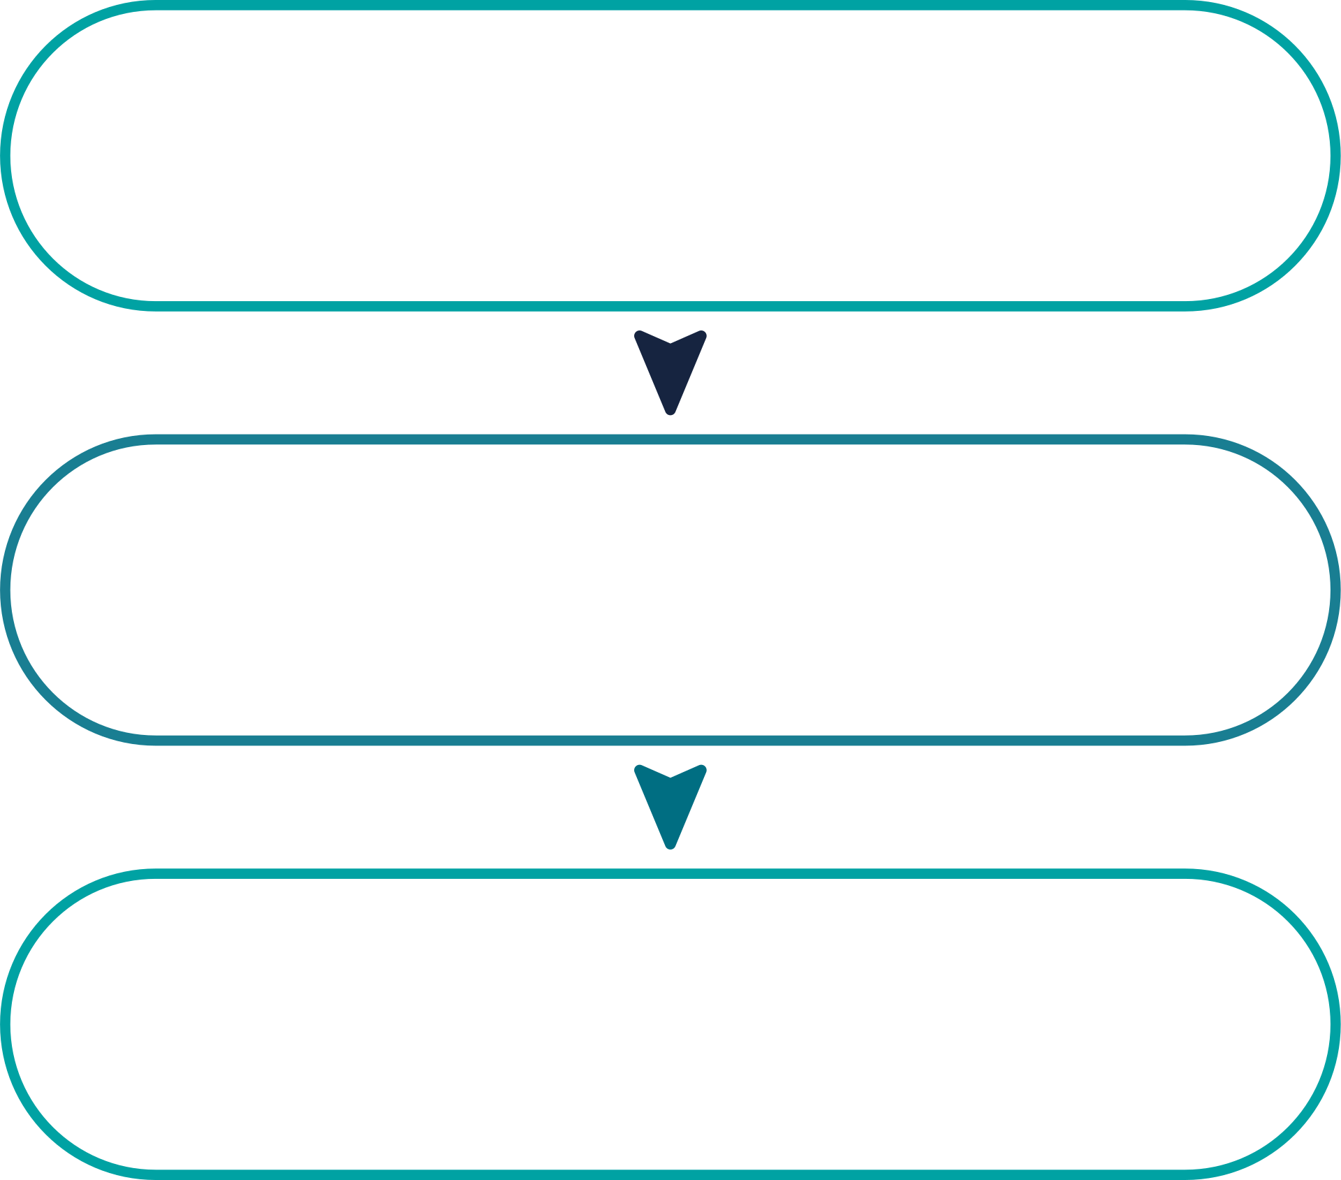
Market Research
Three gaps stand between a planner and that answer today:
  Pressure is observable but not assembled. Carpark and charger feeds are live, but nothing joins them spatially or turns them into a per-area saturation measure.
  Selection is heuristic. Ranking by current utilisation over-invests in saturated sites and misses high-demand areas with zero existing supply.
  Reasons are not retained. Rejection logic lives in a spreadsheet, not the system — decisions can't be reconstructed later.
OptEV+ fixes all three: it turns live feeds into per-area pressure indicators, replaces ranking with constrained optimisation, and keeps every decision as a traceable record a natural-language interface can read back.
Our Market Research
EXISTING SOLUTIONS
• PlugShare
• SG EV 2030
• Charge+
• More Chargers
• EV Growth
• SP Mobility
Market Gap
No intelligent government planning platform
for dynamic EV charger deployment
Our Solution
Dynamic AI Reasoning + Optimization +
Explainable EV Infrastructure Planning

Slide 6






Project Scope & Deliverables
Data Integrity
Demand & Spatial Analysis
Intelligent Recommendation
Government datasets covering EV chargers, HDB/public car parks, vehicle data and spatial information.
Analyse EV concentration, charging demand, existing coverage, accessibility and parking availability.
Rank feasible candidate locations and recommend the required charger quantity/type based on demand.
Resource Optimisation
Dynamic Updating
Explainable Decision Support
Select the best combination of locations under constraints such as budget, capacity, distance and site feasibility.
Simulate changing EV demand and infrastructure to recalculate rankings as new chargers are selected or added.
Provide planners with ranked recommendations and reasons explaining why locations are recommended, rejected or prioritised.

Slide 7
System Design
Five stages, as built. Each technique group lives in one stage, and each stage feeds the next.
01
02
03
04
05
Data foundation
Measurement & inference
Scenario generation
Reasoning & optimisation
Explanation & interface
One week of 5-minute polls (7–14 Oct) plus 14 government datasets. Sites matched at 50, 100 and 200 m; each placed in its planning area.
Utilisation and saturation per site and hour, usage patterns, and demand: a lower bound where saturated, and estimated where no charger exists.
Demand projected to 2030 under declared growth assumptions, held as a separate simulated layer that is never mixed with observed data.
Rules give accept, reject, defer or conditional with a reason. The optimiser allocates points under points, budget and room; a separate checker re-tests every constraint.
A knowledge graph linking sites, evidence, rules, assumptions and decisions; plain-language answers; a map of rankings and allocations.
Built: PostGIS spatial joins
Built: Erlang B inversion, k-means, regression
Built: logistic growth fit, ×3.26 / 3.65 / 3.99
Built: forward chaining, OR-Tools CP-SAT
Built: Neo4j, LangGraph, Streamlit
Decision automation
Foundation
Knowledge discovery
Scenario layer
Resource optimisation
Cognitive techniques
↻ A planner selects a site → it is stored as planned capacity → the scenario re-solves and the next recommendation reflects it
Three layers, never merged: OBSERVED from the feeds, SIMULATED by stage 3, PLANNED by the planner. A selection is reversible and never alters the evidence behind it.
Each stage reads only what earlier stages wrote. The whole pipeline runs on the real data in about two minutes.
Notes:
About 60 seconds. The five stages as built. Data: one collected week plus 14 datasets, joined spatially. Stage 2 is knowledge discovery: Erlang B turns occupancy into demand per hour, k-means finds usage patterns, and a regression carries demand to sites with no chargers. Stage 3 projects to 2030 with fitted growth. Stage 4 holds the rules and the CP-SAT optimiser with its independent checker. Stage 5 is the knowledge graph and grounded explanations. Point at the banner: planner choices are planned capacity and never change observed data.

Slide 8
Data Collection
Fourteen government datasets and one declared assumption, grouped as in the proposal. Each one is used by a named stage.
A
Live feeds · observed
B
Car park registry
C
Boundaries & land use
D
Amenity candidates
EV Charging Points Batch
LTA DataMall · every 5 min
Carpark Availability
LTA DataMall · every minute
HDB Carpark Availability
data.gov.sg · every minute · history to 2018
HDB Carpark Information
type, night parking, gantry, basement
Capacity of URA Parking Places
car lots per car park
MP2025 Planning Area Boundary
55 planning areas
MP2025 Land Use Layer
land type per plot
Hawker Centres
NEA
Community Clubs
People's Association
Licensed petroleum premises
Singapore Customs
Used in S1 S2 S3 S4
Used in S1 S4
Used in S1 S2 S4
Used in S1 S2 S4
E
Demand context
F
Growth & calibration
G
Optional & assumed
Deliberately not used
Resident population by planning area
SingStat · yearly
New car registrations
monthly
EV & Charging Points Dashboard
LTA · monthly
EV Charging Points CSV
quarterly · back-test only
Cost per charging point
declared, cited, varied
Eight more were checked and rejected: duplicates such as URA Parking Lot, outdated tables such as MP2019 subzones, or sources outside the proposal such as OneMap themes.
No dataset holds charging sessions, EV owners' homes, future demand or cost. Each is handled by a proxy, the scope, or a declared assumption.
Used in S2 S3 S4
Used in S3 S4
Used in S1 S4
S1 foundation · S2 measurement & inference · S3 scenarios · S4 reasoning & optimisation · Stage 5 links every site to all of them.
Notes:
About 60 seconds. Groups A to D are the four inputs the proposal lists: live feeds, the car park registry, boundaries, and amenity candidates. E, F and G are what later stages need: context for sites with no chargers, growth for the 2030 scenarios, and cost for the budget. Stress the test: every dataset is used by a named stage, and eight others were rejected for a stated reason. If asked about private car parks: out of scope, we plan the 40,000 public points.

Slide 9
Data Preparation
Everything becomes one candidate-site table. Most links are spatial, so every link reports its coverage.
1
Coordinates into one system
100%
Candidate-site table
SVY21 converted to latitude and longitude; distances in metres
one row per site · what the rules and the optimiser read
2
HDB availability ↔ HDB registry
88%
Exact match on car park number
Site type and location
Planning area and land use
Capacity, and where it came from
Existing charging points
Utilisation and saturation
Car park occupancy
Amenities nearby, residents in area
Car park features
Layer: observed, simulated or planned
3
Charging point ↔ site
68 / 73 / 83%
Nearest site within 50, 100 and 200 m
4
URA car parks
659 sites
Registry places with car lots; malls out of scope
5
Amenity ↔ car park
86%
Nearest within 150 m, else a standalone site
6
Site ↔ planning area, land use
100%
Point-in-polygon on Master Plan 2025
Handled from day one
Out-of-service and planned points never count as capacity
A linked amenity is a feature of its car park, not a second site
The HDB feed is never queried at exactly midnight: it returns nothing
7
Charger ↔ car park snapshots
330 / 330
Aligned to the same 30-minute slot
Notes:
About 50 seconds. Every link now reports its measured coverage. 88% of HDB car parks matched the live feed, 1,997 of 2,273. Charging stations matched a site at 68, 73 and 83% within 50, 100 and 200 m. 86% of amenities sit within 150 m of a car park and become a feature of it, not a second site. Every one of the 2,967 sites is in a planning area, and both feeds were present in all 330 half-hour slots.

Slide 10
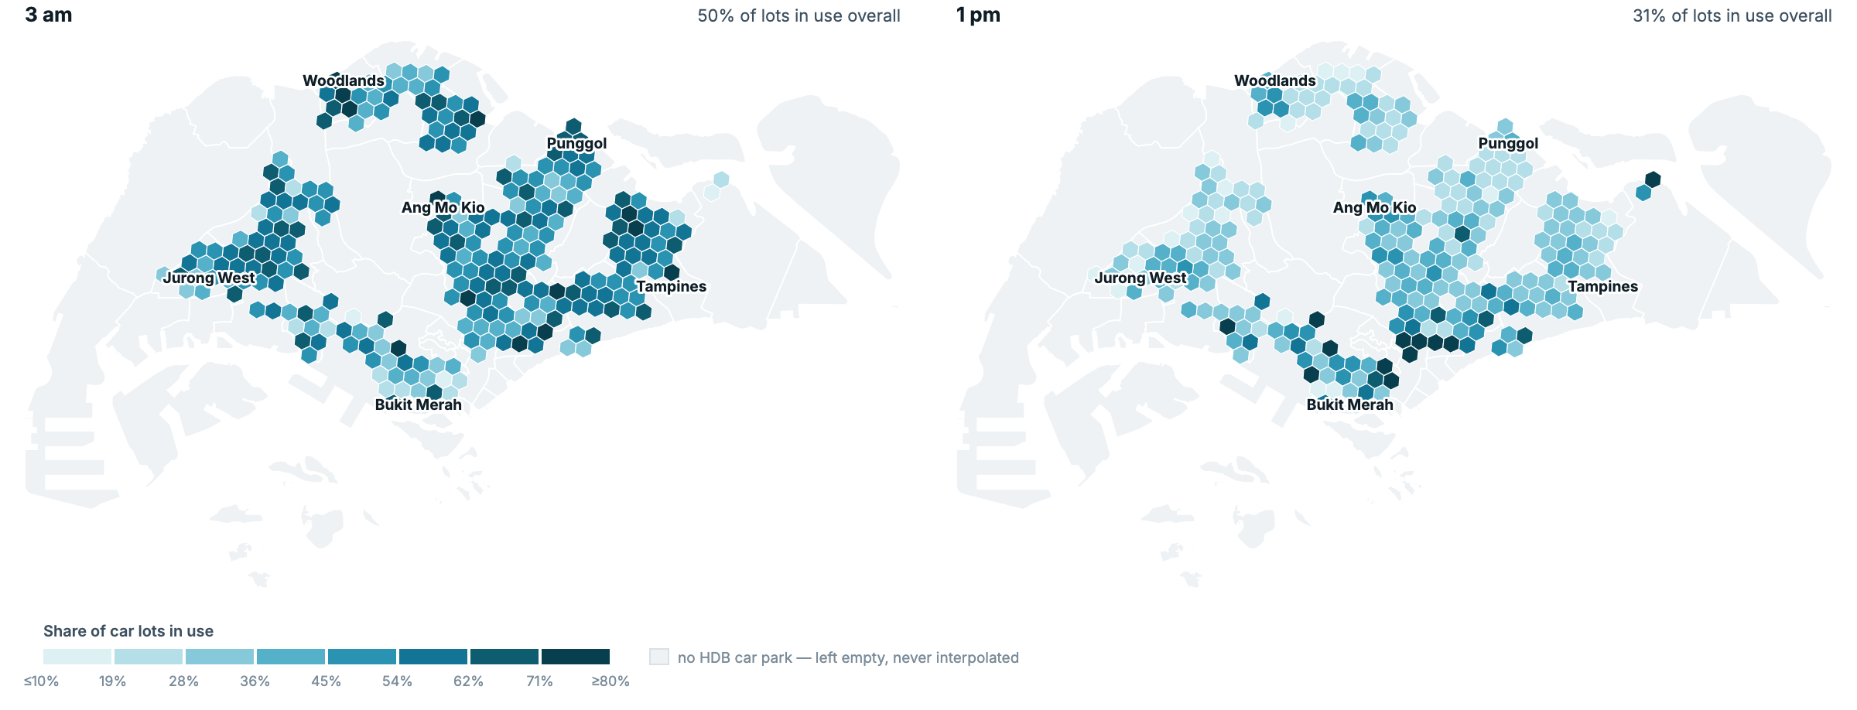
The Collected Week
Charging point and HDB car park feeds, polled every 5 minutes from 7 to 14 Oct 2026 and loaded at half-hour snapshots.
330 / 330
half-hour slots loaded, both feeds
3.83 M
charging point readings, plus 662,310 car park readings
2,967
Same car parks, 3 am and 1 pm on a weekday. 84% of areas are busier at night: residents park at home and drive out by day. This is car park activity, an input to demand, not a prediction.
candidate sites, every one in a planning area
Both feeds were complete in every slot; 11,580 of 11,698 charging points appear in all 330 slots.
76 s
median age of a charging record when collected
Notes:
About 40 seconds. The real data: one full week, nothing missing. 330 of 330 half-hour slots for both feeds, 3.83 million charging point readings, 2,967 candidate sites, and records were on average 76 seconds old when collected. The maps show car park activity, which is what we use where no charger exists yet.

Slide 11
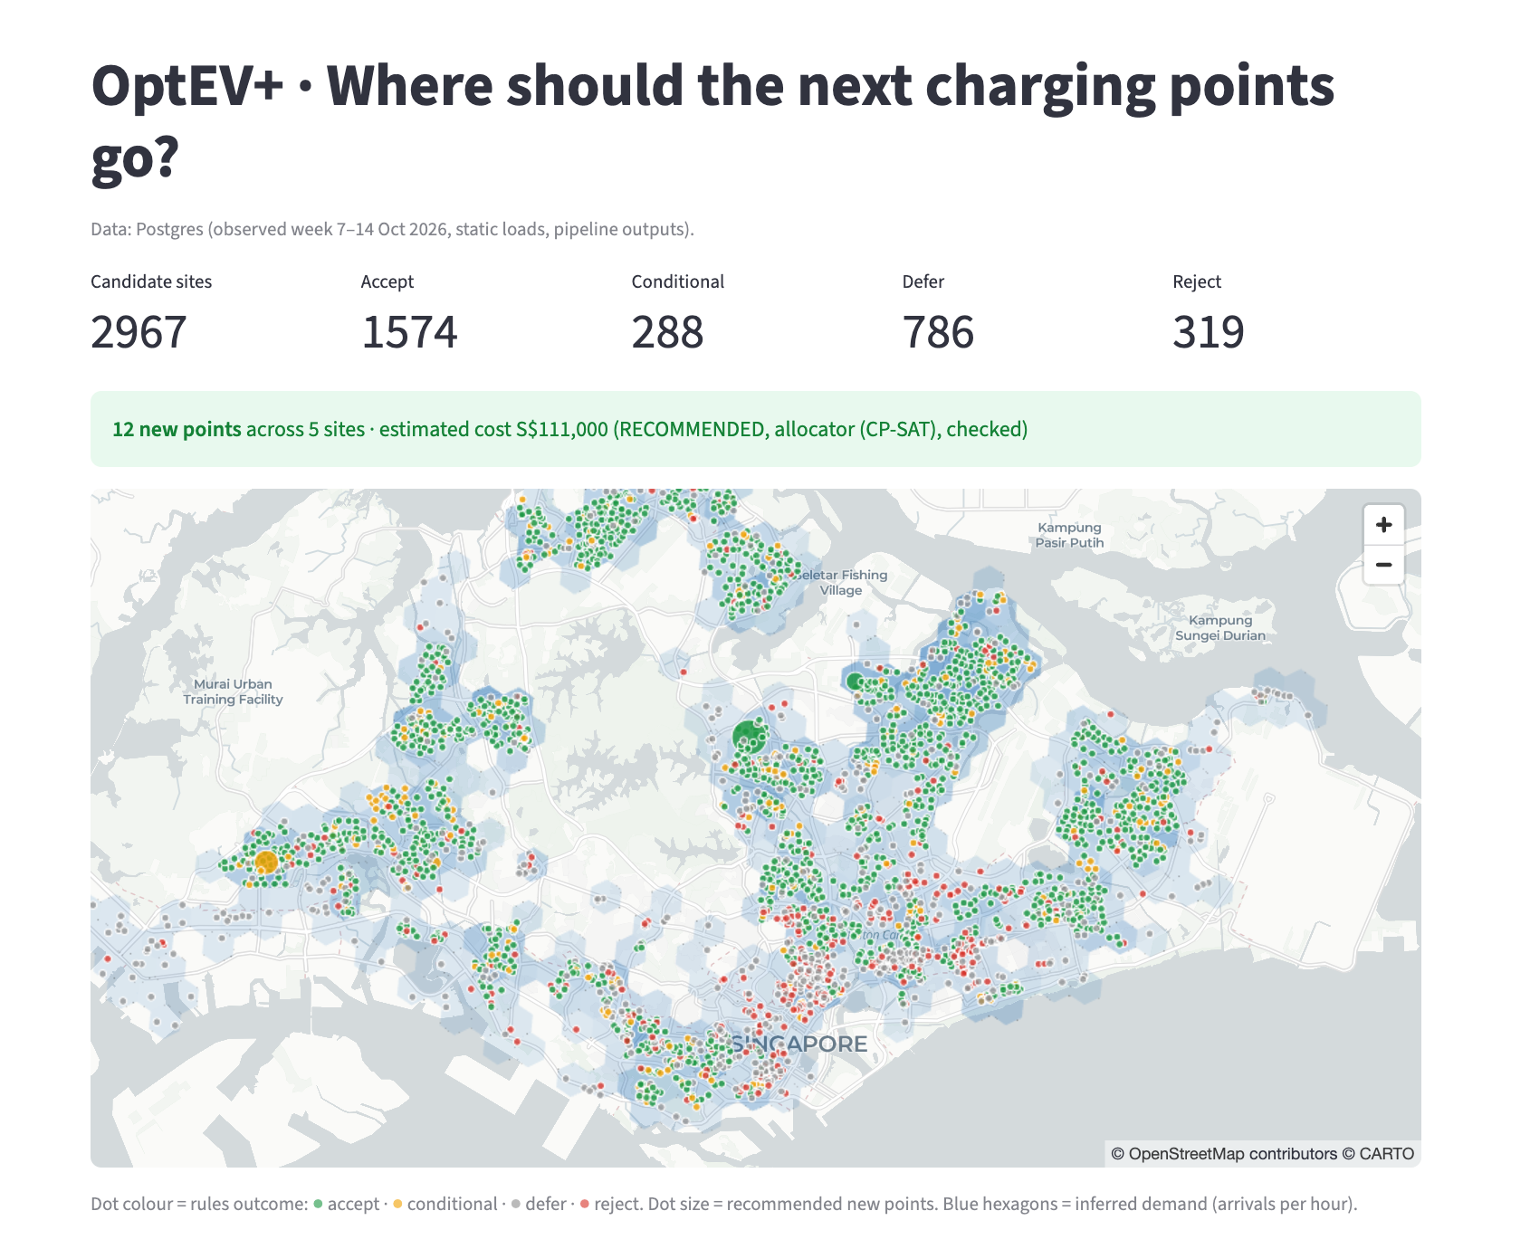
Implementation The App on Real Data
2,967 candidate sites coloured by rules outcome, with a checked 12-point island-wide plan for the base scenario.

Slide 12
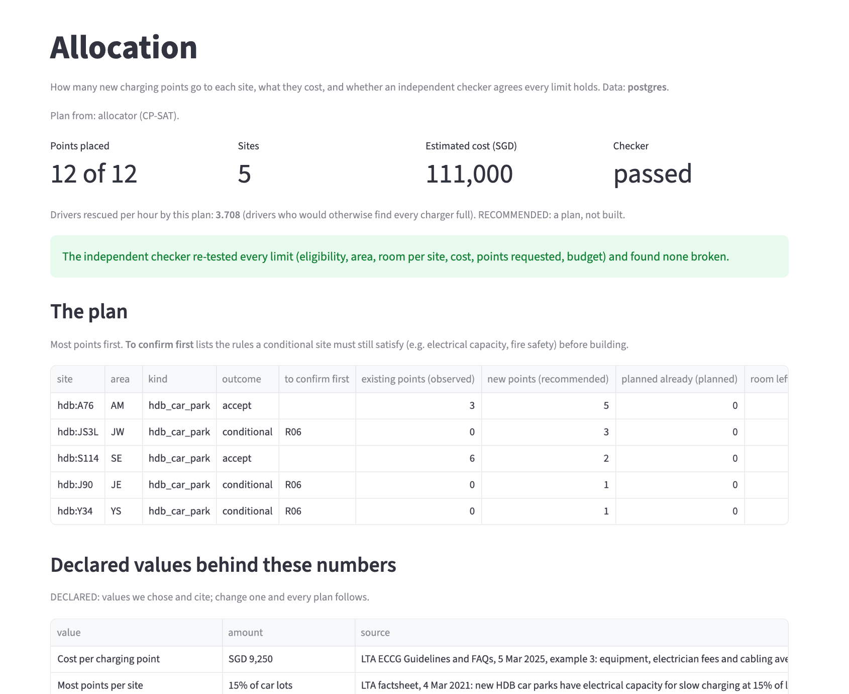
Allocation A Checked Plan
Points per site, estimated cost and drivers rescued; an independent checker re-tests every constraint before a plan is shown.

Slide 13
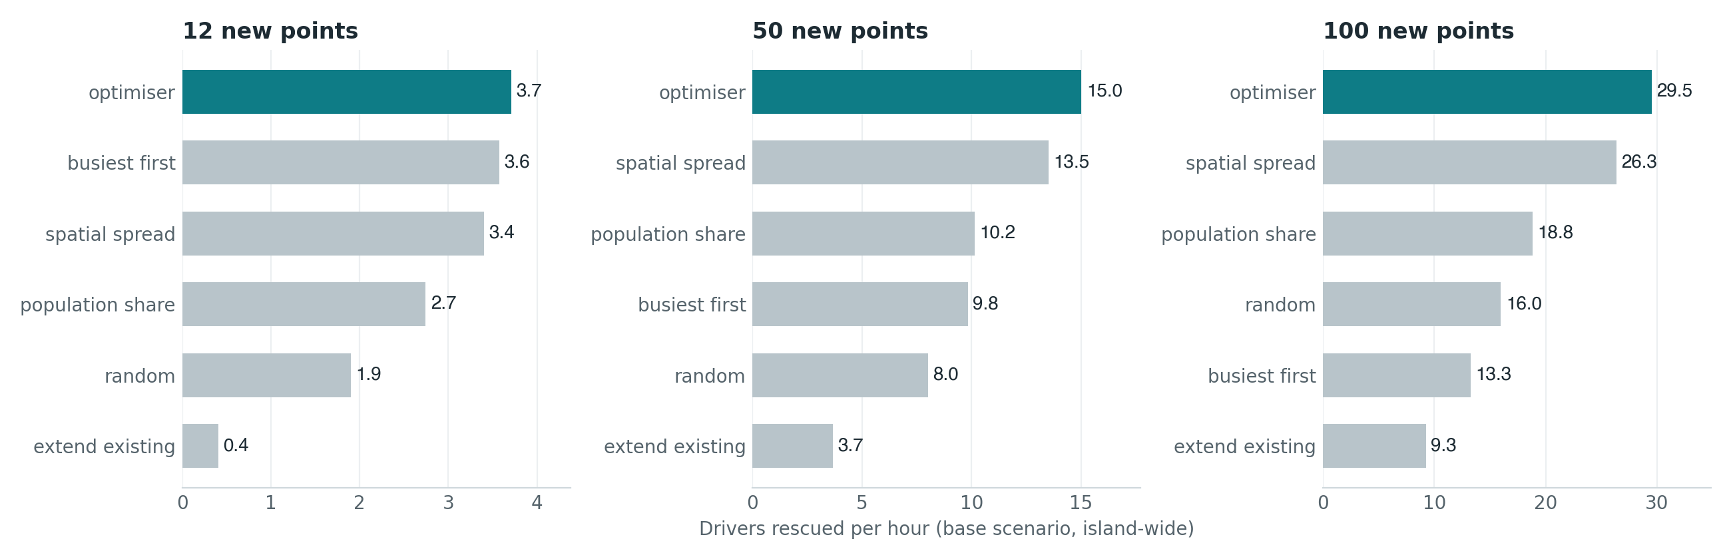
Results Beats Every Baseline
Drivers rescued per hour, island-wide, base scenario. The optimiser's lead grows with the request: 1.04×, 1.11× and 1.12× the best baseline.

Slide 14
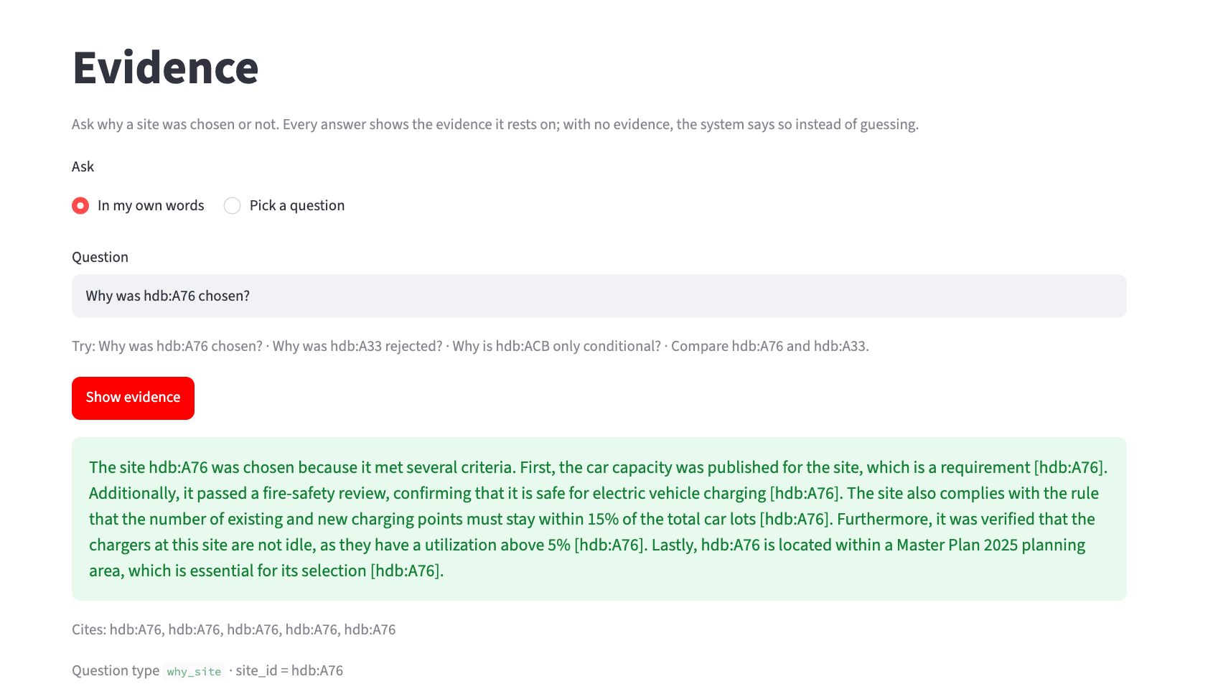
Explanation Answers With Evidence
Fixed retrieval from the knowledge graph; every number must appear in the evidence. 95% accuracy, 0 unsupported claims on 20 questions.

Slide 15
Results Against Targets
Every target was fixed before results were seen. Real collected week, unless marked simulated.
Stage · technique group | What we check | Metric | Target | Result | Status
1 · Data foundation | Complete, fresh, joined? | Snapshot completeness; freshness; join coverage at 50/100/200 m | ≥ 95%; 100% of sites in an area | 330 / 330 slots; 2,967 of 2,967 sites | Met
2 · Discovery: patterns | Do patterns hold on unseen days? | Silhouette; held-back-day agreement | ≥ 0.5; ≥ 80% | 0.16; 55% | Missed
2 · Discovery: demand | Does occupancy-to-demand recover the truth? | Error below the reliability limit (simulated) | ≤ 10% | 14% (whole-window method: 28%) | Close
2 · Discovery: no-charger sites | Can we rank where nothing is measured? | MAE and Spearman ρ on hidden areas | Beat area average; ρ ≥ 0.5 | MAE 0.35 vs 0.38; ρ 0.48 | Partly
3 · Scenarios | Does one assumption drive the answer? | Top-10 kept under ±20% growth, ±10% demand | ≥ 7 of 10 | 8 to 9 of 10 | Met
4 · Decision automation | Do rules decide as a planner would? | Agreement with raters; reason codes | κ ≥ 0.7; 100% | Both raters 30/30; κ 1.00; 100% codes | Met
4 · Resource optimisation | Valid, and better than simpler ways? | Violations; drivers rescued against 5 baselines | 0; beat all | 0; 1.04× / 1.11× / 1.12× best baseline | Met
5 · Cognitive techniques | Correct, evidenced answers? | Accuracy; citations; unsupported claims | ≥ 90%; 100%; 0 | 95%; 100%; 0 | Met
End to end: at 100 points the optimiser rescues 12% more drivers per hour than the best baseline, with zero violations.
Notes:
About 70 seconds. The proposal's metrics table, now with results. Five of eight rows met: data coverage, stability, rules, allocation, and explanation. Be direct about the rest: patterns did not separate cleanly on real data, the demand inversion is at 14% against a 10% target, and the unserved-site ranking is just under 0.5. The rules check is met: both raters agreed with the system on all 30 sites. End on the headline: 12% more drivers rescued at 100 points.

Slide 16
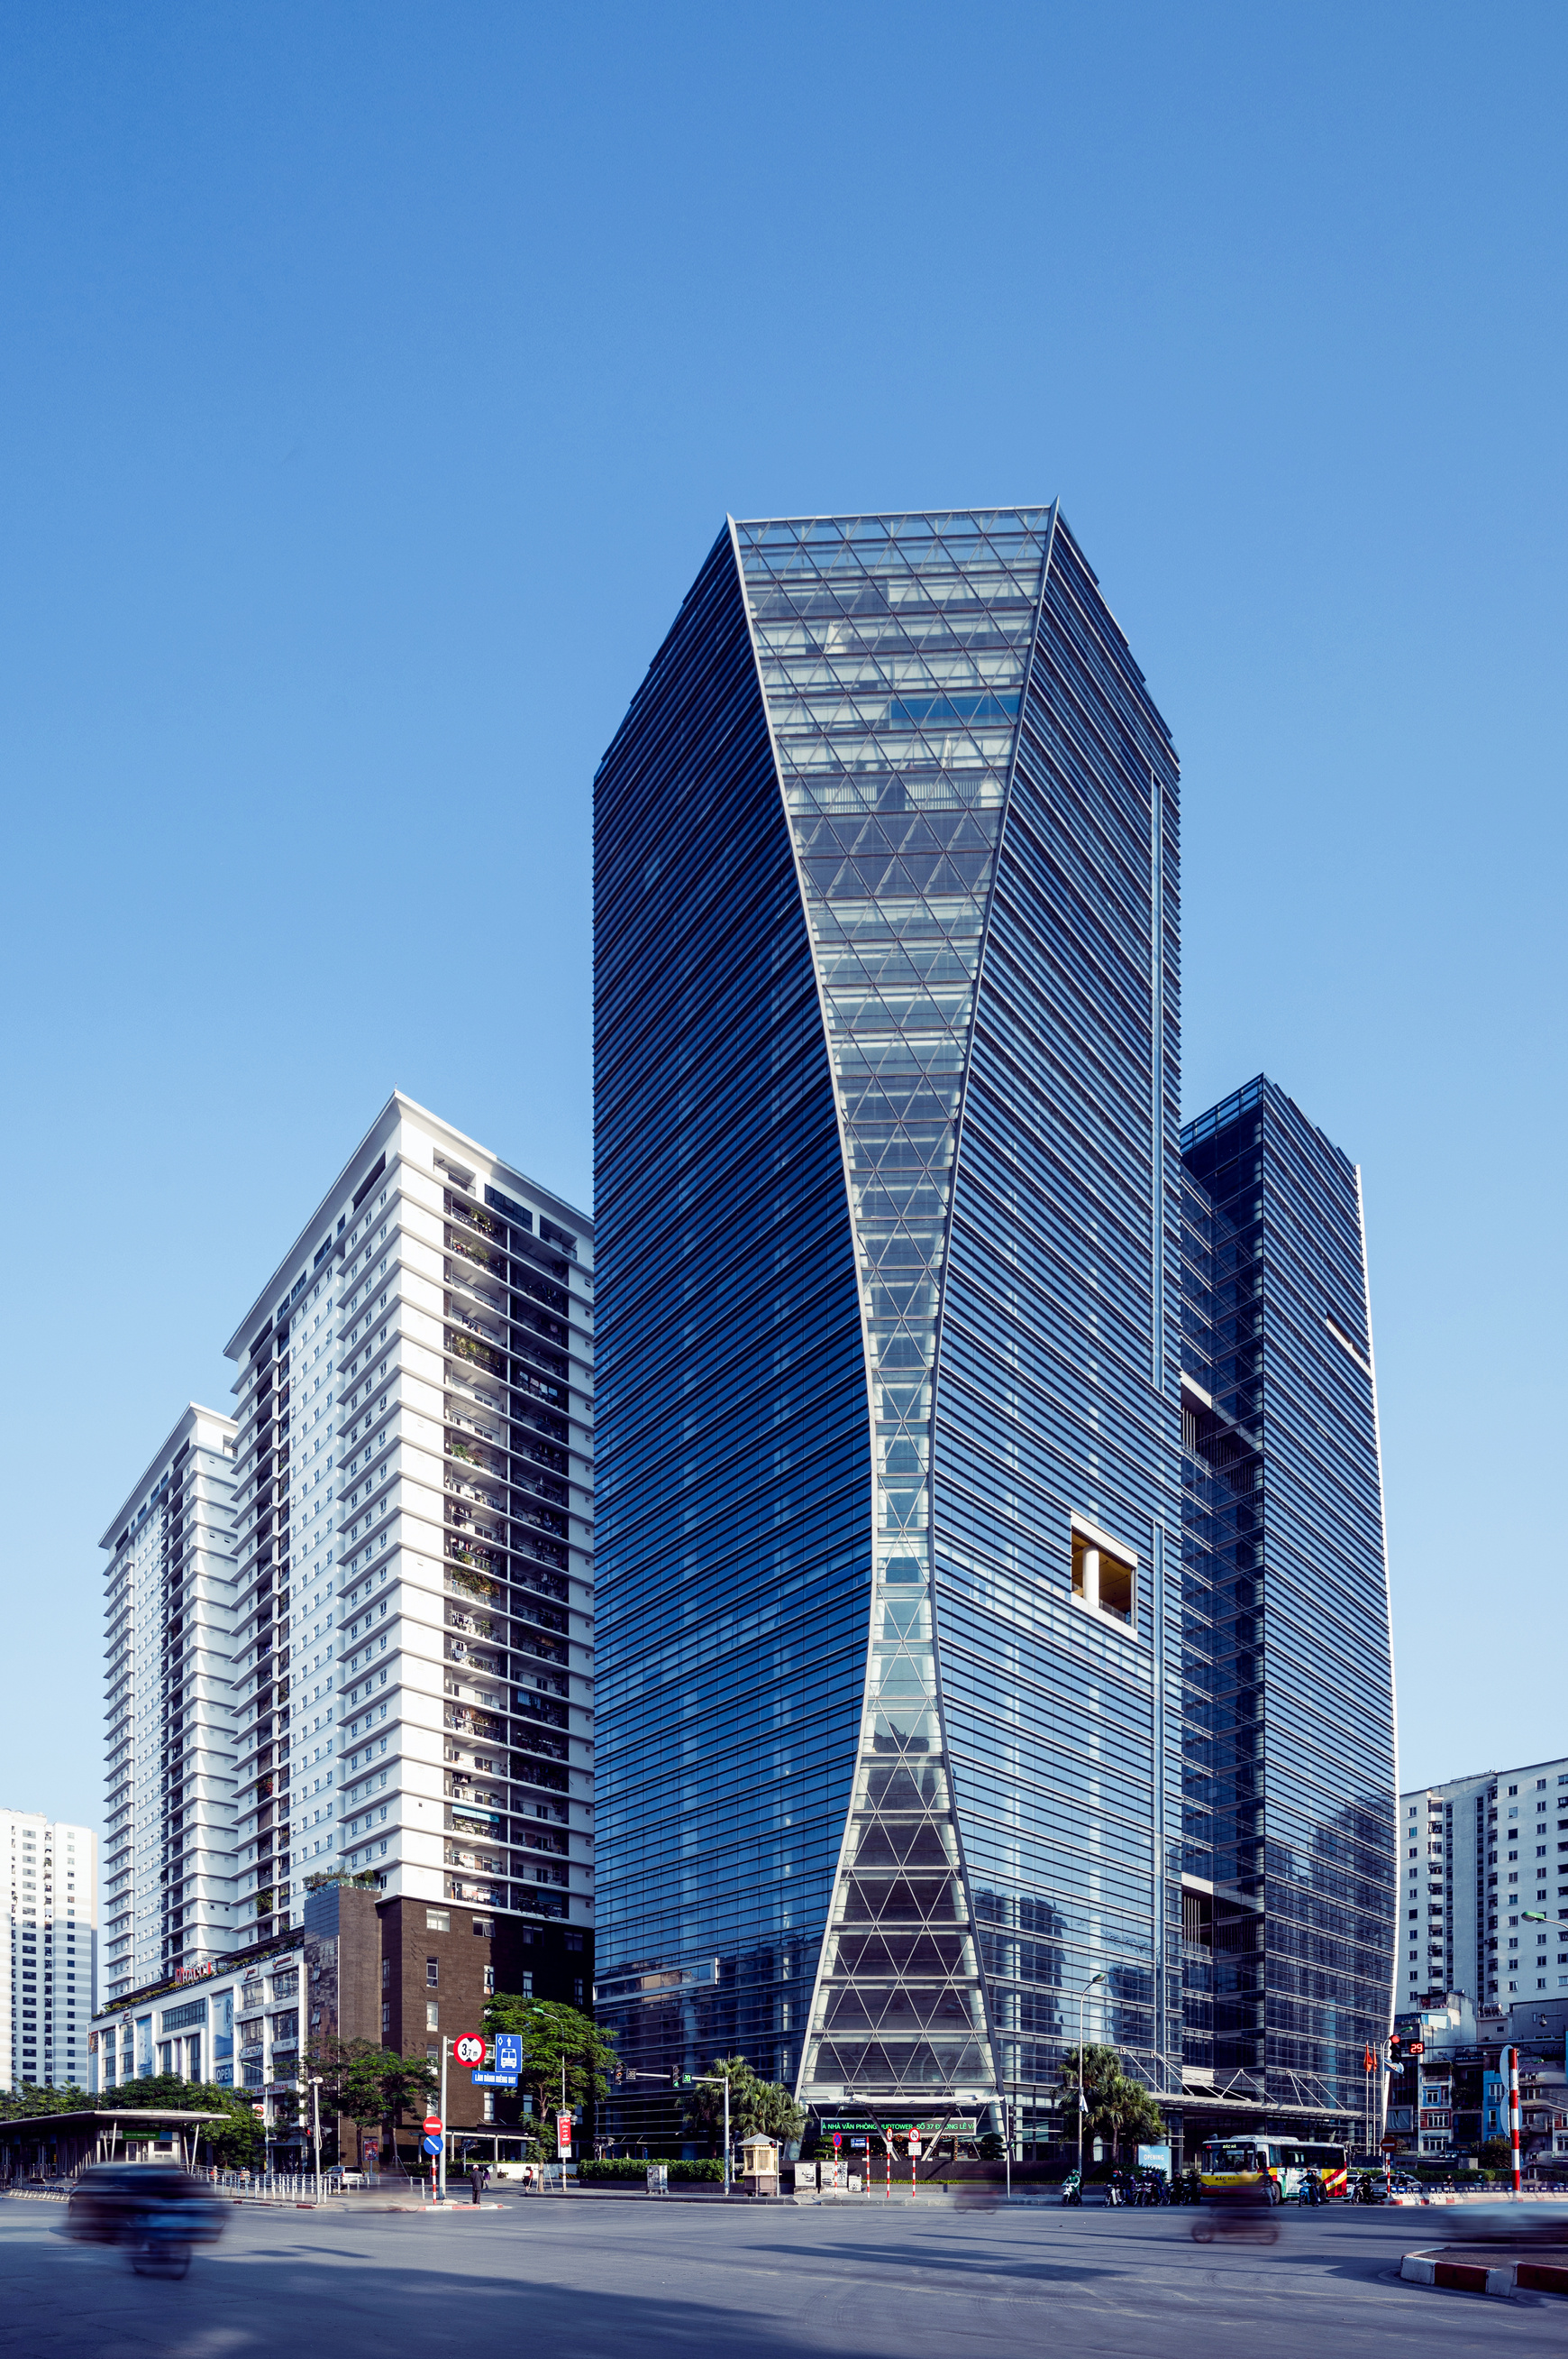
01
What We
Island-wide plans timed out
Solved
Pruned unreachable points: 35 s to 2 s
We also removed an uncited minimum of points per planning area, which made every island-wide request under 100 points infeasible, and made the app plan on hourly demand so it shows exactly the plan in the report.
02
Growth fit exploded
Fitted the electric share: error 8.3%
03
Zero demand at new sites
Dropped distance to nearest charger
Notes:
About 50 seconds. Three problems the real data exposed. Island-wide, the optimiser had 90,000 variables and timed out; dropping points that can never be optimal gives the same optimum in about 2 seconds. The first growth fit projected more EVs a month than the whole car market, so we modelled the electric share. And distance to the nearest charger is zero for every site that has one, which made the model predict zero demand at new sites.

Slide 17
01
Next
Only one week of data
Steps
Next: months of data, refit by season
Published government data is enough to say where Singapore's next public charging points go, how many each site gets, and why. OptEV+ beats every baseline at every request size with zero violations, and every decision traces to its evidence.
02
New-site ranking ρ 0.48
Next: censored regression
03
No power or land data
Next: add those constraints

Slide 18


Still puzzled?

Slide 19
Thank you!

Slide 20
Appendix Use of AI Tools
AI coding assistants, including Claude Code, helped implement modules, write tests and review pull requests against the team's binding design document; ChatGPT, Gemini and Claude helped with research and drafting. Every merged change passed lint, type checks and 388 tests and was reviewed by a team member. One of the two raters in the rules check was an AI assistant, as disclosed in the report. Design decisions and conclusions are the team's own.
As stated in the group report, Appendix E.

