Slide 1

Illuminating Wellness
The Science of Red Light Therapy and Retinal Imaging

Slide 2
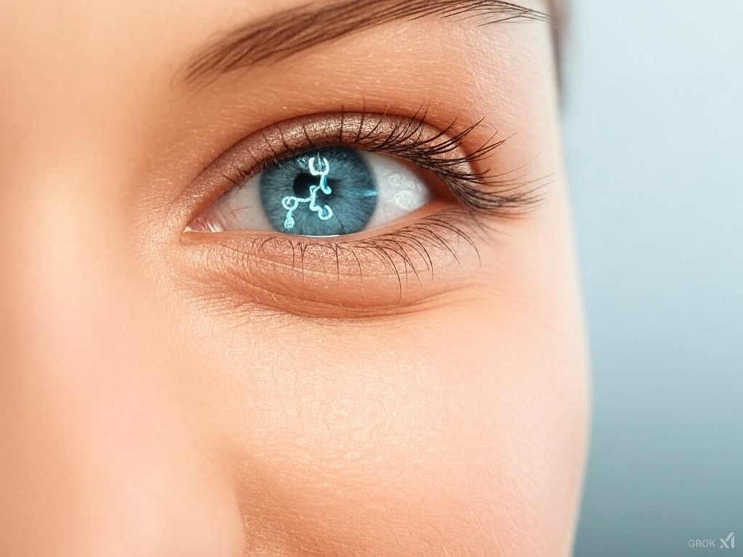
2D Opticare AI
The Red Light Miracle

