Slide 1

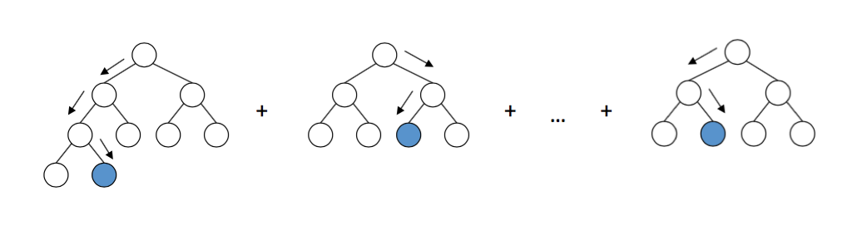
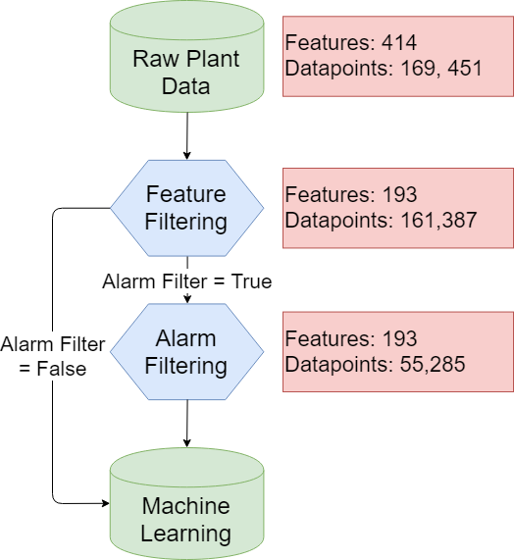
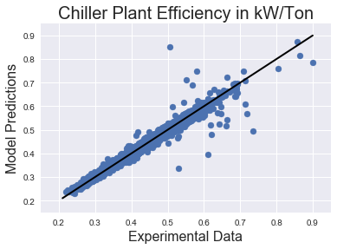
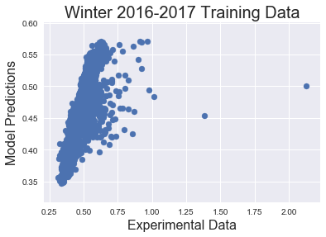
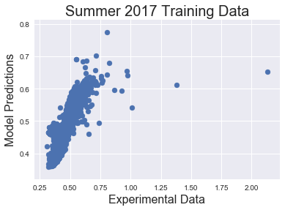
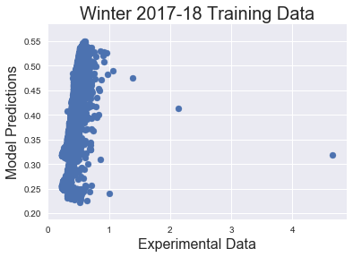
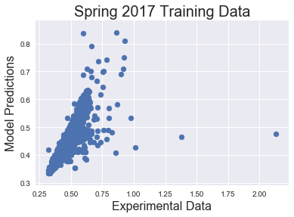
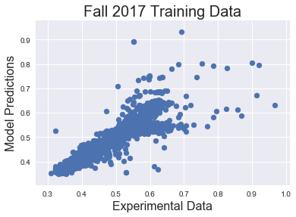
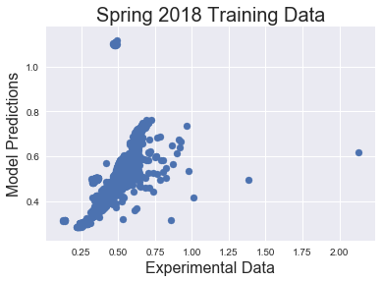





OPTICHILL – DATA SCIENCE TOOL FOR PREDICTION OF CHILLER PLANT EFFICIENCY
PROJECT SPONSOR: Fred Woo, Optimum Energy
Theodore Cohen^{1, 2, 3}, Caitlin Parke⁴, Maitri Uppaluri⁴
1. Department of Chemistry 2. Department of Material Science and Engineering 3. Molecular Engineering and Science Department 4. Department of Chemical Engineering
INTRODUCTION
GRADIENT BOOSTING MACHINES
MOTIVATION
GOALS
To test the GBM model generated by a single chiller plant on a different plant with a similar configuration.
Adding and removing different features to see the effect on prediction across the different feature and how the importance of these features changes.
Changing the control type used on a particular plant and gauging its impact on efficiency and feature importance.
FUTURE WORK
Today, efficiency models of plants run in large excel sheets. These models can take months to create and process. Machine learning can be a powerful tool to automate, streamline and optimize the prediction of the efficiency of a chiller plant.
The efficiency of the chiller plant is determined by kW/ton. A tool that determines which variable from the chiller plant has the highest effect on the efficiency is useful to understand and optimize the plant.
1. DATA CLEANING
Remove unwanted features and alarms from the dataset.
2. FEATURE IMPORTANCE
Create an algorithm that sorts out the features in the order of their importance for plant efficiency.
3. PREDICTION
To predict the efficiency of the chiller plant with machine learning.
Gradient boosting machines (GBM) incorporate decision trees in an additive manner with a gradient descent procedure to minimize the chosen loss function. The decision trees are called weak learners because each tree is capped at a certain depth and does not adequately describe the model well. Subsequent trees are trained to reduce the loss in the direction of the gradient and are added to the model to improve the prediction of the model, while previous trees are left unchanged. Generally, a hyperparameter, like tree depth or the minimum samples for a split, are constrained to maintain weak learners but increase the ability to tune the model; in this work, the tree depth and the number of trees were constrained. In this work, the gradient boosting machines were implemented with the scikit-learn package.
Chiller plant data
Filtering features from the data
Feature importance
Predicting efficiency
DATA CLEANING
RESULTS
FEATURES
OVERALL PREDICTION
TRAINING ACROSS DIFFERENT SEASONS
Raw data from several chiller plants was filtered and optimized for ML implementation. This was started by only using the raw data directly from the plant. These data included readouts form the Building Automation System, chillers, cooling towers, and water pumps.
Additionally, a list of normalized feature importance was made by calculating the number of times a split was made on a particular feature. This tells the user which features have the largest contribution to plant efficiency. From this work, Optimum Energy has been able to explore its data more effectively. This insight will allow for better collection for more representative data. For example, the parameters of a certain chiller continue to be in the top features due to its continuous use. More directed cycling of different machines will better sample their feature space and may lead to improved optimization results for efficiency in the future.
For further exploration of the data, the model was trained on different seasons and then tested on the rest of the data. The transitional seasons, spring and fall, have the best testing results. These results were as expected as these seasons have more varied weather conditions, which make them better candidates for training the model.
Season | R² value (%)
Winter 2016-17 | 74
Spring 2017 | 76
Summer 2017 | 60
Fall 2017 | 81
Winter 2017-18 | 70
Spring 2018 | 79
FILTERING
Various stale features were removed and any feature containing the phrase ‘kW’ was removed to ensure that no calculated data was used for plant performance prediction. Datapoints used for prediction were pre optimized, complete, and in some cases had no alarms going off. Optional inputs for removing any feature was added for flexibility.
When GBM were trained on Plant 1 data, R² value = 98.3%. The Plant 1 data contained around 52,000 data points.
Feature Name | Feature Importance (%)
Chiller 5 Compressor Refrigerant Discharge Temperature (°F) | 100
Maximum Chiller Pressure Lift (psi) | 48.52353
Minimum Chiller Pressure Lift (psi) | 33.44226
Chiller 5 Condenser Approach (°F) | 21.5352
Cooling Tower 5 Fan Speed (Hz) | 20.24397
ACKNOWLEDGEMENTS
Fred Woo, Tim Wehage, Michael Huguenard, Dana Lindquist (Optimum Energy)
Dave Beck and Kelly Thornton
Github URL:
https://github.com/optichill/optichill

