Slide 1

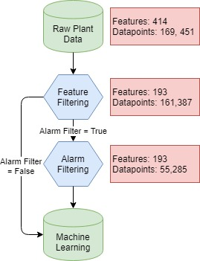




OPTICHILL – DATA SCIENCE TOOL FOR PREDICTION OF CHILLER PLANT EFFICIENCY
Theodore Cohen^{1, 2, 3}, Caitlin Parke⁴, Maitri Uppaluri⁴
1. Department of Chemistry 2. Department of Material Science and Engineering 3. Molecular Engineering Institute 4. Department of Chemical Engineering
INTRODUCTION
GRADIENT BOOSTING MACHINES
FUTURE WORK
MOTIVATION
GOALS
DATA CLEANING
RESULTS
FEATURES
OVERALL
TRAININNG ACROSS DIFFERENT SEASONS
Raw data from several chiller plants was filtered and optimized for ML implementation. This was started by only using the raw data directly from the plant. These data included readouts form the Building
Automation System, chillers, cooling towers, and water pumps.
FILTERING
Various stale features were removed and any feature containing the phrase ‘kW’ was removed to ensure that no calculated data was used for plant performance prediction. Datapoints used for prediction were pre optimized, complete, and in some cases had no alarms going off. Optional inputs for removing any feature was added for flexibility.

