Slide 1

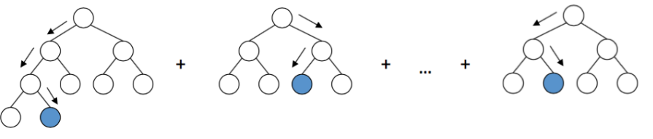
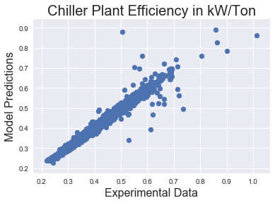



OPTICHILL – DATA SCIENCE TOOL FOR PREDICTION OF CHILLER PLANT EFFICIENCY
Theodore Cohen^{1, 2, 3}, Caitlin Parke⁴, Maitri Uppaluri⁴
1. Department of Chemistry 2. Department of Material Science and Engineering 3. Molecular Engineering and Science Department 4. Department of Chemical Engineering
INTRODUCTION
GRADIENT BOOSTING MACHINES
FUTURE WORK
MOTIVATION
Gradient boosting machines (GBM) incorporate decision trees in an additive manner with a gradient descent procedure to minimize the chosen loss function. The decision trees are called weak learners because each tree is capped at a certain depth and does not adequately describe the model well. Subsequent trees are trained to reduce the loss in the direction of the gradient and are added to the model to improve the prediction of the model, and previous trees are left unchanged. The number of estimators is the hyperparameter that controls the total number of trees. Generally, a hyperparameter, like tree depth or the minimum samples for a split, are constrained to maintain weak learners but increase the ability to tune the model. In this work, the gradient boosting machines were implemented with the Scikit-learn package.
GOALS
DATA CLEANING
RESULTS
FEATURES
OVERALL
TRAINING ACROSS DIFFERENT SEASONS
Another important part of the package was the generation of a feature list. A list of normalized feature importance was made by calculating the number of times a split was made based on a feature. This information allows a look into what features are affecting the efficiency the most. From this work, Optimum Energy has been able to explore the data more efficiently. This insight into the data may lead to better collection for more representative data. For example, the parameters of a certain chiller continue to be in the top features because it is continually used at Plant 1. More directed cycling of different machines can better sample the feature space that may lead to better optimization results for efficiency in the future.
For further explorations of data, the model was trained on a season and then tested on the rest of year. The transitional seasons, spring and fall, have the best testing results with R2 values of 76%, 81%, and 79% for Spring 2017, Fall 2017, and Spring 2018, respectively. These results were expected as the spring and fall have more varied weather conditions, which is better for training data.
ALARMS
When GBM were trained on Plant 1 data, R² value = 98.3%. The Plant 1 data contained around 52,000 data points.

