Slide 1

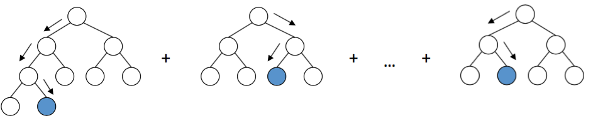
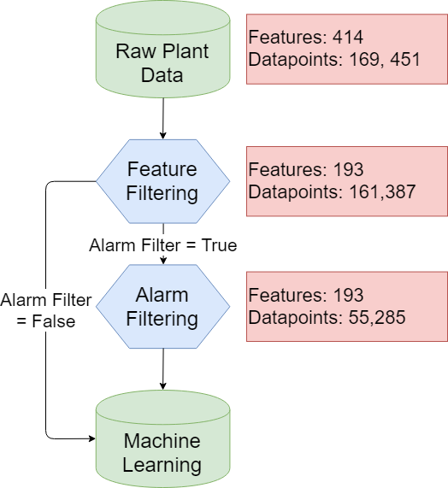
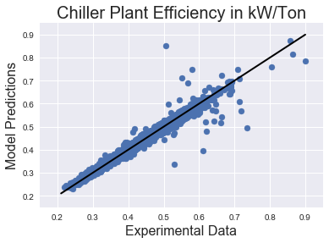





OPTICHILL – DATA SCIENCE TOOL FOR PREDICTION OF CHILLER PLANT EFFICIENCY
Theodore Cohen^{1, 2, 3}, Caitlin Parke⁴, Maitri Uppaluri⁴
1. Department of Chemistry 2. Department of Material Science and Engineering 3. Molecular Engineering and Science Department 4. Department of Chemical Engineering
To be able to predict the plant efficiency on more plants and test the prediction model on these plants with training data from a different plant.
Adding and removing different features to see the effect of prediction across the different feature, and how the importance of these features changes.
Changing the control of the plant and producing predictive optimization based on the choice of control on the plant.
INTRODUCTION
GRADIENT BOOSTING MACHINES
FUTURE WORK
MOTIVATION
GOALS
Today, efficiency models of plants run in large excel sheets. These models can take months to create and process. Machine learning can be a powerful tool to automate, streamline and optimize the prediction of the efficiency of a chiller plant.
The efficiency of the chiller plant is determined by kW/ton. A tool that determines which variable from the chiller plant has the highest effect on the efficiency is useful to understand and optimize the plant.
1. DATA CLEANING
To remove unwanted features and alarms from the dataset.
2. FEATURE IMPORTANCE
To create an algorithm that sorts out the features in the order of their importance to plant efficiency.
3. PREDICTION
To predict the efficiency of the chiller plant with machine learning and optimize the prediction.
Gradient boosting machines (GBM) incorporate decision trees in an additive manner with a gradient descent procedure to minimize the chosen loss function. The decision trees are called weak learners because each tree is capped at a certain depth and does not adequately describe the model well. Subsequent trees are trained to reduce the loss in the direction of the gradient and are added to the model to improve the prediction of the model, and previous trees are left unchanged. The number of estimators is the hyperparameter that controls the total number of trees. Generally, a hyperparameter, like tree depth or the minimum samples for a split, are constrained to maintain weak learners but increase the ability to tune the model. In this work, the gradient boosting machines were implemented with the scikit-learn package.
Chiller plant data
Filtering features from the data
Feature importance
Predicting efficiency
DATA CLEANING
RESULTS
FEATURES
OVERALL PREDICTION
TRAINING ACROSS DIFFERENT SEASONS
Raw data from several chiller plants was filtered and optimized for ML implementation. This was started by only using the raw data directly from the plant. These data included readouts form the Building Automation System, chillers, cooling towers, and water pumps.
Another important part of the package is the generation of a feature list. A list of normalized feature importance was made by calculating the number of times a split was made based on a feature. This information allows a look into what features are affecting the efficiency the most. From this work, Optimum Energy has been able to explore the data more efficiently. This insight into the data may lead to better collection for more representative data. For example, the parameters of a certain chiller continue to be in the top features because it is continually used at Plant 1. More directed cycling of different machines can better sample the feature space that may lead to better optimization results for efficiency in the future.
FILTERING
Various stale features were removed and any feature containing the phrase ‘kW’ was removed to ensure that no calculated data was used for plant performance prediction. Datapoints used for prediction were pre optimized, complete, and in some cases had no alarms going off. Optional inputs for removing any feature was added for flexibility.
When GBM were trained on Plant 1 data, R² value = 98.3%. The Plant 1 data contained around 52,000 data points.
Feature Importance (%) | Feature Name
21.5352 | CH5CondApproach
33.44226 | MinCHDPLift
48.52353 | MaxCHDPLift
100 | CH5DISTEMP
ACKNOWLEDGEMENTS
Optimum Energy
Dave Beck and Kelly Thornton

