Slide 1

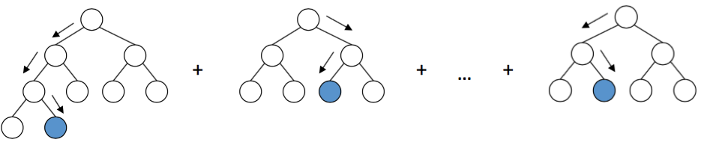
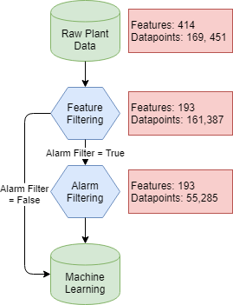
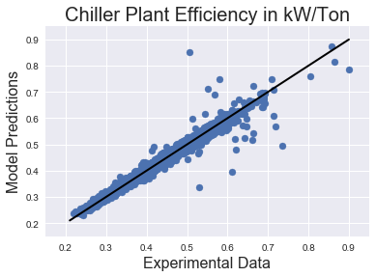





OPTICHILL – DATA SCIENCE TOOL FOR PREDICTION OF CHILLER PLANT EFFICIENCY
Theodore Cohen^{1, 2, 3}, Caitlin Parke⁴, Maitri Uppaluri⁴
1. Department of Chemistry 2. Department of Material Science and Engineering 3. Molecular Engineering and Science Department 4. Department of Chemical Engineering
To run the model on more plants and test the model on these plants without training data from the plant.
Changing the control of the plant.
Adding and removing different features to see the effect of prediction across the different feature, and how the importance of these features changes.
INTRODUCTION
GRADIENT BOOSTING MACHINES
FUTURE WORK
MOTIVATION
GOALS
Today, efficiency models of plants run in large excel sheets. These models can take months to create. Machine learning can be a powerful tool to predict the efficiency of the chiller plant and for optimization.
1. DATA CLEANING
To remove unwanted features and alarms from the dataset.
2. FEATURE IMPORTANCE
To create an algorithm that sorts out the features in the order of their importance to plant efficiency.
3. PREDICTION
To predict the efficiency of the chiller plant.
DATA CLEANING
RESULTS
FEATURES
OVERALL PREDICTION
TRAINING ACROSS DIFFERENT SEASONS
Raw data from several chiller plants was filtered and optimized for ML implementation. This was started by only using the raw data directly from the plant. These data included readouts form the Building
Automation System, chillers, cooling towers, and water pumps.
FILTERING
Various stale features were removed and any feature containing the phrase ‘kW’ was removed to ensure that no calculated data was used for plant performance prediction. Datapoints used for prediction were pre optimized, complete, and in some cases had no alarms going off. Optional inputs for removing any feature was added for flexibility.
Results from GBM on Plant 1 data. R² value = 98.2%
ACKNOWLEDGEMENTS
Optimum Energy
Dave Beck and Kelly Thornton

