Slide 1

Nutrition
General framework
1

Slide 2
The Optima Nutrition model: an overview
Optima Nutrition is an allocative efficiency model to minimize stunting, wasting, anaemia and mortality
The underlying model is a reproduction of the LiST framework
Tracks the under-5 population over a designated time period (e.g. 2018-2030)
The model includes risk factors that contribute to these outcomes:
Birth outcomes (small versus average for gestational age; term versus pre-term)
Breastfeeding behaviours
Diarrhoea incidence
Key outcomes: stunting cases, deaths (maternal and child), wasting prevalence and incidence, and anaemia prevalence (maternal and child)
An optimization algorithm is included, which can determine how to allocate a budget across a interventions to achieve the objective of choice, or a combination of objectives.
2

Slide 3
How Optima Nutrition works
Women of
reproductive age (WRA)
Non-pregnant
Risk factors for maternal mortality
Haemorrhage
Hypertensive disorders
Sepsis
Abortion
Embolism
Other
SGA: Small for gestational age
AGA: Appropriate for gestational age
Pregnant
Maternal death
Key endpoints
Stunting
Deaths
Births
Pre-term SGA
Term SGA
AGA
Risks of stunting include
-breastfeeding practices
-past stunting
-diarrhoea incidence
<1 month
1-6 months
6-12 months
1-2 years
2-5 years
Stunted
Four categories tracked
Others not stunted by age 5 years
Relative to global mean
-3
-2
-1
Risk factors for mortality
Diarrhea
Pneumonia
Measles
Other
Risk factors for mortality
Diarrhea
Pneumonia
Asphyxia
Sepsis
Prematurity
Other
Neonatal death
Post-neonatal death

Slide 4
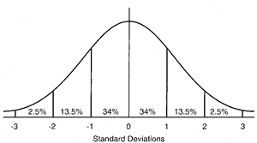
Weight-for-height categories
Children are divided into weight-for-height Z-scores (WHZ) categories (similar to stunting)
Categories: severe acute malnutrition [SAM], moderate acute malnutrition [MAM], mild, and normal
Wasting considered to be SAM + MAM categories
Normal
Mild
Moderate acute malnutrition (MAM)
Severe acute malnutrition (SAM)
← Wasting
WHZ
4

Slide 5
Model populations: overview of stratifications
15 - 19 years | Not anaemic | Anaemic
20 - 24 years | Not anaemic | Anaemic
25 - 29 years | Not anaemic | Anaemic
30 - 39 years | Not anaemic | Anaemic
40 - 49 years | Not anaemic | Anaemic
15 - 19 years | Not anaemic | Anaemic
20 - 29 years | Not anaemic | Anaemic
30 - 39 years | Not anaemic | Anaemic
40 - 49 years | Not anaemic | Anaemic
0 - 1 months | Not anaemic | Anaemic
1 - 6 months | Not anaemic | Anaemic
6 - 11 months | Not anaemic | Anaemic
12 - 23 months | Not anaemic | Anaemic
24 – 59 months | Not anaemic | Anaemic
Non-pregnant women of Reproductive Age (WRA)^{a,b}
Pregnant women^{b,c}
Children
Also stratified by:
Stunting
Wasting
Breastfeeding
ª Age brackets determined according to current age-specific fertility rate data (2014 Bangladesh Demographic and Health Survey)
^{b} Age bands may vary based on the needs of the future family planning module
^{c} Anaemia risks for pregnant women taken from non-pregnant WRA due to scarcity of data and unclear clinical definition
5

Slide 6
Stunting: risk factors, outcomes and interventions
Risk factors
Mortality
Balanced energy protein supplementation
Multiple micronutrient supplementation
Birth outcomes
SGA / AGA
Neonatal mortality
Infant and Young Child Feeding Education (IYCF)
Pre-term / term
Interventions
Public provision of complementary foods
Stunting
Past stunting
Vitamin A supplementation
Diarrhoea incidence
1-59 month mortality
IYCF
Breastfeeding practices
6

Slide 7

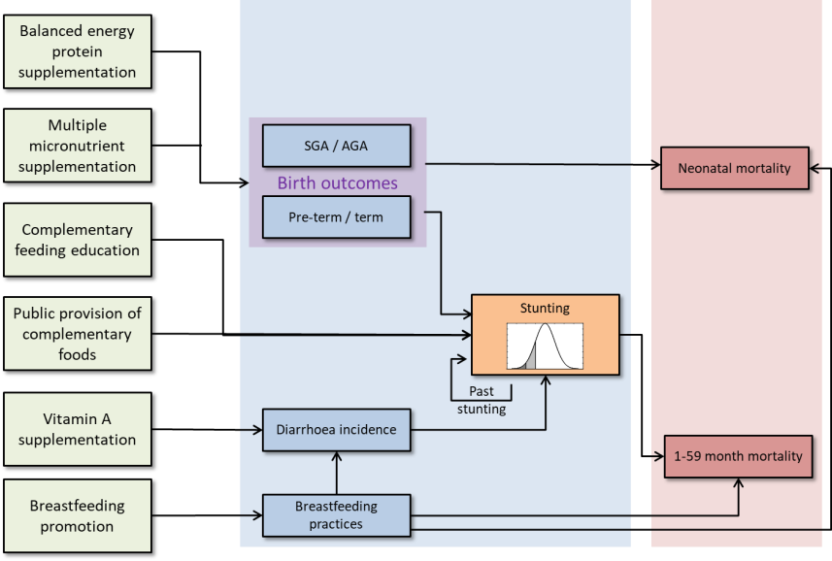
Linking investment in programs to impact
$
Which investment combination leads to optimal outcomes?
For each intervention, investment:
Increases the number of people receiving the intervention
Leads to reductions in stunting and deaths according to estimated effectiveness / odds ratios from the literature
There is a saturation effect when scaling up programs
7

Slide 8
Wasting: risk factors, outcomes and interventions
Risk factors
Mortality
Treatment of SAM
Birth outcomes
SGA / AGA
Interventions
Neonatal mortality
Cash transfers
Pre-term / term
Wasting
Public provision of complementary foods
Stunting
Past stunting
Lipid-based nutrition supplements
Diarrhoea incidence
1-59 month mortality
Breastfeeding practices
8

Slide 9
Anaemia: risk factors, outcomes and interventions
IFAS supplementation
Risk factors
Mortality
Anaemia: women of reproductive age
Maternal mortality
IPTp
Birth outcomes
SGA / AGA
Neonatal mortality
Food fortification
Pre-term / term
Wasting
LLINs
Stunting
Lipid-based nutrition supplements
Past stunting
Interventions
Diarrhoea incidence
1-59 month mortality
Anaemia: children
Micronutrient powders
Breastfeeding practices
9

Slide 10
Diarrhoea and other supplements
Calcium supplementation
Risk factors
Mortality
Anaemia: women of reproductive age
Maternal mortality
Magnesium sulphate
Birth outcomes
SGA / AGA
Neonatal mortality
Prophylactic zinc supplementation
Pre-term / term
Wasting
Oral rehydration solution (ORS)
Stunting
ORS + Zinc
Past stunting
Interventions
Diarrhoea incidence
1-59 month mortality
Anaemia: children
Breastfeeding practices
10

Slide 11
WASH interventions
Improved water source
Risk factors
Mortality
Anaemia: women of reproductive age
Maternal mortality
Piped water
Birth outcomes
SGA / AGA
Neonatal mortality
Improved sanitation
Pre-term / term
Wasting
Hygienic disposal of stools
Stunting
Handwashing with soap
Past stunting
Interventions
Diarrhoea incidence
1-59 month mortality
Anaemia: children
Breastfeeding practices
11

Slide 12
Infant and young child feeding (IYCF) packages
An IYCF package in the model refers to a user-defined collection of breastfeeding promotion and complementary feeding education interventions
Multiple delivery modes:
Health facilities (GP, hospital)
Can reach only pregnant women and mothers seeing a doctor
Much lower maximum coverage (depends on availability of health facilities / free health care)
Community health workers
Reaches all women and can therefore have much higher coverage
Mass media
Can cover all groups, depending on the message, with high coverage possible
Greater impact for parents receiving multiple delivery models
12

Slide 13
User defined IYCF packages and input sheet
Users can design their own IYCF packages using the table below
For example, below might reflect an IYCF package that includes:
Pregnant women: counseling for pregnant women attending health facilities
<6 months: visit from community health worker + counseling during facility child visits
> 6 months: community lectures
Mass media messages
Target population | Health facility | Community | Mass media
Pregnant women | x |  | x
< 1 months | x | x
0- 5 months | x | x
6-23 months |  | x
13

Slide 14
Interventions
Intervention | Target population | Effects | Source / effect size
Balanced energy protein supplementation | Pregnant women below the poverty line | Reduces risk of SGA birth outcomes | RRR = 0.79 [Ota et al. 2015, The Cochrane Library]
Multiple micronutrient supplementation in pregnancy | Pregnant women | Reduces risk of SGA birth outcomes | RRR = 0.77 [LiST†]
Vitamin A supplementation | Children 6-59 months | Reduces diarrhoea incidence mortality | Incidence RRR = 0.87 [Imdad et al. 2011, BMC Public Health] Mortality RRR = 0.82 [Imdad et al. 2011, BMC Public Health]
Public provision of complementary foods | Children 6-23 months below the poverty line | Reduces the odds of stunting | OR = 0.89 [Bhutta et al. 2008, The Lancet; Imdad et al. 2011, BMC Public Health]
Breastfeeding promotion | Children <6 months | Improves odds of correct breastfeeding | See parameters document; parametersand sources consistent with LiST.
Partial breastfeeding + complementary feeding education | Children 6-23 months | Improves odds of correct breastfeeding Reduces probability of stunting
† Source to be confirmed

Slide 15
Wasting prevention interventions
Intervention | Target population | Effects | Source / effect size
Public provision of complementary foods (PPCF) | Children 6-23 months below the poverty line | Reduces the odds of stunting Reduces the incidence of SAM Reduces the incidence of MAM Indirectly reduces SAM mortality Indirectly reduces MAM mortality | Stunting: OR = 0.89 [Bhutta et al. 2008, The Lancet; Imdad et al. 2011, BMC Public Health] SAM / MAM incidence RRR = 0.913 [LiST†]
Lipid-based nutrition supplements (LNS) | Children 6-23 months below the poverty line | Similar to PPCF but also impacts anaemia (see next session)
Cash transfers | All children below the poverty line | Reduces the incidence of SAM Reduces the incidence of MAM Indirectly reduces SAM mortality Indirectly reduces MAM mortality | SAM incidence: RRR = 0.766 for 6-23 months, RRR = 0.792 for 24-59 months [Langendorf et al. 2014, PLoS Med] MAM incidence: RRR = 0.719 for 6-23 months, RRR = 0.792 for 24-59 months [Langendorf et al. 2014, PLoS Med]
† Source to be confirmed
15

Slide 16
Anaemia interventions
Intervention | Target population | Effects | Source / effect size
Lipid-based nutrition supplements (LNS) | Children 6-23 months below the poverty line | Reduces stunting Reduces incidence of MAM/SAM Reduces anaemia | Stunting OR = 0.89 [assumed the same as PPCF] MAM/SAM incidence RRR = 0.913 [assumed to be the same as PPCF] Anaemia RRR = 0.69 for all-cause anaemia[assumed to be the same as micronutrient powders]
Micronutrient powders | Children 6-59 months, not already receiving LNS | Reduces anaemia | RRR = 0.69 [De-Regil et al. Chochrane review 2013]
IFAS pregnant women | Pregnant women. Not given to women receiving MMS | Reduces anaemia Reduces SGA birth outcomes | Anaemia RRR = 0.33 [Pena-Rosas et al, Cochrane Database Reviews 2015] SGA RRR = 0.85 [Pena-Rosas et al, Cochrane Database Reviews 2015]
IFAS non-pregnant WRA |  | Reduces anaemia | RRR = 0.73 [Fernandez-Gaxiola & De-Regil 2011, Cochrane Database Syst Rev]
IPTp | Pregnant women in areas where there is malaria risk | Reduces anaemia Reduces SGA birth outcomes | Anaemis RRR = 0.83 [Radeva‐Petrova et al. 2014, The Cochrane Library] SGA RRR = 0.65 [Eisele et al. 2010, I J Epi]
Long-lasting insecticide-treated bed nets | Everyone in areas where there is malaria risk | Reduces anaemia Reduces SGA birth outcomes | Anaemia RRR = 0.83 [Eisele et al. 2010, Int J Epi] SGA RRR = 0.65 [Eisele et al. 2010, Int J Epi]
Food fortification | Everyone | Reduces anaemia Reduces neonatal mortality | Anaemia OR = 0.976 [RRR = 0.678 Barkley et al. 2015, B J Nutrition] Neonatal mortality RRR = 0.678 [congenital defects; Blencowe et al. 2010, I J Epidemiology]
16

Slide 17
Other supplement interventions
Intervention | Target population | Effects | Source / effect size
Oral rehydration salts (ORS) | Children 0-59 months (different quantity by age) | Reduces diarrhoea mortality | RRR = 0.18 [Munos, et al. 2010, I J Epi; Walker & Black 2010, I J Epi]
ORS + Zinc | Children 0-59 months (different quantity by age) | Reduces diarrhoea mortality | RRR = 0.14 [Munos, et al. 2010, I J Epi; Walker & Black 2010, I J Epi]
Prophylactic zinc supplementation | Children 1-59 months | Reduces diarrhoea incidence Reduces diarrhoea and pneumonia mortality | Diarrhoea incidence RRR = 0.805 [Bhutta et al. 2013, The Lancet; Yakoob et al. 2011, BMC Public Health] Mortalities RRR = 0.85 [Bhutta et al. 2013, The Lancet; Yakoob et al. 2011, BMC Public Health]
Calcium supplementation | Pregnant women | Reduces maternal mortality (hypertensive disorders) Reduces pre-term births | Mortality RRR = 0.80 [Ronsmans et al. 2011, BMC Public Health] Pre-term RRR = 0.78 [Imdad et al. 2011, BMC Public Health]
MgSO4 for pre-eclampsia / eclampsia | Pregnant women | Reduces maternal mortality (hypertensive disorders) | RRR = 0.41 [Ronsmans et al. 2011, BMC Public Health]
17

Slide 18
IFAS: non-pregnant women of reproductive age
Delivered through four modalities:
Schools (the only modality for 15-19 year olds who attend)
Health facilities (available for those not at school and attending clinics)
Community centres (available for those not at school)
Retail (only available for the fraction who are not poor and not at school)
Target populations
15-19 years
Poor
Delivery through retail
Delivery through health facilities
Delivery through community centres
School
attendance
Delivery through schools
> 20 year olds
Poor
Delivery through health facilities
Delivery through retail
Delivery through community centres
*Coloured areas represent 100% coverage of IFAS through a particular delivery mode.
18

Slide 19
Interventions: fortification of foods
Target population: everyone excluding <6 months
Fortification with iron and folic acid:
Three vehicles: wheat, rice and maize flour
Coverage restricted to fraction who eat each food as their staple, determined from consumption data
Does not reach the fraction on subsistence farming
Double fortification of salt (iron + iodine)
Targets entire population
Food fortification
target populations
Rice: Proportion eating rice flour as primary food
Proportion on subsistence farming
Maize: Proportion eating maize flour as primary food
Wheat: Proportion eating wheat flour as primary food
Salt
*Coloured areas represent 100% coverage of a particular food fortification.
**Depending on the country, the target population of a particular food vehicle may be zero
19

Slide 20
Acknowledgements
Optima Nutrition team
[Optima Consortium for Decision Science + Burnet Institute+ UCL]
Sam Hainsworth
Nick Scott
David Wilson
Support also provided by Jolene Skordis-Worrall, Cliff Kerr, George Chadderdon, and Robyn Stuart
Regular advice, provision of data and other support also provided by: Jakub Jan Kakietek (World Bank)
Past contributors: Ruth Pearson and Madhura Killedar, with additional support by Kelsey Grantham and Janka Petravic
20

