Slide 1
CURATOR TRAINING HALL · UNIT 1 · WEEK 1
What
Historians
Study
Lesson 3.01.01 · 3rd Grade Social Studies
Junior Curator · Evidence Keeper Badge
Notes:
WELCOME — 30 sec Script: 'Good morning, historians! This year we are Junior Curators building a museum exhibit called Our World, Our Choices. Today is Day 1 of Curator Training Hall — and the very first thing every curator must learn is HOW historians study the past. Four tools. One real source. Many open questions. Step inside.'

Slide 2
OAO
Museum Memo — Curator Training Hall
Welcome, Junior Curator.
The Curator Training Hall is open — but the first display case is still empty.
Inside that case: an old photograph, a handwritten letter, a bronze coin, and a hand-drawn map. They all come from the same community. But we don't yet know what they tell us, or how to look at them carefully.
Before visitors arrive, you need to learn the four types of evidence historians use and how to examine each one.
The museum cannot open until the curators are ready.
Today, you get ready.
Notes:
MUSEUM MEMO — Read aloud (60 sec) Read slowly and deliberately — this is the year's story opening. After reading, pause: 'You just heard about four objects in a display case. Which one do you think would teach you the most about that community? Hold that thought — you'll get to respond on the next slide.' Advance to the gallery slide.

Slide 3
The First Gallery
Four objects wait in the display cases. Look closely.
🏺
🗺️
1
2
Bronze Coin
Hand-Drawn Map
📜
📸
3
4
Handwritten Letter
Old Photograph
Which object would teach you the most — and why? Type your answer in the chat.
Notes:
THE FIRST GALLERY — 4 min All students type in chat simultaneously. Read 4-5 responses aloud. Don't resolve the disagreement — name it: 'Some of you chose the photograph. Some chose the map. Real historians argue about this too. By the end of class, see if you'd change your answer.' Note who said what — you may want to call back to specific students later. Transition: 'Before we examine any of these, we need one big question first...'

Slide 4
CURATOR'S QUESTION · GALLERY ONE
If the people who lived in the past
could not speak to us —
how would we ever know their story?
In the Chat
Raise Your Hand
Type one idea — how could we learn about people who lived long ago?
Raise your hand — share your idea with the group.
Notes:
CURATOR'S QUESTION — 5 min This is the conceptual anchor for everything. Students must feel the problem of the past being silent. Step 1: Everyone types in chat simultaneously (30 sec). Read 3-4 aloud. Step 2: Call on 3-4 students to elaborate. Teacher follow-up moves: 'You said they left objects behind — what do objects NOT tell us?' 'Can objects lie? Can they give us a false picture?' 'What if only the objects of wealthy people survived — what would we get wrong?' Anchor: 'Historians piece together incomplete evidence — like a puzzle with missing pieces. There are four types of pieces we look for. Let's learn what they are.'

Slide 5
The Four Fields of Social Studies
1
2
3
4
📜
🗺️
💰
⚖️
History
Geography
Economics
Civics
The study of people, events, and change over time.
The study of places, landforms, and how people relate to where they live.
The study of how people use limited resources to meet their needs.
The study of government, laws, rights, and citizen responsibilities.
What in the past still shapes how people live TODAY?
How does WHERE you live change what you eat, wear, or do?
What does your community have plenty of — and what does it lack?
Name one rule in your community — WHY does it exist?
Notes:
FOUR FIELDS — 5 min For each field, read the exhibit question aloud and call on 2-3 students. HISTORY: 'What happened in the past that still shapes how people live today?' (Laws, borders, inventions, traditions) GEOGRAPHY: 'How does WHERE you live change what you eat, wear, or do?' ECONOMICS: 'What does your community have plenty of — and what does it lack?' CIVICS: 'What's one rule in your community — WHY does it exist?' Anchor: 'When historians study a community, they ask all four questions at once. And the four tools we're about to learn help them answer all four.'

Slide 6
The Historian's Toolkit
Historians cannot interview someone who lived 300 years ago.
They look at what that person LEFT BEHIND — in four forms.
🏺
🗺️
📄
📸
Artifacts
Maps
Documents
Photographs
We will examine each one — then look at a real source together.
Notes:
TOOLKIT INTRO — 30 sec transition Say: 'Historians can't interview someone who died 300 years ago. So they look at what that person LEFT BEHIND. We call those leftovers SOURCES. There are four main types. We're going to look at each one — but here's my challenge: as we go, think about what each tool CAN do that the others cannot. Because at the end, we'll need all four together.' Don't explain the cases — just point and advance.

Slide 7
Exhibit 1 & 4 — Artifacts and Photographs
🏺
📸
1
4
Artifact
Photograph
A physical object made or used by people in the past.
e.g. a coin, a tool, clothing, pottery, a piece of jewelry
A visual image captured at a specific moment in time.
e.g. a family portrait, a community gathering, a landscape
Raise Your Hand
In the Chat
If a future historian found YOUR backpack — what would they get WRONG about you?
What can a photo show that a coin NEVER could? Type one thing.
Notes:
TOOLS 1 & 4 — 5 min ARTIFACTS after teaching: Raise Hand: 'If a future historian found YOUR backpack in 200 years — what would they get WRONG about you?' (Objects don't show personality, relationships, or context.) Push: 'Could someone CREATE a fake artifact to mislead historians? How?' PHOTOGRAPHS after teaching: Chat: 'What can a photo show that a coin NEVER could?' (Faces, expressions, moment-in-time, scale, emotion.) Critical lens: 'Can a photographer choose what to include or leave out? Does that mean photos always tell the truth?' Tease: 'We have a real photograph to examine together — coming up soon. Start thinking like detectives.'

Slide 8
Exhibit 2 & 3 — Maps and Documents
🗺️
📄
2
3
Map
Document
A drawing showing where places, features, or routes are.
e.g. a trade route, a city plan, a kingdom border, a voyage
Written words recorded by someone in the past.
e.g. a letter, a diary, a law, a newspaper, a treaty
In Your Groups
Groups discuss: An old map marks unknown lands as 'Here Be Dragons.' Is it useless — or what can it still tell us?
Notes:
TOOLS 2 & 3 — 5 min + breakout (3 min) MAPS after teaching: 'What can a map show that a written description CANNOT?' (Visual relationships, distances, scale.) 'If a map is 500 years old and some things are WRONG — is it still useful?' DOCUMENTS after teaching: 'If someone wrote a diary about a war — what might they LEAVE OUT? Why?' 'Does that make the diary useless?' (No — the gaps are also evidence.) BREAKOUT: Rooms of 2-3, 3 minutes. Debrief: Take 3 groups. Push: 'What does 'Here Be Dragons' tell us about what that society DIDN'T KNOW? Is ignorance a kind of evidence?'

Slide 9
CURATOR'S CHALLENGE — THINK CAREFULLY
Can any of the four sources
give us a FALSE picture of the past?
Artifact: Could someone CREATE a fake one to mislead historians?
Map: Could a mapmaker draw borders to favor one side?
Document: Could a writer leave out things that make them look bad?
Photograph: Could a photographer frame a misleading image?
Notes:
SOURCES CAN LIE — Socratic Discussion (4 min) This is the conceptual turning point. Students often think sources = truth. Ask the big question first. Take 2-3 hands. For each row, ask: 'Has this actually happened in history?' • Artifacts: Yes — forgeries exist. Some are made to sell to museums. • Maps: Yes — colonial powers drew borders that erased indigenous territories. • Documents: Yes — diaries can be self-serving. Official records can hide atrocities. • Photographs: Yes — propaganda photos staged or cropped to hide conflict. Anchor: 'So if ALL four sources can mislead us — does that mean history is impossible? No. It means historians use all four TOGETHER and ask hard questions about each one. That's the job. That's what you're learning to do.'

Slide 10
Two Wings of the Archive
WING A · PRIMARY SOURCES
WING B · SECONDARY SOURCES
📜
📚
Created AT THE TIME
by someone who was there.
Created LATER
by someone who studied it.
• The photograph we'll examine today
• A letter from an explorer
• A bronze coin from ancient Rome
• A hand-drawn map of a voyage
• Your social studies textbook
• A documentary about World War II
• A museum exhibit about ancient Egypt
• An encyclopedia article
Raise Your Hand
Can you name one real example from Wing A — and one from Wing B — from your own life?
Notes:
PRIMARY vs SECONDARY — 5 min After teaching both, call on 4-6 students to name examples. Correct as needed: Key misconception: 'old = primary.' Clarify: PRIMARY means created AT the time by someone who was there — not just old. Socratic extension: 'Is a primary source always MORE trustworthy than a secondary one?' (No — secondary sources synthesize many primaries and correct for bias. Both are tools.) Bridge: 'Now let's look at a REAL primary source together — a photograph from the early 1900s.'

Slide 11
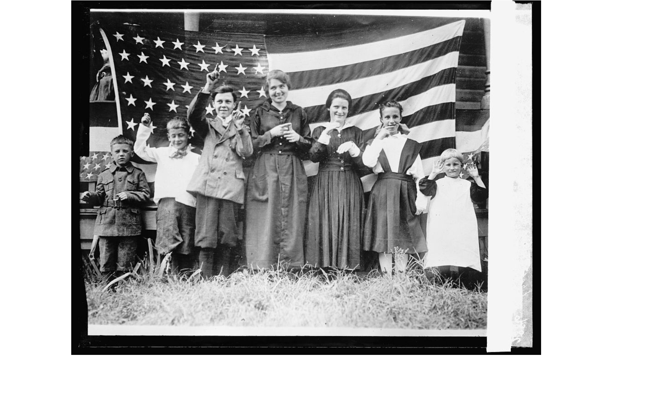
CURATOR'S
CLIPBOARD
Primary Source
Photograph · c. 1900s
What do you
NOTICE?
What do you
WONDER?
What QUESTION
would you ask?
Type one thing you notice in the chat.
Notes:
SOURCE ON SCREEN — 3 min What students see: Early 1900s black-and-white photo, a group of children and adults standing in front of a large American flag, several making hand gestures. Step 1: Show the slide. Say NOTHING for 30 seconds. Let students look. Step 2: 'Type ONE thing you notice in the chat.' Read 5-6 aloud. Praise precision. Step 3: Push with the clipboard prompts: 'What do you WONDER? What question would you ask?' Step 4: Cold-call 2-3 students to elaborate on something specific they see. Transition: 'Now let's work through this source like trained curators.'

Slide 12
Work Through the Evidence
1. What TYPE of source is this? How do you know?
Raise Your Hand
2. List THREE specific things you can see. Describe — don't interpret.
In the Chat
3. Who are these people? What might have brought them together?
Raise Your Hand
4. What does this photo NOT show us? What would you still need to find out?
In Your Groups
Working like real historians
Notes:
SOURCE ANALYSIS — 8-10 min (the heart of the lesson) Q1 (Raise Hand): Answer = primary source, photograph. Ask WHY it's primary. Q2 (Chat): Push for precision — not 'I see people' but 'I see a boy in a dark jacket on the left who is NOT smiling.' Read 5-6 aloud. Celebrate detail. Q3 (Discussion): Genuinely open. Possible: 4th of July, school event, patriotic rally from WWI era, a community organization. Push: 'What evidence supports that idea? What goes against it?' Q4 (Groups, 2 min): What the photo doesn't show: names, relationships, sounds, temperature, whether photographer chose what to include, who was NOT invited. Debrief: 'A photograph is powerful AND limited. That's why historians never rely on just one source.'

Slide 13
Your Independent Curator Task
Open the lesson page and work through all four tabs on your own:
📍 Enter the Museum
Read the Museum Memo and Curator's Question. Review vocabulary cards.
1
🔍 Explore
Study the four sources in the display case — including a photograph.
2
🧠 Check
Complete the knowledge check quiz.
3
📝 Assignment
Write your Evidence Report. Complete the Curator's Chronicle sentence at the bottom.
4
In the Chat: Type the ONE thing from today you most want to remember.
Notes:
CURATOR TASK PREVIEW — 2 min Briefly show the HTML lesson page on your screen. Key reminder: SHOW where the Curator's Chronicle sentence is (bottom of Tab 4). It's required. Read it aloud: 'In this exhibit, I learned that ___ because ___.' Students will write this in their notebook AND type it as their assignment submission. Chat: 'Type the ONE thing from today you most want to remember.' Read 3 aloud. This closes retrieval and activates the memory before students leave. Respond to each with a follow-up: 'Why does that matter?'

Slide 14
Curator's Chronicle — Exit Ticket
Complete this sentence before you leave:
"In this exhibit, I learned that ___________
because ___________."
In the Chat
Raise Your Hand
Type your complete sentence in the chat — before you close Teams.
Raise your hand to share aloud.
You will also write this sentence at the bottom of the Assignment tab.
Notes:
EXIT TICKET — 2-3 min Run simultaneously — everyone types AND 3-4 share aloud. What to listen for: Strong: 'I learned that ALL four sources can mislead us, because historians need to question every source, not just trust it.' Needs support: 'I learned about maps.' → 'What specifically? What can a map show that a photograph cannot?' Close: 'You just did what historians do every day — examined evidence, asked hard questions, and admitted what you don't know yet. That's the job. See you next session.'

Slide 15
Coming Up in Unit 1
Evidence Keeper
Badge
🏅
Master the 4 tools · Explain primary vs. secondary · Complete the Curator's Chronicle
Notes:
CLOSING — 30 sec Say: 'Complete the Curator Training Hall lesson page independently this week. Three turn-in items: Evidence Report, quiz, and the Curator's Chronicle sentence. Master those, and you earn the Evidence Keeper badge — and we open the museum. Next session: Lesson 3.01.02 — What Communities Have in Common. You'll use the same four tools on a whole new set of sources. See you then, historians!' Optional: Leave this slide up while students log off.

