Slide 1
Introduction to IoT Architecture & Embedded Systems
A Comprehensive Engineering Masterclass

Slide 2





TRAINING OUTCOME
Architecture
Hardware
Deployment
Master the 4-layer IoT stack, middleware functions, and data integration patterns.
Identify, configure, and interface sensors, actuators, and Raspberry Pi GPIOs.
Develop, troubleshoot, and deploy end-to-end industrial IoT system solutions.

Slide 3

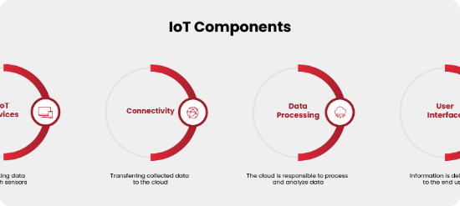
WHY THIS TECHNOLOGY MATTERS
Industry 4.0: Foundation of the fourth industrial revolution and digital twin technology.
Market Growth: $12.6 Trillion economic value projected by 2030 (McKinsey).
Data Monetization: Turning raw physical signals into actionable business intelligence.

Slide 4
INDUSTRY APPLICATIONS
Smart Manufacturing: Asset tracking and predictive maintenance.
Smart Cities: Intelligent traffic control and energy grids.
Agri-Tech: Precision farming and soil health monitoring.
Health-Tech: Remote patient monitoring and smart surgery.

Slide 5


PROBLEM STATEMENT SOLVED
The Legacy Gap
The IoT Solution
Isolated machines, manual data logging, high reactive maintenance costs, and operational data silos.
Unified digital visibility, real-time telemetry, automated control loops, and AI-driven predictive insights.

Slide 6


SENSING FUNDAMENTALS
Sensors Overview
Devices that detect changes in environment and convert them into electrical signals.
Types: Analog (LDR, Thermistor) and Digital (DHT11, MPU6050).

Slide 7

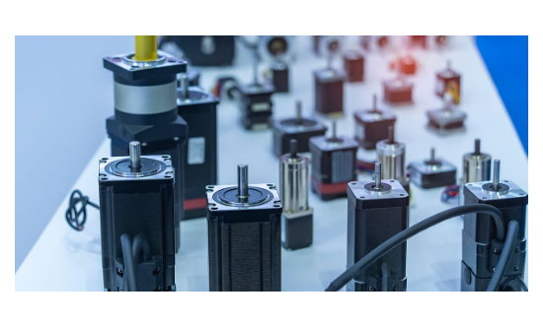
EXECUTING ACTION
Actuators Overview
The "hands" of the system. Converts electrical energy into mechanical movement or thermal energy.
Relays: High voltage switching.
Servos: Precise angular control.
Solenoids: Linear motion control.

Slide 8
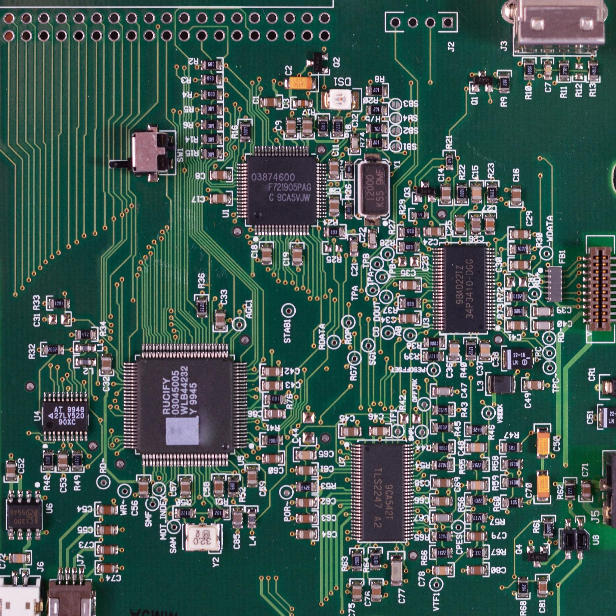
EMBEDDED SYSTEM DESIGN
What is an Embedded System?
A combination of computer hardware and software designed for a specific dedicated function.
Working: Fetches instruction → Decodes → Executes in real-time constraints.

Slide 9
MCU VS MPU COMPARISON
Feature | Microcontroller (MCU) | Microprocessor (MPU)
Architecture | CPU + RAM + ROM on single chip | Standalone CPU (External RAM)
Operating System | Bare-metal / RTOS | Linux / Android / Windows
Power Consumption | Very Low (milliwatts) | High (Watts)
Example | ESP32, Arduino Uno | Raspberry Pi, Intel Core

Slide 10

REAL-TIME OPERATING SYSTEMS
RTOS: An OS designed for real-time applications with deterministic response times.
Preemption: Critical tasks can pause lower-priority ones.
Used in: Automotive ABS, Airbag control, Medical ventilators.
Determinism: Guaranteed completion within time bounds.

Slide 11
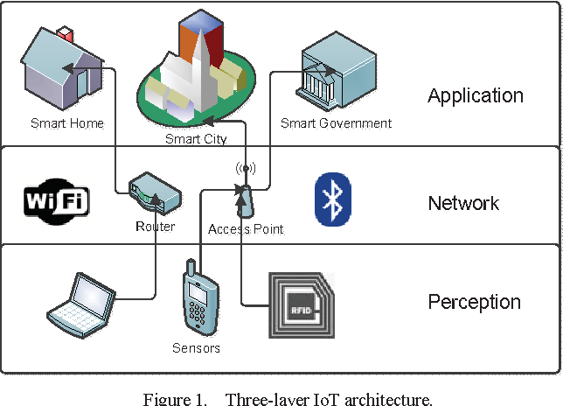

LAYERED IOT ARCHITECTURE
The 4-Layer Model
Perception: Physical interface.
Network: Connectivity & Gateway.
Middleware: Data orchestration.
Application: UX & Analytics.

Slide 12

THE PERCEPTION LAYER
Involves hardware for data acquisition. Sensors gather analog values, processed by ADC, and prepared for digital transmission.
Edge nodes like sensors tags and RFID readers reside here.
Functional Block: Transducer → Signal Conditioning → ADC → Processor Interface.

Slide 13

THE NETWORK LAYER
Short Range
Long Range
Wi-Fi, Zigbee, Bluetooth BLE, Thread.
LoRaWAN, Sigfox, NB-IoT, Cellular (5G/4G).
Gateway: Bridges local protocols to the global IP-based Cloud network.

Slide 14


THE MIDDLEWARE LAYER
Data Management Hub
The software bridge connecting devices to apps. Handles device management, message brokers, and security authentication.
Stacks: MQTT Brokers, Database storage (InfluxDB), and Logic engines (Node-RED).

Slide 15

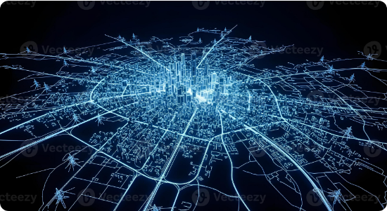
THE APPLICATION LAYER
User Interaction
Final interface for end-users. Dashboards, Mobile Apps, and AI-driven decision engines.
Deliverables: Data visualization, real-time alerts, and remote command execution.

Slide 16

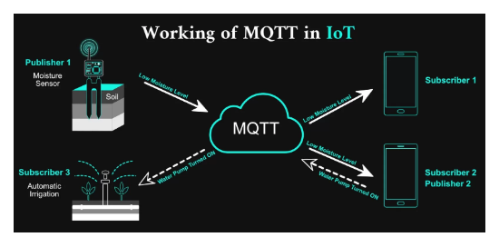
COMMUNICATION PROTOCOLS
I2C: Inter-Integrated Circuit. 2-wire serial.
SPI: Serial Peripheral Interface. 4-wire high-speed.
UART: Universal Asynchronous Receiver/Transmitter.

Slide 17

MQTT DEEP DIVE
Broker
Message Queuing Telemetry Transport (MQTT): A lightweight publish/subscribe protocol designed for low-bandwidth, high-latency environments.
Central hub routing messages between clients based on topics.
Advantage: Minimal packet overhead (2 bytes header).

Slide 18
PROTOCOL STACK COMPARISON
Layer | Standard Web (HTTP) | IoT Solution (MQTT)
Application | Request/Response | Publish/Subscribe
Transport | TCP (Heavyweight) | TCP (Lightweight)
Header Size | ~800 bytes - 2KB | ~2 bytes - 256MB
Overhead | High | Extremely Low

Slide 19
MEMORY ARCHITECTURE
Flash Memory
SRAM
EEPROM
Non-volatile storage for firmware and code instructions.
Volatile memory used for variables, stack, and heap during runtime.
Byte-addressable storage for config data (Wi-Fi SSID/Pass).

Slide 20
PROCESSING FLOW
Instruction Fetch: Load from program memory.
Decode: Translate opcode to control signals.
Interrupt: Immediate jump to ISR for external events.
Execute: ALU performs operation.

Slide 21

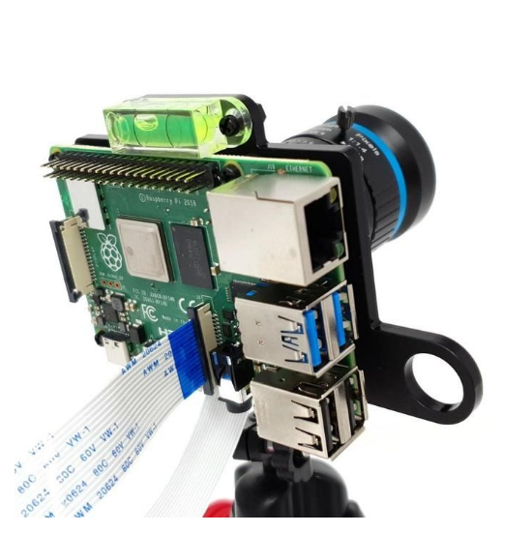
RASPBERRY PI GATEWAY
RPi 4 Specifications
The ultimate IoT edge node. Capable of running full Linux stacks and acting as a local broker.
GPIO: 40-pin header for direct physical interfacing.

Slide 22
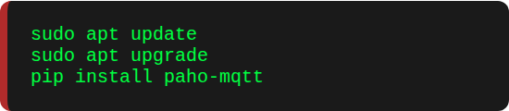
IMPLEMENTATION SETUP
Config Steps:
1.
Flash RPi OS (64-bit) using RPi Imager.
2.
Enable SSH and VNC for remote access.
3.
Update repository and install Python 3.
4.
Install MQTT libraries (Paho-MQTT).

Slide 23
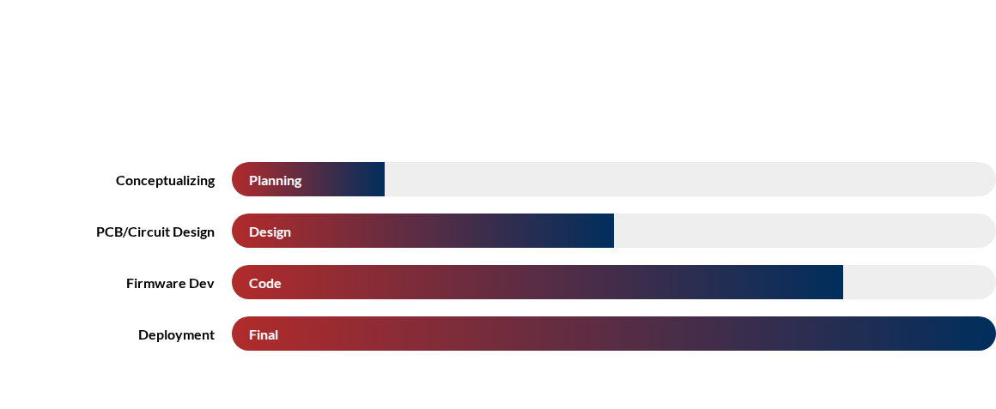
DEVELOPMENT WORKFLOW
Requirements Definition → Hardware Interfacing → Coding → Testing → Cloud Sync

Slide 24
TROUBLESHOOTING TECHNIQUES
Hardware
Network
Software
Check logic levels with multi-meter. Ensure common ground between RPi and modules.
Use ping to check connectivity. Verify broker address and port (1883).
Implement verbose logging. Use mosquitto_sub to verify published data.

Slide 25
SMART MANUFACTURING
Use Case 1: IIoT
Predictive maintenance of motors. Vibration sensors send telemetry to RPi gateway. Analytics detect failure patterns 72 hours early.
Zero unplanned downtime.
Optimized tool lifespan.

Slide 26
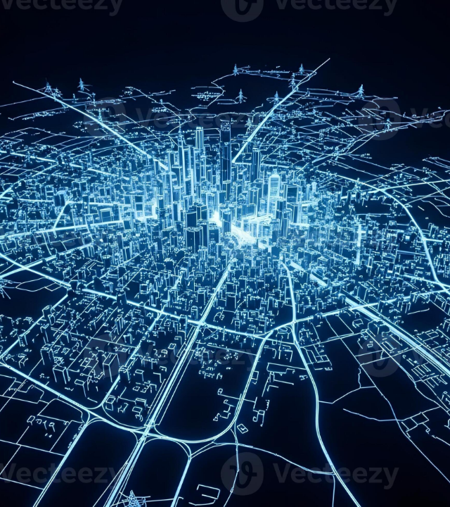
SMART CITIES
Use Case 2: Infrastructure
Smart lighting systems that dim based on human presence. Energy consumption data aggregated in cloud for city planning.
40% energy savings.
Enhanced public safety.

Slide 27
SMART AGRICULTURE
Use Case 3: Agri-Tech
Automated irrigation systems. Soil moisture sensors trigger pumps only when needed, minimizing water waste.
30% water conservation.
Maximum crop yield.

Slide 28



MINI PROJECT: GREENHOUSE
Project Components
RPi 4: Master Controller.
DHT11: Temp/Hum Sensor.
Objective: Automate climate control for precision indoor farming.
Relay Module: For Fan/Lamp.
Cloud: ThingsBoard Dashboard.

Slide 29
PROJECT ARCHITECTURE
Input: DHT11 sends Digital values to RPi.
Connectivity: Publish data to cloud dashboard via MQTT.
Logic: If Temp > 30°C, Activate Relay.

Slide 30


PROJECT WORKING PRINCIPLE
The RPi polls sensor data every 10 seconds. Python logic evaluates threshold conditions. Actuators are switched via GPIO signals. Final status is synced to a mobile dashboard.
Expected Output
Real-time graph of environment and automatic temperature stabilization.

Slide 31
EMERGING TECHNOLOGIES
Edge AI
Digital Twins
6G & Beyond
Neural networks running locally on MCUs to avoid cloud latency.
Virtual replica of physical assets for stress-testing and simulation.
Massive connectivity with sub-millisecond latency for tactile IoT.

Slide 32
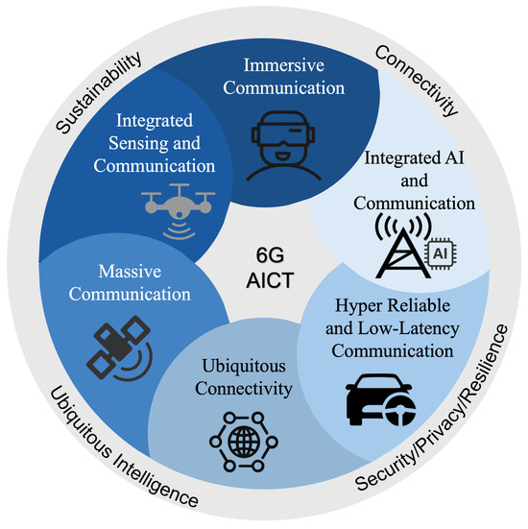
FUTURE SCOPE
By 2030, IoT will evolve into Autonomy-of-Things. Embedded systems will shift towards Zero-Power Architecture using energy harvesting (Solar/RF).

Slide 33
TECHNICAL INTERVIEW PREP
What are the differences between MQTT and CoAP?
Explain the role of a Bootloader in Embedded Systems.
How does an I2C protocol address multiple slave devices?
Compare Edge Computing and Cloud Computing for a Smart Factory.
What is the significance of the 6LoWPAN layer in IoT?

Slide 34
Summary & Conclusion
Architecture | Hardware | Software | Future
Q & A SESSION

