Slide 1
Real-Time Monitoring, Data Logging & IoT Analytics
Time-Series Architecture, Processing Pipelines & Insight Dashboards

Slide 2





COURSE MODULES
Streaming Pipelines
Time-Series Storage
Edge & Cloud Insights
Ingesting concurrent high-throughput field telemetry using low-overhead messaging architectures.
Optimizing write compaction, retention rules, and indexing across columnar structures.
Implementing windowed aggregations, anomaly patterns, and predictive asset intelligence.

Slide 3

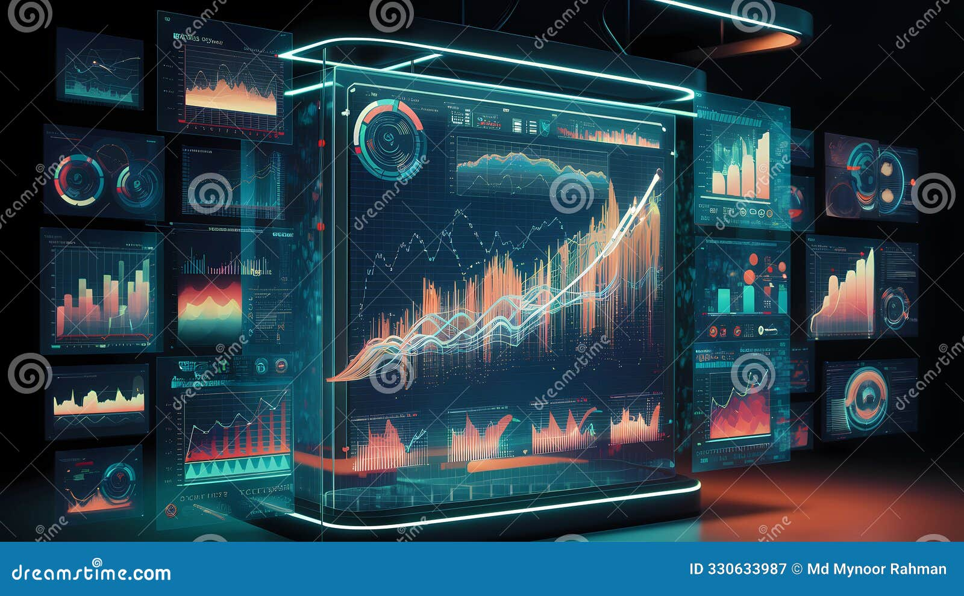
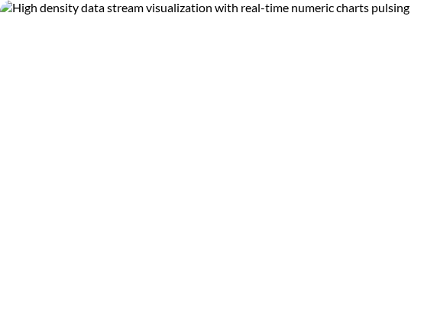
TELEMETRY DATA CHARACTERISTICS
IoT data streams present unique computational challenges compared to traditional relational database records.
Time-Stamping: Every incoming datum is strictly tied to a chronological timeline asset.
Append-Only Influx: Telemetry systems rarely modify historical records;
High Density: Thousands of nodes generating sub-second metric intervals can easily over standard storage backends.

Slide 4
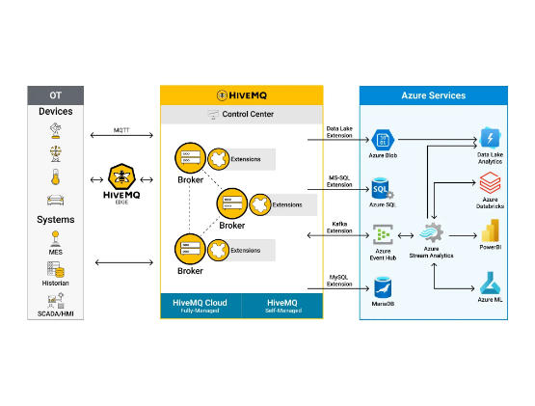
REAL-TIME INGESTION BROKERS
Decoupling Producers & Consumers
Direct database writes from millions of active field nodes create immediate connection locks and data loss.
Message Queuing (Kafka/EMQX): Act as elastic, high-throughput memory buffers that absorb rapid data spikes.
They decouple high-speed edge ingestion from downstream data processing and storage engines.

Slide 5
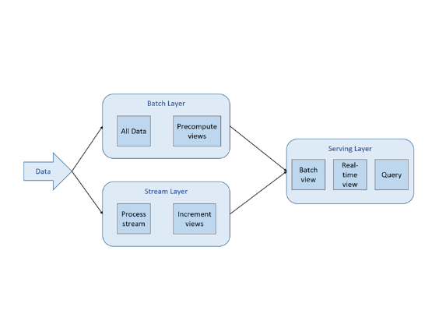
LAMBDA ARCHITECTURE DATA PATHS
Parallel Pipeline Topologies
Enterprise analytics requires balancing immediate real-time insight with thorough, long-term historical analysis.
The Speed Layer (Hot Path): Processes live, in-flight streams to power operational dashboards and trigger immediate anomaly alerts
The Batch Layer (Cold Path): Routes raw telemetry into deep data lakes for model

Slide 6

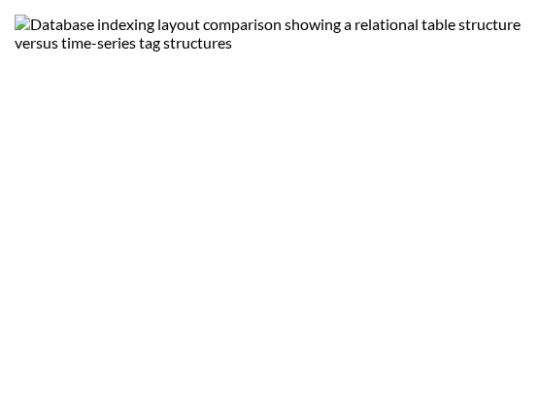
TIME-SERIES DATABASES (TSDB)
Optimized Columnar Engines
Traditional SQL databases index by primary keys, making them highly inefficient for mass queries filtered by time ranges.
TSDBs (InfluxDB, TimescaleDB) arrange metrics inside localized memory structures indexed explicitly by timestamps.
Data Compaction: Aggregates older milli-second data points into hourly summaries, saving valuable disk space.

Slide 7
STORAGE STRATEGY COMPARISON
Database Archetype | Optimal Workload Type | Query Performance Focus | Example Systems
Relational (RDBMS) | Asset tracking, user access controls, billing structures | Complex relational tables | PostgreSQL, MySQL
Time-Series (TSDB) | High-frequency raw machine metric ingestion | Time range group-by filters | InfluxDB, Prometheus
Object Storage / Lakes | Cold historical data retention and batch analytics | Mass asynchronous table scans | AWS S3, Apache Iceberg

Slide 8
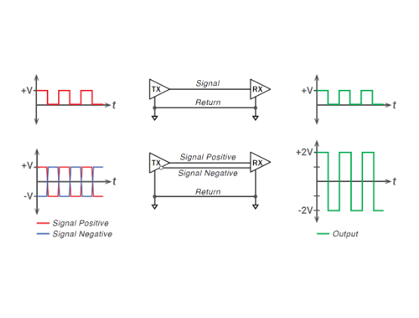
STREAM PROCESSING WINDOWS
Temporal Aggregation Concepts
Running analytics on a never-ending data stream requires defining clear boundaries using time windows.
Tumbling Windows: Fixed-size, contiguous, non-overlapping time blocks (e.g., computing averages every 5 minutes).
Sliding Windows: Overlapping time spans that update continuously with each new data point (e.g., monitoring a 10-minute running variance).

Slide 9
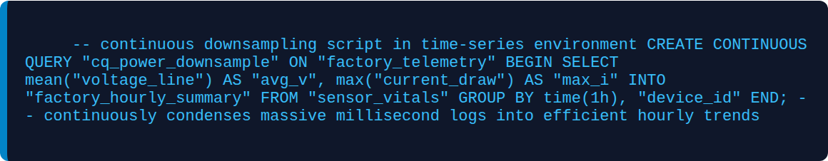
CONTINUOUS TIME-SERIES QUERYING

Slide 10
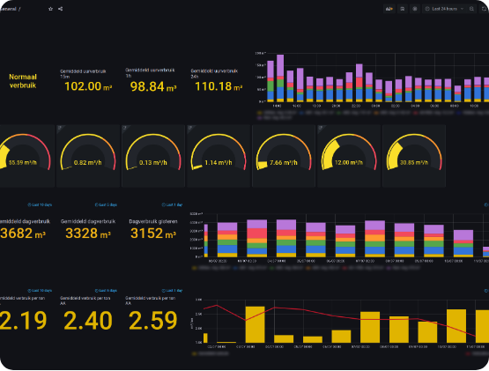
INDUSTRIAL DASHBOARD DESIGN
Prioritizing Actionable Views
Industrial monitoring interfaces must prioritize clear, actionable information over complex, crowded aesthetics.
High Contrast Indicators: Use distinct green, amber, and red color states to immediately draw attention to critical events.
Consistent Layouts: Keep real-time statuses and emergency controls in fixed locations to ensure quick response times for field operators.

Slide 11

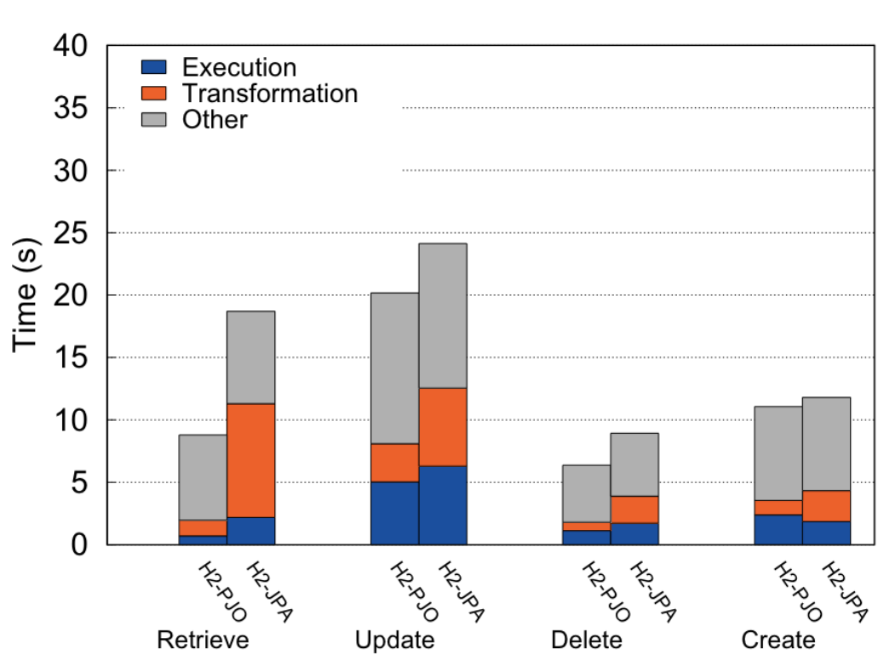
REAL-TIME WEB TOKEN STREAMING
Low-Latency WebSockets
Traditional HTTP polling forces dashboards to repeatedly request data, causing unnecessary lag and high server overhead.
The WebSocket Advantage: Opens a permanent, bi-directional communication channel between the client and server.
This allows the cloud back-end to push telemetry updates to dashboards instantly (< 200ms latency), delivering a truly live experience.

Slide 12
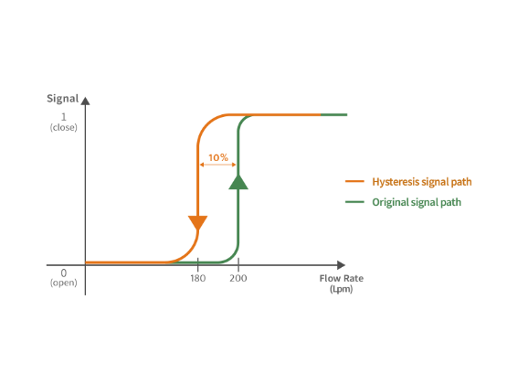
PREDICTIVE MAINTENANCE FRAMEWORKS
Moving Beyond Reactive Maintenance
Using historical data to predict equipment failures before they cause costly, unplanned downtime.
Anomaly Detection: Machine learning models evaluate multiple data points simultaneously (e.g., matching temperature spikes with subtle vibration changes) to identify early signs of wear.
This enables teams to schedule maintenance proactively, extending the operational life of industrial assets.

Slide 13
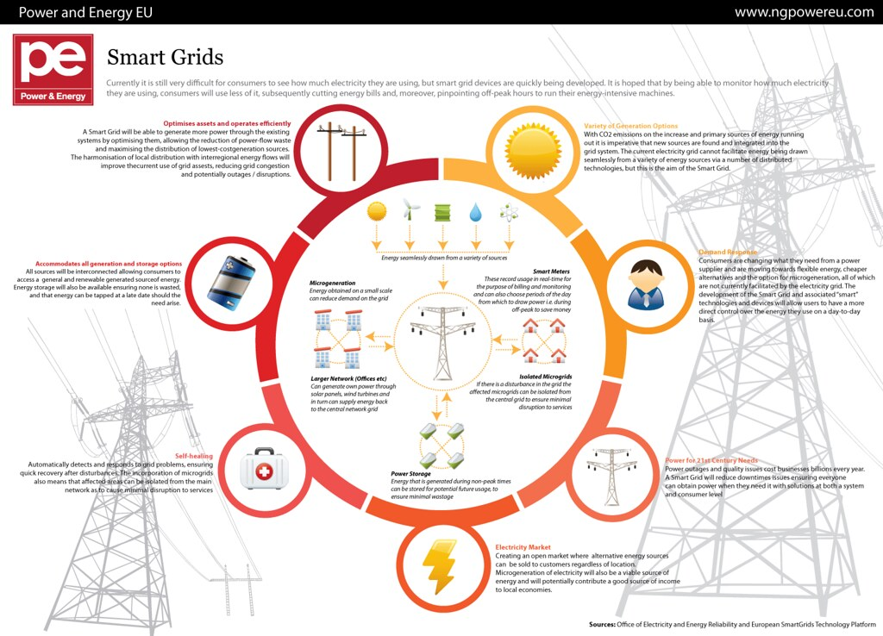
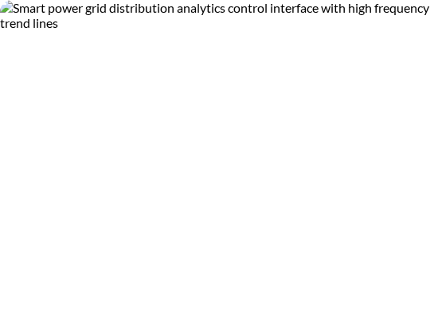
CASE STUDY: ENERGY GRID MONITORING
High-Frequency Grid Stabilization
Deploying wide-area monitoring systems to balance load across modern electrical grids:
Distributed sensor nodes continuously sample grid parameters and stream data to a centralized processing core.
Advanced time-series tools track real-time phase imbalances and automatically route power to stabilize the grid, preventing widespread outages.

Slide 14
Turning Data Into Actionable Insights
Building efficient ingestion streams, optimized time-series storage, and live dashboards creates a robust foundation for modern industrial intelligence.
QUESTIONS & TRAINING WRAP-UP | SERIES COMPLETE

