Slide 1

Integrated IoT System Architecture & Product Development
From Conceptual Architecture to Mass Manufacturing

Slide 2




LEARNING OUTCOMES
Development Lifecycle
Architectural Vision
Industrial Readiness
Navigate the V-Model from requirements engineering to validation.
Master the 4-layer and 7-layer integrated models for enterprise-grade IoT.
Learn hardware selection, DFM, and regulatory compliance for global markets.

Slide 3

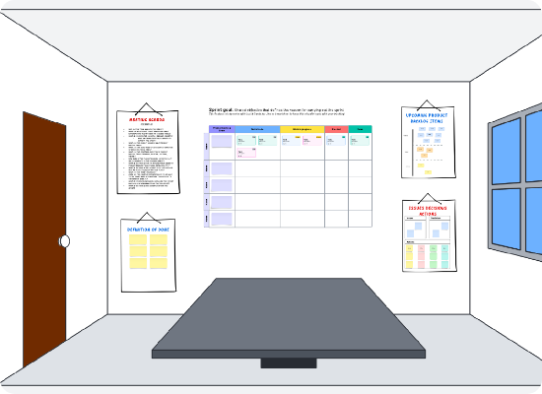
THE IOT PRODUCT LANDSCAPE
Developing an IoT product is not just about a board and an app; it's an integrated system of systems.
Market Shift: Moving from isolated gadgets to connected ecosystem assets.
Industrial Focus: High reliability, 10+ year lifecycles, and harsh environment operation.

Slide 4
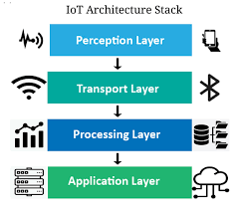
INTEGRATED ARCHITECTURE OVERVIEW
The 4-Layer Model
1.
Perception: Physical interface.
2.
Transport: Data transport protocols.
3.
Processing: Edge and Cloud analytics.
4.
Application: Business logic and UX.

Slide 5
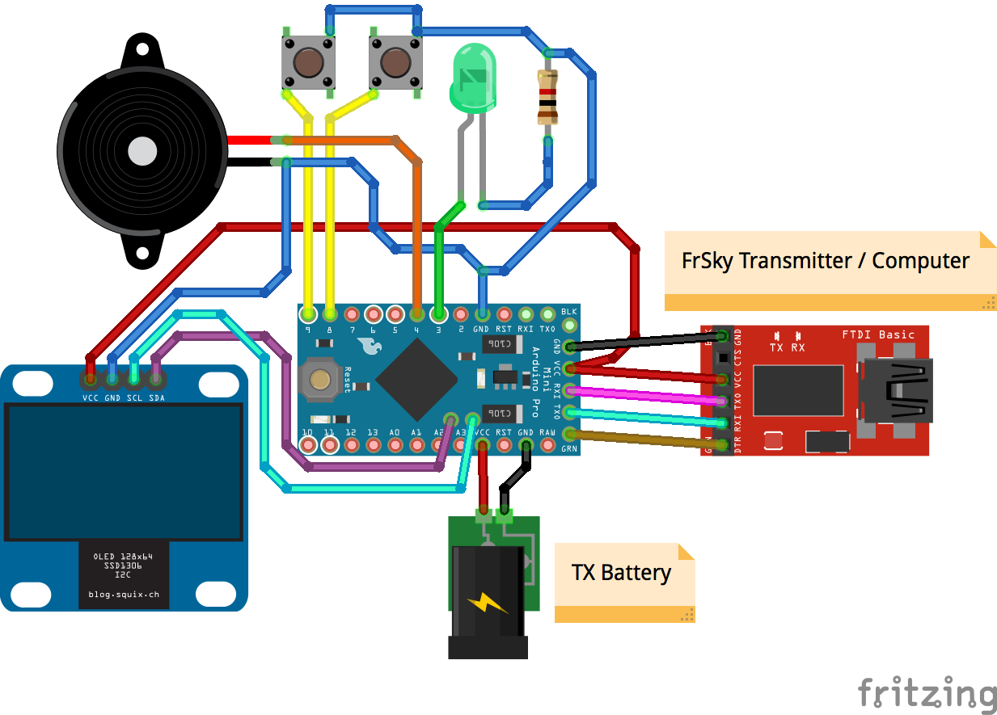
LAYER 1: PERCEPTION & ACTUATION
The interface where physics meets silicon. Sensors convert phenomena to electrical signals.
Analog/Digital: From 4-20mA loops to I2C/SPI digital buses.
Smart Sensors: Integrated MCUs for local calibration and noise reduction.

Slide 6

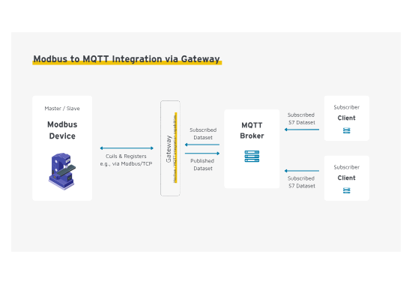
LAYER 2: CONNECTIVITY & NETWORKS
Bridging the Gap
Gateways translate localized fieldbus protocols (Modbus, CAN) into cloud-compatible telemetry (MQTT, CoAP).
LPWAN: LoRaWAN for 15km range.
PAN: Bluetooth/Zigbee for local mesh.
WWAN: 5G/LTE for high throughput.

Slide 7
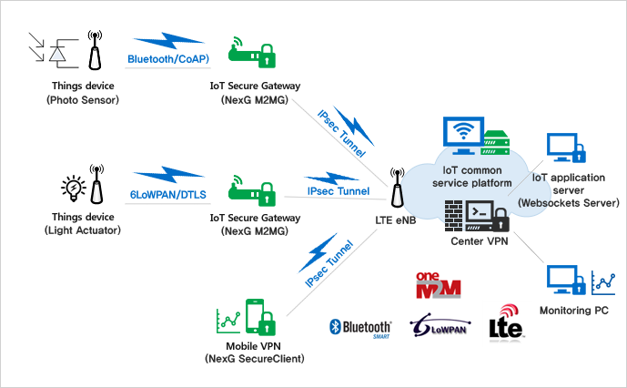

LAYER 3: EDGE COMPUTING
Decentralized intelligence reduces latency and cloud bandwidth costs.
Local Inference: Running AI models for defect detection.
Data Filtering: Discarding redundant noise locally.
Critical Control: Executing safety loops independently of cloud uptime.

Slide 8

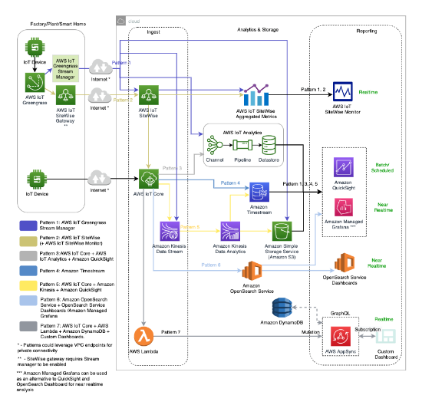
LAYER 4: CLOUD & ENTERPRISE
Massive Ingestion
The cloud handles billions of events, providing long-term storage and horizontal compute scaling.
Device Twins: Virtual JSON states of physical assets.
Big Data: Historical trend analysis over years.

Slide 9

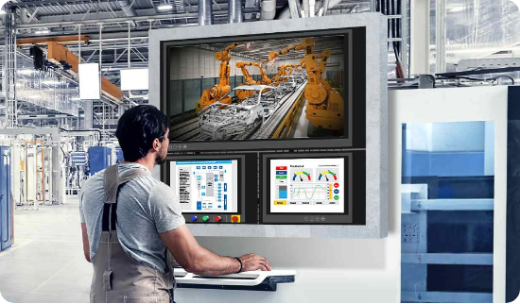
LAYER 5: APPLICATION & UX
Transforming raw field bits into actionable human insights.
HMI Dashboards: High-contrast views for factory floor operators.
Mobile Alerts: Push notifications for critical threshold breaches.

Slide 10
Product Development
Engineering the Lifecycle of a Connected Asset

Slide 11

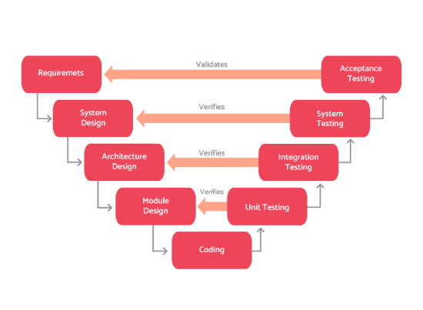
THE V-MODEL LIFECYCLE
Verification & Validation
Ensures that every requirement defined on the left side is rigorously tested on the right side.
Unit → Integration → System → Acceptance.
Early detection of defects saves 10x in rework costs.

Slide 12

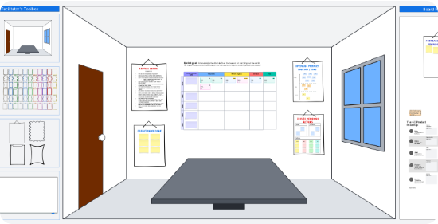
REQUIREMENT ENGINEERING
Functional: What the device DOES (e.g., sense temp every 10s).
Non-Functional: Latency, Battery Life, Security.
Constraints: Operating temperature (-40 to 85C), Form factor.

Slide 13
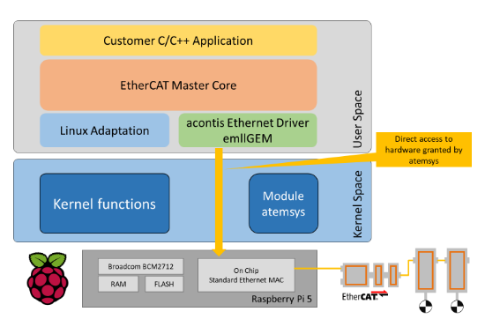
HARDWARE SELECTION (SOC)
The Silicon Heart
Choosing the SoC defines the compute boundary. The Broadcom BCM2712 (RPi 5) offers:
Quad-core ARM A76 performance.
Integrated I/O via RP1 controller.
Hardware crypto acceleration.

Slide 14
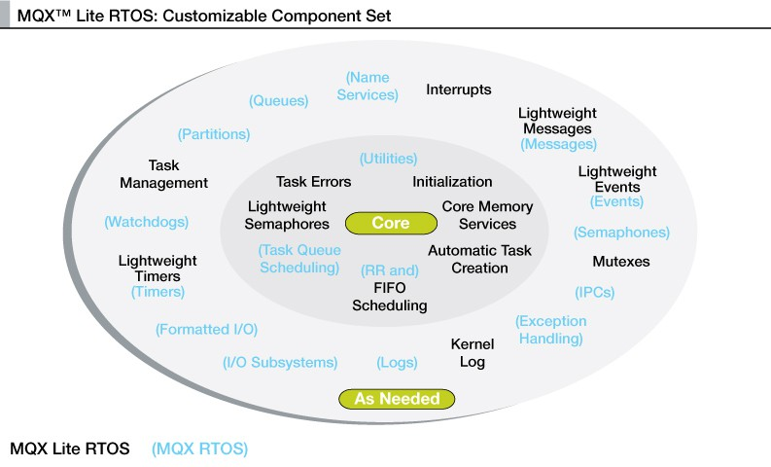
FIRMWARE & SOFTWARE STACK
Bare Metal: Zero overhead for simple tasks.
RTOS: Deterministic multitasking (FreeRTOS).
Embedded Linux: Full stack for complex gateways.

Slide 15
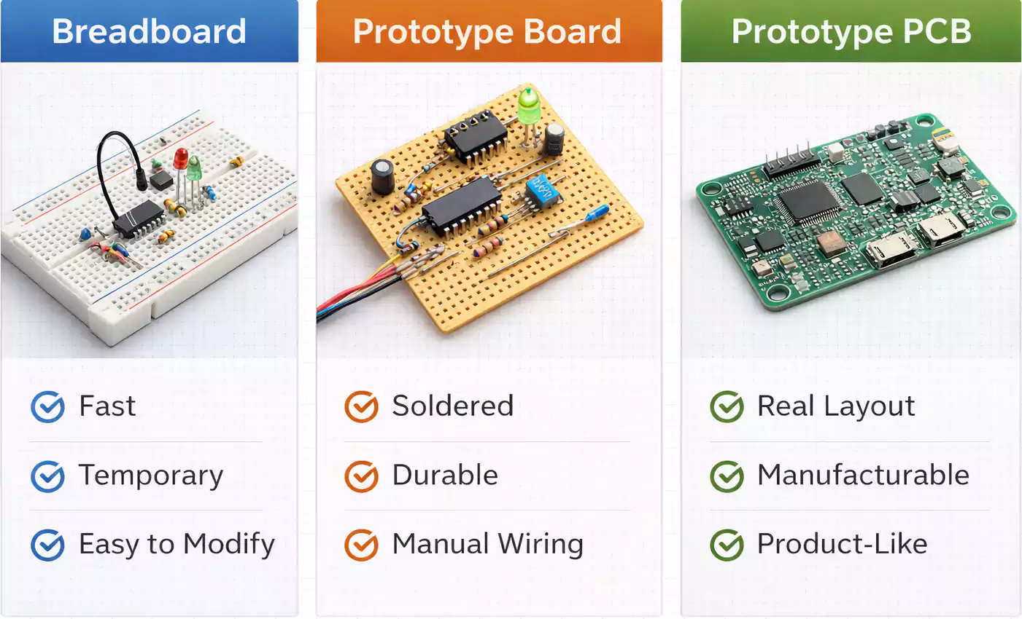

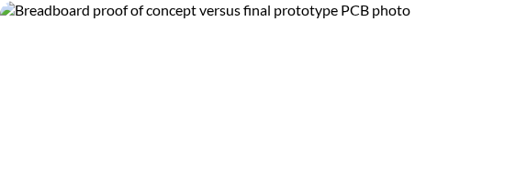
PROTOTYPING STAGES
PoC: Prove it works (Breadboard/Dev Kits).
MVP: Core features on custom PCB.
DVT: Design Validation Test units.

Slide 16

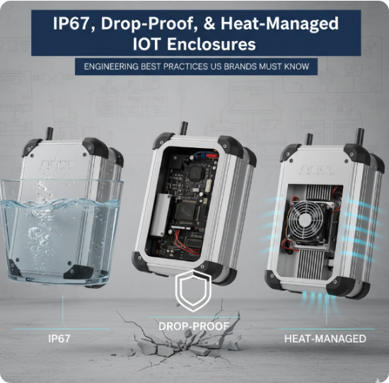
MECHANICAL & ENCLOSURE DESIGN
Industrial electronics must survive physical stress.
IP67: Protection against dust and water immersion.
Thermal Management: Heat sinks and active cooling for high-performance SoCs.

Slide 17
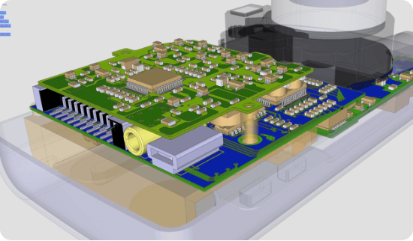
PCB DESIGN & SIGNAL INTEGRITY
Designing for multi-GHz clocks requires careful layout.
Differential Pairs: For USB/Ethernet noise rejection.
Ground Planes: Isolating digital and analog noise.

Slide 18
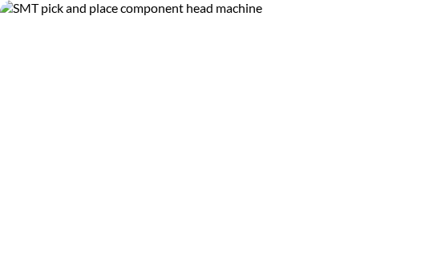
DESIGN FOR MANUFACTURING (DFM)
Optimizing for high-yield assembly from day one.
Component Selection: Avoiding single-sourced or obsolete parts.
Test Points: Mandatory for Automated Test Equipment (ATE).

Slide 19


CONNECTIVITY SELECTION MATRIX
Protocol | Range | Power
BLE | 10m | Ultra Low
WiFi | 50m | High
LoRa | 15km | Low

Slide 20

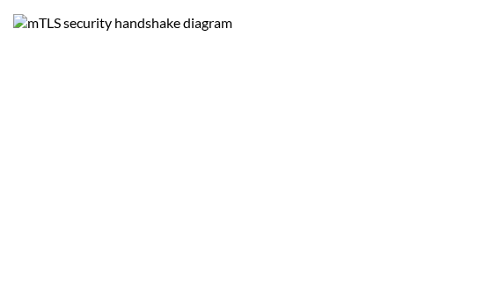
SECURITY BY DESIGN
IoT nodes are high-risk physical targets.
RoT: Hardware Root of Trust for key storage.
Secure Boot: Authenticating code before execution.
mTLS: Dual-sided certificate validation.

Slide 21

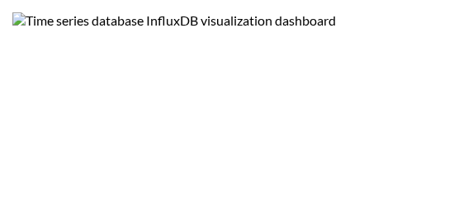
DATABASE DESIGN (TSDB)
Optimized for Time
Telemetric data is best stored in Time-Series Databases (InfluxDB, TimescaleDB) to allow massive write ingestion and rapid trend queries.

Slide 22
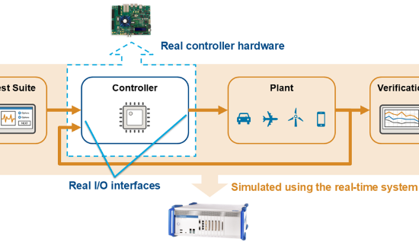
QUALITY ASSURANCE & HIL
Testing the real hardware against a virtualized environment.
HIL: Hardware-in-the-Loop simulation for safety critical logic.
Regression: Automated tests for every code commit.

Slide 23

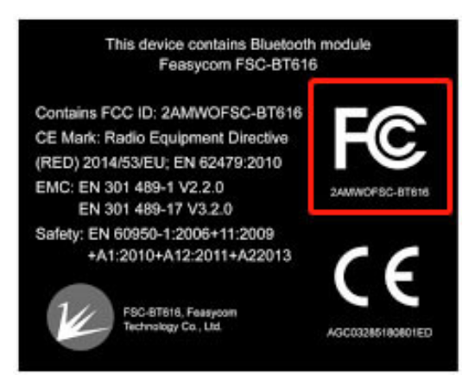
COMPLIANCE & CERTIFICATION
No product hits the market without a passport.
CE: Europe requirements.
FCC: US radio frequency emissions.
RoHS: Lead-free environmental safety.

Slide 24
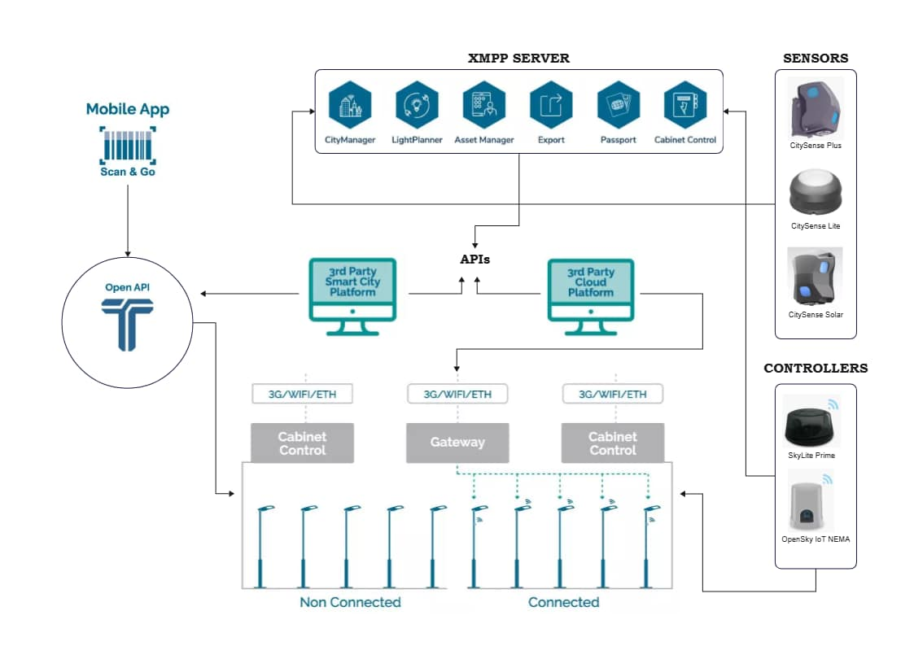
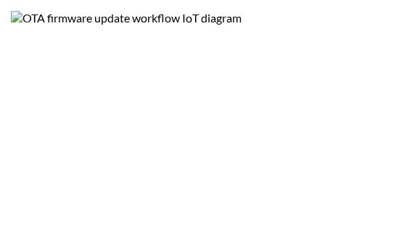
DEVOPS & MAINTENANCE (OTA)
Deploying updates to millions of remote nodes.
A/B Partition: Preventing "bricking" via dual-boot fallback.
Delta Updates: Only sending changed binary blocks to save data.

Slide 25
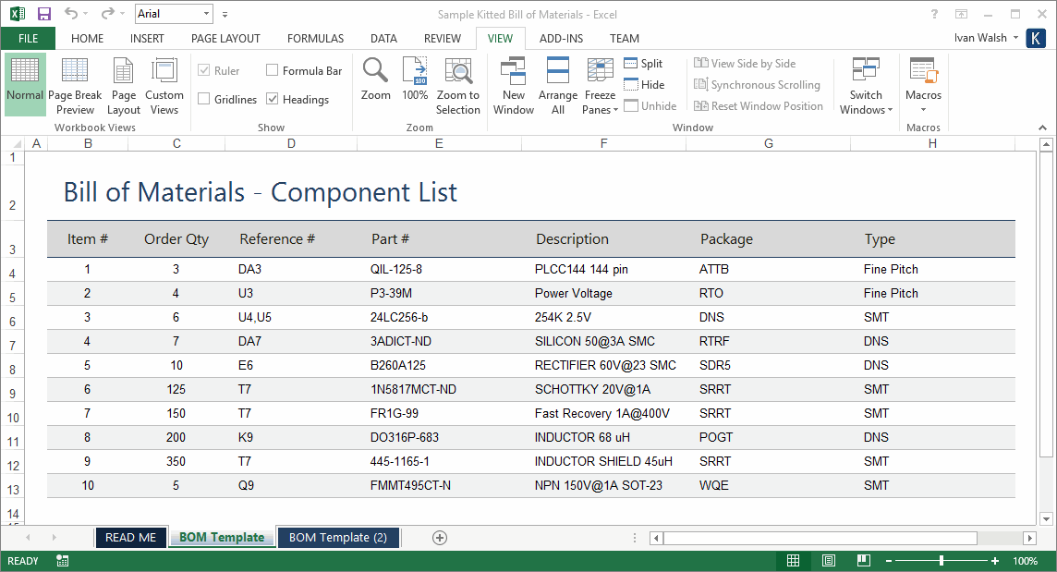

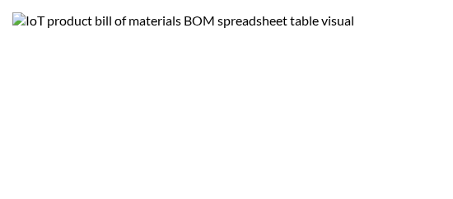
COST ANALYSIS & BOM
Unit Economics
BOM: Bill of Materials - target reduction for scale.
OpEx: Cloud hosting and cellular data monthly costs.

Slide 26

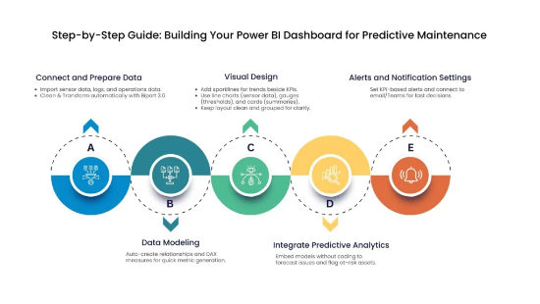
MINI PROJECT: SMART MONITOR
The Challenge
Build a predictive maintenance architecture for an industrial pump.
Vibration Sensor → RPi Edge → MQTT → Cloud InfluxDB → Grafana.

Slide 27
Summary & Questions
Architecture | Lifecycle | Reliability

