Slide 1
Capstone Project Development, Validation & Deployment
Professional Engineering Lifecycle Series
End-to-End System Design Mastery

Slide 2






LEARNING OBJECTIVES
Ideation
Engineering
Deployment
Learn to define precise problem statements and conduct market gap analysis.
Master integrated hardware/software design and simulation workflows.
Deploy secure, scalable industrial edge nodes with remote observability.

Slide 3

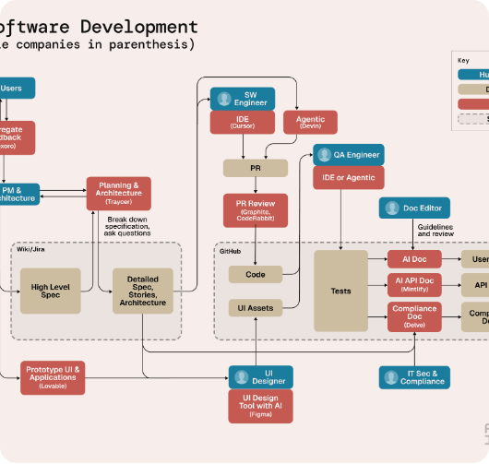
PHASE 1: IDEATION & RESEARCH
Every successful project begins with identifying a genuine friction point in industry or society.
Market Research: Analyzing existing patents and competitor products.
Stakeholder Mapping: Who is the end-user? (Factory Manager, Farmer, Doctor).
Gap Analysis: Identifying what standard solutions miss.

Slide 4


PROBLEM STATEMENT DEFINITION
Poor Example
Engineering Example
"Build an IoT device for monitoring factories to make them better."
"Develop an edge-based vibration analyzer to detect bearing defects in industrial pumps before failure, reducing downtime by 15%."
Reason: Too vague, no target metrics, no specific pain point.
Reason: Quantifiable, technical, and industry-focused.

Slide 5
NEED ANALYSIS & CONSTRAINTS
Requirement Type | Example Requirement | Impact on Design
Functional | Device must log temp data every 10ms | Requires high-speed ADC and DMA
Environmental | Must operate in -20°C to 70°C | Requires industrial-grade components
Connectivity | Must transmit data over 5km distance | Forces LoRaWAN or Cellular choice
Power | Must run 2 years on battery | Requires Deep Sleep architecture

Slide 6

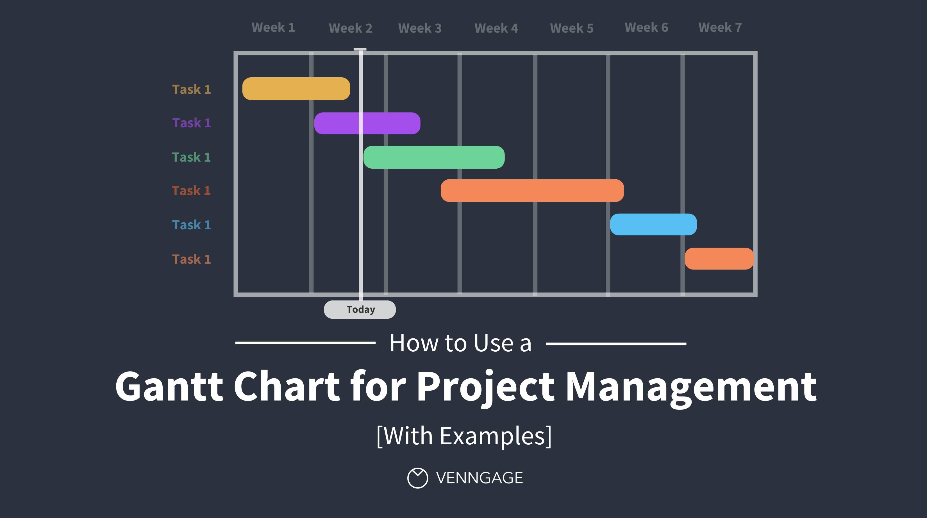
PHASE 2: PROJECT MANAGEMENT
Planning for Success
Managing dependencies is critical. Hardware delays can stall firmware teams if not tracked.
Gantt Charts: Mapping task durations and milestones.
Agile Sprints: Two-week development cycles with clear demo-able outputs.
BOM Tracking: Managing lead times for silicon components.

Slide 7

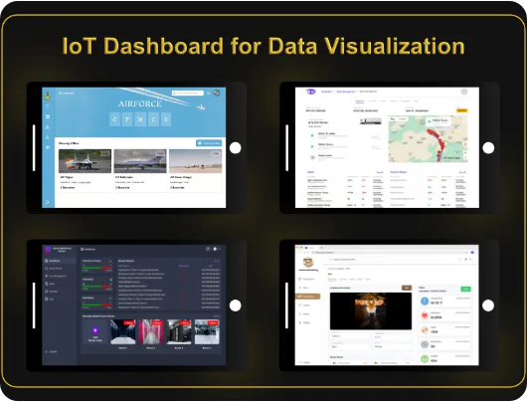
SYSTEM ARCHITECTURE
A capstone IoT project must follow the integrated 4-layer model to be considered industrial-grade.
Perception: Sensors/GPIO/ADC.
Network: MQTT/TLS/TCP.
Processing: Edge filtering/Cloud DB.
Application: Dashboards/HMIs.

Slide 8

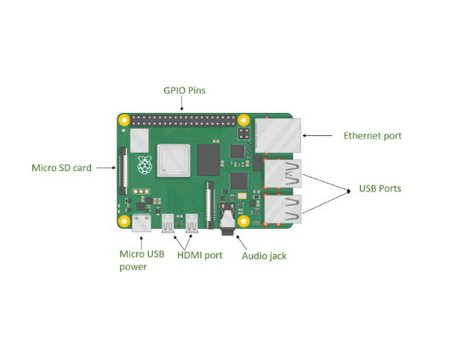
HARDWARE SELECTION
The Silicon Foundation
Choosing the **Raspberry Pi 5** for Capstone projects provides:
Performance: Cortex-A76 for Edge AI.
I/O Step-change: Dedicated RP1 southbridge for stable GPIO.
Software Depth: Full Linux stack for rapid prototyping.

Slide 9



SOFTWARE STACK SELECTION
Firmware
Middleware
Cloud/Storage
Python (Rapid) vs C++ (Performance). Linux kernel overlays for custom peripherals.
MQTT Brokers (EMQX/Mosquitto) for decoupled messaging layers.
InfluxDB for time-series logs and Grafana for insights.

Slide 10

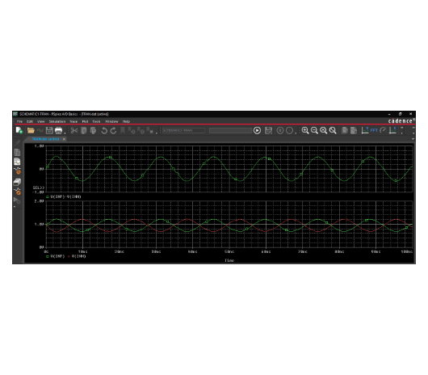
CIRCUIT SIMULATION
Never solder before you simulate. Use LTSpice or Multisim to verify analog conditioning paths.
Frequency Response: Testing hardware filters.
Transient Analysis: Checking voltage spikes during relay switching.
Power Analysis: Predicting battery drain cycles.

Slide 11
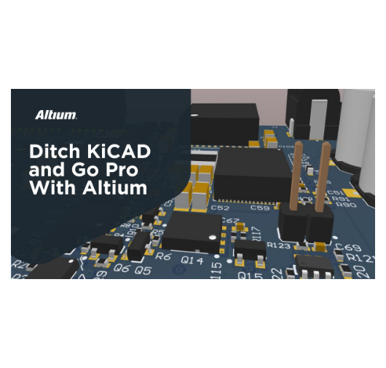
PCB DESIGN MASTERY
From Prototype to Product
Transitioning from jumper wires to a custom printed circuit board (PCB) is mandatory for validation.
Signal Integrity: Managing differential pairs for USB/Ethernet.
Thermal Dissipation: Designing ground planes for SoC cooling.
DFM: Designing for manufacturing yield.

Slide 12
Phase 3: Validation
Testing Beyond Functional Benchmarks

Slide 13

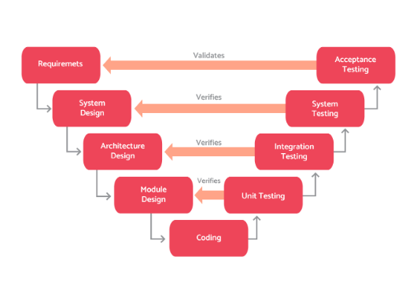
THE V-MODEL FRAMEWORK
The standard systems engineering approach to validation. It ensures every design step has a corresponding test phase.
Left Side: Requirements and Architectural Design.
Right Side: Unit, Integration, and Acceptance Testing.

Slide 14
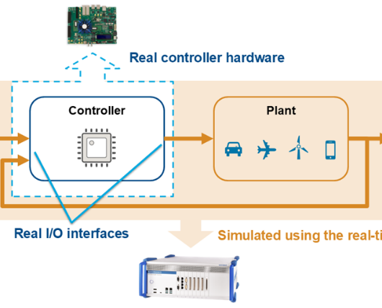
HARDWARE-IN-THE-LOOP (HIL)
Safety-First Testing
Instead of connecting to real industrial motors or power grids, connect your controller to a real-time simulator.
Simulate fault states (short circuits, spikes) without destroying hardware.
Verify real-time control stability.
Automate 24/7 stress testing.

Slide 15


ENVIRONMENTAL TESTING
Thermal Soak: Running the device at 55°C for 48 hours to find memory leaks.
Vibration Test: Ensuring connectors don't shake loose in industrial settings.
EMI/EMC: Testing radio emissions compliance (CE/FCC standards).

Slide 16
Phase 4: Deployment
Transitioning from Lab to Field

Slide 17





THE DEPLOYMENT WORKFLOW
Site Survey
Pilot Check
Pre-wiring
Radio-mapping to ensure Wi-Fi/Cellular signals penetrate factory metal structures.
Running a single unit for one week to establish baseline data fidelity.
Configuring static IPs and SSH keys before shipping to site.

Slide 18

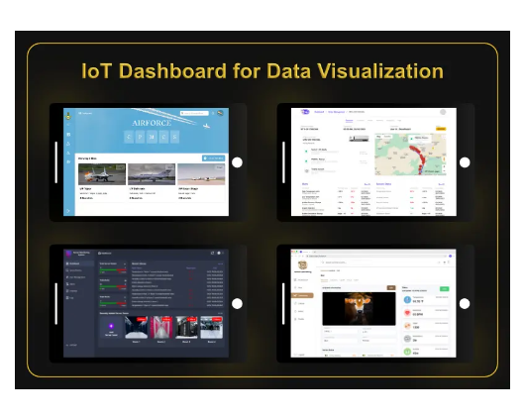
REMOTE FLEET MANAGEMENT
Once deployed, the project isn't "over." You must maintain observability.
Heartbeat Signals: Knowing instantly if a node goes offline.
Metric Logging: Tracking CPU temperature and memory usage.
Remote Console: Fixing bugs without physical site visits.

Slide 19
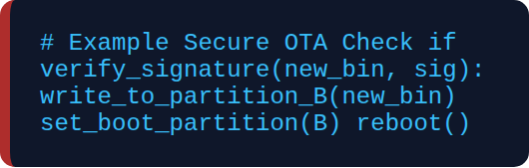
OVER-THE-AIR (OTA) UPDATES
Maintaining Security
Flashing new code remotely must be secure and resilient.
A/B Rollbacks: Reverting to last working version if update fails.
Binary Signing: Using ECDSA keys to ensure code hasn't been tampered with.
Delta Updates: Sending only changes to save data costs.

Slide 20

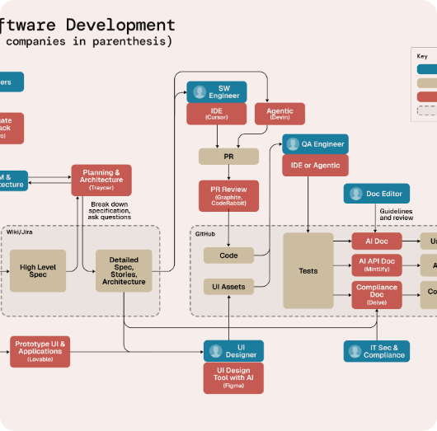
PHASE 5: DOCUMENTATION
The Technical Legacy
An engineer's work is only as good as their documentation. Mandatory sections:
Abstract: 200-word concise summary.
Architecture: Wiring and Block diagrams.
Test Reports: Proof of validation results.
User Manual: How to install and operate.

Slide 21


PREPARING THE FINAL PITCH
Hook: Start with the industrial pain point.
Demo: Show the real-time dashboard data.
Results: Quantify the improvement (e.g., 20% energy saved).
Scalability: Explain how to build 1,000 more units.

Slide 22
UNIT ECONOMICS & BOM
Component | Prototype Cost | Scale Cost (1k units)
SoC (Raspberry Pi 5) | ₹5713 | ₹4,951
Custom PCB & SMD | ₹14,284 | ₹1,190
Sensors (MEMS/DHT) | ₹2,380 | ₹799
Enclosure (IP67) | ₹3,333 | ₹399
Total Base Cost | ₹25,712 | ₹7,342
Scaling reduces the per-unit cost by over 70% through industrial SMT assembly.

Slide 23
TECHNICAL INTERVIEW PREP
What was the most critical failure during your Integration Testing phase?
How did you ensure your data transmission was secure from local tampering?
Why did you choose a TSDB over a standard SQL database for this project?
Explain the difference between Unit Testing and System Validation in your project context.

Slide 24
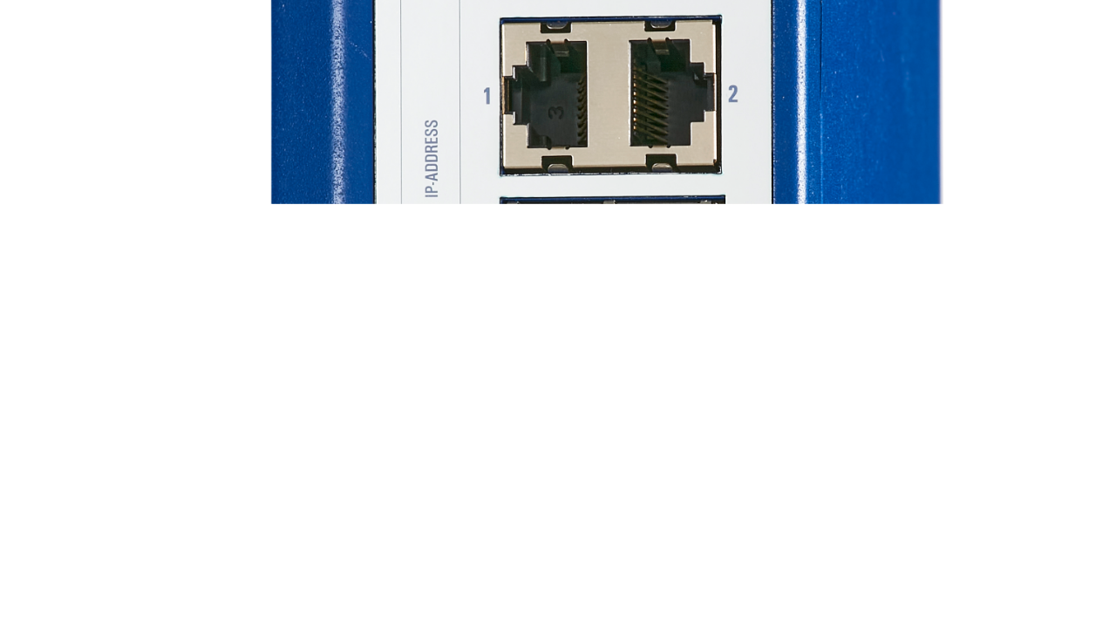
Summary
The Capstone project is the bridge between student theory and industrial expertise.
Q&A SESSION | TRAINING COMPLETE

