Slide 1

Raspberry Pi Architecture & Embedded Linux
Fundamentals for Industrial Systems & Edge Computing

Slide 2





TRAINING OUTCOMES
Hardware Literacy
System Engineering
OS Proficiency
Master the silicon architecture of the Broadcom BCM2712 SoC and high-speed I/O busses.
Learn to navigate Embedded Linux kernels, filesystem structures, and Shell programming.
Build and deploy industrial-grade data loggers and HMIs using professional workflows.

Slide 3

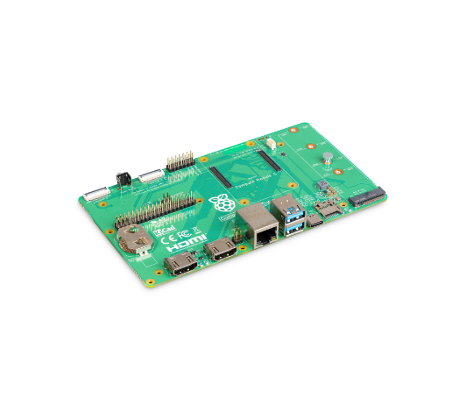
WHY SINGLE BOARD COMPUTERS?
The Raspberry Pi 5 has bridged the gap between a hobbyist board and a robust industrial compute node.
Versatility: Runs a full Linux stack while providing direct hardware I/O control.
Ecosystem: Millions of developers and standardized libraries reduce time-to-market.
Reliability: 10+ year availability for industrial-grade Compute Modules.

Slide 4
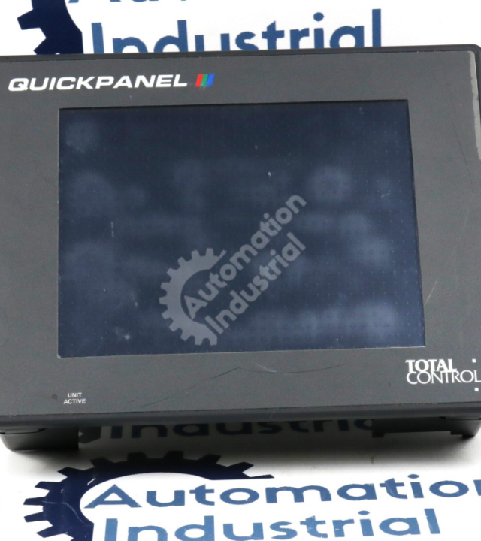
INDUSTRIAL FOOTPRINT
From smart factories to hospital monitoring, Embedded Linux is everywhere.
Edge Gateways: Aggregating PLC data and pushing to Cloud (Azure/AWS).
Industrial HMIs: Driving interactive touch-panels on the factory floor.
Predictive Maintenance: Real-time vibration and thermal analysis.

Slide 5


THE LEGACY SILO PROBLEM
Legacy Systems
The Linux Solution
Proprietary machines, manual data logging, high maintenance costs, and zero cloud visibility.
Open standards, real-time telemetry, automated control loops, and unified remote management.

Slide 6
Fundamental Concepts
SoC Architecture & Hardware Operating Principles

Slide 7

THE SOC FUNDAMENTALS
System-on-Chip (SoC)
Unlike traditional PCs with discrete components, an SoC integrates the CPU, GPU, RAM, and I/O controllers into a single silicon substrate.
The Broadcom BCM2712 is the heart of RPi 5, featuring quad-core ARM Cortex-A76 performance.
Why it's used: Massive power efficiency, lower thermal footprint, and high-speed internal bus communication.

Slide 8

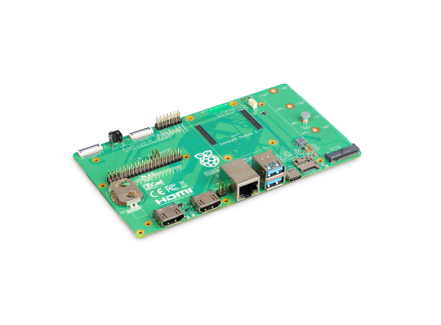
GPIO: THE PHYSICAL LINK
GPIO (General Purpose Input/Output) pins allow the Raspberry Pi to interact with the analog world.
Pins: 40-pin header for digital I/O.
Logic: 3.3V Logic level (Strictly non-5V tolerant).
Multi-function: Can be configured for UART, SPI, or I2C communication.

Slide 9
RPI VS TRADITIONAL PC
Feature | Standard Desktop (x86) | Single Board Computer (ARM)
Architecture | Complex (CISC) | Reduced (RISC)
Storage | SATA / NVMe SSD | MicroSD / PCIe NVMe
Power | 150W - 600W | 15W - 25W
I/O | USB / PCIe / Thunderbolt | GPIO / I2C / SPI / MIPI

Slide 10

POWER OPERATING PRINCIPLES
Technical Specs
The Raspberry Pi 5 requires a 5V / 5A USB-C PD supply for peak performance. The dedicated DA9091 PMIC manages internal voltages for the SoC cores, LPDDR4X, and I/O banks.
Supports Power Delivery (PD) to negotiate higher currents for external USB peripherals.
Limitation: Inadequate power results in "Under-voltage" throttling, causing system instability.

Slide 11
Core Architecture
Silicon, Memory, and the RP1 Southbridge

Slide 12

BCM2712 DEEP DIVE
The Compute Engine
CPU: Quad-core ARM Cortex-A76 (2.4GHz).
GPU: VideoCore VII (OpenGL ES 3.1).
3x performance increase over Raspberry Pi 4 due to re-architected pipelines.
Bus: Internal AXI bus fabric for low-latency memory access.

Slide 13

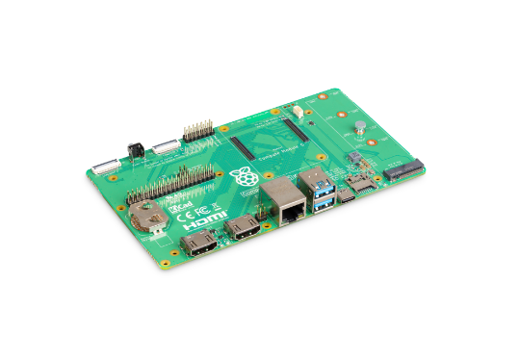
THE RP1 CONTROLLER
Custom Silicon
For the first time, RPi uses in-house silicon for I/O. The RP1 manages Ethernet, USB 3.0, and GPIO, connected to the main SoC via PCIe lanes.
Impact: Massive bandwidth boost for all external peripherals without taxing the main CPU cores.

Slide 14



LPDDR4X MEMORY SUBSYSTEM
Bandwidth
LPDDR4X-4267 SDRAM providing peak bandwidth of 17 GB/s.
Unified RAM
GPU and CPU share the same memory pool (User-configurable split).
Capacity
Available in 1GB to 8GB variants for diverse compute loads.

Slide 15
EXPANSION & HIGH-SPEED I/O
PCIe Gen 2.0 x1
The RPi 5 exposes a single PCIe lane, enabling direct connection to NVMe SSDs and high-speed network cards via HATs.
Ethernet: Dedicated RGMII interface for full 1Gbps throughput.

Slide 16
Embedded Linux Foundations
Kernel Architecture, Shell & Filesystems

Slide 17
THE LINUX KERNEL LAYERS
The Kernel acts as the "Manager" between User Applications and Physical Hardware.
User Space: Shell, Python, User Apps.
Kernel Space: Process scheduling, Drivers.
Hardware Abstraction: Unified interface for sensors.

Slide 18

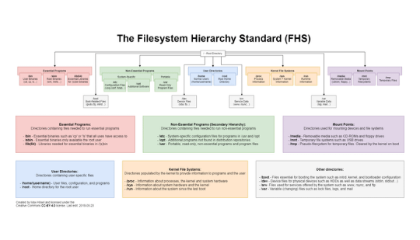
FILESYSTEM HIERARCHY (FHS)
/bin & /sbin: Essential binaries.
/etc: Configuration files.
/dev: Hardware devices as files.
/var: Variable data (logs/caches).
/proc & /sys: Virtual filesystems for kernel info.

Slide 19
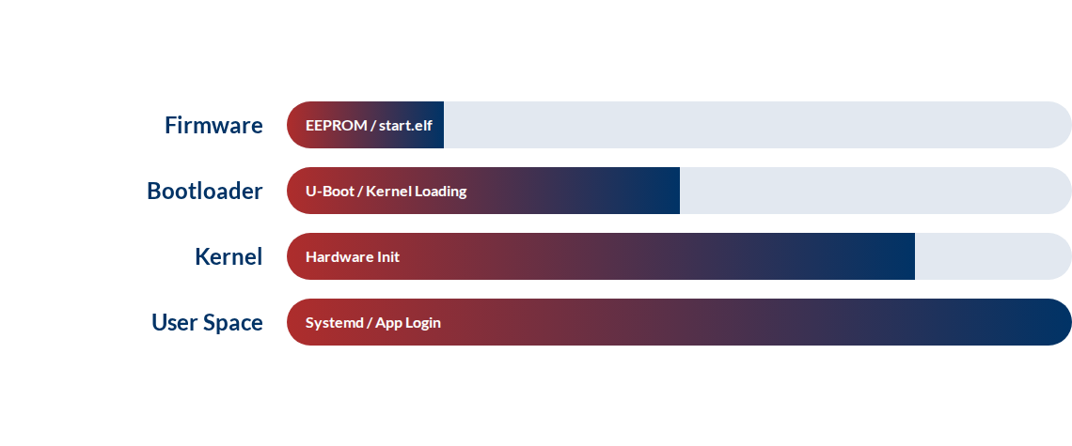
THE LINUX BOOT SEQUENCE

Slide 20
LINUX DISTRIBUTIONS (DISTROS)
Raspberry Pi OS
Ubuntu Core
Yocto / Buildroot
Standardized, Debian-based, easy to use for rapid development.
Security-focused, transactional updates for mass IoT deployment.
Custom industrial Linux. Extremely small and highly specialized.

Slide 21
Technical Deep Dive
Device Trees, systemd & Shell Mastery

Slide 22


DEVICE TREE OVERLAYS
A Device Tree (DT) is a data structure describing hardware to the Kernel. Overlays allow you to add peripherals at runtime without re-compiling the kernel.
Enables the same Kernel to run on hundreds of different board revisions.

Slide 23

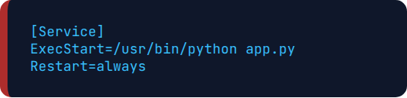
THE SYSTEMD INIT SYSTEM
systemd manages background services (daemons). It ensures your IoT application starts automatically after a power failure.
sudo systemctl status my_app.service
The standard way to monitor, stop, and start industrial application flows.

Slide 24
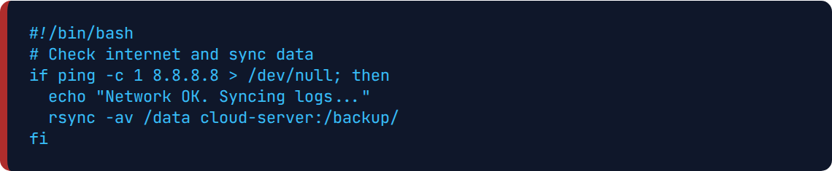
BASH SCRIPTING AUTOMATION
Industrial reliability requires automated tasks. Use Bash for hardware monitoring and log rotation.

Slide 25
Implementation Workflow
Configuration, Programming & Toolchains

Slide 26

HEADLESS SETUP (SSH)
Most industrial nodes run without a monitor (Headless). We use SSH (Secure Shell) for configuration.
Command: ssh pi@192.168.1.10
Tool: raspi-config for CLI interface setup.
Connectivity: Static IP or MDNS (.local) addressing.
Remote: SCP/SFTP for file transfers.

Slide 27
DEVELOPMENT TOOLCHAINS
C / C++ (GCC)
Node-RED
Python / pip
For high-performance drivers and memory-critical tasks.
Visual programming for rapid dashboarding and logic flow.
High-level libraries like paho-mqtt and gpiozero.

Slide 28
USE CASE: OPERATOR HMI
Visual Interface
Using RPi 5 to drive industrial touch-screens. Kiosk mode Chromium allows web-based dashboards to act as local controllers for PLCs.
Real-time OEE Dashboard.
Digital Work Instructions.

Slide 29
USE CASE: IOT GATEWAY
Data Bridge
Acts as the bridge between legacy serial devices (RS-485/Modbus) and modern Cloud servers. It provides local buffering and encryption.
Impact: Secure, stable connectivity for brown-field factory floors.

Slide 30

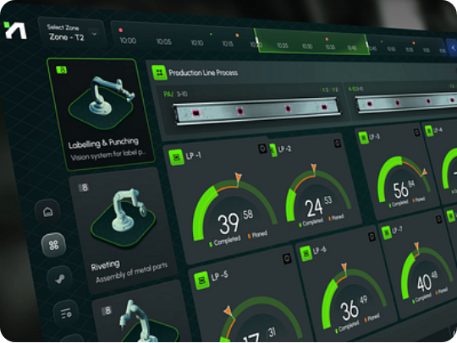
USE CASE: EDGE AI
Local Inference
Running Neural Networks (TensorFlow Lite) directly on RPi 5 to identify defects in manufacturing without cloud latency.
Benefit: 100% Privacy and Zero dependency on internet uptime.

Slide 31
Mini Project
Industrial Edge Data Logger Implementation

Slide 32

PROJECT COMPONENTS
Gateway: Raspberry Pi 5.
Sensors: MPU6050 & BME280 (I2C).
Protocol: MQTT (HiveMQ Broker).
Objective: Track vibration and temperature trends to predict motor failure.
Visualization: Grafana Dashboard.

Slide 33

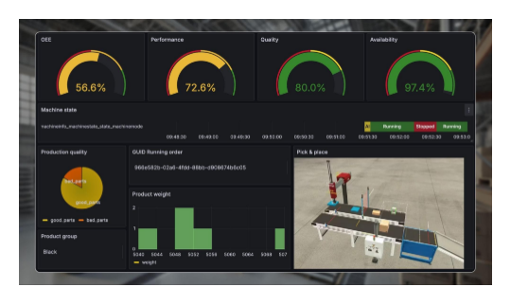
WORKING PRINCIPLE
1. Polling: Python script reads I2C busses every 1s. 2. Formatting: Data converted to JSON. 3. Pub/Sub: Published to factory/vib topic. 4. Auto-start: Systemd ensures service resilience.

Slide 34
TECHNICAL INTERVIEW PREP
What is the significance of the /proc filesystem in Linux?
How does an I2C protocol address 127 different devices?
Differentiate between Kernel Space and User Space.
What is a Device Tree Overlay and why is it used for HATs?
Explain the "systemd" unit file structure for an IoT app.

Slide 35
Summary & Conclusion
Architecture | Linux | Industrial IoT
The connected industrial future is open, modular, and Linux-powered.
Q & A SESSION

