Slide 1

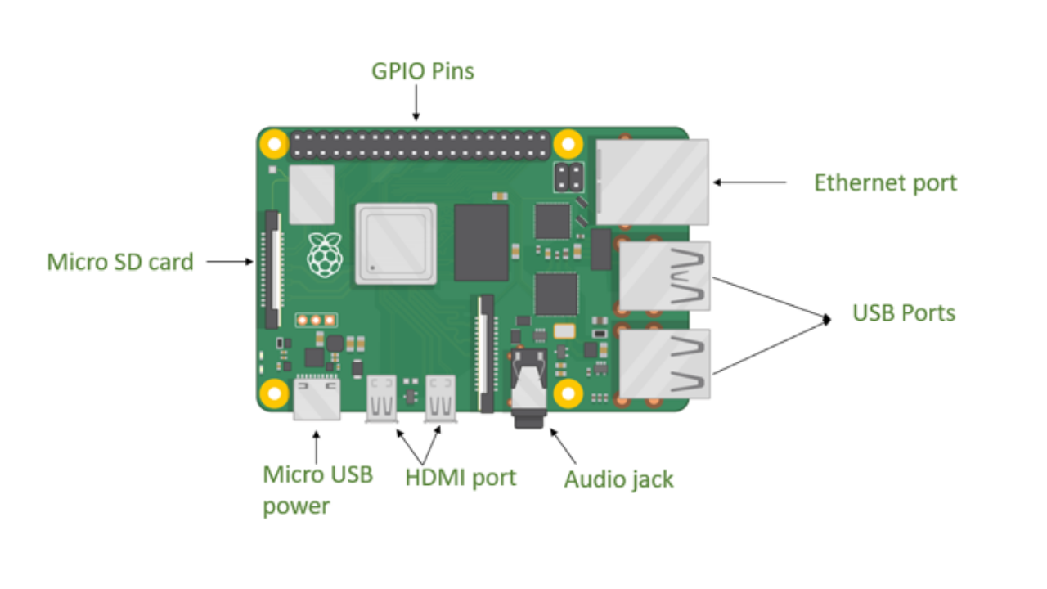

Embedded Programming & GPIO Control Systems

Slide 2






TRAINING OUTCOMES
Low-Level Control
Electrical Safety
Concurrency
Master interrupt-driven architectures and real-time operations.
Understand physical register mapping and bit manipulation protocols.
Design reliable interfaces handling current constraints and isolation.

Slide 3
EMBEDDED VS. STANDARD SYSTEMS
Feature | Standard PC Application | Embedded Control System
Execution | Managed by heavy OS abstraction | Direct hardware bare-metal/RTOS execution
Resources | Gigabytes of RAM / Scalable storage | Highly constrained RAM (Kilobytes/Megabytes)
Time Bounds | Soft timing (UI responsiveness) | Hard real-time bounds (Microsecond limits)
Peripherals | Indirect access via complex drivers | Direct register control of physical hardware

Slide 4
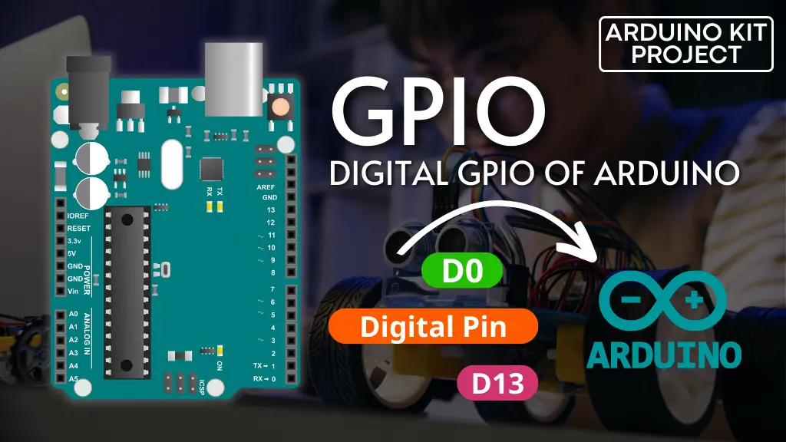

ANATOMY OF A GPIO PIN
A General Purpose Input/Output pin isn't just a wire; it is a highly multiplexed logic block:
Input Buffer: Reads voltage states high/low.
Output Driver: Push-pull or Open-drain MOSFET pairs.
Pull Up/Down: Internal resistors ensuring steady default logic states.

Slide 5
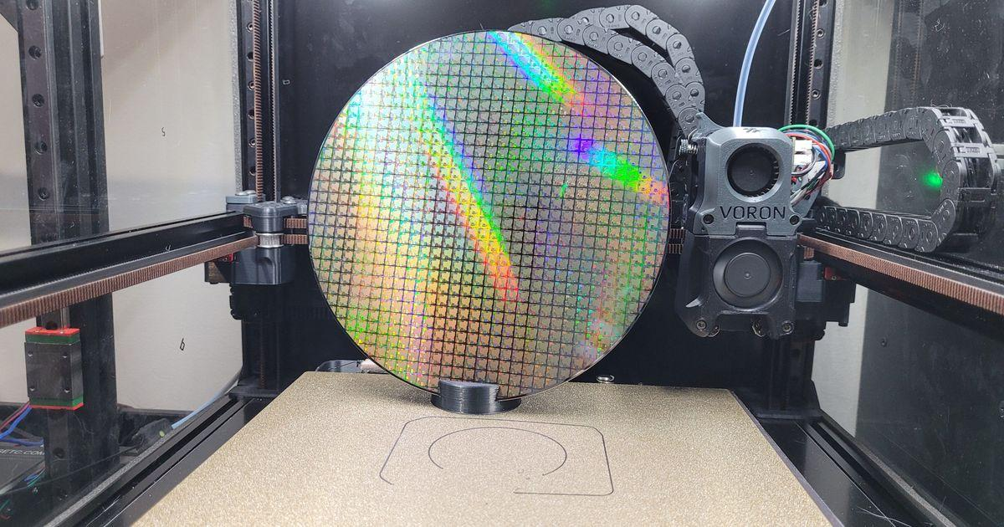
ELECTRICAL CONSTRAINTS
The Silicon Speed Limit
Exceeding current specs permanently destroys the silicon substrate within the microprocessor.
Source Limits: Max current a pin can supply (~16-20mA).
Sink Limits: Max current a pin can safely ground.
Total Rail Limits: Aggregate chip limits (typically ~100-150mA).

Slide 6
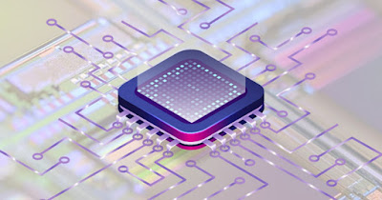
OUTPUT: PUSH-PULL CONFIGURATION
Active Drive Architecture
The standard choice for digital outputs like driving LEDs or communicating over SPI lines.
Logic 1: Upper P-MOS turns ON, sourcing voltage to the pin.
Logic 0: Lower N-MOS turns ON, sinking current to ground.

Slide 7
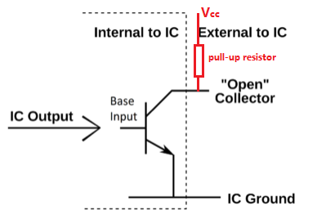
OUTPUT: OPEN-DRAIN ARCHITECTURE
Bus Dominance Design
In open-drain mode, the top P-MOS is omitted completely. The pin can only pull low actively.
Logic 0: Pulls line actively to GND.
Logic 1: Pin floats high-impedance (Hi-Z); requires an external pull-up resistor.
Use Case: Shared wired-AND logic.

Slide 8
MEMORY-MAPPED I/O
Registers as Addresses
Hardware state manipulation happens by executing standard pointers directly on fixed peripheral register addresses.
MODER: Configures input/output mode.
ODR: Output Data Register.
IDR: Input Data Register.

Slide 9
ALTERNATIVE PIN FUNCTIONS
Maximizing Package Space
Modern MCUs are small. Pins must alter personalities dynamically through internal register multiplexers.
ADC: Direct analog channel path bypasses logic.
UART: Pin switches to communication TX/RX.
TIM: Attaches internal timer for capture/compare.

Slide 10
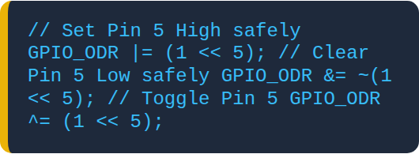
BITWISE OPERATIONS: MASKING
Precise Manipulation
Never rewrite an entire register block blindly; use bitwise operators to shift specific target pins while preserving neighbors.
Bitwise OR (|): Sets target bits to 1.
Bitwise AND (&): Clears target bits to 0.
Bitwise XOR (^): Toggles bit states.

Slide 11

Interfacing & Isolation
Protecting Weak Silicon from Harsh Loads

Slide 12
DRIVING TRANSISTORS
Amplifying Current Capacity
When driving loads that demand more than 20mA (relays, motors), a transistor must be integrated as a low-side driver switch.
GPIO supplies 1-2mA to the base gate.
Transistor handles hundreds of milliamps on the collector loop.

Slide 13
GALVANIC ISOLATION: OPTOCOUPLERS
Zero Electrical Contact
Optocouplers turn electrical inputs into light pulses internally, completely breaking physical wire paths between subsystems.
Protects the core MCU from high-voltage main shorts.
Eliminates massive industrial ground loops entirely.

Slide 14
SWITCH CONTACT BOUNCE
The Mechanical Chaos
When closing a switch, metal leaves slam and rebound repeatedly for 5-10 milliseconds before resting.
The Bug: One physical button press register looks like 20 distinct fast pulses to a fast CPU.

Slide 15


DEBOUNCING SOLUTIONS
Hardware RC Filters
Software Debounce
An analog low-pass filter smooths out fast voltage spikes into a continuous ramp waveform.
Using timer polling delays or state tracking checks to wait until contact noise signals completely settle.

Slide 16
REAL-TIME CONCURRENCY: INTERRUPTS
Asynchronous Priority
Interrupts stop main loop thread routines instantly to execute urgent, high-priority peripheral requests.
ISR: Interrupt Service Routine.
Must be lightning fast; never execute delay commands inside an ISR block.

Slide 17
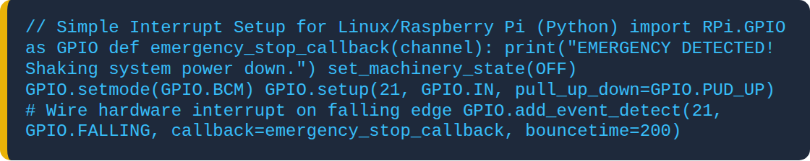
INTERRUPT CONFIGURATION CODE

Slide 18
PULSE WIDTH MODULATION: PWM
Faking Analog with Digital
Varying the ratio of ON-to-OFF time creates an adjustable average voltage equivalent.
Duty Cycle: Ratio of ON time to sum of OFF and ON time
Used for dimming LEDs and controlling motor speeds.

Slide 19
HARDWARE TIMERS
Precision Timekeepers
Never implement timing with software delay counters (`delay_ms()`), which paralyze processing workflows completely.
Prescalers: Divide hardware master clocks down to manageable tick frequencies.
Auto-reload mechanisms trigger consistent intervals natively.

Slide 20
SYSTEM SAFETY: WATCHDOG TIMERS
The Ultimate Fault Guard
A hardware down-counter that resets the entire system if software freezes due to a bug or EMI lockup.
Kicking the Dog: Code must regularly clear the timer before it hits zero.
If it reaches zero, a full hardware reset executes.

Slide 21

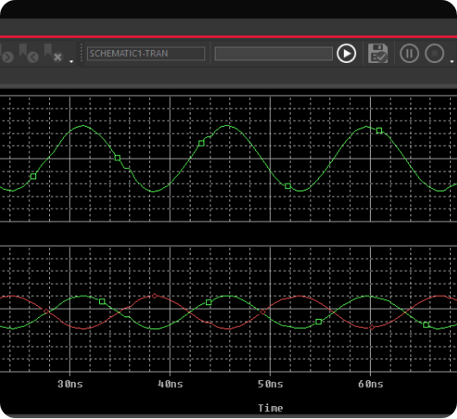
DEBUGGING HARDWARE: LOGIC ANALYZERS
Visualizing Invisible Pins
Print debugging commands are slow and alter timing profiles destructively. Use real-time logic analyzers to inspect lines.
Captures exact signal states at megahertz rates.
Decodes protocols ($I^2C$, SPI, UART) live.

Slide 22
INDUSTRIAL INTEGRATION CHECKLIST
Are all capacitive switch bouncing lines cleaned up via RC filters or logic delays?
Do inductive power lines have clamping flyback protection diodes connected?
Is current drawn from any microcontroller output pin safely restricted below 15mA?
Are high-voltage main fields completely isolated using optical gates?

Slide 23

Masterclass Summary
Bridging the gap between software instructions and physical control lines requires a rigorous grasp of register masking, electrical isolation, and interrupt determinism.
Q&A SESSION | SYSTEMS MASTERED

