Slide 1

Industrial Communication Protocols for IoT Systems
The Digital Architecture of Modern Factories

Slide 2






TRAINING OUTCOMES
Legacy Integration
Messaging APIs
Standardization
Master Fieldbus protocols like Modbus and CAN for connecting established hardware.
Implement modern telemetry protocols like MQTT and CoAP for cloud scalability.
Understand the OPC UA framework for cross-vendor industrial interoperability.

Slide 3

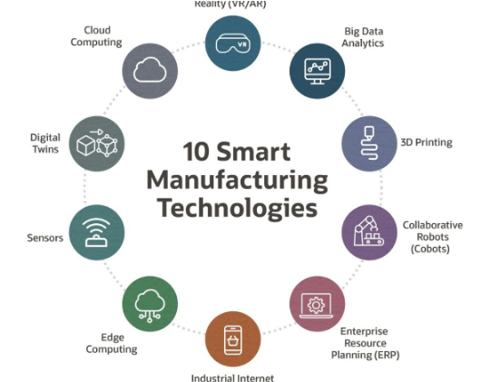
WHY IT MATTERS
Communication protocols are the "language" of industrial automation. Without them, machines cannot share state or data.
Market Impact: 75B+ connected devices by 2030 require standardized protocols.
Operational Alpha: Enables Predictive Maintenance and Digital Twins.
Efficiency: Reduces manual data logging by 90% via automated telemetry.

Slide 4
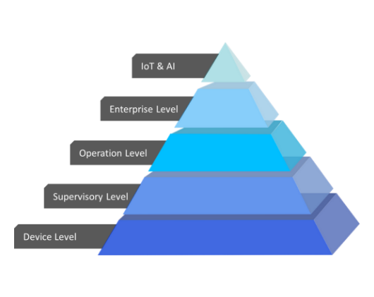
THE AUTOMATION PYRAMID
ERP/Cloud: HTTP, AMQP, MQTT (Business Logic).
SCADA/MES: OPC UA, Modbus TCP (Operational Control).
Control: Profinet, EtherCAT (PLC Management).
Field: Modbus RTU, IO-Link (Sensors/Actuators).

Slide 5


THE "DATA SILO" PROBLEM
Legacy Isolation
The Protocol Bridge
Analog machines speak proprietary languages. Data is trapped in local memory and cannot reach the analytics cloud.
Translation gateways convert Modbus/Serial into MQTT/TCP, allowing real-time visibility across the enterprise.

Slide 6
OSI MODEL VS IOT STACK
OSI Layer | Industrial Context | Example Protocols
Application | Data Representation | MQTT, HTTP, OPC UA
Transport | Delivery Reliability | TCP, UDP
Network | Routing | IP (IPv4/IPv6), 6LoWPAN
Physical | Signals & Hardware | Ethernet, RS-485, LoRa

Slide 7



COMMUNICATION TOPOLOGIES
Star
Mesh
Bus
Centralized hub (Gateway) managing nodes (LoRaWAN).
Self-healing, redundant node connections (Zigbee).
Sequential Daisy-chain connectivity (Modbus/CAN).

Slide 8
Fieldbus & Serial
The Legacy Roots of Industrial Data

Slide 9
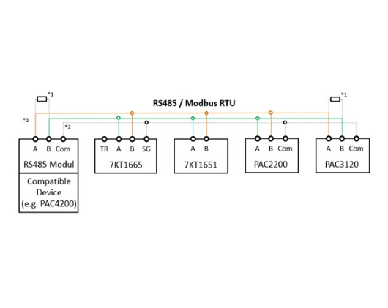
MODBUS RTU (SERIAL)
The 1979 standard that still powers 40% of industrial sensors. Reliable, simple, and master-slave based.
Wiring: Uses RS-485 (Differential Pair) for noise immunity.
Max Nodes: 247 devices on one segment.
Payload: Raw binary with CRC checksum.

Slide 10
MODBUS MEMORY MAP
Object Type | Access | Typical Usage
Coils | Read / Write | Relay/Motor Status
Discrete Inputs | Read Only | Limit Switches, Push buttons
Input Registers | Read Only | Analog Sensors (Temp/Pressure)
Holding Registers | Read / Write | Configuration, PWM values

Slide 11
MODBUS TCP (ETHERNET)
Wraps the Modbus frame in a TCP/IP packet. No more RS-485 daisy-chaining; uses standard network switches.
Enables integration into standard IT infrastructure while maintaining legacy data structures.
Speed: 10/100 Mbps (vs 115 kbps for Serial).
Addressing: Uses IP Addresses.
Port: Default Port 502.

Slide 12
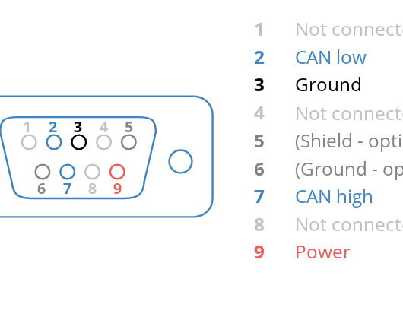
CAN BUS (CONTROLLER AREA)
High-reliability bus for automotive and robotics. Message-based, not node-based.
Priority: Lower ID = Higher priority.
Collision: Uses Non-destructive arbitration.
Wiring: Shielded twisted pair (CAN-H, CAN-L).

Slide 13
Messaging Protocols
Telemetric Data Flow in Cloud IoT

Slide 14

MQTT: PUB-SUB MODEL
Broker-based: Decouples the Publisher (Sensor) from the Subscriber (Dashboard).
Lightweight: Smallest packet header is only 2 bytes.
Topics: Logical paths (e.g., factory/line1/temp).
Persistence: Broker stores messages for offline clients.

Slide 15



MQTT QUALITY OF SERVICE
QoS 0
QoS 1
QoS 2
At most once. Fast but unreliable (Fire and forget).
At least once. Guaranteed delivery but may duplicate.
Exactly once. Guaranteed and unique (Critical data).

Slide 16
COAP (CONSTRAINED APP)
Designed for low-power nodes on 6LoWPAN. A specialized version of HTTP over UDP.
Ideal for battery-operated sensors that sleep often.
Efficiency: No TCP handshake required.
Model: RESTful (GET, POST, PUT, DELETE).
Discovery: Supports device resource discovery.

Slide 17

AMQP (ADVANCED QUEUEING)
The standard for Enterprise Messaging (Azure IoT Hub). Focused on interoperability and security at scale.
Heavy Duty
Reliability: Guaranteed End-to-End delivery.
Rich features, complex routing, and transactional reliability.
Enterprise: Integrates easily with high-level business software.

Slide 18
Industrial Standards
OPC UA, IO-Link, and Deterministic Data

Slide 19
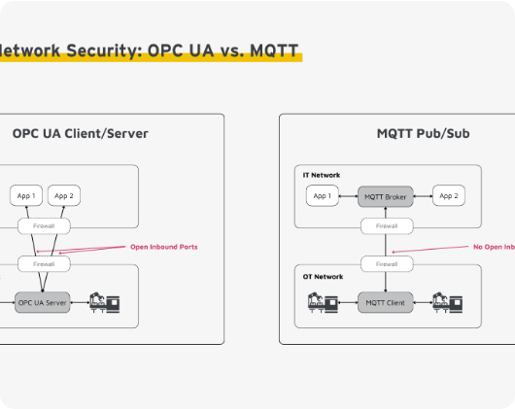
OPC UA (UNIFIED ARCH)
The "Universal Language" for industrial integration. Platform independent and highly secure.
Metadata: Data tags include units and context.
Security: Built-in encryption and certificate exchange.
Model: Client-Server and Pub-Sub support.

Slide 20

ETHERCAT (REAL-TIME ETH)
"Ethernet for Control Automation Technology". The fastest protocol for motion control.
Speed: Processes data "on-the-fly" as packet passes through node.
Sync: Distributed clock for sub-microsecond synchronization.

Slide 21
IO-LINK FOR SENSORS
The final meter of connectivity. Standard 3-wire cabling for "Smart" sensors.
Turns standard I/O into a high-fidelity digital diagnostic channel.
Diagnostics: Detects if a sensor is broken or needs cleaning.
Auto-Config: Replace a sensor, and the master auto-configures it.

Slide 22
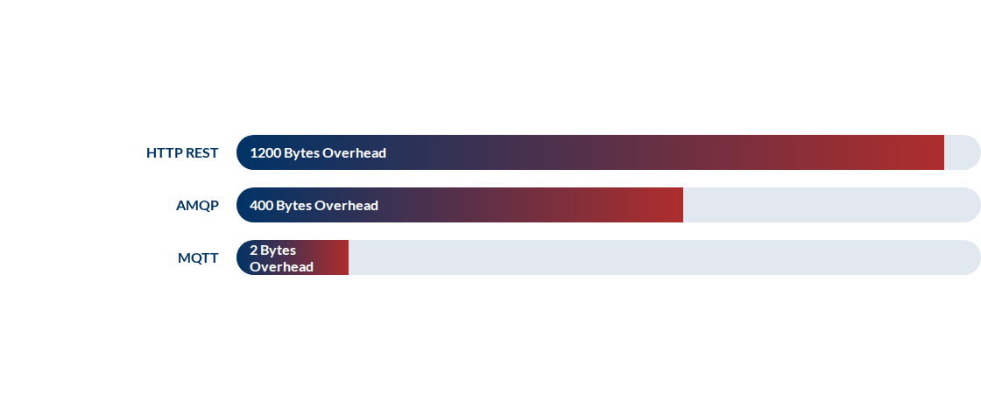
PROTOCOL BENCHMARKING

Slide 23
Gateways & Implementation
Bridging the OT-IT Gap

Slide 24
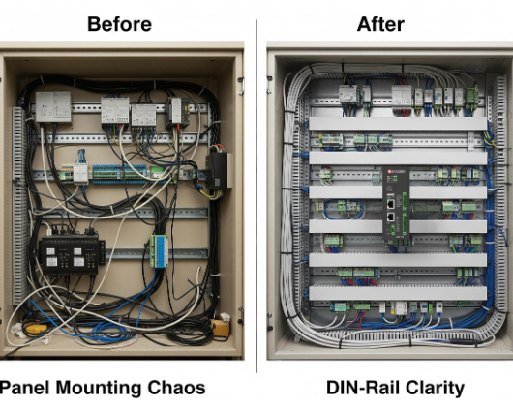
IOT GATEWAY ARCHITECTURE
The "Translator" between local Fieldbus and Cloud Telemetry.
Edge Processing: Filters noise before cloud upload.
Security: Firewall between PLC network and Internet.
Caching: Stores data during network outages.

Slide 25
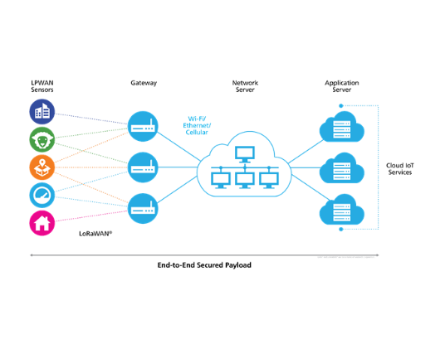
WIRELESS: LORAWAN
Long Range, Low Power. Perfect for Agriculture and Smart Cities.
Range: Up to 15km in rural areas.
Battery: 10 years on a coin cell.
Speed: Low (bps), for small telemetry bursts.

Slide 26

CELLULAR: NB-IOT
Mobility: Works across moving assets (Trucks/Trains).
Cellular IoT
Security: SIM-based hardware authentication.
Uses licensed spectrum for massive node density and high reliability.

Slide 27
DEPLOYMENT WORKFLOW
Hardware Setup
Local Logic
Security
Cloud Sync
Register Mapping & Polling
TLS Certificates & Firewalls
MQTT Broker Configuration
RS-485 / Ethernet Cabling

Slide 28
TROUBLESHOOTING TOOLS
Wireshark
Modscan
MQTT.fx
Packet analysis for Ethernet protocols.
Verification of Modbus registers.
Monitoring MQTT topic traffic.

Slide 29
Mini Project
Modbus-to-MQTT Telemetry Bridge

Slide 30

PROJECT ARCHITECTURE
Objective
Bridge an industrial power meter (Modbus RTU) to a cloud dashboard (MQTT).
Edge: Raspberry Pi 5.
Field: RS-485 USB Adapter + Meter.
Cloud: HiveMQ Broker + Grafana.

Slide 31
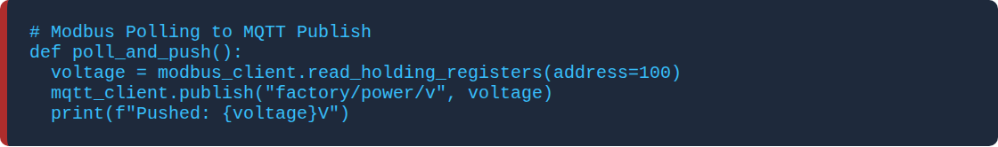
WORKING PRINCIPLE (CODE)
Ensures deterministic sampling of field data pushed into an asynchronous cloud stream.

Slide 32
FUTURE: TSN
Time-Sensitive Networking
Standard Ethernet with guaranteed latency. Merges IT and OT into one single wire.
Enables real-time motion control over standard IT switches.
Sync: Nanosecond timing accuracy.
Reliability: Redundant paths for zero-loss packet delivery.

Slide 33



FUTURE: 5G / 6G
URLLC
mMTC
Network Slicing
Ultra-Reliable Low-Latency Communication for robotics.
Massive Machine-Type Communication (1M nodes / km²).
Dedicated virtual pipes for critical industrial safety data.

Slide 34
TECHNICAL INTERVIEW PREP
What are the differences between Modbus RTU and Modbus TCP?
Explain the Pub-Sub model of MQTT. Why is it better than HTTP for sensors?
What is the role of an OPC UA Server in a multi-vendor factory?
Differentiate between Determinism and Latency in industrial networks.
What are the 3 QoS levels in MQTT?

Slide 35
Summary & Conclusion
The Future of Industry is Connected
Architecture | Fieldbus | Messaging | Standards | Future
Thank you for your attention!
Questions? Reach out to your Training Coordinator.

