Slide 1

Data Acquisition, Processing & Edge Computing Systems
Systems Engineering Division

Slide 2






TRAINING OUTCOMES
Ingestion
Edge Logic
Telemetry
Master multi-channel signal capture and hardware synchronization.
Develop real-time processing and local state machine logic.
Architect robust Edge-to-Cloud telemetry data pipelines.

Slide 3

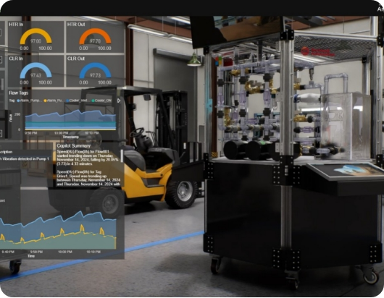

INDUSTRIAL CONTEXT
In modern factories, Data Acquisition (DAQ) is the "Sensory Nervous System" of the enterprise.
Safety: Real-time fault detection.
Yield: Precision tuning of variables.
Downtime: Predictive analytics to avoid machine failure.

Slide 4
THE 4-LAYER STACK
Modern IoT architecture logically separates data flow into manageable engineering silos:
Perception: Physical sensor interaction.
Processing: Edge filtering & Cloud DB.
Network: Protocol translation & transport.
Application: Dashboards & HMI logic.

Slide 5
THE DIGITAL PIPELINE
Sequential Transformation
1.
Transducer: Physics to Electrical.
ADC: Analog to Digital Bits.
3.
4.
Driver: Register to Memory Array.
2.
Conditioner: Filter & Amplification.

Slide 6

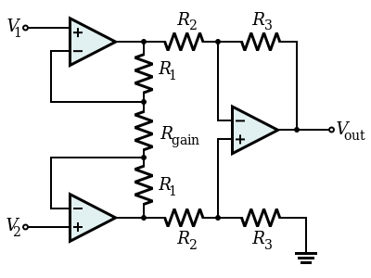
SIGNAL CONDITIONING
Cleaning the Edge
Raw signals are often weak (μV range) and noisy. Hardware pre-processing is mandatory.
InAmp: High CMRR to reject EMI.
Filtering: Eliminating high-freq jitter.
Isolation: Protecting the processor from kilovolt spikes.

Slide 7

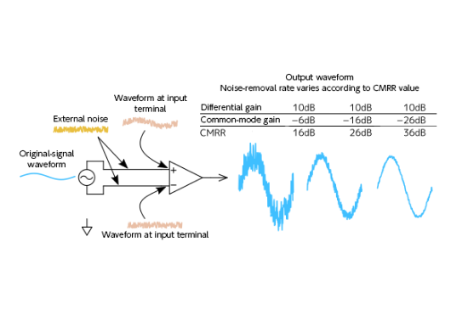
ANALOG NOISE MANAGEMENT
Differential Advantage
By subtracting two inverse lines (A-B), industrial systems cancel noise that hits both wires simultaneously.
Crucial for: Long cable runs (>10m) across noisy motor control centers.

Slide 8

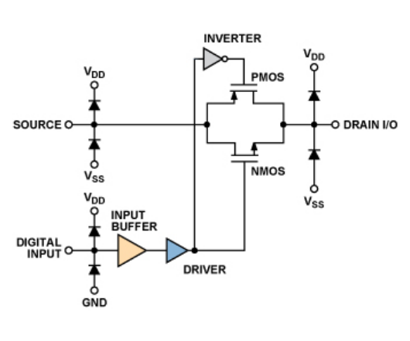
MULTICHANNEL INGESTION
Hardware Sharing
Multiplexing allows a single expensive high-resolution ADC to process dozens of sensors.
Addressing: Logic lines select the active sensor.
Switching: High-speed MOS switches ensure minimal crosstalk.

Slide 9
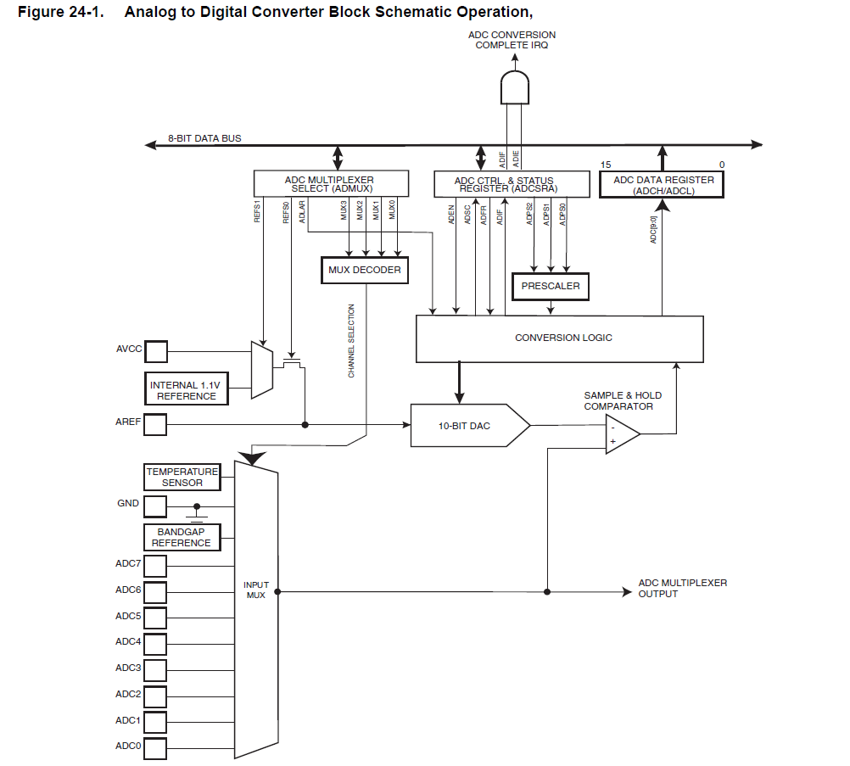

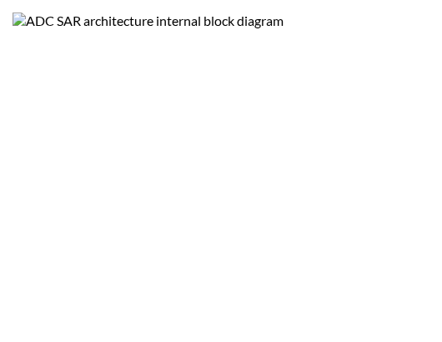
QUANTIZATION ENGINES
SAR vs. Delta-Sigma
SAR: Moderate speed, high efficiency. The workhorse of standard microcontrollers.
Delta-Sigma: Slow but extreme resolution (24-bit). Ideal for scientific weighing and audio.

Slide 10
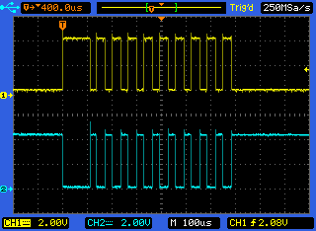
SYNCHRONOUS BUS: SPI
The Gold Standard for DAQ
Serial Peripheral Interface (SPI) provides the deterministic, high-speed link needed for raw sensor data.
Full-duplex (simultaneous Rx/Tx).
Speeds up to 100MHz+ possible.
Hardware chip-select for zero address lag.

Slide 11
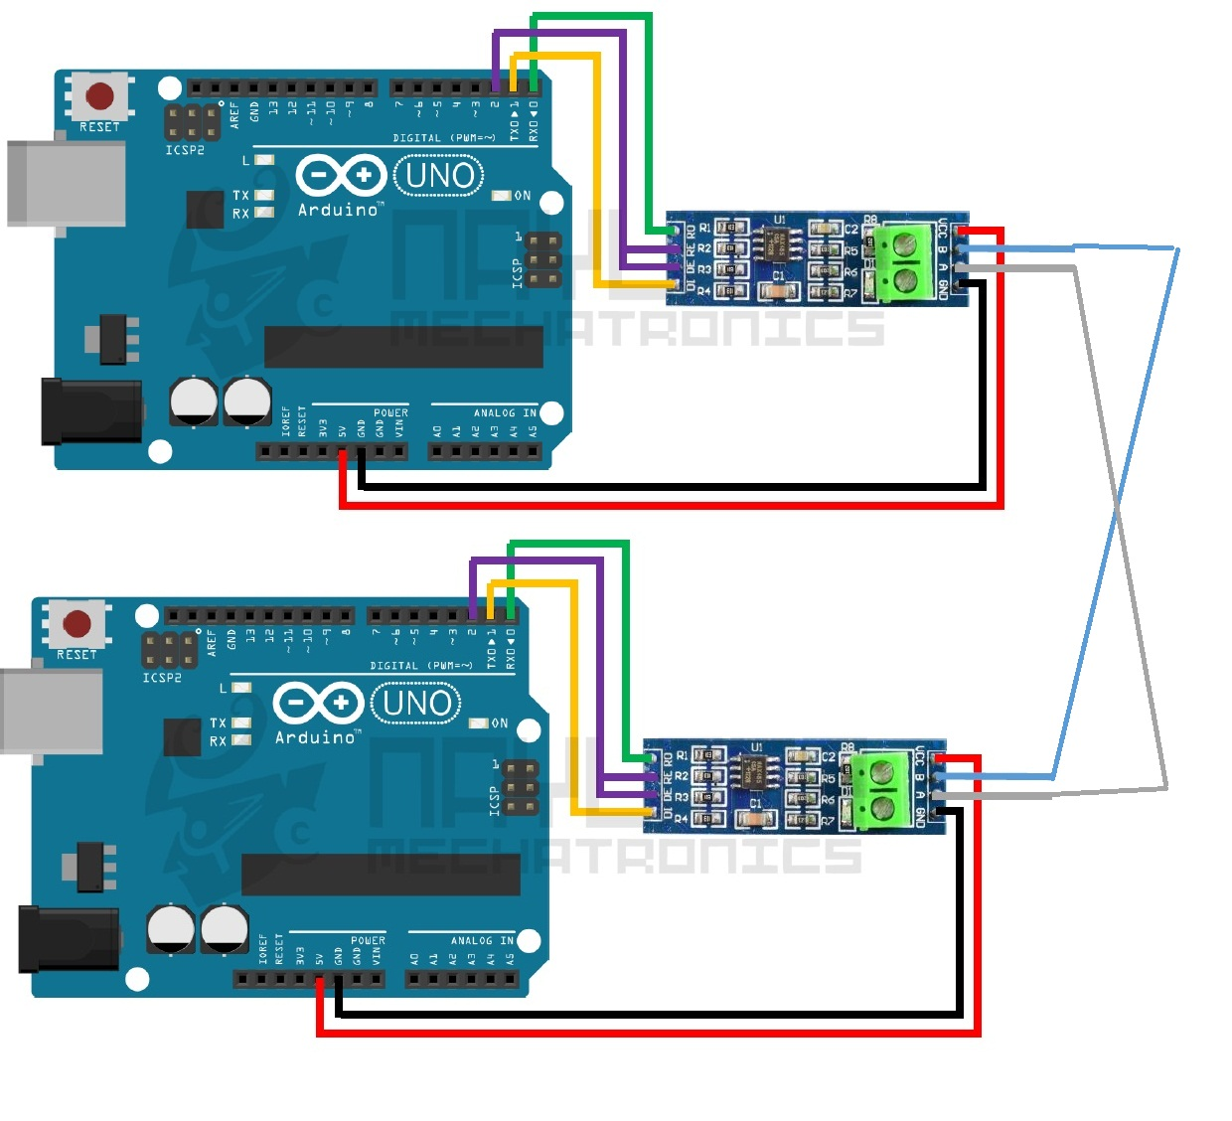


FIELDBUS: RS-485
Industrial Reliability
For connectivity spanning up to 1.2km, RS-485 is the industry's resilient choice.
Differential pair: Immune to EMI.
Multi-drop: Connect up to 32 nodes on a simple twisted pair cable.

Slide 12

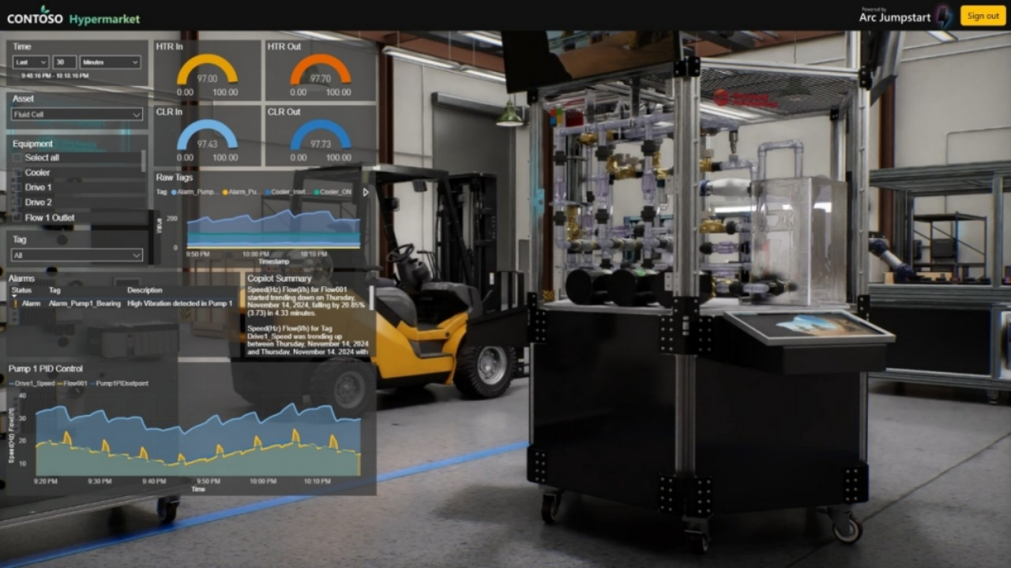
Edge Computing
Intelligence at the Hardware Boundary

Slide 13
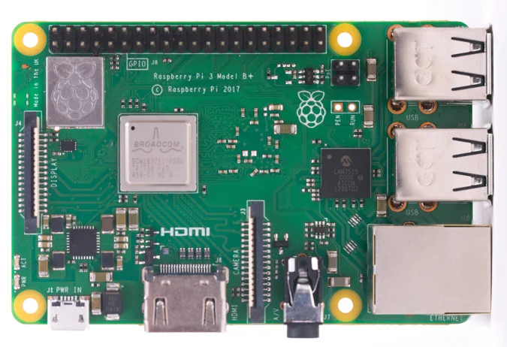
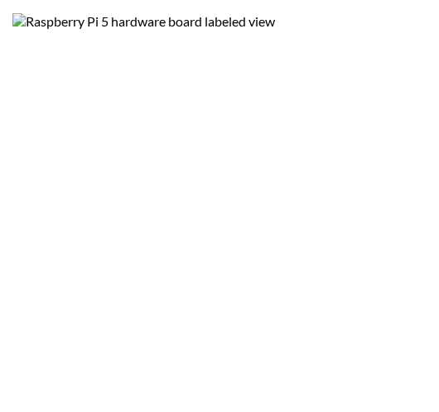
THE PLATFORM: RPI 5
Production-Ready Edge
The Raspberry Pi 5 transitions from "maker gadget" to a high-performance Edge Node.
Cortex-A76: Performance cores for AI.
RP1 Southbridge: Deterministic GPIO control.
PCIe: High-speed NVMe storage.

Slide 14

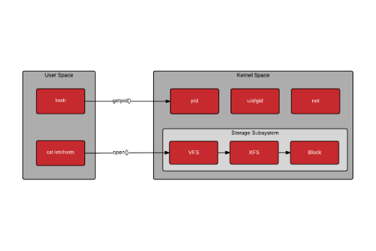
THE SOFTWARE STACK
Architecting for Stability
Kernel Space: Low-level hardware drivers.
User Space: Python/C++ Application logic.
Real-time patches: (PREEMPT_RT) for sub-millisecond determinism.

Slide 15
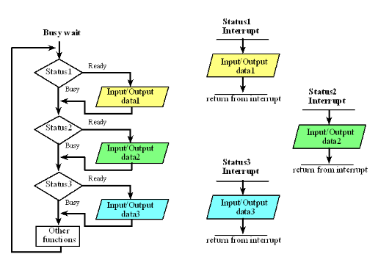
DETERMINISM ANALYSIS
Jumping to Action
Polling: CPU repeatedly checks a pin. High waste, high latency variation.
Interrupts: Hardware triggers the CPU. Sub-microsecond response, perfect for high-speed alarms.

Slide 16
DIRECT MEMORY ACCESS
Bypassing the CPU
DMA allows hardware to dump data straight to RAM without core processor intervention. Mandatory for high-speed logging.
CPU Load: 0% for data movement.
Efficiency: Direct peripheral-to-memory block transfers.

Slide 17

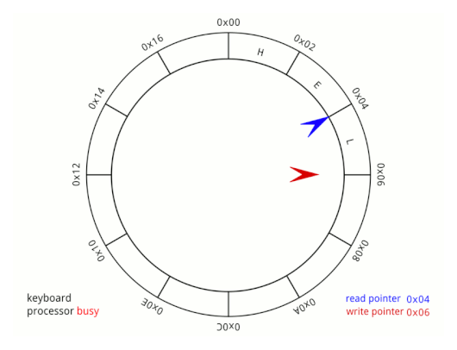
IN-MEMORY RING BUFFERS
Handling Data Spikes
Circular arrays decouple the high-priority Producer (ADC) from the slower Consumer (Cloud Upload).
Constant memory footprint.
Zero dynamic allocation (no heap fragmentation).

Slide 18
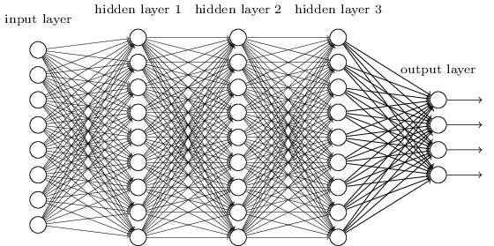
LOCAL AI INFERENCE
Intelligent Boundary
Moving machine learning to the Edge reduces cloud bandwidth by 99% and latency to milliseconds.
CNNs: For real-time visual inspection.
FFT: For frequency-domain anomaly detection.

Slide 19
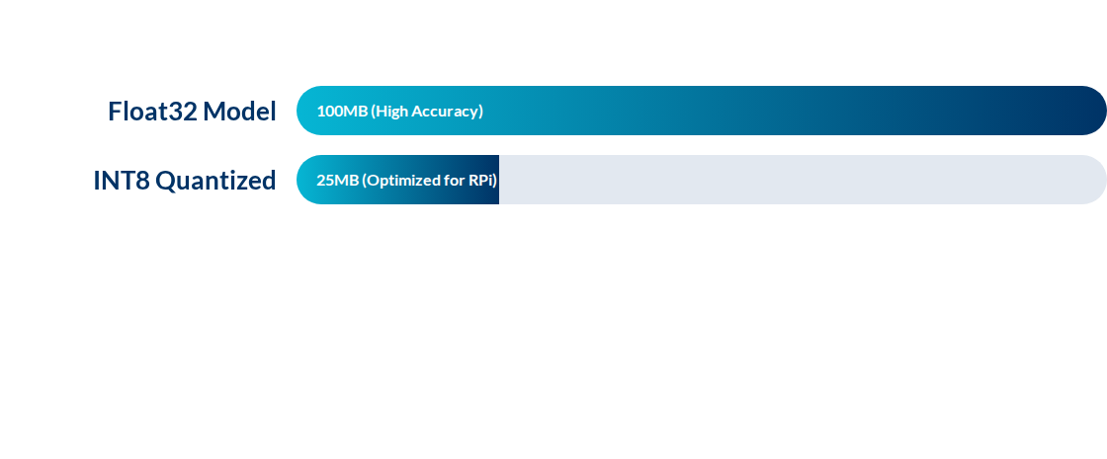
MODEL QUANTIZATION
Converting 32-bit weights to 8-bit integers increases speed by 3x on Edge hardware with minimal accuracy loss.

Slide 20

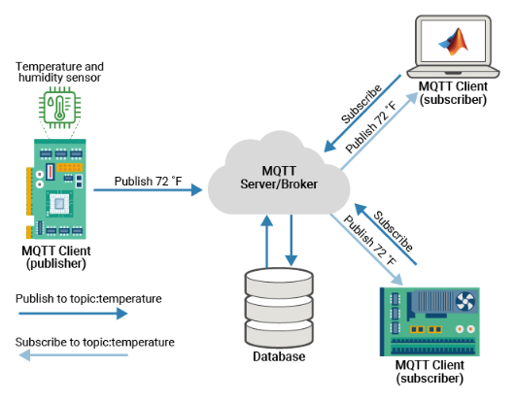
BACKBONE: MQTT
Pub-Sub Paradigm
The standard "language" for Edge-to-Cloud connectivity.
Decoupled: Sensors don't need to know where the cloud is.
QoS: Built-in delivery guarantees.
Payload: Supports Binary or JSON.

Slide 21
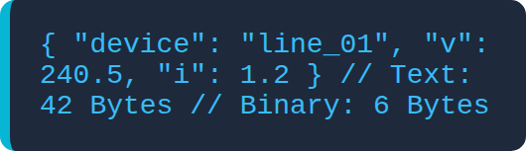
PAYLOAD EFFICIENCY
JSON vs. Protobuf
Industrial cellular links are expensive. Protocol Buffers reduce data usage by up to 10x compared to text-based JSON.

Slide 22
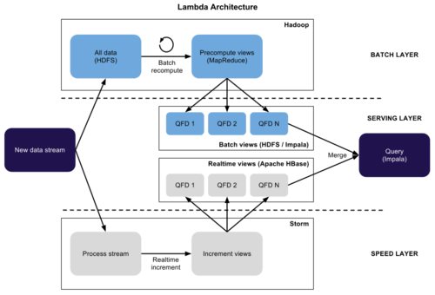
LAMBDA ARCHITECTURE
The Dual Path
Hot Path: Live data bypassed directly to real-time dashboards (low latency).
Cold Path: Raw logs archived for deep historical auditing and ML training.

Slide 23
STORAGE: TSDB
Optimized for Chronology
Standard SQL fails under millions of concurrent sensor writes. TSDBs (InfluxDB) use Columnar Compression.
Rapid time-range queries.
Automated data aging rules.

Slide 24
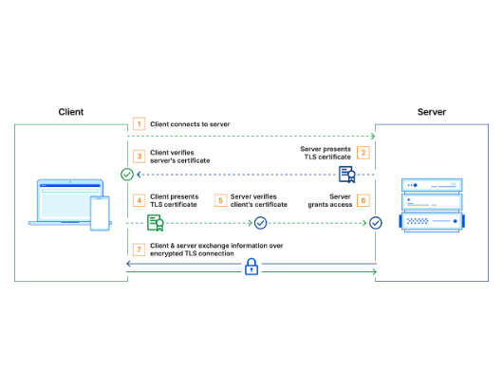
SECURING THE EDGE
Mutual Identity
IoT nodes are physical targets. Mutual TLS (mTLS) ensures that only verified nodes talk to the cloud, and vice-versa.
RoT: Keys must be stored in hardware secure elements.

Slide 25
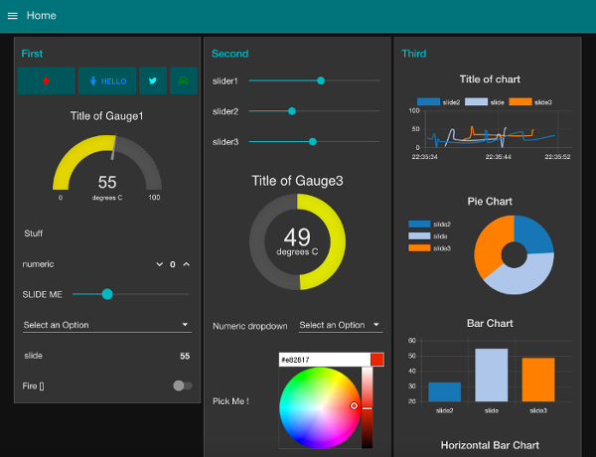
OPERATIONAL INSIGHTS
Grafana HMI
The ultimate view of your Edge network. Combines real-time telemetry with threshold alerts.
Rolling line charts.
Color-coded health gauges.
Global fleet map views.

Slide 26
Masterclass Summary
Integrating robust physical ingestion with intelligent Edge processing and secure Cloud synergy creates the modern industrial edge.
Q&A SESSION | TRAINING COMPLETE

