Slide 1



























•
•
•
•
Enterprise Scalability & Insights
Engineering Masterclass Series

Slide 2











600 X 400
•
I
Breaking the Silo
SCADA system components: What is SCADA?
SCADA
Operator Terminal
Traditional SCADA is localized and reactive. Cloud loT enables Global Visibility, Predictive Analytics, and Elastic Scaling.
••
C
0 0
----}A
Control Systems Adjustments
1
Alarm Monitoring
Radio/ Cellular Telemetry
(<•>)
�
�
Cloud allows the storage of petabytes of
I
history for Machine Learning that local PLC memory simply cannot hold.
RTU1 �
�
RTU2
1'
f Instrumentation 1
•• Inputs
II
( Instrumentation
t•J>•
•
.
,
Inputs

Slide 3









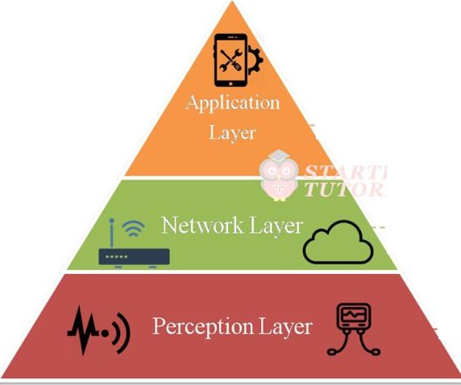
600 X 400
Three Tier Separation
O Edge: Sensors & Local Logic.
O Platform: Ingestion, Storage, Security.
0 Application: Dashboards, Mobile, ERP Link.
. Responsible for delivering application
services to theusers via user interfaces.
_ _ ____ _ _ ___ _
Responsible for connecting to other devices or servers. Also includes transmitting and processing the data from sensors.
_ _ _ _ _ _
Is the physical layer which contains sensors to gather data.

Slide 4











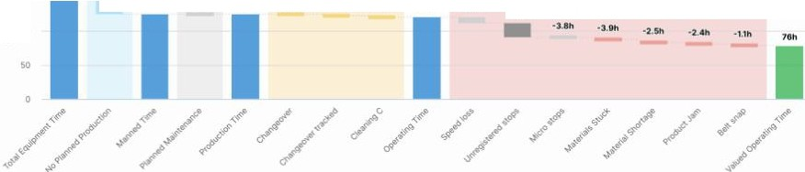
Visualizing OEE
600 X 400
600 x400
TCU
Overall Equipment Effectiveness (OEE) is the gold standard for manufacturing. Cloud integration allows calculating this across global fleets in real-time.
52.9 o/o
Ta19e1: so.o•�
61.8 °/o
TaigeL 520':<.
61.9 °/o
Target. 55 �.
64.0 °/o
200
21h
Oh
4h
43h
--
150
e
1100
144h
--21h
123h
O.ll\
123h •2..th
·Uh
-0,1h
119h
-S..4h
·21h
Reduces downtime by 30% via automated anomaly alerts.

Slide 5











600 X 400
40
I
Managed Hubs
�MQTT Broker Architecture Diagram
AWS loT Core and Azure loT Hub use MQTT as the primary Pub-Sub engine. They
decouple high-speed ingestion from slow-speed storage.
O Supports 1M+ concurrent connections.
O
Integrated security rules.

Slide 6








600 X 400
600 X 400
I
Bridging OT to IT
�Industrial Edge Gateway Hardware
Legacy machines speak Mod bus or Profinet. The Edge Gateway translates these binary field protocols into JSON/MQTT for Cloud consumption.
Essential for securing ''Brownfield'' environments.

Slide 7








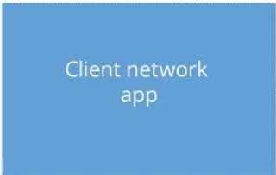



600 400
600
x400
X
I
Mutual TLS mTLS
Unlike standard web browsing, loT devices must prove their identity to the cloud, and vice versa. X.509 Certificates ensure no rogue nodes inject false data.
Client-authenticated TLS handshake
Client device
Secure session server
Secure session module
Certs
Private key
Client hello
Server hello (including certificate)
Client certificate request
◄
Client certificate
Client sends key info
Decrypt key info with server private key, and verify client certificate with client public key
(encrypted with server's public key)
Certificate verify

Slide 8








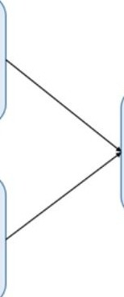

O Hot Path: Real-time streaming for live gauges and safety alerts (ms latency).
600 X 400
600 x400
Batch Layer
All Data
Precompute views
•
Cold Path: Batch processing for training ML models and reports (Hours/Days).
Serving Layer
Data
Batch view |  | Real-time view |  | Query
Stream Layer
Process stream
Increment views

Slide 9








600 X 400
600 x400
I
Shadow Representati•on
Device Twins track Desired vs. Reported properties. This allows operators to update configurations even when the device is currently offline.
Client Application
Device twin/shadow
Device
Properties
-��� .,,�
Reading. writing /
desired
/u...........L-�--,
"' Reading
----,,,-------,:-:------1�"'
reported
/
Reading, writing
'-------^{R}-^{e}-ª=^{din}-^{g}.--,,, v/
"

Slide 10








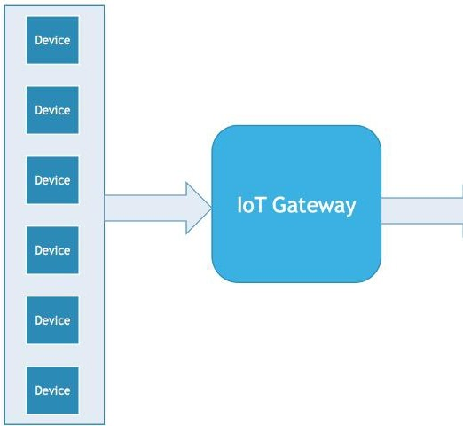
•
600 X 400
600 x400
The Kafka Backbone
Real-time
Analytics
When millions of sensors stream concurrently, standard databases lock up. Apache Kafka acts as a high-durability Message Buffer that scales horizontally.
(Hot Path)
Apache Kafka
Batch
Processing
(Cold Path)

Slide 11









-
600 X 400
600 X 400
Optimized for Time
Relational DBs index by primary keys. TSDBs (InfluxDB) index by Timestamps. This enables querying 1B points per second for trend calculations.
�ime Series Database Internal Table Comparison

Slide 12











•
600 X 400
600 x400
Payload Efficiency
O JSON: Human readable, flexible, but high overhead.
Python Conversion Times For Popular Serialization Formats
7
serialization
Deserialization
6
O Protocol Buffers: 10x smaller, faster to parse, essential for cellular/satellite loT.
-Ill
5
-4
Ill
"C
C
0_{u}
(I) 3
U'J
2
1
c:sv
json
protobuf tomI Serialization Format
xml
yaml

Slide 13






Functional Visuals
600 X 400
600 x400
�Grafana Industrial Real-time Dashboard
Industrial dashboards must prioritize Actionability over aesthetics. Using high-contrast color coding (Red/Amber/Green) targets operator attention to critical faults.

Slide 14








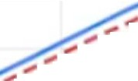
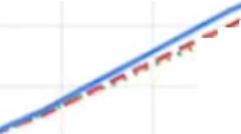
-
600 X 400
600 x400
Beyond Polling
,, .....
&
Dashboards shouldn't ''refresh." WebSockets push data from the cloud the instant it arrives, providing a sub-200ms ''Live'' experience for field operators.
2500
11
- ..
• •
,,. ..
......
2000
., ..
I
,,. I I
•• •• ••
_{I f} ••
1.SOO
• • ••••
.-",.'·.
1000
•
•
500
0
500 2 000 2 500 3000 3 500
(tnC!)
0
500 1 000
000

Slide 15












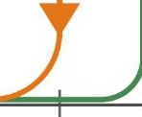
•
600 X 400
600 X 400
Preventing Alert Fatigue
Signal
1
(close)
Simple thresholds cause alarm ''chatter'' if the signal is noisy. Hysteresis requires a signal to drop significantly before clearing an alert.
•
10%
►
Hysteresis signal path
Original signal path
0
(open)
180
200
Flow Rate
(I.pm)

Slide 16







600 X 400
600 X 400
I
Hybrid Approaches
O NoSQL: Massive telemetry scaling.
O SQL: Asset hierarchies, user roles, and maintenance records.
�SQLvs NoSQL Database Schema Diagram

Slide 17









•
600 X 400
600 x400
On-the-go Mon1•tor1•ng
Responsive UI design is critical for field technicians. Prioritizes Health Checks and Emergency Shutdown commands over complex trends.
�Industrial Remote Monitoring Mobile App UI

Slide 18






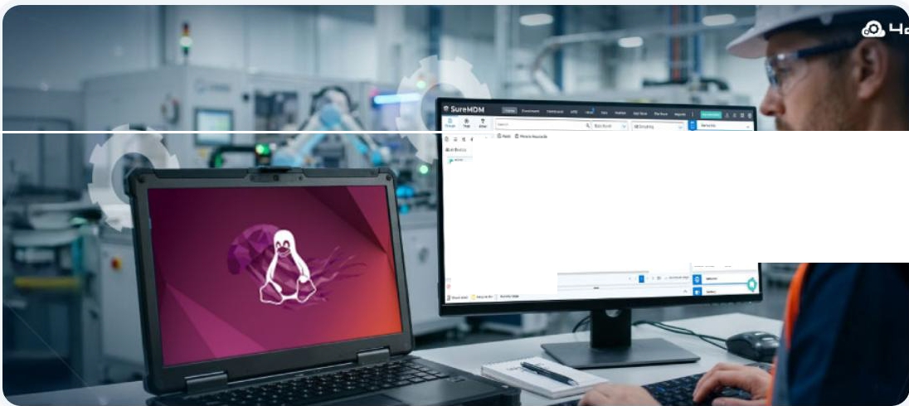

600 X 400
600 X 400
•
I
Massive Visibility
·- -- -
, ·-
·- , .-- ...
Driving large TV displays on assembly lines using Chromium Kiosk Mode on Raspberry Pi edge nodes. Displays live production counts vs. targets.
--
-... - - --- - -
•: - •- ·- . - --- --
-- --,
•C -
\•• •••· •
- --
- - .
!I
•• fl-
·- - ... -
- - '
I - - • -
,
- -- '
₋ ₋ - . -
-- -

Slide 19




600 X 400
600 x400
I
•
Energy Anal
•
ICS
�Smart Grid Analytics Dashboard
Balancing load across renewable sources using high-resolution cloud dashboards.
Visualizes demand spikes and grid stability metrics.

Slide 20








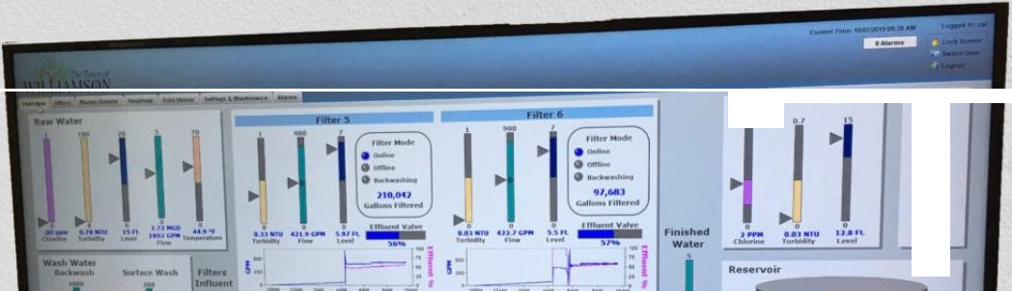
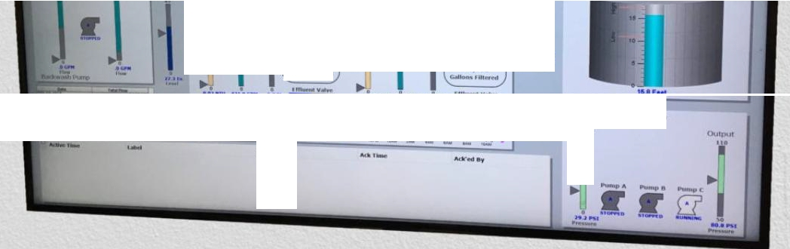
600 X 400
600 X 400
Cloud-Enabled SCADA
Combining traditional local HMI controls with cloud archival for chemical usage optimization and compliance logging.
clurwell
..
►
·,•.₋,..
·-
·--
1--�i.r.7-------=�'
Felt.• a
--��
....,
' ... '
,-
I
...
I ---
••
flllt!r.._,...
...,,^{n}.^{U},⁻,..ª.
·• -0....1•
..,Ila.�
•
M9.M:>
,._
6:!l,IU
........._ftlh•�NI
Manon 8"5"te, StlUon
Jlll"\11
110
c..,.........

Slide 21








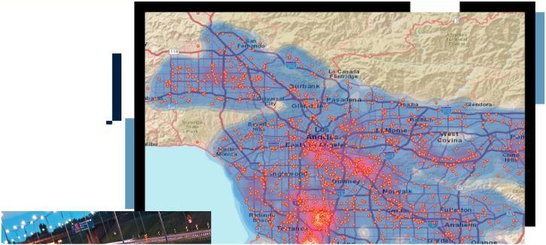
•
600 X 400
600 x400
Geospatial loT
Integrating GPS/GNSS data into cloud maps. Tracks cold-chain temperature compliance across global supply routes.

Slide 22




•
600 X 400
600 x400
Securing Data Access
�RESTvs GraphQL API Flow Diagram
Dashboards query data via REST or GraphQL. API Gateways handle rate limiting and security token verification to prevent DDOS on loT cores.

Slide 23










-
600 X 400
600 x400
-
The Firmware Cycle
Cloud visualization isn't just about reading; it's about Management. OTA updates push security patches to 10k+ nodes simultaneously.
Connected Devices
In the Field
••
Engineering Console
Secure OTA Delivery Infrastructure
(<<l(�)r»
•
✓
•
(<<l(�)r»
Receiving secure, wireless updates without manual intervention.
• •
Where firmware updates are built, signed, andmanag-&d.
En<;:rypted, 3uthentic;ated,
(<�(�)r»
and staged update
distribution.

Slide 24






600 X 400
600 X 400
Permission Silos
�Role Based Access Control RBAC Diagram
O Operators: Read-only Dashboards.
O O
Managers: Historical Reports.
Engineers: Remote Control & Setup.

Slide 25












600 400
600 x400
X
Packet Analysis
Cloud systems monitor the health of the MQTT Socket. Logs identify if packet loss is due to industrial noise or cloud rate-limiting.
Network Security - SFD © O
Vttua, Clo.JCNet,111'0fk I 'Anl.8CIOOO1"91wllfk • Nel\vOfkO"n�es
•
Tor.al t1�"-'l(<Tratrc
Net..,'1::111<,EQ'e68Trant to Ptlb IC
r!/
t�,
� "11'\(l
'"'
� '"
J! 400
j ,8.,)
.,------------------
;
� ,oo
0
� 1:!!I
8:-,CAAI 4!.llltllr.1 9:l>)/11,l 'l:ICAM !120.AAI 9:33:..�
(l,t{l.41.1 ll�AM l<'@AM ljllQ�, "?0,._._, P-:l(IJ.1,,1
101,;��WN
11:JOA>.I 8::CJIJA '::00,V.! ti:10,\.. 921)/.t,.I !1:ro/,1.1
lOOr.'l X!�4
HIOci�I»-'
ca
t.�,......_,r:
\.�r.•r.t�tC...
tJSeu.t,o\stl:u,..
W,.·11t�1C.
\.Sl.'fct,¥,:!.:/'C...
\,$�1�1)1;.
\.,$ t,.•v.t��t-C,..
\,t'H,'i:t...- ir:
\.'$"';:t�,c
P.
Sr,o.,.•Ui>&:U{D
P.
P.
..,.
••••
··--
·-
·-
No Aesuh1.Found
Nofwsutts Found
1$:QAM
�tl0:1;w,
?.OOH,"
11.l),A).t
?;':TJNJ
�· tr.0011V1ng tre QIJ8:'\'. ootllie<$oril'l'leruQe.
_ --�
5.632oro,o,
.C.o.o.nt
�
24.4KLogP..,.,,
3
SourceIP
..,
"""'"
DeStl1'18t10fl (P
Desltlatlon Pon
Protocol(Trall&port)
ScopeReglOfl
206.2:'!8118 1l;
10.(),() 11 l
....,
"'
22
"'
t::p
.:tta:q:,I
US Mi'.l':IHI ,:Chit�j
162 :)230,20
IQQ,O 111
,op
I AS,4;!
acCGPI
US r,11.::l\'IGSI+;ctlC80Qt
ino.n1m
10.0.0.101
i::p
UP!!
Jl?:1:t;fTI
US M•1\'lll�I i(:rAr.ill)Clj
�
10.1,1.49
tep
1.617
aecepi
usMl:lwee-1,:cr.1cagc1
101.0.193
102.05
<OP
703
aec,;pi
US Ml�WG$l(Ct,lCeQCI

Slide 26








600 X 400
600 x400
I
•
��Cloud lo T Device Management Console Screenshot
Global Device Health
Tracking battery levels, signal strength, and firmware versions across the entire deployment globe.

Slide 27










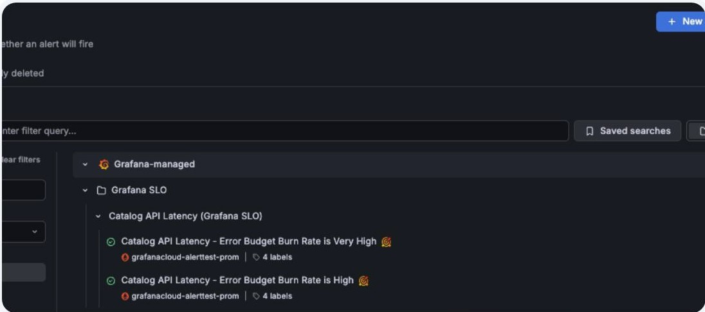
Triggering Action
600 X 400
600 X 400
Configuring notification channels (Slack/Email/SMS) based on TSDB queries. Ensures critical events reach the right person in seconds.

Slide 28







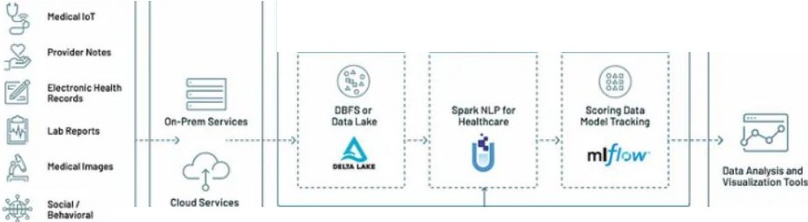


•
600 X 400
600 x400
Big Data Convergence
� databricks
L A K E H O U S E
P L AT F O R M
Merging unstructured raw logs with structured data tables. Enables massive scale SQL queries over uncleaned field sensor data.
DATA SOURCES
INGEST
DATA ANALYTICS • NLP • Al/ML PIPELINE
SERVE
STORE
PREPARE
HODEL
�
Clllm1

Slide 29







Deterministic Wireless
600 X 400
600 x400
�SG Network Slicing Architecture Diagram
Network Slicing provides a dedicated virtual pipe for mission-critical industrial data, bypassing standard public congestion.

Slide 30






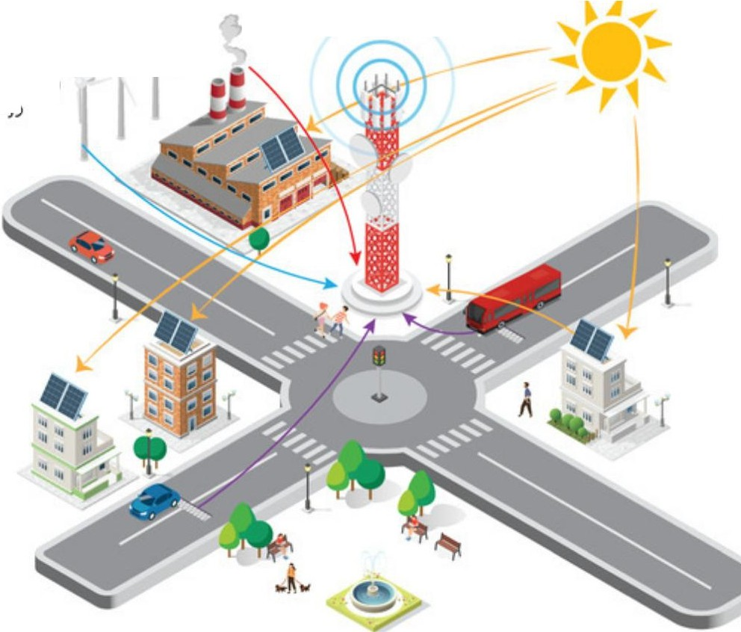

-
600 X 400
600 x400
-----> Wind E11er'"g'.v,
Piezoelectric Energy
Tl1er111oelectric Energ_)'
The 6G Vision
olar E11Crg)'
I
Future sensors will run without batteries, using Ambient Backscatter to communicate with cloud gateways. Massive density i•ncrease.
.... ) )
))
(
�

Slide 31





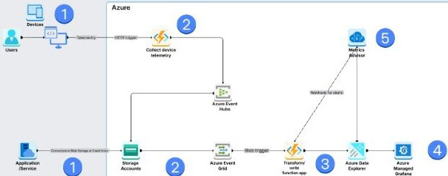








-
600 X 400
600 X 400
I
•
Smart Greenhouse Cloud
O RPi 5 polls DHT22 sensors.
0 Publishes to MQTT HiveMQ.
Cloud Monitoring ArehitKture Template
Us,en.£ �•tion Service
IXOft9Q1\0J:t!O IOIOMOIIYd\llllt vb
w,p11'4tions,
ArureEw-n1Hubs
COl!&Cttand $lteMttde1nee
telemetrydMa.
O Grafana visualizes heat maps.
lhobStoraoel £vent Gt-id
S101"ec atlcltriggedWYOl\tsIOI fm::0tnr19
telemtlrydeto
O Alert triggers cooling fan.
AZ-UR Ocu E11ptore,-Ana1yHtW.Oltl011)' Cl3t3 IOf moniloring P!IDOSe�
Azure�Or•f•M V,w,1�P«)Ci1$$ed i\llomrft.ry do)lil fot roal--tim�in,igt'!ti.,

Slide 32






600 X 400
600 x400
§ Design Query Cache
•
•
Explain TSDB columnar storage.
Hot path vs Cold path trade-offs. How does a Device Shadow work?
Ea High-level design
0 Cache hit
0 Cache miss
Clienl
0'91\t
nds query | R8t1Jm
WebSeivet
que1y | Aetuni
Querym ''f
crienl
Se
r
Sendsquerf
•
Web Server
Web Ser,..
tn"9rted Index
Service
,
Inverted Index
Servloo
d$ qverv
1
Re-lurn resd1
Sendsquery
lnvaned In�
Service
Query API
Pa,sesq<.:.ery
Parsesqt)!!fy
0!.lefy APf
AeMr.$dOCI billion
,
OoourtMtnt
Ser...loe
Aetum reo\l"h
Ooourneni Servioe
aohO
Return result
Oooumem Service
MemoryCacM
ChcOk$¢30ht ,,,
Cache hh Memory Cache
Updateoaot-e
Requaa1doc
Cache hit
Memory CaCtle
Memory Caoht
l l
Memory cactie
Memory cad'le
l
[
[
KCy·Valvt LOOkup
Rei;rievevalue
Kc1·V�1,1t Lookup
Add key-value
[
[
Kt;-·Valu�Lookup
Doubly UMed List
move_to_front
[
DoublyLif'lkedlJst
l
append_lo_front
rem¢'¥e_rrom_;iilil
Doubly Lin�ed List
l

Slide 33



















600 X 400
600 x400
Integration of Edge,Cloud, and Visuals
creates the ultimate industrial feedback loop.
Morutoong and OptJmtzatJon
Standardized protocols and TSDB backends are the bedrock of reliable systems.
r
Mlp1pehne
Feature Eng1neenng
Feature Selection
t -
t.tOdel Tra1n1ng
"10del va dal1on
ETl (ExtradJon- Transfonn-Load)
�,
l.oad 10 Time-MOU 08
t
Data Sources
I I

