Slide 1
Power Management & Energy-Efficient IoT Design

Slide 2






COURSE MODULES
Power Profiles
Sleep Topologies
Energy Harvesting
Analyzing static vs. dynamic power dissipation and tracking profile transients.
Deep sleep, standby configurations, and ultra-low leakage state machine states.
Solar, thermal, piezomechanical transduction, and power management ICs.

Slide 3

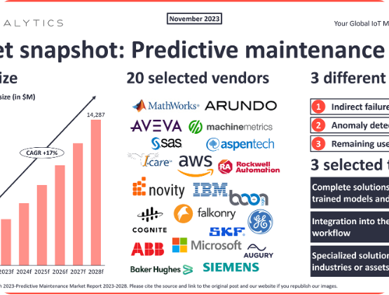
THE POWER CRISIS IN IOT
Deploying billions of remote sensory units makes routine battery replacement logistically impossible.
The target: Achieve 10+ years of operational runtime on a single CR2032 lithium coin cell.
The constraint: Active wireless communication loops can draw up to 100 mA, while baseline standby targets must stay under 1mu

Slide 4
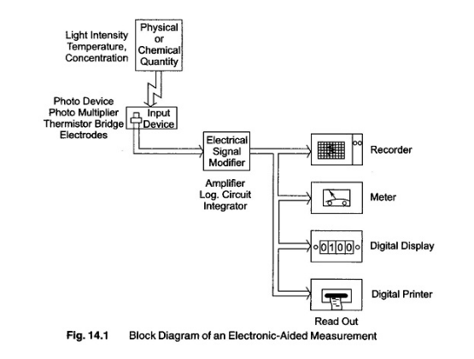
CMOS POWER DISSIPATION MECHANICS
Mathematical Modeling
Total power dissipation within an embedded complementary metal-oxide-semiconductor (CMOS) core is modeled as:
represents the dynamic charging and switching workload.
sub-threshold leakage currents present even at idle.

Slide 5
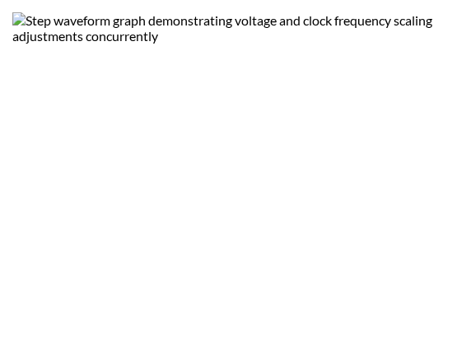
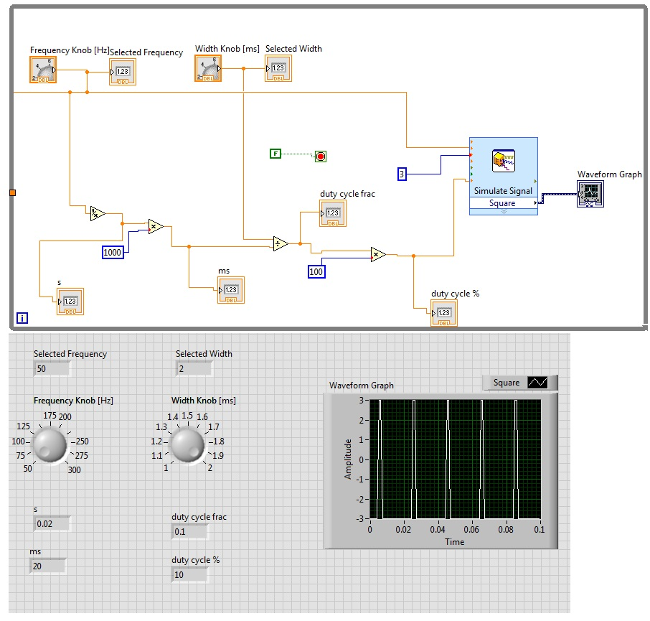
DYNAMIC VOLTAGE & FREQUENCY SCALING
DVFS System Control
Because dynamic energy demands scale quadratically with operating voltage, matching performance parameters to the instant workload saves significant capacity.
High-Throughput Task: Scale clock rates up along with supply voltages to finish processing rapidly.
Idle Monitoring: Drop operational clock rates and supply currents to minimum stable bounds.

Slide 6
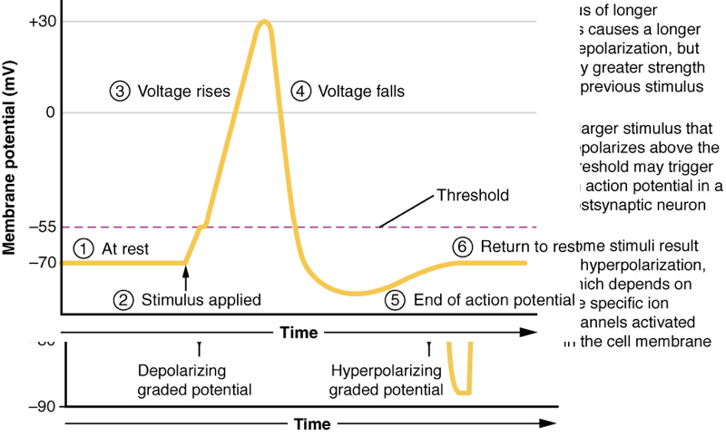

ANATOMY OF AN IOT POWER PROFILE
Transient Current Tracking
An IoT device's operation cycle is highly non-continuous. High-resolution current monitoring reveals clear phase steps:
Deep Sleep Base: Sub-microamp constant line.
MCU Wakeup & Boot: 5-15 mA for a few milliseconds.
RF Ingestion & Tx: Severe current spikes up to 120 mA during radio transmission.

Slide 7
MICROCONTROLLER SLEEP MODES
Operating State | Subsystems Kept Active | Typical Current Draw
Run Mode | CPU core active, flash memory reading, all peripherals clocked | 4-12mA
Sleep Mode | Peripherals and clocks active, CPU core clock gated | 1-3 mA
Stop/Standby | Internal core powered down, SRAM contents retained, RTC active | 2-15micro Amps
Deep Sleep | SRAM lost, internal regulators disabled, hardware wake pin active | 1 micro Amps

Slide 8
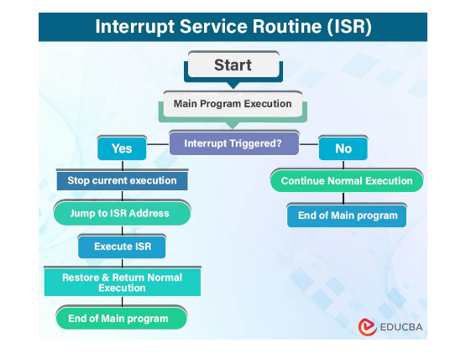
HARDWARE WAKEUP STRATEGIES
Deterministic Pin Alerts
Polling internal state lines forces the processor to stay in high-power operational profiles. True energy-efficient setups run entirely on hardware events.
The system gates the core clock completely, remaining in an ultra-low current draw state.
An external edge event on a designated General-Purpose Input/Output (GPIO) pin instantly triggers the internal wakeup sequence.

Slide 9
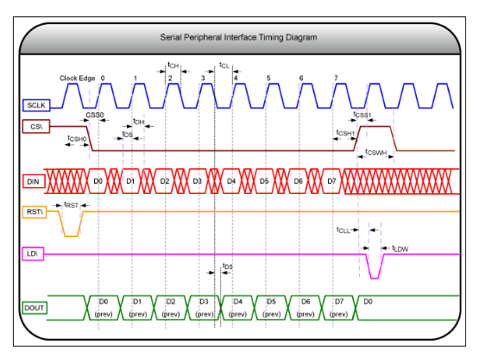
REAL-TIME CLOCK (RTC) CALENDARING
Periodic Sleep Gating
For telemetry applications that compile samples at regular intervals (e.g., once per hour), an auxiliary clock handles scheduling.
The system configures an external ultra-low current RTC module with a target countdown period.
The main processor drops into deep sleep, drawing sub-microamp current. The RTC counts down and pulls the wake pin low at the target threshold.

Slide 10
BROWNOUT RESET (BOR) PROTECTION
Preventing Memory Corruption
As battery cells exhaust their capacity, their output voltage can sag during high-current radio transmissions.
The Danger: If supply lines drop beneath critical thresholds, the core processor can execute corrupted instructions, risking flash memory damage.
The Shield: BOR circuits permanently track input voltage rails, forcing a clean hardware reset if parameters sag beneath unsafe bounds.

Slide 11
POWER DOMAIN GATING ARCHITECTURE
Eliminating Peripheral Leakage
Even when a sensor isn't actively compiling metrics, its internal input stages draw constant leakage current if left connected to active supply rails.
Load Switching: Designers place P-channel MOSFETs directly on auxiliary sensor power tracks.
The microcontroller turns off the gate pin when idle, physically disconnecting power rails to stop all peripheral leakage.

Slide 12

LOW-DROPOUT REGULATORS VS. BUCK CONVERTERS
DC-DC Converter Trade-offs
Choosing the wrong power distribution topology can ruin an otherwise efficient low-power design layout.
LDO Regulators: Simple, exceptionally low quiescent current but efficiency drops significantly when stepping down high input-to-output voltage differentials
Switching Buck Converters: Highly efficient ($\eta \approx 90\%+$) under heavy loads, but complex and can exhibit higher standby current losses.

Slide 13
ENERGY-EFFICIENT RADIO PROTOCOLS
Wireless Protocol | Tx Current Peak | Maximum Range Space | Ideal Low-Power Scenario
BLE (Bluetooth Low Energy) | 5 – 15 mA | 50 m | Short-range personal wearables and localized asset tracking beacons
LoRaWAN | 30 – 120 mA | 2-15 km | Long-range distributed agricultural arrays and infrastructure monitors
NB-IoT (Cellular) | 120 – 250 mA | Global cellular networks | High-bandwidth smart city metering configurations requiring broad infrastructure links

Slide 14
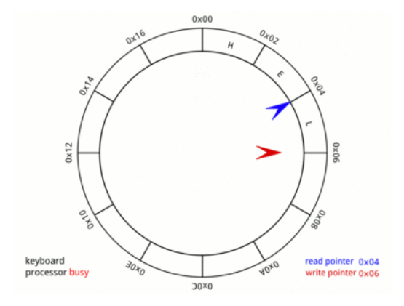
ENERGY HARVESTING FRAMEWORKS
Battery-Free Operations
Capturing ambient micro-energy assets removes dependency on traditional electrochemical batteries.
Photovoltaic cells: Captures solar or ambient indoor lighting.
Thermoelectric Generators (TEG): Converts industrial machine thermal gradients into voltage potentials via the Seebeck effect.
Piezoelectric elements: Harnesses structural vibrations and mechanics.

Slide 15
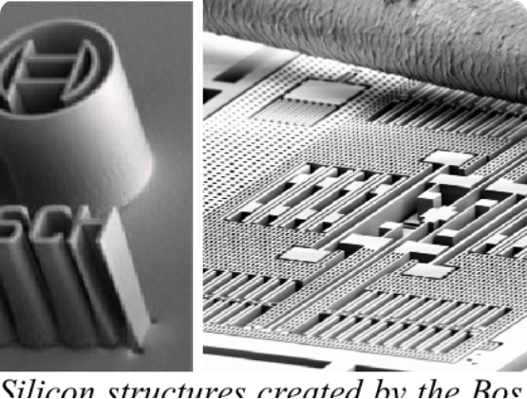
POWER MANAGEMENT ICS (PMICS)
Managing Tiny Energy Inputs
Environmental harvesting sources produce erratic, micro-level voltage inputs that cannot directly power an active processor core.
Ultra-Low Voltage Bootstrapping: Specialized PMICs can cold-start on input voltage steps as low as $100\text{ mV}$.
Dynamic Maximum Power Point Tracking (MPPT): Dynamically matches internal impedance profiles to pull maximum efficiency from solar arrays or transducers.

Slide 16
SUPERCAPACITOR ENERGY STORAGE
Endless Cycling Lifespans
Standard rechargeable batteries degrade significantly after 500 to 2,000 deep cycle transactions.
Supercapacitors: Deliver up to 1,000,000 stable charge/discharge transitions without structural degradation.
They tolerate massive instantaneous discharge currents, providing the power needed for energy-intensive radio transmissions.

Slide 17
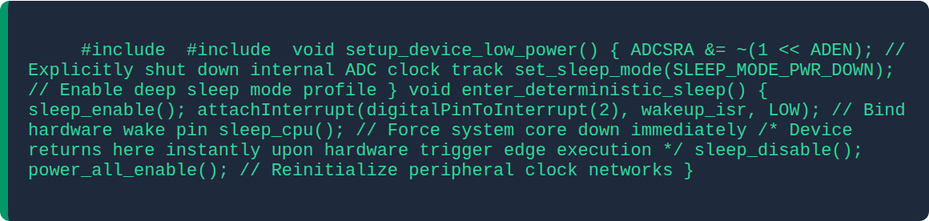
FIRMWARE IMPLEMENTATION PATTERN

Slide 18
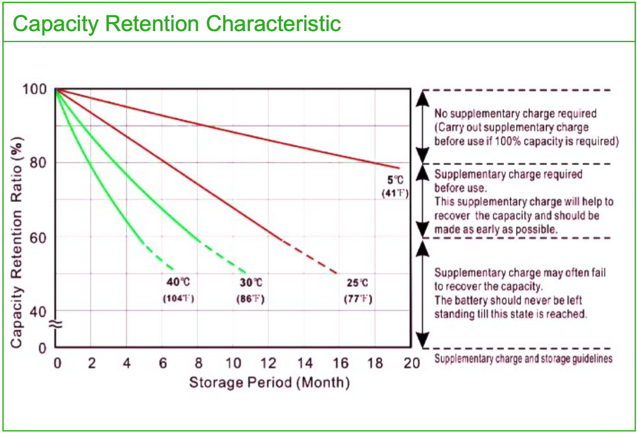

BATTERY SELF-DISCHARGE REALITIES
The Hidden Capacity Loss
Batteries lose stored charge over time even when completely disconnected from an electrical load.
Alkaline/NiMH Cells: High internal loss profiles, discarding up to 10 of their capacity each year.
Lithium Thionyl Chloride : Exceptional long-term shelf performance, retaining capacity with annual loss. This makes them ideal for decade-long remote deployments.

Slide 19
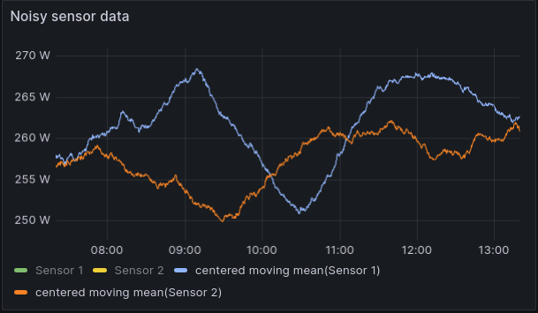
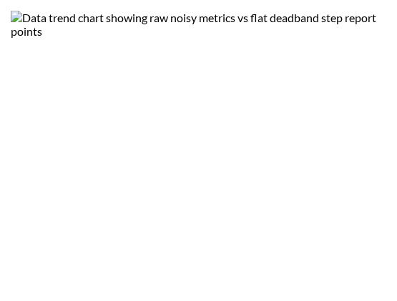
ENERGY-AWARE EDGE FIRMWARE
Algorithmic Data Compression
Because RF transmission consumes orders of magnitude more energy than local data processing, reducing transmission frequency extends battery life.
Deadband Filtering: Only transmit a sensor update if the reading deviates from the last reported value by more than a set threshold.
Local Aggregation: Compress hours of raw sensor data into simple minimum, maximum, and average summaries locally before transmitting.

Slide 20
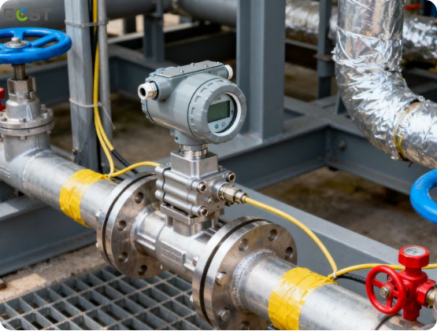
FIELD DIAGNOSTIC PROFILE SETUP
Vibration Monitoring Case Study
A battery-free industrial tracking node deployment:
A piezoelectric transducer converts structural machine vibration into electrical energy.
A low-power PMIC regulates this harvested energy to charge an on-board supercapacitor bank.
The system runs an optimized local analytics routine and sends a compressed LoRaWAN status update every 4 hours,

Slide 21


Designing Sustainable IoT Systems
Balancing hardware gating, sleep scheduling, and energy harvesting creates reliable, decade-long edge tracking nodes.
QUESTIONS & TRAINING WRAP-UP | END OF SERIES

