Slide 1
Cybersecurity & Secure IoT System Design
Hardware Security, Cryptography, & Device Hardening

Slide 2






COURSE MODULES
Hardware Roots
Transport Security
Lifecycle Security
Securing the physical boundary through Secure Boot, PUFs, and Cryptographic Co-processors.
Implementing mutual TLS authentication, payload encryption, and lightweight cipher suites.
Managing cryptographically signed over-the-air firmware modifications and key revocation frameworks.

Slide 3
THE UNIQUE VULNERABILITIES OF IOT
Unlike standard enterprise endpoints, IoT devices operate at a high risk of compromise due to their physical exposure.
Resource Constraints: Low-power microcontrollers lack the memory space needed for massive asymmetric crypto libraries.
Physical Threat Vector: Adversaries can buy field nodes, probe memory traces, or force fault injections.

Slide 4
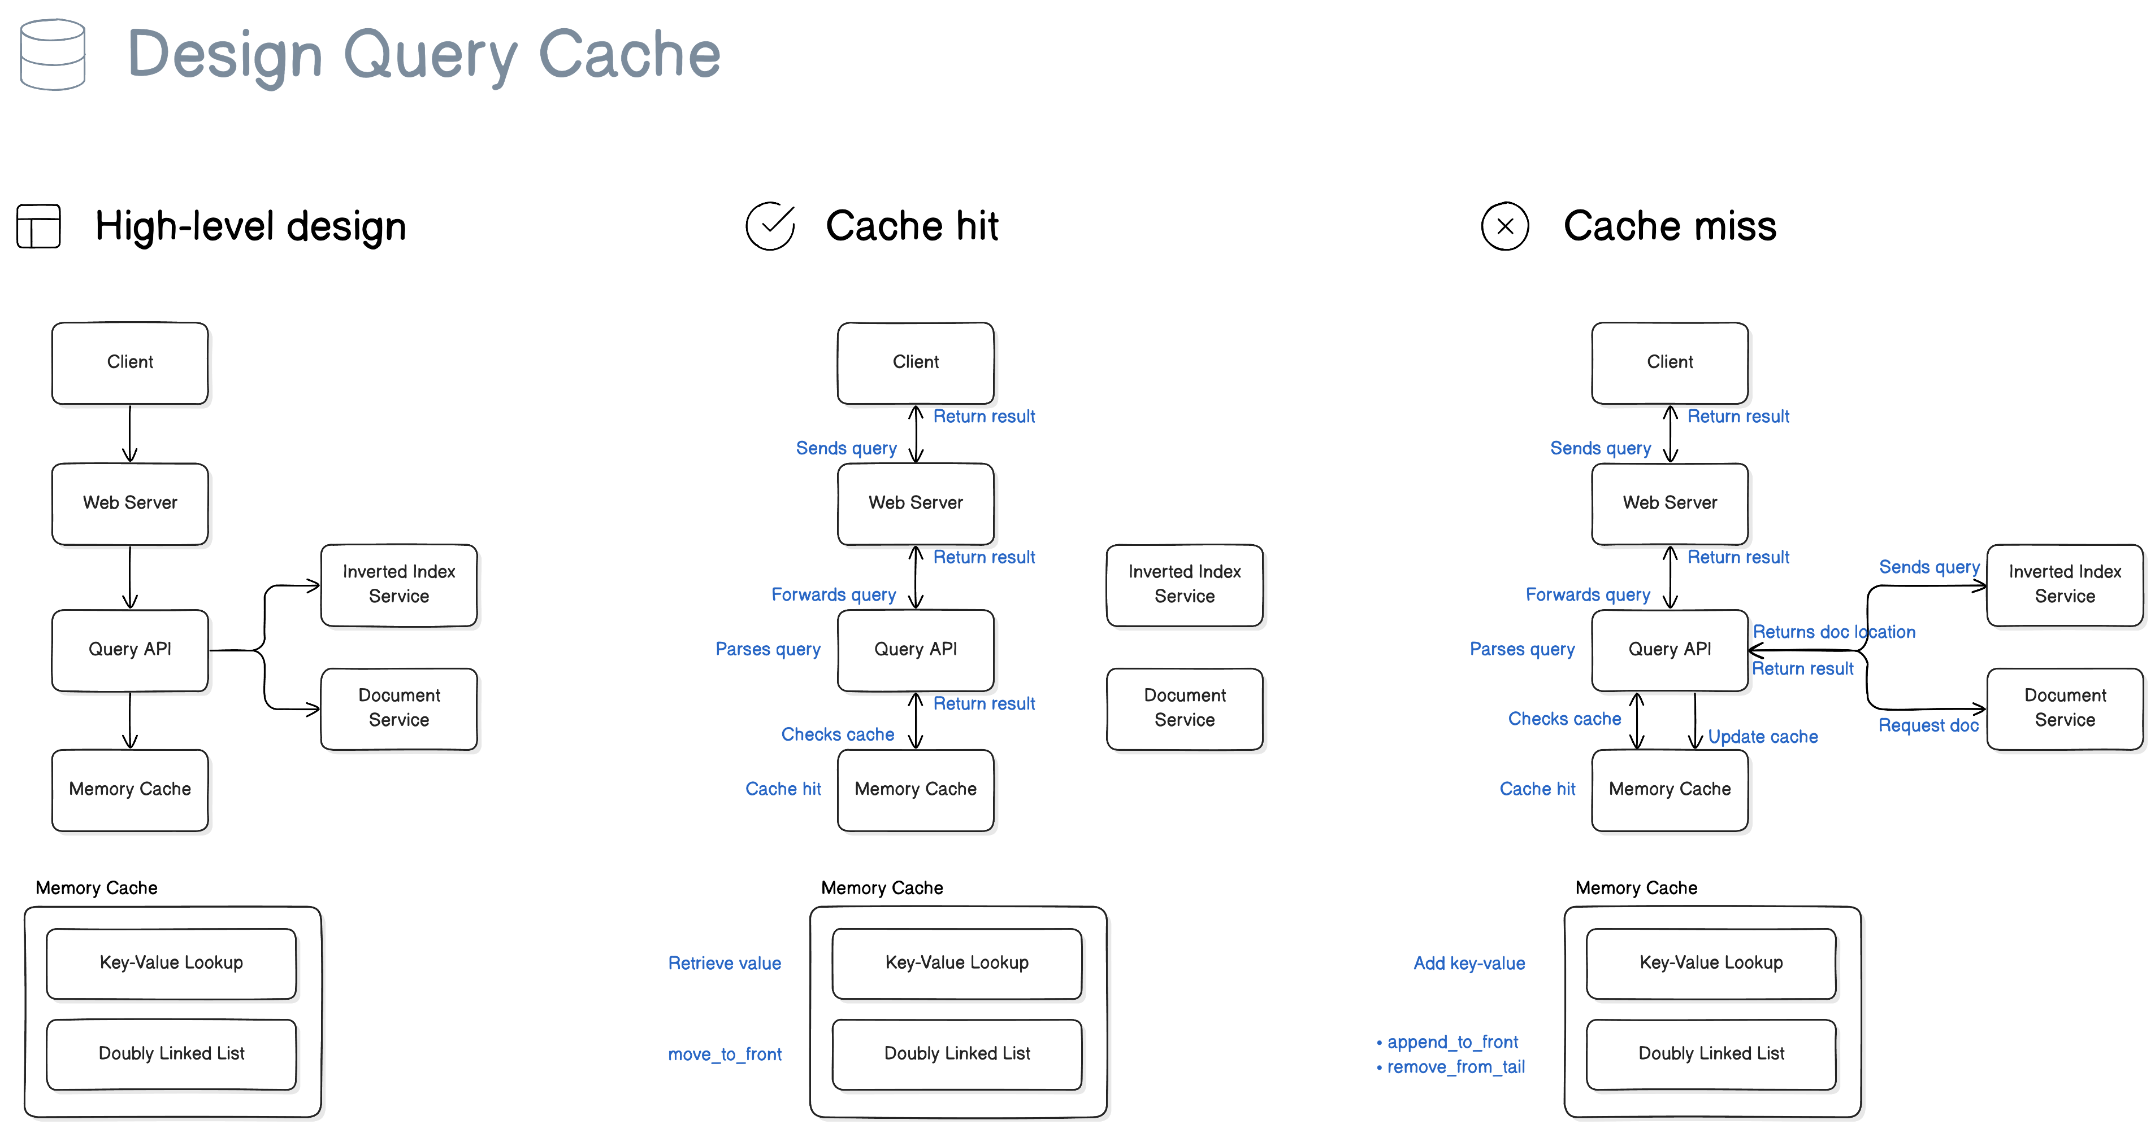
HARDWARE ROOT OF TRUST (ROT)
The Anchor of Trust
Security must start in hardware. Software protections mean nothing if the underlying silicon layer is compromised.
Secure Element (SE): An isolated hardware vault designed to shield private keys from the application code.
Hardware Cryptographic Accelerators: Offload resource-intensive AES-256 and ECC math operations to dedicated silicon logic gates.

Slide 5
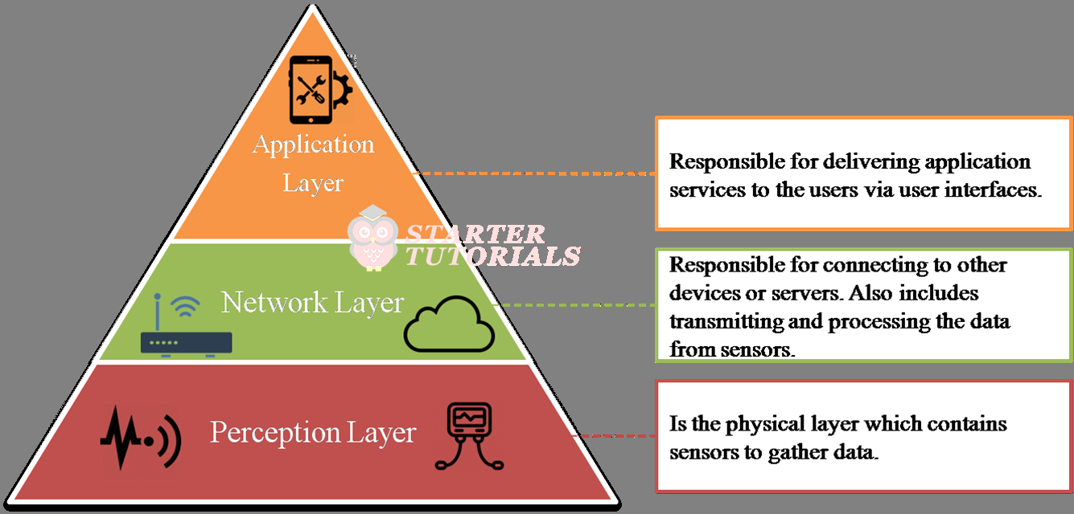
PHYSICALLY UNCLONABLE FUNCTIONS (PUF)
Silicon Fingerprinting
Storing static cryptographic keys in digital flash memory creates a vulnerability to physical readout attacks.
The Mechanism: A PUF leverages atomic micro-variations introduced during wafer fabrication to form a unique hardware signature.
The Advantage: Keys are generated on-demand from silicon characteristics and disappear instantly when power is removed, leaving nothing for attackers to dump.

Slide 6
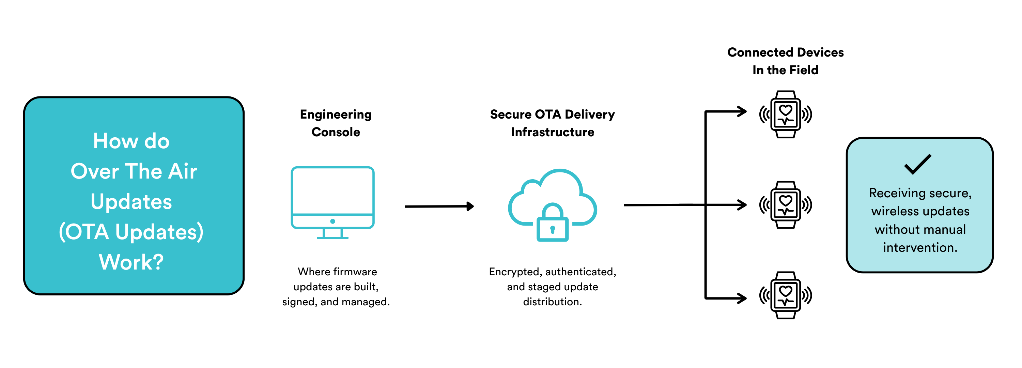
THE IMMUTABLE SECURE BOOT CHAIN
Establishing Chain of Custody
Secure Boot stops unauthorized or altered code from executing during the initialization process.
Stage 0 (Mask ROM): Code burned directly into silicon that cannot be altered. It holds the root public key.
Verification Steps: Every boot stage calculates a SHA-256 hash of the next stage's payload, verifying it against a digital signature before executing.

Slide 7

LIGHTWEIGHT CRYPTOGRAPHY CIPHERS
Cipher Target | Structural Type | Memory Resource Footprint | Primary IoT Application Scenario
AES-128 / GCM | Symmetric Block | Moderate ($4\text{--}8\text{ KB}$) | Standard gateway nodes with hardware acceleration blocks
ChaCha20 / Poly1305 | Symmetric Stream | Low ($2\text{--}4\text{ KB}$) | Ultra-low-power devices lacking dedicated hardware ciphers
ASCON (NIST Standard) | Authenticated Encryption | Extremely Low ($<1.5\text{ KB}$) | Resource-constrained smart sensor tags running on minimal energy
ECC (ECDSA P-256) | Asymmetric Public-Key | High ($12\text{--}24\text{ KB}$) | Securing handshake protocols and verifying OTA firmware signatures

Slide 8
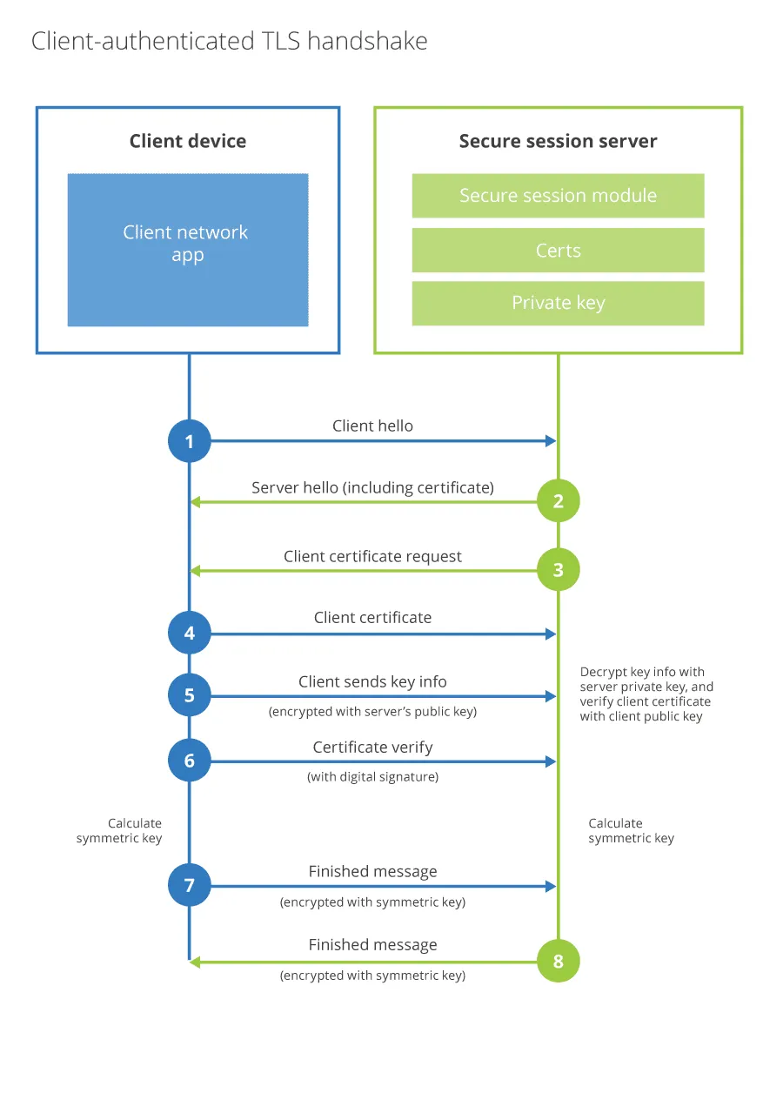
MUTUAL TLS HANDSHAKE MECHANICS
Dual-Sided Verification
Standard web browsing requires only the user to verify the server's identity. Secure IoT systems mandate **Mutual Authentication (mTLS)**.
The cloud endpoint verifies the unique X.509 certificate stored in the node's secure hardware.
The node verifies the cloud server's root certificate bundle, neutralizing potential Man-in-the-Middle (MitM) interceptions.

Slide 9
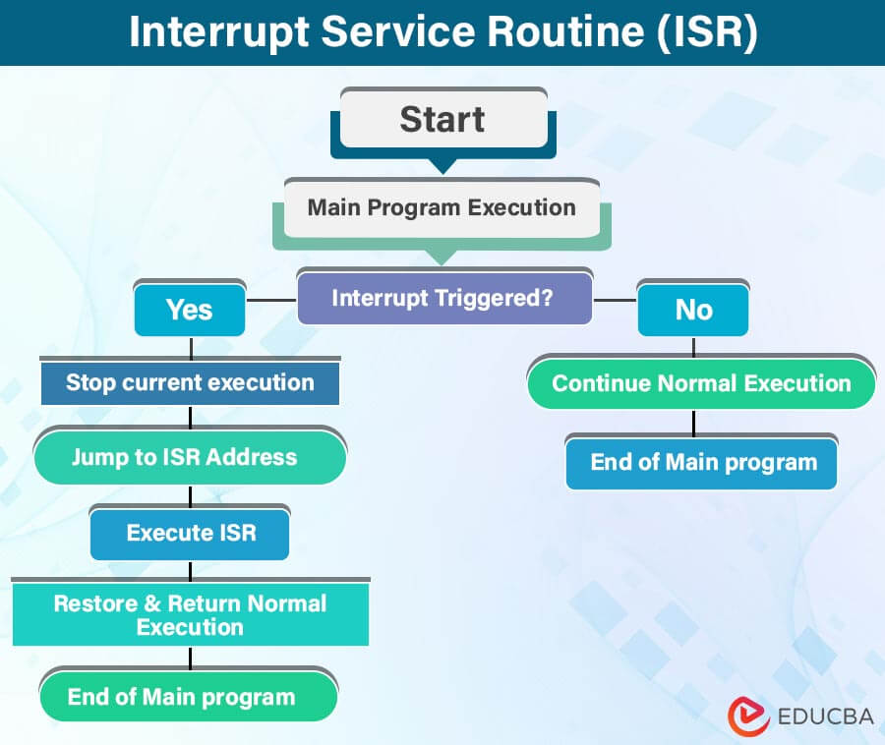
HARDENING EDGE DEVICE INTERFACES
Closing Physical Backdoors
Unused diagnostic entry points on physical circuit boards are frequently targeted by malicious reverse-engineers.
JTAG/SWD Disabling: Production firmware must blow internal silicon fuses to permanently deactivate debugging access before field deployment.
Console Gating: Serial UART console lines must be password-protected or entirely muted in production builds.

Slide 10
SECURE OVER-THE-AIR (OTA) UPDATES
Defending Firmware Distribution
Flashing new code remotely introduces a critical risk of complete system takeover if unauthorized binaries are accepted.
Asymmetric Signing: Firmware blobs must be compiled and signed offline inside a secure build facility using a private RSA/ECDSA key.
Device Validation: The target device uses its embedded public key to verify the binary signature before writing it to a flash partition.

Slide 11
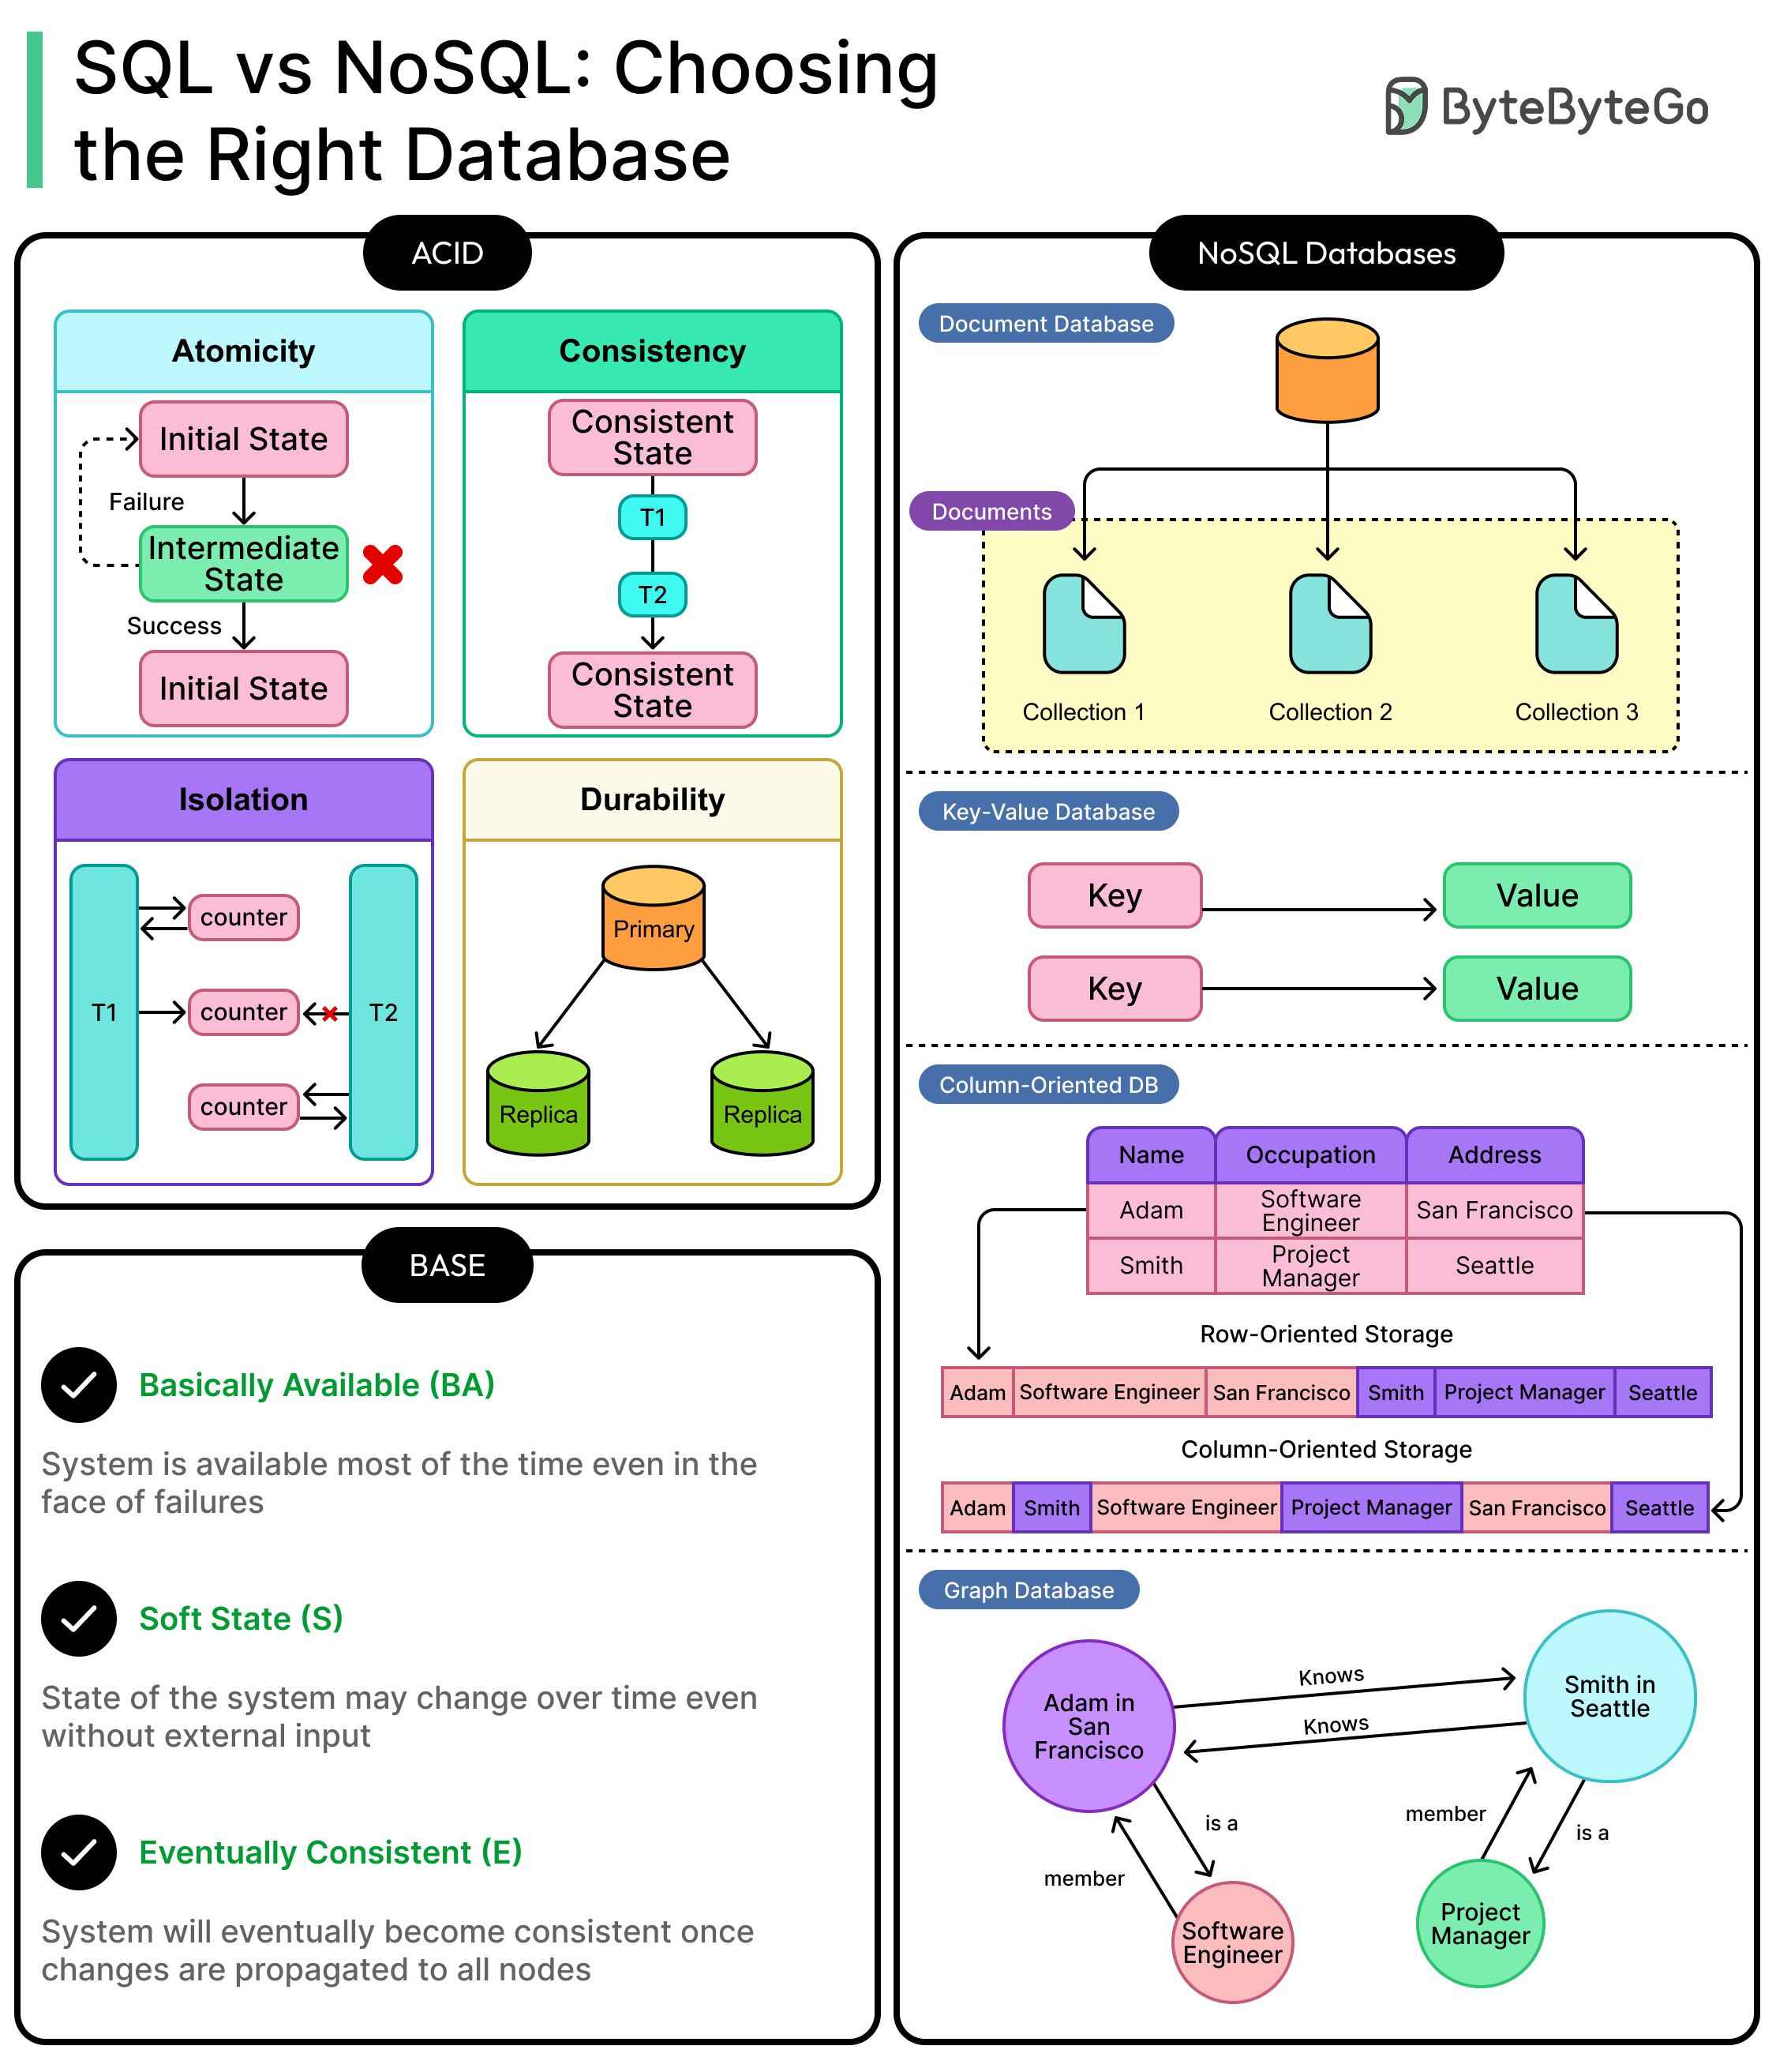
DUAL-PARTITION ANTI-BRICK ROLLBACKS
Resilient Recovery Design
A failed firmware write can easily brick a remote node, requiring expensive manual field recovery.
A/B Memory Partitioning: Devices maintain two distinct runtime banks. The active system executes from Bank A, while the update writes to Bank B.
Automated Fallback: If the updated image fails to boot or clear watchdogs, the bootloader safely reverts control back to the known stable partition.

Slide 12
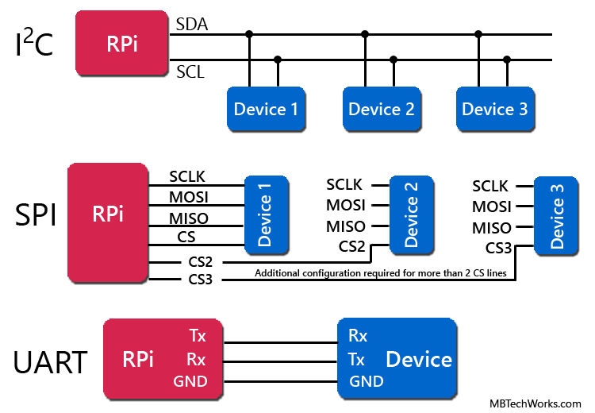
THE RISK OF REPLAY ATTACKS
Preventing Command Interception
Even if an attacker cannot decrypt a payload, they can capture a valid ciphertext command (such as "Unlock Gate") and resend it later.
Cryptographic Nonces: Every transaction incorporates a unique, single-use pseudorandom token string.
Monotonic Counters: Messages include sequentially increasing indexes, forcing the system to reject any duplicated or out-of-order data packets.

Slide 13
NETWORK MICRO-SEGMENTATION
Containing Compromise
A compromised IoT node should not provide an attacker lateral access to critical corporate infrastructure layers.
Isolated Subnets: Field nodes must be kept on dedicated VLANs isolated from corporate workstations and sensitive asset databases.
Zero-Trust Architecture: Firewalls enforce strict access policies, restricting device traffic solely to authorized destination cloud endpoints and gateway servers.

Slide 14
DEVICE ATTESTATION ARCHITECTURES
Remote Health Audits
Before a device is permitted to download configuration charts or fetch message blocks, its integrity must be verified remotely.
The Attestation Challenge: The cloud issues a random challenge payload token to the field node.
The Proof: The hardware sign module generates a cryptographic digest of the running memory map, proving the device is operating an unmodified, secure software stack.

Slide 15


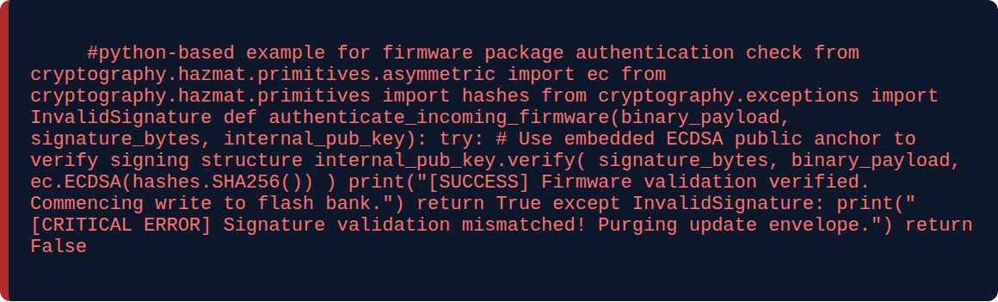
FIRMWARE VERIFICATION SCRIPT
Python validation logic

Slide 16
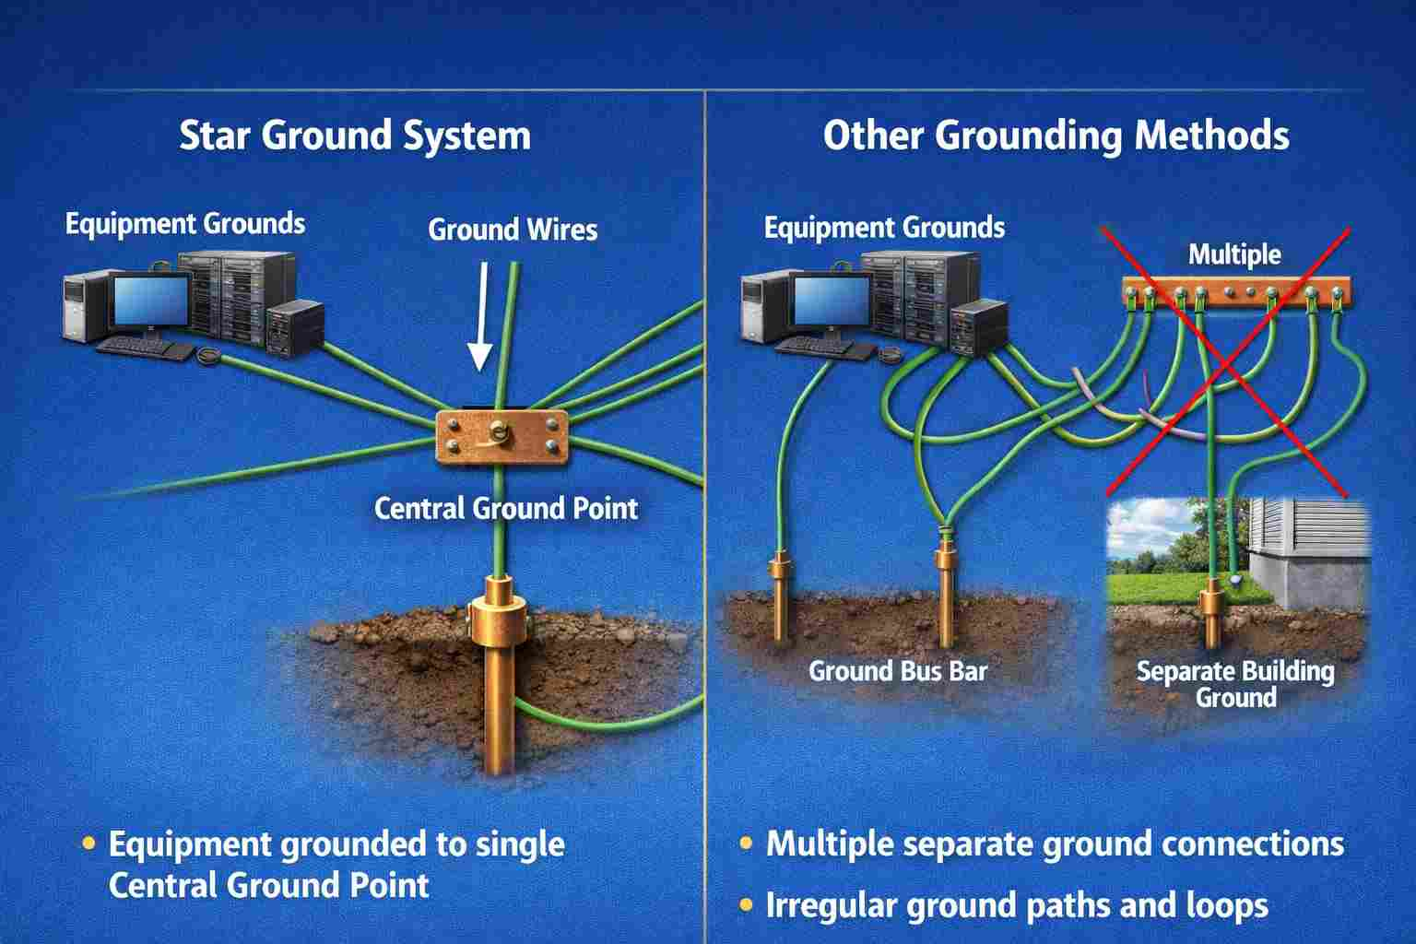
SECURING THE SUPPLY CHAIN LIFECYCLE
Secure Factory Provisioning
Devices must be secured from the start, well before they are installed in a client environment.
Zero-Touch Staging: Unique cryptographic identities and mTLS device certificates must be injected into the silicon vault inside a trusted, secure manufacturing facility.
This prevents third-party contract manufacturers from copying the firmware image onto unauthorized clone hardware.

Slide 17

TECHNICAL REVIEW QUESTIONS
How does a Hardware Root of Trust protect a remote device from runtime firmware modifications?
Explain why Mutual TLS (mTLS) is preferred over standard asymmetric encryption strategies in industrial IoT networks.
Describe the advantages of implementing a dual-partition memory layout for automated fallback during remote OTA updates.
Concept recap visual

Slide 18
Defense in Depth for the Edge
Integrating secure hardware boundaries, strong cryptographic transport tunnels, and automated recovery loops builds resilient defenses against modern network threats.
QUESTIONS & DISCUSSION | END OF MASTERCLASS

