Slide 1
Side Channel and Fault Attack Testing of Cryptosystems in the view of Dr AI
Debdeep Mukhopadhyay
Institute Chair Professor
(FIEEE, FNA, FASc, FNAE, FAAIA)
Secured Embedded Architecture Laboratory (SEAL)
Department of Computer Science and Engineering
IIT Kharagpur
debdeep@cse.iitkgp.ac.in
debdeep.mukhopadhyay@gmail.com

Slide 2


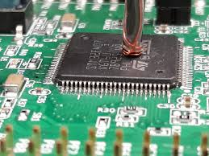
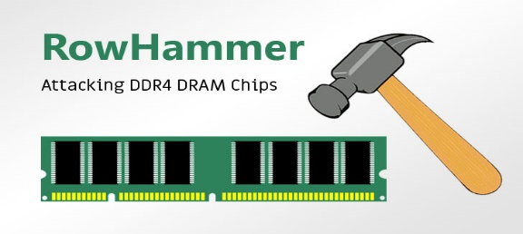


Artificial Intelligence: Boon for Security Evaluations of Cryptosystems
AI for Attacks
Targets insecure real-life implementation of provably secure cryptographic encryption
Can be used to attack cryptographic implementation using side-channel information
More efficient than standard statistical techniques
Can even break efficient side-channel countermeasure implementation like masking
Can be used to evaluate fault attack countermeasures
Aids to mount efficient fault attacks on cryptographic implementation
Image Source: Google Images

Slide 3
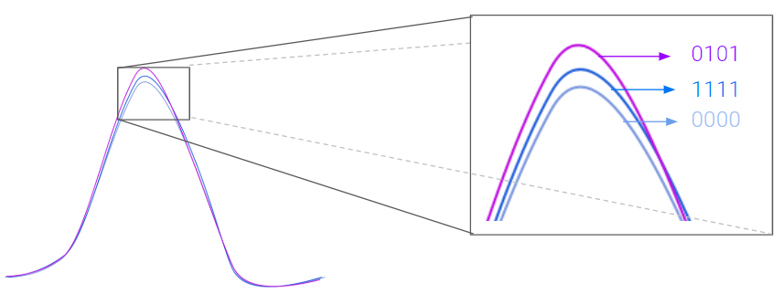

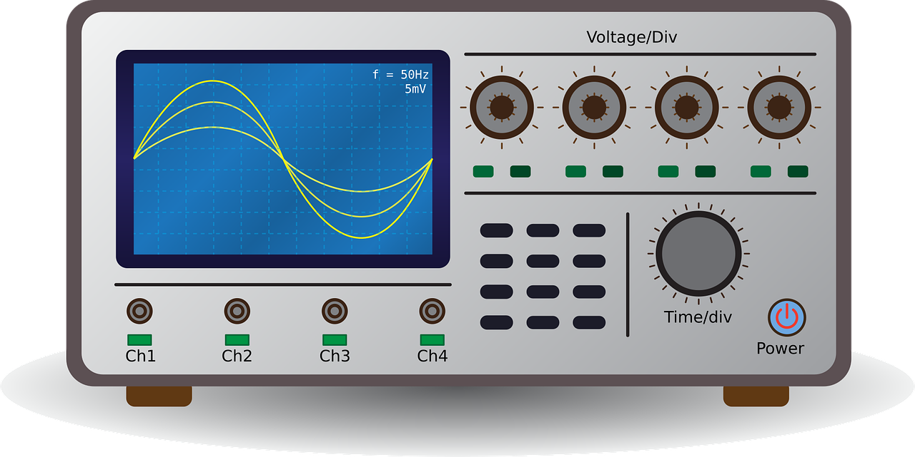






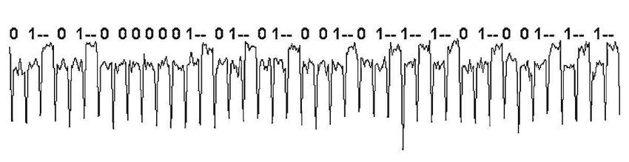
Side Channel Attack: Targets Implementation
Side-Channel Attacks are performed through an indirect measurement of a computation result via an auxiliary mechanism
These are covert channels that leak information which the designers of cryptographic algorithms did not consider
Encryption
Time
Heat
Current
EM radiations
Acquired Traces
Leakage
Plaintext
Analysis
Trace Acquisition
Retrieved Secret Key
Image Source: Google Images

Slide 4





Side-Channel Analysis Methods
Profiled Analysis
Profiled Device
(Open)
Target Device
(Close)
Strongest form of side channel attacks
Requires an adversary to have access to an identical experimental device that he can program to his choice
The success of these attacks relies on the ability to model noise
Side-Channel Analysis
Non-Profiled Analysis
Target Device
(Close)
Targets intermediate computation of the target device
Typically the input or output of an S-Box.
Adversary generates hypothetical power trace of the target device with guessed key byte.
Secret key is obtained by correlating the hypothetical power trace with the actual power trace.
Image Source: Google Images

Slide 5
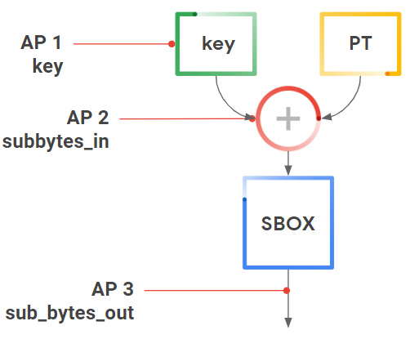
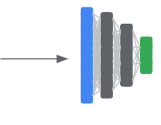
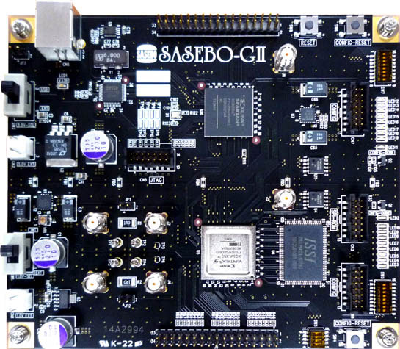
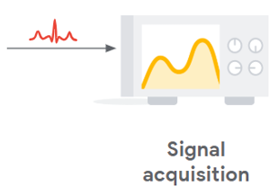
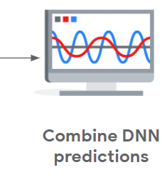
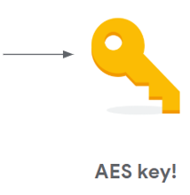

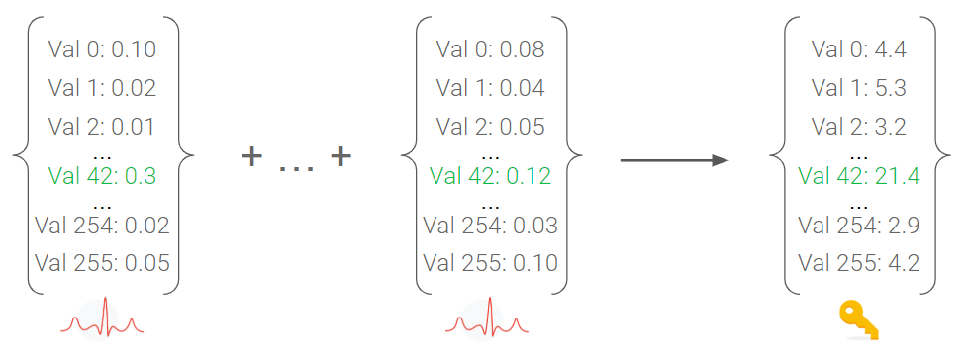
Profiled Deep Learning based Attack
Image Source: Google Images
Advantage of Deep Learning Approach
Template attacks (profiled attacks) are based on the Gaussian Assumption of the leakage distribution
Deep Learning-based approach relaxes the Gaussian Assumption
The acquired traces do not require any types of pre-processing (like trace synchronization, denoising, feature selection, feature extraction, etc.)
The deep learning model can combine multiple leakage points
Works efficiently against masking-based countermeasures than classical statistical methods
Profiling
Phase
Attack
Phase
Known Key
Unknown Key
Targeted
Operation
H. Maghrebi et al., “Breaking cryptographic implementations using deep learning techniques.” SPACE 2016

Slide 6
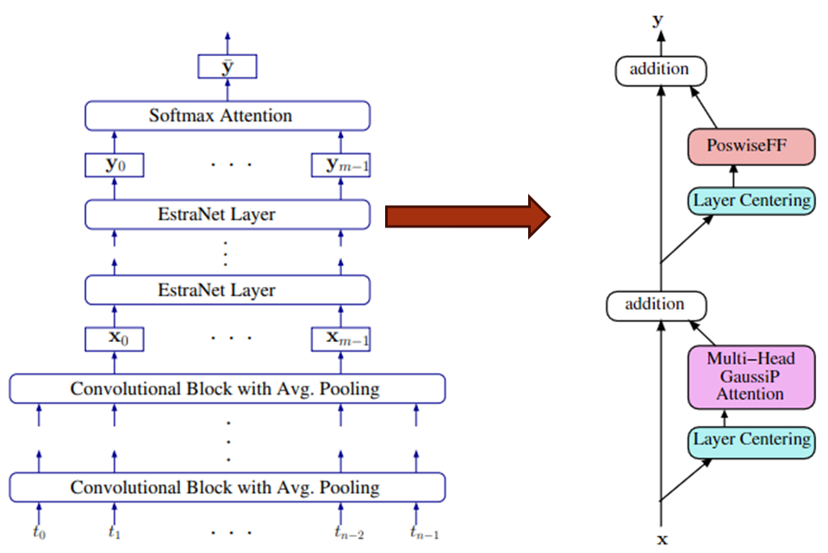
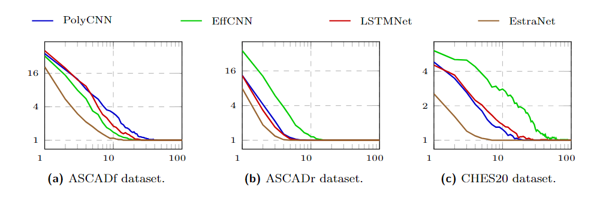
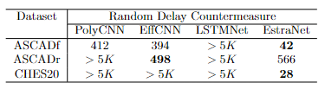
EstraNet: An Efficient Shift-invariant Transformer Network
Incorporates novel self-attention called GaussiP attention
Has linear time & memory complexity
Computationally scales to traces with lengths > 10K
Shift-invariant
Highly effective against several jitter based countermeasures
Good at capturing long distance dependency
Highly effective against masking countermeasures
Sparse attention scores
Makes it effective for attacking very long traces (lengths > 10K)
Gaussian kernel
Makes it highly effective against clock jitter countermeasures
Suvadeep Hajra, Siddhartha Chowdhury, Debdeep Mukhopadhyay:
EstraNet: An Efficient Shift-Invariant Transformer Network for Side-Channel Analysis. IACR Trans. Cryptogr. Hardw. Embed. Syst. 2024(1): 336-374 (2024)

Slide 7

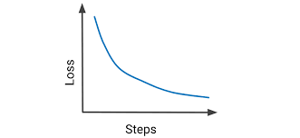
Non-Profiled Deep Learning based Attack
Image Source: Google Images
Advantage of Deep Learning Approach
The translation-invariance property of CNN to outperform non-profiled Correlation Power Attack
The sensitivity analysis reveals points of interests such as leakage and mask locations in the trace
Breaks masked implementation without the knowledge (order of masking) about the underlying implemented protection
Unknown Key
Targeted
Operation
Trains a model for each possible key byte
Correct key produces best training
Benjamin Timon, " Non-Profiled Deep Learning-based Side-Channel attacks with Sensitivity Analysis." TCHES 2019.

Slide 8
Deep Learning-based Fault-Attack Leakage Assessment
PART II

Slide 9
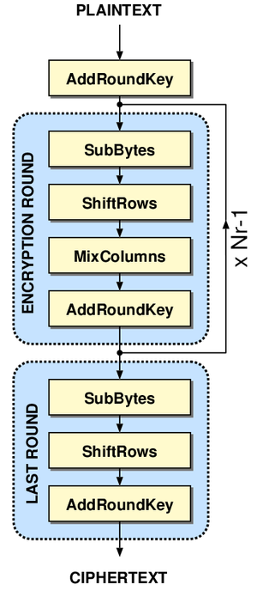
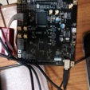




Fault Attacks on Block Ciphers
Image Source: Google Images
AES-128
Attacks based on induction of faults during Encryption
First conceived in 1996 by Boneh, Demillo and Lipton
A single fault can reduce the AES Key Size to around 2^8 values.
A double fault can uniquely retrieve the Key!
Fault Injection Techniques
Clock Glitch
Voltage Glitch
Laser Gun
Electromagnetic Emanation
Rowhammer
Tunstall, Mukhopadhyay, “Differential Fault Analysis of the Advanced Encryption Standard using a Single Fault.” WISTP 2011.

Slide 10
























































Fault Propagation
f
f’
f’
2f’
Fault Models
f’
Key component of a fault attack
Attack procedure changes according to the fault model
Random localized faults
Bit/nibble/byte fault
Most general model
Biased faults
Device-dependent model
Instruction skip/modify.
Constant fault
Stuck-at-0/1¸
f’
3f’
9th Round
Sub-Byte
8th Round
Sub-Byte
8th Round
Shift-Row
8th Round
Mix-Column
10th Round
Shift-Row
10th Round
Sub-Byte
9th Round
Mix-Column
9th Round
Shift-Row

Slide 11
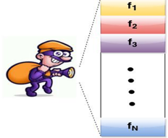
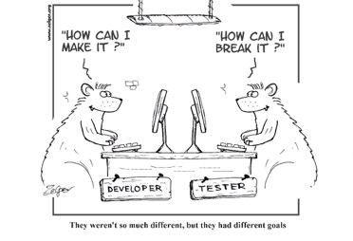
Testing Block Ciphers for Fault Attacks
Challenges
Several countermeasures exist
Either extremely resource hungry
Or not robust against all possible faults
Broken!!!
Malicious faults are highly repeatable
Different fault models
No existing theory for countermeasure design and evaluation
Designs are evaluated in-house
No standard design style
How do we know what is secure and what is not?
Image Source: Google Images

Slide 12
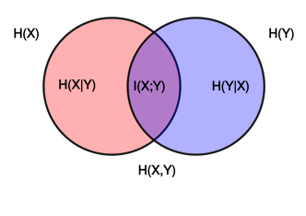
Automated Leakage Assessment
Condition for No-Leakage
General idea
Mutual Information (MI) between the secrets and the observables should be zero
Plaintext variable must be kept fixed
Violating of any of these two conditions indicates leakage
We use the first one in this work.
How to detect Leakage?
Measure Mutual Information
Challenging without detailed knowledge of the countermeasure scheme
Insight
We do not require accurate estimate
It is sufficient to know if it is non-zero
Solution
Theory of Non-Interference
Image Source: Google Images

Slide 13
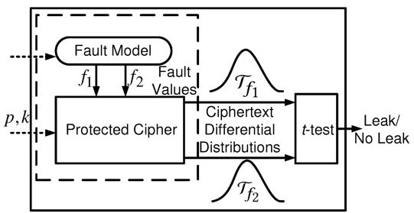
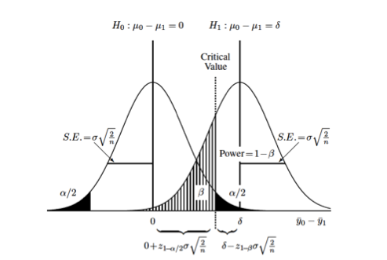

ALAFA: Automatic Leakage Assessment
Image Source: Google Images
A t-Test based Framework
Keep the key and plaintext fixed
Constant fault model
Strongest among all
No leakage imply strong security
Fix two different fault values one at a time and simulate
Perform t-test on the outcome of the two simulations
Saha, Mukhopadhyay, DasGupta, "ALAFA: Automatic Leakage Assessment for Fault Attack Countermeasures." DAC 2019.

Slide 14
ALAFA: Automatic Leakage Assessment
A t-Test based Framework
Keep the key and plaintext fixed
Constant fault model
Strongest among all
No leakage imply strong security
Fix two different fault values one at a time and simulate
Perform t-test on the outcome of the two simulations
Advantages
Formalization of leakage due to faults
Simple and Statistical
Similar to well-accepted Side-Channel Leakage assessment method TVLA
Simulation-based
Algorithm-agnostic
Saha, Mukhopadhyay, DasGupta, "ALAFA: Automatic Leakage Assessment for Fault Attack Countermeasures." DAC 2019.

Slide 15

Deep Learning for Leakage Assessment
Issues with ALAFA
Advantage of Deep Learning
t-test can only capture difference in statistical moments
Sub-optimal.
False-negatives
In side channel analysis (SCA), countermeasures like masking, the order of masking decides the maximum allowable leakage order
In FA the leakage order depends on the fault propagation and not available a-priori to the tester.
Security guarantee depends on the evaluator’s choice!
Deep Learning (DL) methods can be a powerful tool as it is renowned to learn in highly multi-variate scenarios and can take several complex inter-relations among different features.
DL does not need order-related information from the evaluator.
DL performs better in noisy scenarios compared to the t-test based approach.
Image Source: Google Images

Slide 16







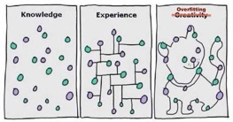
DL-FALAT: Deep Learning-based Automatic Leakage Assessment
Image Source: Google Images
K-Fold
Cross-Validation
Validation
Accuracy
Decision Making
Faulty
Ciphertexts
Start with small sample size of 500
Perform the training and validation
Stratified K-fold cross validation with K=50
Good for preventing overfitting
One-sided t-test over the cross-validation accuracies
Increase the sample size if no leakage is detected
A₀
F₀
Dataset
A₁
A₂
H₀: X_{mean} > 0.5
Encryption
F₁
Binary Labels
A_{K-2}
Is the accuracy result more than a random guess?
Faulty
Ciphertexts
A_{K-1}
Observation
Learning need not require to be the “best”
A small indication of leaning is sufficient to decide leakage
Sayandeep Saha, Manaar Alam, Arnab Bag, Debdeep Mukhopadhyay, Pallab Dasgupta: Learn from Your Faults: Leakage Assessment in Fault Attacks Using Deep Learning. J. Cryptol. 36(3): 19 (2023)

Slide 17
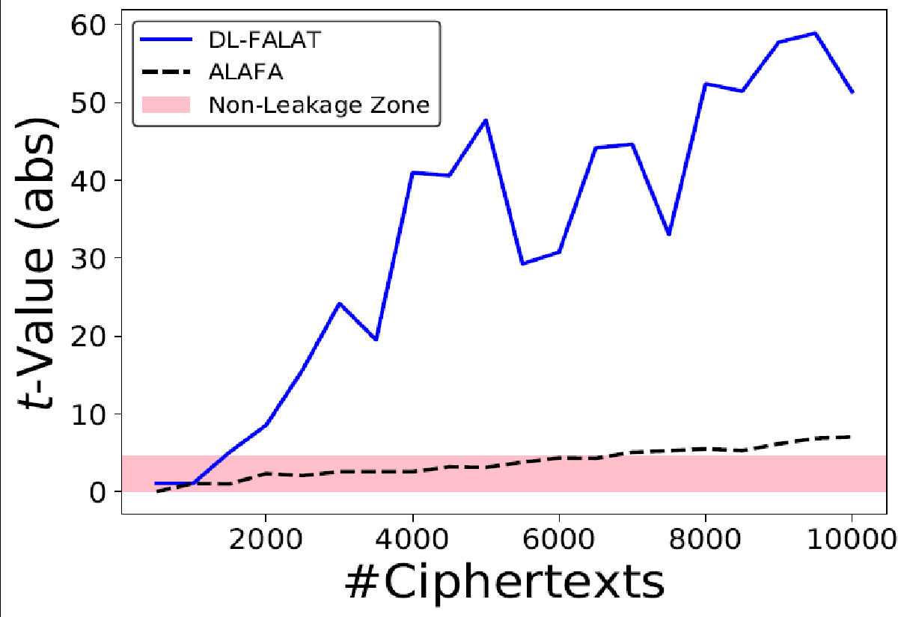
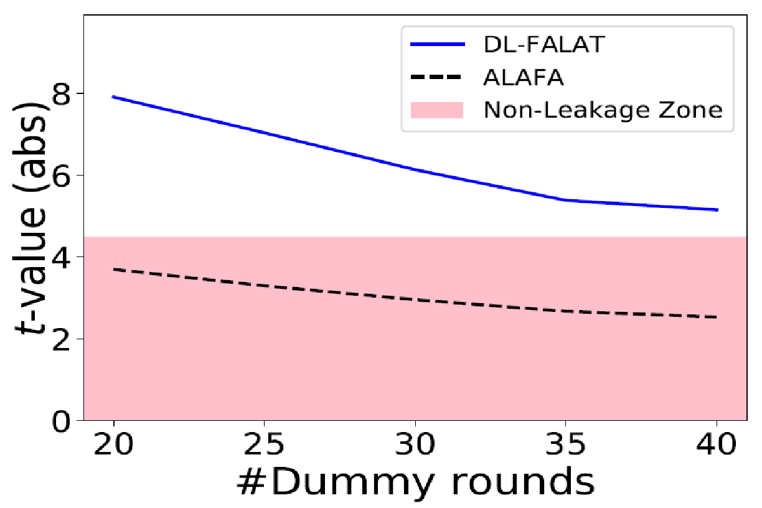
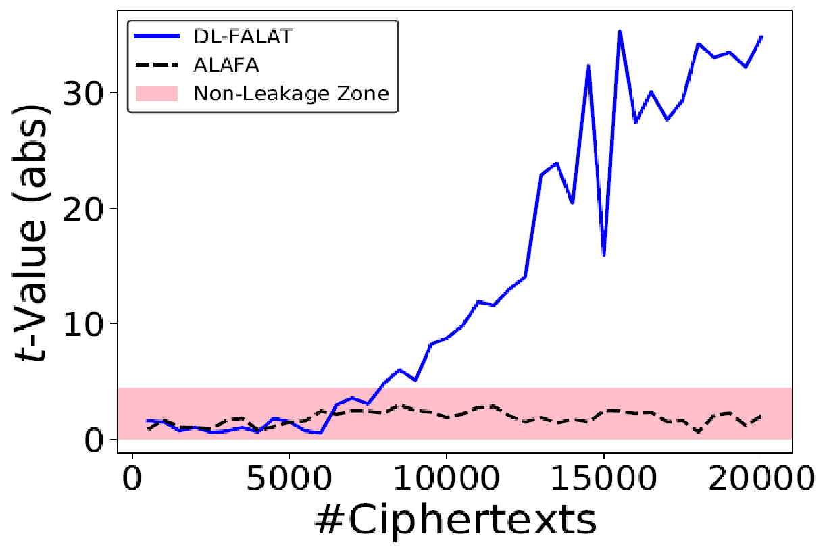
Results on Leakage Detection
Infective Countermeasure
RIMBEN Countermeasure
Noise-Free
Noisy
B. Wang et al., "Exploration of benes network in cryptographic processors: A random infection countermeasure for block ciphers against fault attacks." IEEE TIFS 2016.
B. Gierlichs et al., "Infective computation and dummy rounds: fault protection for block ciphers without check-before-output." LatinCrypt 2012.
False negative for t-test but DL-FALAT detects leakage
128th order statistical moment – data complexity for t-test would be very high

Slide 18
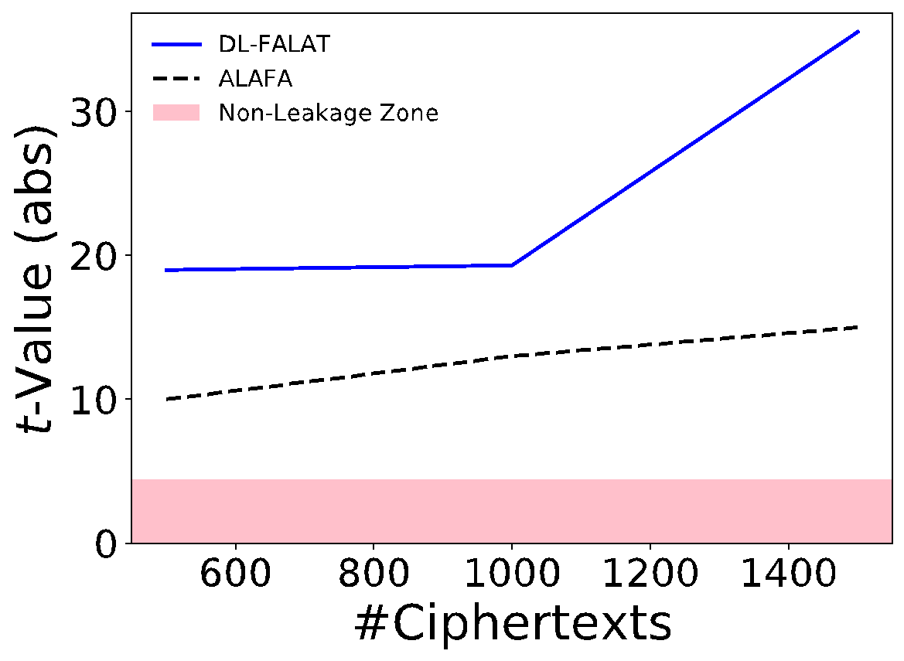
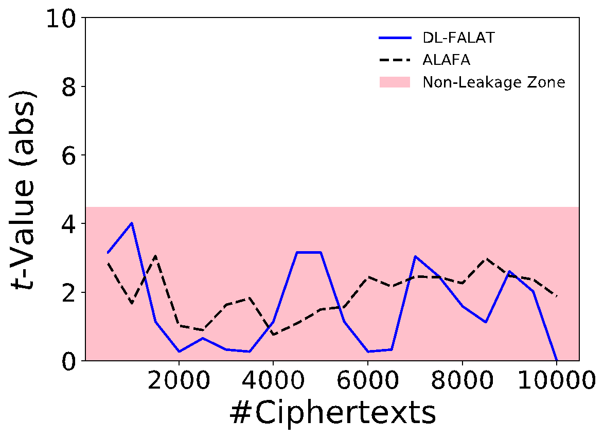
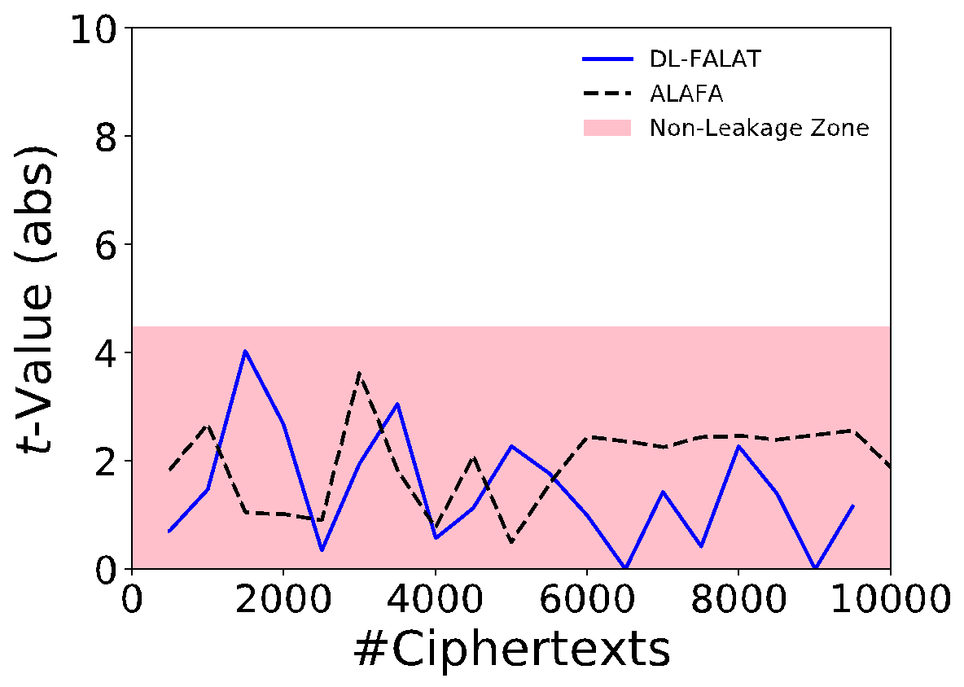
Results on Leakage Detection
Detection Countermeasure
SIFA Countermeasure
1-bit Parity
AntiSIFA
Impeccable Circuit II
Saha, Jap, BasuRoy, Avik Chakraborty, Bhasin,Mukhopadhyay,"A framework to counter statistical ineffective fault analysis of block ciphers using domain transformation and error correction." IEEE TIFS 2019.
R. Shahmirzadi et al., "Impeccable Circuits II." IACR Cryptology ePrint Archive 2019.

Slide 19
Take-away
Deep Learning can aid an adversary/tester to compromise/assess the security of a cryptographic implementation using power side-channel
More efficient than classical statistical approaches in terms of number of attack traces
Also efficient against masking-based countermeasures
Deep Learning can aid an adversary/tester to compromise/assess the fault-attack leakage of a cryptographic implementation
More efficient than t-test based approach in terms of number of ciphertexts
Less false negatives and easy to interpret leakage order

Slide 20
AI for Implementation Security : The Way Forward
Pertinent questions facing the implementation security community for AI adoption:

Slide 21
AI for Implementation Security : The Way Forward
Pertinent questions facing the implementation security community for AI adoption:
Lack of documentation for AI specific pitfalls in implementation security context
How to pre-process data (like side-channel traces) to render them training friendly ?
How to avoid overfitting ?
Which architectures to use for what use-cases? Is deep = better?
How to ensure quality of training data? Issues like class imbalance, requisite amount of data.
Is the inference result interpretation reliable (like high accuracy, but on unbalanced data) ?
Not all implementation security engineers may know ML internals/details to take decisional calls on these issues

Slide 22
AI for Implementation Security : The Way Forward
Pertinent questions facing the implementation security community for AI adoption:
Lack of documentation for AI specific pitfalls in implementation security context
Need for suggestive guidelines/procedures for ensuring research portability
Statistical tests (like CPA) are inherently portable. But what about ML models?
Can a ML model for testing leakage on Arduino Uno be reused for testing leakage on Raspberry Pi?
Educate testers on ML transfer learning. Again, lack of easy-to-access documentation for the same.

Slide 23
AI for Implementation Security : The Way Forward
Pertinent questions facing the implementation security community for AI adoption:
Lack of documentation for AI specific pitfalls in implementation security context
Need for suggestive guidelines/procedures for ensuring research portability
Consensus on how we build upon each other’s research
Statistical tests are algorithms; we publish the same, and anyone can use it.
Trained ML models + collected datasets are often considered as IPs. Not everyone open-sources them!
A lack of consensus on how to share models/datasets will create isolated islands in the implementation security community.

Slide 24
AI for Implementation Security : The Way Forward
Pertinent questions facing the implementation security community for AI adoption:
Lack of documentation for AI specific pitfalls in implementation security context
Need for suggestive guidelines/procedures for ensuring research portability
Consensus on how we build upon each other’s research
Licensing !
What is the goodwill policy of licensing a model for testing my implementation, that had been partially trained on dataset curated by somebody else?
Consensus on licensing of such models, especially if they are transfer learned!

Slide 25

Thank You
For any query please feel free to contact
Debdeep Mukhopadhyay: debdeep.mukhopadhyay@gmail.com

