Slide 1

A study of using hadronizer tuning to improve the aggrement between simulation and measured φ* distributions with the CMS experiment at center-of-mass energy of 8 TeV
Zachary Lesko
Thesis Defense

Slide 2
Theory and Motivation

Slide 3
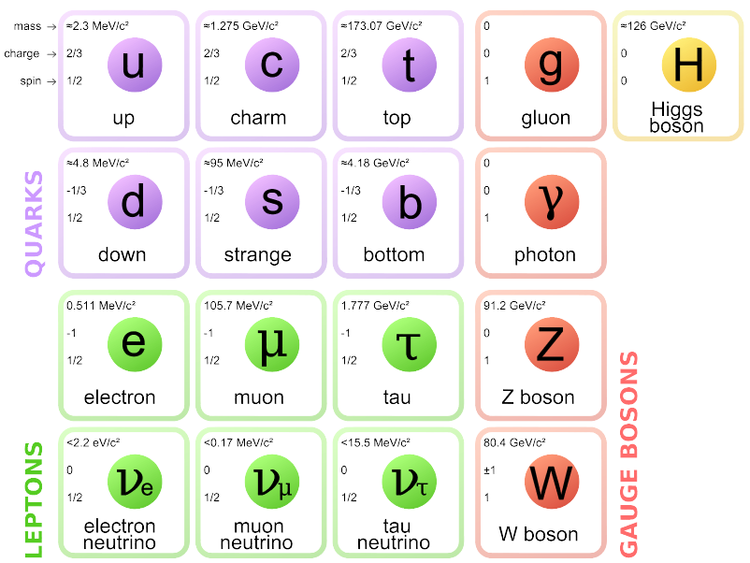
Fermions
Notes:
Fermions make up matter.
Quarks make up hadrons, with the two most well known being proton and neutron, which are made of two ups and a down and two downs and an up respectivly.
The second group is Leptons which can be divided into charged and uncharged. The electron is the most well known charged lepton. The uncharged variety are collectivly known as neutrinos. Do to there lack charge they are very hard to study since they tend to not interact with anything.

Slide 4
Bosons
Notes:
Bosons are the force carriers.
The newest boson to the standard model is the higgs which was discovered in 2012
Of the others The photon is the most well known, and propagates the electromagnetic force
The gluon propagates the Strong Nuclear force
The W and Z propagate the Weak nuclear foce.

Slide 5
Particles of the Standard model
Notes:
Together these particles make up the standard model

Slide 6
The Forces
Gravitational Force
  By far the weakest force
  Responsible for astronomical interactions
  Not included in the Standard model
Electromagnetic Force
  Responsible for magnets and electricity
  Chemistry
Strong Nuclear Force
  Keeps nuclei together
  Keeps quarks bound together
Weak Nuclear Force
  β decay (allows for particle flavor change)

Slide 7
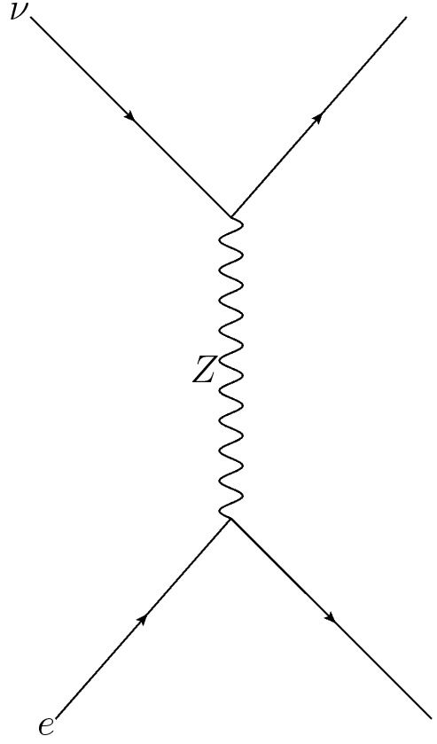
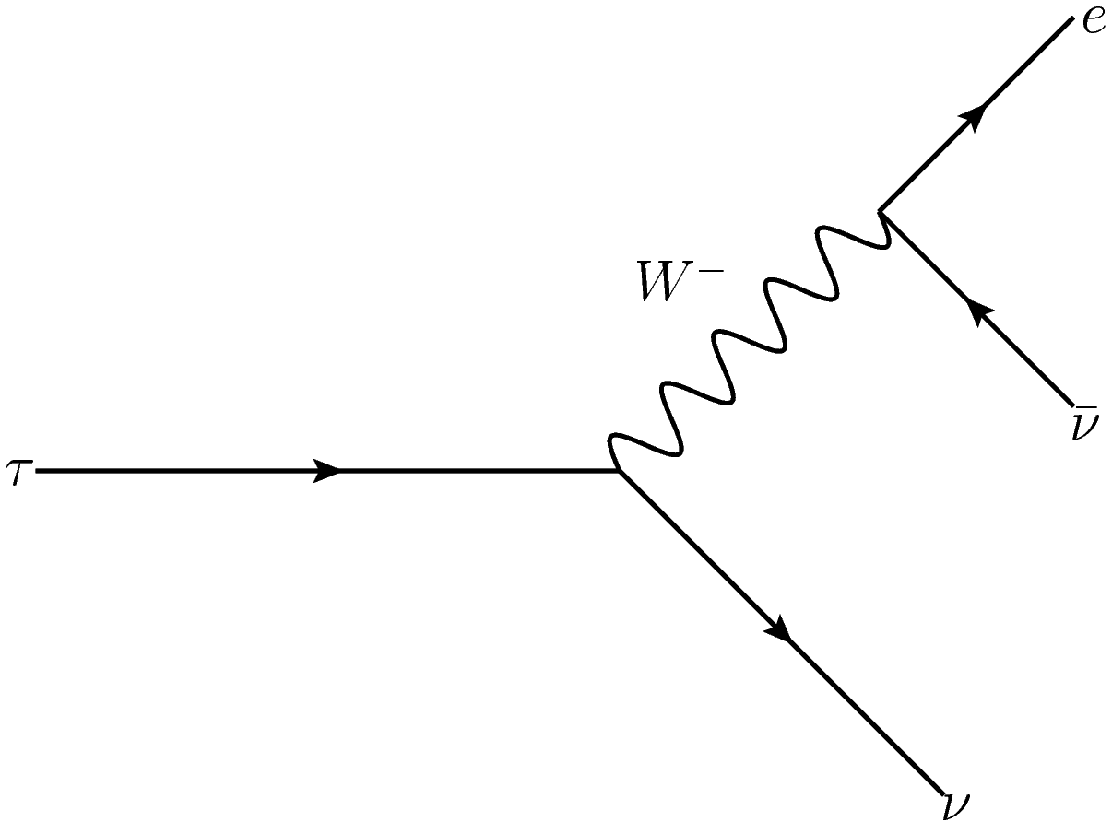
Weak Nuclear Force
Can interact with all fermions including neutrinos.
Allows for elementary particles to decay.
Very short range.
Both the W and the Z have mass.
The Decay of the τ to a electron and
neutrino, antineutrino pair
A momentum exchange between a
neutrino and an electron
Notes:
Short range means subatomic

Slide 8
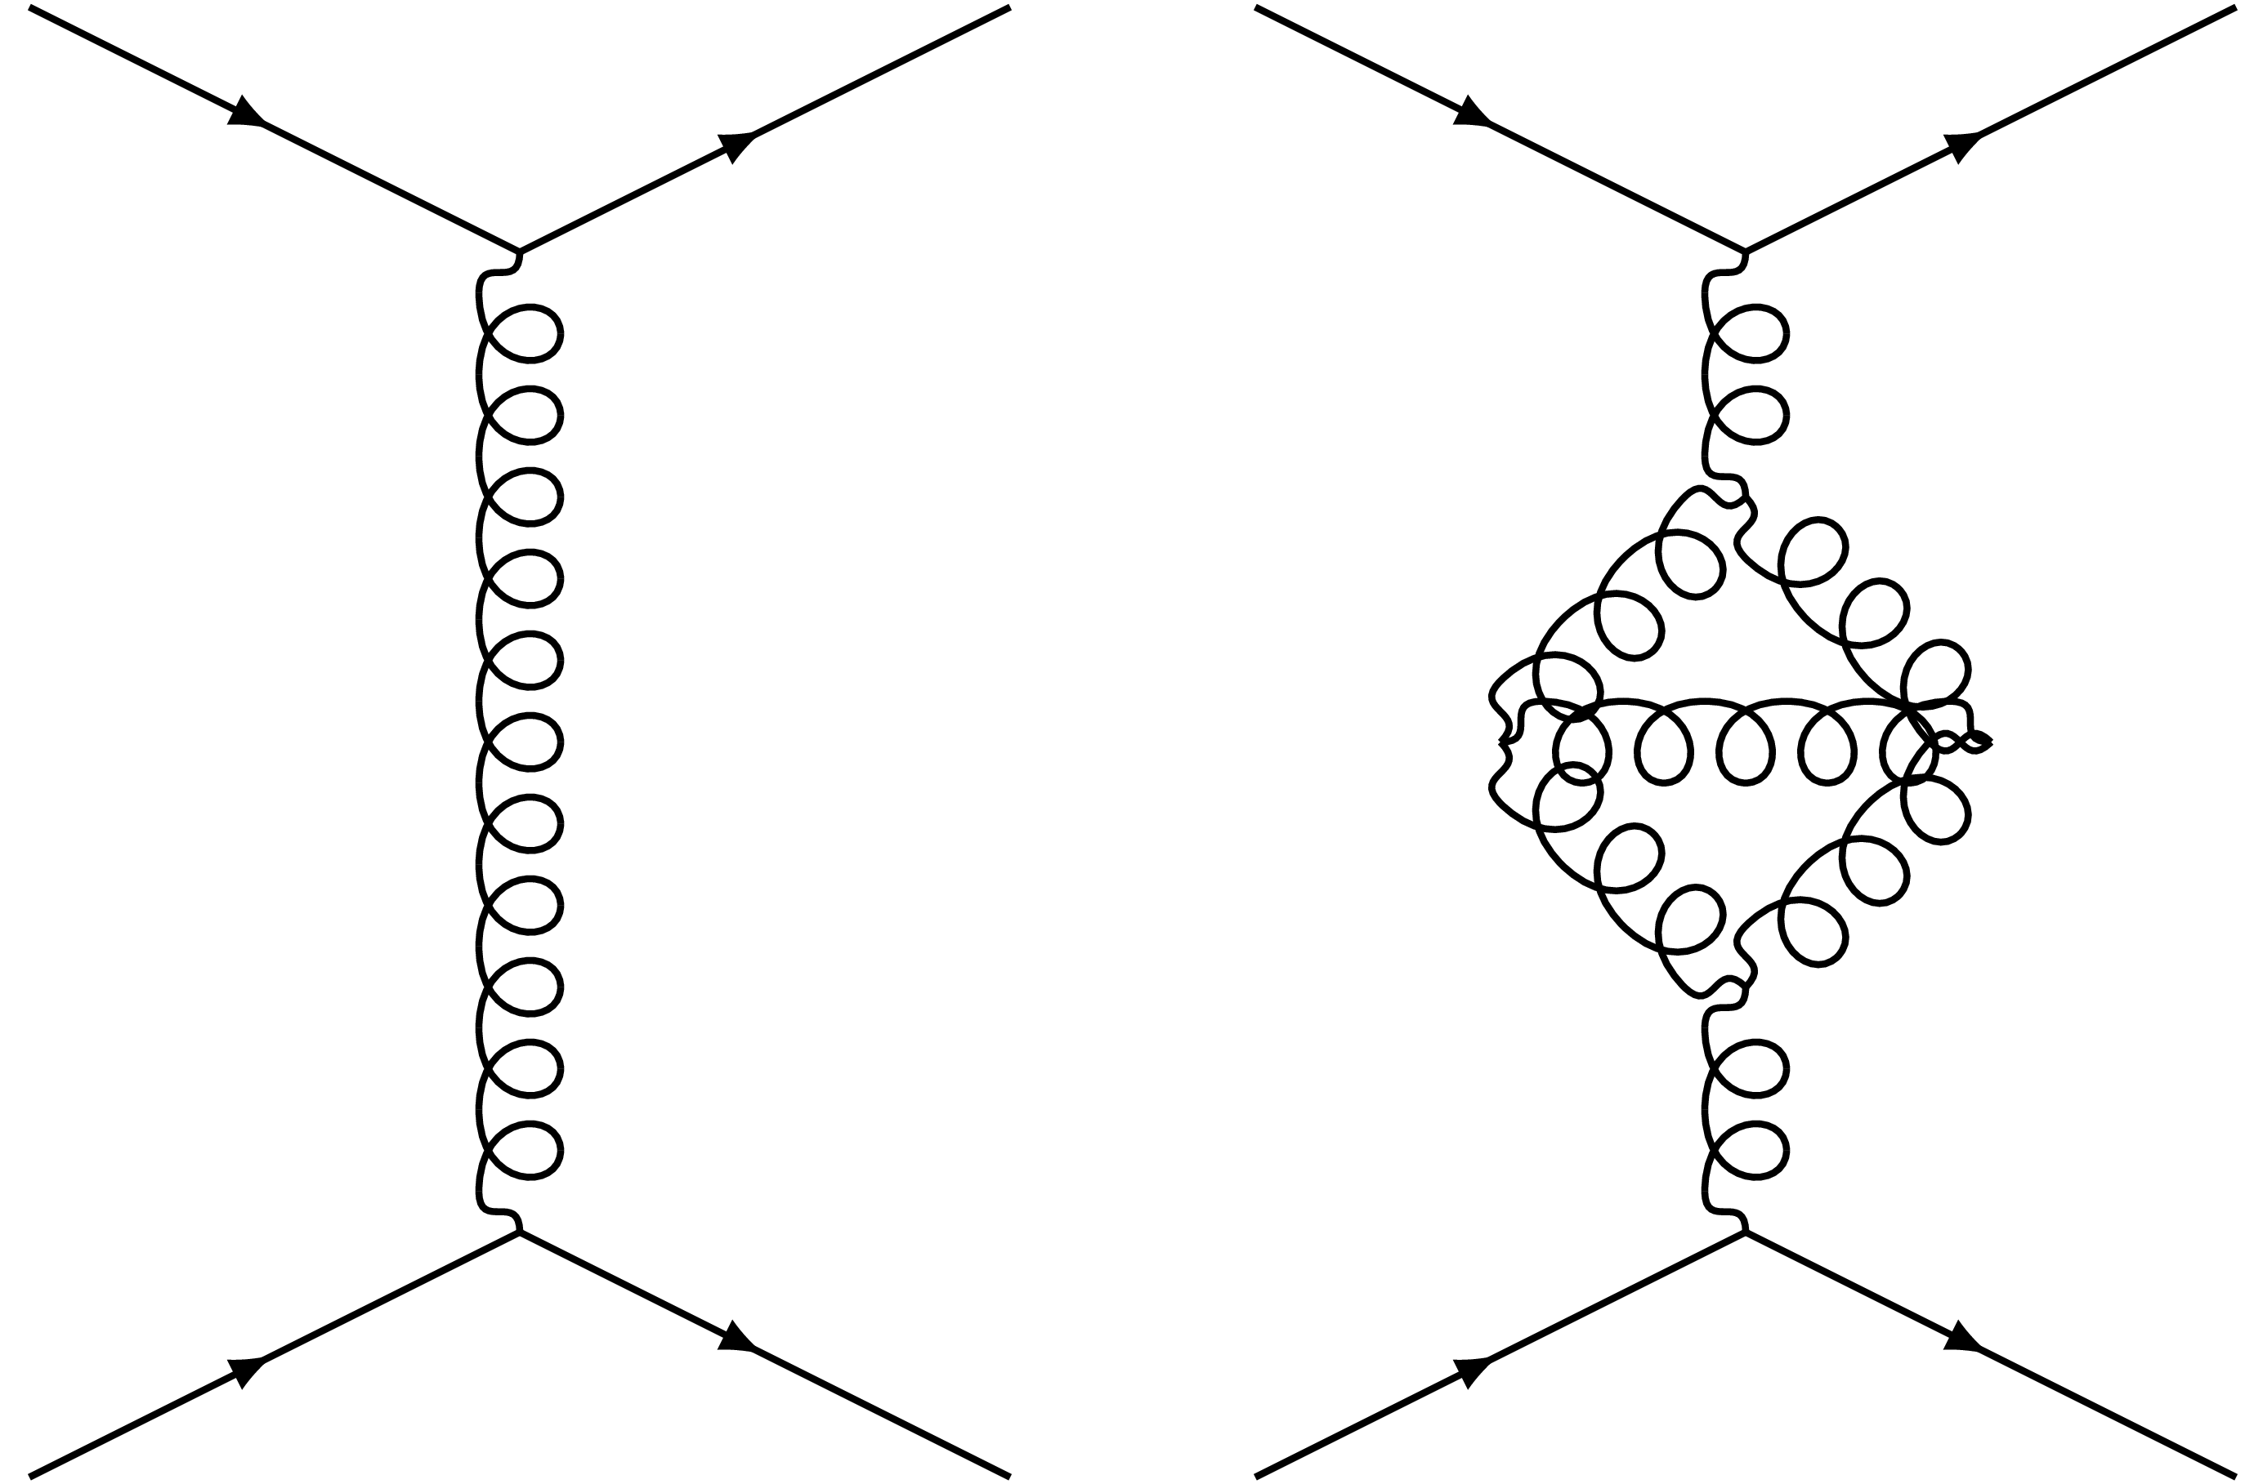
Strong Nuclear force
Gluons self interact.
Requires confinement of quarks in hadrons
The strong force's coupling is not constant.
α_{s} (E) ≈1/ln (E/Λ_{QCD} )
For small E (E/Λ_{QCD}<e) α_{s} >1
  This leads to more complex diagrams having larger effects then simple diagrams.
Notes:
Here Delta is a constant. This means that at low Qs That Alpha_s is greater then 1. this leads to the inability to use the perturbation to preform calculations

Slide 9
Jet Formation
As mentioned quarks can not exist by themselves.
As energy is added to quarks some of it goes into the field.
This can result in the spontaneous generation of new quarks.
This can happen multiple times leading to “jet” of hadrons

Slide 10
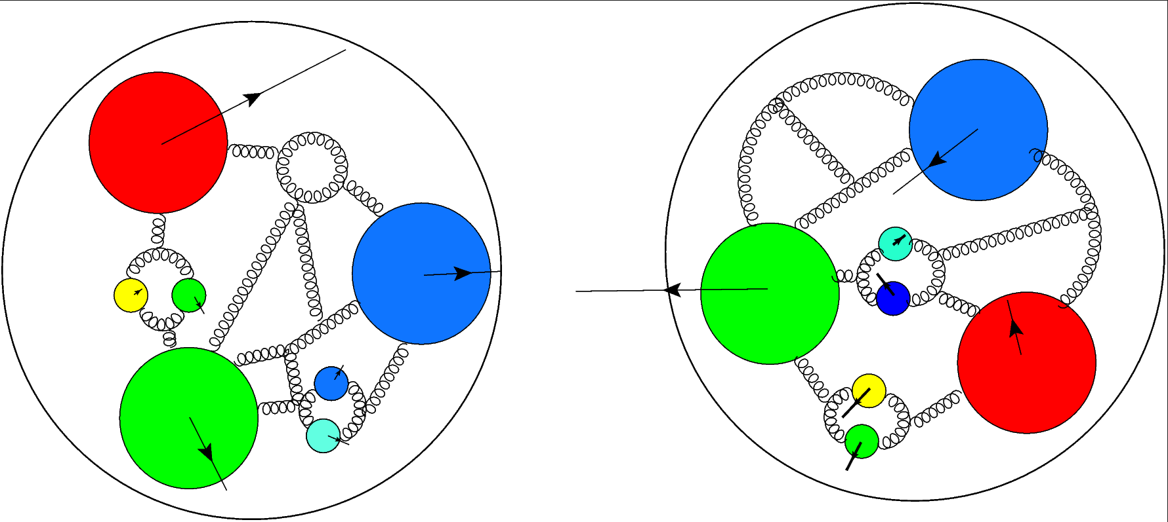
Nature of Proton Collision
Notes:
Because of the strong force Hadron collisions are complicated
Besides the three “real” quarks gluons and virtual quarks exist.
All of these can carry momentum

Slide 11
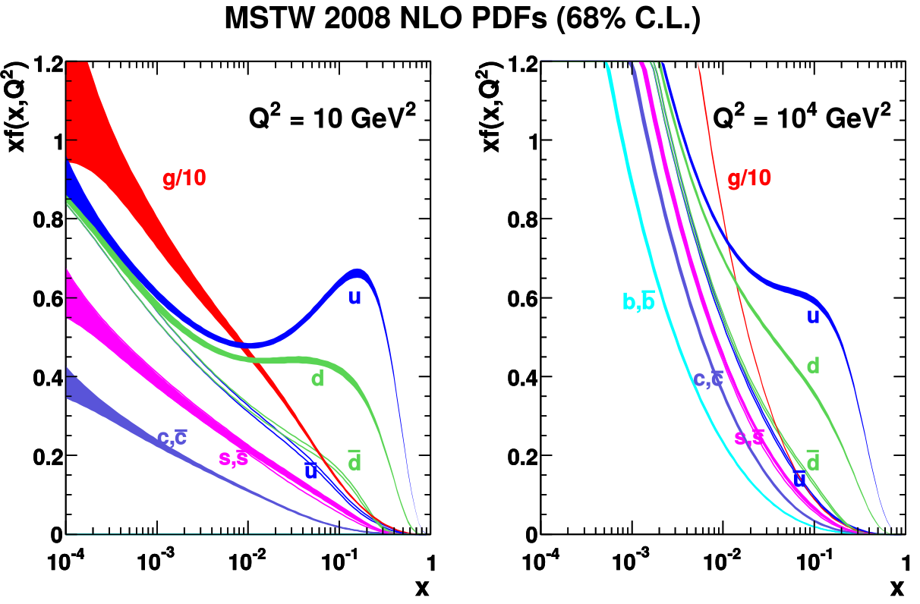

PDF
Notes:
It is intuitive that the real quarks would contain roughly the same Fraction of the protons momentum of about 1/3 with some small amount carried by gluons and virtual particles
Instead the amount of momentum that all parts of the proton carry is a non constant, and can be drastically different from interactions to interaction. As can be seen in both plots the real particles (up and down) are highly likely to carry the largest fraction of momentum of the proton,
however at higher energy interactions, the virtual particles have a higher chance of carrying some of it

Slide 12
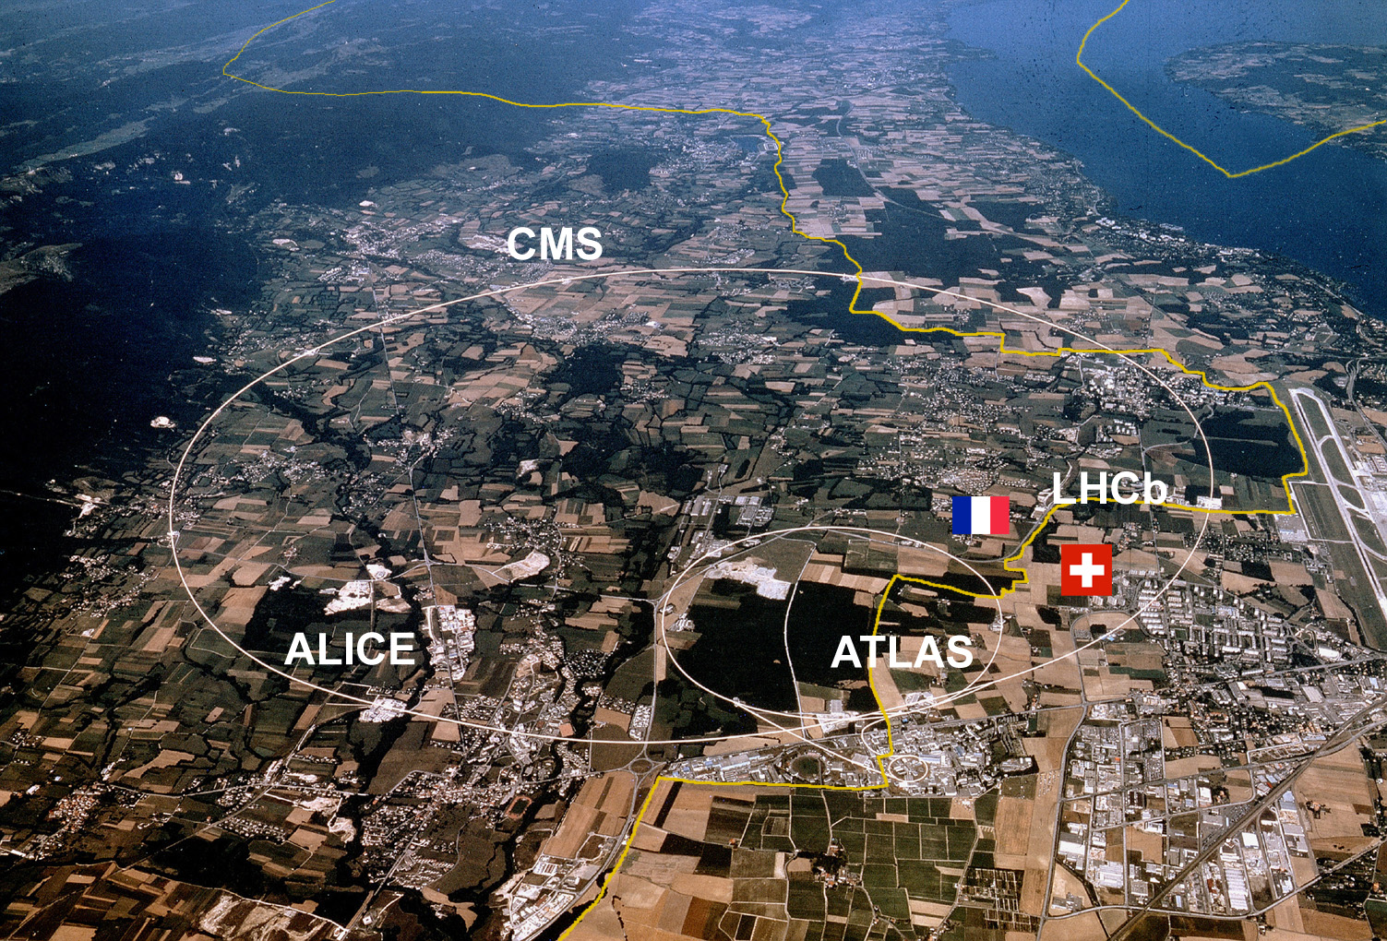
LHC
neutrino
neutrino
neutrino
neutrino
neutrino
neutrino
neutrino
neutrino
neutrino
neutrino
neutrino
neutrino
Notes:
27 km in Circumferance
Built on the border between france and switzerland
Where is CMS where is point out on map

Slide 13
LHC
neutrino
neutrino
neutrino
neutrino
neutrino
neutrino
neutrino
neutrino
neutrino
neutrino
neutrino
neutrino
Notes:
27 km in Circumferance
Built on the border between france and switzerland
Where is CMS where is point out on map

Slide 14
LHC
neutrino
neutrino
neutrino
neutrino
neutrino
neutrino
neutrino
neutrino
neutrino
neutrino
neutrino
neutrino
Notes:
27 km in Circumferance
Built on the border between france and switzerland
Where is CMS where is point out on map

Slide 15
CMS Detector
Notes:
CALLED the compact muon solinoid. Creates field up to 3.8 tesla
Current detector. Silicone tracker on inside 3 layers by ten layers of strips
Muon chamber on outside
Drift tubes 1 mm by 42 mm
Electrons travel at 55 microns per nanosecond
10^5 electrons at a time
Chambers at a couple kV
As is argon Co2 at around 70 to 30

Slide 16
CMS Detector
Notes:
Silicone tracker on inside 3 layers by ten layers of strips

Slide 17
CMS Detector
Notes:
Ecal
Made of lead tungstate crystals.
Measures the energy of electrons and photons

Slide 18
CMS Detector
Notes:
Hcal hadron calorimeter
Is a sampling calorimeter
Made of alternating layers of brass and plastic scintilator.

Slide 19
CMS Detector
Notes:
The part that which CMS is named
Solenoids carries 17 kAmps
Creates 3.8 tesla field

Slide 20
CMS Detector
Notes:
Muon chambers. Detects and measures the energy of muons

Slide 21
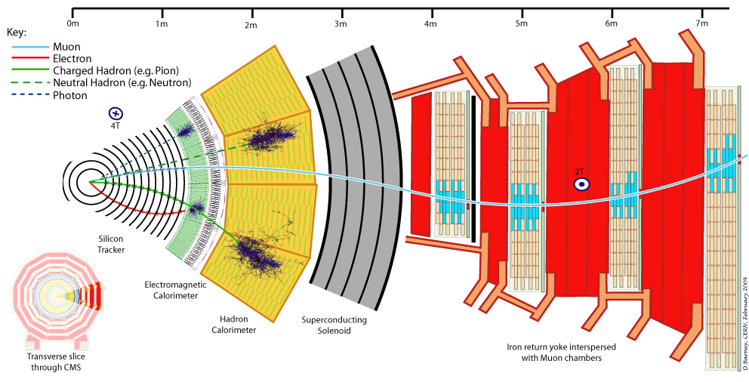
CMS Particle Detection
Notes:
Tracker all charged particles
Ecal photons and electrons
HCAL Hadrons brass plastic sampling calrimator
Solinod
Muon chamber
Both Electron and muon have energy resolutions of the order of a couple %
Note Neutrino pass through completely

Slide 22

Coordinate system
Y
Z
X (Center of LHC)
θ is the angle with respect to the Z axis
φ is the angle with respect to the X axis in the xy plane
Pseudorapidity:
Notes:
Why use Pseudorapidity
Because of PDF distributions partices are not produced in a spherically symmetric distribution. They are produced in a relativly consistent distribution in pseudorapidty.

Slide 23
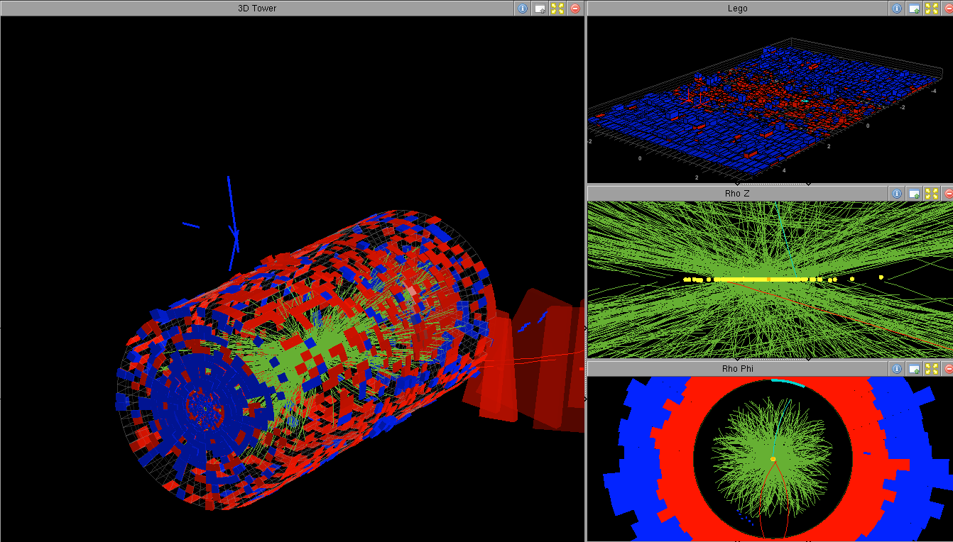
Trigger
In 2012 bunches collide every 50ns, (20 MHz)
The disk write speed limits us to saving events at a rate of around 400 Hz
Therefore only events that have characteristics implying they are “interesting.”
Notes:
This is complicated in every event multiple non interesting things happen so characteristics must be distinguishable from non-interesting

Slide 24
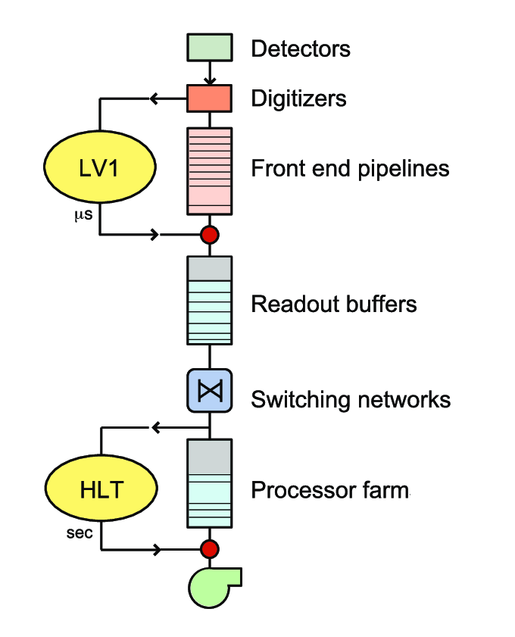
Trigger
L1 trigger reduces the rate to 100 kHz.
  Uses specialized hardware and a granulated version of the detector
HLT reduces the rate further to 400 Hz
  Uses more generic hardware, regular computers in a farm and a complete event
If the event passes the HLT the whole event is written to tape.
Notes:
Mention that although we call it the L1 trigger and the HLT each are made up of triggers

Slide 25
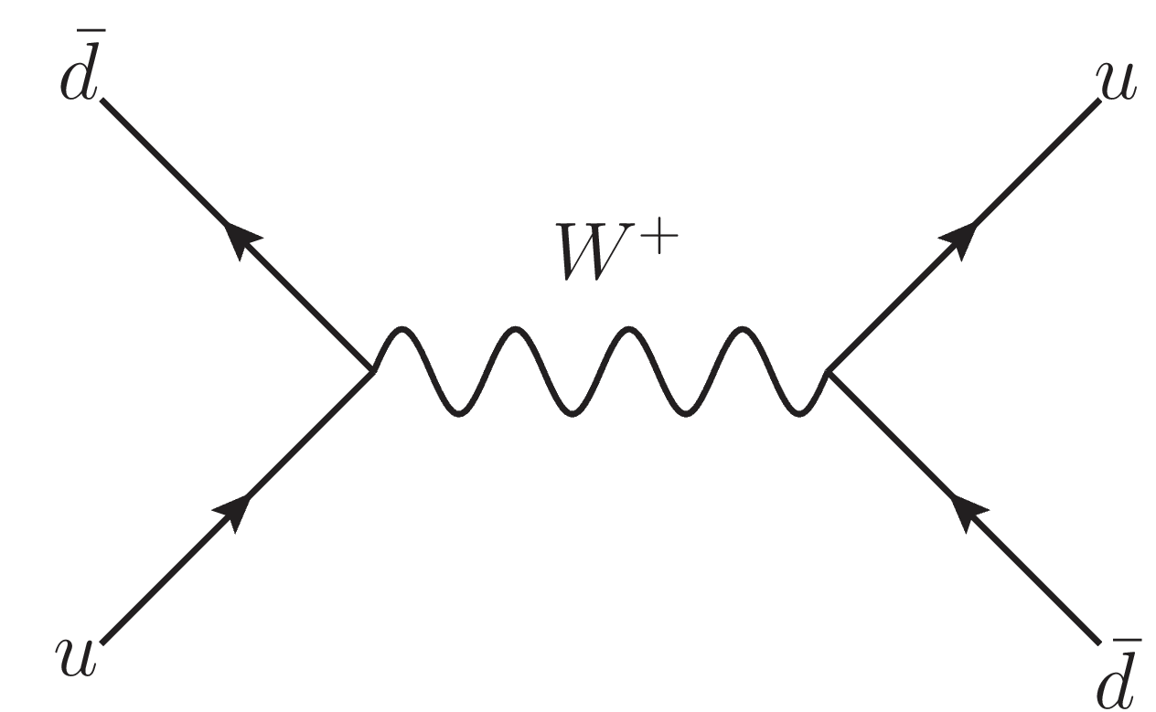
W Hadron channel Decay
Notes:
This produces two charged particles, which in theory could easily be used to calculate the mass of the W

Slide 26
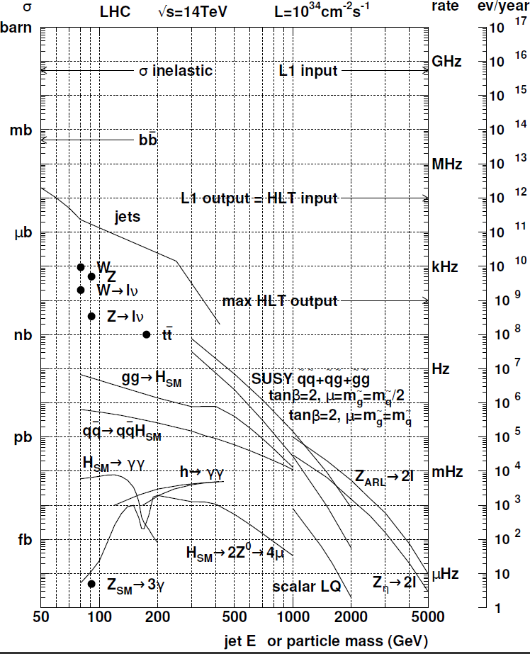
Trigger and Cross-Sections
The vast majority of events are due to QCD interactions
Because of QCD events it is hard to make a trigger based on hadrons
Notes:
Point out W and Jets

Slide 27
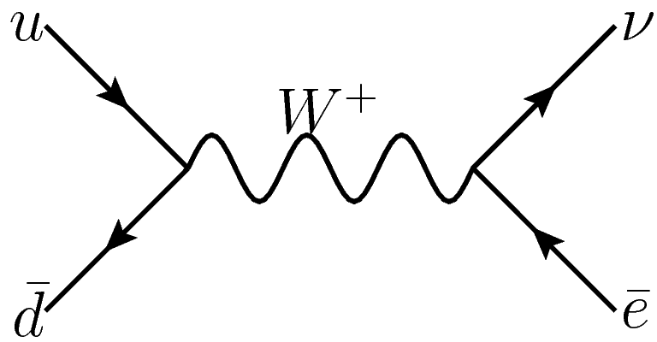
W measurement at CMS
Notes:
We do this since charged high energy leptons are produced rarely alone from QCD even.
Impossible to see the neutrino
Mass can't be observed directly

Slide 28

Measurement of Transverse momentum
Because of the wide variability of parton momentum inside a hadron, particles created from parton interactions are not made at rest.
parton momentum perpendicular to the beam direction is relatively small.
Therefore particles produced directly from quarks(such as ) have a small inherent transverse momentum(Q_{T}).
The transverse momentum of the decay products(p_{T}) of these produced particles is mostly due to the rest energy of the particle.
Notes:
Up quark with 20 GeV down with -80Gev momentum create a W with mass 80 GeV with momentum 60 GeV. Therefore if we looked at the momenutm distribution of the charged lepton, Much of the momentum would be dependent on strong interactions that inherently are difficult to simulate

Slide 29
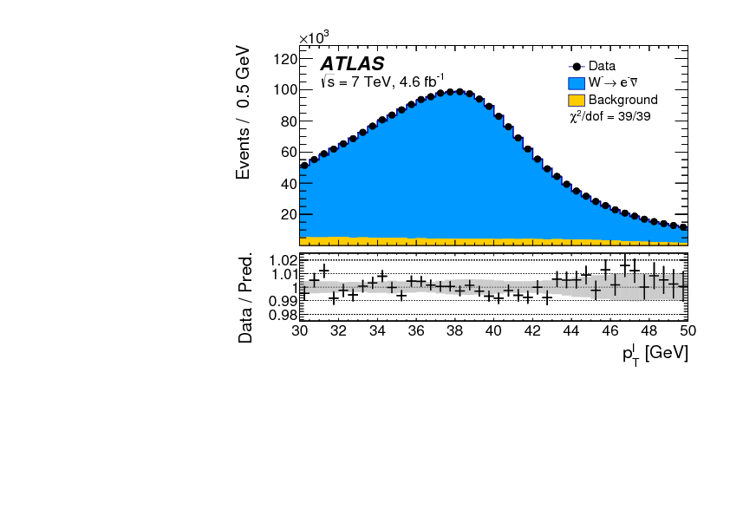
W Mass Results
The p_{T} distribution of the electron is compared to simulations.

Slide 30
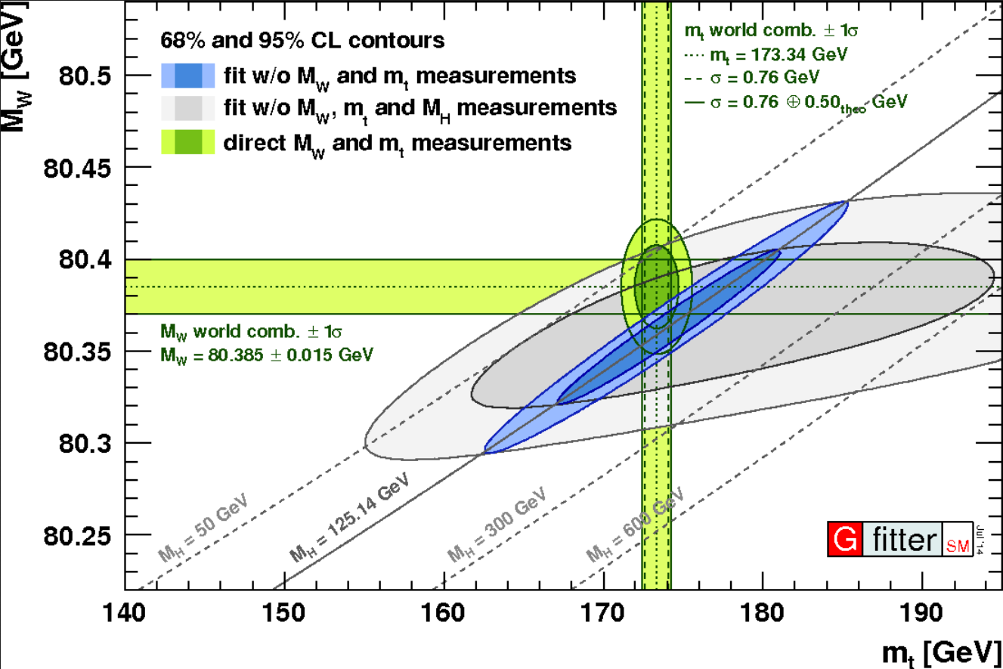
W mass disagreement
Notes:
This COULD be a flaw in the standard model. However due to the high error bars it is not possible to actually say if it is.
Lowering the uncertainty is necessary to figure out if this is due to an issue with the standard model

Slide 31
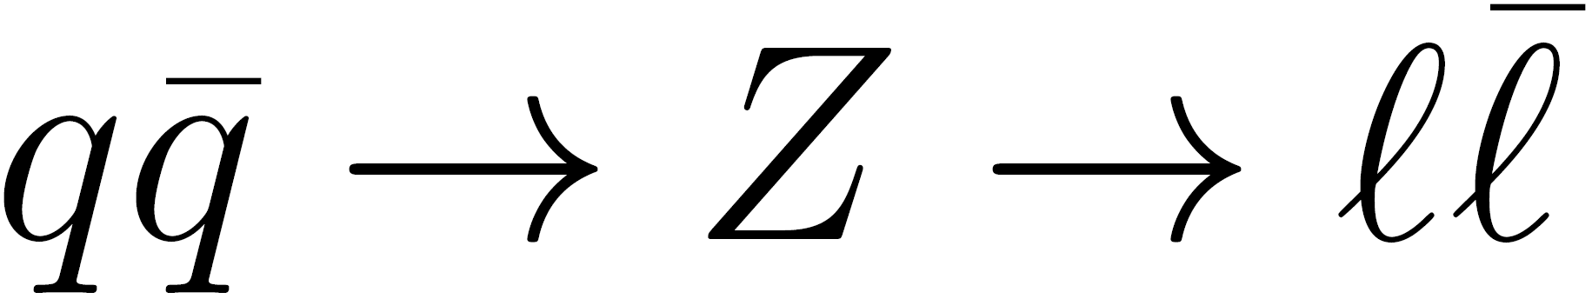
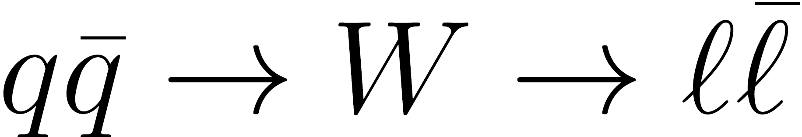
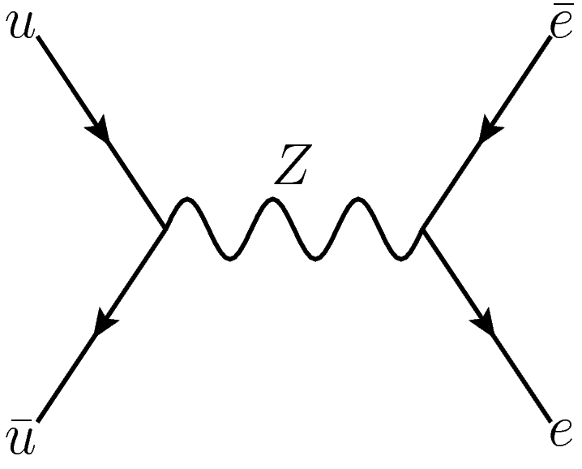
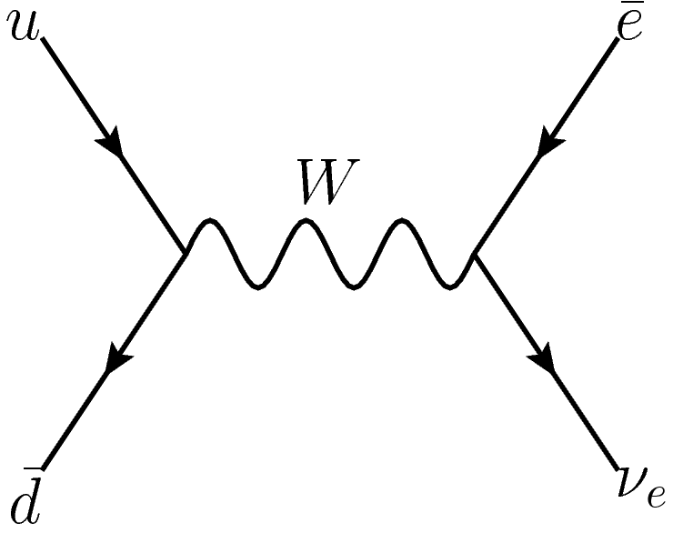
Difficulty in Simulated Q_{T}
Flaws in the way that the simulator produces the Q_{T} of the W could affect the p_{T} of its decay product.
It is not possible to measure the Q_{T} of the W directly to test the accuracy of the produced Q_{T.}
The process does have a measurable Q_{T} and is very similar physically to
Notes:
Although the transverse momentum of the quarks that produce the W should be small, it is non zero and could have small effects on the Pt of the decay products

Slide 32
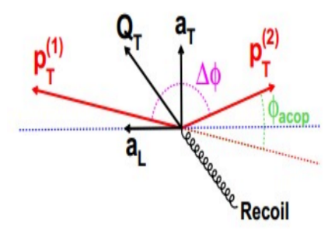
φ*
Definition:
φ* = tan (∆φ/2) sech (∆η/2 )
∆φ : azimuthal opening angle between l⁺l^{-,}
θ=Angle from the beam line
φ=Angle from Vertical.
∆η: The change in η between l⁺l⁻
Notes:
Although we describe the beam axis as the Z direction for simplicity sake any Pz is the momentum of the Z

Slide 33
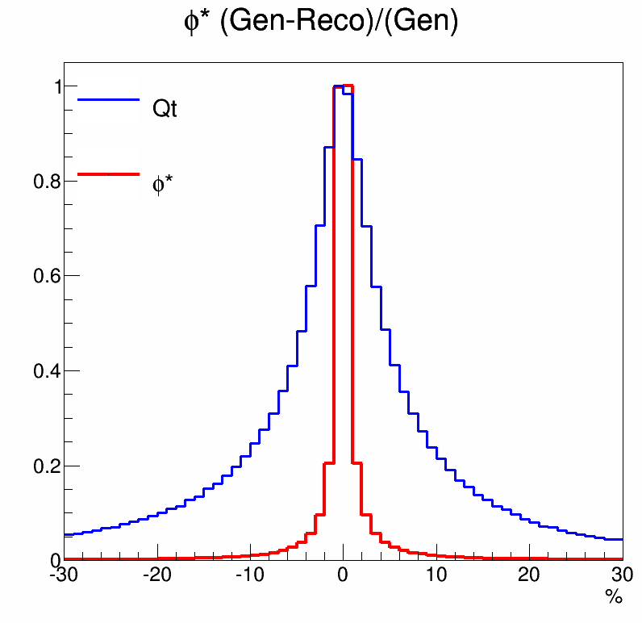
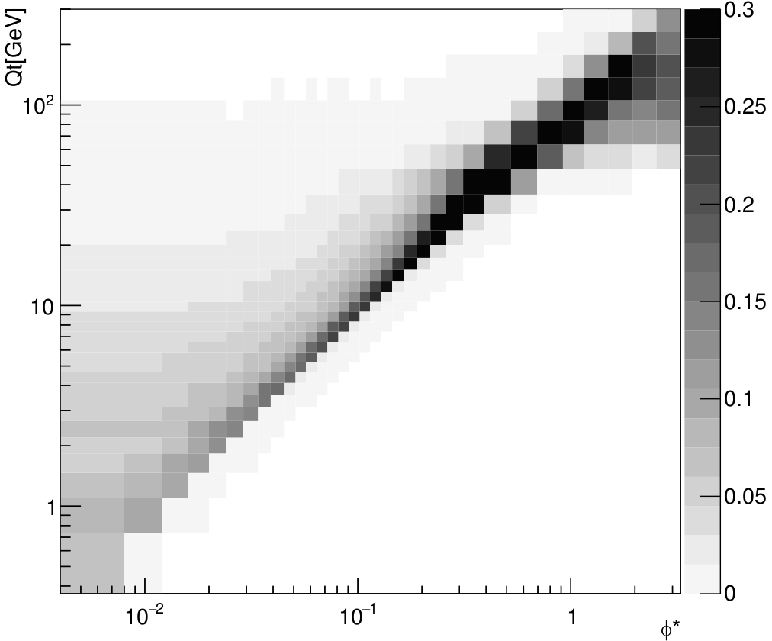
Purpose of φ*

Slide 34
Data Samples
The trigger used to create the data sample in this analysis was “HLT_ELE27_WP80”. This trigger requires an event to contain a electron with P_{T} >27 GeV .
This sample uses comes from the CMS detector. It contains 19.7 fb⁻¹ of data from 2012 with a center of mass energy of 8 TeV.

Slide 35
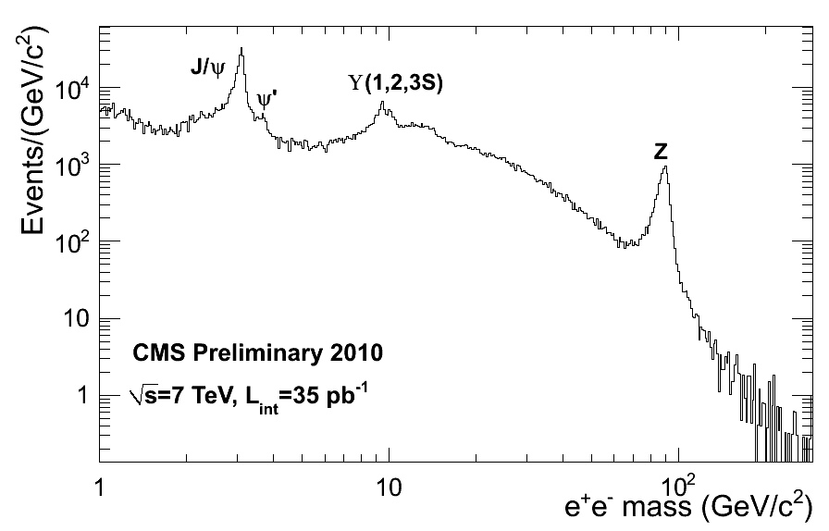
Acceptance
Our detector limits what Z decays can be seen.
Therefore the cross-section calculation is for Z decays that fall in an acceptance window:
  p_{T}(l₁)> 30 GeV, |η(l₁)| < 2.1
  p_{T}(l₂)> 20 GeV, |η(l₂)| < 2.4
  Φ* <3.277
  Invariant Mass (GeV):
  60 < M_{ll} < 120
Notes:
Because the Z is so sharply peaks a mass cut can be used to remove a lot of the Background while removing few Z's
Pt cuts are placed to require a good Z
We can place a phistar cut sunce we are interested in low pt Z bosons

Slide 36
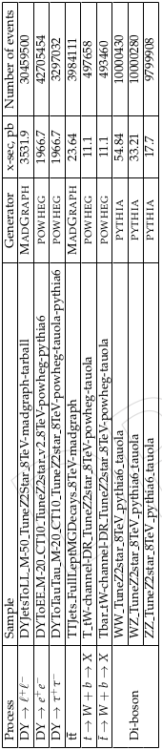
Simulated samples
Both the signal and all the backgrounds were simulated with Monte Carlo generators with the only exception being the background due to QCD

Slide 37
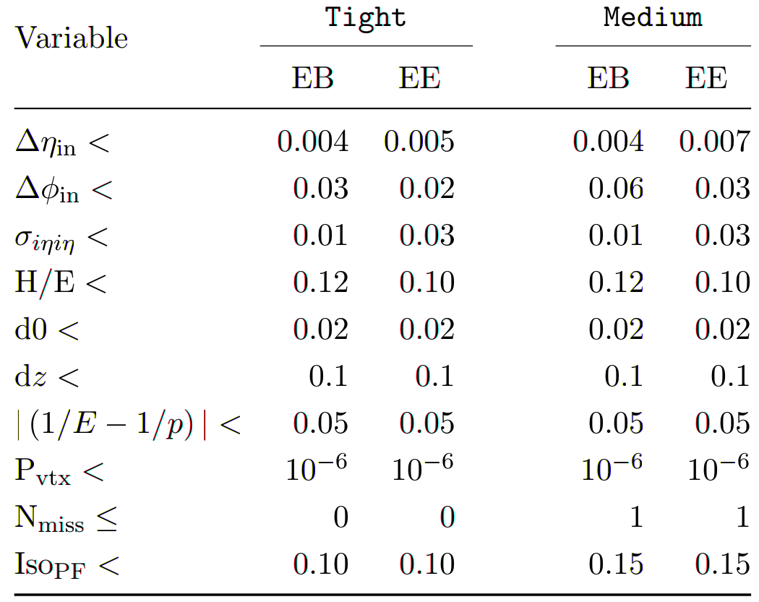
Electron Quality Cuts
A central electron must be matched with a trigger object. This electron pass “tight” requirements and be isolated
The second electron must pass “medium” requirements and be isolated.

Slide 38
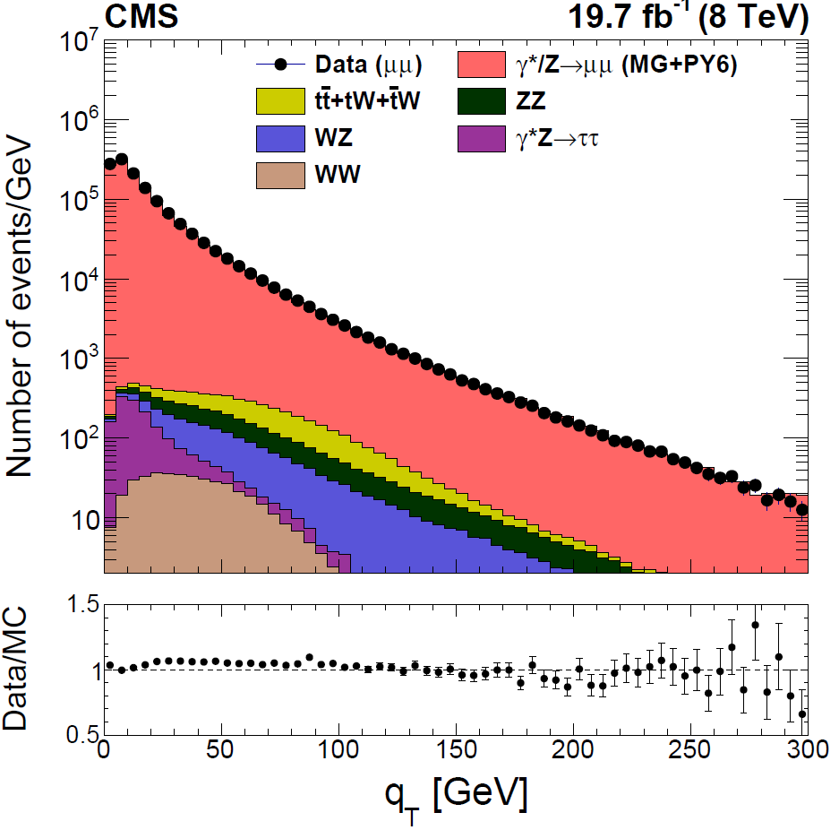
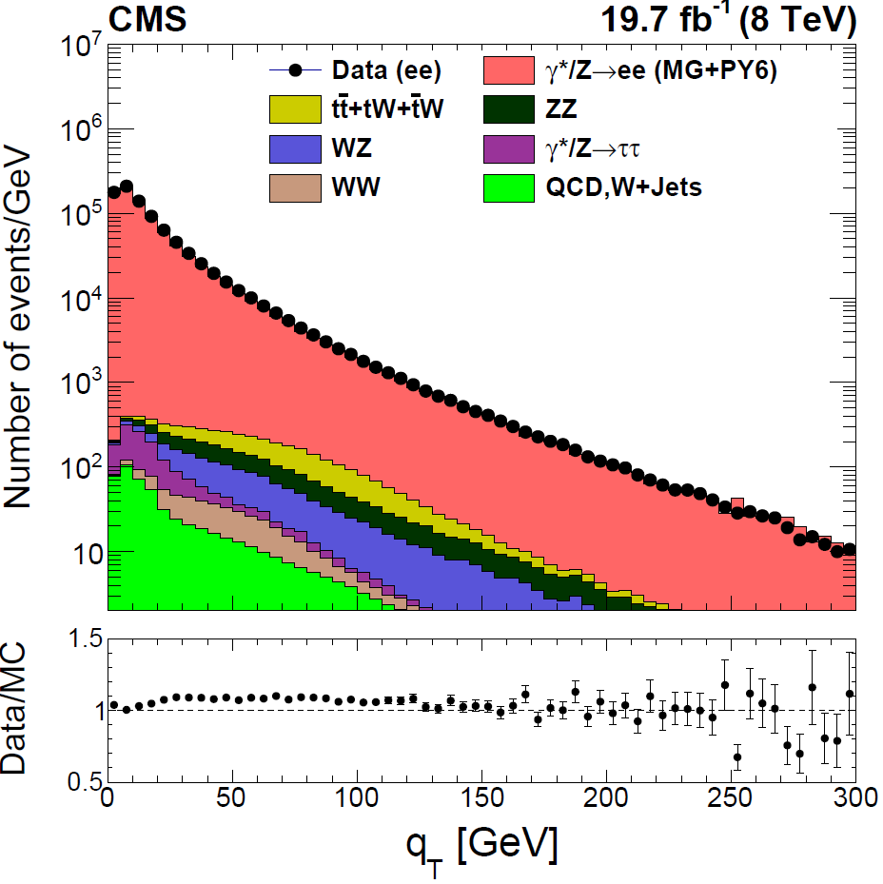
Q_{T}
Notes:
So here we have the 2 channels, the z->ee and the z->mumu

Slide 39
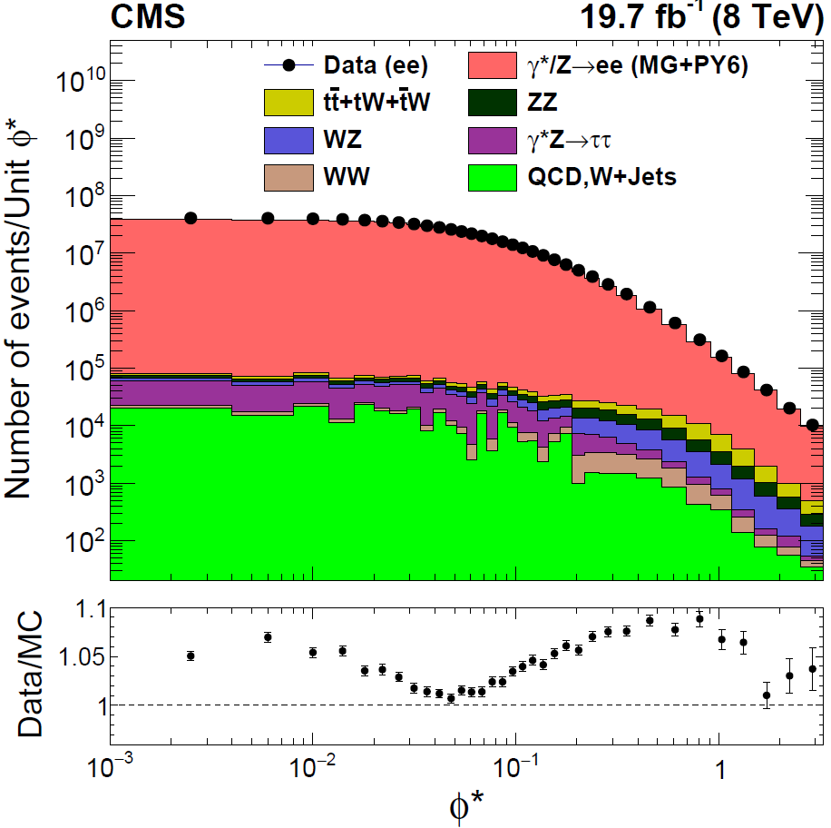
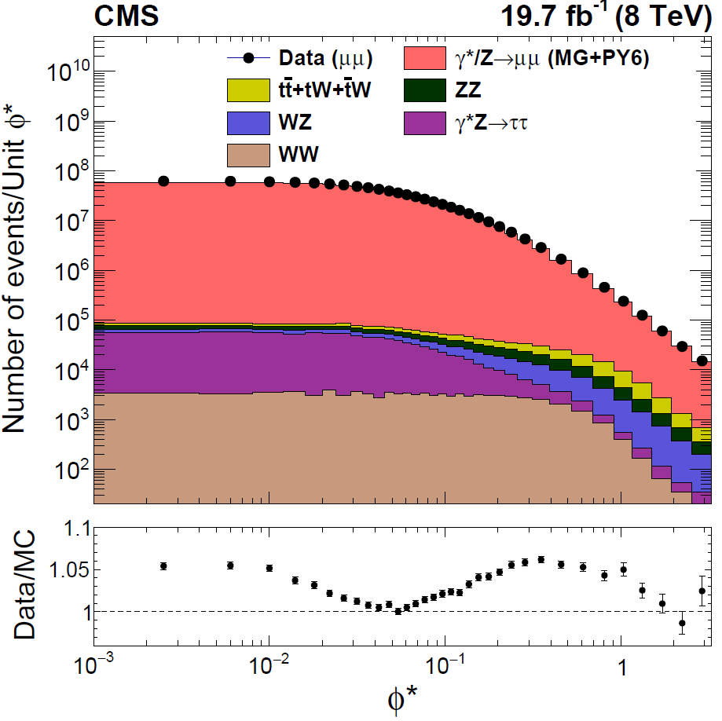
φ*

Slide 40
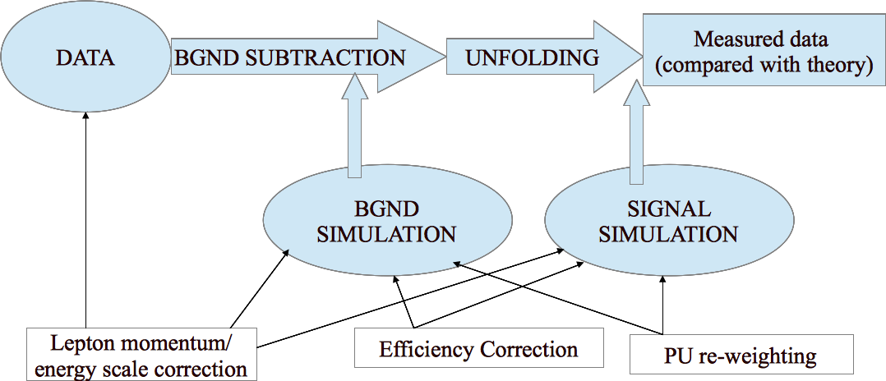
Finding “true” φ* distribution

Slide 41
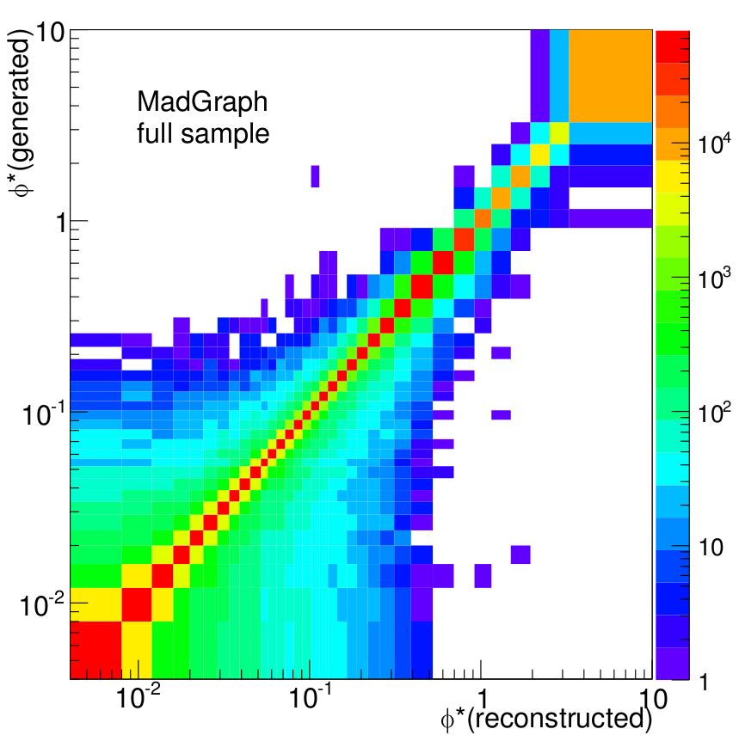
Bin Migration
For the electron (muon) data set approximately 10%(3%) of events reconstructed value falls in a different bin then its generated value due to detector effects
  In order correct for detector effects the the sample data is unfolded with a MadGraph sample using the d’Agostini method.
Notes:
To compensate for Bin migration the Baysian unfolding method is used
he migration of events from one φ∗ bin to another bin is at the
level of 10 (3) % for the dielectron (dimuon) channel, while for |y| the migration between bins
is much smaller because the |y| bins are large compared to the resolution
The observed distributions are unfolded to pre-FSR or “Born-level” distributions using the
d’Agostini method [47] as implemented in the R OO U NFOLD package [48]. Four iterations have
been performed for the unfolding of the distribution

Slide 42
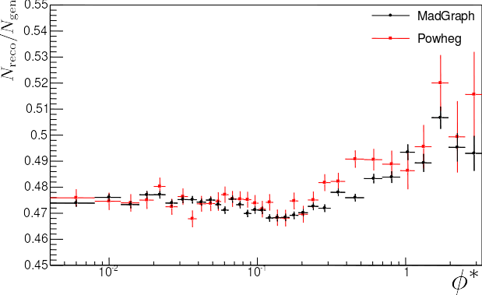
Efficiency Correction
The efficiency refers to the number of events that are in the acceptance window and pass our electron quality cuts compared to the total number of events in the acceptance window. This is corrected for after unfolding.

Slide 43
Uncertainty
Statistical uncertainty: uncertainty due to statistics of the data
Unfolding uncertainty: This uncertainty comes from the statistics of the MC sample that is used to unfold the data
Background uncertainty:
  ttbar cross-section varied by 10%
  WZ and ZZ cross-section varied by 20%
  QCD varied by 100%

Slide 44
Uncertainties
  Lepton trigger, reco and iso efficiency uncertainty
  Lepton enegy/p_{T} scale: uncertainty due to uncertainty in the energy/p_{T} of the leptons.
  Pileup: uncertainty due to other collisions that happen in a bunch crossing.
  Final State Radiation (near negligible): uncertainty due to the emission of photons by the leptons .
  Luminosity:uncertainty due to the integrated luminosity of the run.

Slide 45
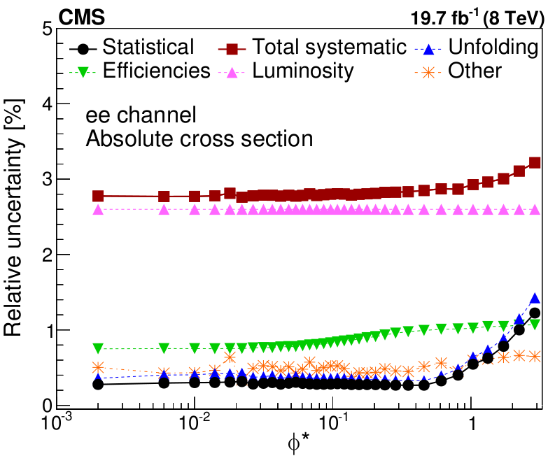
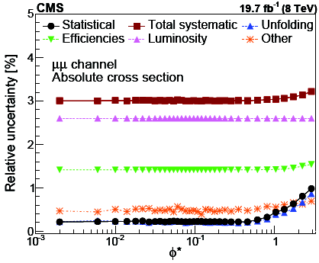
Absolute 1D Uncertainty

Slide 46
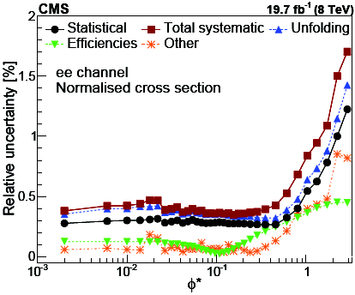
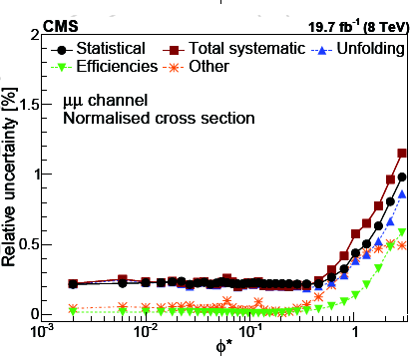
Normalized 1D Uncertainties
Notes:
Other includes Background
PDF
Energy Scale
Background Errors

Slide 47
Blue Combination
Because of leptons universality it is possible to combine the results of the Z->ee with the Z->mumu to lower the uncertainty of the φ* measurement.
Single and double cross sections measured for the di-muon and di-electron channels are combined using best linear unbiased estimator (BLUE)
BLUE is able to take correlations between bins and channels into account. These correlations come from background, pileup and FSR uncertainties.
Luminosity and Efficiency uncertainty is taken into account after combination.
Notes:
blue simply uses linear algebra to do the same taking the correct correlations into account

Slide 48
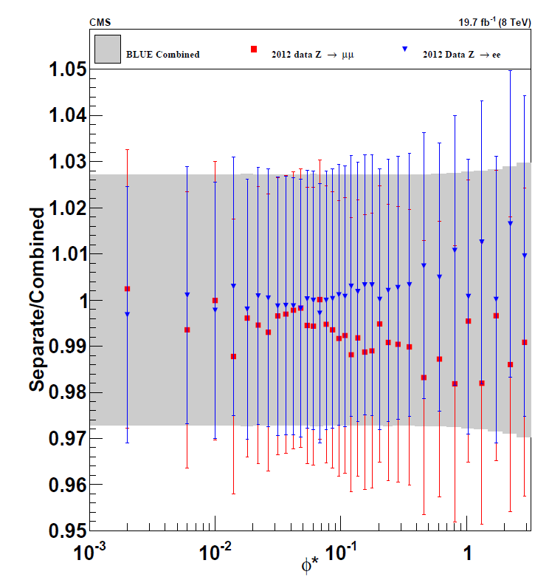
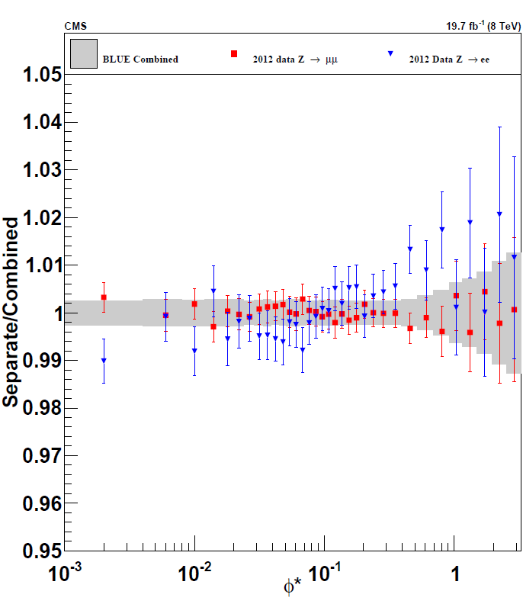
Combined Results
Absolute
Normalized

Slide 49
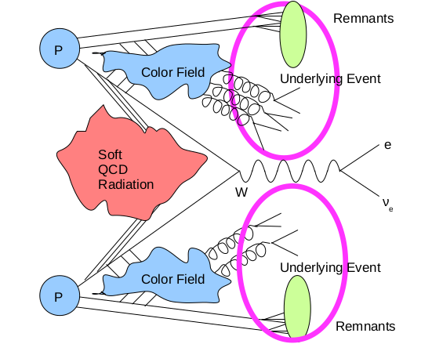
Production of simulations
Two step process using a “Generator” and a “Hadronizer.”
The Generator uses the First priciples
  Is used to produce the “interesting” part of the event.
The hadronizer is not based on the first principles.
  Adds the rest of the proton along with strong interactions to the event
  Usually has effects on the GeV scale

Slide 50
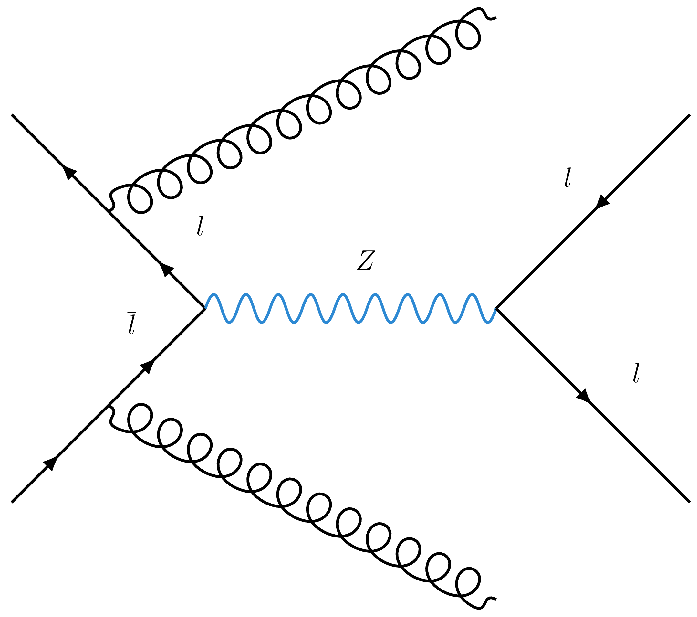
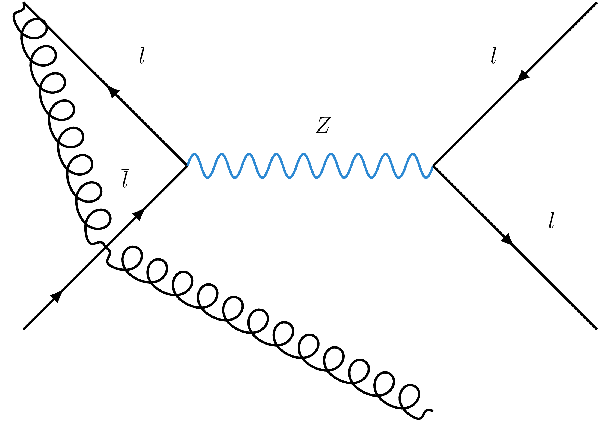
Difference between Generators
Madgraph
  Includes multiple final partons
PowHeg
  Includes (some) loops
  Focuses on first hard emission
Notes:
Powheg tends to be less accurate at high Pt since the Z gets less of a kick.

Slide 51
Hadronization
Hadronization is accomplished with Pythia
Does not use first principles
First an initial input is given to Pythia with a final state of Z+parton(either single gluon or single quark)
Other particles (quarks and gluons) are then added to the system. Secondary interactions are then produced.

Slide 52
Hadronizer(Pythia)
Pythia creates Jets in order of hardness with the hardest jets being the first created.

Slide 53
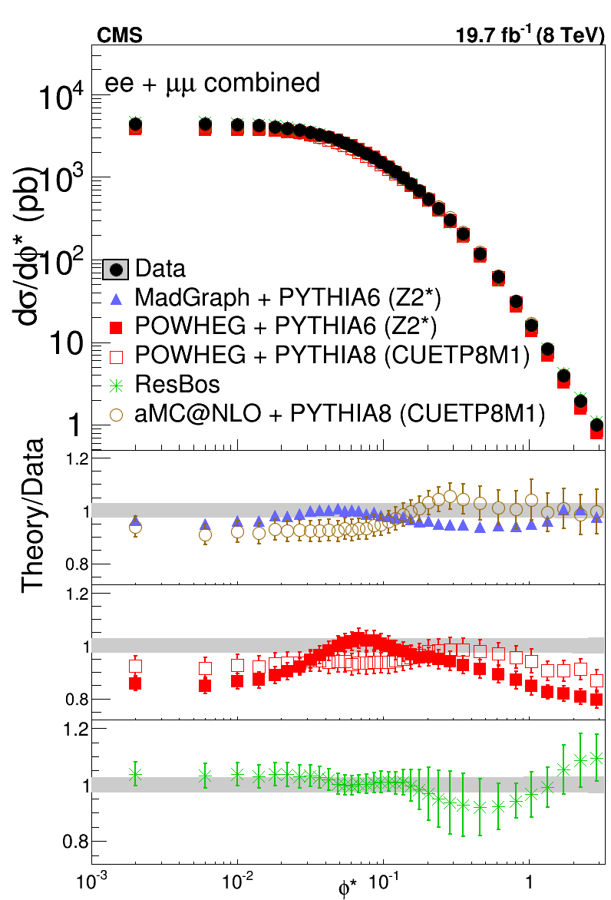
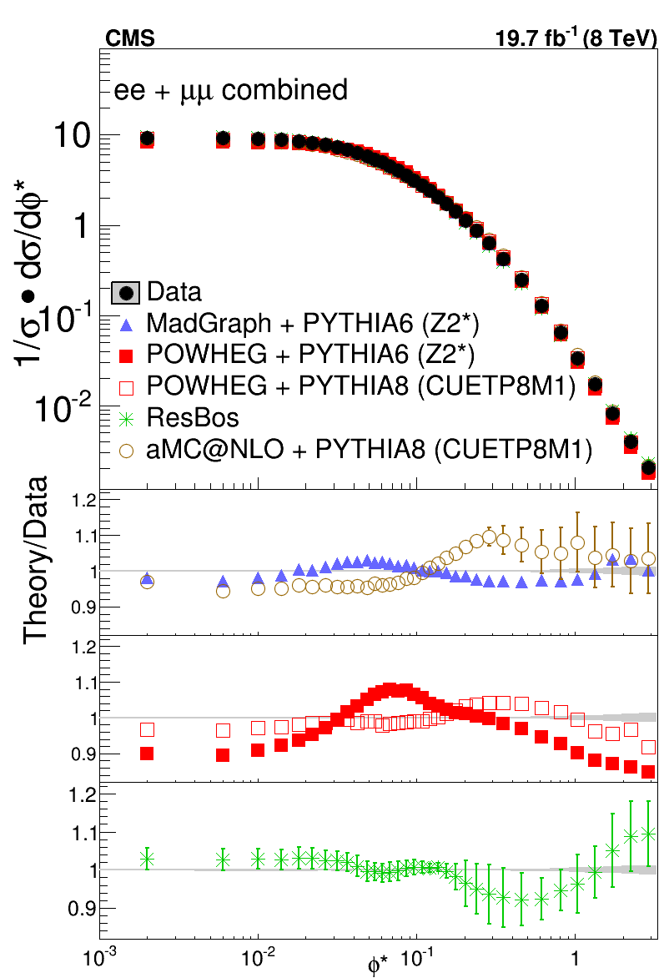
Results

Slide 54
Pythia6 VS Pythia8
Pythia8 is a complete different program, written in C++ unlike Pythia6 which is fortran
Pythia6 uses a separate PDF from Pythia8
Pythia8 uses Gaussian with different widths to pick the p_{x} and p_{y} of the partons produced while Pythia6 uses a Gaussian of constant with.

Slide 55
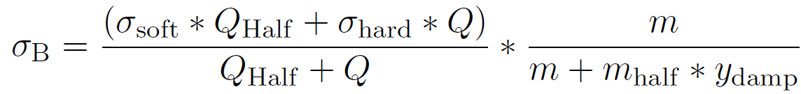
σ_{B} Width
The p_{x} and p_{y} momentum of the partons produced by Pythia8 comes from a Gaussian of width σ_{B.}
Here Q is the hard-process renormalization scale for the hardest process and the pT scale for subsequent multiparton interactions
The width σ_{soft} in the above equation, assigned as a primordial kT to initiators in the soft-interaction limit. This is one of the variables changed in the tune
The width σ_{hard} in the above equation, assigned as a primordial kT to initiators in the hard-interaction limit. This is the other variable changed.
The scale Q_{half} in the equation above, defining the half-way point between hard and soft interactions.
m the mass of the system
The scale m_{half} in the equation above, defining the half-way point between low-mass and high-mass subsystems.
y_{damp} is a term designed to damp interaction at high Y range.

Slide 56
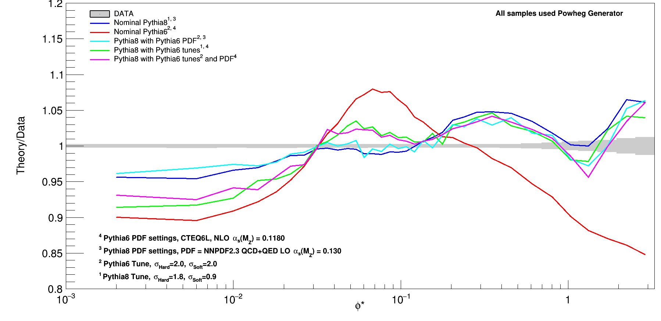

Slide 57
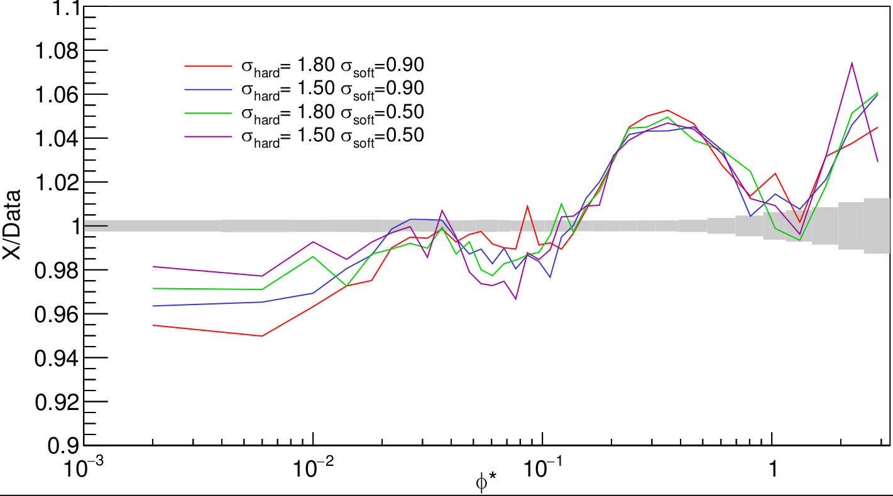

Slide 58
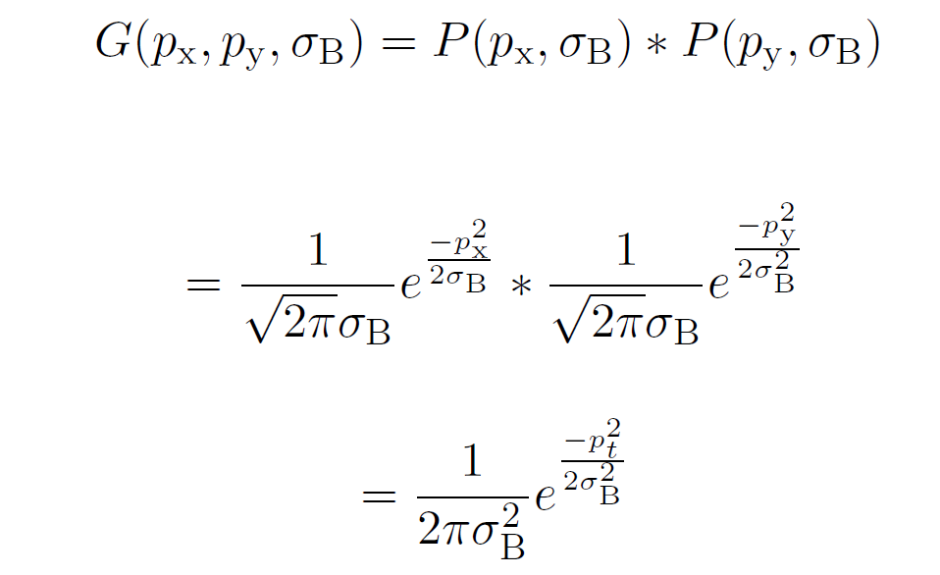
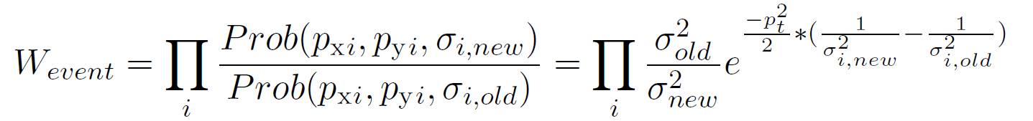
Calculating weights
Notes:
changes to σ_{soft} and σ_{hard} affect the width of a Gaussian that produces the p_{x} and p_{y} of each parton produced by the hadronizer.
Different σ_{soft} and σ_{hard} could produce the same p_{x} and p_{y}.
By comparing the likelihood of the p_{x} and p_{y} of the original σ_{soft} and σ_{hard} to a new σ_{soft} and σ_{hard} a weight can be produced.

Slide 59
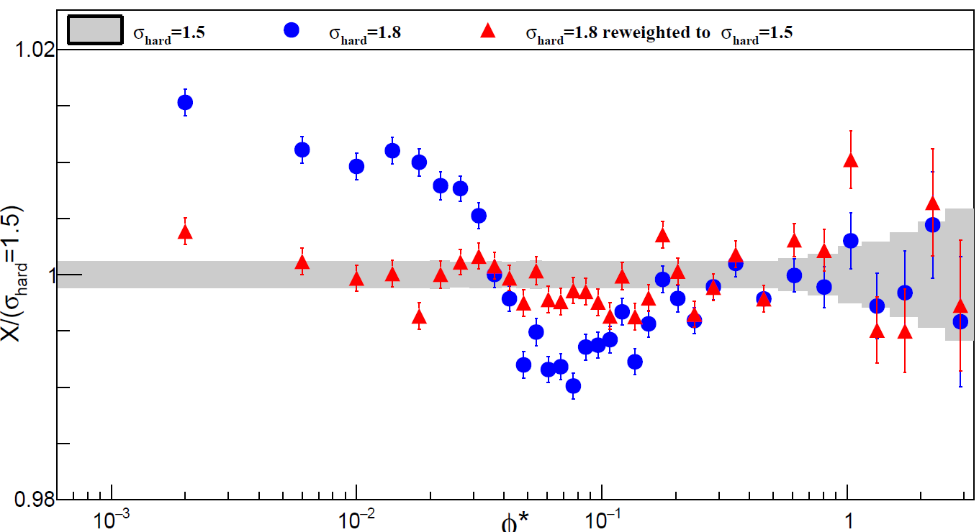

Slide 60
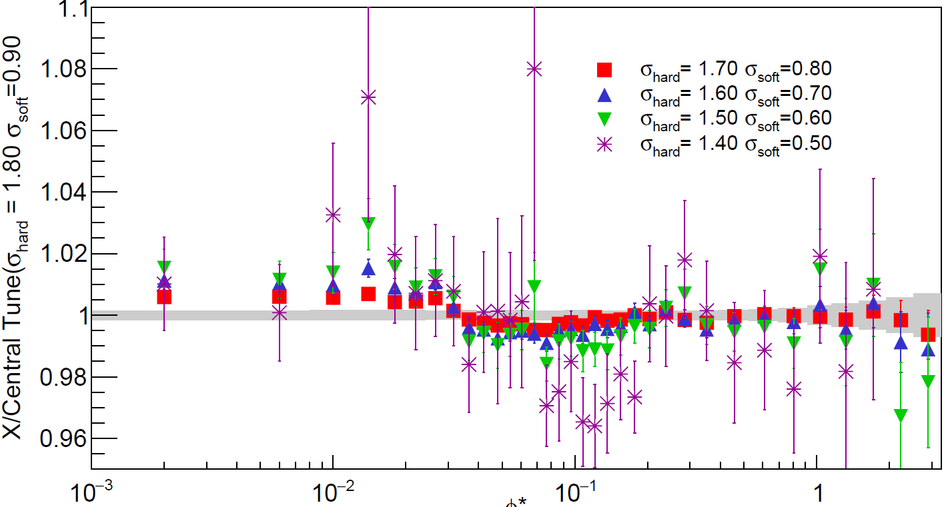

Slide 61

Parton Weight

Slide 62

Event Weight

Slide 63
Conclusion
Currently there is disagreement between the measured φ* and simulated φ*
Although there is evidence that it is at least partially caused by the hadronizer, changing the PDF, or σ_{soft} and σ_{hard} is unable to fix the disagreement.
Without an agreement between simulation and measurement of φ*, it is difficult to lower the uncertainty of the W mass measurement.
These new method of calculating a new tune distribution can be used to ease of testing new tunes.

Slide 64
COPIED SLIDES

Slide 65

Tunes effects(Backup)

Slide 66

QCD rate is so high it is not practical to create a simulated sample.
Instead a data driven method was created.
Apply acceptance criteria except for the invariant mass cut
Apply a same sign cut is then applied to remove signal

Slide 67

QCD Background
The MC is then subtracted from data and fit with the function
This is function is then integrated from 60-120 GeV and is defined as the QCD BG
Notes:
Talk about same sign requirement
100% uncertainty

Slide 68

LHC performance
Notes:
The luminosity has been increasing every year. This can be used to do collect more data, but makes it harder to see stuff over the BG

Slide 69
P measurements
Because of the PDF distribution it is unlikely that the interaction has a net momentum of 0 along the beam line.
Instead of measuring absolute energy, p_{T} is studied
p_{T}=(p_{x}²+p_{y}²)^{1/2}
p^{Z}=p^{ele}+p^{pos}
Example
p^{ele} = 45± 4 GeV p^{Pos} =42± 3 GeV
p^{Z}=3± 5GeV

Slide 70

CMS Detector
Notes:
CALLED the compact muon solinoid. Creates field up to 3.8 tesla
Current detector. Silicone tracker on inside 3 layers by ten layers of strips
Muon chamber on outside
Drift tubes 1 mm by 42 mm
Electrons travel at 55 microns per nanosecond
10^5 electrons at a time
Chambers at a couple kV
As is argon Co2 at around 70 to 30

Slide 71
CMS Particle Detection
Ecal has an Energy resolution of 2-5% depending on the pseudorapidity
Notes:
Tracker all charged particles
Ecal photons and electrons
HCAL Hadrons
Solinod
Muon chamber
Both Electron and muon have energy resolutions of the order of a couple %

Slide 72

CMS measurements
Notes:
Many many cross sections have been measured more precisely sinceCMS has been operational and new limits have been placed

Slide 73

Definitions
Definition: φ* = tan (φ_{acop/2}) sin (θ_{η}* ),
φ_{acop} = (π - ∆φ)
∆φ : azimuthal opening angle between l⁺l^{-,}
θ=Angle from the beam line
φ=Angle from Vertical.
θ_{η}* : scattering angle of the leptons w.r.t.
proton beam in rest frame of l⁺l⁻ system
cos (θ_{η}* ) = tanh [(η⁻ - η⁺⁾/2],
η− and η+ : pseudorapidities of l⁺ and l⁻)
Rapidity y= =
pseudorapidity
Notes:
Although we describe the beam axis as the Z direction for simplicity sake any Pz is the momentum of the Z
Mention that x is the beorcan x from the PDF slide

Slide 74
Purpose of φ*

Slide 75
p_{T}
Notes:
So here we have the 2 channels, the z->ee and the z->mumu

Slide 76
φ*

Slide 77
Analysis Flow Chart

Slide 78

Background
Most Backgrounds taken from MC samples
QCD created using mass fits. For each phi* Bin

Slide 79

Unfolding and bin migration
Notes:
To compensate for Bin migration the Baysian unfolding method is used
he migration of events from one φ∗ bin to another bin is at the
level of 10 (3) % for the dielectron (dimuon) channel, while for |y| the migration between bins
is much smaller because the |y| bins are large compared to the resolution
The observed distributions are unfolded to pre-FSR or “Born-level” distributions using the
d’Agostini method [47] as implemented in the R OO U NFOLD package [48]. Four iterations have
been performed for the unfolding of the distribution

Slide 80
Absolute 1D Uncertainty

Slide 81
Normalized 1D Uncertainties
Notes:
Other includes Background
PDF
Energy Scale
Background Errors

Slide 82
Blue Combination
Single and double cross sections measured for the di-muon and di-electron channels are combined using best linear unbiased estimator (BLUE)
BLUE is able to take correlations between bins and channels into account. These correlations come from background, efficiency, pileup and FSR uncertainties.
Luminosity uncertainty is taken into account after combination.
Notes:
blue simply uses linear algebra to do the same taking the correct correlations into account

Slide 83


Combined Results

Slide 84

Blue high correlation feedback
Notes:
This was caused by the luminosity uncertainty feedback

Slide 85


2D Results

Slide 86
Difference between Generators
Madgraph
  Includes multiple final partons
PowHeg
  Includes (some) loops
  Focuses on first hard emission
Notes:
Powheg tends to be less accurate at high Pt since the Z gets less of a kick.

Slide 87
Hadronization
Hadronization is accomplished with Pythia6 and 8
Does not use first principles
First an initial input is given to Pythia with a final state of Z+parton
The hardest process (the Z) is given a boost of transverse momentum
Other particles (quarks and gluons) are then added to the system. Secondary interactions are then produced.

Slide 88
1D Results

Slide 89

2D Normalized Ratio Results

Slide 90
Pythia8 Hadronization tuning
2 Variables are chosen that control the width of the Gaussian that chooses the Pt of the other partons making up the proton
  One affects the width based on the energy of the hardest interaction
  The other is based on the relationship between the hard and soft interactions
Because these 2 variables effect only the width of the Pt of the partons, it should be possible to reweight the central tune into other ones

Slide 91

Creating Weights Example
For First Event Parton 1 has P_{x}= 2 GeV
For the Central Tune
P_{T}Width=2 GeV
New Tune P_{T}Width=6 GeV
Weight = 1.97
P_{T} [GeV]

Slide 92

Weighting Results
Sample/Tune 1.5

Slide 93
Conclusion
The transverse momentum of the Z is useful for probing properties of the partons
Φ* Can be used for checking the accuracy of the transverse momentum at small values
No current simulation matches the data however it is possible in the future with tuning of the hadronization to create more accurate simulations.

Slide 94
Back up

Slide 95


Absolute 2D Uncertainty

Slide 96


Normalized 2D Uncertainties

Slide 97


Validation Plot: y

Slide 98

2D Bin0 Ratio Plots
This is a plot comparing each |y| bin divided by the centermost bin, |y|<0.4.

Slide 99
Samples Used
Data Samples
  /Single(Mu)Electron/Run2012A-22Jan2013-v1/AOD, 889.362 pb⁻¹
  /Single(Mu)Electron/Run2012B-22Jan2013-v1/AOD, 4.429 fb⁻¹
  /Single(Mu)Electron/Run2012C-22Jan2013-v1/AOD, 7.152 fb⁻¹
  /Single(Mu)Electron/Run2012D-22Jan2013-v1/AOD, 7.318 fb⁻¹
MC Samples

Slide 100


BLUE 2D
1D chi^2= 45.271
2D chi^2 = 241.679
2D chi²=238.659
1D chi²=41.513

