Slide 1
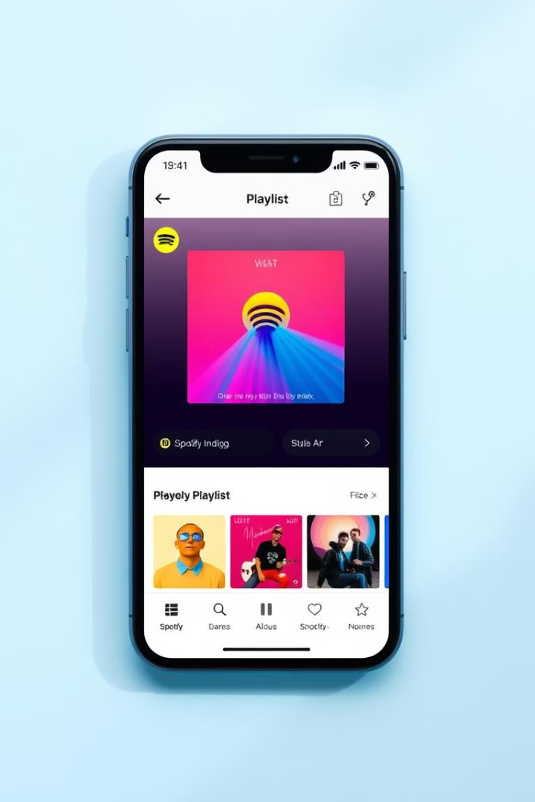

Spotify UI/UX Evaluation and Redesign Proposal
This presentation evaluates Spotify's user interface (UI) and user experience (UX), identifying key strengths and weaknesses. We will explore the app's visual design, usability, navigation, and performance, highlighting areas for improvement to enhance user engagement and satisfaction.
by Quwamdeen Durojaiye

Slide 2
Spotify App Overview
Purpose
Target Audience
Core Features
Spotify is a digital music, podcast, and video service providing access to millions of songs and content from creators worldwide.
The target audience is broad, encompassing music lovers of all ages, demographics, and tastes, with a focus on younger, tech-savvy users.
Music streaming
Podcast streaming
Offline downloads
Social sharing
Personalized recommendations
Search and discovery

Slide 3

UI Evaluation: Visual Design
1
Strengths
2
Weaknesses
3
Typography, Colors, and Iconography
Spotify has a clean and modern design. The dark theme is visually appealing and reduces eye strain, especially in low-light environments.
The visual consistency can sometimes be inconsistent between different sections of the app (e.g. podcast page vs music page).
The use of circular font is easily readable. The green color is iconic and recognizable. Icons are generally clear and intuitive.

Slide 4
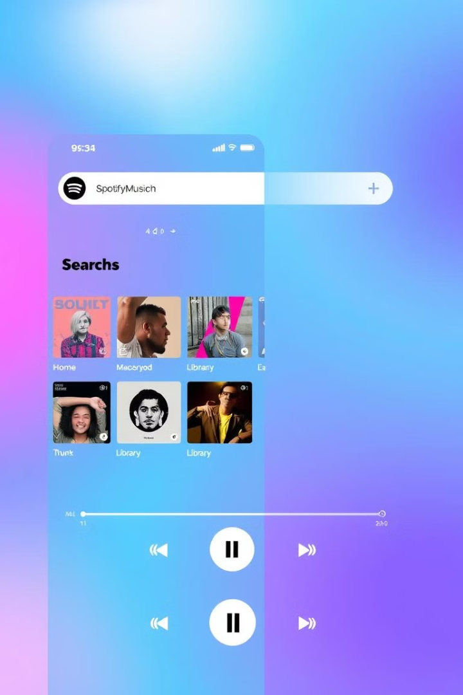



UX Evaluation: Usability & Navigation
The search function is powerful and effective. Creating and managing playlists is relatively straightforward.
The bottom navigation bar on mobile is intuitive and provides quick access to core features.
Music playback is generally smooth and reliable.

Slide 5
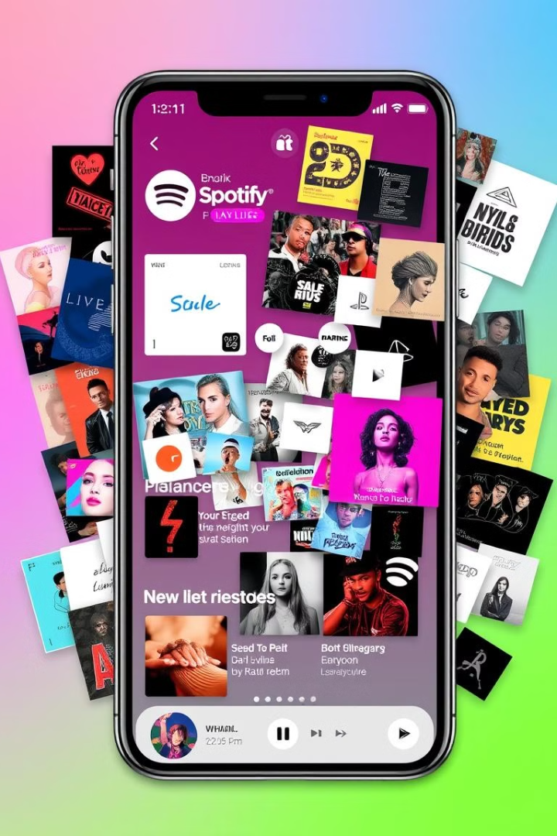



Problem 1: Cluttered "Home" Section
Explanation
The "Home" section displays a large amount of content, including recently played items, recommended playlists, and new releases. This can overwhelm users.
Impact
Reduces user engagement and discoverability of new content.
Solution
Implement better filtering and categorization options to declutter the "Home" section and improve content discoverability.

Slide 6



Problem 2: Inconsistent Navigation
Impact
2
Leads to user frustration and confusion.
Explanation
Navigation within the "Podcast" and "Library" sections is inconsistent. Back buttons may not always return to the previous screen.
1
Solution
Ensure consistent back button behavior and clear information hierarchy within all sections of the app.
3

Slide 7
Problems 3 & 4: Podcast Discovery & Font Size
Podcast Discovery Challenges
Small Metadata Font Size
Finding new and relevant podcasts can be difficult due to the lack of effective filtering and categorization options, limiting user engagement.
On Mobile devices, the font size for artist names, album titles, and other metadata is often too small, decreasing readability and accessibility.

Slide 8
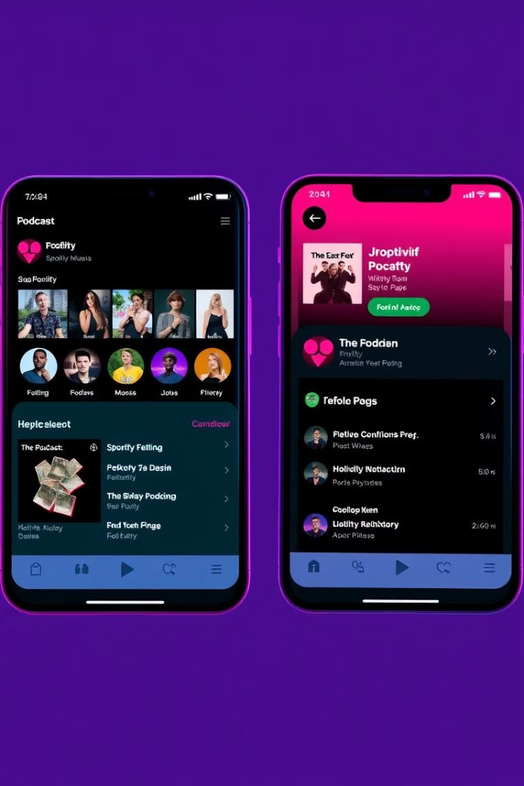
Problem 5: UI Inconsistency
Explanation
Impact
Some UI elements change between the music and podcast sections, causing a jarring experience for the user.
Breaks immersion and lowers the overall polish of the application.
Solution
Maintain consistent UI elements across all sections of the app to provide a seamless and polished user experience.

Slide 9
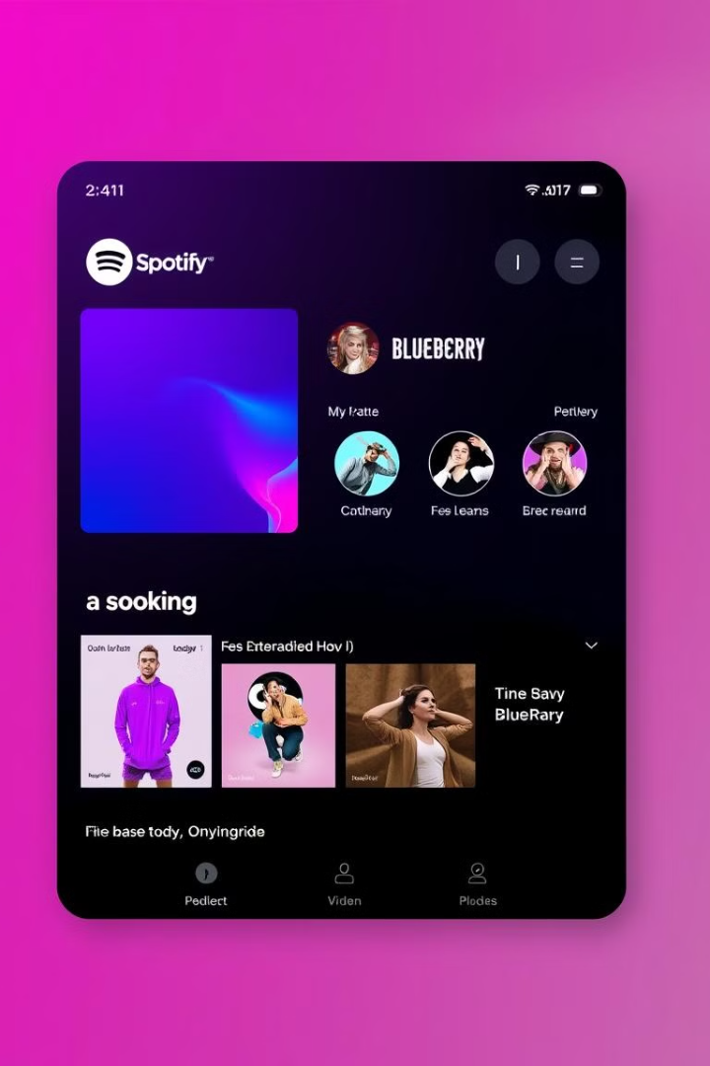
Redesign: Cluttered Home Section
The redesign addresses the cluttered home screen.
It introduces a tabbed interface for clear categories. These include "Recently Played", "Recommended", and "New Releases".
Customizable filters allow users to personalize their feed. This enhances content discoverability.

Slide 10
Conclusion
1
Key Findings Summary
2
Benefits of Redesign
Identified critical areas for enhancement in Spotify's UI/UX.
The proposal addresses key pain points. It enhances usability.
3
Future Considerations
4
User-Centered Design
Continuous user feedback ensures ongoing improvements.
A user-centric approach is vital for app improvements.

Slide 11
Slide Deck: Key Considerations
1
Clear Language
2
Visual Support
Use simple words. Ensure clarity and easy comprehension.
Add mockups. Also use screenshots for analysis.
3
User-Centered Design
4
Clean Design
Prioritize user needs. Focus on usability principles.
Maintain a simple design. This shows professionalism.

