Slide 1
Centralized Services Node

Slide 2
Introduction
A centralized Services Node offers a new deployment model that enables hosting a services node in a data center.
Provides 3G UMTS and 4G LTE service to a small medium enterprises (SME).
Each enterprise requiring no more than ten radio nodes.
The radio nodes at each SME will be connected to the centralized services node via fronthaul.

Slide 3
Centralized Services Node Architecture

Slide 4
Provisioning the Services Node

Slide 5
Provisioning the Services Node
Provisioning the centralized services node is similar to the existing procedures for stand-alone on-premises services node.
Upload the root certificate of the Security Gateway via the Local Configuration Interface (LCI).
Upload an LCI-profile that includes:
Security Gateway credentials such as IP Address, Layer3Forwarding, attributes to be used for IKE negotiation with Security Gateway, etc.
Management server configuration for connectivity to SpiderNet.
LAN-Device configuration including IP-Address for Core Network connectivity (for example, via LAN-Device 1).
NOTE: Ensure IP address assigned for this LAN Device is reachable from the SME locations where the Radio Nodes will be installed. This IP address should be configured as the DHCP Option 43 Controller-IP at the SME.

Slide 6
Provisioning the Services Node
After the centralized Services Node has connected to SpiderNet, use standard procedure to perform the following operations:
Upgrade the centralized Services Node software to the latest qualified release, if applicable.
Download relevant templates from SpiderNet associated with performance, fault and file management aspects.
Before the Radio Nodes can connect to the centralized Services Node, it is important to create RF Zones on the centralized Services Node.
Grouping one or more Radio Nodes into RF zones enables independent RF management, including provisioning operational RF parameters and self-configuring (such as neighbor relations and transmit-power) through REM scans without affecting other operational zones.

Slide 7
Provisioning the Services Node
Recommended zone configuration for Dual Mode UMTS+LTE Deployments
Band-specific zones are not required for Dual Mode deployments.
Configure UMTS and LTE site-specific zones to enable independent SON and REM scan operations per-site.
Since each services node supports a maximum of 100 Dual-Mode radio nodes.

Slide 8
Recommended zone configuration for Dual Mode UMTS+LTE Deployments
For UMTS
Provision system-wide attributes such as PLMN-ID, Operating UARFCN, PSC pool, etc. System wide attributes are configured via the ‘FAPService’ data model attribute, instead of zones.
Configure UMTS site-specific zones to enable independent REM scan and SON procedures per-site. For example, configure UMTS Zone “X” for UMTS cells at Site # ”X”.

Slide 9
Recommended zone configuration for Dual Mode UMTS+LTE Deployments
For LTE
Provision system-wide attributes such as PLMN-ID, Operating EARFCN, Bandwidth, etc. System wide attributes are configured via the ‘FAPService’ data model attribute, instead of zones.
Configure LTE site-specific zones to enable independent REM scan per-site. For example, configure LTE Zone “X” for LTE cells at Site # ”X”.

Slide 10
Recommended zone configuration for Dual Mode
When Site #X is installed with one or more Radio Nodes, the mapping will be as follows:
- UMTS cells will be added to UMTS Zone ‘X’
- LTE cells will be added to LTE Zone ‘X’
Recommended zone configuration for Dual Mode use-case

Slide 11
Connecting Radio Nodes to a centralized Services Node

Slide 12
Pre-Requisites for installing Radio Nodes at SME
Ensure the following on-site requirements are understood prior to the installation of the Radio Nodes:
Number of Radio Nodes: Based on coverage and capacity requirements, determine the number of radio nodes required for the SME location.
Note that the centralized Services Node supports a maximum of 100 Dual Mode, or Dual Carrier LTE Radio Nodes, with a maximum of 10 radio nodes per SME
If a site requires more than 10 radio nodes, the design should consider installing on-premises Services Node.

Slide 13
Pre-Requisites for installing Radio Nodes at SME
Availability of LAN Equipment:
An enterprise DHCP server with support for Option 43 will be required to provide the radio nodes, both its own an IP address and that of the centralized Services Node.
Is the Vendor Specific Information. This option is used by clients and servers to exchange vendor-specific information
Ensure the DHCP server is configured with centralized Services Nodes publically reachable IP address. The string included by the Radio Node, in DHCP Option 60 will be “SpiderCloud RN”.
Vendor class identifier.
Is a text string that uniquely identifies a type of vendor device.
Identifies and associates a DHCP client with a particular vendor.

Slide 14
Pre-Requisites for installing Radio Nodes at SME
Also ensure DHCP server assigns IPv4 addresses to the Radio Node.
Ensure PoE+ ports, configured for 25W of power is available to power the Radio Nodes.

Slide 15
Pre-Requisites for installing Radio Nodes at SME
Ensure WAN connectivity from the SME location to the centralized Services Node adheres to the supported latency and jitter requirements.
Round trip latency.
UMTS-only, or Dual-Mode deployments with UMTS.
Up to 20msec round trip latency is recommended. If latency degrades beyond the recommended value, it could degrade UMTS call performance, due to packet loss on the RAN.
LTE-only deployments.
In the case of LTE-only deployments (including Dual-Carrier LTE), a round trip latency of up to 50msec on the fronthaul is recommended. If latency degrades beyond the recommended value, it could degrade VoLTE quality.

Slide 16
Pre-Requisites for installing Radio Nodes at SME
Up to 3msec mean packet delay variation
Up to 1% round trip packet loss
Bandwidth to the SME is dependent on the number of subscribers at the site, and desired LTE quality of user experience.

Slide 17
Pre-Requisites for installing Radio Nodes at SME
Ensure the relevant firewall ports within the SME are opened to connect the Radio Nodes to a centralized Services Node.
Firewall ports to be opened at SME

Slide 18
Radio Node Post Installation procedures
Initiate a REM scan through SpiderNet for the new site (via site-specific zone-ID).
As an optional step, the new zone can be put into a closed mode via the CSG per zone feature.
Configure a test UE’s IMSI, in the IMSI access list, to ensure basic call setup functionality before putting the zone into open access mode to provide general service.
Execute link test to a targeted Radio Node via the centralized Services Node, including estimating fronthaul bandwidth to specific Radio Nodes.

Slide 19
Centralized Services Node Fronthaul Requirements

Slide 20
Centralized Services Node Fronthaul Requirements
The services node must be reachable over the WAN and not hosted behind a NAT.
Ensure that the WAN routers between the services node and the radio node support Quality of Service (QoS) and prioritize packets based on DSCP marking of IP packets.

Slide 21
Other recommendations for Centralized Services Node deployments
Single LAC/TAC is sufficient and recommended across all Radio Nodes served by a centralized Services Node.
For UMTS Public Warning message broadcast, configure a single Broadcast SAC (service area code) across all Radio Nodes (dependency on HNBGW for multiple Broadcast SAC support).
Configure a common UMTS SAC for each cell in a zone, if applicable for Emergency calls.
Configure a common LTE TAC, or geographic coordinates for each cell in an LTE zone, if applicable for Emergency VoLTE calls.

Slide 22
Required Equipment
Equipment | Description
1x SN9000 | SpiderCloud ServicesNode
RN310 | SpiderCloud RadioNodes
1x WAN/ISP | Fronthaul
1x Cisco 3560CX-8PC-S | POE+ switch with dhcp option43 and option 60
Carrier Ethernet S1 | Backhaul to SN

Slide 23
Centralized Services Node Example Diagrams

Slide 24
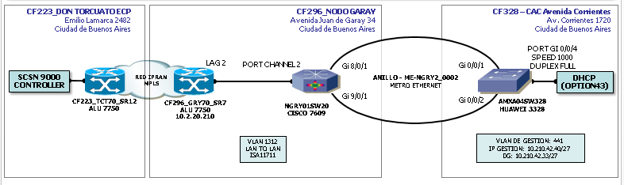
CAC CLARO. Diagram connection. Argentina
Por el lado de Torcuato, se conecta a un equipo del tipo IPRAN (CF223_TCT70) que está en Torcuato.
Por el puerto 2/2/19 del IPRAN, se establece la conexión con el SecGW.
Por el puerto 2/2/18 del IPRAN, se establece la conexión hacia el backbone MPLS / red Metro, que es donde se encuentran los SW MetroEthernet que posee AMX en los CACs.
En cada uno de los CACs, tenemos un equipo MetroEthernet (AMX HUAWEI). Se muestra el diagrama de conexiones del CAC Congreso, donde DHCP opción 43 es el SWPOE+ (los RNs estan conectados directamente al SW POE+)

Slide 25
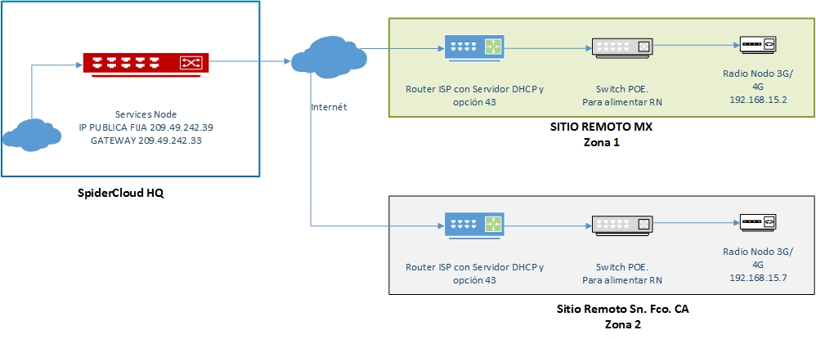
Lab ISP connection
Ensure the DHCP server is configured with centralized Services Nodes publically reachable IP address. The string included by the Radio Node, in DHCP Option 60 will be “SpiderCloud RN”. Also ensure DHCP server assigns IPv4 addresses to the Radio Node.

Slide 26
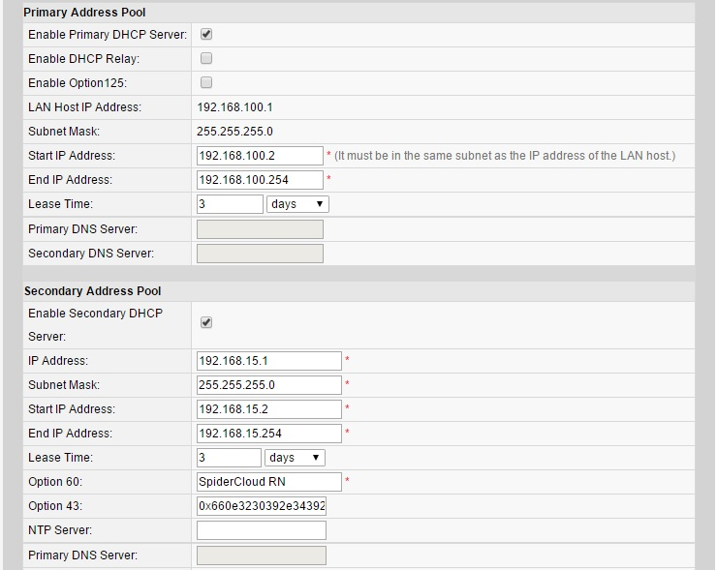
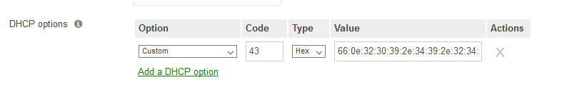
ISP router configuration example
Router 2. Mexico
Router 1. USA

