Slide 1

Before we start
Basic skill set required
Who can become Devops engineer
Scope for freshers
Overall schedule

Slide 2
Basic skill set required
Linux fundamentals
Perform basic command line operations with Linux machine.
Know about SSH
Network fundamentals
TCP/UDP
Firewall
Ports
IP address
DNS names
Infrastructure fundamentals
On-premise infrastructure
Cloud infrastructure

Slide 3
Who can become Devops Engineer
Cloud Engineers [Already might be familiar with cloud operations]
Focus :
More on operating system
More on Devops tools
System Engineers & System administrators (Linux/Windows) [Already might be familiar with operating systems]
Focus :
More on cloud
More on Devops tools
Database engineers [Already might be familiar operating systems]
Focus :
More on operating system
More on cloud
More on Devops tools
Network engineers [Already might be familiar with networking concepts]
Focus :
More on operating system
More on Devops tools
More on cloud
Developers : [Already might be familiar with coding concepts]
Focus :
More on operating system
More on Devops tools
More on cloud

Slide 4
Scope for freshers
Scope for Freshers?
For freshers who aspire to become devops engineer may not be possible immediately without any prior exposure.
Instead they can start their carrier as Junior Devops engineer or Cloud engineer and then gradually move towards full fledged Devops engineer.
Overall growth would be like
Junior Devops engineer
Devops Engineer
Senior Devops Engineer
Devops Architect

Slide 5
Overall schedule
Linux Basics
AWS
Terraform
Ansible
Docker
Kubernetes
Git
Maven
Jenkins

Slide 6
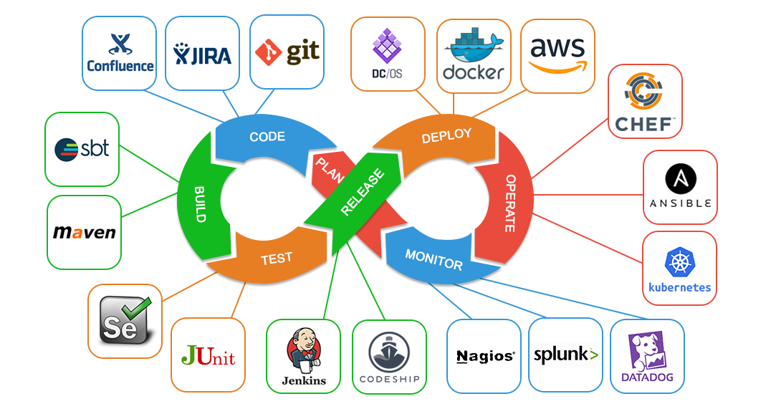
Any questions?

