Slide 1
Machine Translation using Seq2Seq model
Payraw Salih
Parth Shah

Slide 2
Dataset
The dataset used was the WMT'16 German to English sentence pair dataset. The data was taken from the Europarl v7, Common Crawl, and News Commentary v11 corpora.
The system obtains the dataset through a shell script which can be found in nmt/nmt/scripts/wmt16_en_de.sh

Slide 3
Subword Unit
Code: https://github.com/rsennrich/subword-nmt
Paper: http://www.aclweb.org/anthology/P16-1162
Developed for encoding rare words under the assumption that they're made up of smaller components
Useful in particular for German-English translation because of German's agglutinative word formation of noun lexemes.
Subwords are encoded using BPE – Byte Pair Encoding – and these subwords are used in the vocabulary.

Slide 4
Model
The Model consist of LSTM Recurrent Neural Network
The model can be divided in three parts Encoder, Attention, and Decoder
LSTM encoder is built of 1 layer of bidirectional_dynamic_rnn and remaining layers of 3 layers of dynamic_rnn for 4 layer model.
LSTM decoder is built of 4 layers of BasicDecoder with it’s cell wrapped in AttentionWrapper both available in seq2seq package
All layers use BasicLSTMCell as LSTM cell base available in TF’s rnn package.

Slide 5
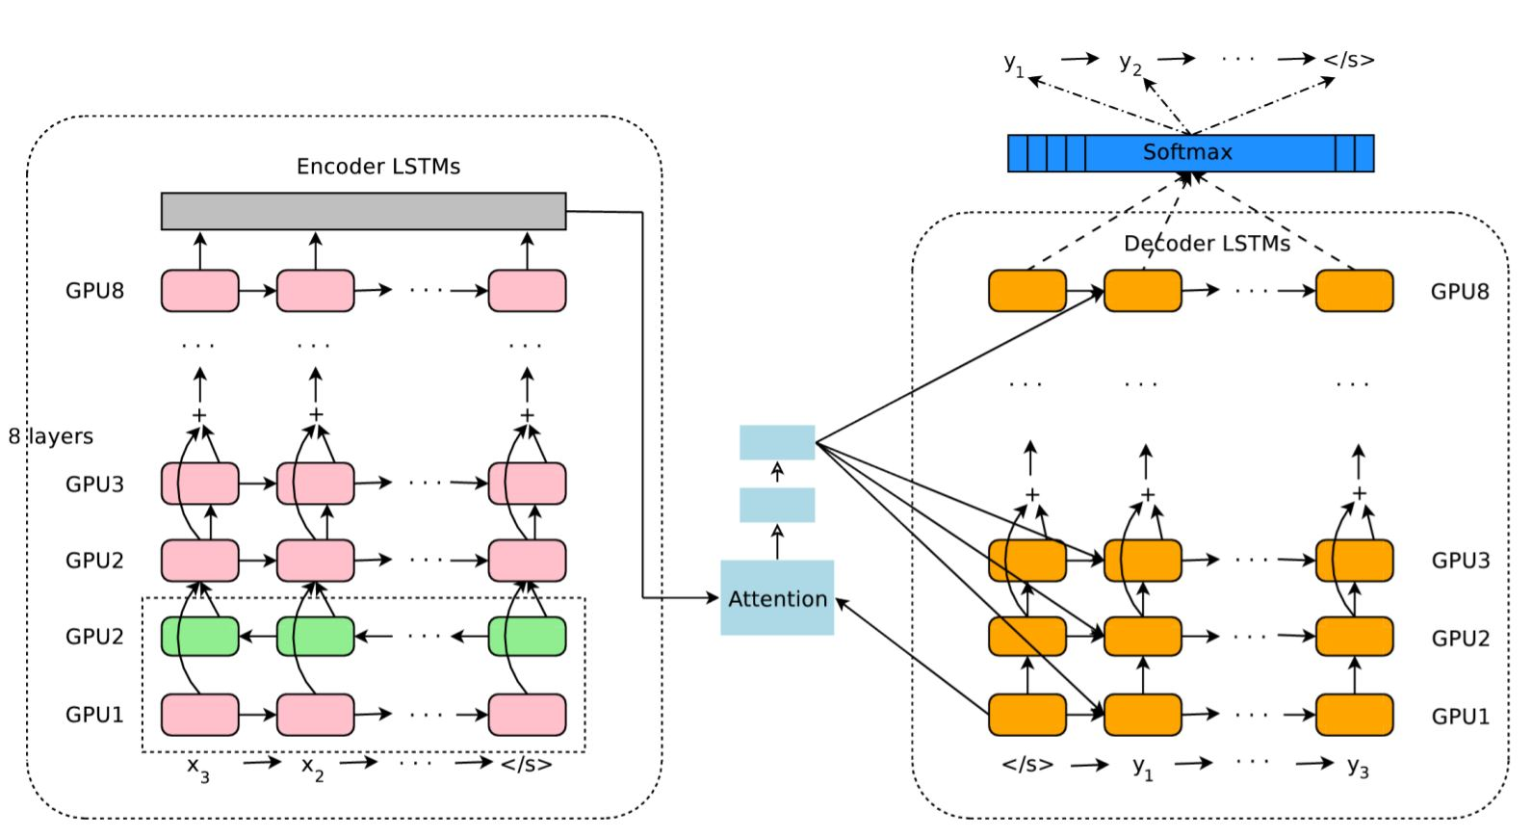
Model
Reference to our model

Slide 6
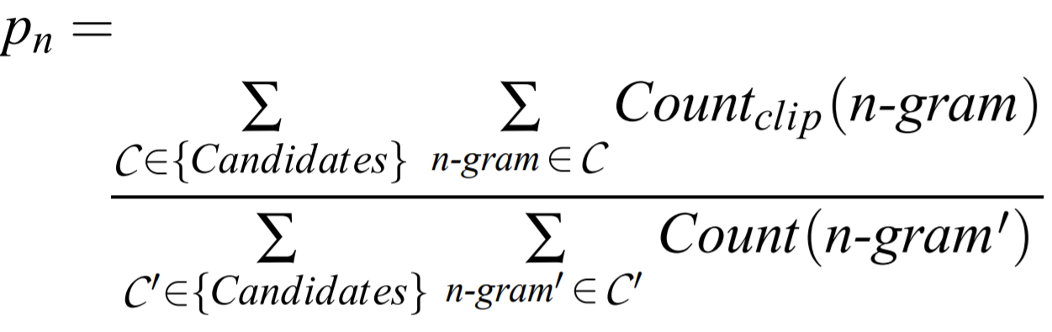
Metrics – BLEU score
Compute modified n-gram precision:
compute the n-gram matches sentence by sentence
add the clipped n-gram counts for all the candidate sentences
divide by the number of candidate n-grams in the test corpus to compute a modified precision score, pn:
Compute the geometric average of the modified n-gram precisions, pn, using n-grams up to length N and positive weights wn summing to one.

Slide 7
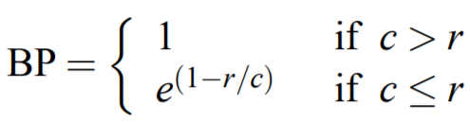
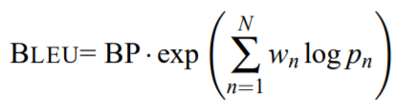
Metrics – BLEU score
Multiply the result by an exponential brevity penalty factor:
let c be the length of the candidate translation and r be the effective reference corpus length. We compute the brevity penalty BP:
BLEU score then is:

Slide 8
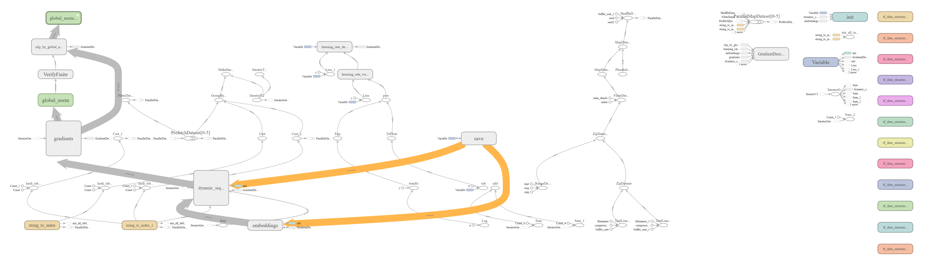
Computation Graph

Slide 9
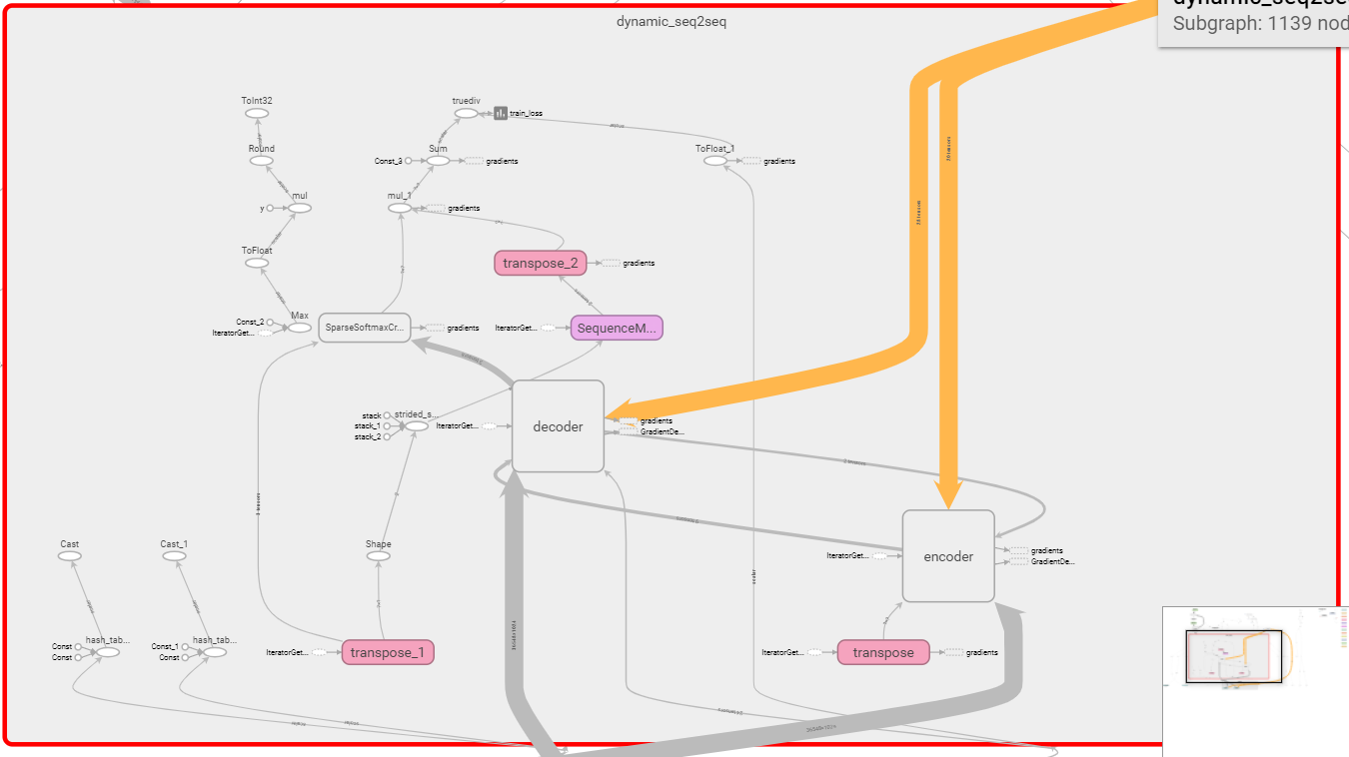
SEQ2SEQ model Graph

Slide 10
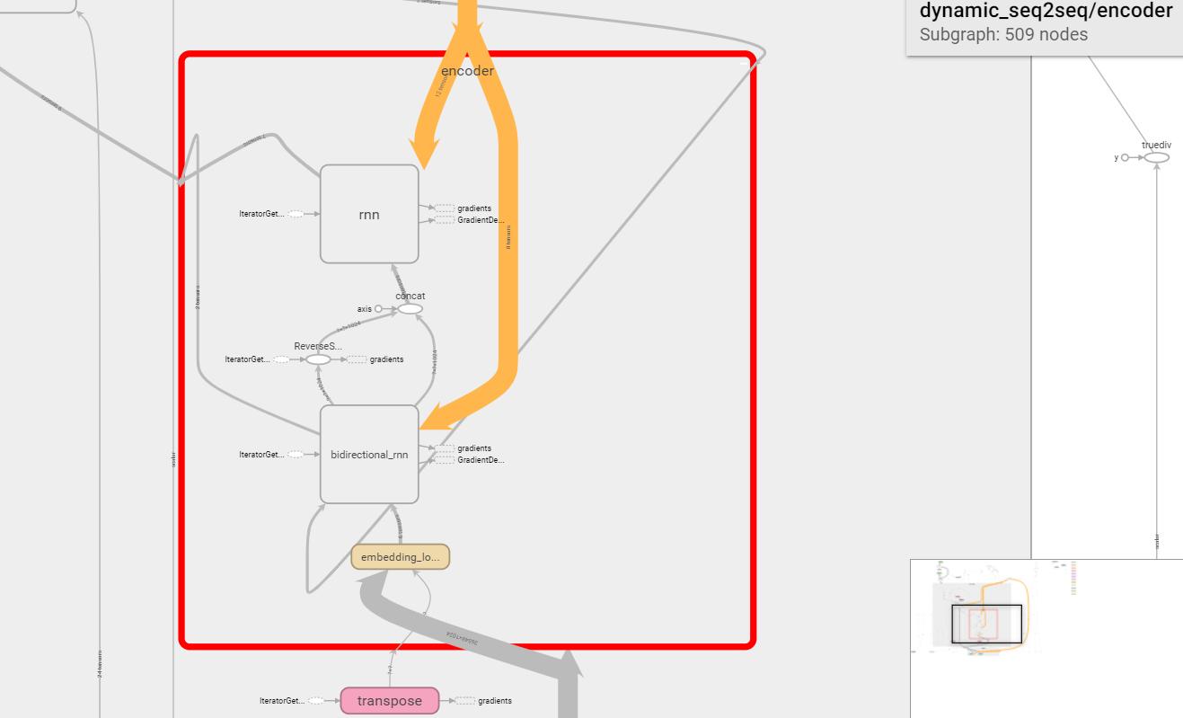
Encoder
3 layers
1 layer

Slide 11
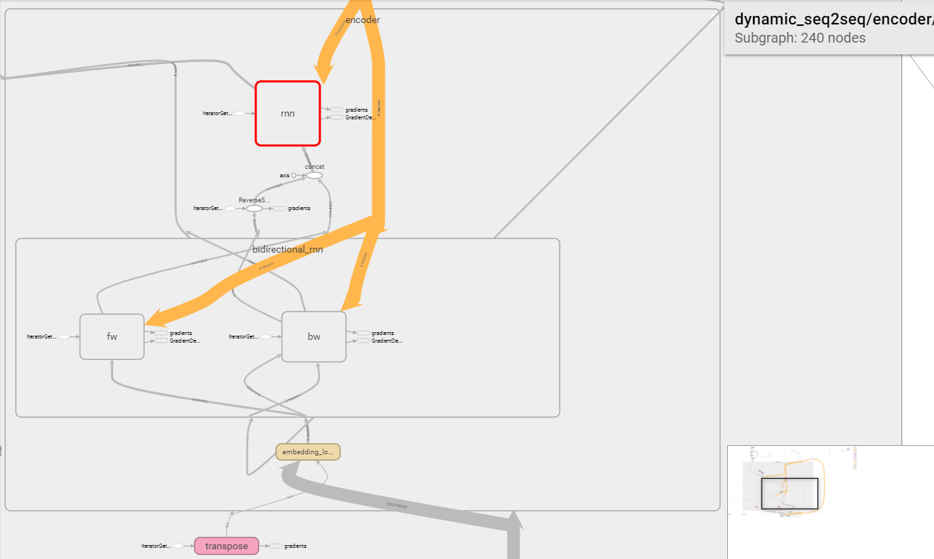
Encoder
3 layers
1 layer

Slide 12
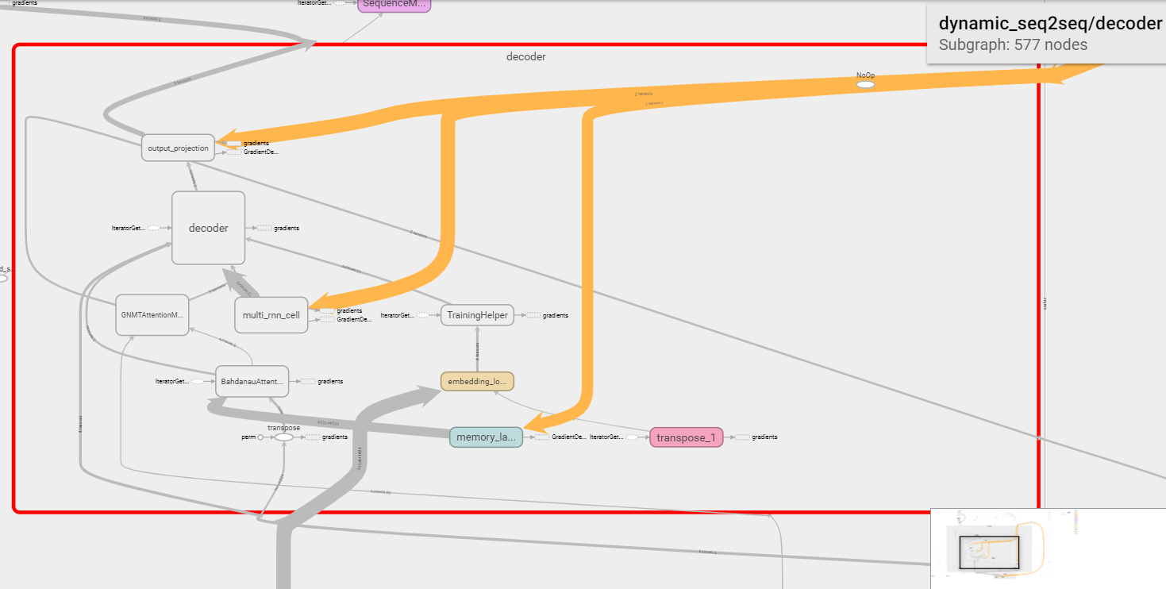
Decoder
4 layers
Attention Wrapper

Slide 13
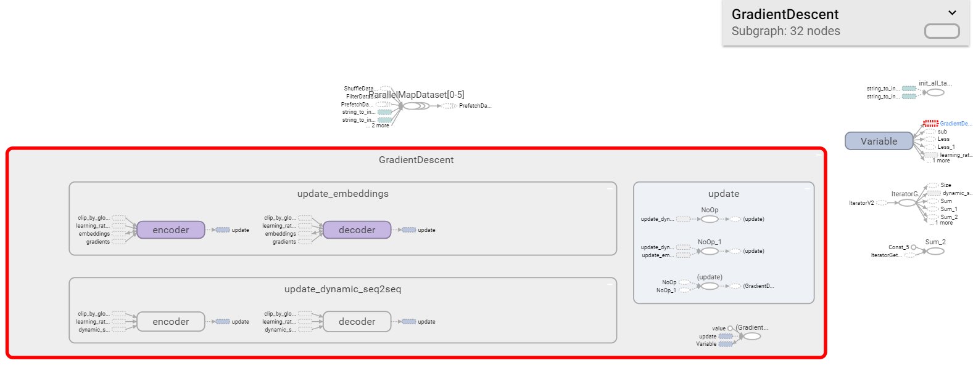
SGD optimizer

Slide 14
Computation Graph Explanation
Hash table is created for mapping words to word embeddings.
Iterator is created for iterating over dataset by network.
Data is gotten via iterator and entered into model.
Gradients are calculated and gradient clipping is applied for gradient descent.
Learning rate decay and warmup are also calculated for update steps.
The model periodically saves checkpoints, which it can load.

Slide 15
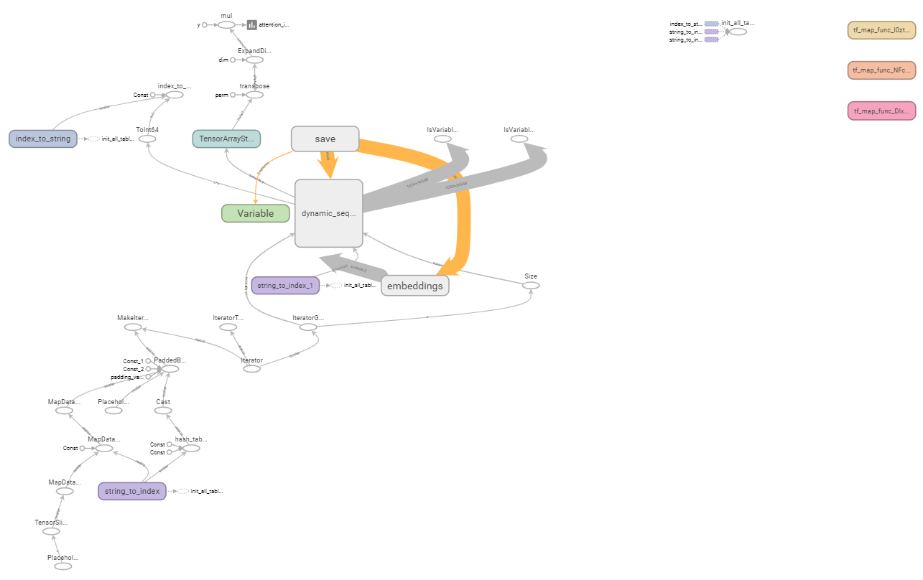
Inference Graph

Slide 16
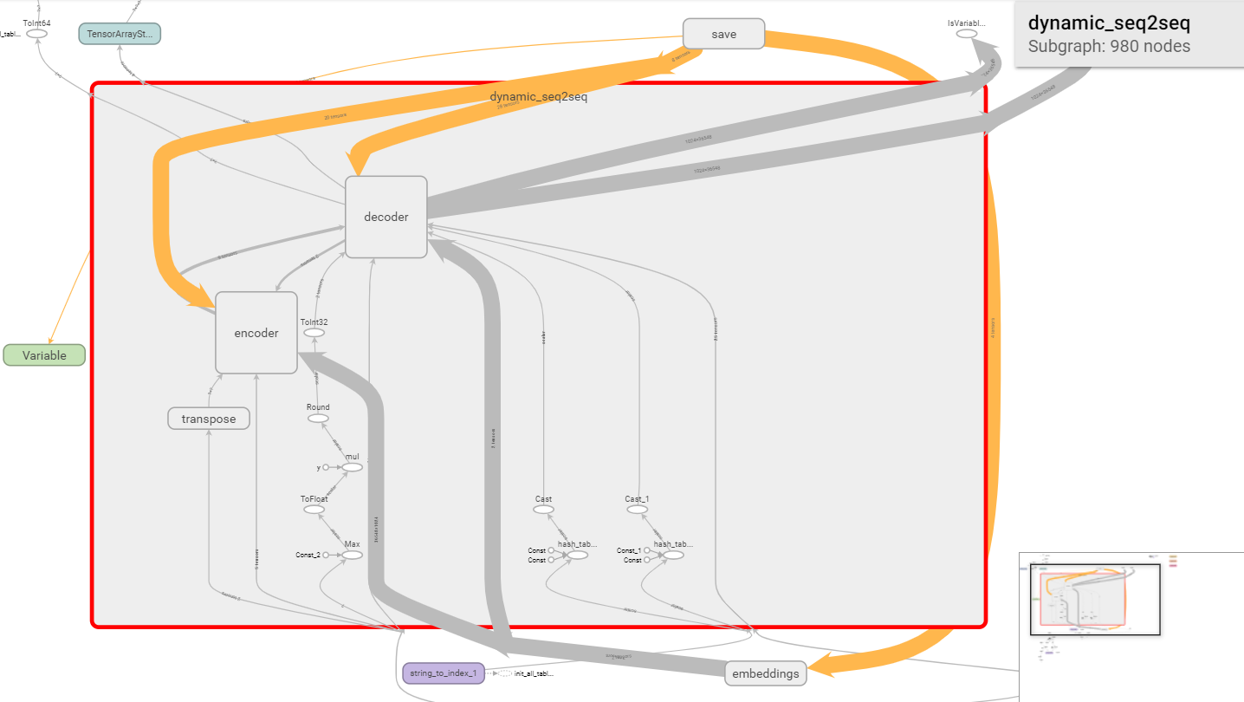
Model

Slide 17
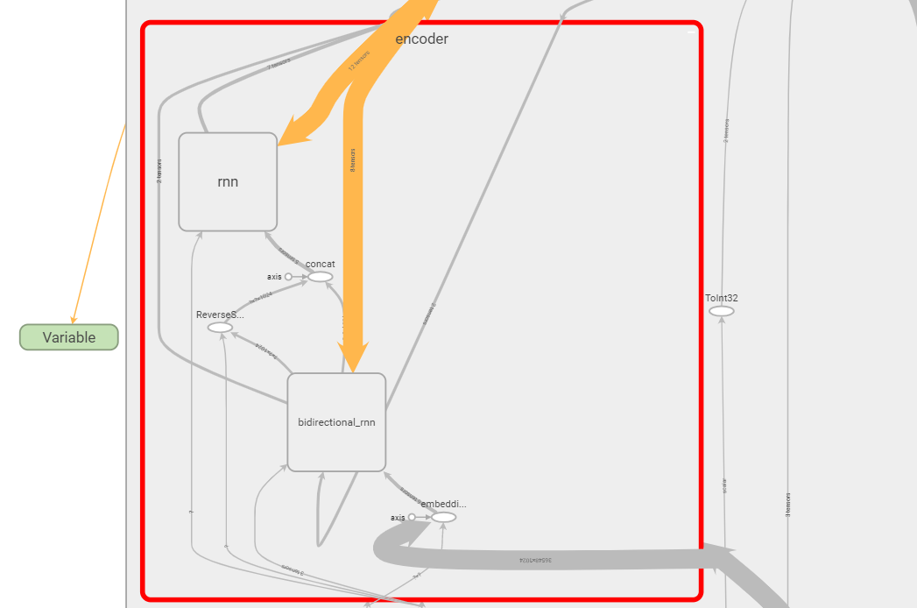
Encoder

Slide 18
Inference Graph explanation
Save node loads parameter values of encoder, decoder and embeddings nodes.
The graph on lower left in inference graph (string_to_index node) slide is responsible for converting string sentences to numeric tensors.
The tensors are fed into encoder where embeddings node convert numeric tensors to embeddings.
These embeddings are fed in to encoder, encoder’s output is sent to decoder node which produces sentences in form of embedding tensor, this is again processed by embedding node to produce numeric tensor.
The numeric tensor is converted back to sentences by index_to_string node.

Slide 19

Training parameters
4 layer model
Encoder: 1 bidirectional, 3 unidirectional;
Decoder: 4 unidirectional layers
2 layer model
Encoder: 1 bidirectional, 1 unidirectional
Decoder: 2 unidirectional layers
Units in layer: 1024 units (LSTM)
Optimizer : SGD
Batch size: 128
Search parameter: Beam search (width=10), bleu score metric
Learning rate: Start with 1 then change following t2t (warmup_steps=0):

Slide 20
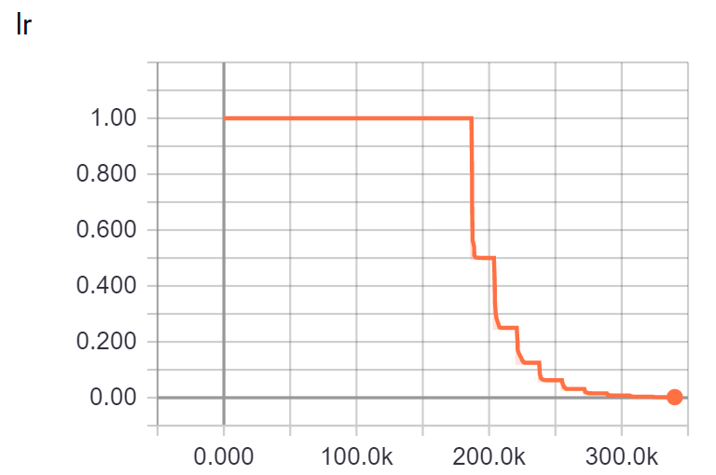
Learning Rate

Slide 21
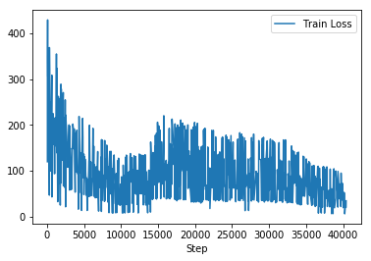
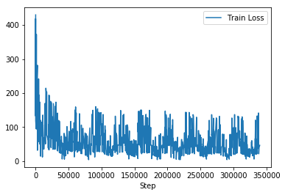
Training Loss
2 Layer GNMT
4 Layer GNMT

Slide 22
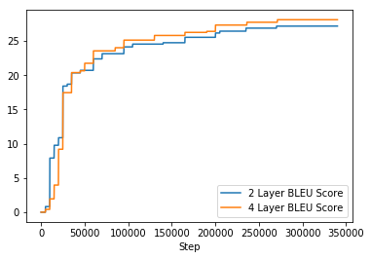
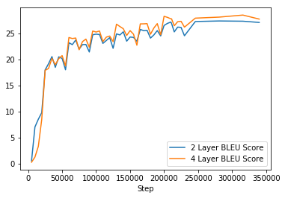
BLEU Score vs Step
Training
Test Set

Slide 23
Comparison
Model | BLEU Score
NMT (greedy) | 27.6
NMT + GNMT attention (beam=10) | 29.9
Our GNMT 2 layer | 27.6
Our GNMT 4 layer | 28.7

