Slide 1
Deep Neural Network Robotic Mapping based on 3D Scan
NICF- human robot systems engineering
Name: Ong Boon Ping (A0195172B), Cao Liang
Date: 7 Nov 2020
OVER

Slide 2
Introduction
Currently, SLAM can be performed with Kalman filter, particle filter and K-Means method.
With development of deep neural network, it is possible to train a neural network that can predict the mapping based on point cloud or lidar data.

Slide 3
Objective
The project is aimed to predict the 2D terrain and re-generate front/rear view image using neural network based on point cloud/Lidar data.

Slide 4
Dataset Preprocessing
The scan data are coordinates based on local frame centered at the point cloud sensor.
Hence, it is possible to convert it into 2D array before input into Convolutional neural network.

Slide 5
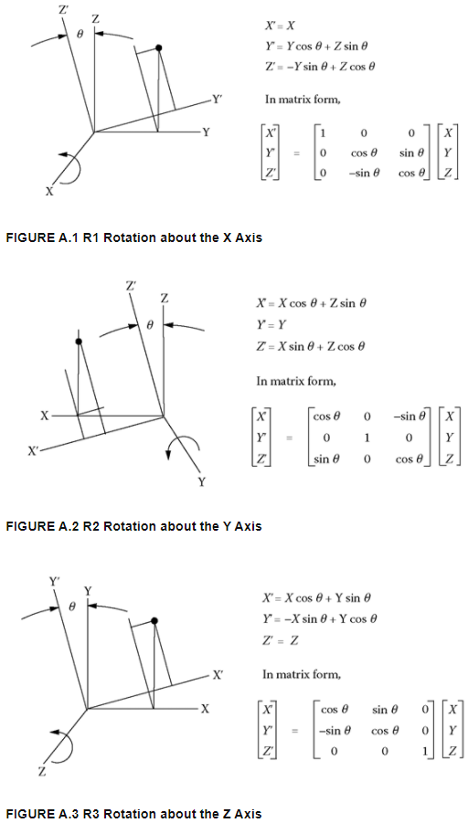
Dataset Preprocessing

Slide 6
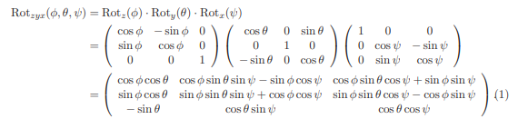
Dataset Preprocessing
In this dataset, Euler angle and GPS position is appended along with all the scan point in local Cartesian coordinates.
Hence, conversion is made using the rotation matrix.

Slide 7

Dataset Preprocessing
Interpolations can be done in between scan points and the sensor position.
The interpolation is limited to the grid point which is near to the ground level.

Slide 8
Design Idea
To process the 2D map prediction for the autonomous vehicle from pre-processed 2D map, we have 2 phases of neural network
Scan Points
Interpolation Area Identifier
Interpolation Value Refiner
Output 2D Map

Slide 9
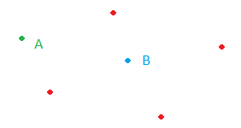
Design Idea
Interpolation area identifier focus on identification of unknown points that are in the interpolation bound.
A point which is out of interpolation bound can be wrongly predicted based on nearest scan point value.

Slide 10
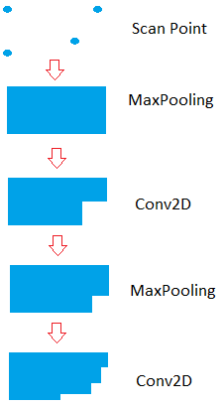
Design Idea
Interpolation area is identified through the Max-Pooling2D and Conv2D filters

Slide 11
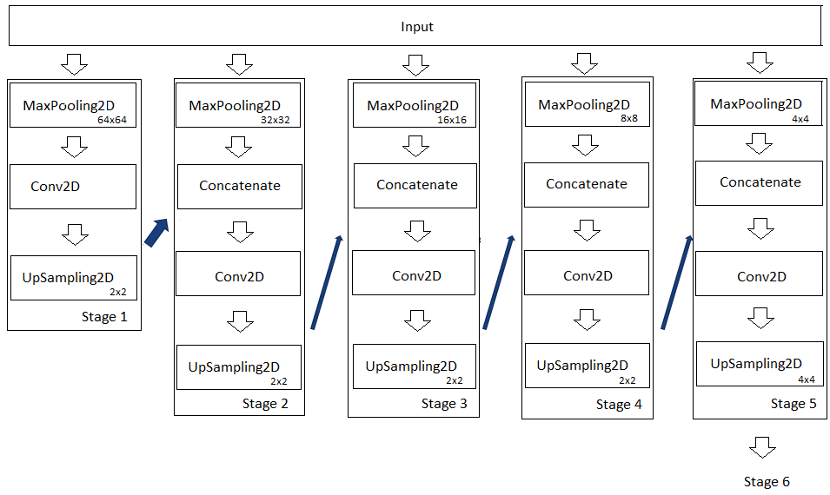
Design Idea
After the interpolation area is identified, the value of the pixel can be refined thru stages of Conv2D layers.

Slide 12
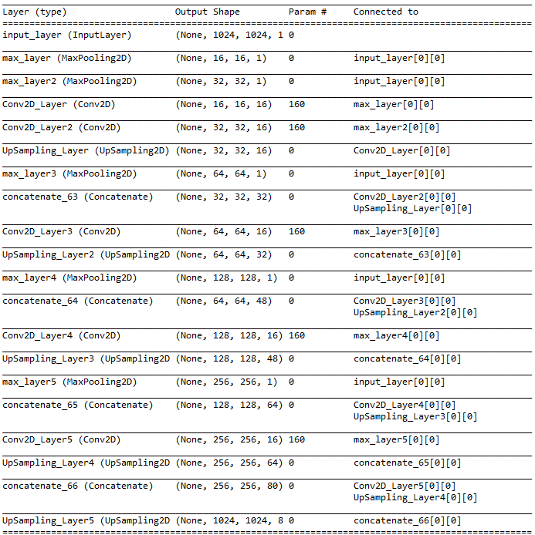
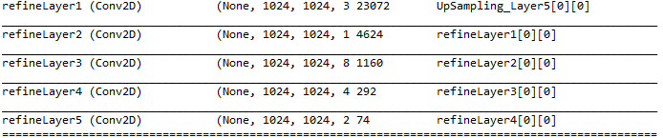
Neural Network Architecture

Slide 13
Training
The neural network is trained using 640 2D Point Cloud maps. Each map is taken from lidar scan on wall and various building surfaces.
The scan points are all collected from a single point cloud scan. The sensor is placed at different angle from the wall or building surfaces.
Each 2D Point Cloud map has a matching terrain map. As a result, the 2D Point Cloud map serves as input to the network while the expected output is the matching 2D terrain map.

Slide 14
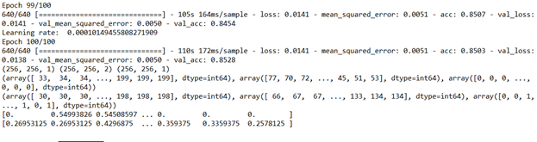

Training Result

Slide 15
Network Refinement
The design of stage 6 is further enhanced by changing the Conv2D with 6 residual blocks.
Each residual block is having 2 Conv2D layers with 3x3 kernel.
Residual blocks also reduce overfitting and hence provide better performance than simple Conv2D layer.
As a result, RESNET enhancement of the neural network

Slide 16
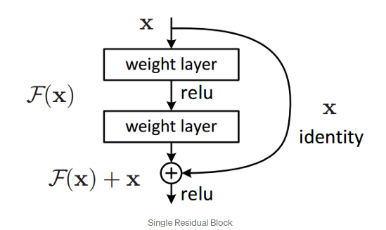
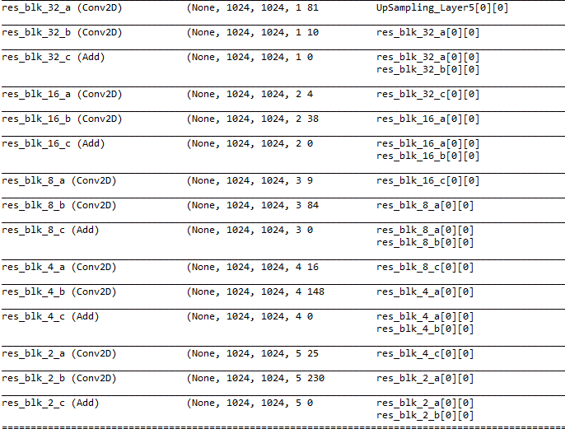
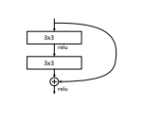
Network Refinement

Slide 17
Training Result
The RESNET has helped to increase the accuracy to 86.2%.
 | Accuracy | RMS Error
Neural Network (without RESNET) | 85.0% | 0.0051
RESNET Enhanced Neural Network | 86.2% | 0.0044

Slide 18
Application
The neural network is applied on the point cloud scan data gathered in Leibnitz University using autonomous robot.
During testing, the network model and weights are preloaded during system initialization.
Python script will be converting point cloud scan data into 2D map.
Interpolation is made on the newly created 2D map from the scan point to the source point

Slide 19
Application
Due to processing limitation, input is sliced into 1024x1024 regions.
After all the regions are processed by neural network, all the PNG image will be combined into one single output terrain map.
Since there are multiple scan files, previous output saved in PNG image will be preloaded before subsequent scan points are loaded.
The latest scan points will be overriding the existing values.

Slide 20
Testing Process

Slide 21
Testing Result
The neural network predicts the height value in unknown grid points.
The testing accuracy is 93% when comparing the generated map against the expect mapping.
Inaccuracy comes from noise reflected by the tree leaves and other objects.
Due to slicing, certain bordering pixel is not showing intended pixel.

Slide 22
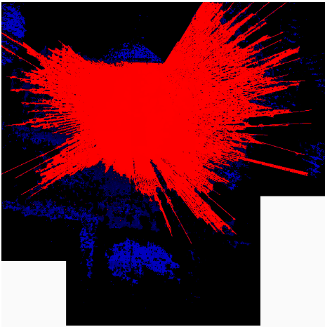
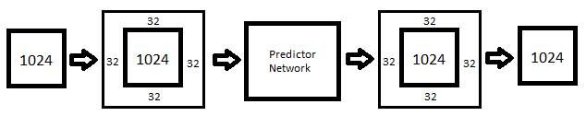
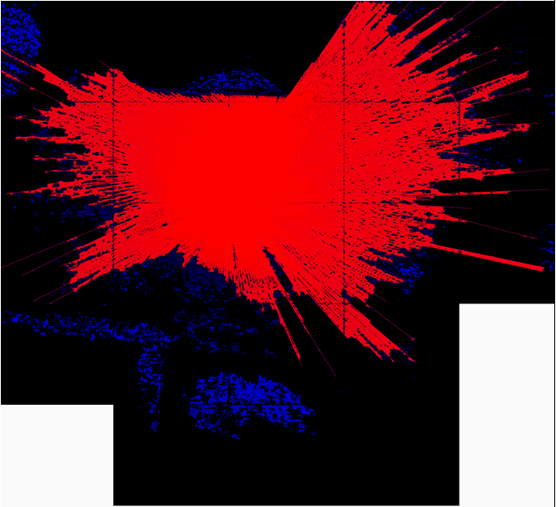
Testing Result
Without Padding
After edge noise reduction
Edge Noise Reduction

Slide 23
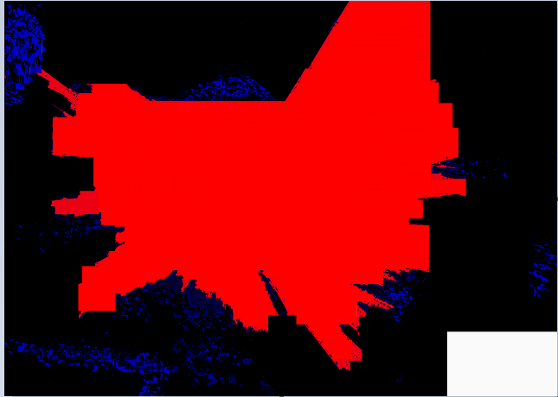
Testing Result
Expected Map
Neural Network Generated Map

Slide 24
Testing Result
The RESNET enhanced neural network is having higher testing accuracy of 94.8% when comparing the generated map against the non-RESNET neural network.
Noise reflected by the tree leaves and other objects has been reduced.

Slide 25
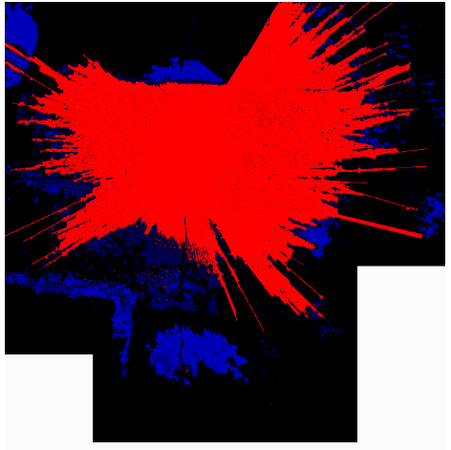
Testing Result
RESNET Neural Network Generated Map
Neural Network Generated Map

Slide 26
Testing Result
K-means algorithm is also used to generate the result.
The testing accuracy is 70%. The method is using Means of nearest 7 neighbors.
Hence, neural network can generate the 2D mapping better than the K-means filter on Lidar/Point cloud scan data.

Slide 27
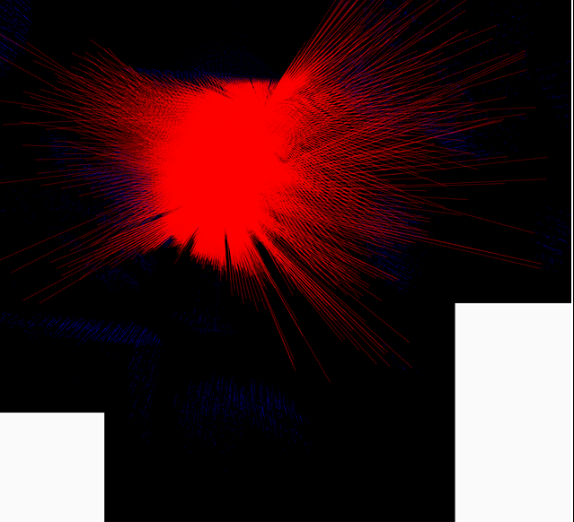
Testing Result
K-means generated map
RESNET Neural Network Generated Map

Slide 28
Testing Result
K-Means method is not able to make prediction accurately when the distance between scan points are further away. (clustered with wrong points at boundary)
In comparison, 1st MaxPooling2D layers have a pooling area of 64x64 pixels. It allows the prediction to be made in between scan points that have distance of 64 pixels.
Hence, neural network is performing better than the K-Means method.
The RESNET enhanced neural network is performed better since it has deeper layers than the non-RESNET enhanced neural network.
Network | Accuracy
Neural Network (without RESNET) | 93.0%
RESNET Enhanced Neural Network | 94.8%
K-Means | 70%

Slide 29
System Design - Visualization

Slide 30
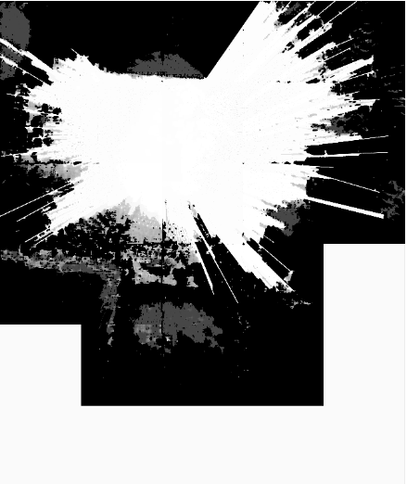
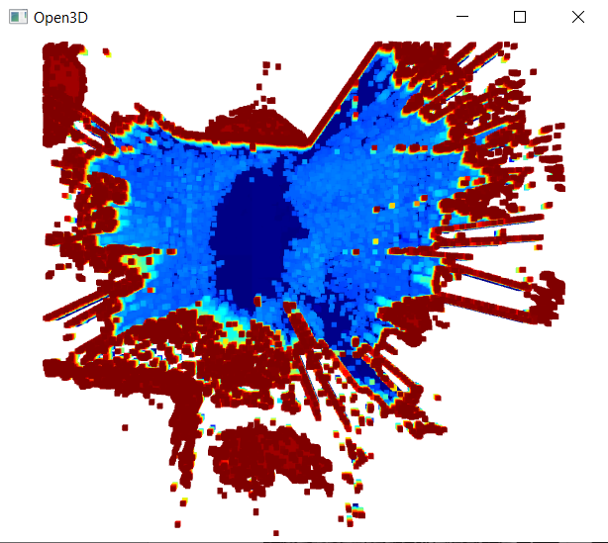
Open3D Visualizer
Input Data
Grayscale 2D map
Robot localization
robot position
orientation
Output Views
Map
Front / Rear View

Slide 31
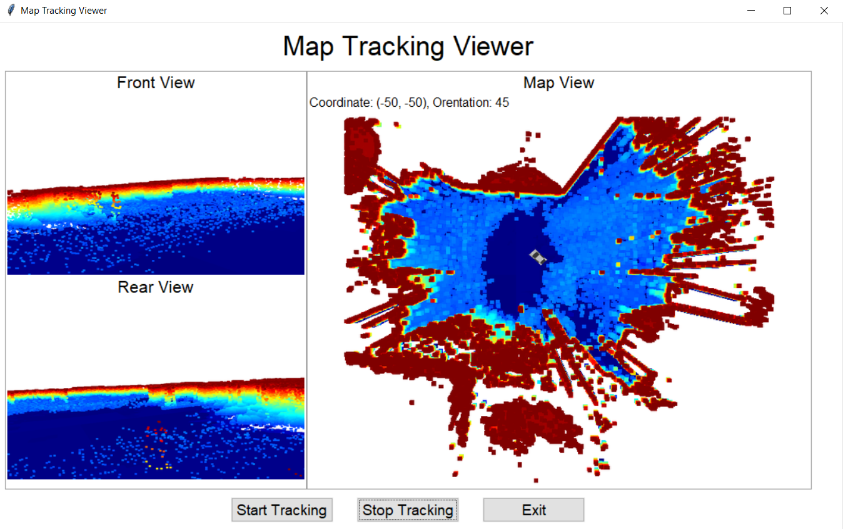
Map Tracking Viewer
Python Tkinter GUI
Robot Simulation
Position
Orientation
Visualization
Map
Front / Rear View

Slide 32
Future Usage
Localization Algorithms
Monte Carlo Localization (MCL)
Most popular in robot localization
Also referred to as Particle Filter
Relies on
Accurate Environment Map
Particle position and orientation
Adaptive Monte Carlo Localization (AMCL)
Improved version of MCL
Deep Neural Network Robotic Mapping
Produces more accuracy map
Comparing with traditional approach such as k-means
Therefore, Deep Neural Network Robotic Mapping will benefit AMCL with more accurate map, and will provide map when map is not available

Slide 33
Thank you! ☺

