Slide 1
Autonomous Burn-in BOARD CART
NICF- Robotics systems
Name:Ong Boon Ping (A0195172B)
Date: 5 July 2020
OVER

Slide 2



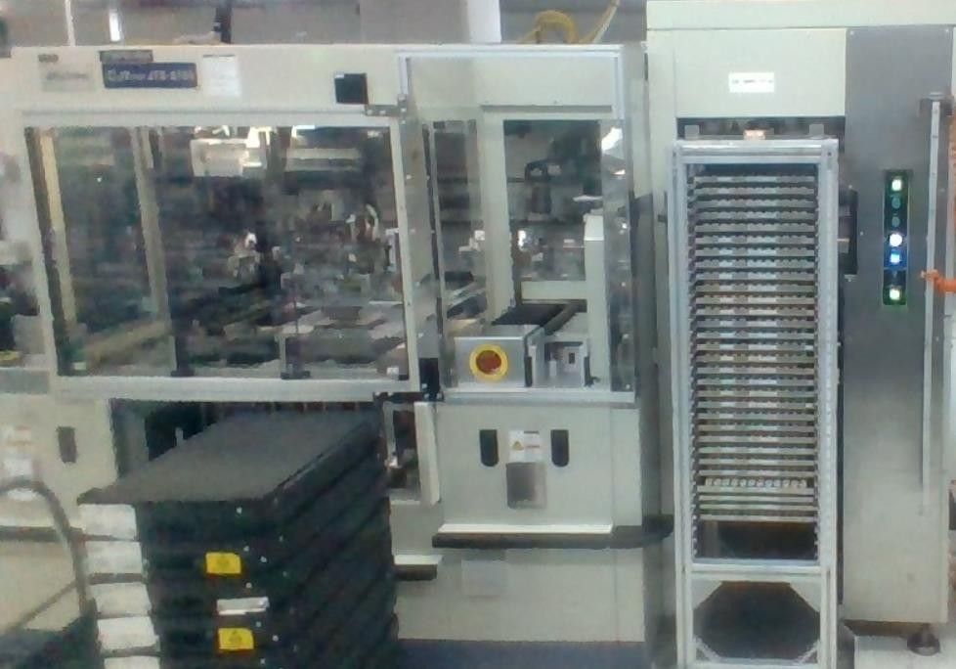
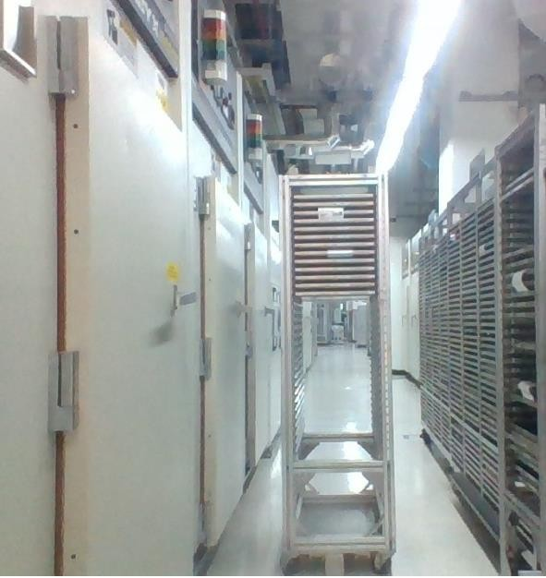
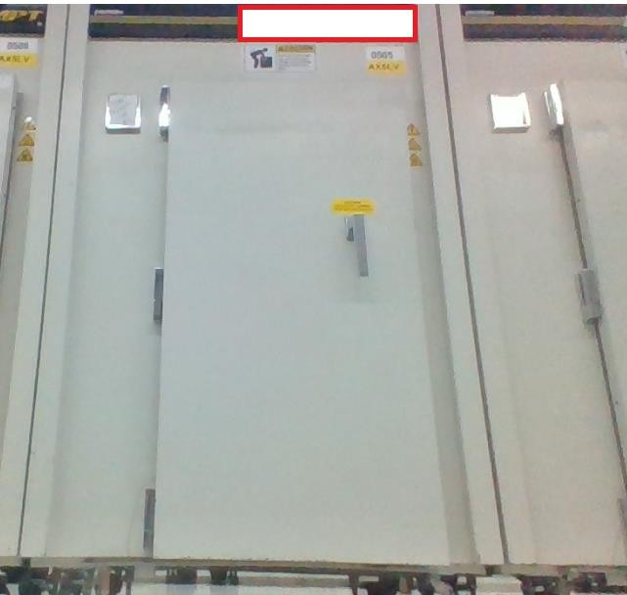
Introduction and Business Case
On the Burn-in testing production floor, 15 loaders are used to load the IC chip onto burn-in board.
Operators are required to push the burn-in board cart from loader to oven.
To prevent injury and reduce manpower, autonomous cart is feasible here

Slide 3
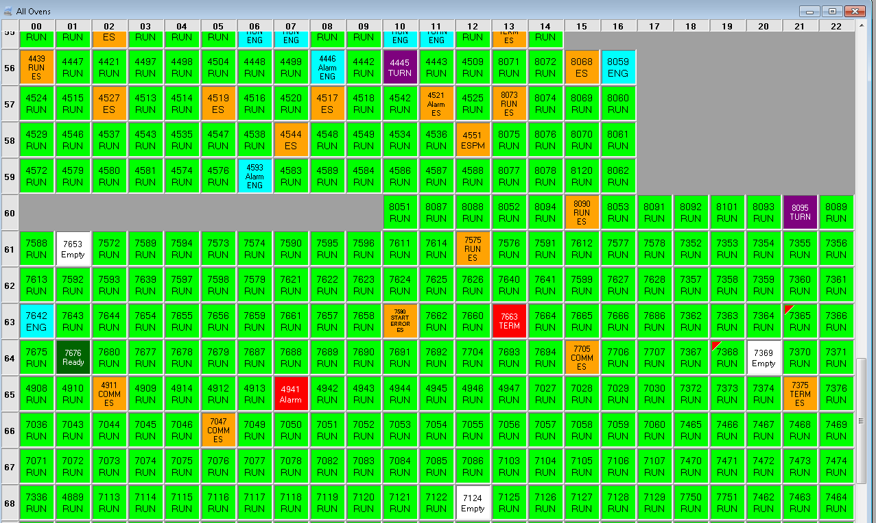
Introduction and Business Case
In long run, manpower reduction saves cost
Development cost of autonomous cart is one time off and maintenance cost is cheap.
It also reduces delay since planning of movement can be centralized using autonomous carts.

Slide 4
Objective and Requirements
The objective is to design an autonomous cart that can eliminate the need of operator in pushing the cart by moving cart based on the target given.
The technical requirement is to have
1. Centralized master PC generate destination positions (oven/loader/power station), maintaining mapping and localization of multiple carts (swarm).
2. The cart is required to perform obstacle sensing and avoidance, broadcast fingerprint Wifi signal, motor actuation.

Slide 5
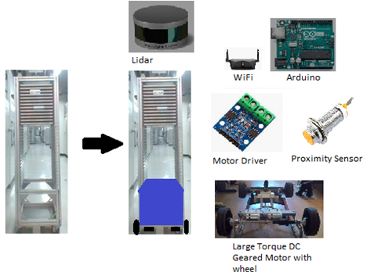
Cart Design
The cart is supposed to perform obstacle sensing and avoidance (object <1 m) using lidar and Arduino.
Sensing is using proximity sensor to detect loaders entry.

Slide 6
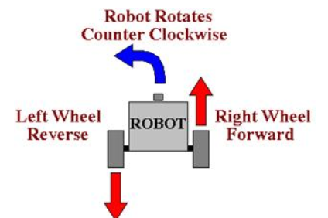
Cart Design
Motor is controlled by Arduino using the driver. Odometry is done thru the encoder feedback so to control speed and acceleration.
Differential steering is used since production space can be limited. Electrical locomotion is used since electric station can be built easily.

Slide 7
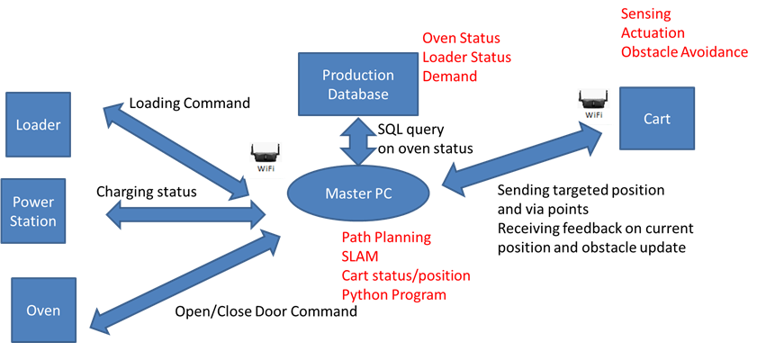
Interaction plan

Slide 8
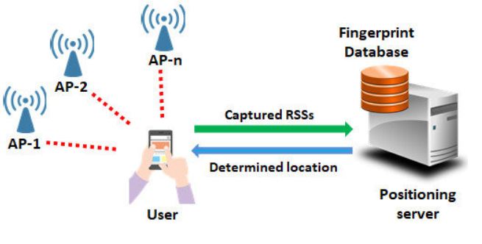
Localization
Using Wifi Positioning System.
Cart will send out fingerprint signals to several WIFI transmitter.
Based on signal strength, master PC which gets back data from transmitter, can estimate the exact position of cart in production floor.

Slide 9
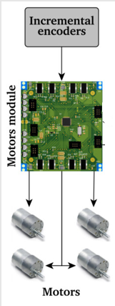
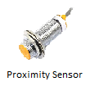

Robotic Flow Process
Wifi Fingerprint Signal
Wifi Positioning Signal
Path Planning
Issue Signal
Cart Path
Command
Wheel Controller
Arduino Cart Control
Master PC (Python program)
Update obstacle
Status/Obstacle
Mapping
Odometry
Signal Conditioning
Sensors
Target Location
Destination Planning
Production SQL Database
Cart
Master PC

Slide 10
Production and Maintainence
The wheel needs to be replaced with suitable wheel that can be catered for Geared DC motor.
Power station will be built for recharging.
With obstacle avoidance, the cart is not expecting damages.
The maintenance is performed every 3 months to examine for hauled wheels.

Slide 11
Thank you! ☺

