Slide 1
Autonomous testing board loader
NICF- AUTONOMOUS ROBOTS AND VEHICLES
Name: Ong Boon Ping
Date: 19 Aug 2020

Slide 2
Introduction and Business Case
In memory system test development, a sample memory card is usually inserted into customer provided system for testing.
Delay in memory system test development cause loss of opportunity of gaining customers’ contract.
Hence, autonomous memory system loader is important in testing a specimen memory system card using different customer server system.

Slide 3
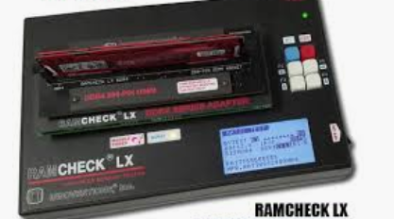
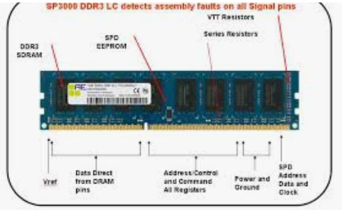
Objective and Requirements
The objective is to design an autonomous robotic arm that can insert the memory card from designated input area to target customer system.
The technical requirement is to have
1. The autonomous robotic arm must recognize the designated area with memory card and maneuver to the input area.
2. The autonomous robotic arm must recognize the targeted server and insert the memory card into the server.

Slide 4
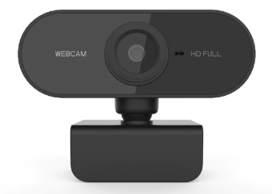
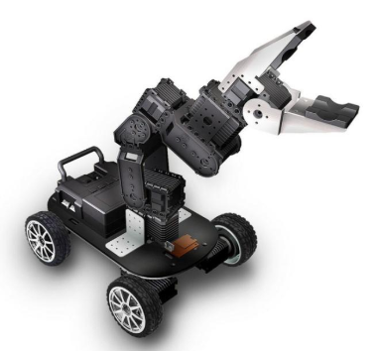

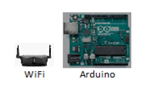
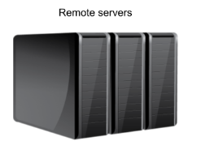
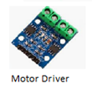
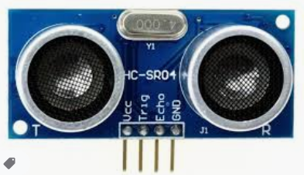
Implementation Plan - Design
The autonomous sample memory card loader is a mobile robot with 6-DOF robotic arm.

Slide 5
Implementation Plan - Design
The camera is used for image processing purpose to recognize the RAM check site and targeted RAM. Mainly for robotic arm vision.
Ultrasonic sensor will be used for obstacle avoidance.

Slide 6
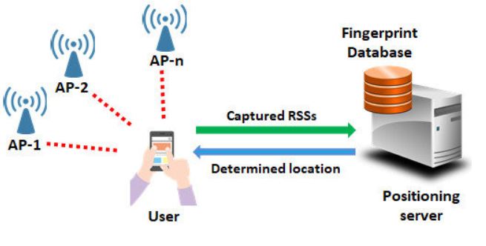
Localization
Using Wifi Positioning System.
Cart will send out fingerprint signals to several WIFI transmitter.
Based on signal strength, master PC which gets back data from transmitter, can estimate the exact position of cart in production floor.

Slide 7
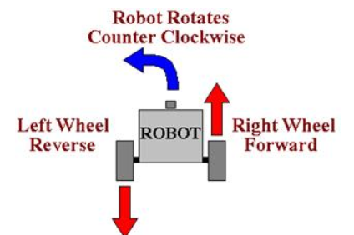
Design
Motor is controlled by Arduino using the driver. Odometry is done thru the encoder feedback so to control speed and acceleration.
Differential steering is used since production space can be limited. Electrical locomotion is used since electric station can be built easily.

Slide 8
Robotic Architecture
Targeted Area
Remote Server
WIFI Beacon Signal
Memory Module Image
Giving command and position (beacon) of target.
Record command and execution
Controller
WIFI Positioning
Processing image for target detection
Path Planning
Reporting task execution status
Targeted Server/Tester
WIFI Beacon Signal
Server/tester image

Slide 9
Robotic Flow Process
Start
Sensing WIFI Beacon
Not
Reaching
Path Planning
Actuation
Power On
Reaching
Target
Odometry Feedback
Sensing WIFI Signal for Localization
Target
Image processing
idle
Report status to remote server
Receive Feedback
Detect Module/Server?
Insert Module
Pick Up Module
Server
Module

Slide 10
Thank you! ☺

