Slide 1
Memory CHIP Sampling ASSISTANT
NICF- human robot systems engineering
Name: Ong Boon Ping
Date: 21 Sept 2020
OVER

Slide 2
Introduction and Business Case
In memory IC testing plant, test engineer need to obtain samples and compactible test system PCB from test production floor.
The operator will need to checkout the IC sample in the system in the presence of engineer.
The operator also need to give engineer the matching testing PCB to the engineer to conduct the testing.

Slide 3
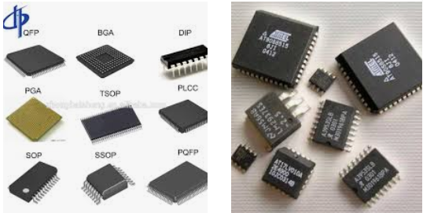
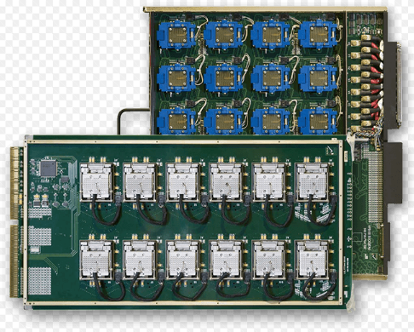
Introduction and Business Case
However, IC/PCB may not be in the recorded location in the database.
Engineer is wasting time and yet the request is not having any progress.
Engineer need an autonomous robot as agent so it can trigger a search in designated production area and report any missing case
The robot can also pick up and send the IC/board and saves Engineer’s time used in the trips.

Slide 4
How does HRI help?
Getting the correct memory chips from production floor based on engineer’s request.
Send the memory chips to the destination based on engineer’s request
Report cases to engineer where IC/PCB is missing or not in the recorded physical location.

Slide 5
Case Study Design Considerations
Who is the design for?
Test Engineer
Why do they want it?
Getting memory chips/PCB from production area based on engineer’s request and pass the memory chips/PCB to test technician/engineer
What are the materials required?
Autonomous vehicle attached with robotic arm and necessary sensors
What is the cost?
$10000
What are the safety/ethical issues?
Convey precise information or there will be loss if there is any delay.

Slide 6
HFE Design
Type of HFE | Design
Physical HFE | Auto filling suggestion for engineers when filling the request form (based on frequent combination of IC model and PCB model) Voice recognition to allow voice input from engineer. Display the request content and request progress to engineer Display the pre-taken image of PCB/IC after engineer enters the model name and allow engineers to make alternation. Pattern recognition/matching on IC/PCB image against the pre-taken image of the targeted engineer.
Cognitive HFE | Machine learning to recognize engineer’s request. NLP on voice
Organizational HFE | Allow feedback to engineer Allow feedback to production leadership on operator (missing IC/PCB cases)

Slide 7
HRI Design Process
Knowledge of Situation
Sensors
Touch Screen
Microphone
Camera
IMU
WIFI Signal Receiver
Progress, IC/PCB Availability
Of the Engineering Request

Slide 8
HRI Design Process
Sensors
Recognized Entities
Touch Screen
Microphone
Camera
WIFI Signal Receiver
(for WIFI Positioning
using transmitted signals)
WIFI
Requested IC model
Requested PCB model
Destination of IC/PCB delivery
Engineer’s confirmation
Surrounding RGB Image
Position of IC/PCB
Position of Robot
Position of Destination
Documented IC/PCB image and expected location

Slide 9
HRI Design Process
Recognized Entities
Semantic Relationships
Requested IC model
Requested PCB model
Destination of IC/PCB delivery
Engineer’s verification
Surrounding RGB Image
Position of IC/PCB
Position of Robot
Position of Destination
Documented IC/PCB image and expected location
IC availability (in database/physically contacted)
PCB availability (in database/physically contacted)
Distance to destination

Slide 10
HRI Design Process
Semantic Relationships
Contextual
IC availability (in database/physically contacted)
PCB availability (in database/physically contacted)
Distance to destination
IC is missing
PCB is missing
The request is on track/completed

Slide 11
HRI Design Process
Contextual
Decision/Response
IC is missing
PCB is missing
The request is on track/completed
Trigger operator to search through email
Trigger operator to search through email
Sending email after each milestone (IC collection, PCB collection, completed)

Slide 12
Thank you! ☺

