Slide 2
Face Recognition Framework FAQ
Not using 1 network/program: Haar Face Cascade is fast Detection while MTCNN is for fast face landmark detection. Ensures smooth program and not analyzing every frame. Reducing pressure for processing time. Haar Face Cascade (Haar Features) , MTCNN (Neural network), Dlib based Face_recognition (HoG, re-projection) are using different approaches in detecting the face so to reduce false positive case. This will also ensure that the face encoding is accurate. Direct classification of face using deep neural network requires a lot of image as input and the duration of capstone project is not sufficient for the image collection and training effort.

Slide 3
Face Recognition Framework FAQ
Not covering masked face: Masked face is not included since open source face encoding neural networks are mainly trained based on full face feature images. Retraining a network that can encode the masked face is time consuming and demand a lot of real masked face images for training purpose.
DLIB based face landmark libraries can be used to detect masked face. However, face landmark information can be incomplete due to the mask is not consistently covering same portion of the face. To implement the masked face detection can be relatively easy since partial face landmark info will be sufficient. However, face recognition is difficult since different portion of face (cheek area) is covered and distorted. More images are to be collected and there is no reliable source of so many masked faces.

Slide 4
Sampling FAQ
What images are sampled: 3 positive/targeted person, 110 negative/non-targeted person.
Augmentation method: Laplacian of Gaussian is to handle sharpened image (with winckles) while Gaussian Blur is to handle blurred image. Orientations are also handled differently.
This project is not targeted on mass population. It is for targeted personnel only such as in case of office or factory. Hence, raw image number can be limited to few positive image and negative images from different race,gender and age.
Different lighting exposure is handled thru gamma adjustment and additional image taken on the targeted personnel.
Targeted person is having image taken with/without spectacles. Artificial added spectacles can be an approximation but may not be applicable in the real time due to different spectacle shape.

Slide 5
Haar Face Cascade FAQ
Haar feature is not haar wavelet. Integral image computes the multiple selected haar features in a fast manner.
A Haar-like feature considers adjacent rectangular regions at a specific location in a detection window, sums up the pixel intensities in each region and calculates the difference between these sums. This difference is then used to categorize subsections of an image.(It is used to compute the human face feature here)
AdaBoost is used since there are multiple weak classfier which uses haar features as kernel. Need to get the final strong classifier (as weighted average of weak classifiers)
Cascading classifier is required since face features comes in piecewise. Need to define the boundary of full face with all the features.

Slide 6
MTCNN FAQ
MTCNN is a convolutional network. P-net (using 48x48 kernel) proposes the image pyramid which consist of the full face/partial face. R-Net refines the P-net output by giving a more definite area as output. (Using 24x24 kernel)
O-Net (12x12 kernel) is giving final bounding coordinate while giving 5 face landmark (trained against labelled image database)

Slide 7
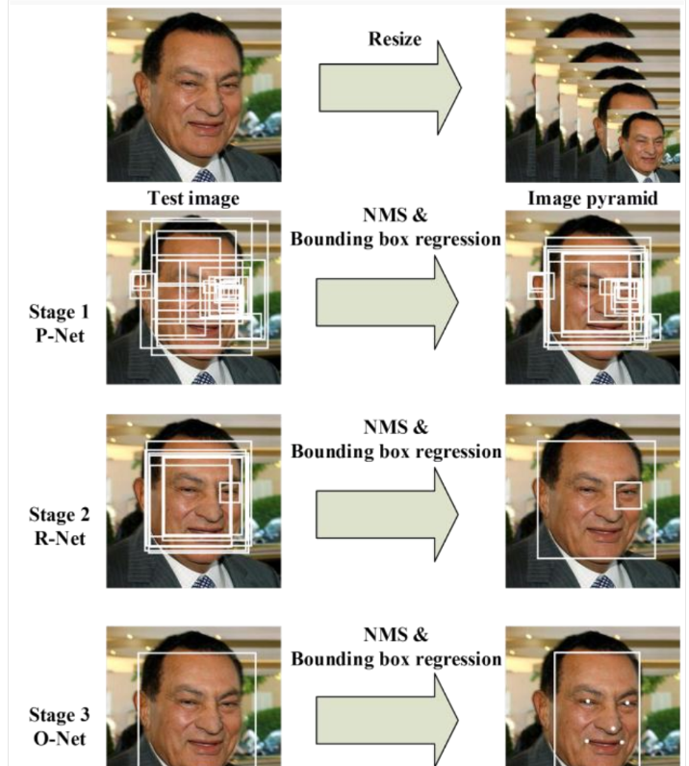

Slide 8
Face_recognition FAQ
At face detection stage, it is based on DLIB (US Navy funded project). Using HoG/DLIB neural network, detect the face.
Face_recognition library is using DLIB for face re-projection. Reducing effect of different slanting face angles.
HoG is useful since it is gradient based and less sensitive to local lighting exposure.
For face encoding, it is still relied on pre-trained triplet loss neural network. It is pre-trained against data set with positive, negative and similar images. Hence, it is able to come out with stable encodes.

Slide 9
Classfier FAQ
KNN – For examine the nearest neighbor in 128-bit encode. Using Minkowski distance for fast computation. Weighted with distance so further points carries less weight and provide better K neighboring result. Using it since neighboring points are usually categorized as same face.
SVM – using supporting vector by finding boundary in between 2 different classes. Useful for moderate dataset size in this case. For bigger dataset or with complex boundary, it may not be suitable and KNN is better in this area. However, if SVM is applicable, its performance can be better than KNN.
MLP – Using multi layer perceptron and hard to be explainable. However, with error gradient, it is able to approximate the classification with >30 layers.
Logistic regression – Attack the issue from regression model. With log model, it is able to approximate the boundary.
Ensemble – Allow voting. Increase coverage when not all classifier is output the same prediction. Able to reduce false negative when strong classfier is not giving the intended classification

Slide 10
Complication FAQ
Multiple face in near proximity may reduce the accuracy. Overcome with face cascade and MTCNN by returning face bound which covering whole face while confirm with full landmark info.
Different Lighting condition is addressed by changing gamma during augmentation and adding samples from different lighting conditions.
Different face angle is addressed using face re-alignment using MTCNN and also face re-projection during face_recognition when generating the face encodes.
Spectacle issue is addressed thru increasing sample size. (wearing spect for positive image, adding spectacle image for non-targeted person)
Image with different hair style, race, age is also gathered.

Slide 11
Result FAQ
The result is computed based on confusion matrix on targeted person 1, 2,3 and all the negative image.
The false negative can be limited since KNN/SVM are strong classifier while the weak classfier is able to reduce false negative when KNN/SVM is not able to generate the same prediction.

