Slide 1
Optaplanner Simulation
The optaplanner options are available at KIE workbench.
In this project, the initial rules are drafted out based on KIE result.

Slide 2
Optaplanner Simulation
The optaplanner planning solution (timeSolution), planning entity (PHQprocess), patient, practitioner, time slot details are implemented under KIE data objects.
TimeSolver is the solver configuration time. It defines termination time as well as construction heuristics and local search type.

Slide 3
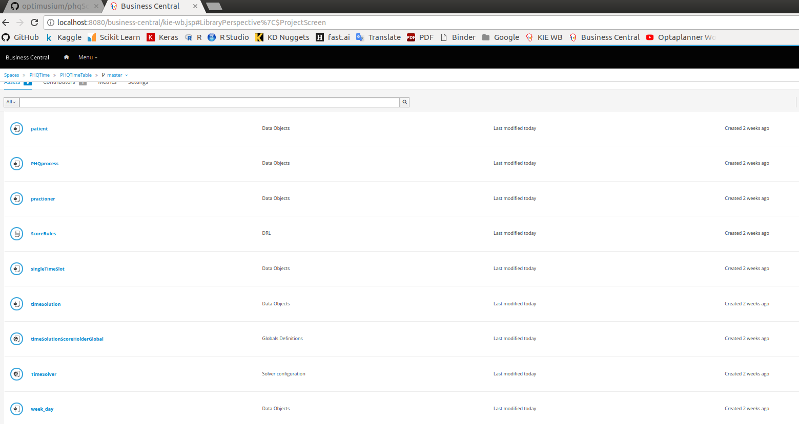

Slide 4
Optaplanner Simulation
In the first attempt, we name the planning solution as timeSolution, planning entity as PHQprocess. Hard Soft Score is chosen as the score type.
In TimeSolution, list of practitioners and list of time slot is linked to the practitioner, time slot in the PHQ process. The planning variable is defined to be many to one relation in between planning solution and entity.
In first attempt, we define the process to include patients’ detail, namely, ID, name, PHQ Score, prefer location, prefer day of session, gender and language.

Slide 5
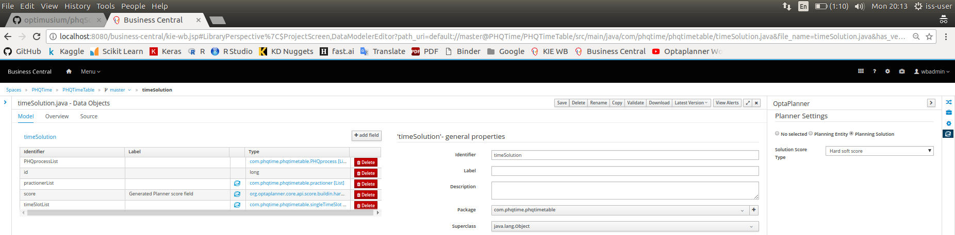

Slide 6
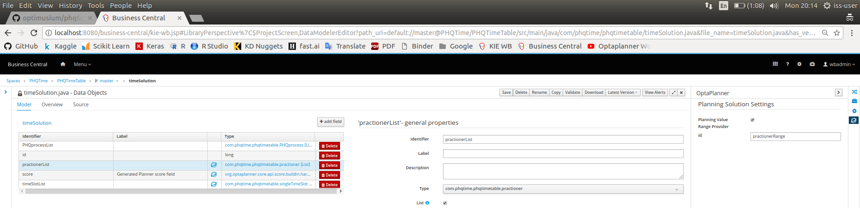

Slide 7


Slide 8
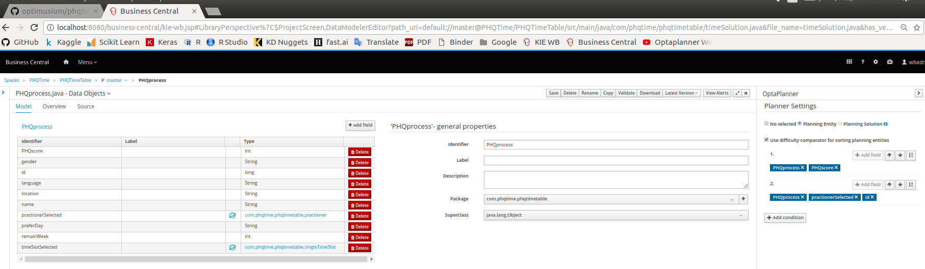

Slide 9
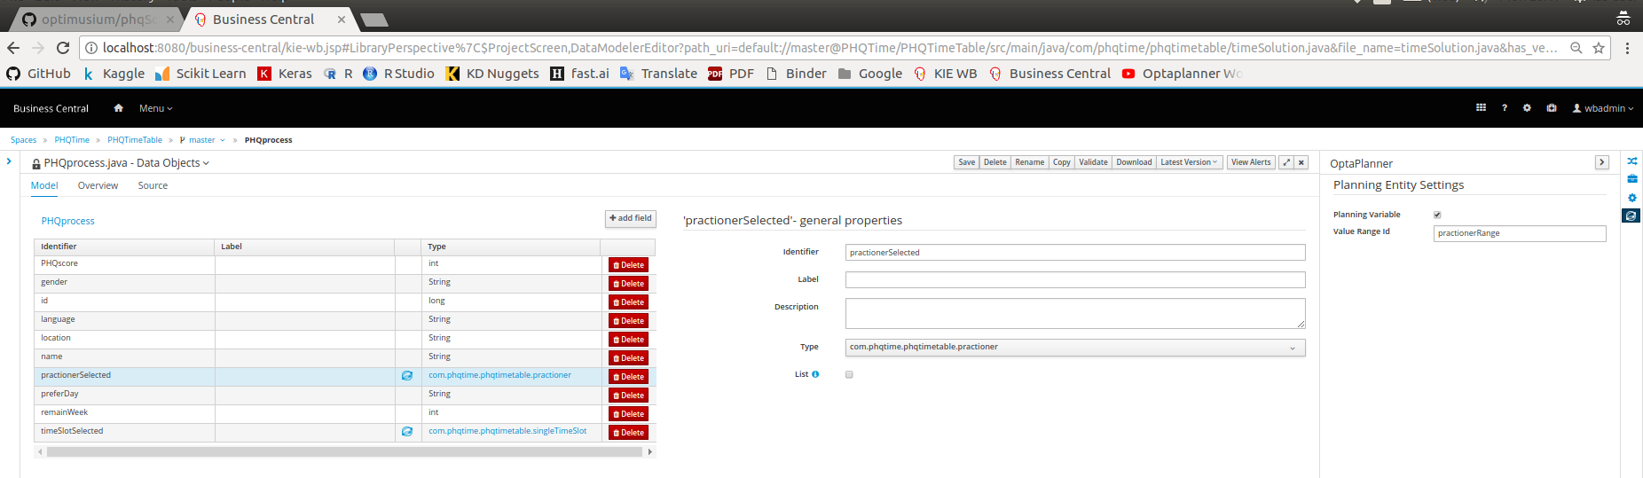

Slide 10
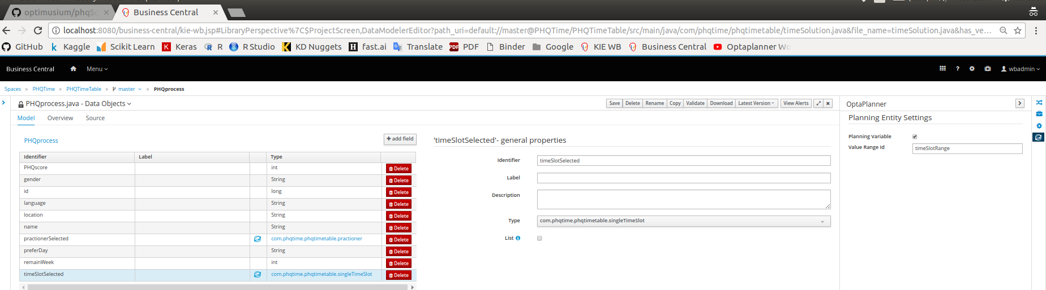

Slide 11
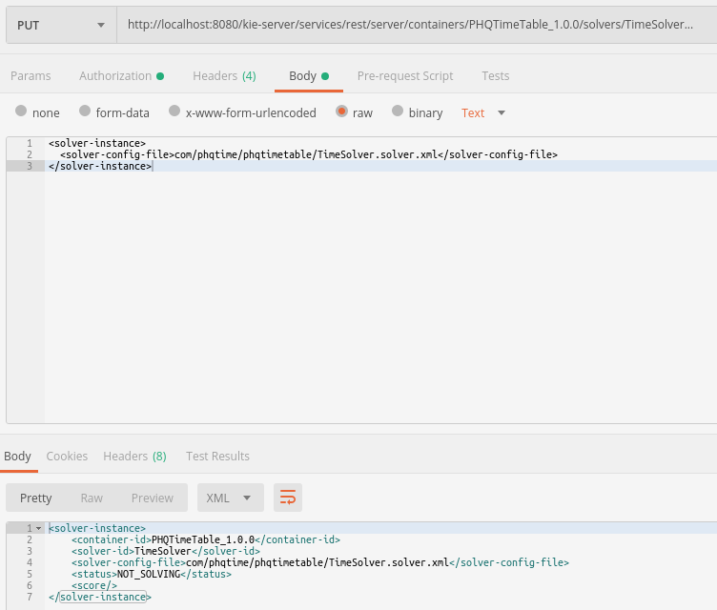

Slide 12
When using the construction heuristics, we choose to use first fit decreasing. This is to quickly construct the initial solution.
Consider a very simple search consists of 3 patients and 3 practitioners, first fit decreasing will be sufficient.
However, first fit decreasing is not enough to cope large state space search.

Slide 13
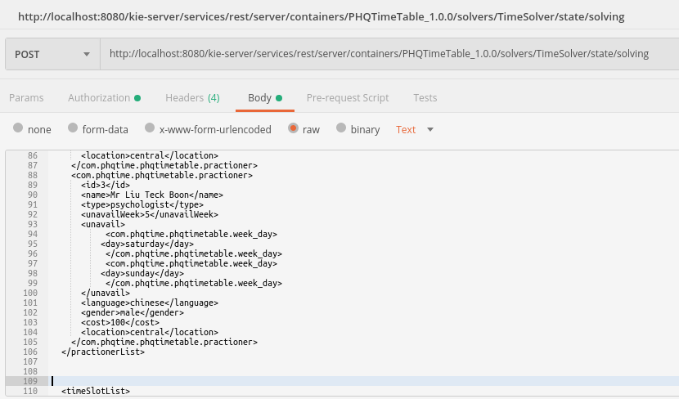
Sending problem facts where state is confined to have 3 practitioners and 3 patients

Slide 14
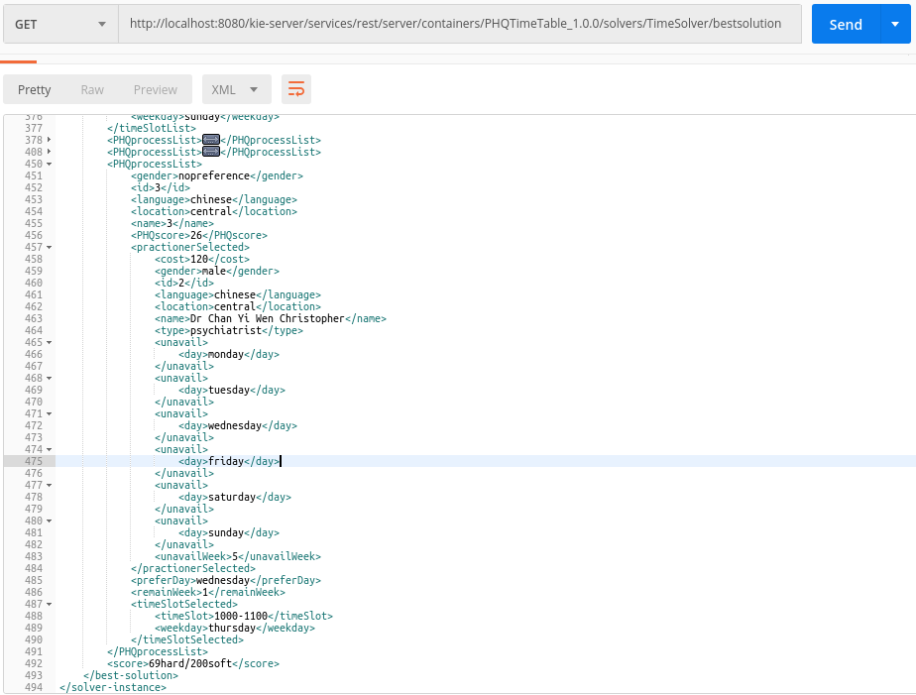
Note that First Fit Decreasing can be sufficient in giving simple solution to small space search. 69 hard points for 3 valid solutions is the expected result. Since there is not negative hard constraint, it is expected.

Slide 15
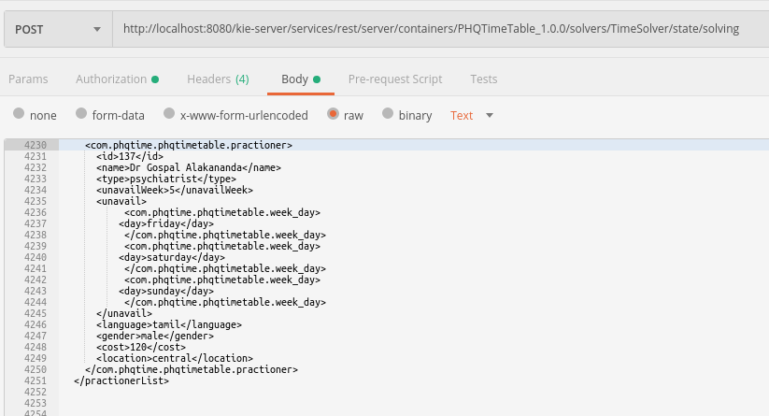
Sending state space with 137 practitioners and 134 patients

Slide 16
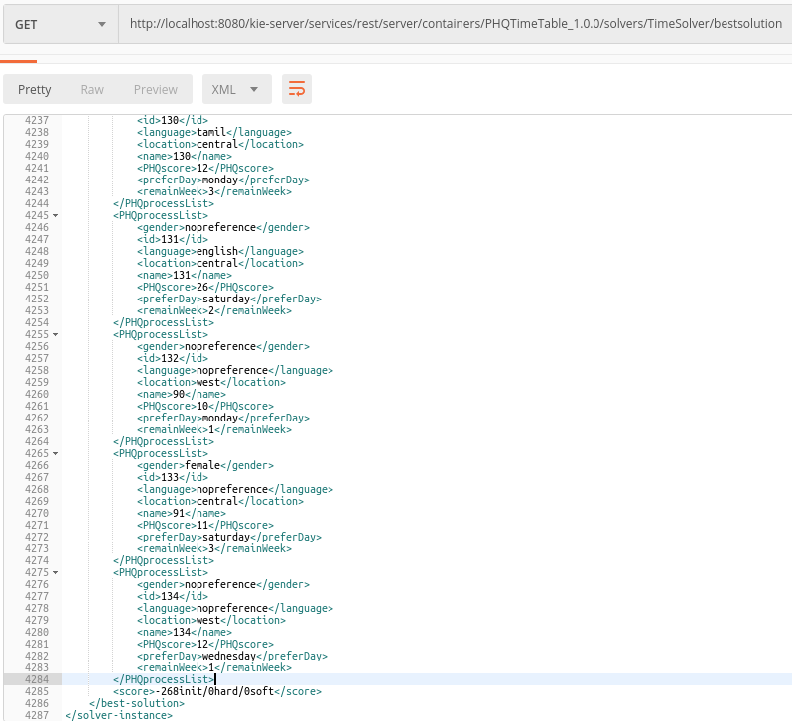
Note that First Fit Decreasing is no longer sufficient in giving feasible solution to large space search. -268 initial points means the simulation will start with solution that is not meeting the constraints.

Slide 17
Local Search - Late Acceptance
Hence, local search is added.
Late acceptance search is chosen in this case.
By adding late acceptable search after first fit, we will be able to generate solution for a scenario where 137 practitioners have to be fitted into 134 patients time slots.

Slide 18
Sending the same state space with 137 practitioners and 134 patients again

Slide 19
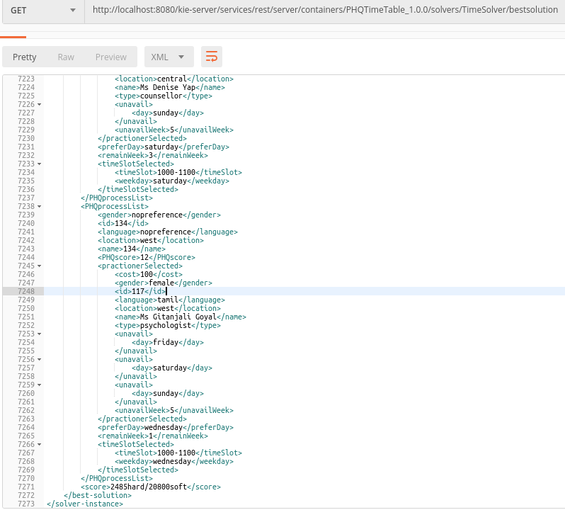
Finding out all the 134 time slot and practitioners needed by 134 patients with expected hard score 2485.

Slide 20
Hill climbing will stuck at local optimum will late acceptance increase the chance the to find the global optimum.

Slide 21
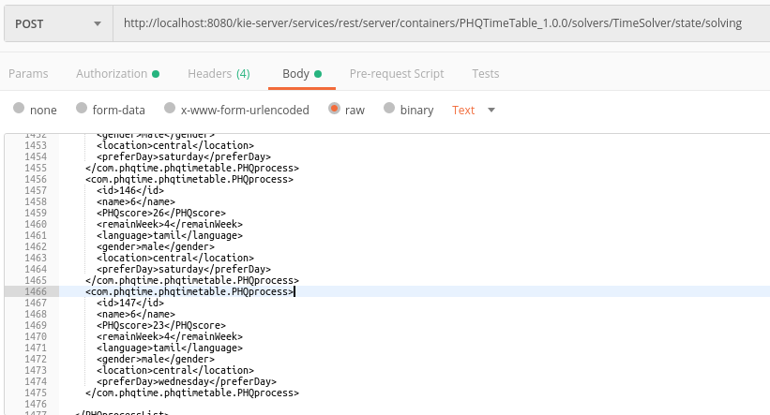
Adding 14 Indian patients which will expected to go to 1 Indian practitioner with cost of $20.

Slide 22
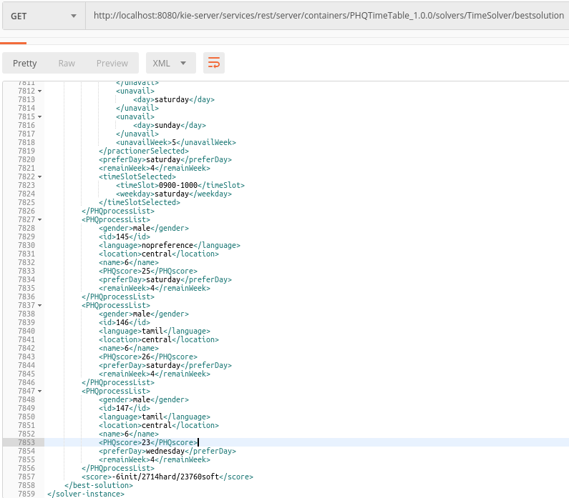
Hill Climbing will stuck at local optimum and not giving solution for each process.

Slide 23
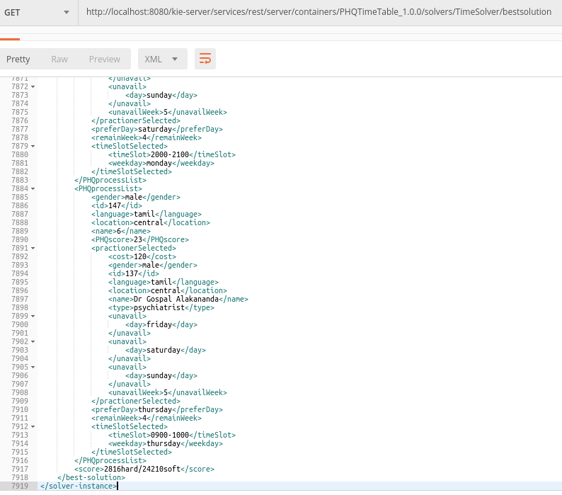
Late acceptance will be able to solve the problem.

Slide 24
On KIE environment, the memory process is intensive and the optaplanner is limited to several function (cannot tune the late acceptance properties and etc).
Hence, using Java Maven libraries to enhance the model.

