Slide 2
The tree obtained from Python Orange is now incorporated into guided tree.
However, as the ruleflow group cannot be defined into guided tree, the processed drool source code is copied and added with rule flow group.
The codes are incorporated as PreScreenRule.drl file.

Slide 3
User defined in KIE
Patient1 is created as actor of the task.
DrHong is created as actor of the task which involves medical officer role.

Slide 4
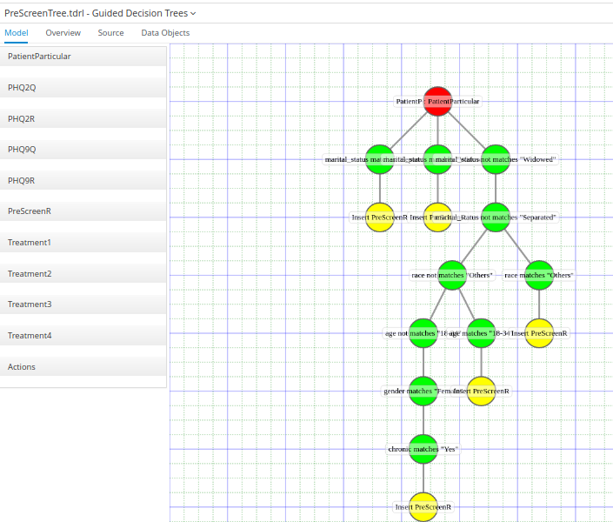

Slide 5
Flow chart 1
The flow starts with actor Patient1 key in Patient Particular.
The Patient Particular will be pre-screened using rules generated from data mining.
In the rule, fact will be inserted only if the conditions are met. If not fact is inserted, the flow will send a short message to user to indicate that there is no concern of his/her stress management.
If the fact is inserted, Q1 and Q2 of PHQ2 will be raised to task actor Patient1.
The PHQ2 rule will than be invoked. If there is any Q1 or Q2 scored larger than 2. Proceed to PHQ9. Else, message will be sent to Patient1 to indicate that there is no concern and end the flow.

Slide 6
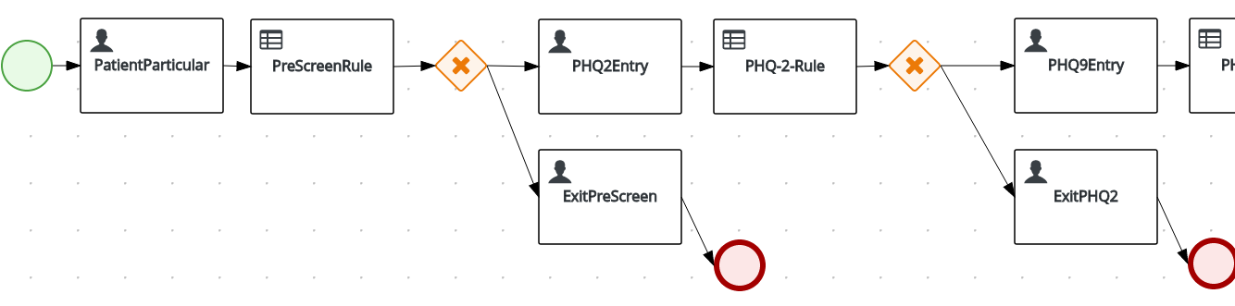
Flow chart 1

Slide 7
Flow chart 2
The Patient1 continue with remaining question in PHQ9.
The result will parsed to the rule task. If 5 questions are scoring more than 2 (except for Q9, the threshold mark is set to more than 1), then proceed. If not, message will be sent to Patient1 to indicate that the flow is ended with no concern.
The TreatmentGen rule task will then compute the total score. The total score will determine which of the treatment level in the 4 leves of treatment is chosen.
Treatment level 4 is least severe, user will be given message to advice taking PHQ9 again later.

Slide 8
Flow Chart 2
For Treatment level 1,2,3, Patient 1 will be given advice to seek doctors health. The medical officer will be triggered after Patient1 read the message. The medical officer will then key in the treatment required based on different level of message that he received in the task inbox.
After medical officer read give the treatment, the flow is completed.

Slide 9
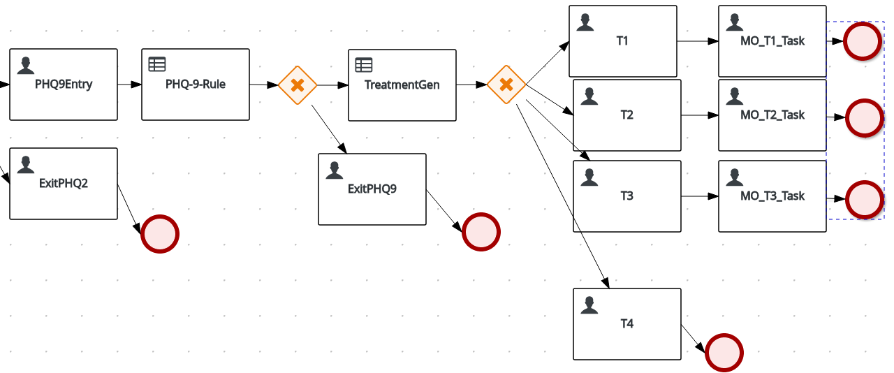
Flow chart 2

Slide 10
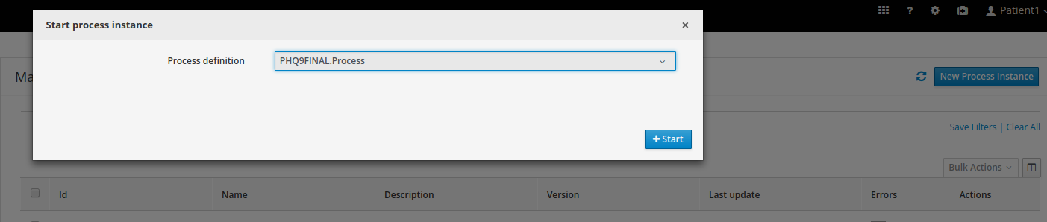

Slide 11
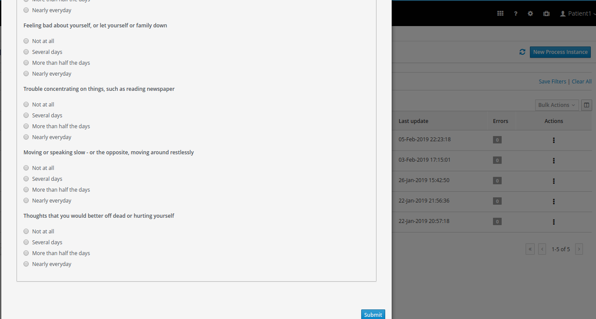

Slide 12
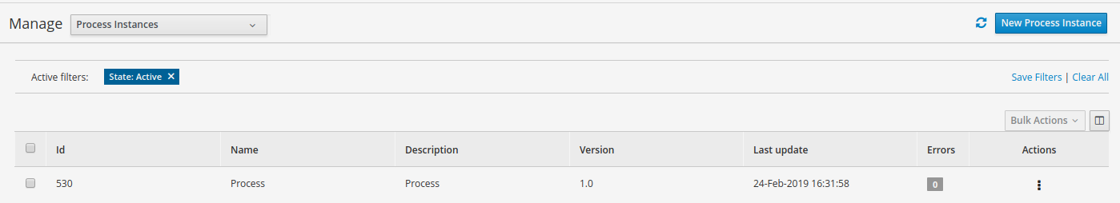

Slide 13
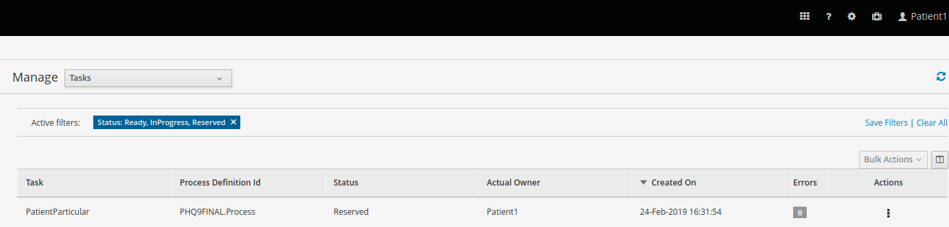

Slide 14
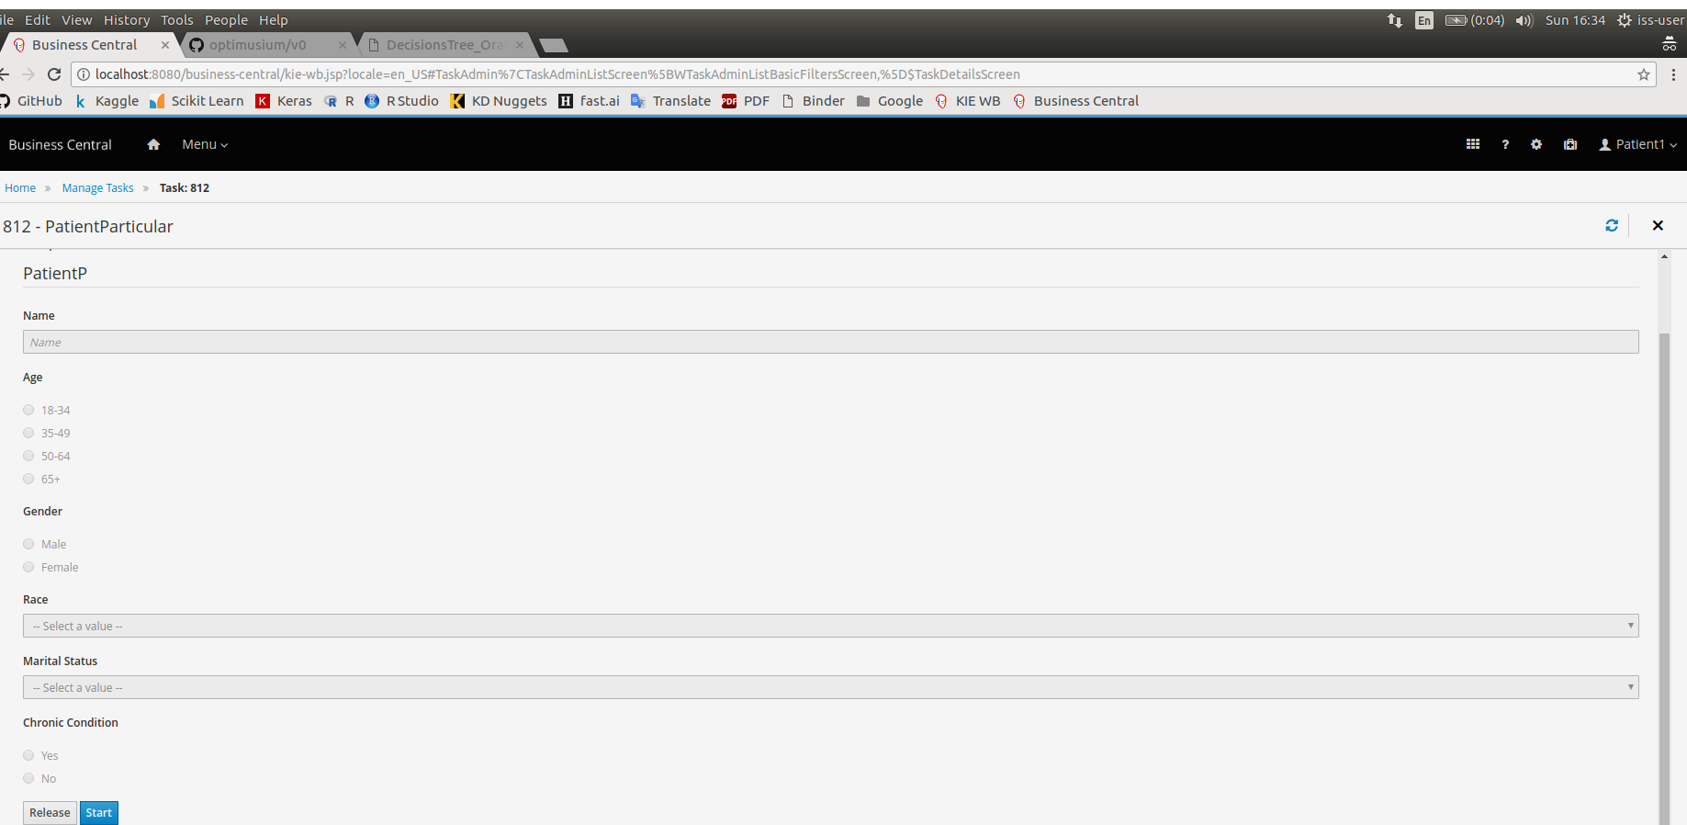

Slide 15
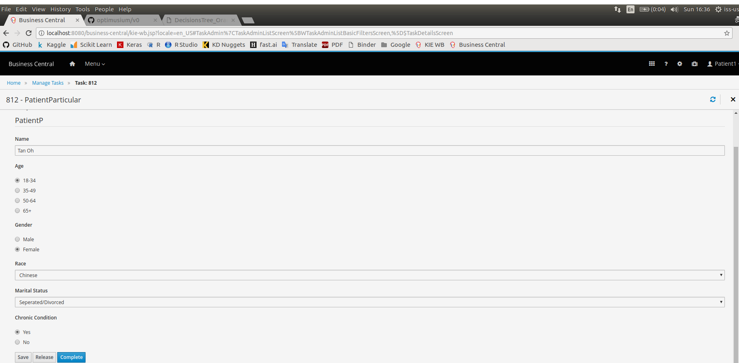

Slide 16
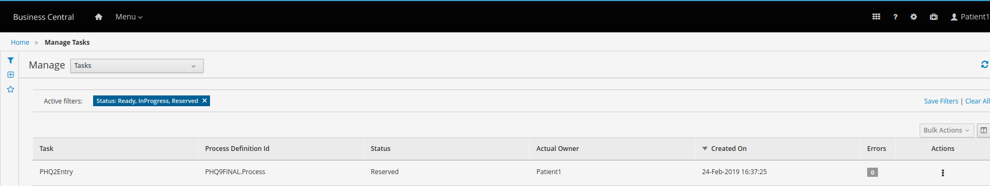

Slide 17
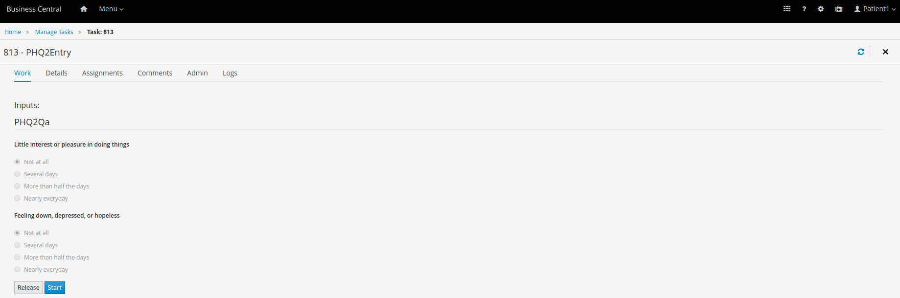

Slide 18
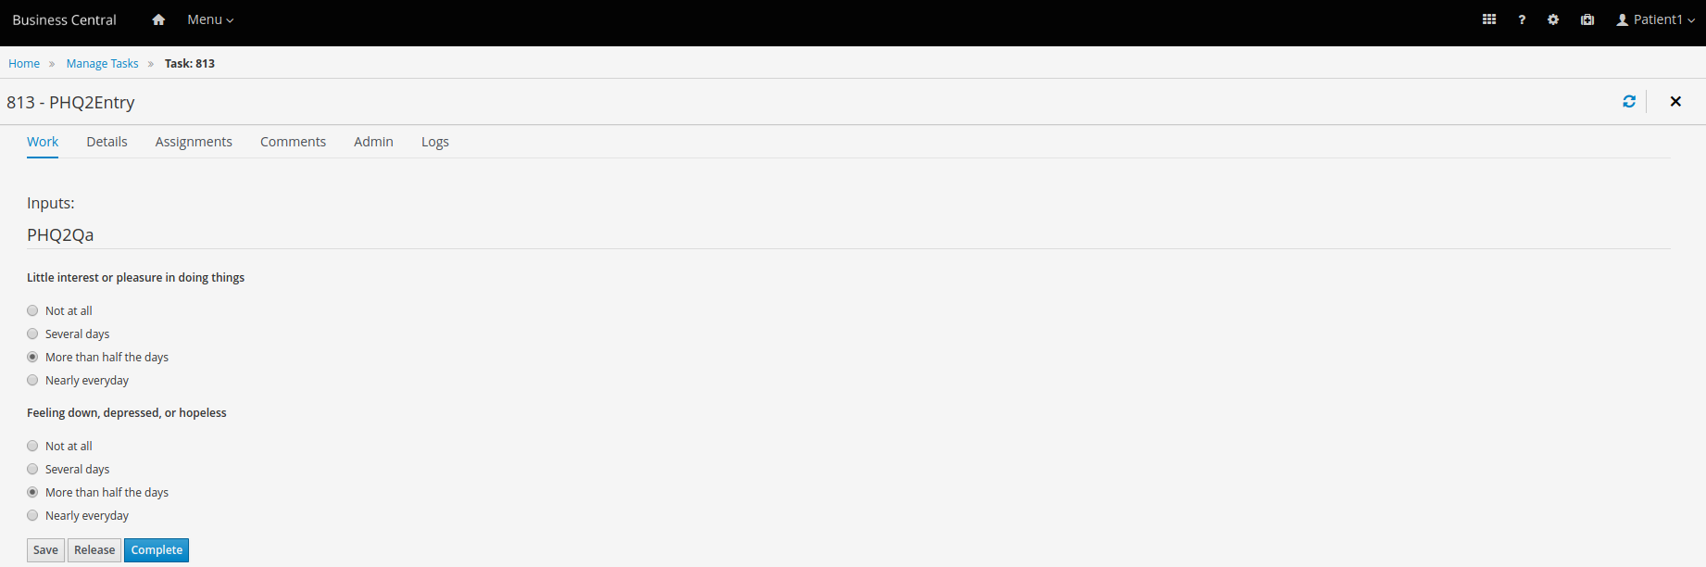

Slide 19
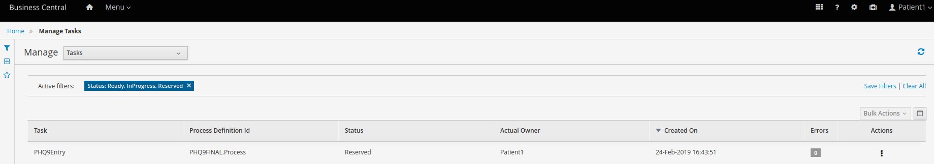

Slide 20
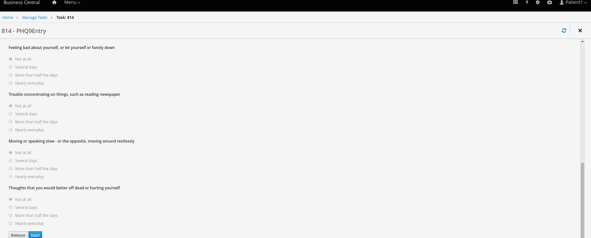

Slide 21
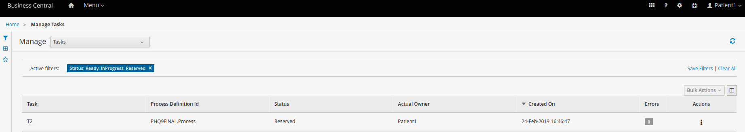

Slide 22
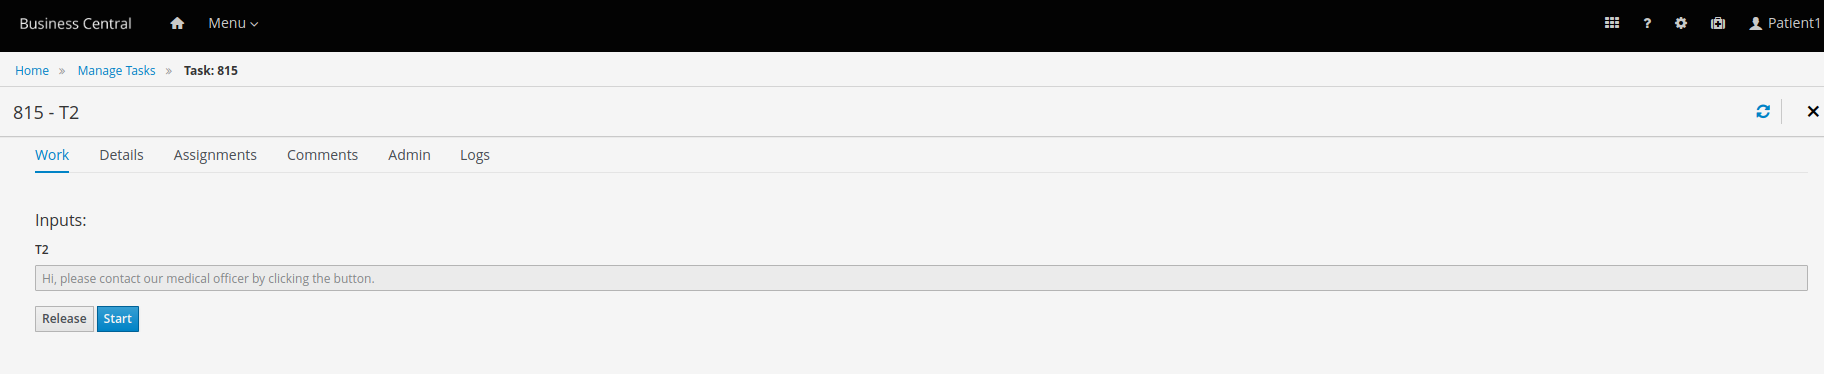

Slide 23
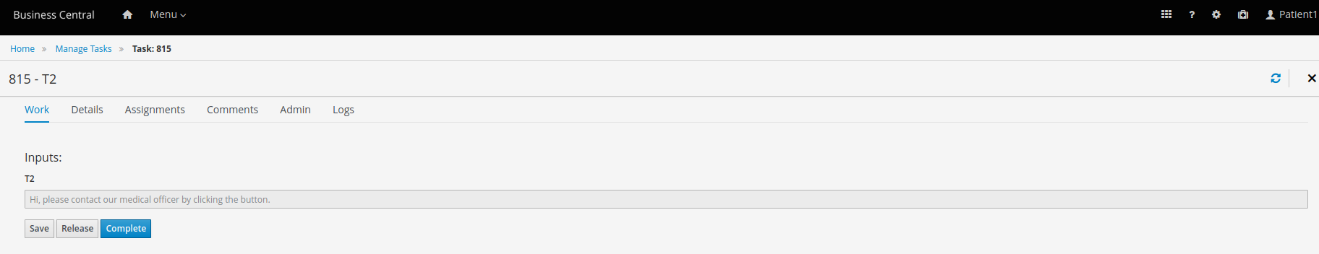

Slide 24


Slide 25
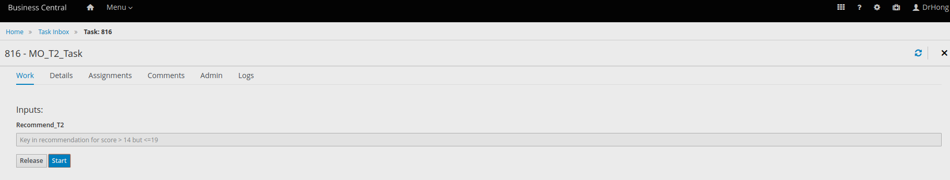

Slide 26
