Slide 1
Managing the
Content Lifecycle
Stephen Benjamin
February 2, 2015
stephen@redhat.com / @stbenjam

Slide 2
Agenda
Intro to Katello
Content & Content Views
Lifecycles
Patching
Demo
Questions

Slide 3
Content Management
Sync repositories or upload content
Spin/control/filter with Content Views
Move Content Views through a Lifecycle
Maintain awareness of what's in the pipeline

Slide 4




Katello

Slide 5
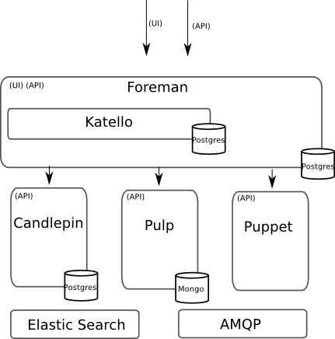
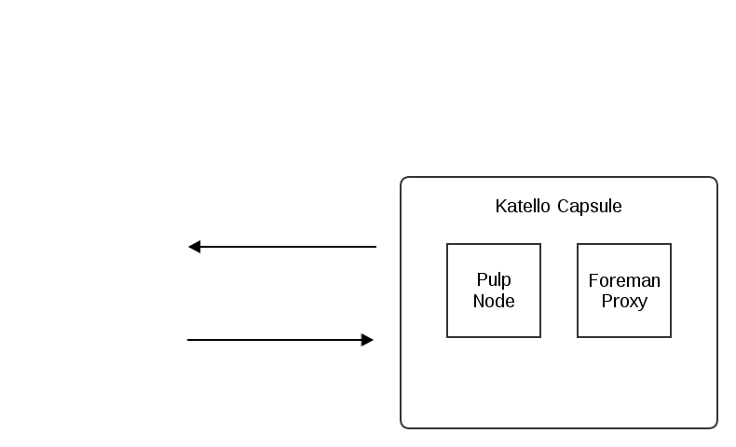
Katello Architecture

Slide 6



Content

Slide 7
Content Sources
Direct Upload
Sync External Sources:
  Yum repositories
  Puppet forges
  Docker registries
  Red Hat CDN (w/ subscription manifest)

Slide 8
Content Views

Slide 9
Default Organization View
Simplest View
  Available by default
  Everything you've synced is visible

Slide 10
Custom Content Views
OS Repo
Version 1.0
Filters
Filtered
Content
View
App Repo
Publish
Publish
Selected Puppet Modules
Puppet Modules
Add repositories
Add filters
Publish a version (snapshot) of the Content View and it becomes available in the Library

Slide 11
Custom Content Views
OS Repo
Version 1.0
Filters
Filtered
Content
View
App Repo
Publish
Publish
Selected Puppet Modules
Puppet Modules
Software
  Include/Exclude Filters On
    Package name
    Package group
    Erratum ID
    Date/Time
Puppet Modules
  Add by specific versions or just latest

Slide 12
Lifecycle Environment
Library is where all content goes first
Then move through one or many defined promotion paths
Version 1
Library
Library

Slide 13
Promotion Path of a Content View
Version 1
Library
Library
Development
Development
Development
Development
QA
Production

Slide 14
Promotion Path of a Content View
Version 1
Version 1
Library
Library
Development
Development
Development
Development
QA
Production

Slide 15
Promotion Path of a Content View
Version 1
Version 1
Version 1
Library
Library
Development
Development
Development
Development
QA
Production

Slide 16
Promotion Path of a Content View
Version 2
Version 1
Version 1
Library
Library
Development
Development
Development
Development
QA
Production

Slide 17
Promotion Path of a Content View
Version 2
Version 2
Version 1
Library
Library
Development
Development
Development
Development
QA
Production

Slide 18
Promotion Path of a Content View
Version 2
Version 2
Version 2
Library
Library
Development
Development
Development
Development
QA
Production

Slide 19
Promotion Path of a Content View
Version 2
Version 2
Version 2
Version 2
Library
Library
Development
Development
Development
Development
QA
Production

Slide 20
Promotion Path of a Content View
Version 3
Version 2
Version 2
Version 2
Library
Library
Development
Development
Development
Development
QA
Production

Slide 21
Promotion Path of a Content View
Version 3
Version 3
Version 2
Version 2
Library
Library
Development
Development
Development
Development
QA
Production

Slide 22
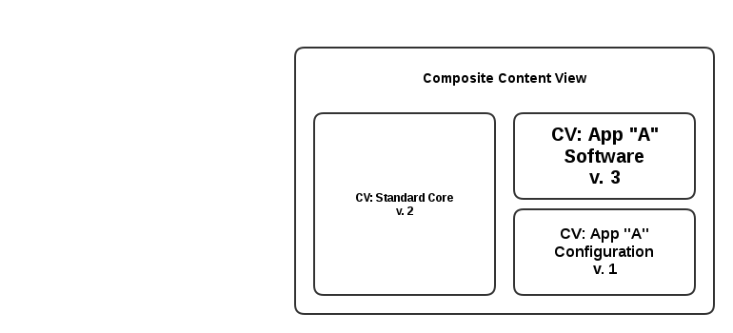
Composite Content View (CCV)
A composite contains other Content Views
Manage OS, App, and Configuration layers separately

Slide 23
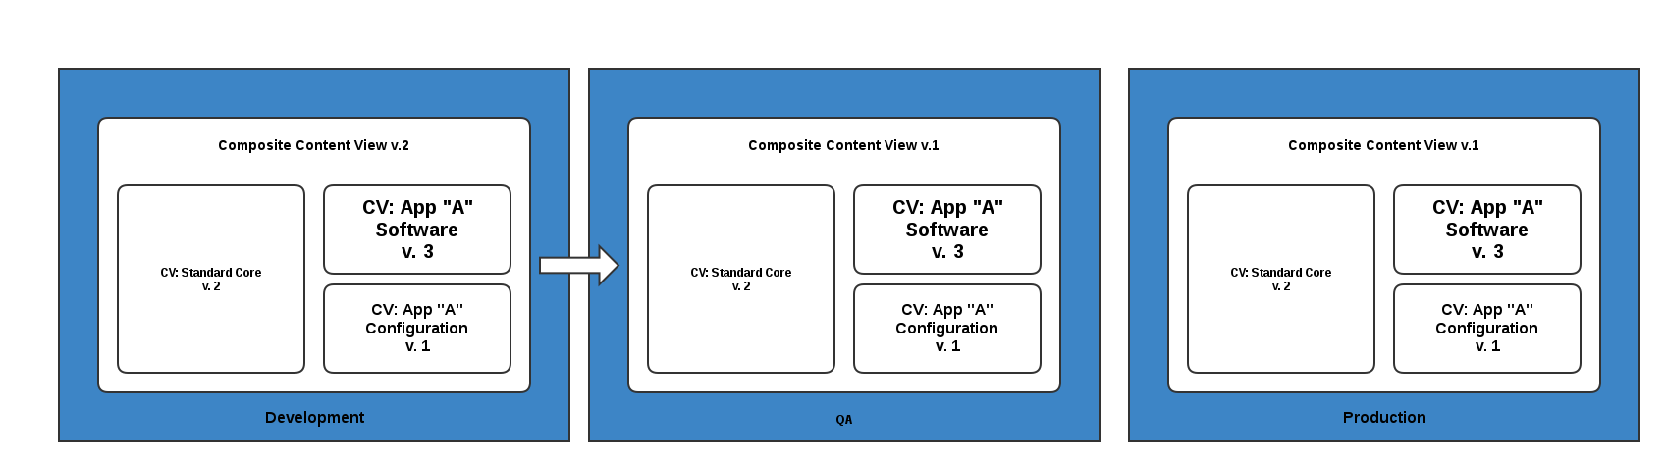
Composite Content View
Composite Content Views are also managed in their own lifecycle...

Slide 24
Situation Awareness

Slide 25
Errata
Software changes issued by Fedora (incl. EPEL) and Red Hat are published via errata advisories.
By category:
  New Package (Fedora only)
  Bugfix
  Enhancement
  Security (and severity – high/medium/low)

Slide 26
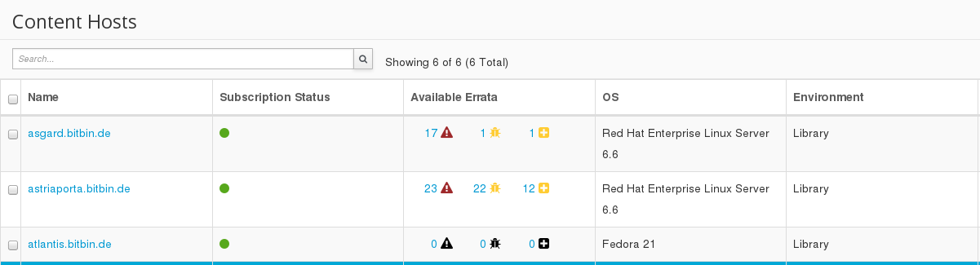
Situation Awareness
Know which systems need critical updates at a glance...

Slide 27
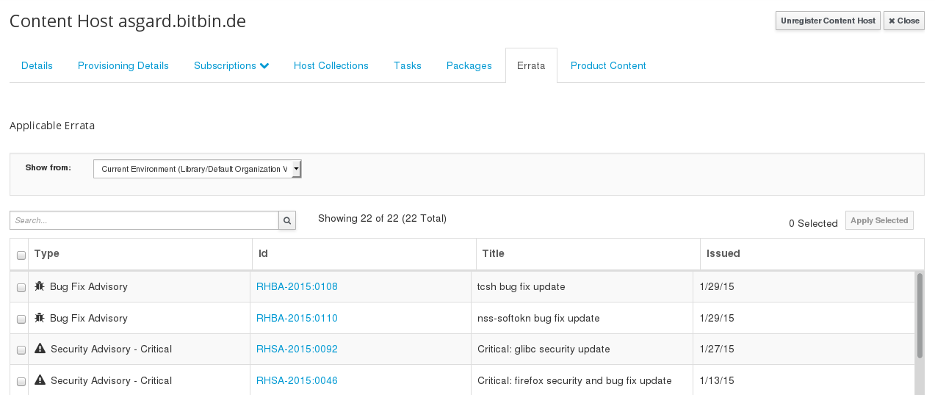
Situation Awareness
See what's coming up through the promotion path

Slide 28
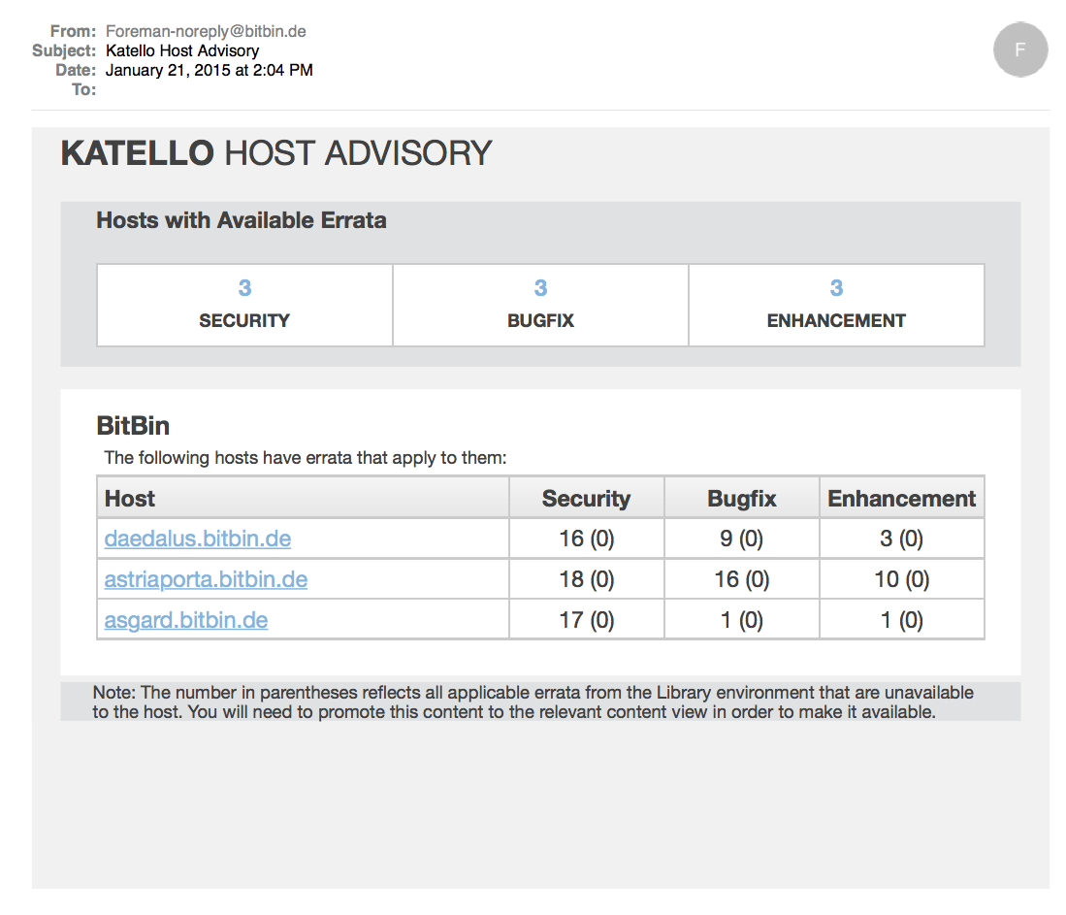
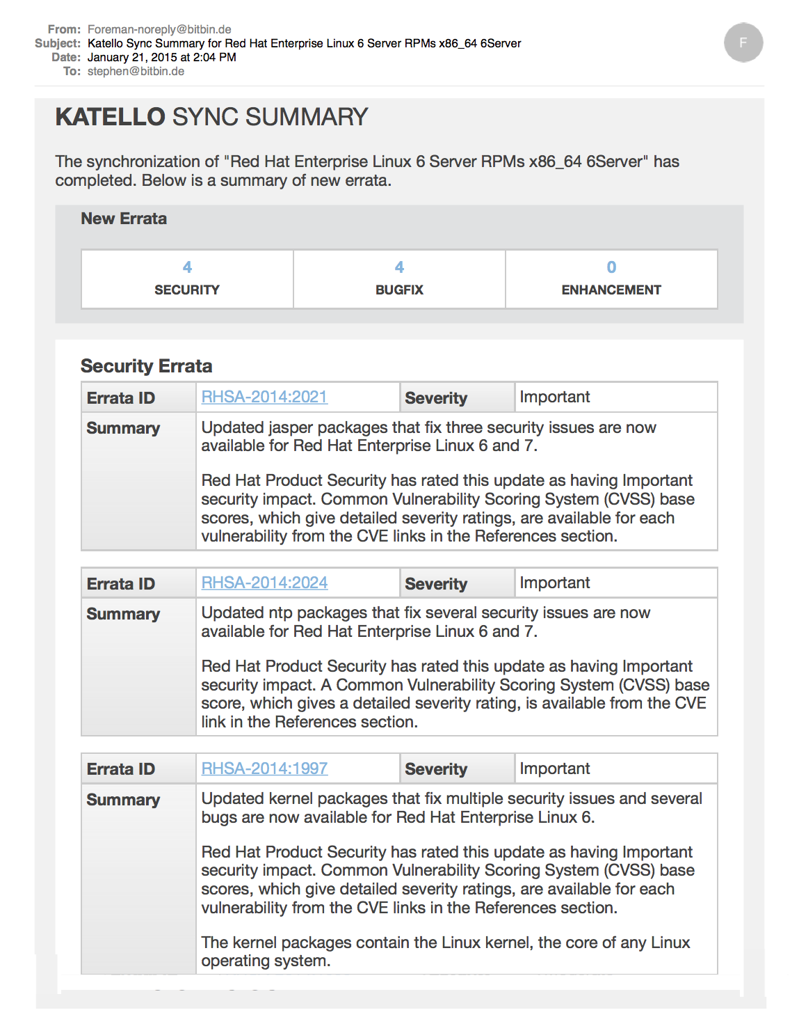
Situation Awareness
Get e-mail notifications

Slide 29

...ok, but what can you do with the information?
Your hosts need a critical update...

Slide 30
Promote/Publish through the whole cycle?
Version 3
Version 2
Version 2
Version 2
Library
Library
Development
Development
Development
Development
QA
Production

Slide 31
Promote/Publish through the whole cycle?
Version 3
Version 3
Version 2
Version 3
Library
Library
Development
Development
Development
Development
QA
Production

Slide 32

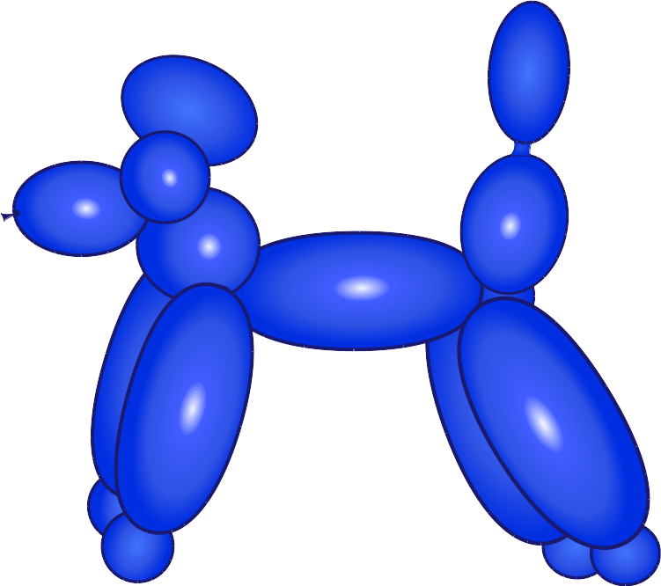
Incremental Update
Skip the lifecycle
  Make an update available now
  Ideal for emergency patches
Katello 2.2 Feature

Slide 33
Incremental Update
Version 3
Version 3
Version 2
Version 2
Library
Library
Development
Development
Development
Development
QA
Production
RHSA-2015:0099, RHSA-2015:0092
Version 3.1
Version 3.1
Version 2.1
Version 2.1
Library
Library
Development
Development
Development
Development
QA
Production

Slide 34
Questions?
Find us:
  http://www.katello.org
  Freenode: #theforeman, #theforeman-dev
  Mailing lists:
    Foreman-users@googlegroups.com
    Foreman-dev@googlegroups.com

