Slide 1

Foreman in Your
Data Center
Stephen Benjamin
@stbenjam
Notes:
Talk slower

Slide 2
Agenda
Introduction
  Provisioning
  Configuration
  Monitoring
Demo
Customizing foreman
  Automating with CLI + API
  Hooks
  Plugins
    Discovery
    Docker
    Katello
    Chef/Salt
    Write your Own
Notes:
Introductory talk – first half basic introduction,
second half – customizing to fit your own needs in your data center
How many people use Foreman today?
Puppet?
Chef?
Salt?
Anyone using non-puppet in foreman?
TALK SLOWER

Slide 3
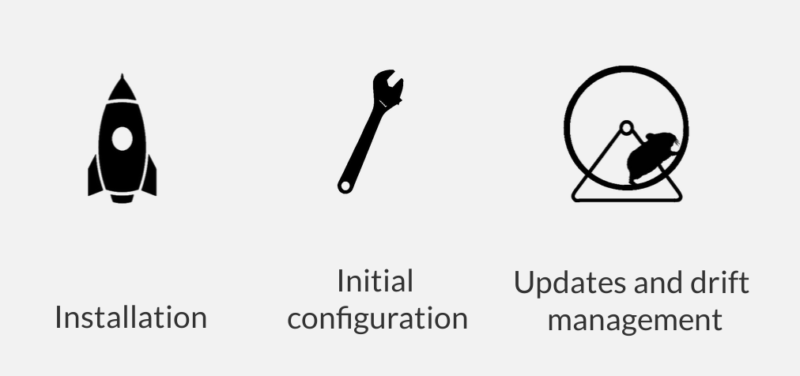
Foreman's Realm
Managing the Lifecycle of your Systems
Notes:
Talk slower

Slide 4

Foreman
Notes:
Talk slower

Slide 5

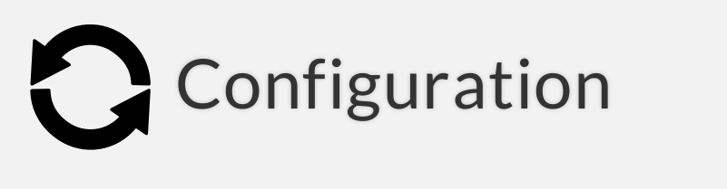
Provision new machines or containers to (almost) anything
  Bare metal, oVirt, Libvirt, vmware, docker, EC2, Rackspace, Digital Ocean, OpenStack, etc.
If we don't support it today, we can via new plugins
Notes:
Talk slower

Slide 6
Provisioning types:
  PXE - via kickstart, preseed, AutoYAST, etc
  Image-based - cloning, configured over SSH or user data (cloudinit)
For virtualization provider, we create the VM
For everything we orchestrate related services through Smart Proxies
  DNS - DHCP
  FreeIPA Realm - Configuration Management
Notes:
Talk slower

Slide 7
Puppet
Via plugins:
  Chef
  Salt
Automatic registration & setup of clients, including autosigning certs/keys
Defining:
  Classes / states
  Parameters / pillars
Inventory data, results of configuration runs
Notes:
Talk slower

Slide 8

System Inventories – puppet/chef/salt grains/facts. Ability to create trends and charts on the data
Reports from Puppet runs, or Salt highstate
More reporting via plugins: ABRT, OpenSCAP
Notes:
Talk slower

Slide 9
Distributed Architecture
Smart Proxies located locally on Foreman itself or independent – used for orchestration of DNS, DHCP, etc.
Notes:
Install a basic foreman – smart-proxy runs on the localhost with foreman

Slide 10
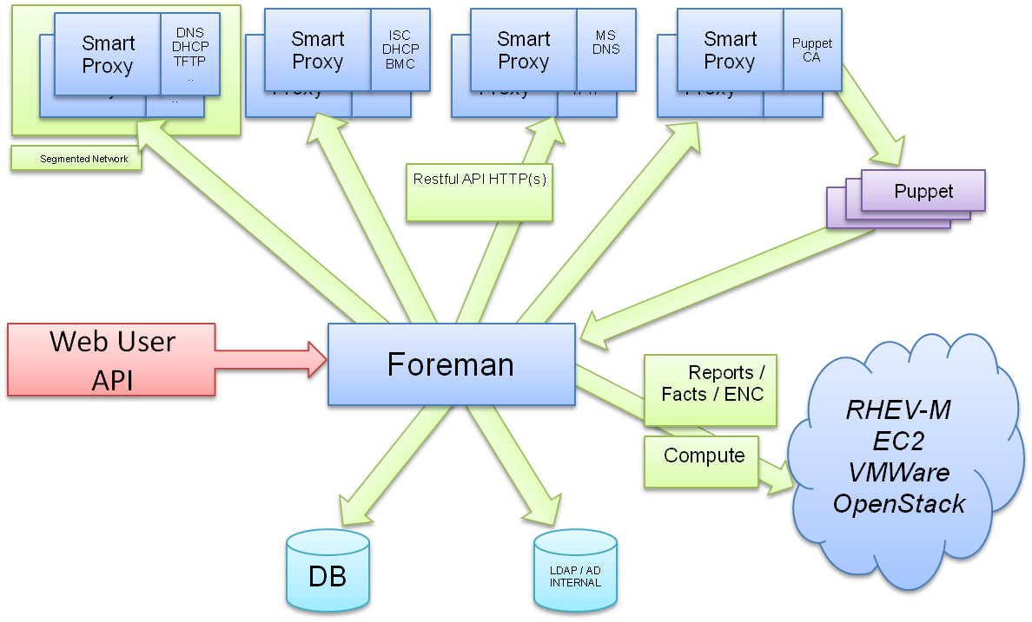
Notes:
Talk slower

Slide 11
Demo
Notes:
Talk slower

Slide 12
Customization
Customize Foreman to support your workflows!
  Automation with API + CLI
  Foreman Hooks
  Foreman Plugins
Notes:
Talk slower

Slide 13
API & CLI
Full RESTful API
  Docs at http://foreman.example.com/apidoc on your Foreman server
  e.g.
curl -k -u admin:changeme \
-H "Accept: version=2,application/json"
https://localhost/salt/api/v2/salt_keys/smartproxy.example.com
Notes:
Talk slower

Slide 14
Hammer CLI
Easy to use, great for working in shell
hammer salt-key list --smart-proxy=smartproxy.example.com
Notes:
Talk slower

Slide 15
Hooks
Hooks
  Triggered on actions: on action, do X
    host create/update/delete, build complete, etc.
    X could be anything
      add to nagios
      send an email
    Can be shell, python, ruby, etc.
  More info: https://github.com/theforeman/foreman_hooks
Notes:
Talk slower

Slide 16
Plugins
Both the Smart Proxy and Foreman have a pluggable architecture
  Foreman
    http://projects.theforeman.org/projects/foreman/wiki/Plugins
  Smart Proxy
    http://projects.theforeman.org/projects/foreman/wiki/Smart-Proxy_Plugins
Plugins written in Ruby, some Rails knowledge needed
Notes:
Talk slower

Slide 17
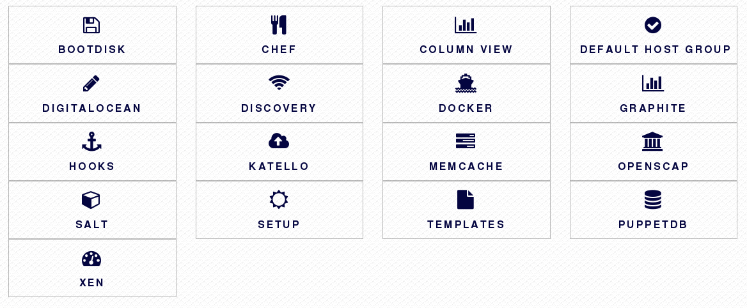
Plugins
Rich ecosystem of existing plugins
More Info: http://projects.theforeman.org/projects/foreman/wiki/List_of_Plugins
Notes:
Talk slower

Slide 18
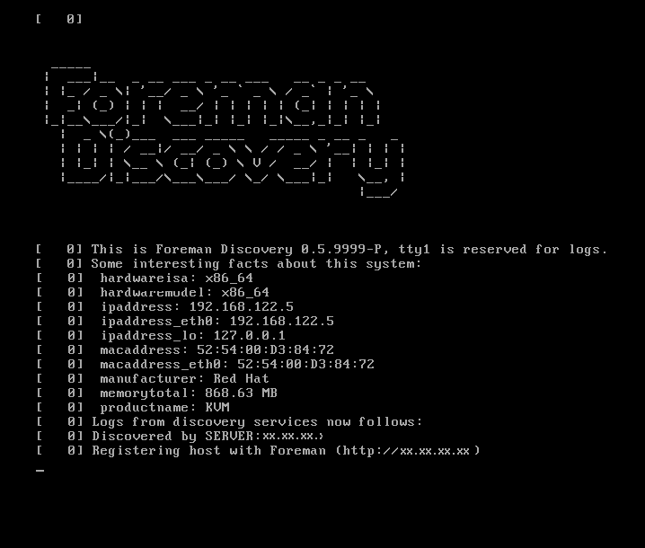
Discovery
Metal as a Service
Notes:
Talk slower

Slide 19
Discovery
http://theforeman.org/plugins/foreman_discovery/2.0/
Unknown host boots via DHCP/PXE
  Becomes available in Foreman as a “Discovered Host”
Provision with as few as NO clicks
  Automatic provisioning via rules on arbitrary facts:
    cpu_count < 8 → web server host group
    cpu_count >= 8 → db box host group
Notes:
Talk slower

Slide 20
Discovery Demo

Slide 21
Docker
Manage many docker hosts
Deploy new containers easily & view their status, logs, etc
Multiple registry support & integration with Katello
https://github.com/theforeman/foreman-docker
Notes:
Talk slower

Slide 22





Katello
Content Lifecycle Management
  http://www.katello.org/
Sync RPM, Docker, and Puppet content
Spin repositories with filters using Content Views
Notes:
Talk slower

Slide 23
Katello
Manage through a lifecycle
  Dev → QA → Production
Patch Management
  Emergency Patches
  Errata Reports
And much more!
Notes:
Talk slower

Slide 24
Katello Demo

Slide 25
Salt
Import reports (state.highstate results) and grains into Foreman
Bootstrapping nodes
Define states, pillars via ext_node and ext_pillar
Full interface to keys/autosign
API & CLI
Notes:
Talk slower

Slide 26
Chef
Import reports and attributes into Foreman
Automatic bootstrapping of clients
Decomission nodes from Chef server when deleted in Foreman
Notes:
Talk slower

Slide 27
Write your Own
More info:
  http://projects.theforeman.org/projects/foreman/wiki/How_to_Create_a_Plugin
Notes:
Talk slower.

Slide 28
What Next?
Visit us http://theforeman.org/
If you do something cool with Foreman, let us know!
Find us:
  IRC: irc.freenode.net
    #theforeman
    #theforeman-dev
  Mailing Lists on Google groups
    foreman-users
    foreman-dev
Notes:
Let us know!

