Slide 1

SaltStack Integration
with Foreman
Stephen Benjamin - February 2, 2016
stephen@redhat.com / @stbenjam

Slide 2
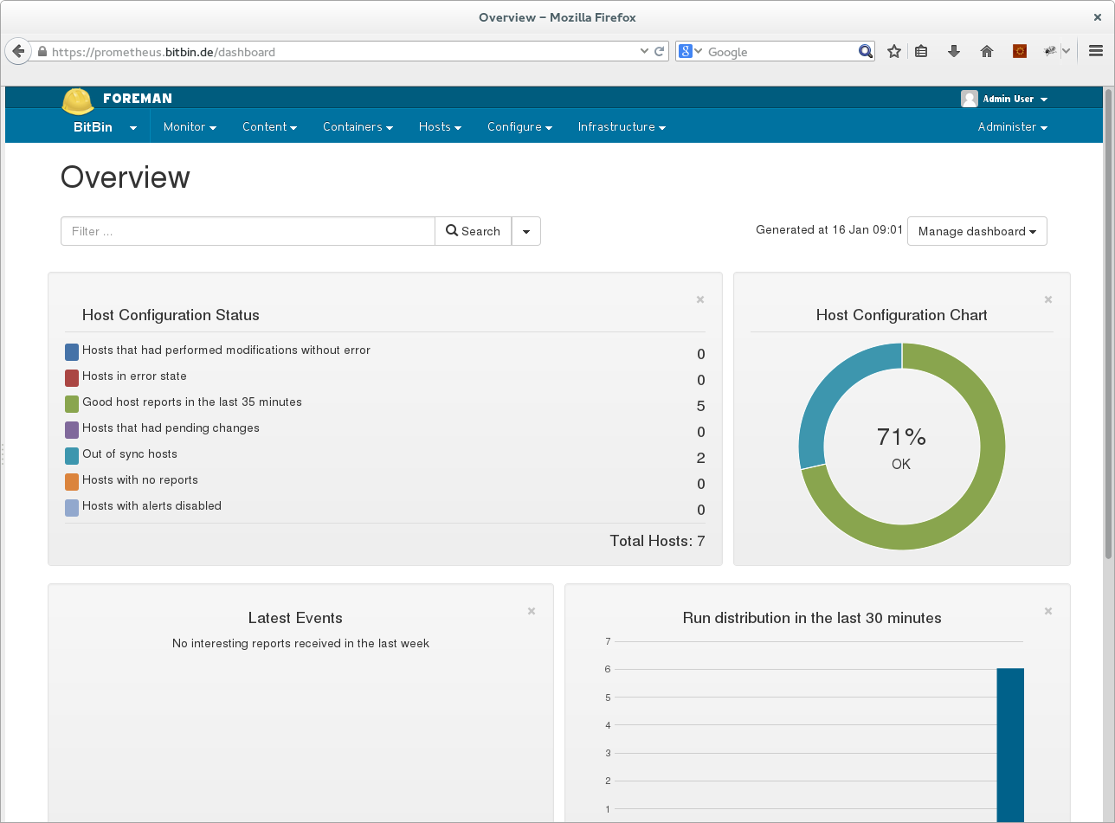

Slide 3

Foreman

Slide 4

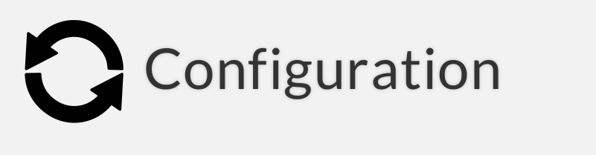
Provision to anything from one interface with one process
  Bare metal, oVirt, Libvirt, vmware, docker, EC2, Rackspace, Digital Ocean, OpenStack, etc.
Orchestration of all dependencies – not just preseed/kickstart/cloud-init

Slide 5
Support for: Ansible, Chef, Puppet, and Salt
For Salt, we provide:
  External node classifier (ENC) for tops system
  External pillar provider

Slide 6

System Inventories – showing grains and activity (i.e. state.highstate results). Ability to create trends and charts on the data.
Reporting plugins for ABRT, OpenScap

Slide 7
Distributed Architecture
Smart Proxies located locally on Foreman itself or independent – used for orchestration of DNS, DHCP, etc.
Smart Proxy manages the Salt Master.

Slide 8
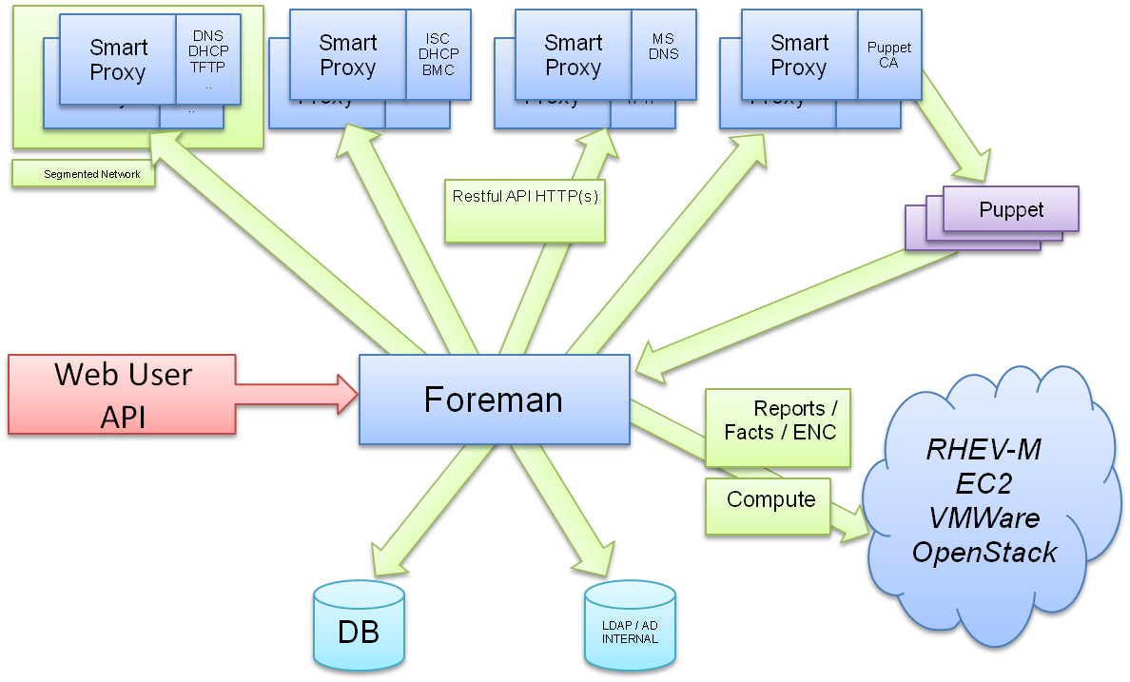

Slide 9
Foreman Plugins
Extensible
  Both the Smart Proxy and Foreman have a plugin architecture.
    Foreman
      http://projects.theforeman.org/projects/foreman/wiki/Plugins
    Smart Proxy
      http://projects.theforeman.org/projects/foreman/wiki/Smart-Proxy_Plugins
  Extend Foreman to do whatever you want!

Slide 10
Foreman Plugins
Rich ecosystem of plugins
  Remote Execution
    SSH, Ansible
  Compute Resources:
    Digital Ocean, Docker, OpenNebula, etc.
  Configuration Management:
    Chef, Salt, Ansible
  Reporting
    ABRT, Graphite, etc.

Slide 11
Salt in Foreman
First support in early 2014 via templates/parameters
Two plugins
  smart_proxy_salt
  foreman_salt
Packaged for Debian & Red Hat family OS's
  Maintain parity w/ whatever Foreman supports

Slide 12
Minion Provisioning
Assign a Salt master to a new host.
Foreman will do the work for you:
  Install Salt packages
  Accept the salt key when complete

Slide 13
Minion Destruction
When you delete a host in Foreman, we clean up – delete the host from Salt (the accepted key).

Slide 14
Key Management
Full web interface to keys
  Accept, reject, delete keys
...and autosign
  Add autosign records (e.g. a domain managed outside of Foreman)

Slide 15
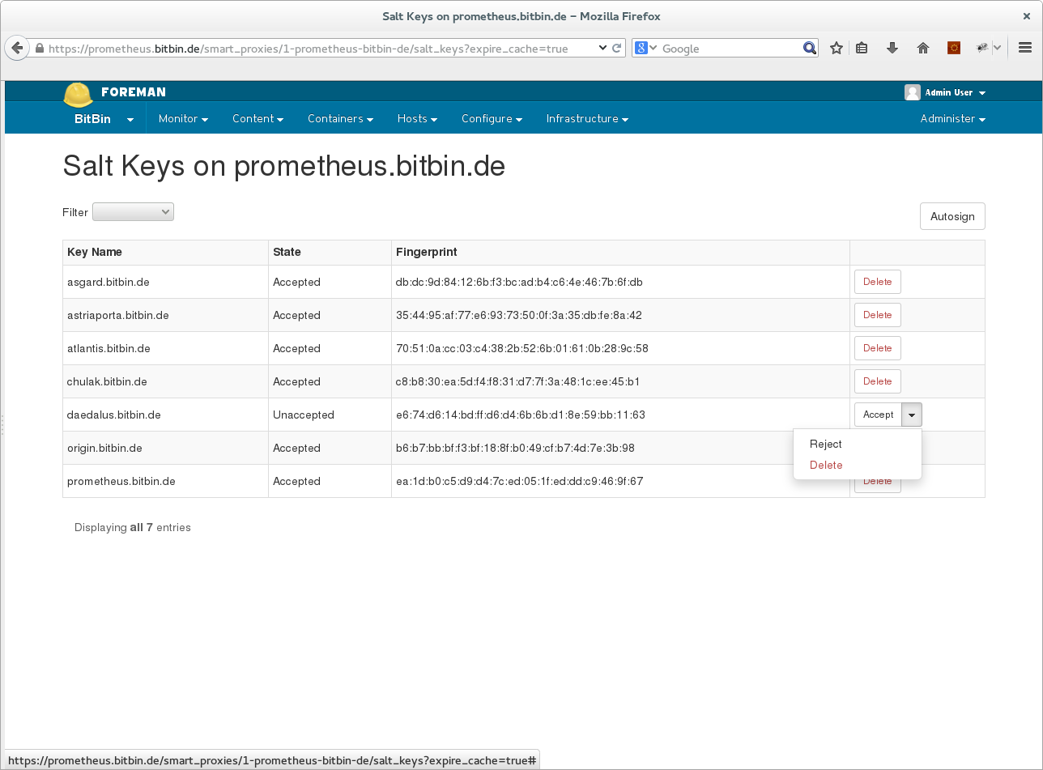

Slide 16
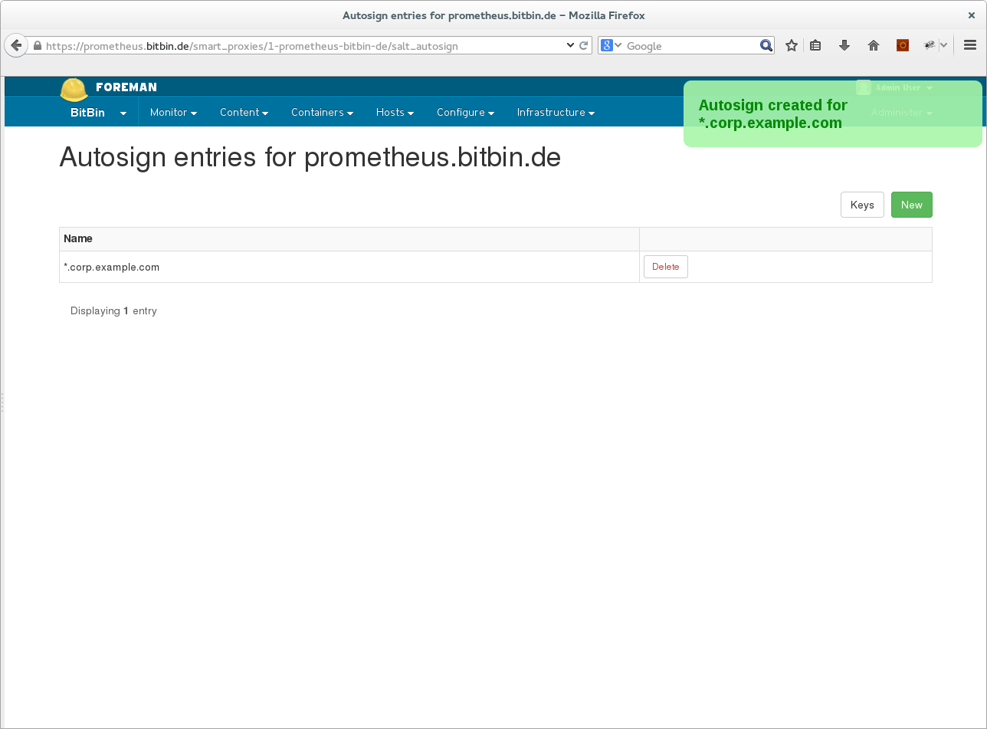

Slide 17
Import States and Environments
Using the salt-api, we can now sync your states + environments with Foreman

Slide 18
Salt States
Assign to host groups (including full inheritance when using netsed host groups), or directly to individual hosts

Slide 19
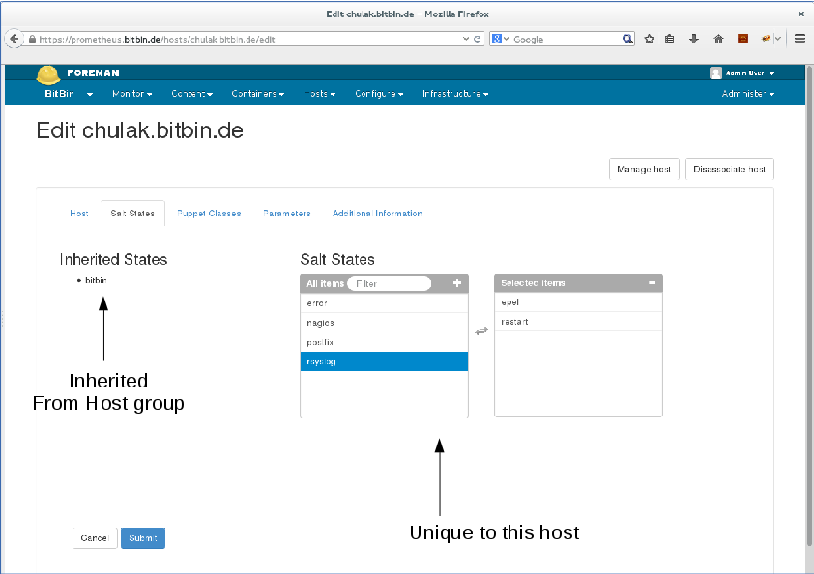

Slide 20
Pillars
Pillars <-> Foreman parameters
  Add parameters to host, host groups, domains, global, etc.
Exposed to Salt via the “external pillars” feature
Currently limited to String values only

Slide 21
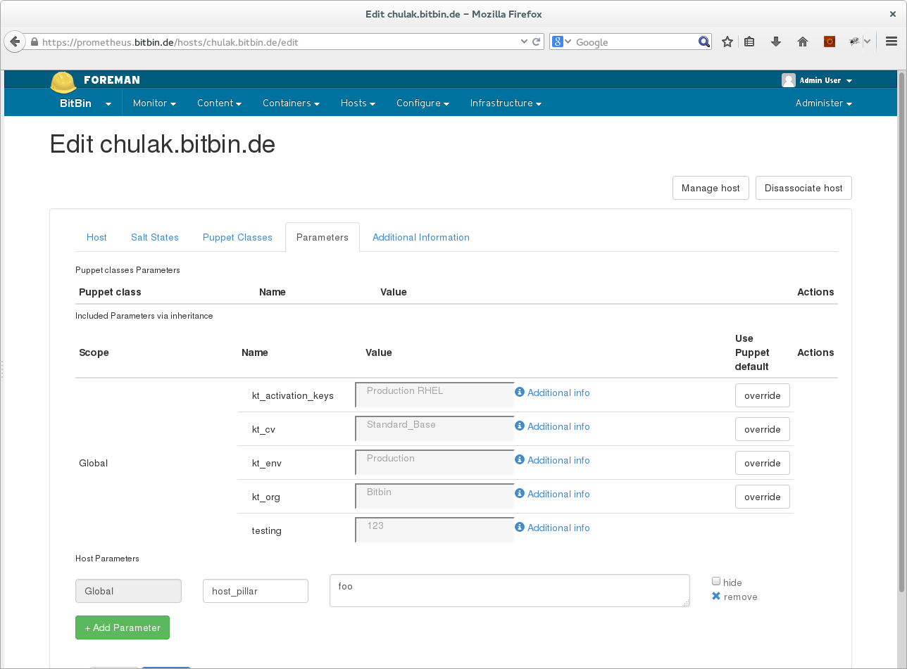
Pillars!

Slide 22
Master Tops
Salt's Master tops system provides a way to generate the top file data for a highstate run from external sources
Foreman uses the external_nodes module in Salt to deliver a YAML document with States and Pillars

Slide 23
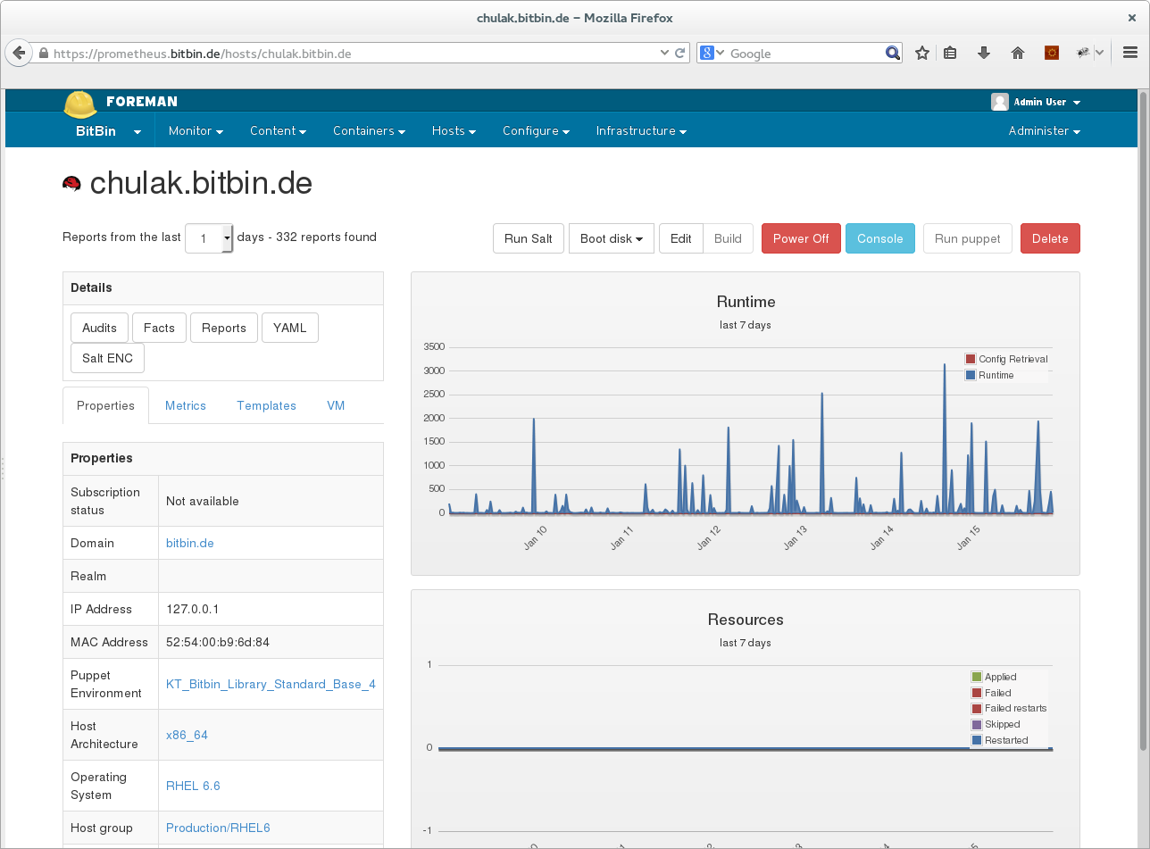

Slide 24
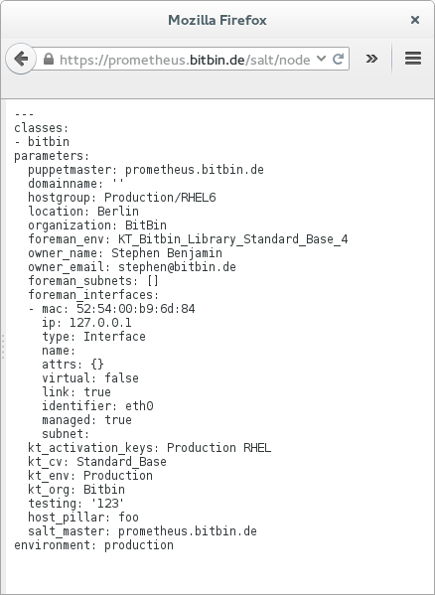
States
}
Pillars

Slide 25
Highstate
Run highstate directly from a node
  'Run Salt' button
Results reported back to Foreman

Slide 26
Highstate

Slide 27
Reporting
When running state.highstate, full reporting inside Foreman of the results!
  What happened on my systems?
  File changes with diffs!
  Other metrics

Slide 28
Grains
Grains map to 'Foreman Facts'
Host grains are uploaded to Foreman
Browseable, chartable, searchable

Slide 29
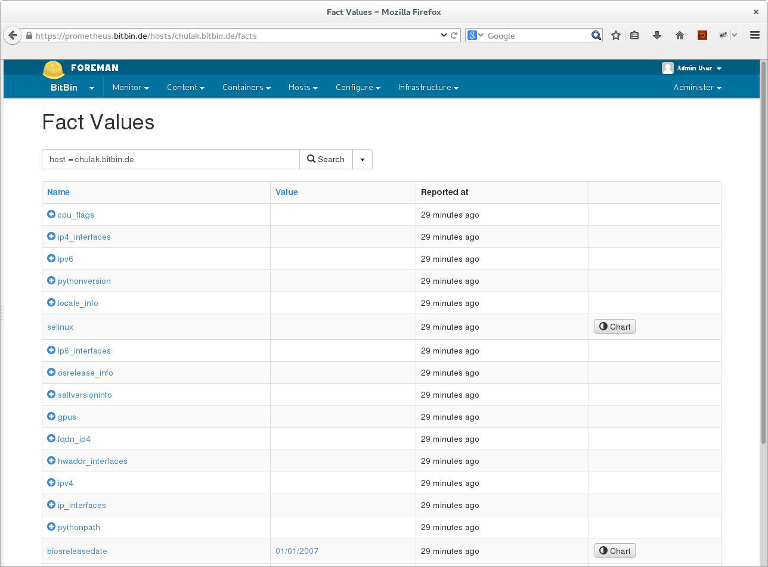

Slide 30
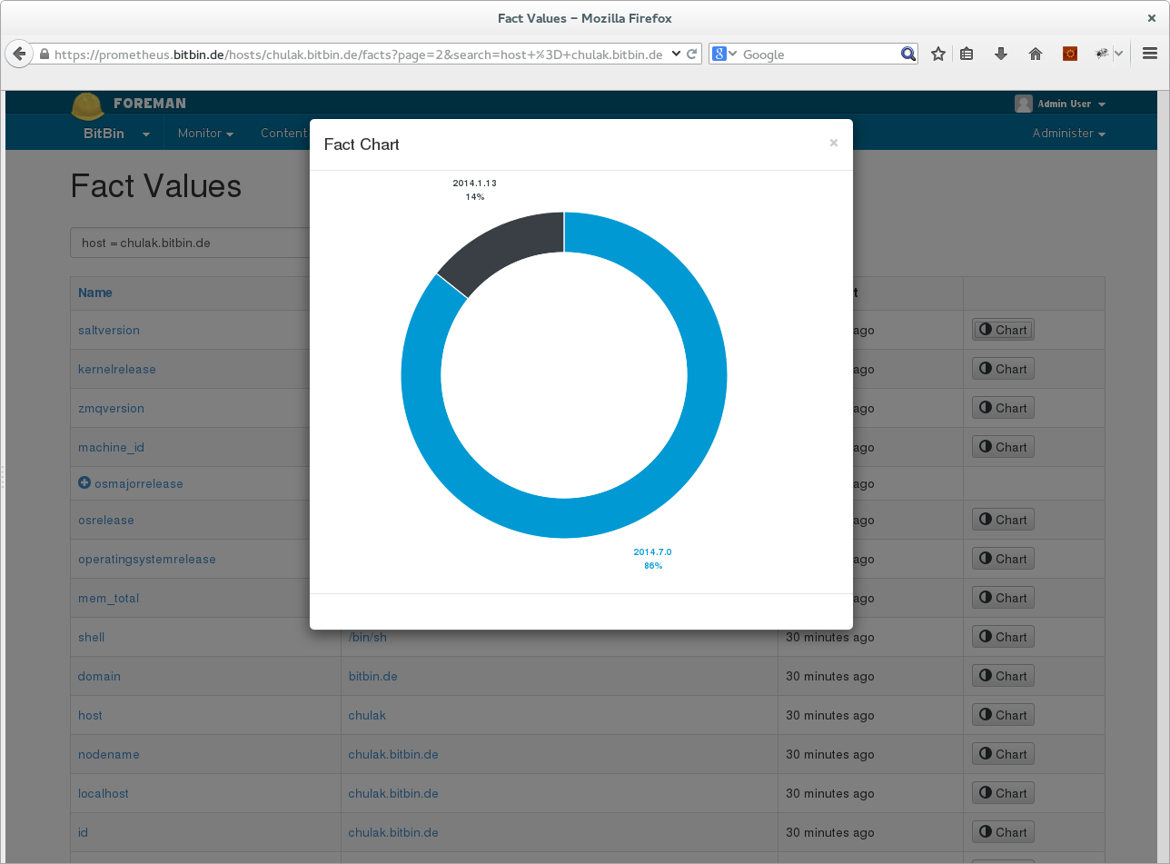

Slide 31
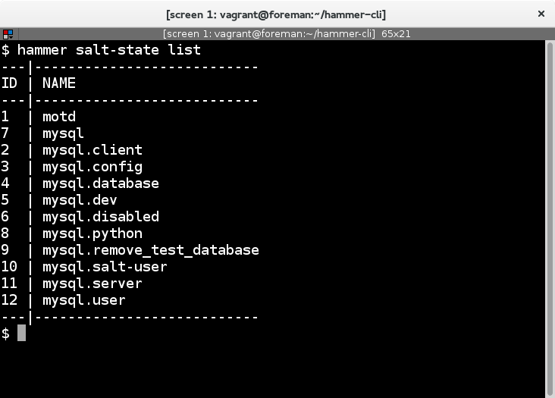
API + CLI
Has a RESTful API and a CLI plugin for 'hammer'

Slide 32
Future
Foreman 1.11 will bring version 5.0 of the plugin
  Rails 4 compatability
    speed improvements
  Autosigning changes
    accept key directly instead of using autosign
  Bug fixes

Slide 33
Future
Remote execution support
State Groups (like Puppet config groups)
???

Slide 34
Conclusion + Q&A
Find us on Freenode!
  #theforeman, #theforeman-dev
Docs
  http://theforeman.org/plugins/foreman_salt/
Bugtracker:
  http://projects.theforeman.org/projects/salt
Want to contribute?
  http://theforeman.org/contribute.html

