Slide 1
Compositional Optimization for Advanced Machine Learning
Tianbao Yang
Professor, Stephen Horn ‘79 Engineering Excellence Chair
CSE@TAMU

Slide 2
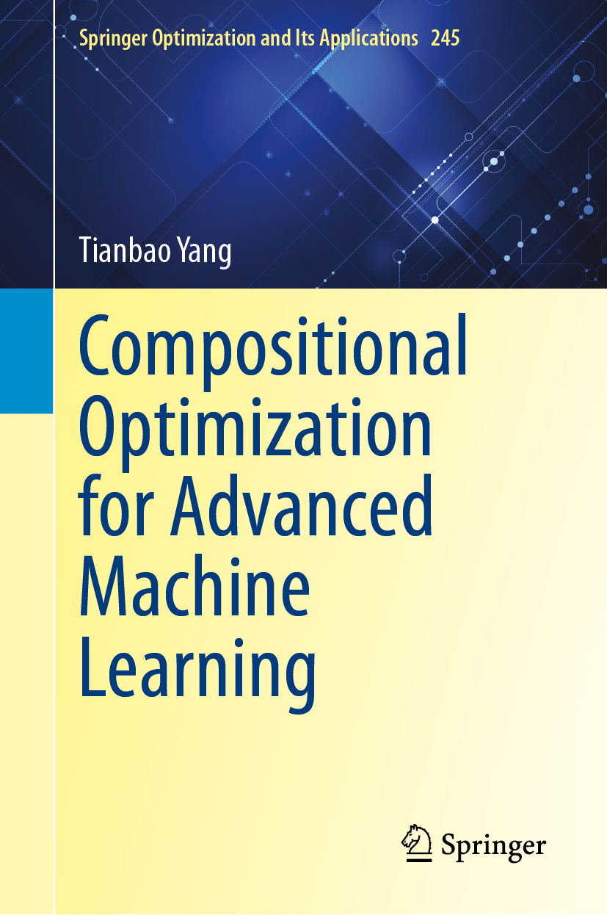
Roadmap
Objectives & Frameworks
Algorithms & Theories
Applications & Software

Slide 3

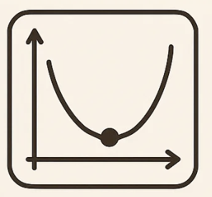

My research philosophy
“The best theory is inspired by practice. The best practice is inspired by theory” - Donald Knuth
“知者行之始，行者知之成 ” - 王阳明
ML/AI
Optimization
Machine Learning

Slide 4
AI, ML and Optimization
AI
ML
Optimization

Slide 5

Optimization for ML/AI
Algorithms
Adam
SGD
Momentum
Objectives
Theories
ERM
optimality
DRO
stability
EXM
generalization

Slide 6
Objectives

Slide 7
Empirical Risk Minimization (ERM)
Stochastic Optimization

Slide 8

Train the model with Mini-batching
STANDARD PYTORCH PIPELINE
1
Compute mini-batch loss
MINI-BATCH LOSS
loss_fn = CrossEntropyLoss()
loss = loss_fn(preds, target)
2
Backpropagate gradients
loss.backward()
3
Update model parameters
You Define the mini-batch loss.
optimizer.step()
handles the rest.

Slide 9
Cross-Entropy loss for Classification
What if K is million even billion?

Slide 10
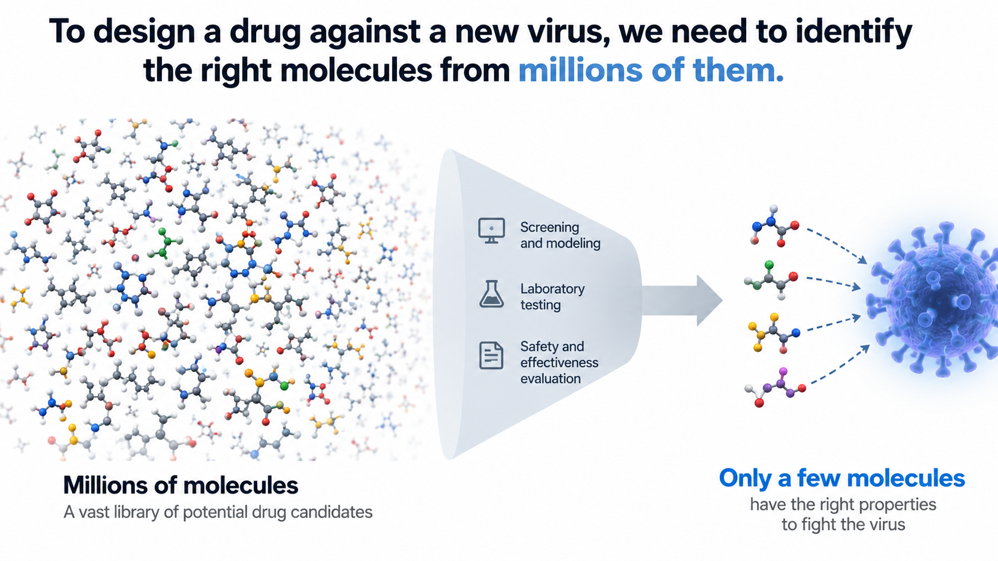
Drug discovery

Slide 11
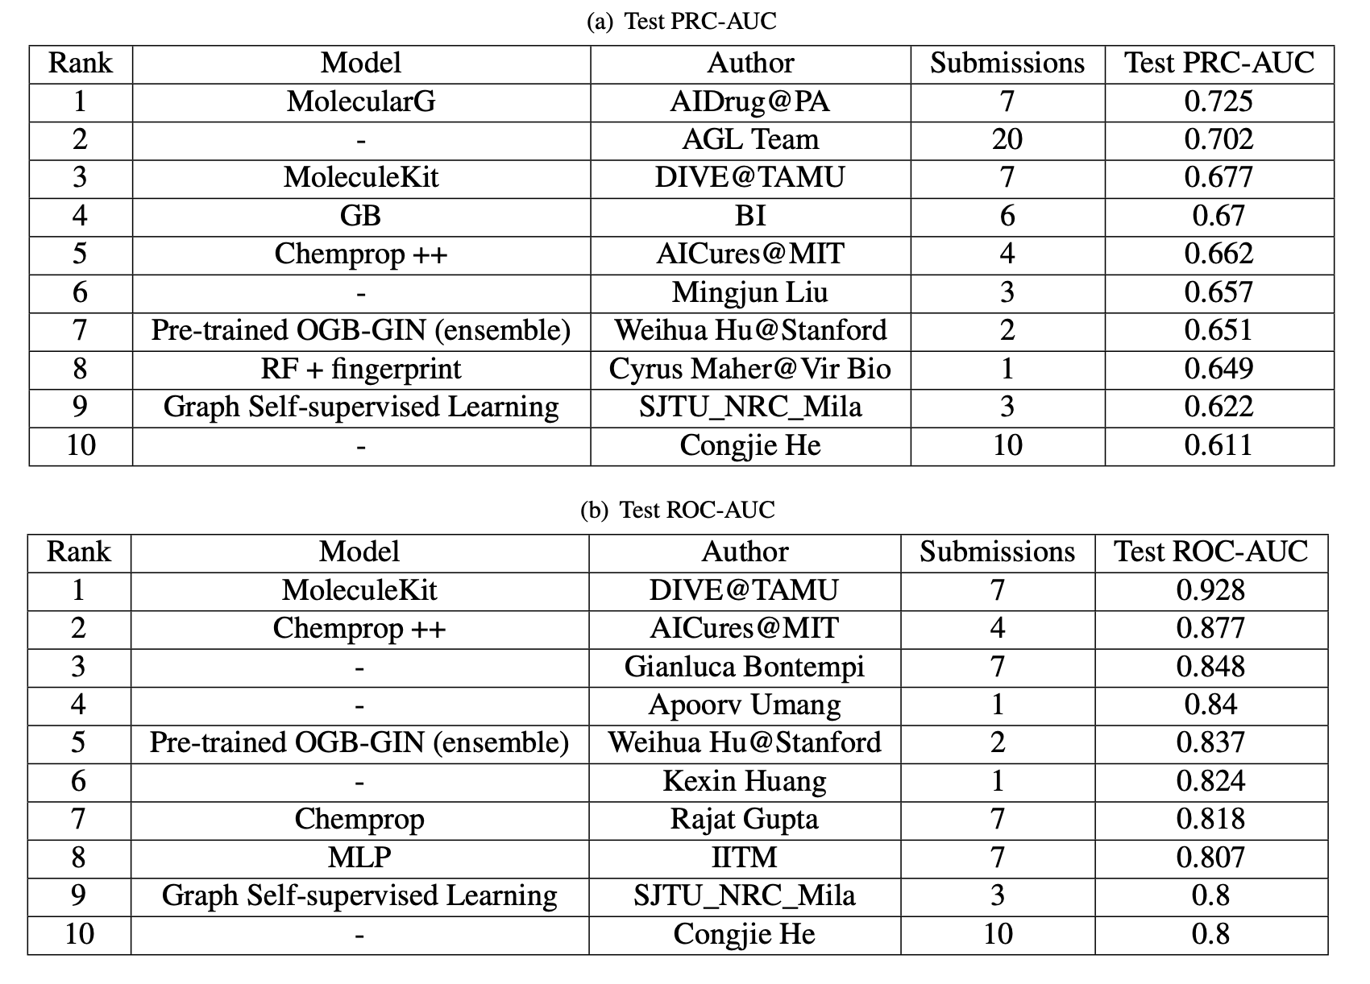

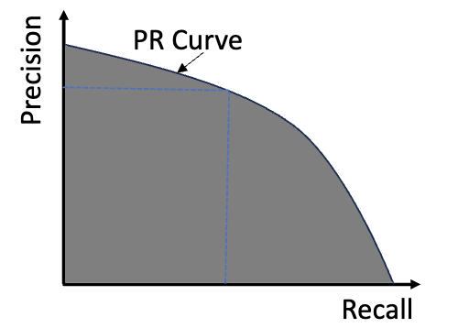
MIT AICures Challenge
Evaluation Metric: AUPRC

Slide 12
Empirical Estimator: Average Precision (AP)

Slide 13
Empirical Estimator: Average Precision (AP)
Positive Examples
What if n is million even billion?
All Examples

Slide 14
Foundation Model by Self-supervised Learning
OpenAI’s CLIP (Radford et al. ’21)

Slide 15
Mini-batch Contrastive Loss
Mini-batch Negative data

Slide 16
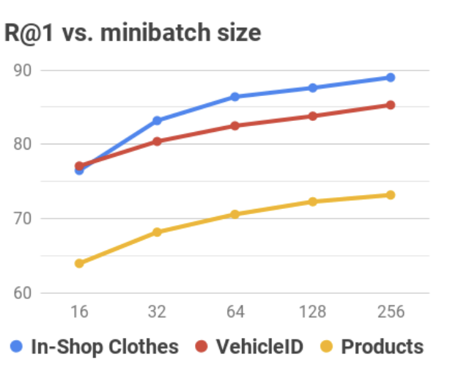
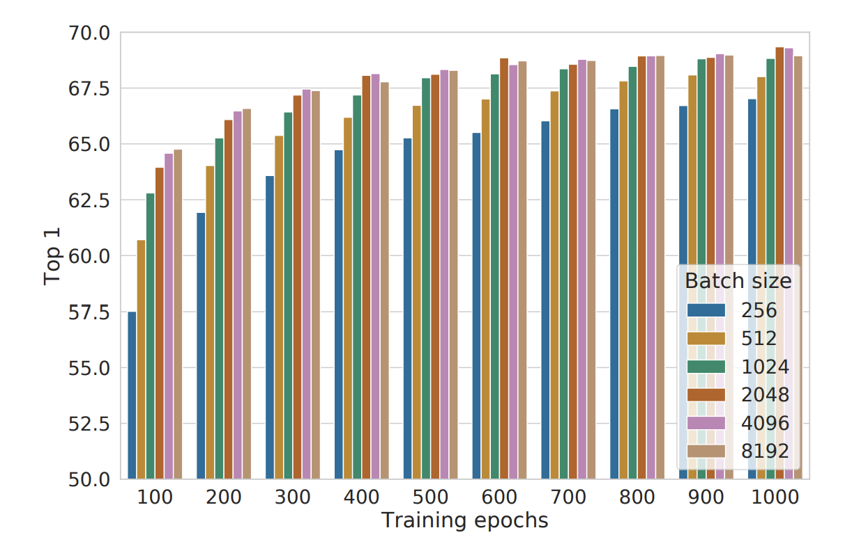
The Issue: Large batch size
Optimizing ranking measures
Self-supervised Learning
FastAP: Cakir et al. 2019
SimCLR: Chen et al. 2020.

Slide 17
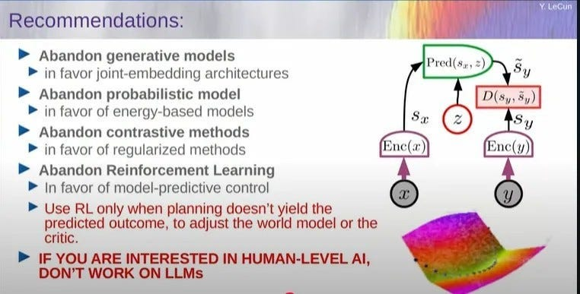

To Contrast or Not to Contrast?
Yann Lecun

Slide 18
Frameworks

Slide 19
We need new frameworks
Crammer-singer loss
AP
Cross-entropy loss
Partial AUC
unify
A Robust
Learning
Framework
A Compositional
Optimization
Framework
Contrastive loss
formalize
Top-k average loss
NDCG
Listwise ranking loss

Slide 20








A Unified Robust Learning Framework
classification
ranking
repre. learning
Contrasting-object space Y
The contrasting object y can be a label, image, text
Anchor space X
Few positives y+
Many negatives y−
Label
objects
golden retriever (ID:1)
⋯
Cat (ID:2)
Bird (ID:3)
Horse (ID:4)
Airplane (ID:5)
⋯
Image
objects
⋯
⋯
Anchor x
"a golden retriever dog"
Text
objects
"a golden retriever dog"
⋯
"a tabby cat"
"a blue bird"
"a horse"
⋯

Slide 21
Aggregating over negatives
Pairwise Loss
Average of Negatives
Treat all negatives equally
All Negatives

Slide 22
Distributionally Robust Optimization (DRO)
Probability weights
Hard negatives get higher weights

Slide 23
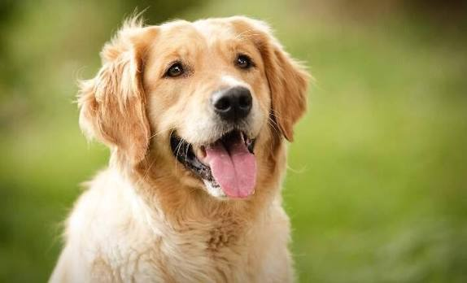
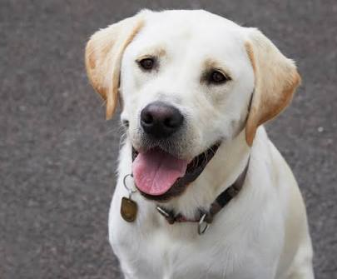
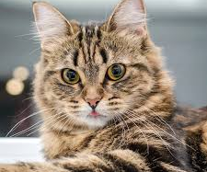
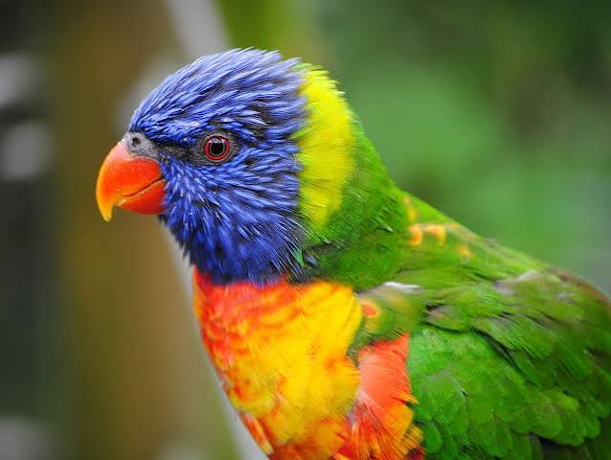
A Unified Robust Learning Framework
Cross-entropy loss
Contrastive loss
Listwise CE loss
dog
“dog”
“this is a dog”
1. Vary scoring function
2. Vary or Optimize Temperature
3. Vary divergence measure

Slide 24
The Optimization Challenge
Large sum

Slide 25
A Compositional Optimization Framework
X-risk
A family of Compositional Risks in which the loss function of each data point is defined in a way that contrasts the data point with many others.
Empirical X-risk Minimization
Yuan et al. (KDD’23)

Slide 26
Map Contrastive Objectives to X-risk

Slide 27
Finite-sum Coupled Compositional Optimization (FCCO)
Coupling
Wang & Yang. (ICML’22)

Slide 28
Algorithms & Theories

Slide 29
Biased Stochastic Gradient
Not Practical
Inner Mini-batch
Large Batch Size
(Hu et al.’19)

Slide 30
A Complete Algorithmic & Theory Landscape
GENERAL FCCO
Log-E-Exp
SMOOTH · NON-CONVEX
CONVEX
FCCO
specialized
structure
2022 · RATE & SCALE
SOAP
MOAP
SOX
MSVR
NeurIPS ’21
AISTATS ’22
ICML ’22
NeurIPS ’22
ALEXR
SCENT
First provable
algorithm
Parallel
speed-up
ICML ’25
ICML ’26
Improved rate
Faster rate
Optimal
convex rates
Optimal rates for
log-E-exp
NON-SMOOTH · NON-CONVEX
UPPER = LOWER
OPTIMAL RATE
SONX
SONEX
NeurIPS ’23
NeurIPS ’25
Non-smooth
non-convex
Improved Rates
Seven algorithms, one unified research program

Slide 31
SOX
Gradient Estimator
Estimator of g_{i}
Moving-Average
Wang & Yang. (ICML’22)

Slide 32
SCENT
Wei et al. (ICML’26)

Slide 33
SCENT
stochastic proximal mirror descent (SPMD)
Recovers SOX

Slide 34
Complexity Theory of SOX
Assumption: Non-convex & Smooth
Iteration Complexity
Better Total Complexity than BSGD when
Wang & Yang. (ICML’22)

Slide 35
Complexity Theory of SCENT
Assumption: Convex & Non-smooth
Iteration Complexity
Wei et al. (ICML’26)

Slide 36
Applications & Software

Slide 37
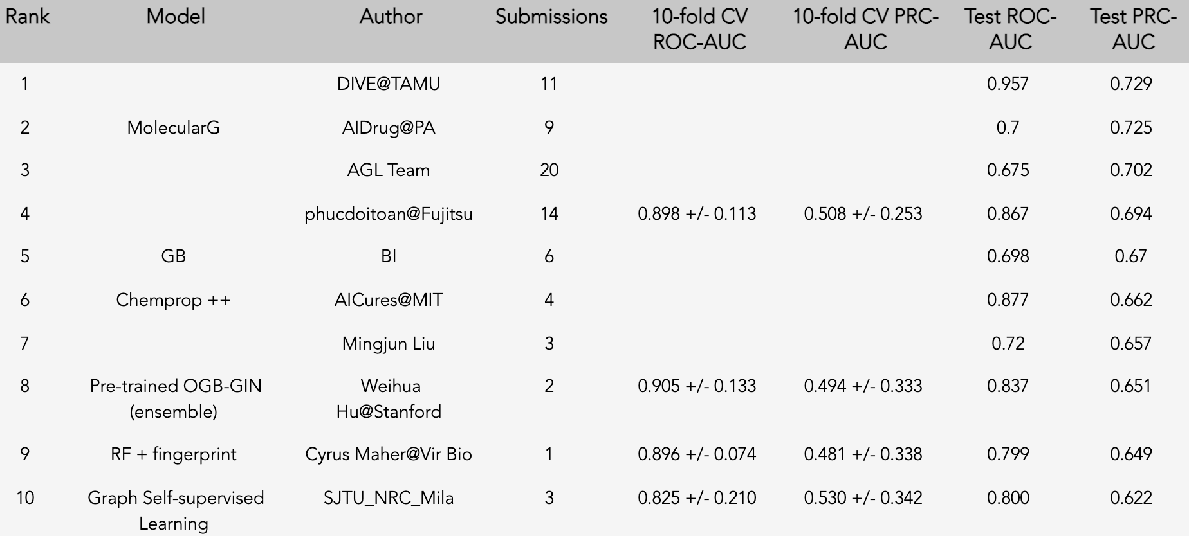
1st Place at MIT AICures Challenge
37
Wang et al. (Bioinformatics’22)

Slide 38
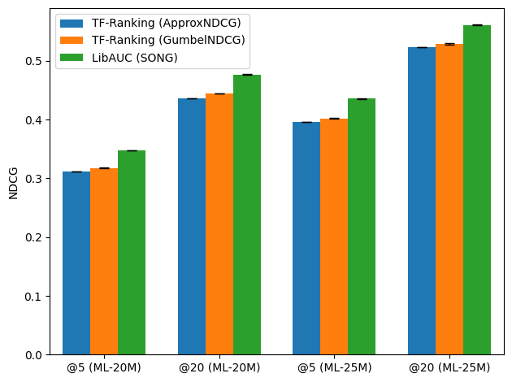
NDCG Optimization
MovieLens (ML) 20M and 25M datasets
Yuan et al. (KDD’23)

Slide 39
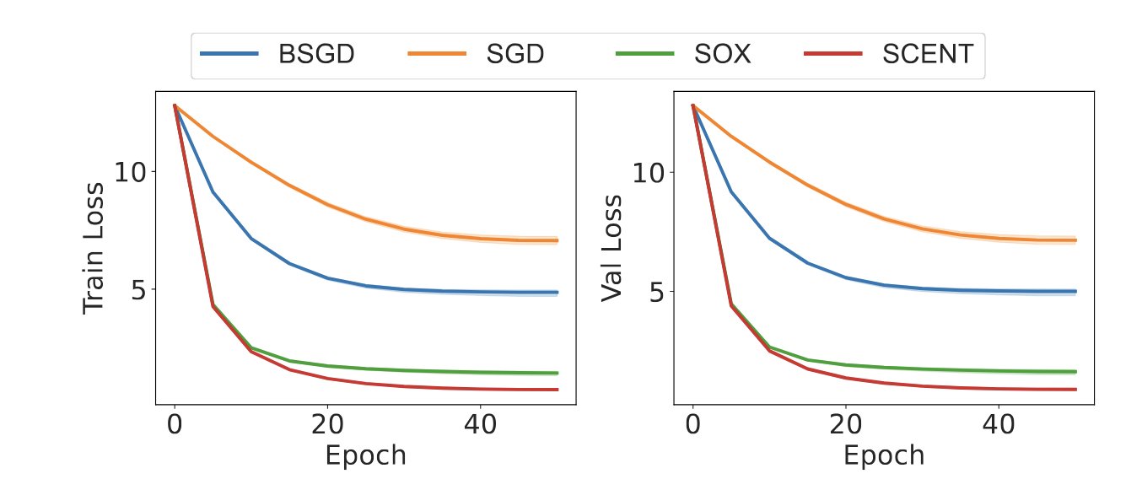
Extreme Multi-class Classification
Glint360K dataset (An et al., 2021): a face recognition dataset consisting of n=17 million images of K=360 thousand individuals
Wei et al. (ICML’26)

Slide 40
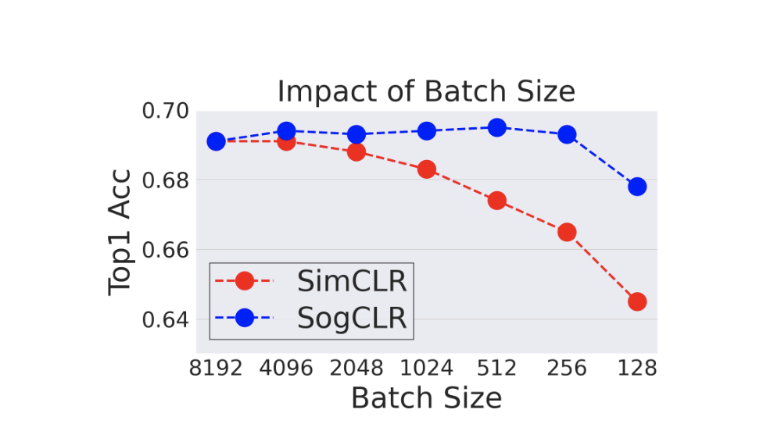
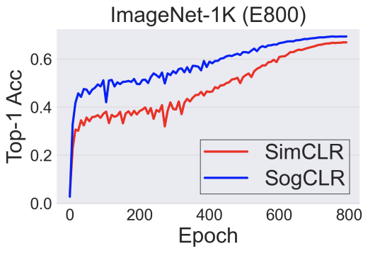
SSL: SogCLR vs Google SimCLR
1.2M ImageNet Images
Yuan et al. (ICML’22)

Slide 41
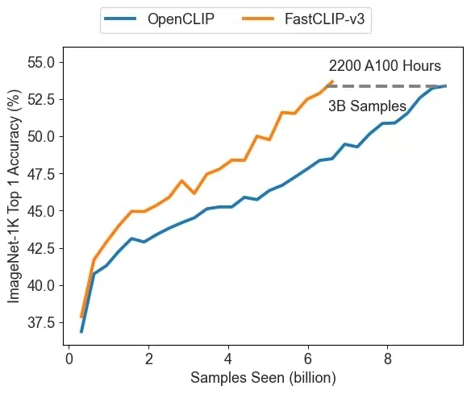
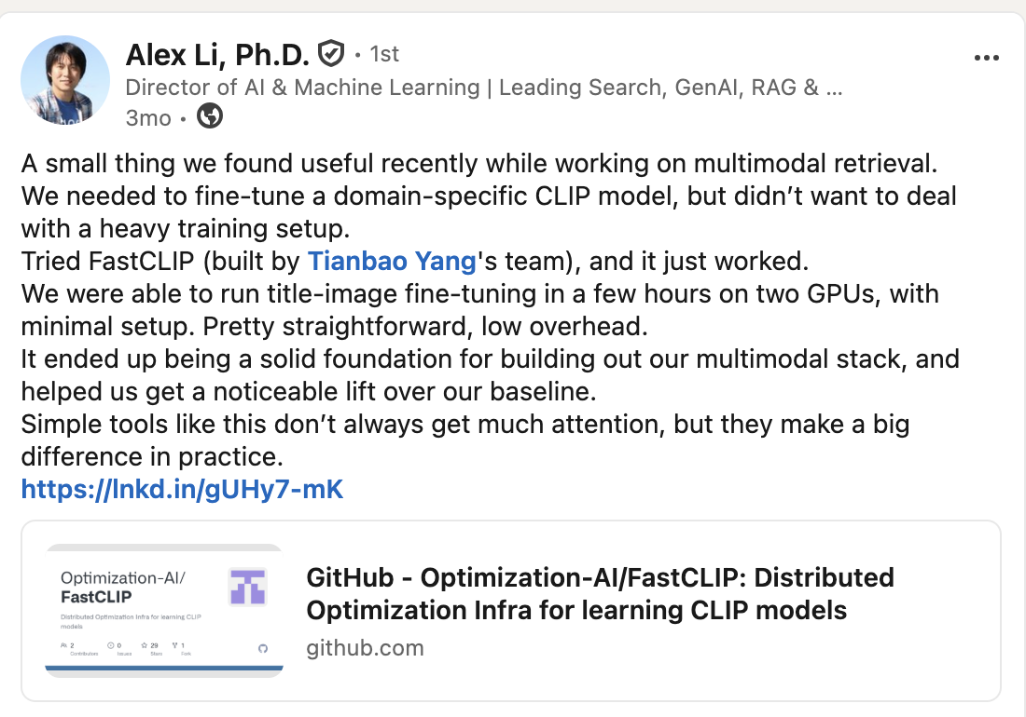
CLIP: FastCLIP vs OpenCLIP
9B samples seen
315M image-text pairs
8 H100s
Adopted by Target
Wei et al. ’24

Slide 42
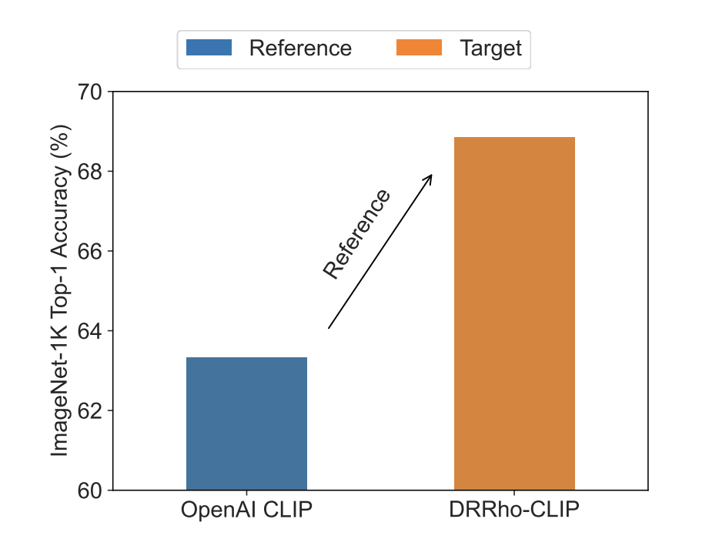
DRRHO-CLIP: reference guided
OpenAI: 400M data, 12.8B samples seen and 32768 batch size
5%
2x less data size
6x less batch size
17x less compute budget
DRRHO-CLIP: 192M data, 1.28B samples seen and 5120 batch size
Wei et al. (ICML’25)

Slide 43
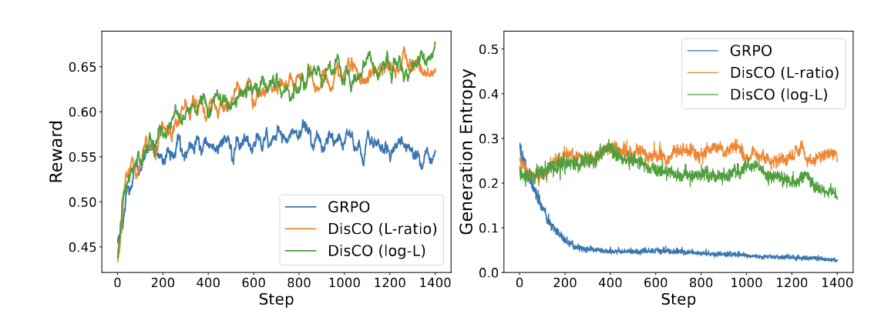
Post-training of LLMs
DPO
GRPO
DisCO
AUC
Weighted AUC
Partial AUC
Li et al. (NeurIPS’25)

Slide 44

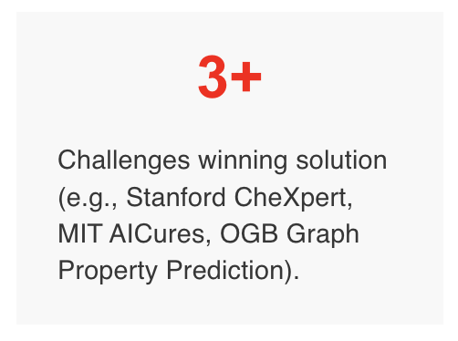
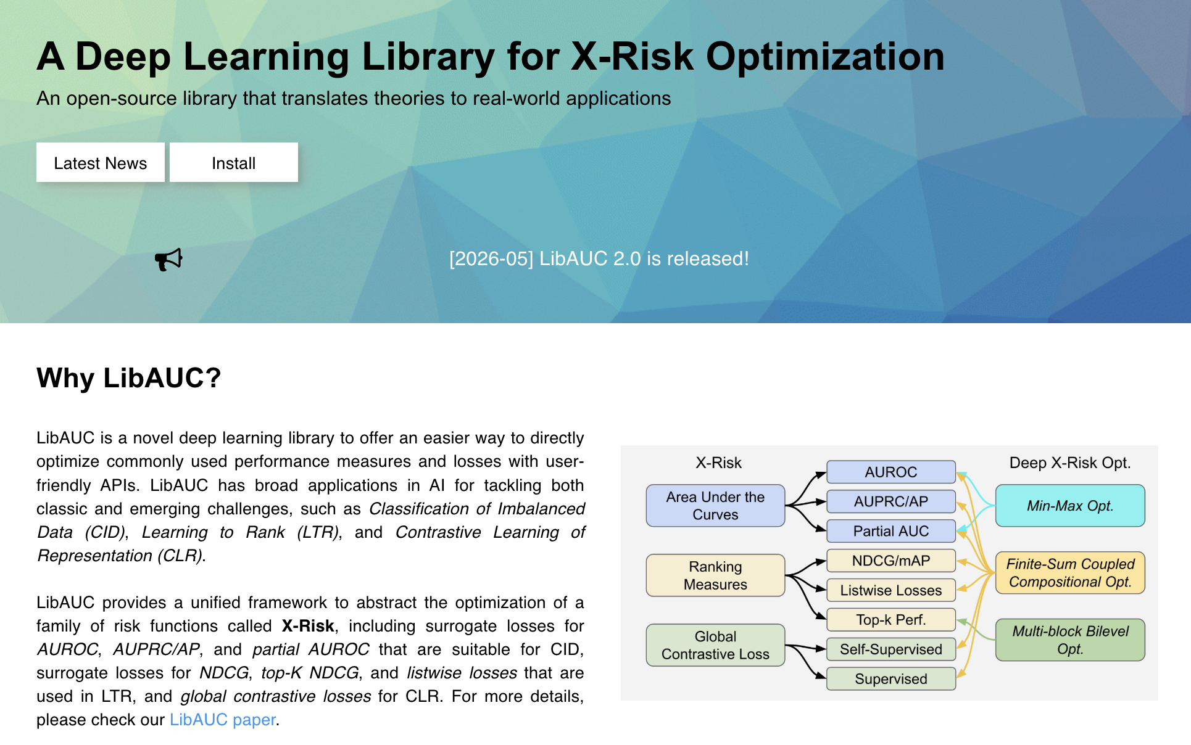
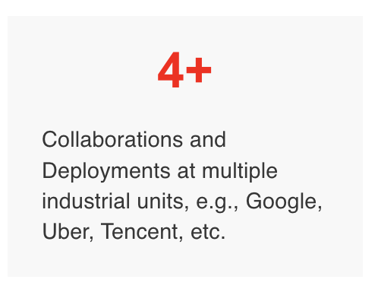
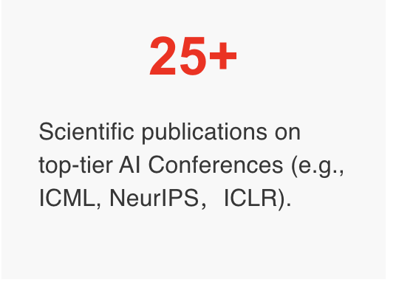
libauc.org
133,000+

Slide 45
LibAUC Training Pipeline
1
Compute Dynamic mini-batch loss
detach
2
Backpropagate gradients
loss.backward()
3
Update model parameters
optimizer.step()

Slide 46
Take-home messages
Empirical X-risk Minimization
  A robust learning framework
  A compositional optimization framework
LibAUC library
  Theory-guided, Broad applicability
DO NOT Abandon Contrastive methods
  Use EXM to formulate and solve them

Slide 47
“Let practice inspire theory, and let theory transform practice”

Slide 48
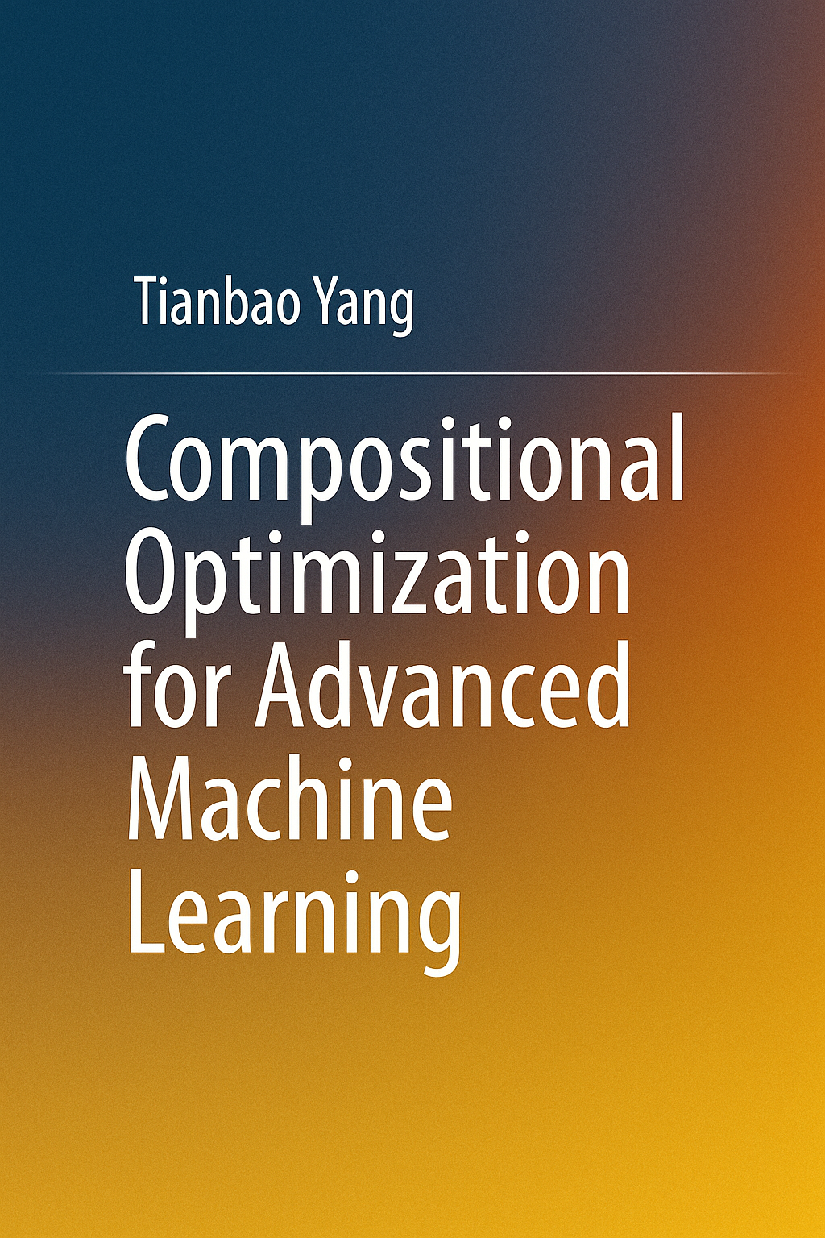

opt4ml.org

Slide 49
Q&A

