Slide 1
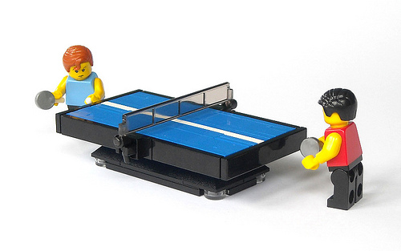
Team -"Cyber yellow”
“Pong-Ball”
A classical ping-pong game with a football “flavour”

Slide 2

Stage 1:Team- Forming
We are cool! We can do it!
.... Столичани в повече! ☺
Пловдив
Ст. Загора
Сливен
Габрово

Slide 3

Java Basics: Team-Workshop
Friday, 12 September 2014
всичкоЕ != Ясно
Има ли
въпроси?

Slide 4

Stage 2: Team- Storming
-Някой писал ли е игра на Java?
Ко? - Не!

Slide 5
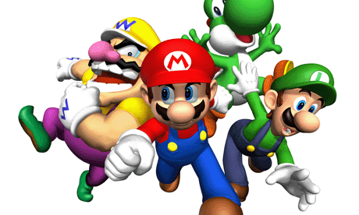

Stage 3:Team- Norming
Уфф… какво е Class ... за какво се използва ???
Имаме само 4 дни !?
Аз в Събота съм на работа…
В Неделя имаме цял ден лекции !?

Slide 6

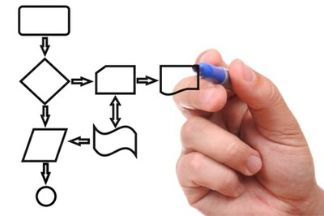
Strategic Decision Making
Да откриваме ли топлата вода …???
… или да видим как работи бойлера …???

Slide 7
Team: the Objectives
To have written a basic Java game,
as a team.
To become all confident in using
Source Control Management.
To present our project well.
To have Fun

Slide 8



Stage 4: Team -Performing
Pulling-in & Pushing-out to the Source Management System.
Object by Object Building.
Learning and Understanding “How it works”.

Slide 9





And having Fun....
Тук - НЕ !?
Тук Работи !

Slide 10

Team: Mission Complete

Slide 11




Team: “Happing”

Slide 12
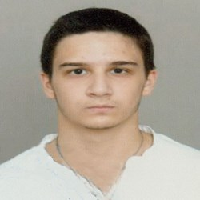
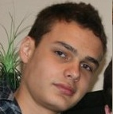

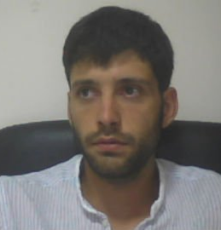
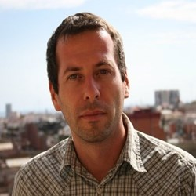
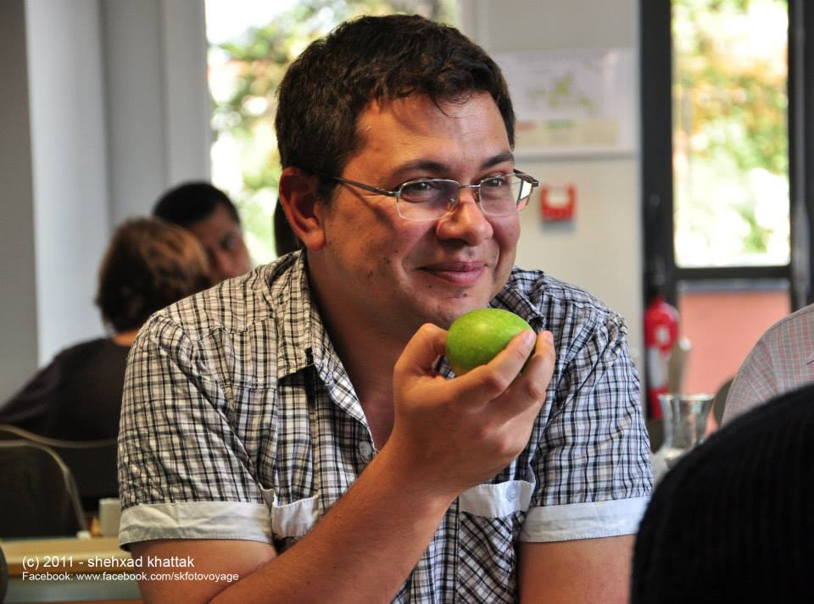
"Cyber yellow”
Ivelin
Rusev
Pavel Rashkov
Code Wizard
The “Reveal Mystery” Compiler
The “Do-It Together” Coordinator
The GitHub Share motivator
Code Wizard
Dimitar Atanasov
Iliya Bakardzhiev
Krasimir
Kirilov

