Slide 1
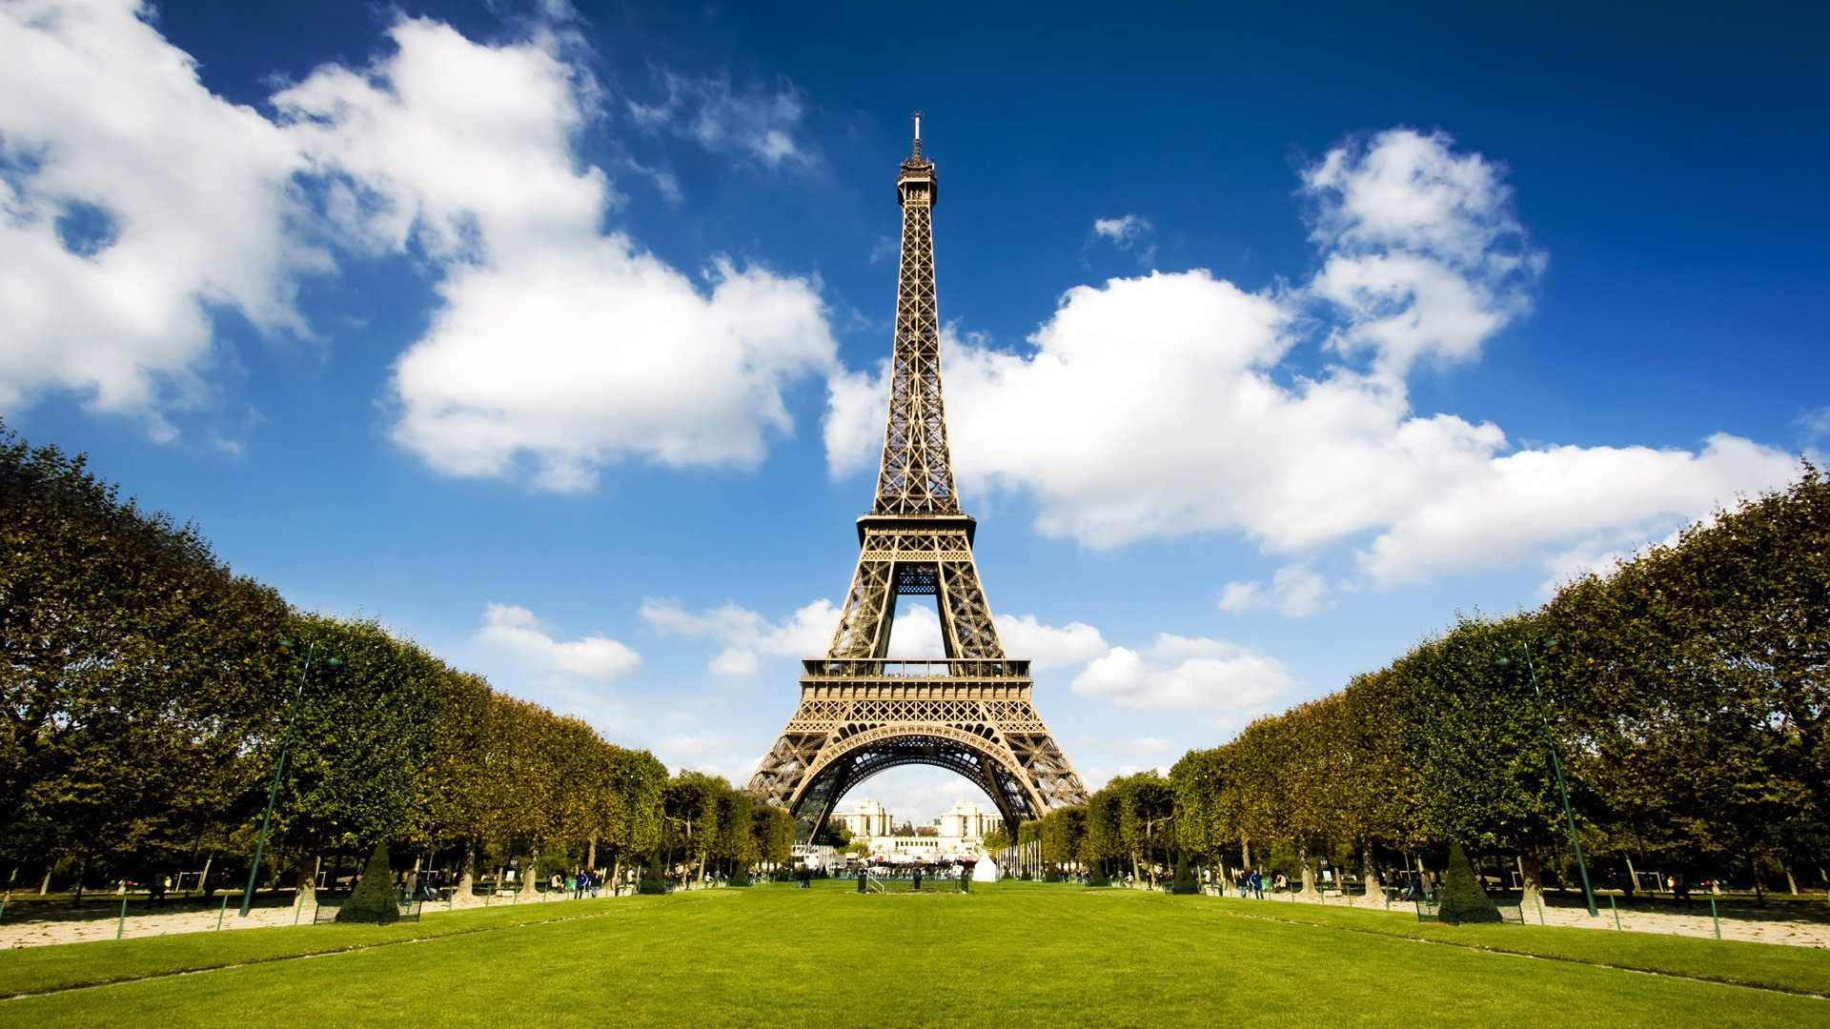
TEAM “PARIS”
Project name and purpose – what you have created?
BLOG “Team Paris”
http://github.com/optodent/Team-Paris_PHP

Slide 2
Team name : PARIS
Ivelin Rusev – samuanne
Martin Kurshumov – devil619
Radoslav Slavkov – R.Slavkov951
Gabriel Dimitrov – Den1eD

Slide 3
Contributions
Ivelin Rusev – samuanne
Martin Kurshumov – devil619

Slide 4
Blog
View post – each post can be viewed by clicking on the heading or by the button “Read More”
Search by tag – searches in posts with the same tags and view them.
Comments – you can add comment, but first you have to write your name, email and content (comments). If one input field is empty the comment won’t be added.
Blog – most functionalities for blog.

Slide 5
Admin Panel
Login – to proceed onto admin panel you have to login with an existing username and password. If not it shows a warning.
Add/Edit/Delete Post – in admin panel you can add, edit or delete posts.
Add/Edit/Delete Users – you can add, edit or delete users.
View website – location: main page (Blog)
Logout

