Slide 1
Member Retention

Slide 2
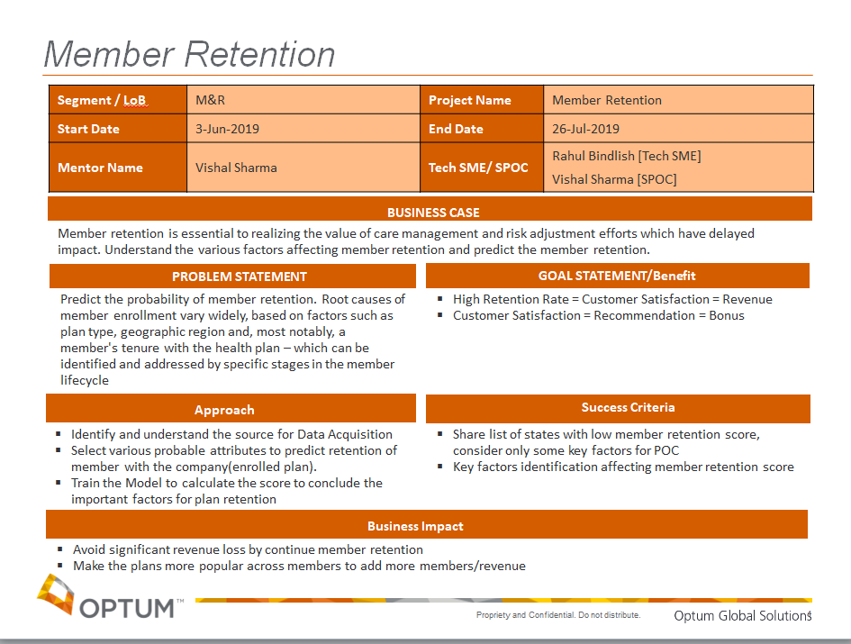

Slide 3




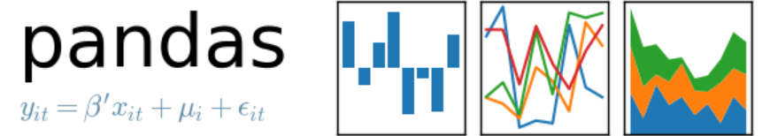
Tools And Technologies
AnaConda → To simplify package management and deployment.
Jupyter Notebook→ To create and share documents that contain live code, equations, visualizations and explanatory text.
Python Libraries →To facilitate data analysis and visualization.
Numpy, Pandas, Scikit-learn, Matplotlib, Plotly, Seaborn
License/infrastructure savings - $1.75 MN per annum
Release four dedicated servers – Savings under estimation
Agile App;
Faster delivery cycle & reduced cost of implementation
No middleware dependency “AE, ISRM, Citrix or SBG)

Slide 4
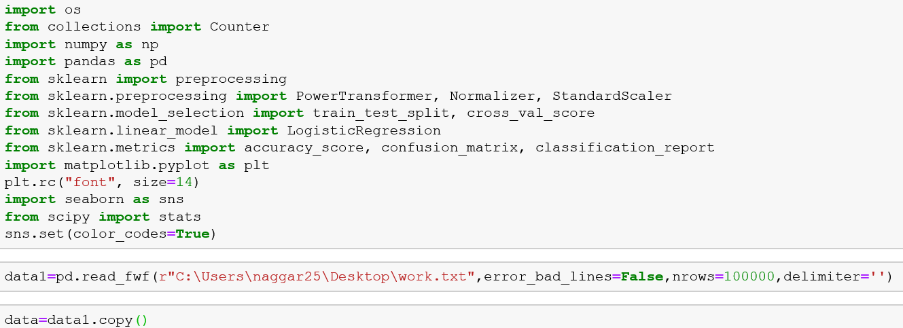
Process Flow
Data Acquisition
To starts with ,firstly import the necessary libraries (for example pandas, numpy, matplotlib and seaborn) and load the GPS text file containing the dataset.
Then load the data instances from text file in pandas DataFrame for data exploratory analysis and data featuring .

Slide 5
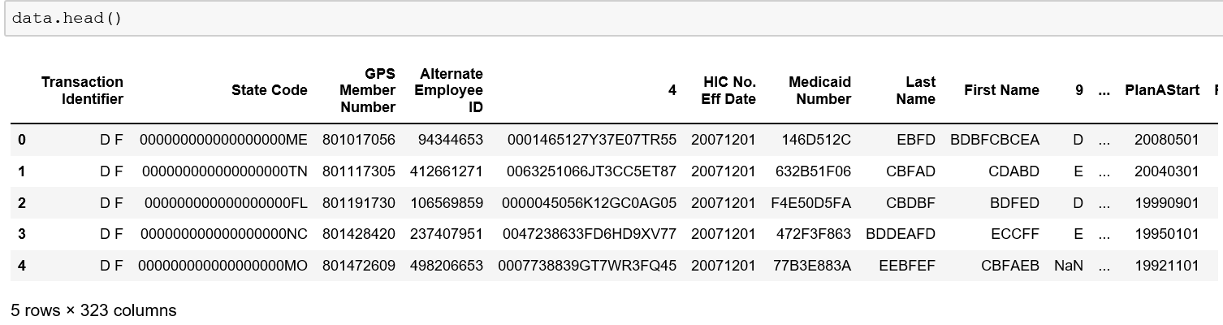
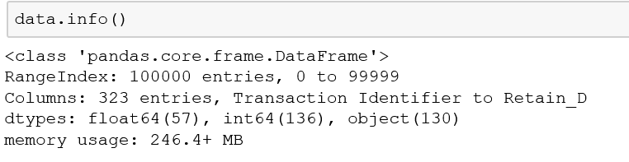
Data Preparation
Exploratory Data Analysis:
Exploratory Data Analysis refers to the critical process of performing initial investigations on data so as to discover patterns, to spot anomalies, to test hypothesis and to check assumptions with the help of summary statistics and graphical representations.
It is a good practice to understand the data first and try to gather as many insights from it.
Dataset comprises of 1,00,000 observations and 323 characteristics.

Slide 6
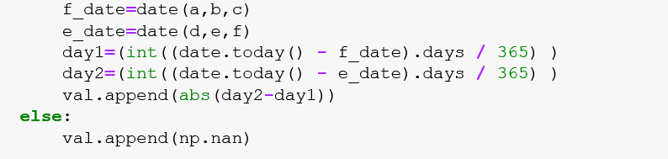
Feature Engineering:
For machine learning model to train, model use some input data to create outputs. This input data comprise features, which are usually in the form of structured columns. Algorithms require features with some specific characteristic to work properly. Here, the need for feature engineering arises
Goals: 1.Preparing the proper input dataset, compatible with the machine learning algorithm requirements. 2.Improving the performance of machine learning models.
Imputation:
Above code give the insight for unique value count for each feature and the percentage of missing value under them, for further imputation(a more preferable option rather than dropping because it preserves the data size).
The best imputation way is to use the medians of the columns. As the averages of the columns are sensitive to the outlier values, while medians are more solid in this respect.
Extracting Date:
Extracting the parts of the date into different columns: Year, month, day, etc.
Extracting the time period between the current date and columns in terms of years for member tenure calculation.

Slide 7
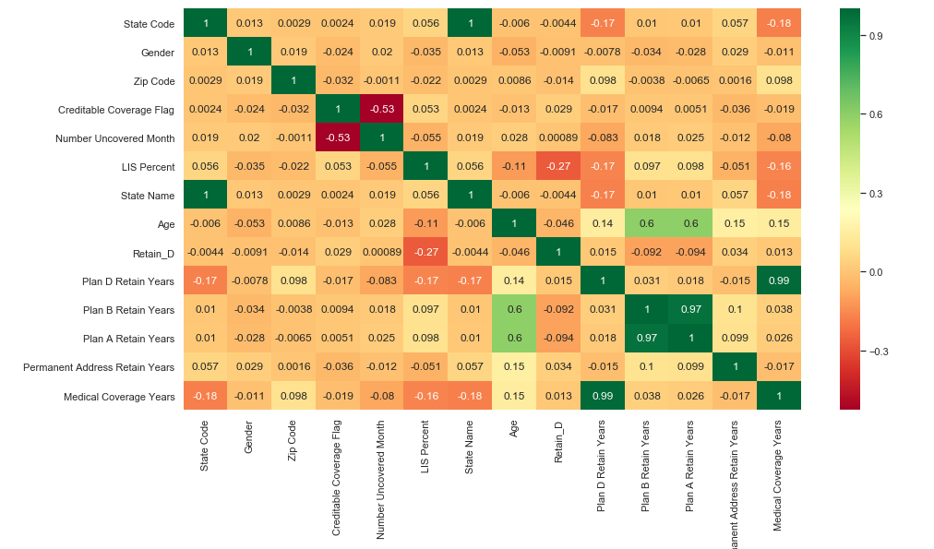

Removing Highly Co-Related Features
Using HeatMap
One can find correlations using pandas “.corr()” function and can visualize the correlation matrix using a heatmap in seaborn.
Highly co-related features can be drop out after observing the heatmap:

Slide 8
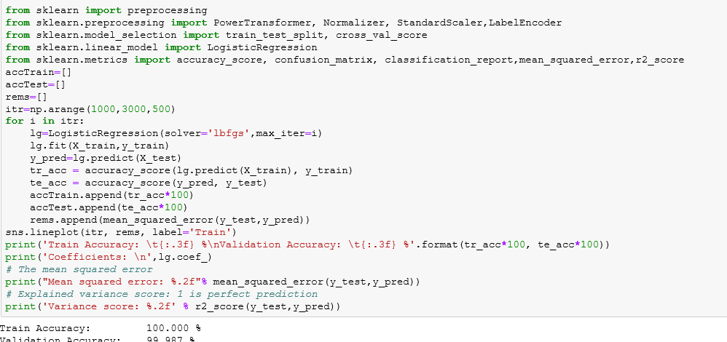
Training Model
Supervised machine learning:
Logistic Regression: Firstly, model is “trained” on a pre-defined set of “training examples”, which then facilitate its ability to reach an accurate conclusion when given test data.
Random forest, consists of a large number of individual decision trees that operate as an ensemble. Each individual tree in the random forest spits out a class prediction and the class with the most votes becomes our model’s prediction.
Then train the model using this technique to improve the accuracy and find the contribution of each feature towards member retention rate.
Standardization:
Data features values are standardize using standard deviation value to range each feature value between mean=0 and standard deviation=1, to improve the model accuracy and reduce overfitting problem.
Again re-train the model for further improvement in accuracy.

Slide 9
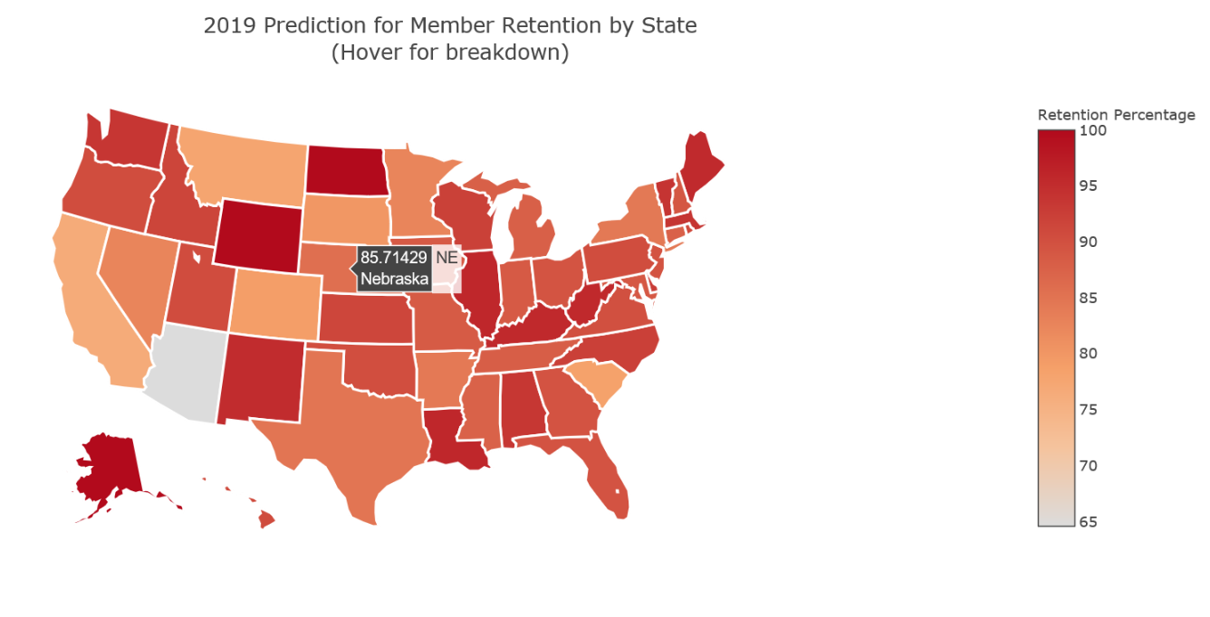
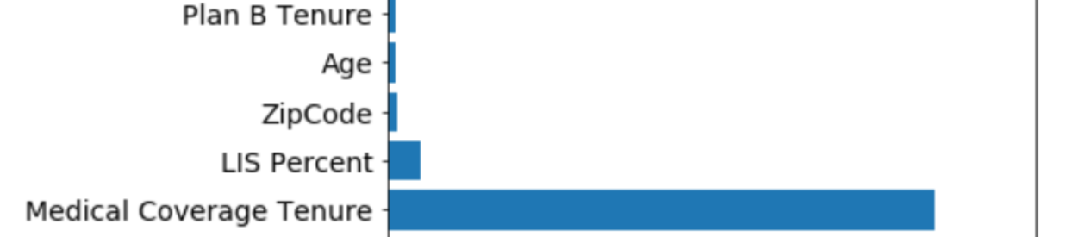
Final output results(State-Wise)
License/infrastructure savings - $1.75 MN per annum
Release four dedicated servers – Savings under estimation
Agile App;
Faster delivery cycle & reduced cost of implementation
No middleware dependency “AE, ISRM, Citrix or SBG)

