Slide 1

GROUP PRESENTATION (CP301)
Thermodynamics Water Heating System
CHENARAM KUMAWAT MAYANK KUMAR
RAHUL GOYAL
VINAY DHARA
COURSE INSTRUCTORS DR. SARANG P. GUMFEKAR
DR. NAVIN GOPINATHAN

Slide 2
CONTENTS
Introduction
Gaps
Problem Statement
Heat Exchanger
Thermodynamics Solar Panel
Compressor
Expansion Valve
Cost Analysis
Conclusions
2

Slide 3
INTRODUCTION
We aim to provide an overview of thermodynamic solar systems, their functionality, and the potential benefits they offer.
We will examine the water heating technology systems, how they work, and the different types of applications for which they can be used.
Additionally, we will consider the economic and environmental advantages of utilizing thermodynamic solar systems in buildings, including reduced energy costs and carbon emissions to create a sustainable society.

Slide 4
GAPS
The project aims to provide warm water using a thermodynamic panel with minimal energy input compared to traditional heating methods.
We incorporates energy technologies to minimize energy consumption and maximize efficiency and also is guided by the science of sustainability, which involves the assessment of environmental, social, and economic factors to create a holistic and sustainable solution.
We also have utilizes sustainable economic models to ensure long-term viability and stability.

Slide 5
PROBLEM STATEMENT AND EXPLANATION
Problem Statement:
As we know that thermal solar collectors are the best source of heat on hot and sunny days but they are totally inefficient whenever there is no sun.
Working Principle:
So, now we are focusing to capture energy using the temperature difference.
It works by difference between the temperature of the air around the panel and the very cold liquid (coolant) in the panel.

Slide 6
Evaporation of the fluid that runs through the closed looped circuit by absorbing heat from the sun, wind and surrounding air by natural convection.
Then heated fluid travel through to the compressor, that basically compress the fluid increasing it’s pressure and also the temperature.
After this it goes through heat exchanger where this heat is transferred to water and then it goes to expansion valve where pressure and temperature drop and fluid travel up to thermodynamic solar panel and cycle repeat again.
Capture heat regardless of weather factors.
High level of efficiency.
Thermodynamics principles.
The system is utilized in various settings, including hotels, hostels, sports complexes, hospitals, and many different industries.

Slide 7
FLOW DIAGRAM
Heat From Air
Liquid R-407C
P =25.07 kPa
T= -20°C
Vapor R-407C
P= 461 kPa
T = 0°C
Expansion Valve
Compressor
Liquid R-407C
P = 2627.4 kPa
T = 65°C
Vapor R-407C
P = 2680 kPa
T = 82°C
Heat Exchanger
7
Notes:
Scroll Compressor - 21,000
thermostatic expansion valve (TXV) -12000
2*0.8 Solar panel - 10000 https://www.made-in-china.com/products-search/hot-china-products/Thermodynamic_Panel.html
Heat Exchanger Condensor -45000 https://www.indiamart.com/proddetail/shell-and-tube-type-condenser-and-chiller-16470313548.html

Slide 8
HEAT EXCHANGER ASSUMPTION
We have assumed a flow rate of 60,000 kg/h of water through the tube side of a horizontal condenser.
Coolant vapor enters the condenser at a saturated temperature of 82°C and condensation is to be completed at 65°C.
Available water temperature ranges from 0°C to 56°C, and total condensation of the vapor is the objective.
The design utilizes a triangular pitch arrangement and begins by assuming an overall heat transfer coefficient of 575 W/m2◦C.
Computation is optimized until the overall heat transfer coefficient (U) is within a ±30% range.
The goal is to ensure optimal heat transfer efficiency while maintaining the required condensation temperature range.

Slide 9
HEAT EXCHANGER
From heat duty calculation mass flow rate of coolant is 36.05 kg/sec.
Overall area for heat exchanger is 175.18 m2.
Total number of tubes required is 580.
From the calculation we came to conclusion that need 1-8 shell side and tube side passes respectively.
Tube side and shell side coefficient is 4630.622 W/m2◦C and 1194.68 W/m2◦C.
Error in the overall heat transfer coefficient is 11.57%.
Tube and Shell side pressure drop is 23.872 kPa and 9017.06 Pa.

Slide 10
THERMODYNAMIC SOLAR PANEL
Thermodynamic solar panels employ a thermodynamic cycle to produce electricity, contrary to conventional solar panels, which use the photovoltaic effect to convert sunlight directly into electricity.
A heat pump, which draws heat from the air, water, or ground, initiates the process. After that, this heat is transferred to a working fluid, like a refrigerant. A pressure difference caused by the working fluid expanding as it warms up can be used to produce steam or drive a turbine to generate electricity.
As long as there is a temperature difference between the heat source and the environment in vicinity to the heat pump, the heat pump will continue to operate and generate energy. The heat pump enables thermodynamic solar panels to produce energy even under low-light scenarios, in contrast to conventional solar panels that need direct sunlight to function

Slide 11

Thermodynamic Solar Panel
Air temperature
above 0॰C
Cold liquid phase inlet stream
Hot gas phase outlet stream

Slide 12
Schematic of flow through a single pipe
d() represents differentiation
do
Tc + dTc
d(Across)
d(x)
T1
T2
Tc
di
d

Slide 13





Computing the required pipe length

Slide 14




Code: https://github.com/vinaydhara2002/Thermodynamic-Solar-Panel.git

Slide 15
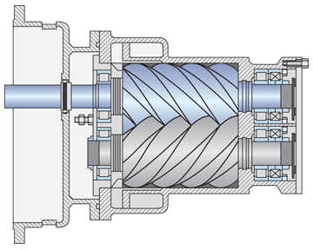
COMPRESSOR
Screw Compressor
A type of gas compressor that uses two interlocking screws to compress gas.
Typically used in industrial applications for compressing large volumes of gas.
Can operate at high speeds and handle a wide range of flow rates.
Low vibration and noise levels compared to other compressor types.
Rotary Screw Compressor
A type of screw compressor specifically designed to compress R407 refrigerant.
Uses two rotors with helical screw-like grooves to compress the refrigerant.
Provides high efficiency and reliability for air conditioning and refrigeration systems.
Can operate at high pressures and temperatures, making it suitable for a variety of applications.
Its compact size of 12m x 5m x 5.3m makes it suitable for installations where space is limited.

Slide 16
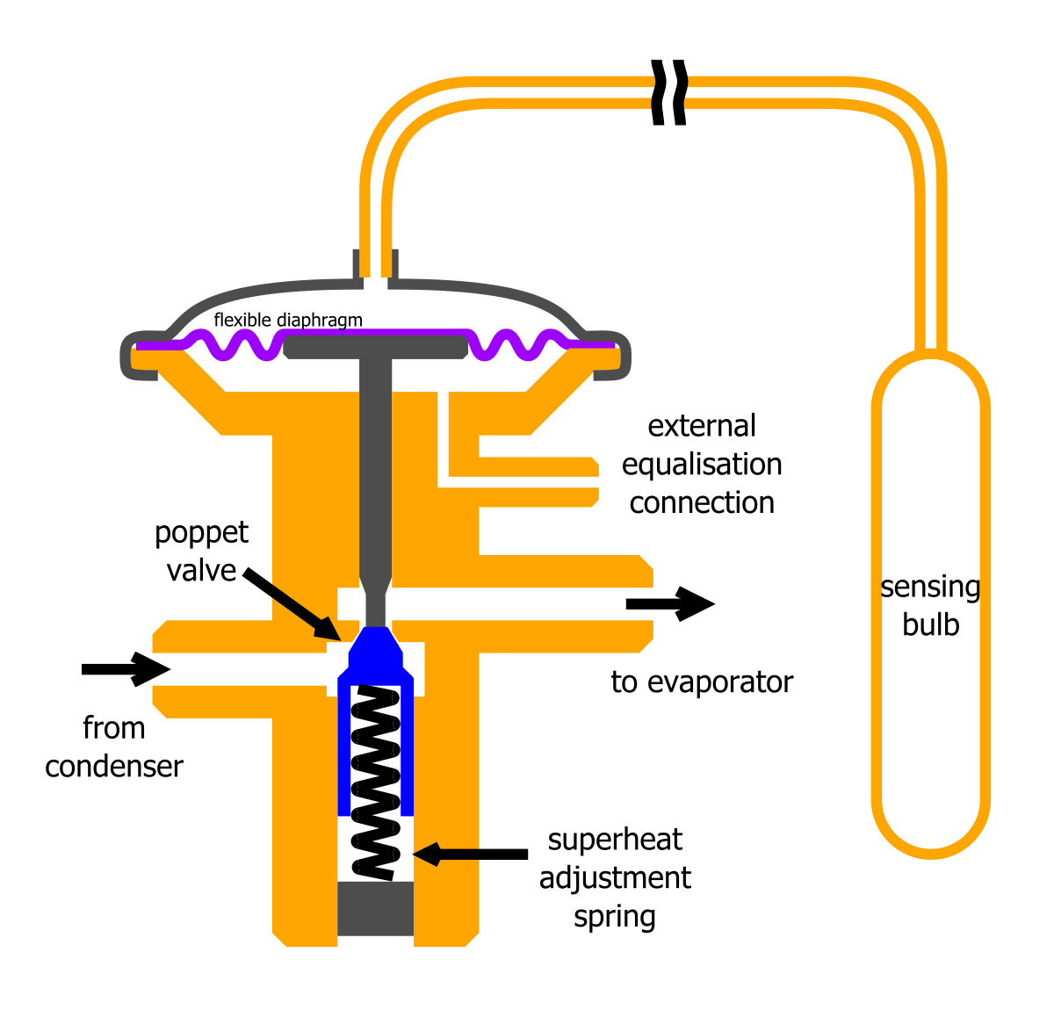
EXPANSION VALVE
Expansion valve regulates refrigerant flow into the panel by controlling its pressure and temperature.
It creates a pressure drop to cause the refrigerant to expand and cool before entering the evaporator.
The valve's function is to reduce and confine the refrigerant flow to achieve efficient cooling.
Thermal Expansion Valve
A type of expansion valve that regulates refrigerant flow using temperature.
Sensing refrigerant temperature leaving the evaporator, it adjusts valve opening accordingly.
Calibrated specifically for R407, ensuring optimal system performance.
Helps maintain proper refrigerant flow for efficient and effective solar panel cooling.

Slide 17
Process Flow Diagram
Q_{air}=9928.11 kW
ṁ_{coolant} = 36 kg/sec
Heat From Air
Expansion Valve
Q = -4193.66 kW
Compressor
P_{electricity} = 9928.11 kW
Heat Exchanger
Q_{Heat Exchanger}=3907.866 kW
ṁ_{water} = 16.67 kg/sec

Slide 18
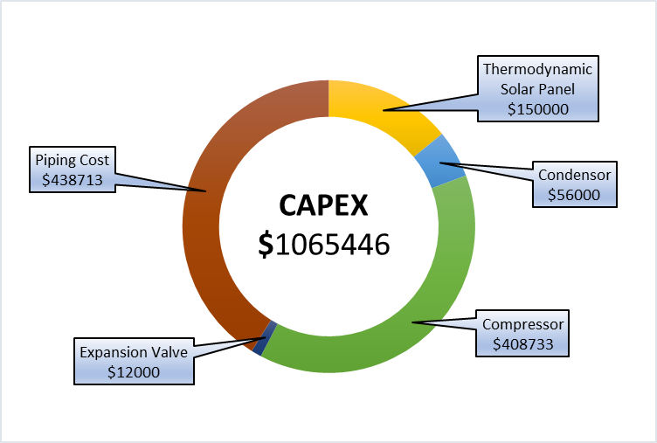
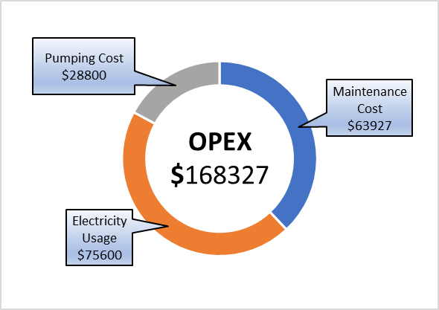
Capital Expenditures(CAPEX)
Total Cost of Equipments = $626733
Considering piping cost as 70% of total cost
Piping Cost = $438713
CAPEX = $626733 + $438713
=$1065446
Operational Expenditures(OPEX)
Maintenance Cost(6% of CAPEX) =$63927
Electricity Usage($0.105 per kWh) =$75600
Pumping Cost = $28800
OPEX = $63927 +$75600+ $28800
=$168327 per year

Slide 19
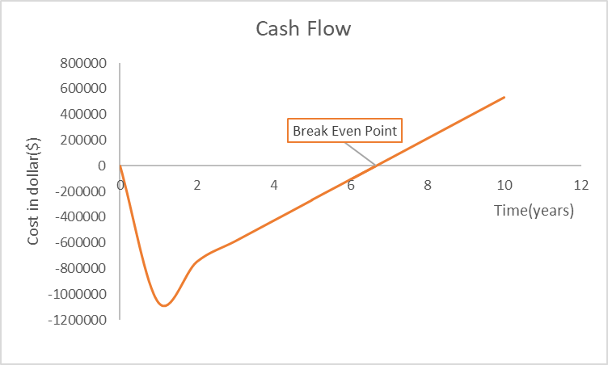
Analysis
Cost of Electricity =$0.105 per unit
If the water is heated with normal geyser having 95% efficiency Cost of electricity used =$328260.8/year
Operational Cost = $168327/year
CAPEX =$1065446
So,
Break even point(years)=6.66 years

Slide 20
Conclusion
Thermodynamic water heating systems use renewable energy sources to provide hot water, reducing reliance on fossil fuels and lowering carbon emissions.
Future scope for water heating includes integration of AI, IoT sensors, and heat recovery systems for improved efficiency, lower operating costs, and reduced downtime.
Emerging technologies will continue to transform the water heating industry towards more sustainable and efficient systems.

Slide 21
THANK YOU!
Notes:
Cp=1.7 kJ/kg°C
m_dot=17.3 kg/min
Outlet Temperature(T2) = -20C
Inlet Temperature(T1)= 56C
ΔH = m_dot * Cp * (T2 - T1)
ΔH = 17.3 * 1.7 * (-20-56)

