Slide 1
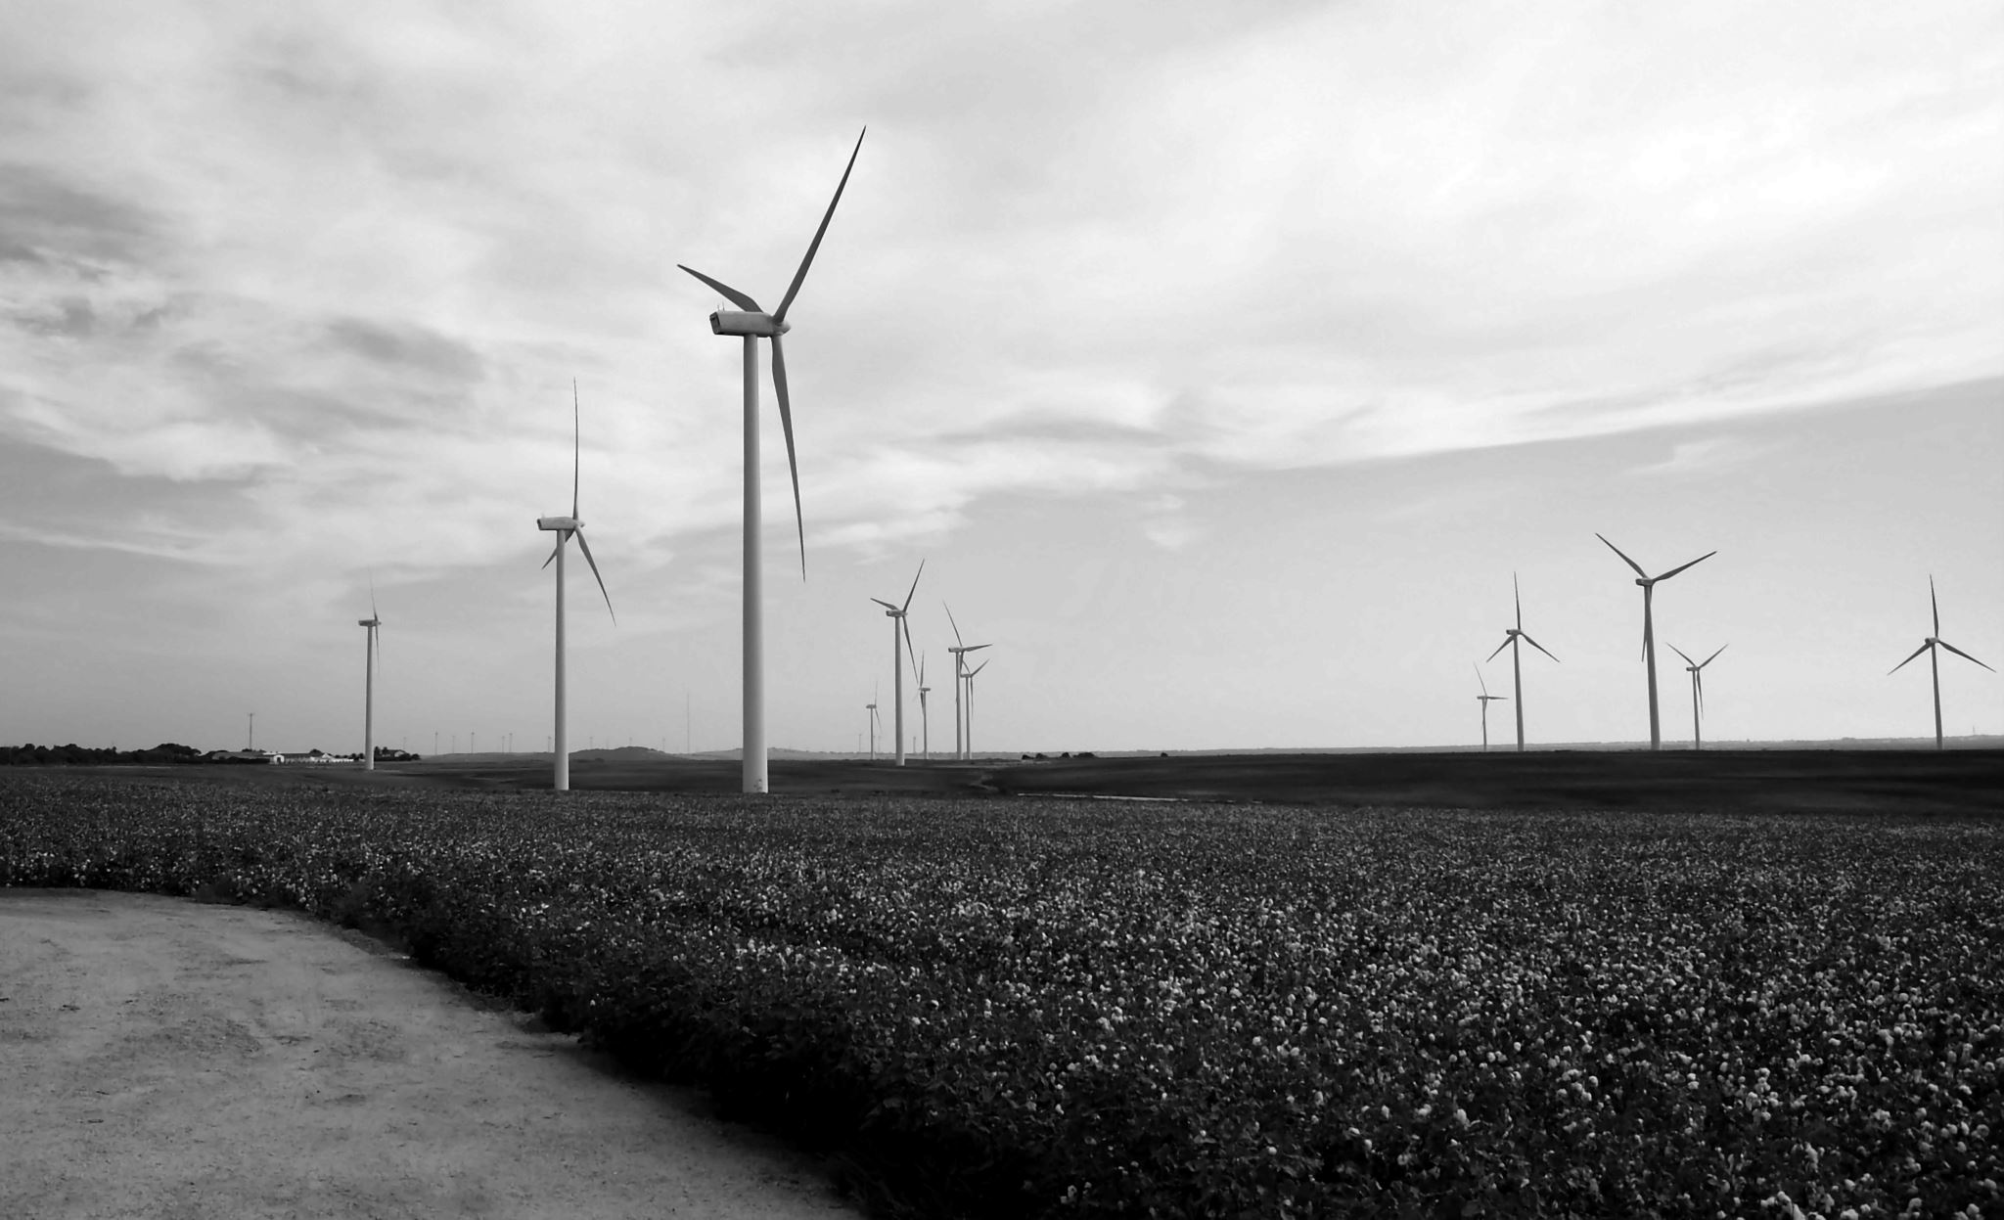
Wind Energy Integration: Challenges and Solutions in Power Grids
Presented By
Opy Das

Slide 2

Introduction
Rise of Wind Energy
Challenges
Outline
Solutions
Smart Grid
Future Outlook
Conclusion

Slide 3
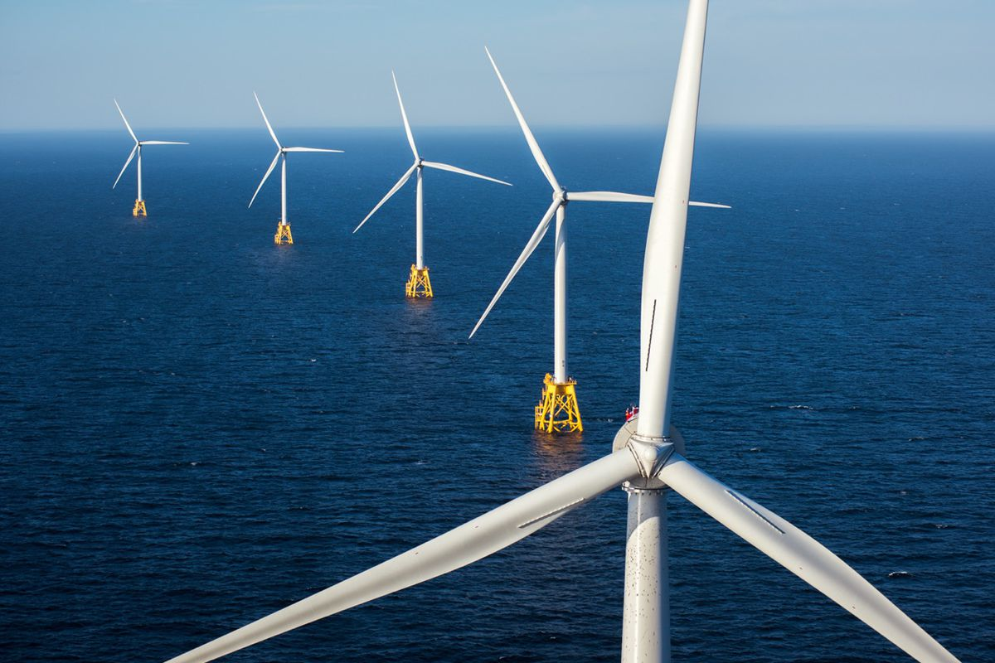
Introduction
Wind energy plays a crucial role in the transition towards renewable energy sources. Integration of wind energy into power grids brings unique challenges.
Wind energy integration problem refers to the challenges associated with incorporating wind power into existing power grids due to the intermittent and variable nature of wind resources[1].

Slide 4
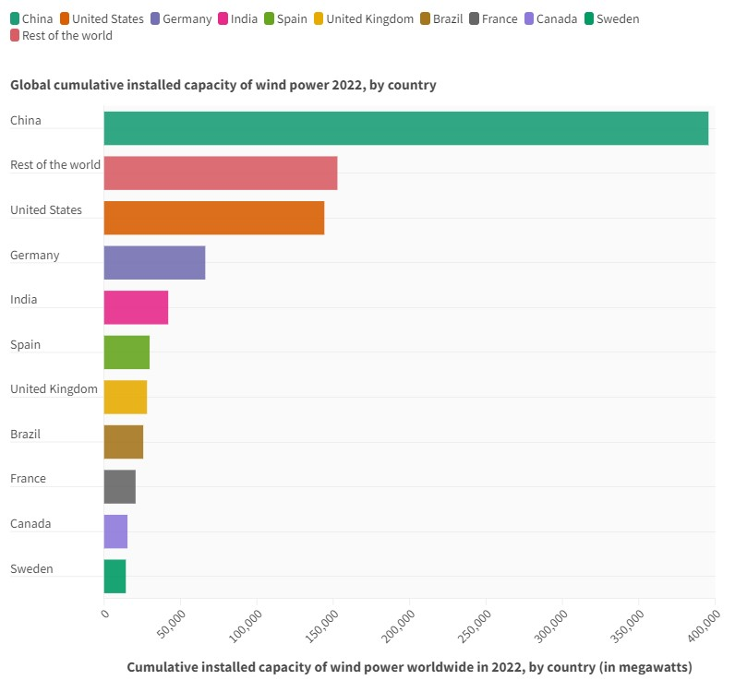
Rise of Wind Energy
Global wind energy capacity: Over 906 GW installed by the end of 2022[2].
New investments in wind energy in 2022: USD 175 billion [3].
Employment in the wind energy sector: Around 1.5 million people globally by the end of 2022.
Cost reduction: Wind energy has become increasingly cost-competitive with traditional sources .
Environmental benefits: The United States has set a goal to reduce net greenhouse gas (GHG) emissions by 50-52% below 2005 levels by 2030[4].
Global cumulative installed capacity of wind power 2022, by country [5]

Slide 5
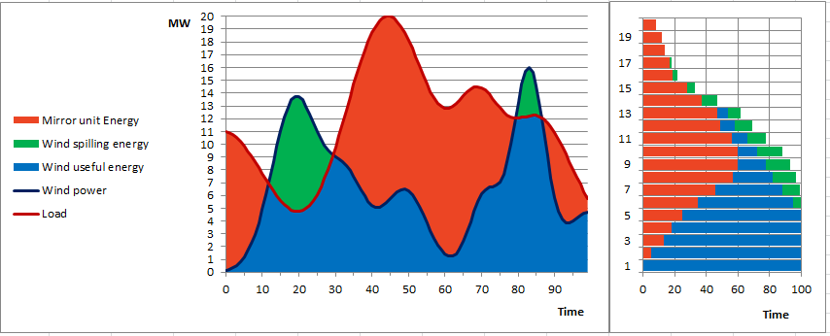
Challenges in Wind Energy Integration
Intermittency and Variability:
Wind energy production fluctuates due to weather conditions.
This intermittency created challenges for grid stability and reliability.
Sudden changes in wind speed can lead to voltage and frequency fluctuations[3].

Slide 6
Challenges in Wind
Energy Integration (Cont…)
Power System stability
2.Grid Stability:
The inherent variability of wind energy can impact the stability of the power grid.
Rapid changes in wind power generation can affect grid frequency and voltage stability.
Balancing supply and demand becomes challenging, especially during periods of low wind generation.
Voltage
Stability
Frequency
Stability
Angle Stability

Slide 7
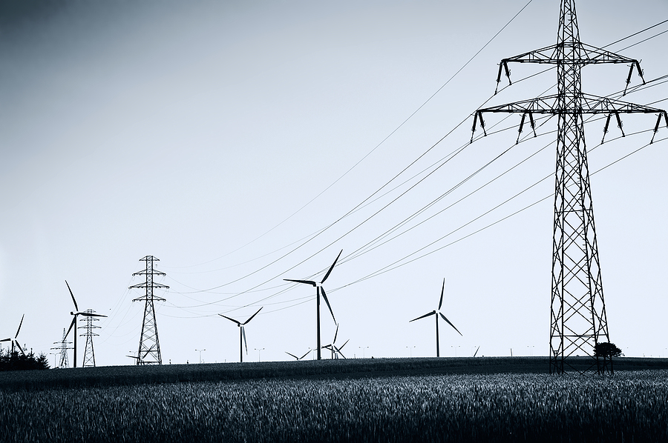
Challenges in Wind Energy Integration(Cont..)
3.Grid Congestion:
Wind farms are often located in remote areas with limited transmission capacity.
Grid congestion occurs when the transmission infrastructure is insufficient to handle the wind energy generated[6].
This can limit the amount of wind energy that can be transmitted to load centers

Slide 8
Grid Balancing Solutions
1. Advanced Forecasting and Predictive Analytics:
Accurate weather forecasting allows for better prediction of wind energy generation.
Predictive analytics can help grid operators anticipate wind power fluctuations and plan accordingly.
This enables better grid management and integration of wind energy[7].
2 . Energy Storage Systems:
Energy storage technologies, such as batteries or pumped hydro storage, can mitigate the intermittency of wind energy[8].
Excess wind energy can be stored and dispatched during periods of low generation.
Use electricity to power 2x to produce hydrogen in that way we can store it[8]

Slide 9
Grid Balancing Solutions
Enhanced Grid Infrastructure:
Expanding and upgrading transmission infrastructure helps alleviate grid congestion.
Building new transmission lines or upgrading existing ones enables the transport of wind energy from remote areas to load centers.
Interconnecting different regions and countries through robust transmission networks facilitates the integration of wind energy across larger geographical areas[9].
4. Demand Response and Flexible Loads:
Implementing demand response programs encourages consumers to adjust their electricity usage based on grid conditions.
Flexible loads, such as electric vehicle charging or industrial processes, can be scheduled to align with wind energy availability.
This helps balance supply and demand, reducing the impact of wind power variability[10].

Slide 10
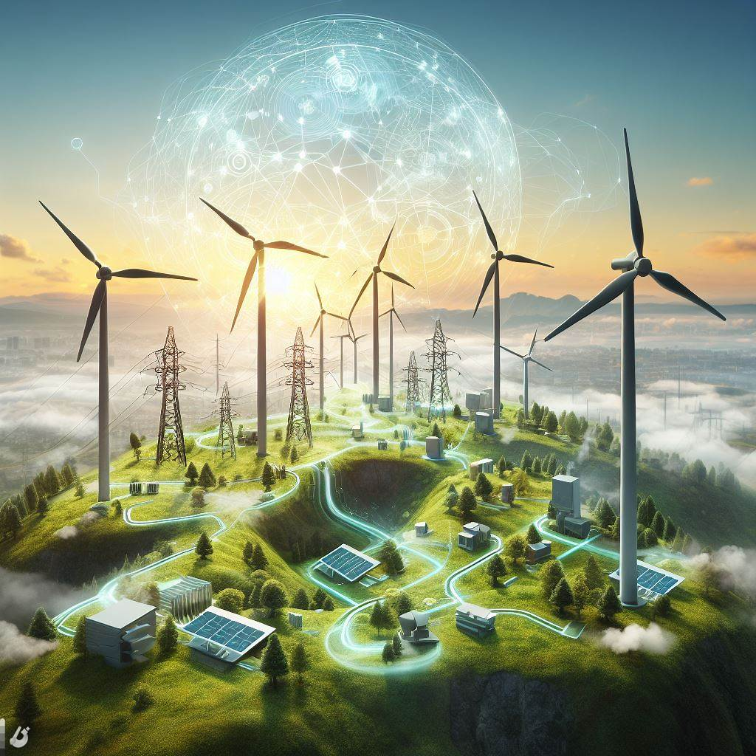
Smart Grid Technologies
Introduction to smart grid technologies.
Advanced monitoring and control systems enable real-time grid monitoring and management.
Smart grid technologies allow for efficient integration and management of wind energy resources.
They enable grid operators to respond quickly to changes in wind generation and maintain grid stability.

Slide 11
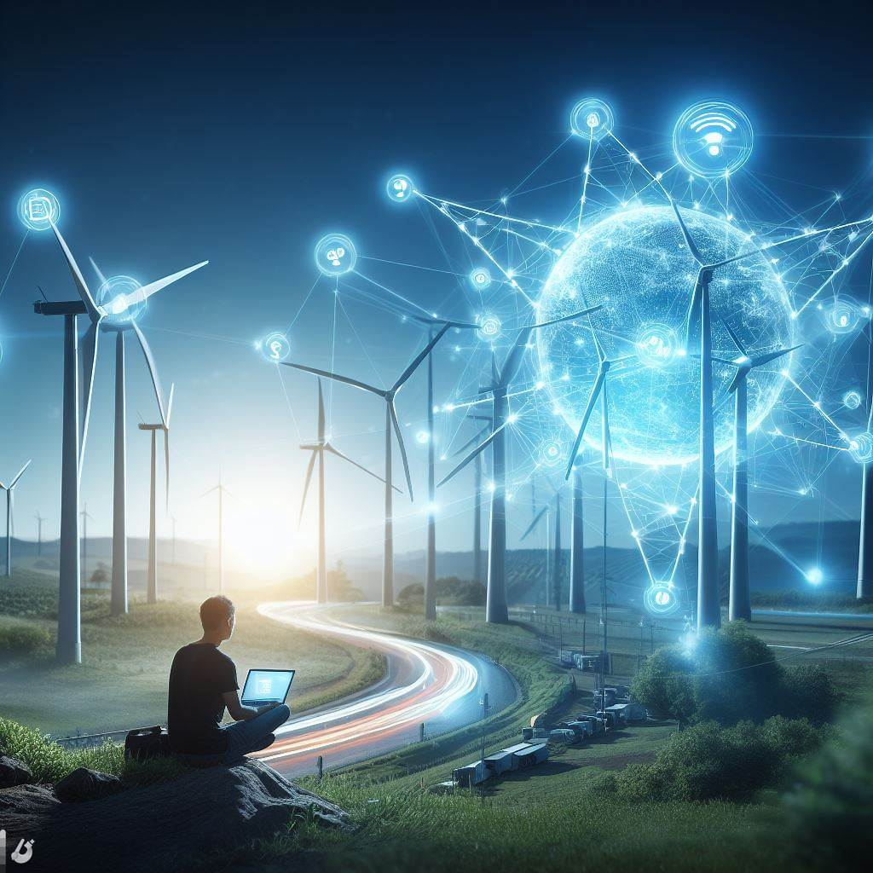
Future Outlook
Emerging technologies and trends in wind energy integration.
Continued advancements in grid infrastructure.
The role of artificial intelligence and machine learning in optimizing wind energy integration
Collaboration between industry stakeholders and regulatory bodies and interconnection between international boundaries[11]
Overview of grid codes and standards specific to wind energy integration.

Slide 12
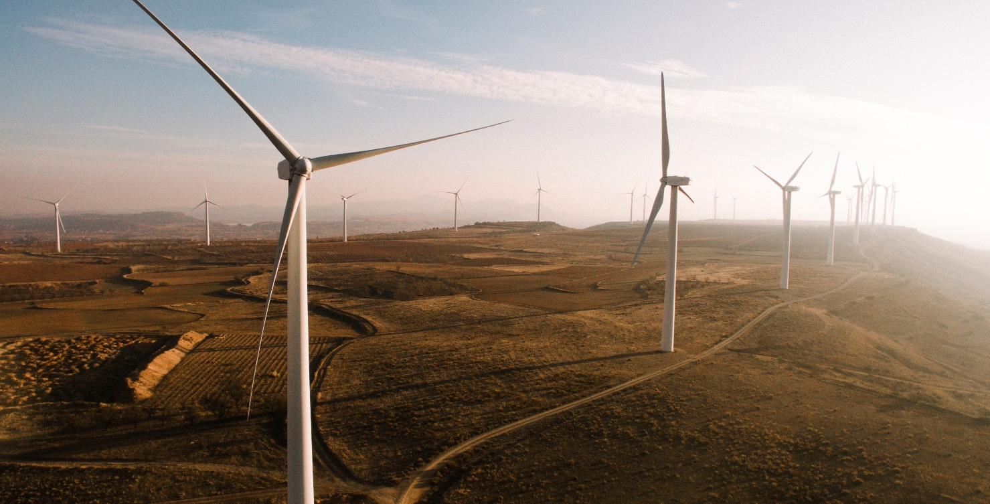
Conclusion
Integrating wind energy into power grids presents challenges, but solutions are available.
Advanced forecasting, energy storage, grid infrastructure upgrades, demand response, and smart grid technologies are crucial for successful wind energy integration.
Overcoming these challenges will lead to a cleaner and more sustainable energy future

Slide 13
References
[1] https://www.sciencedirect.com/science/article/pii/S1876610211015037
[2] https://www.iea.org/energy-system/renewables/wind
[3] https://about.bnef.com/blog/a-record-495-billion-invested-in-renewable-energy-in-2022/
[4] https://www.whitehouse.gov/wp-content/uploads/2021/10/US-Long-Term-Strategy.pdf
[5]https://www.statista.com/statistics/268363/installed-wind-power-capacity-worldwide/
[6] https://community.victronenergy.com/questions/1695/wind-turbines-and-victron-charge-controllers.html
[7] https://www.irena.org/-/media/Files/IRENA/Agency/Publication/2015/IRENA-ETSAP_Tech_Brief_Power_Grid_Integration_2015.pdf
[8]https://www.irena.org//media/Files/IRENA/Agency/Publication/2020/Jul/IRENA_Advanced_weather_forecasting_2020.pdf
[9] https://youtu.be/ANcRnIAT4Fs?si=3Eyd3EfLWm2Q6S2i
[10] https://utilitiesone.com/grid-code-compliance-and-energy-market-integration
[11] https://acee.princeton.edu/wp-content/uploads/2019/04/AndlingerDistillate_Article8.pdf

Slide 14
THANK YOU

Slide 15
Discussions
What are the possible solutions to mitigate the grid integration problem of wind energy?

