Slide 1
SUPER SODUKO
TEAM FOR LOOP: Owen Brooks & Michael Manley

Slide 2
Problem Statement
Problem: Designing a fully functioning replica of the game of Sudoku.
Storing a variety of boards to play on
Allowing user to interact with the board
Updating data based on user input
Checking for the correct solution
Making it look good

Slide 3
The Rules are Simple
The goal of the game is to fill each square with a number in the range of 1-9.
In each row, all 9 numbers must be used.
In each column, all 9 numbers must be used.
In each 3x3 block, all 9 numbers must be used.

Slide 4
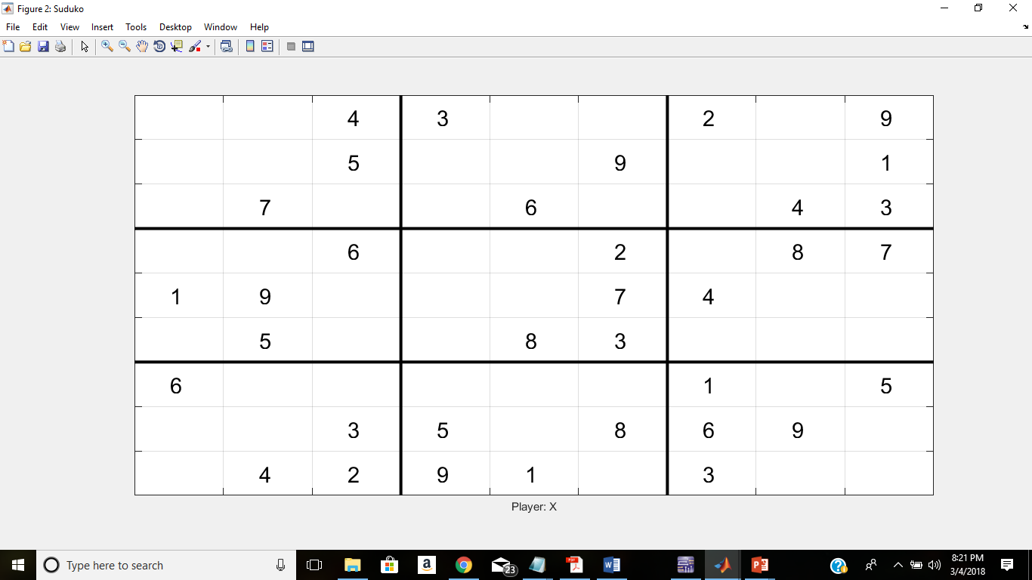
The Board

Slide 5
Approach
Draw board
Use boards that already exist rather than generating our own
Randomly selects board from library
Update board by combining the original with the new
Check if solution is correct based on if it matches preset answer

Slide 6
Algorithm
Selects random board from library
Takes user input
Combines boards based on user input
Incorrect
Display ‘WINNER!!’
Correct
Checks for correct solution

Slide 7
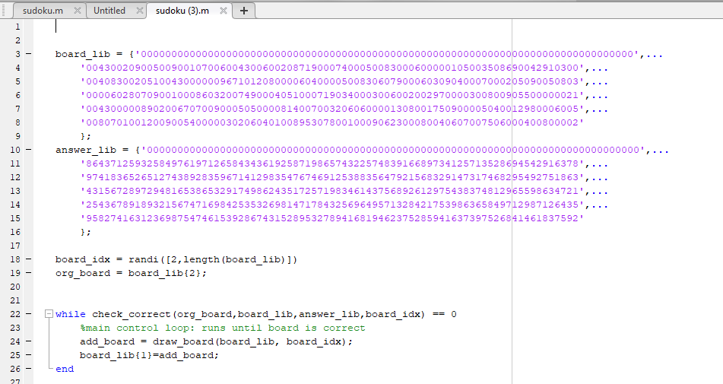
Library and Control Loop

Slide 8
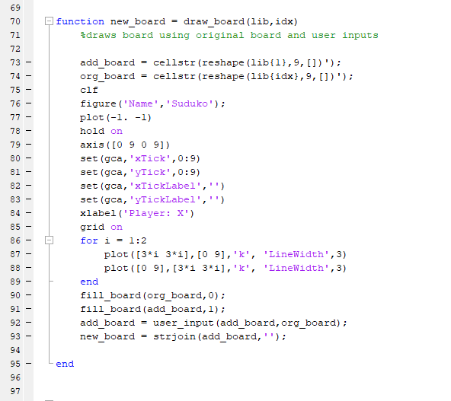
Draw Board Function

Slide 9
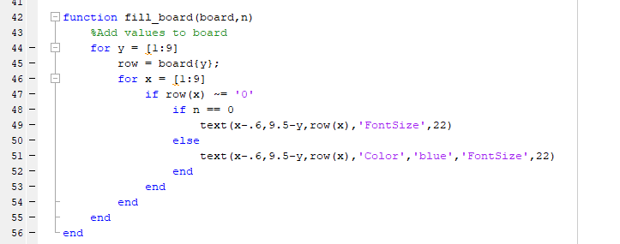
Fill Board Function

Slide 10
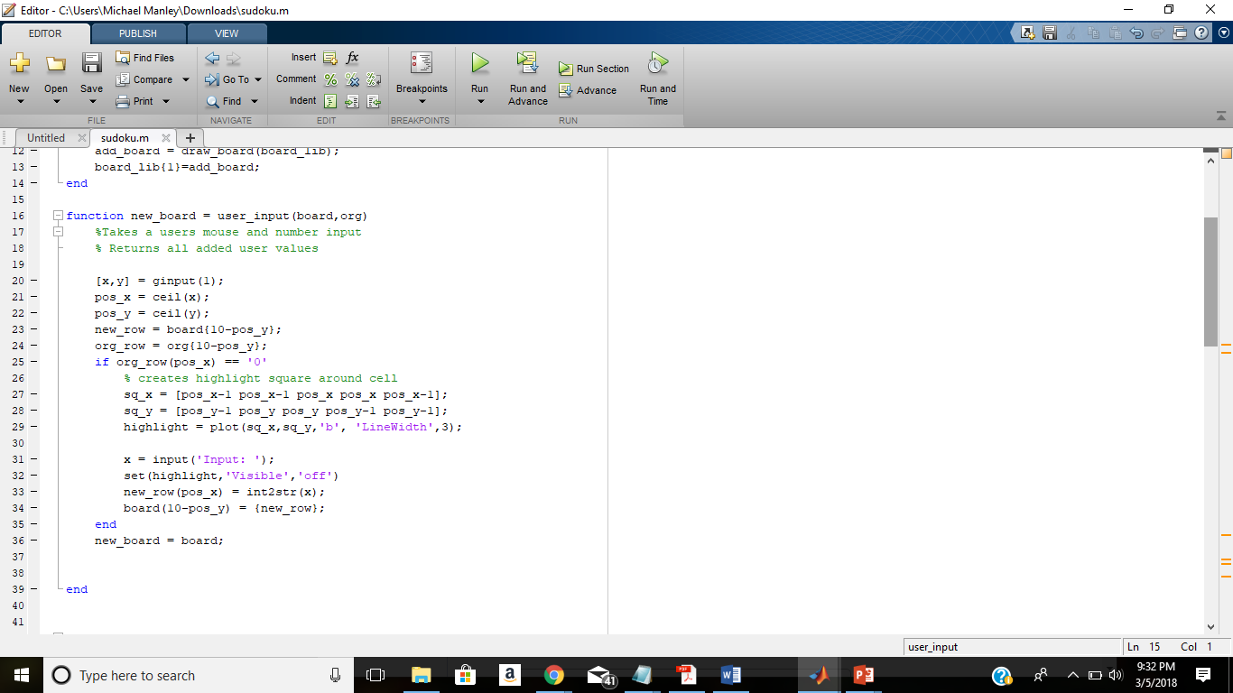
User Input Function

Slide 11
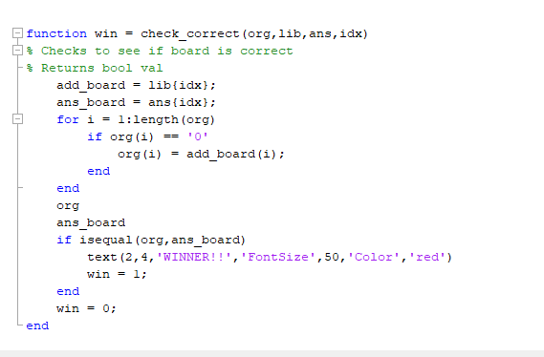
Check Function

Slide 12
Challenges
Generating boards
1
Updating the board
2
Creating check algorithm.
3

Slide 13
Contributions
Owen | Michael
Designed board display | Compiled variety of boards
Designed how user interacts with board | Designed method to check solution
Created method to update the board | Debugged

