Slide 1

Notes:
* Hello, I'm Joshua Plicque * I've been working with Phoenix LiveView for a little under a year now * Chris McCord made a lot of bold statements. I'm here to tell you that it's true

Slide 2
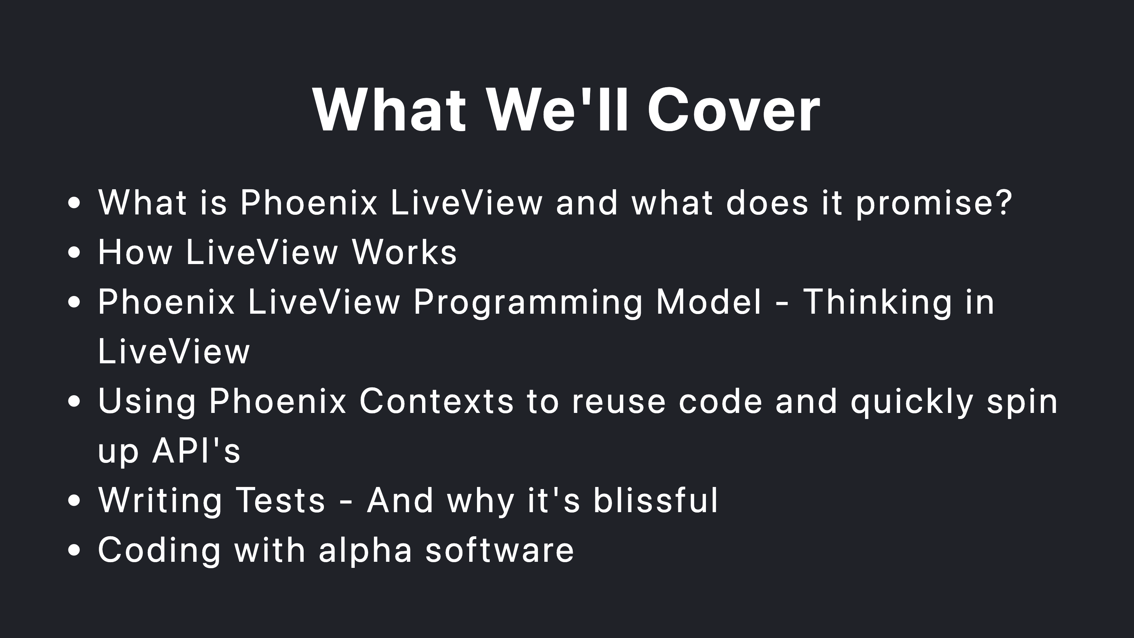
Notes:
* Promise - dynamic web applications without Javascript * We'll walk through 4 real-world features that I've built in LiveView, bolting on increasing complexity * We'll take a brief look at the testing infrastructure and syntax. My entire application's test suite takes less than 10 seconds. My entire application's test suite takes less than 4 seconds. * And I hired someone who knew only a little bit of Python and he's shipping Elixir and LiveView code daily

Slide 3
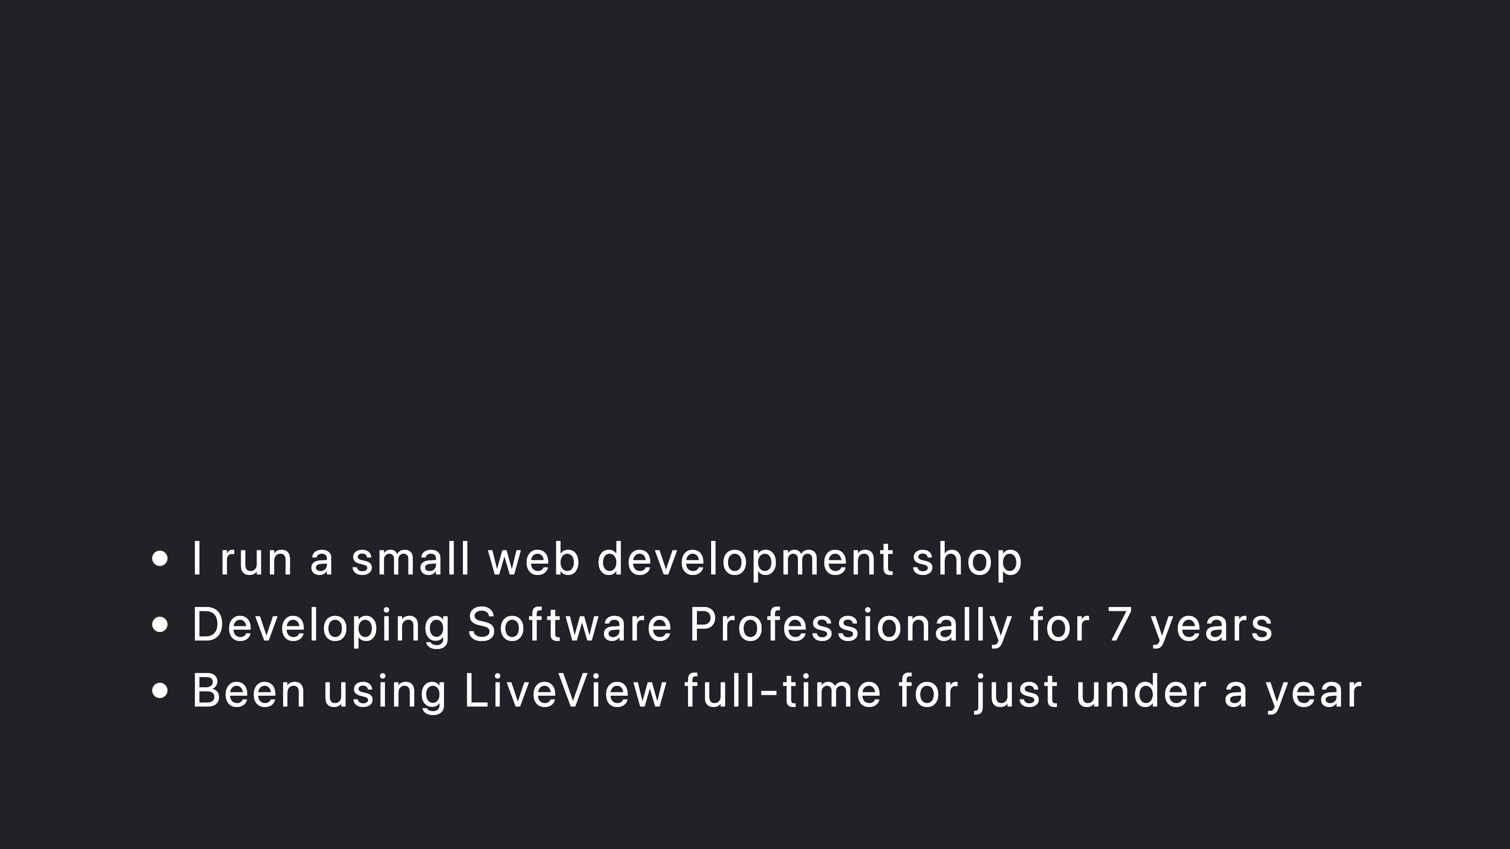

Slide 4
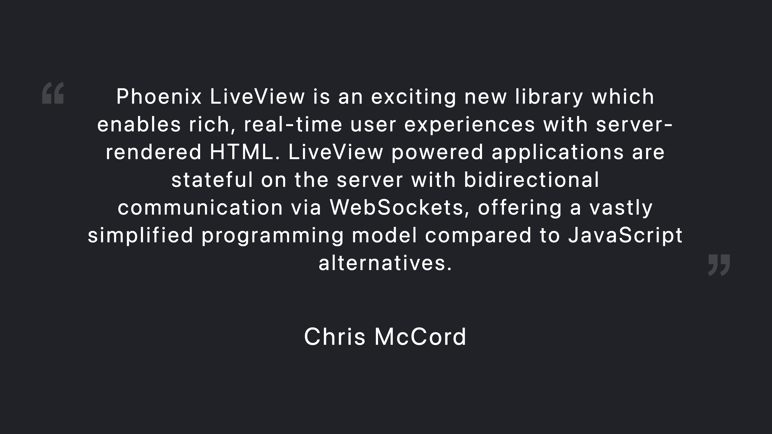

Slide 5


Slide 9
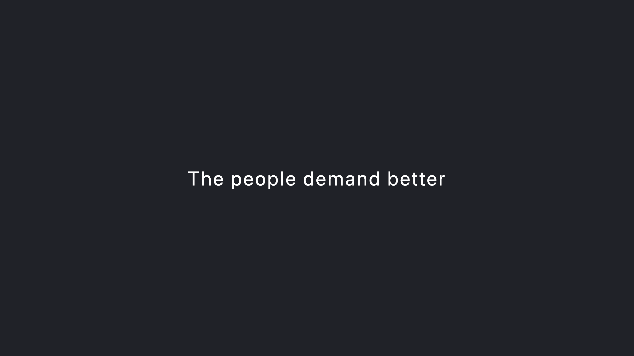

Slide 11


Slide 15
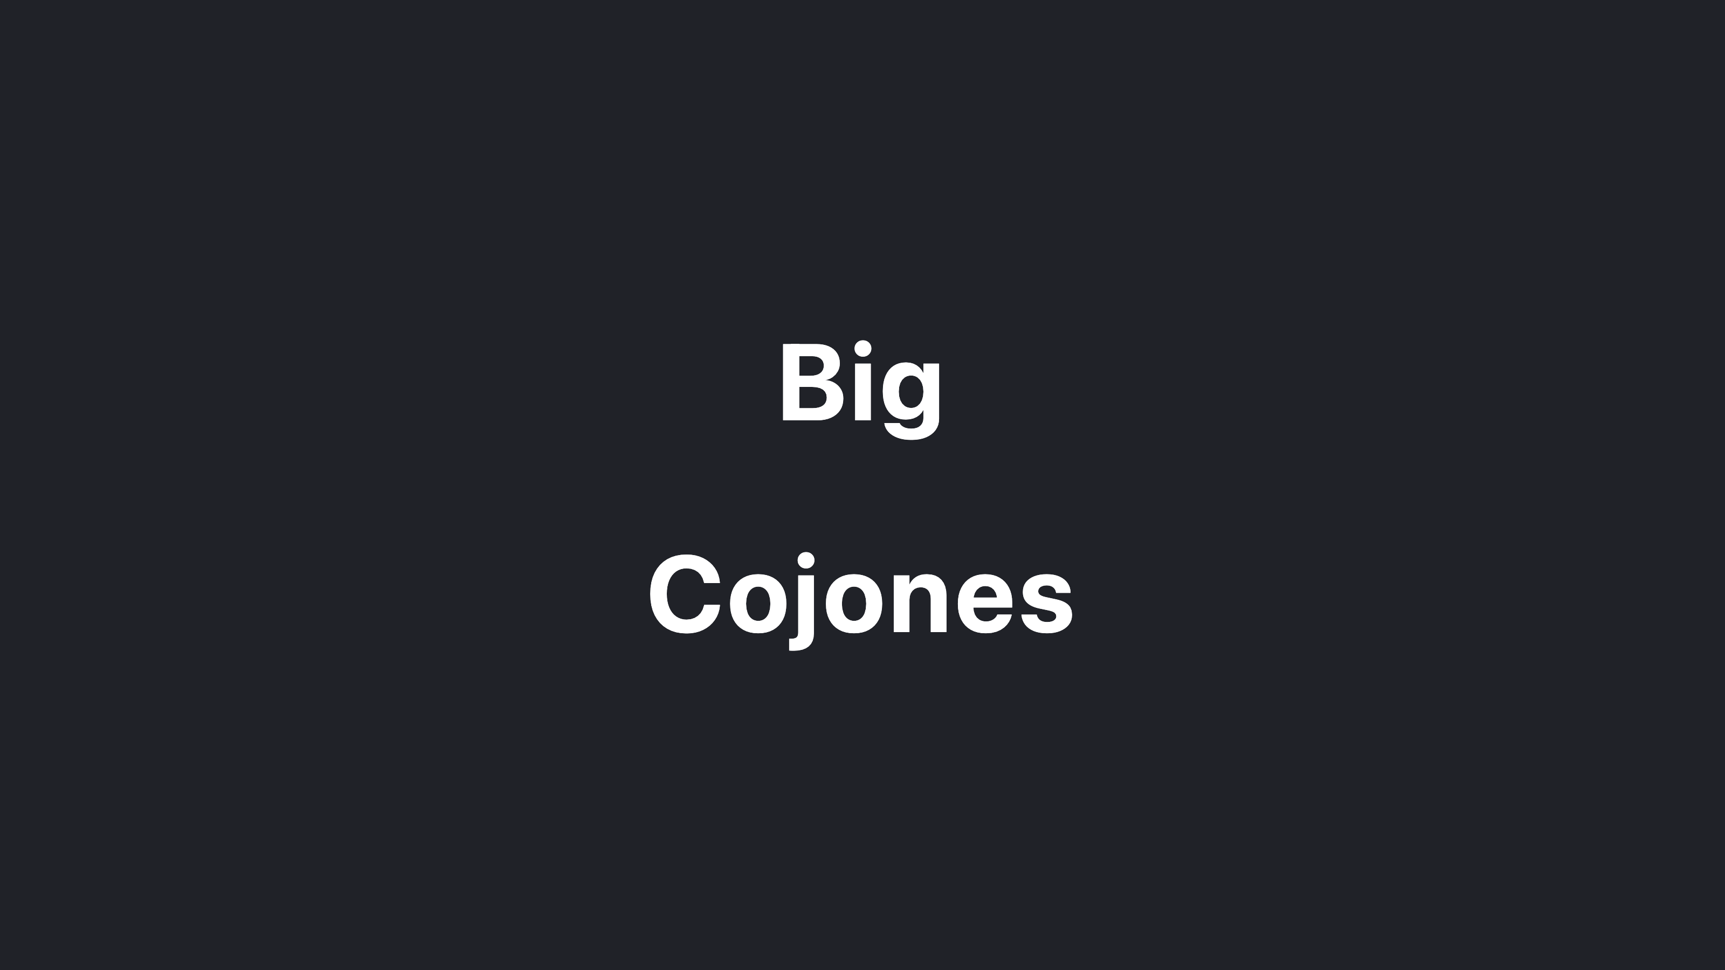

Slide 18
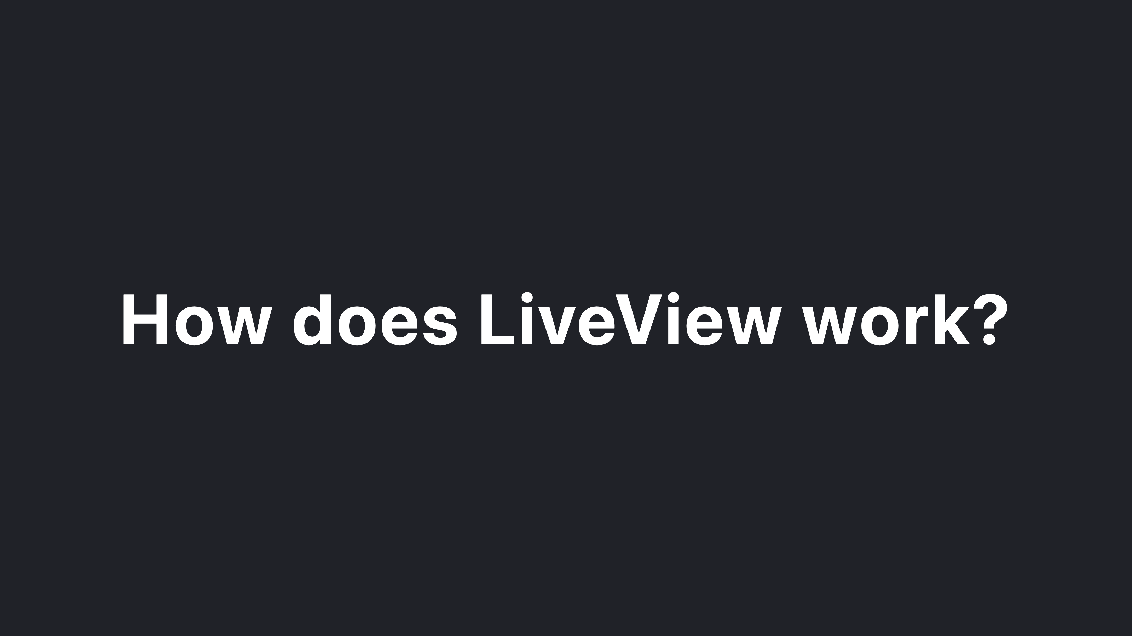

Slide 20
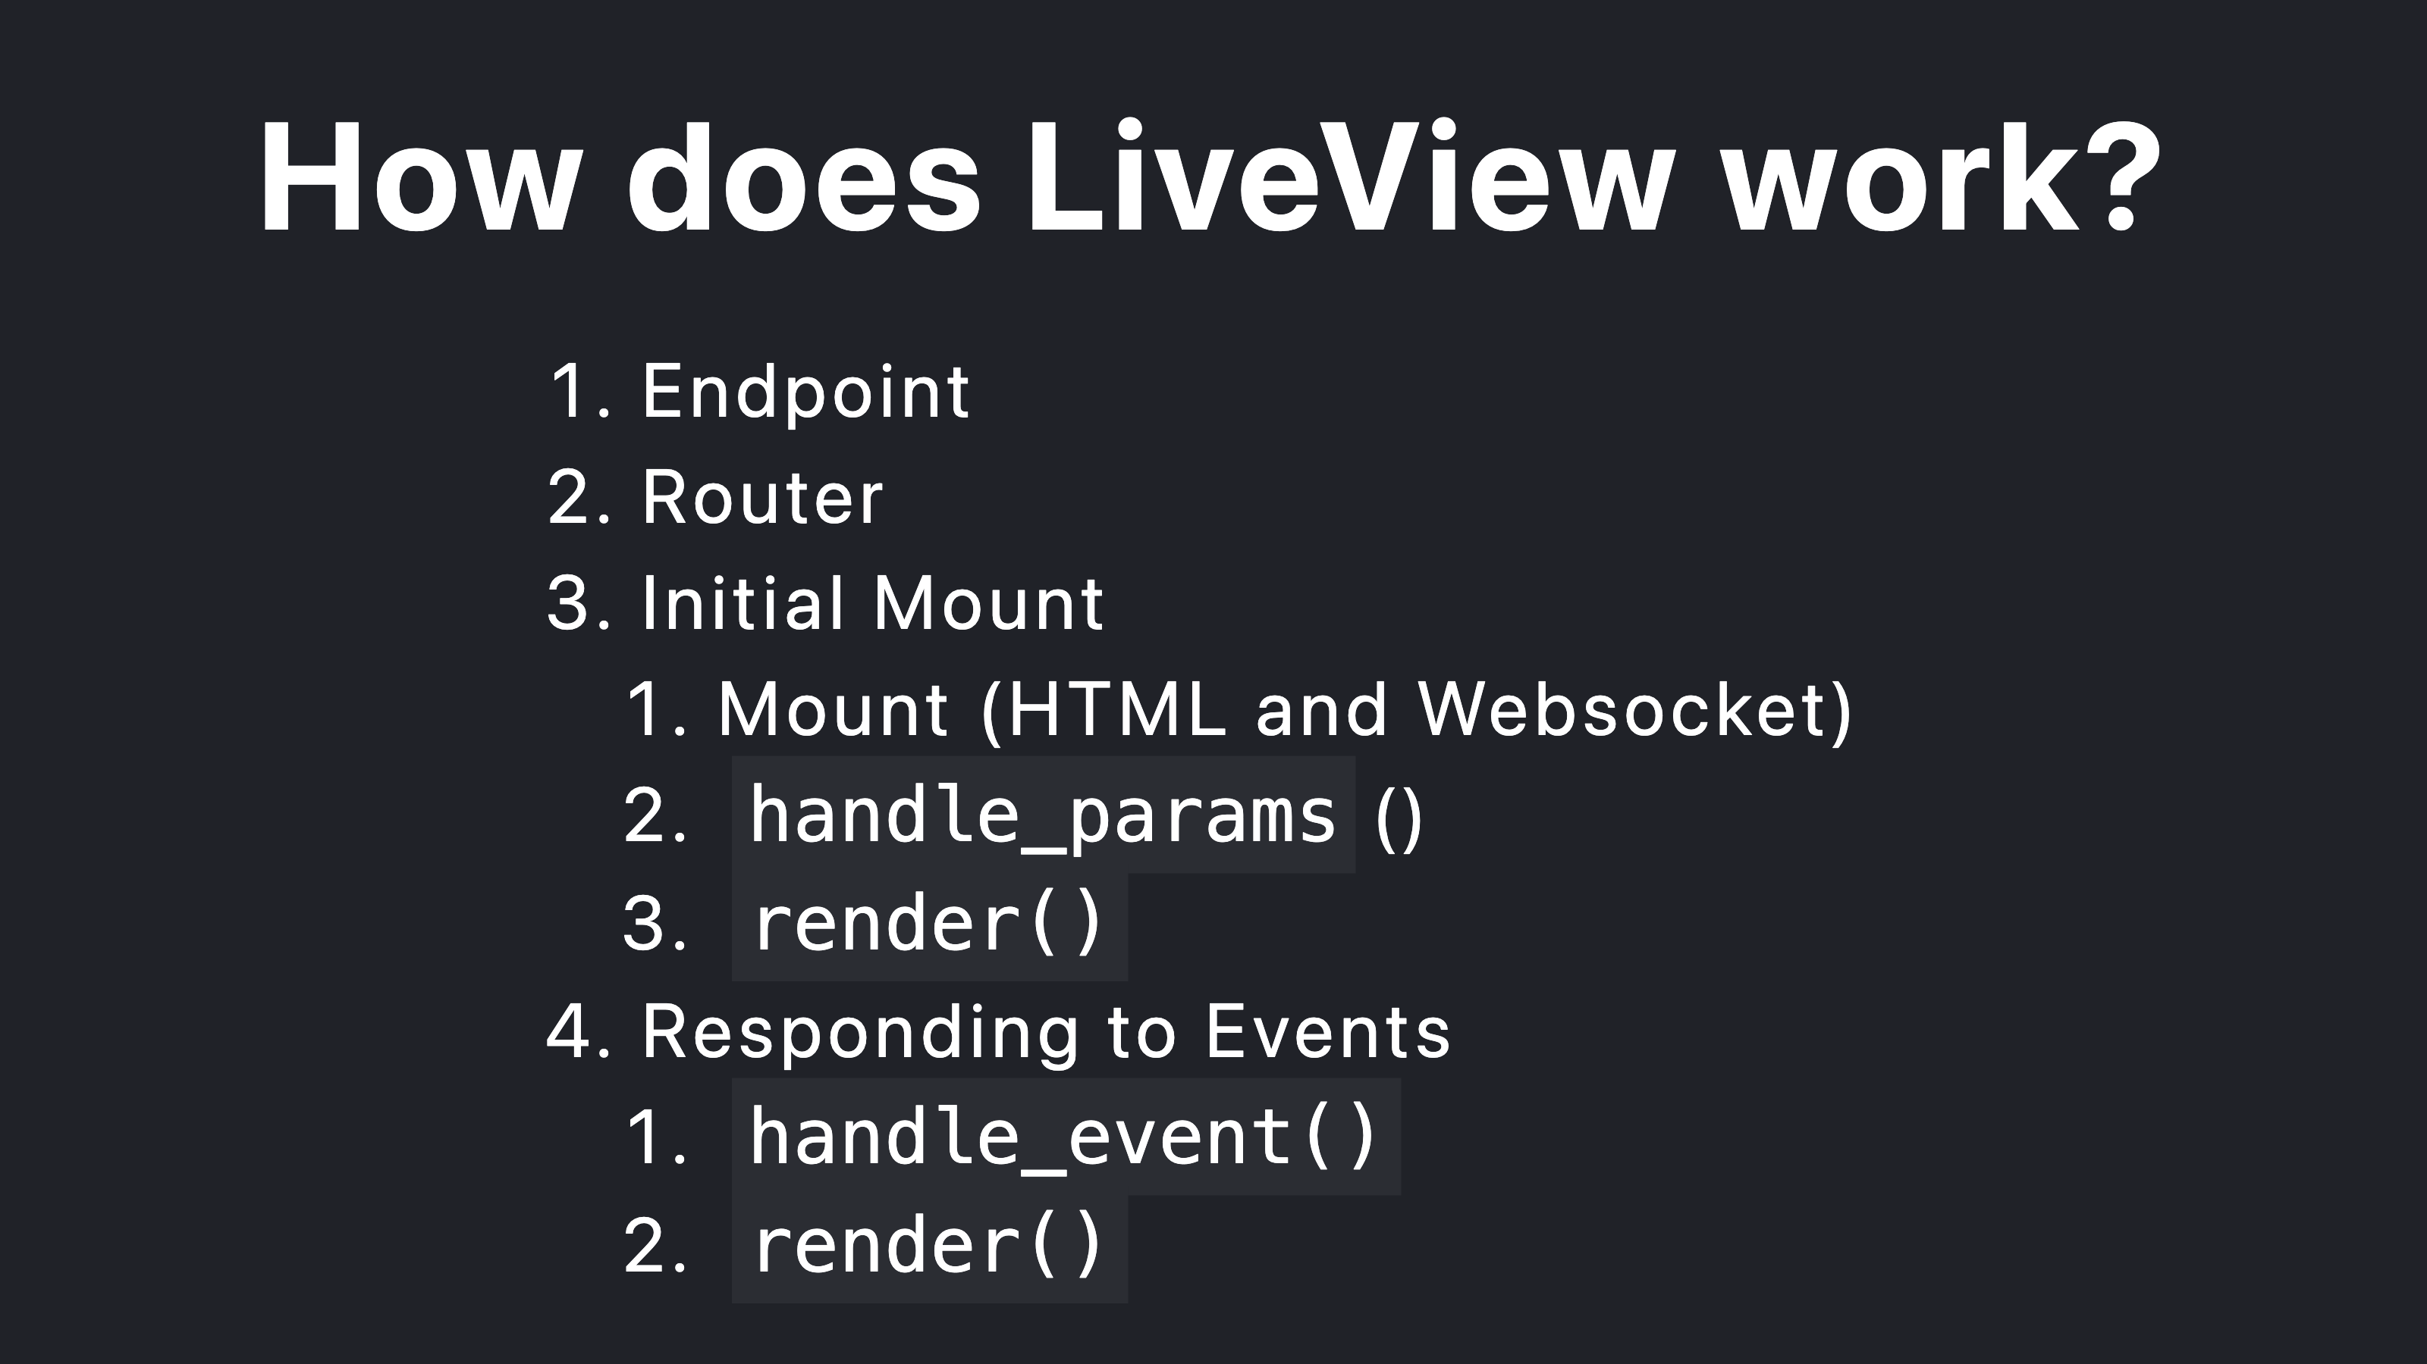

Slide 21

Notes:
Contacts feature

Slide 22
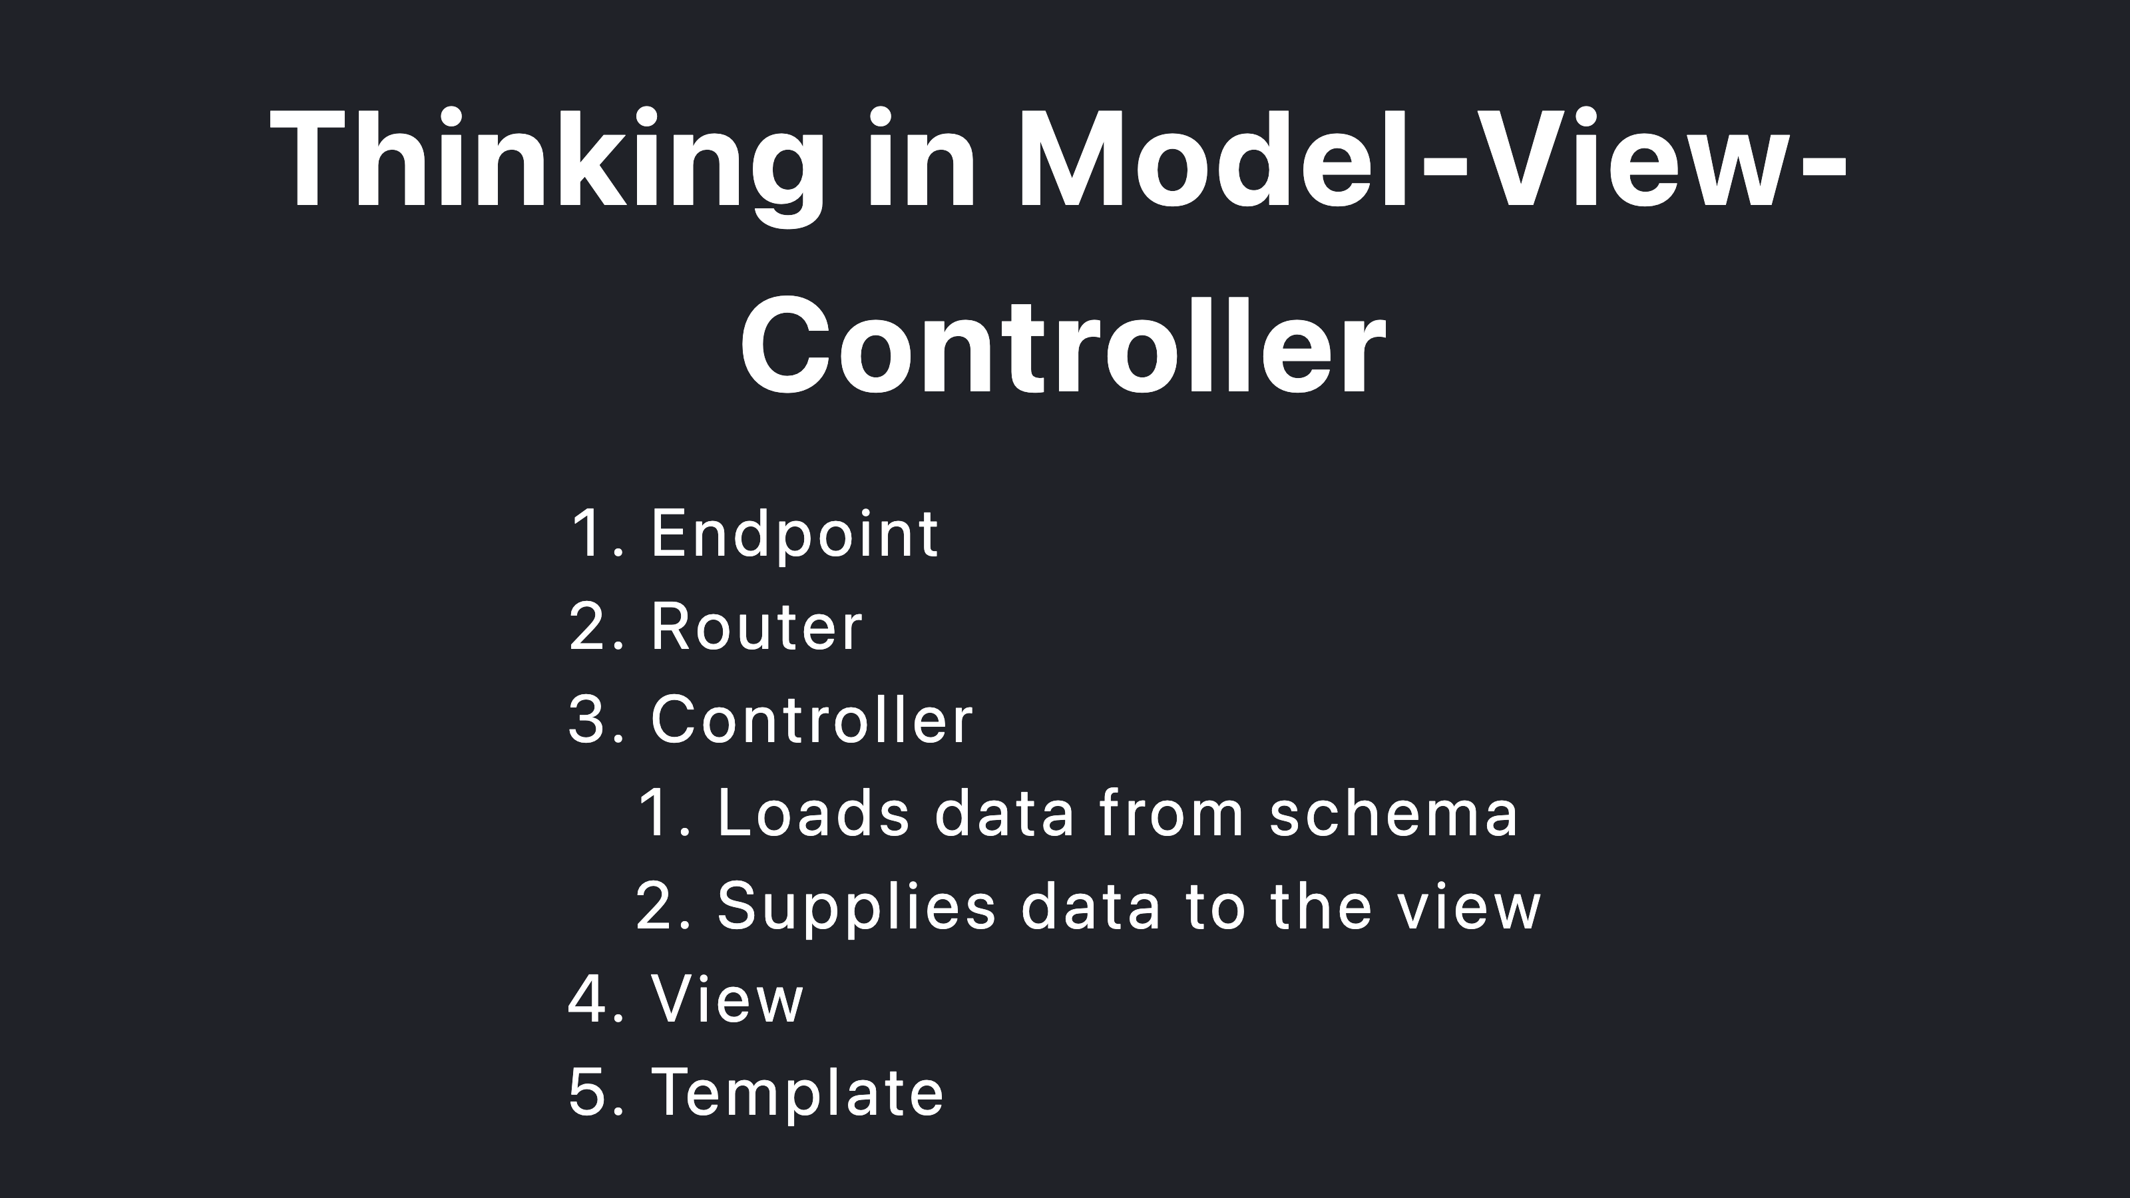

Slide 23


Slide 24
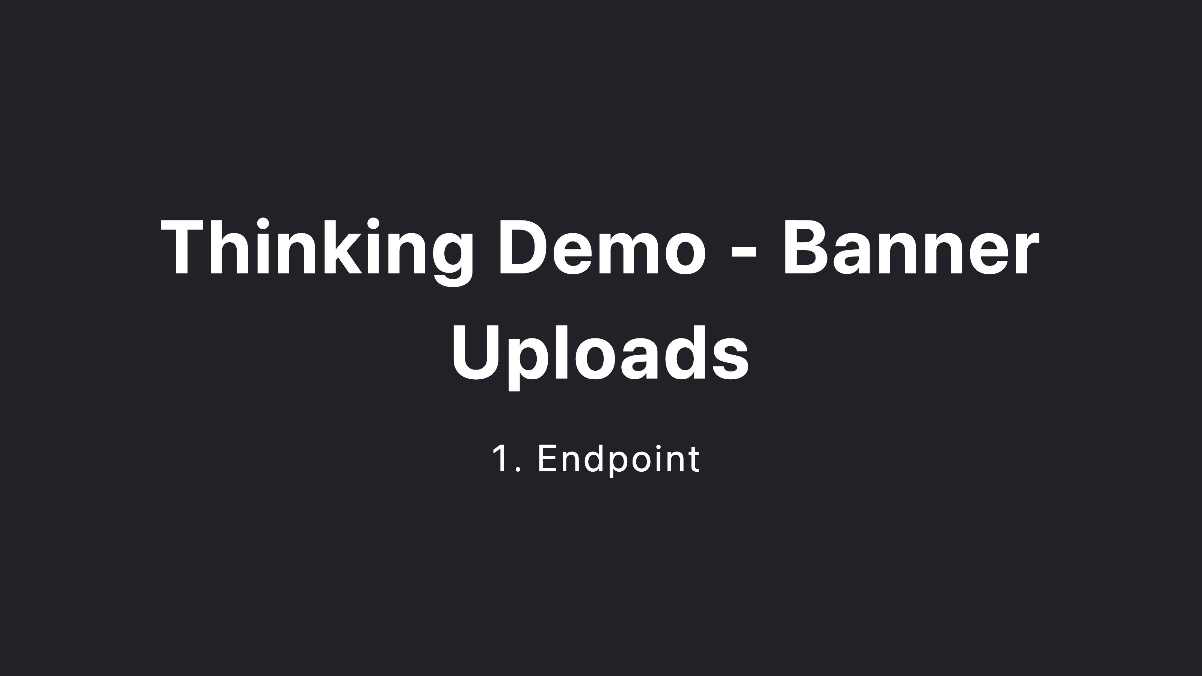

Slide 25


Slide 26


Slide 27
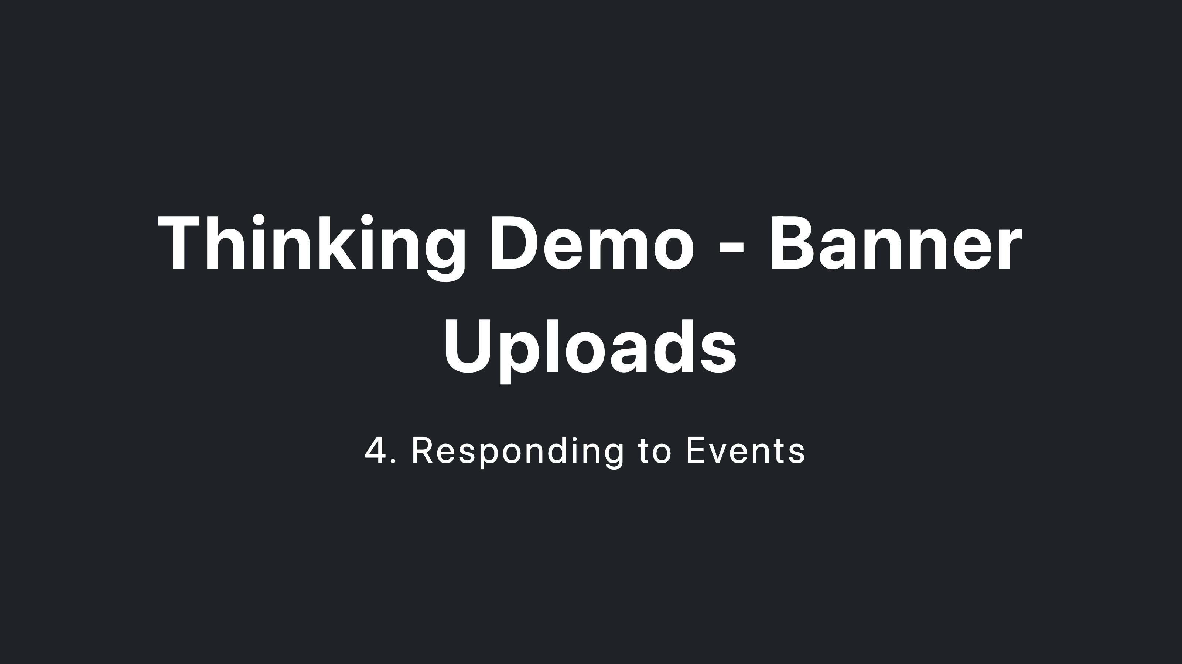

Slide 28
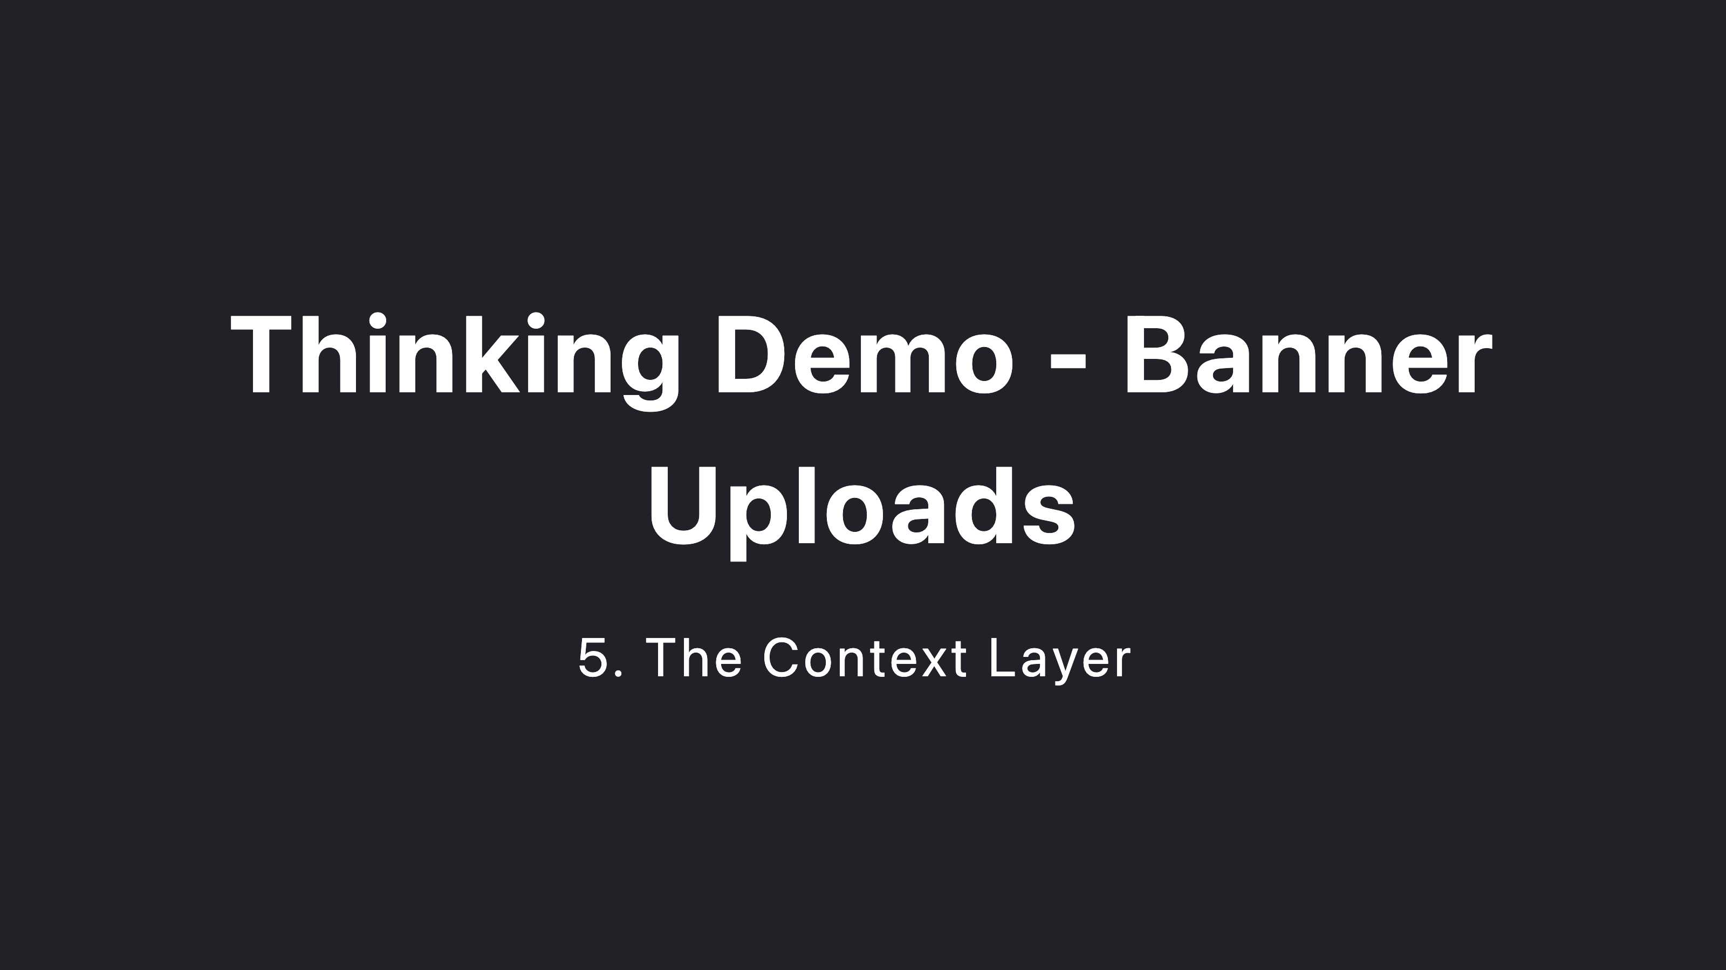

Slide 29


Slide 30
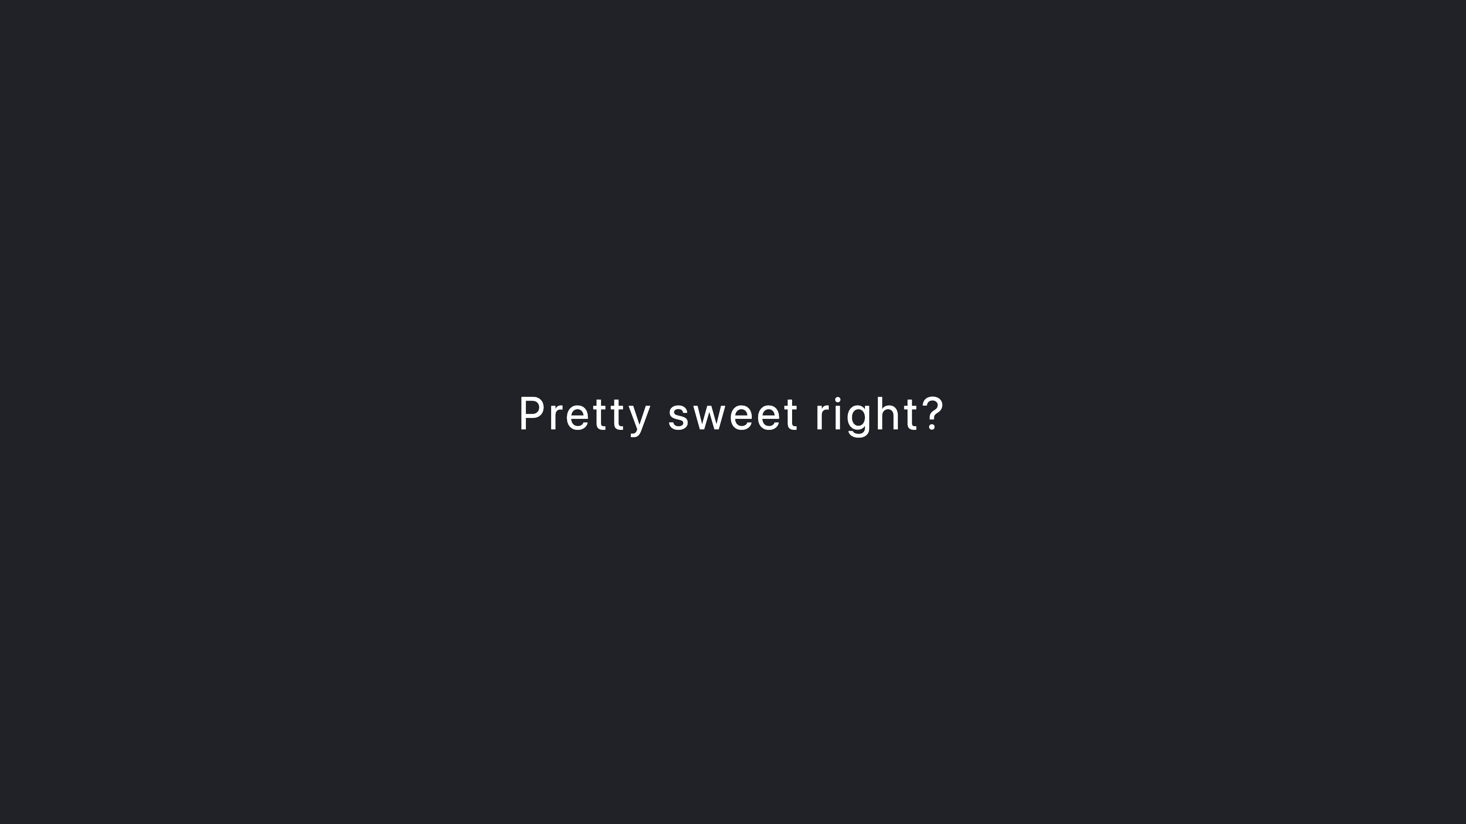

Slide 31
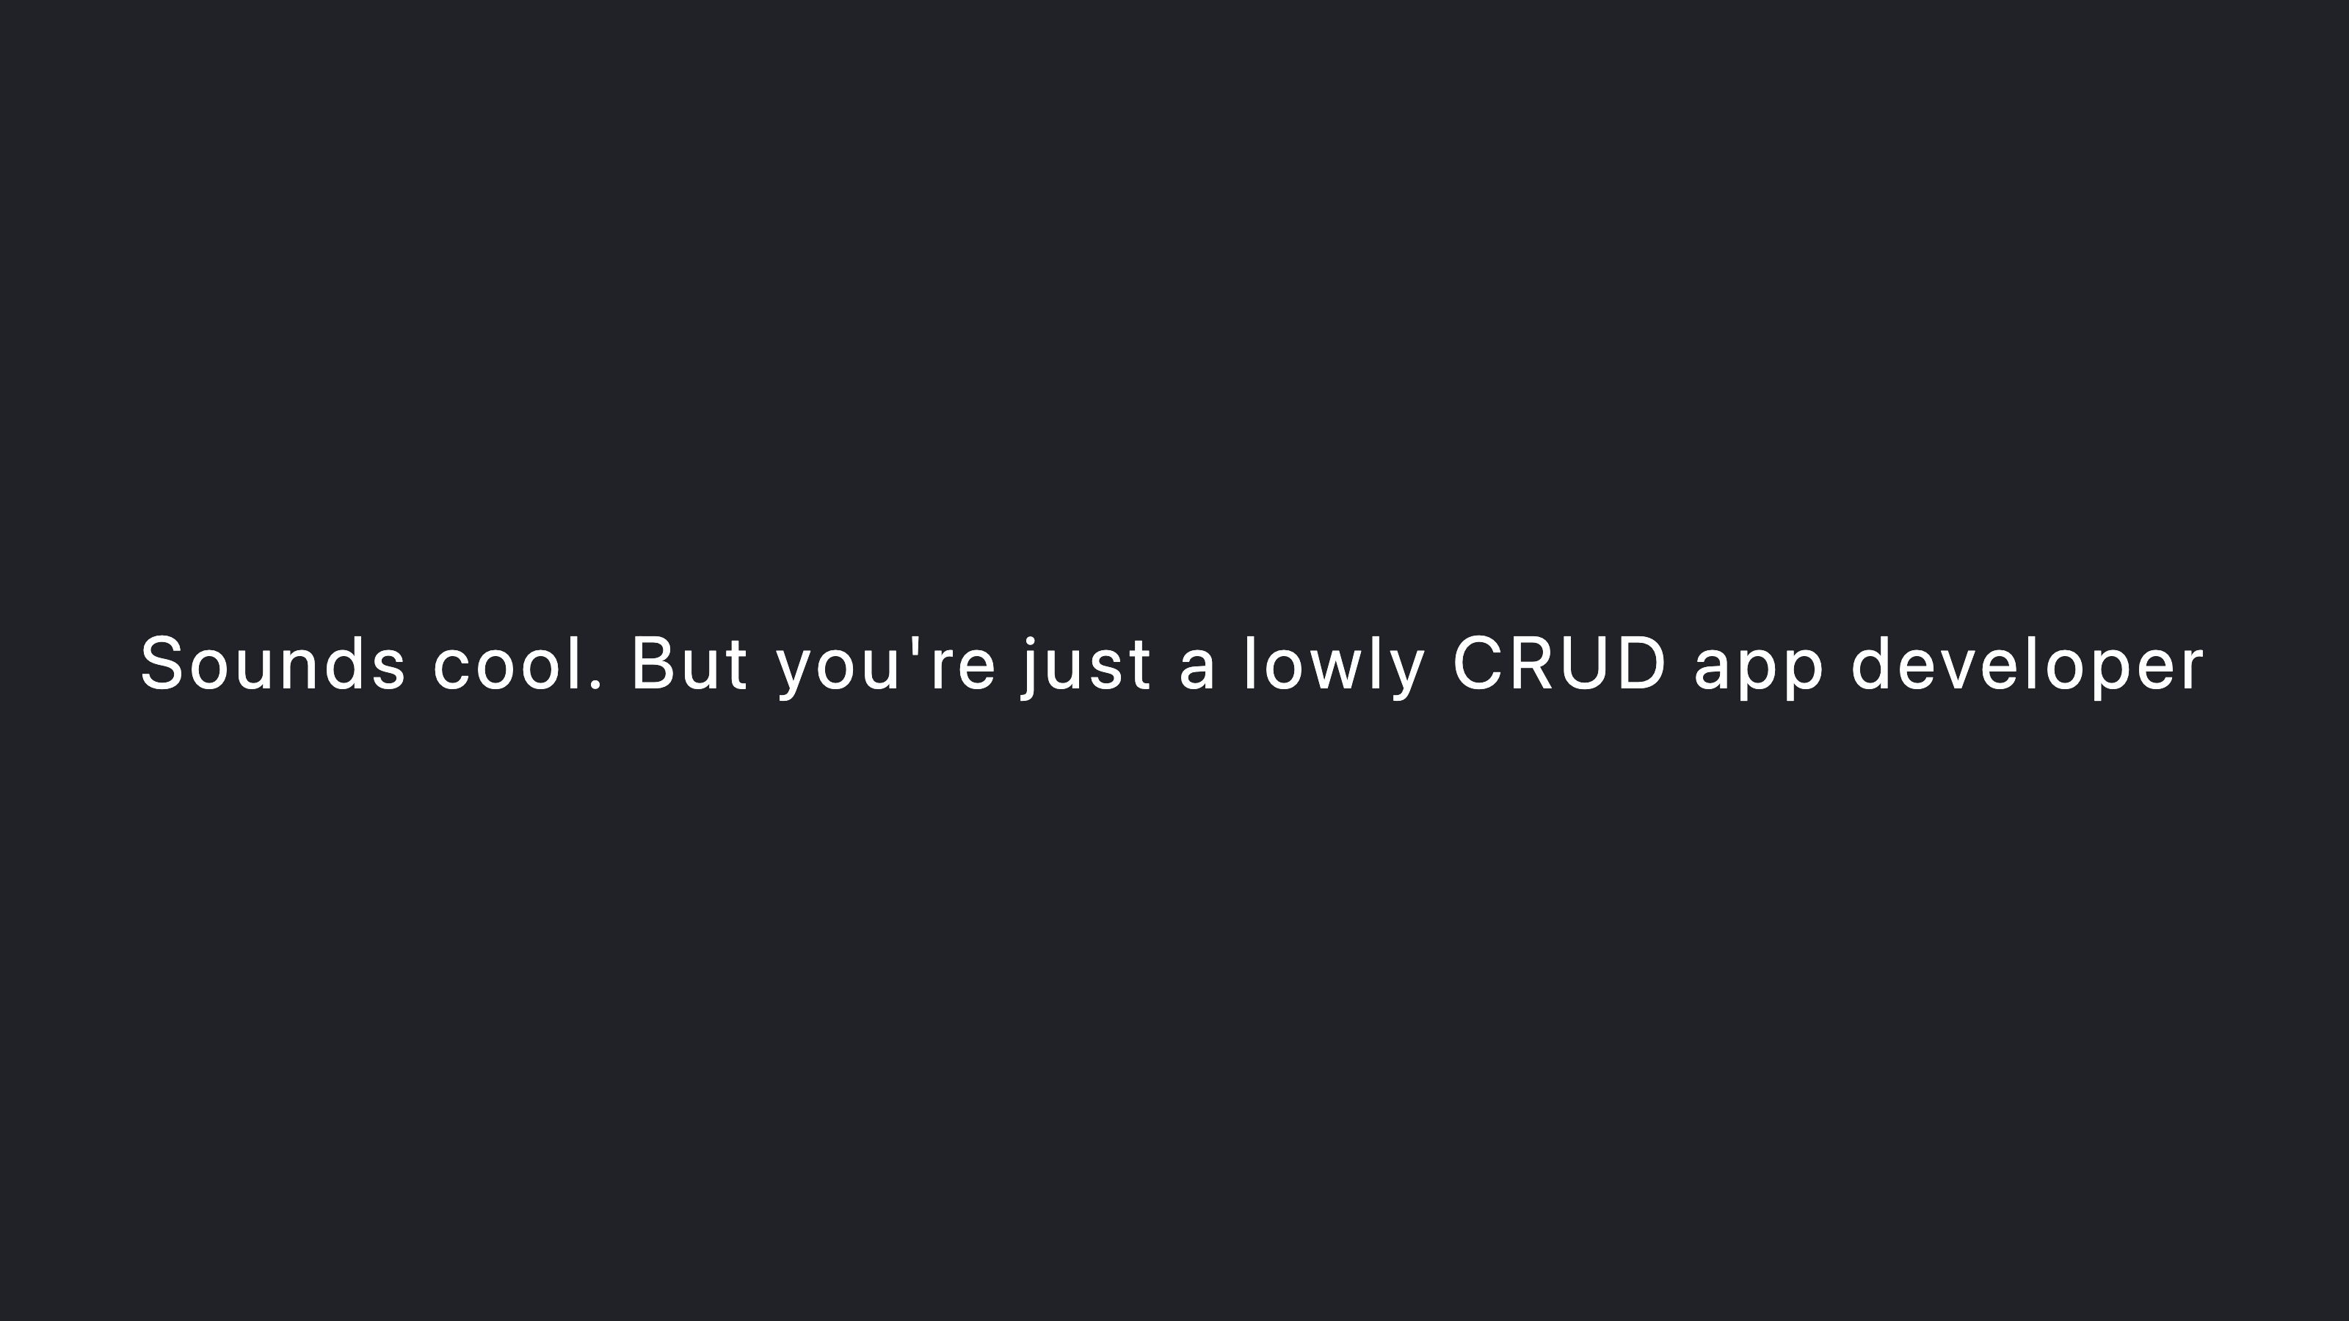

Slide 32
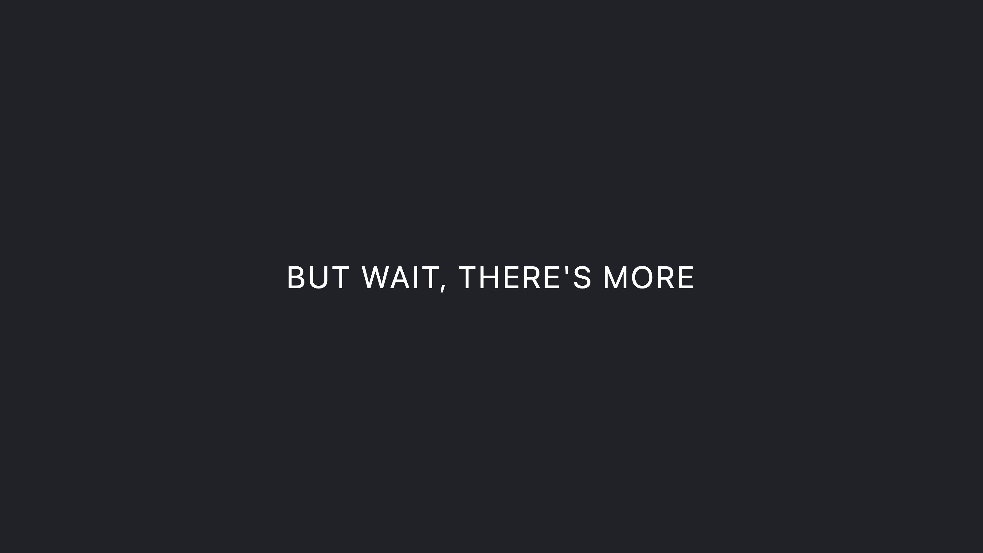

Slide 33


Slide 35
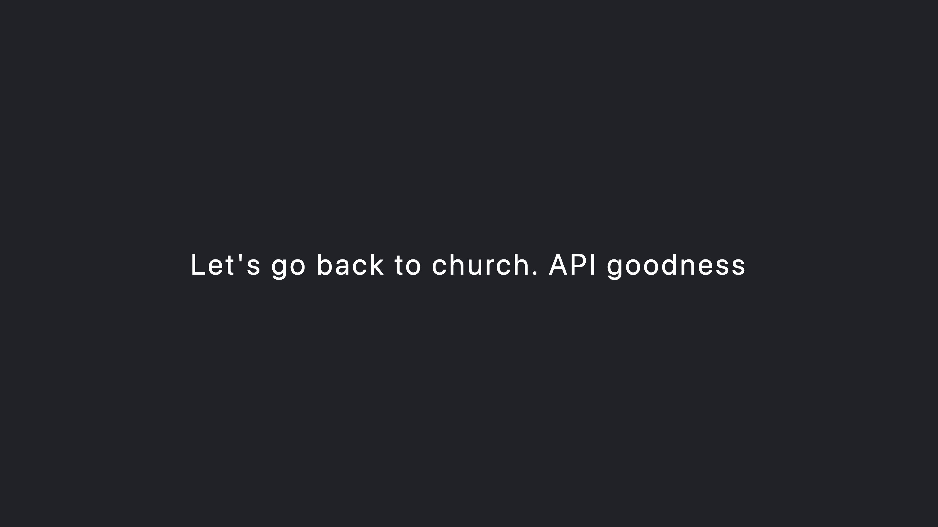

Slide 36
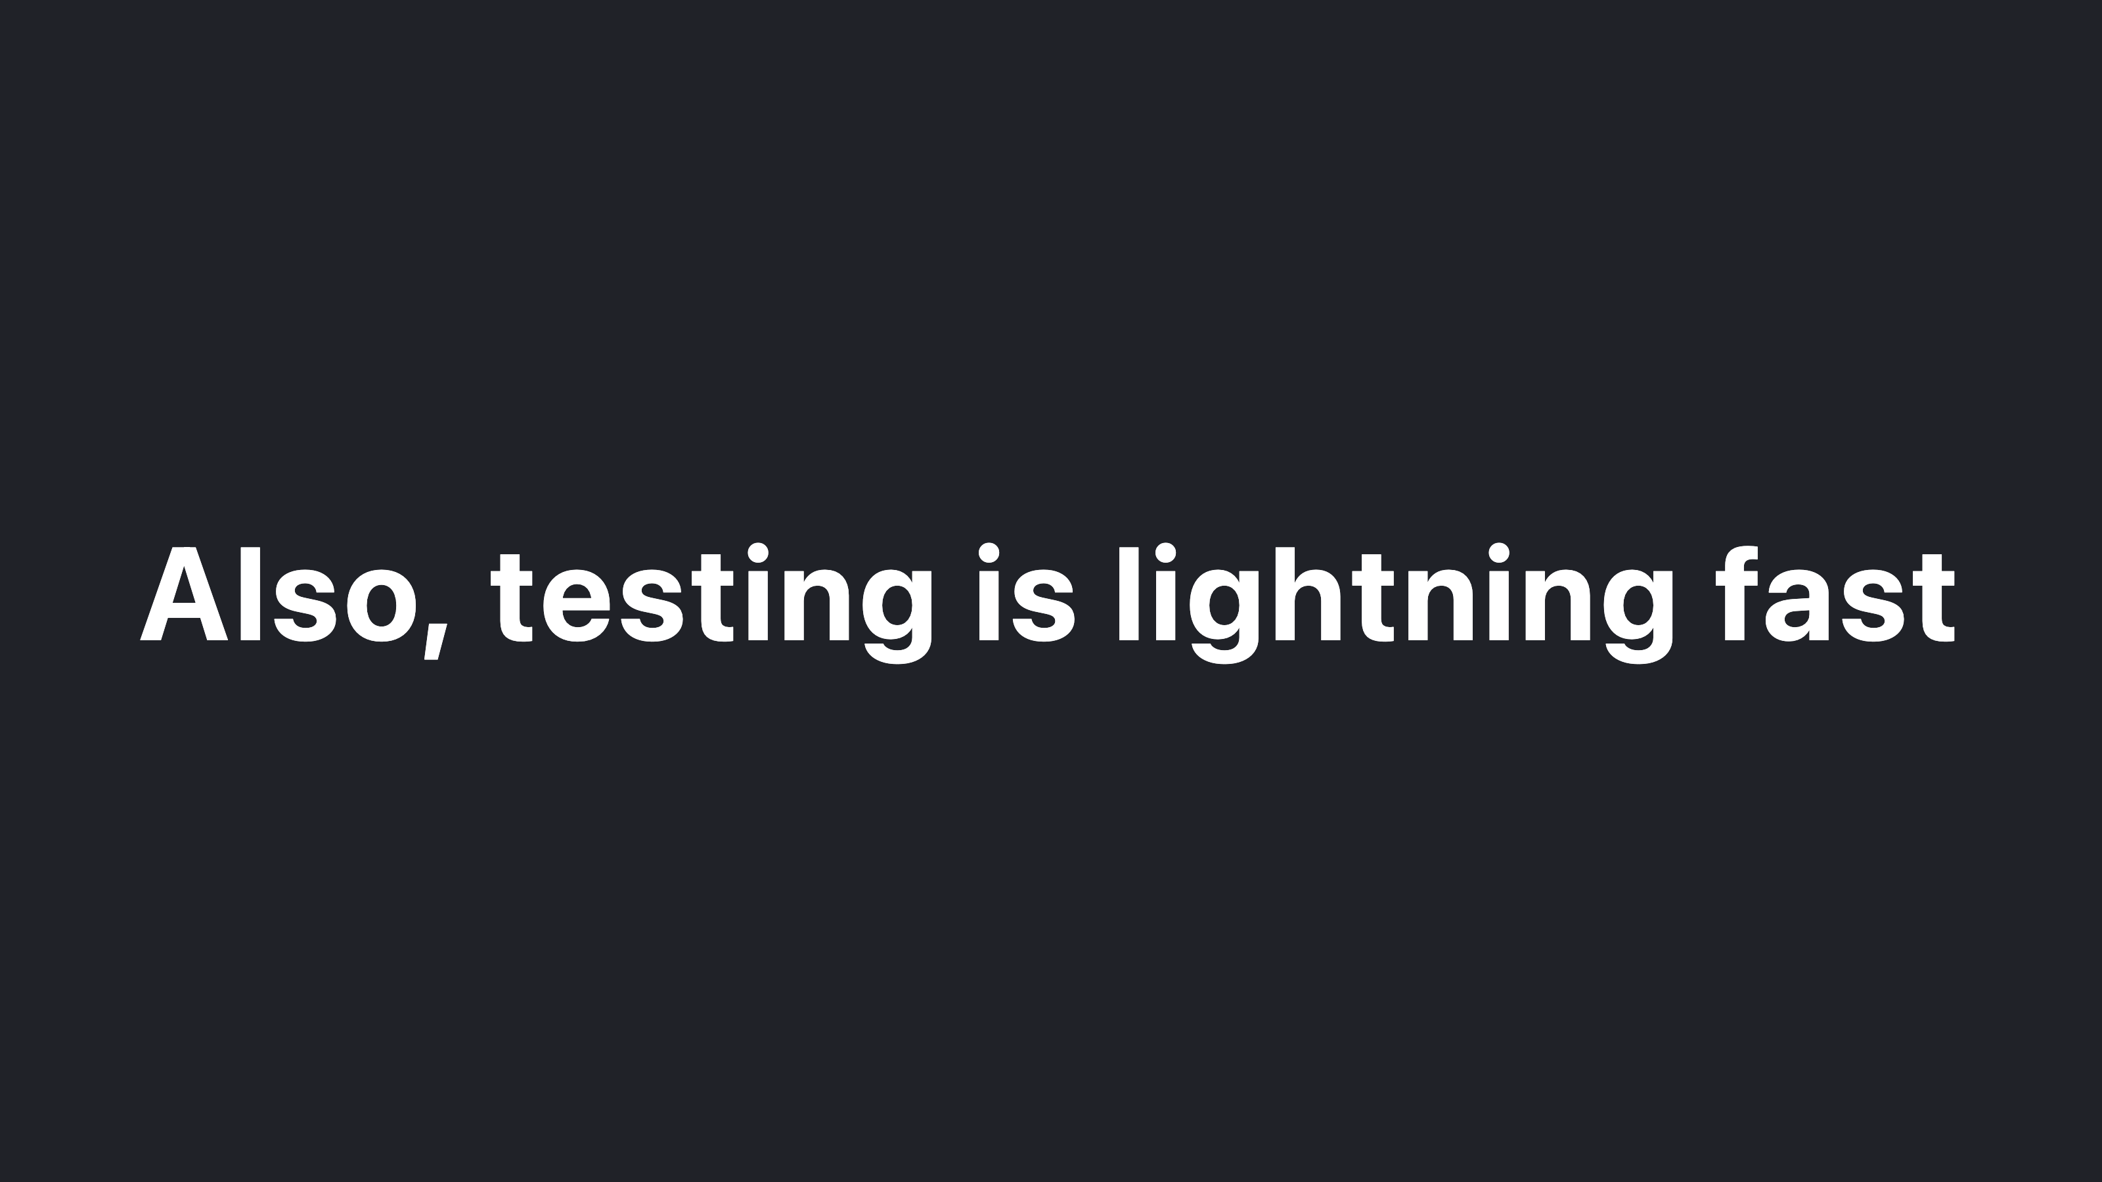

Slide 37


Slide 38


Slide 39


Slide 40


