Slide 1

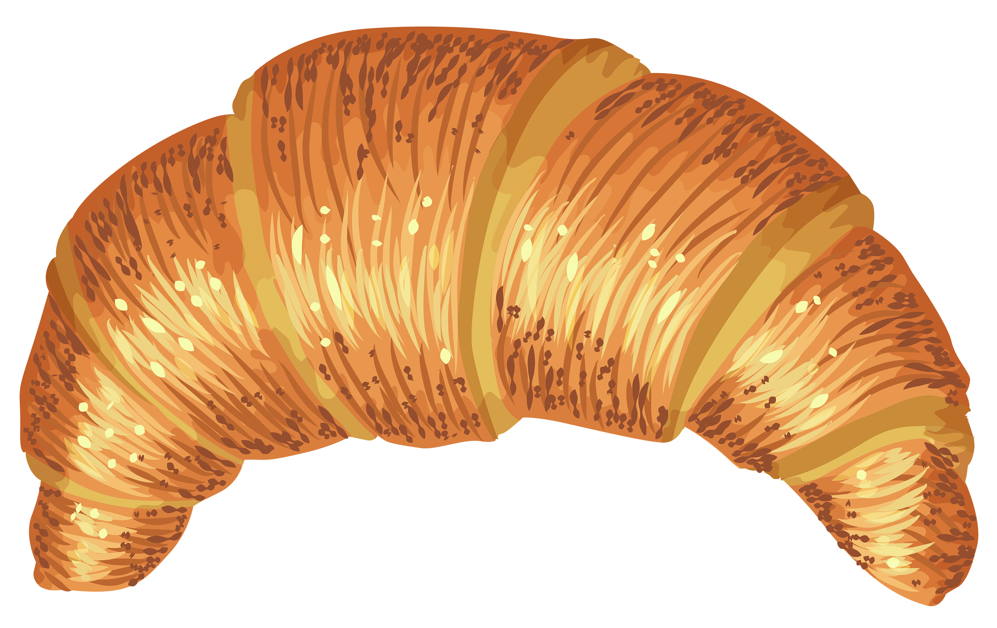
A croissant is dropped from the top of the Eiffel tower.
After 8.1316 seconds, it hits the ground.
Neglecting air resistance, and assuming g = 9.8N,
How tall is the Eiffel Tower? (rounded to the nearest meter)
Oh look, a handy-dandy physics calculator!
Just enter the time (t) in seconds.
Δy = g ∙ t² ∕ 2
t =
Δy =

