Slide 1


GRADUATION PROJECT
AI-Based Analog Layout Automation: A Conversational, Multi-Agent Framework
Mohammed Magdy
SPICE Parser & Ingestion
Noureldin Ayman
LangGraph Placer Agent
Ahmed Khairat
DRC Critic Spatial Healing
Mohammed Wael
PySide6 Canvas GUI
Omar Ahmed
Chatbot Co-Pilot Agent
Eman Sherif
Diffusion Compaction
Submitted To: Prof. DiaaEldin S. Khalil
SI-Vision | Ain Shams University Faculty of Engineering

Slide 2
System Execution Workflow
Import & Ingest
Ingests SPICE netlist and resolves PDK fin/poly track snapping bounds.
Symmetry Match
NetworkX bipartite graph detects matching pairs (diff pairs, mirrors).
AI Initial Placement
LangGraph Specialist agent generates initial symbolic layouts.
DRC Self-Healing
Sweepline Spacing Critic loops corrections to Planner node.
Visual Review & Chat
Designer inspects layout canvas and overrides parameters via chat.
Physical Exporter
Gdstk generates binary GDSII/OASIS; watchdog inserts to database.
AI-Based Analog Layout Automation | Ain Shams University & SI-Vision Collaboration
Slide 2

Slide 3
Section 1: Introduction & Motivation
The Layout Bottleneck, PDK Complexity, and Automation Challenges
AI-Based Analog Layout Automation | Ain Shams University & SI-Vision Collaboration
Slide 3

Slide 4
Revolutionising IC Design: The AI-Assisted Symbolic Layout
The 3-Step Optimisation Workflow
The Complexity Barrier
• Manual sub-micron geometries are too complex for direct AI coordinate mapping.
• Inflexible analytical cost functions fail to capture high-level qualitative designer preferences.
1. Ingestion & AI Proposal
Parses SPICE netlists, detects symmetry matching groups, and suggests initial relative configurations.
2. Human-in-the-Loop Refinement
Designer uses an interactive canvas editor to modify placements and type conversational chat prompt overrides.
Intelligent Symbolic Representation
• Decouples layout: strategic planning (LLM) and geometric grid-snapping compilation.
• Translates absolute shapes into logical parameters (ordering, orientations, finger splits) readable by both humans and AI.
3. Snapping & Physical Conversion
Deterministic compiler snapping compresses layout boundaries and outputs binary GDSII/OASIS streams.
System Component | Primary Function
EDA Interface | Parses netlist and translates symbolic parameters back to database layout.
AI / LLM Engine | Analyzes block relationships and optimizes layouts via conversational loops.
Visualizer GUI | Provides an interactive canvas editor for manual overrides and chat inputs.
AI-Based Analog Layout Automation | Ain Shams University & SI-Vision Collaboration
Slide 4

Slide 5
Introduction: Manual Analog Layout Bottleneck
The Traditional Analog Layout Flow
• Human-Dominated Process: Translation of schematic netlist to layout geometries relies heavily on manual expert drawing.
• High Complexity: Requires strict compliance with design rules (DRC), device symmetry matching, and parasitic minimization.
• Time-Consuming: Layout phase consumes up to 50% of the entire IC design cycle, slowing time-to-market.
Need for Automation & Symmetry
• Cycle Compression: Shifting to automated layout can compress design cycles from weeks to minutes.
• Matching Crucial: Symmetrical placements (e.g. diff pairs) are mandatory to cancel spatial process variations.
• Interactive Interface: Engineers must be able to specify spatial constraints without writing code.
AI-Based Analog Layout Automation | Ain Shams University & SI-Vision Collaboration
Slide 5

Slide 6
Introduction: Challenges in Modern PDKs
Restricted Design Rules (RDRs)
• Sub-20nm PDKs: Deep sub-micron nodes impose strict spacing limits on active diffusions, poly gates, and metals.
• Guard Rings: Boundary guard rings are mandatory to avoid latch-up and shield active transistors from bulk noise.
• Snapping Constraints: Poly gates and fins must align to discrete pitches, restricting spacing configurations.
Layout-Dependent Effects (LDE)
• Well Proximity Effect (WPE): Ion scatter off well edges changes transistor threshold voltage depending on well distance.
• Shallow Trench Isolation (STI): Compressive mechanical stress on active active-area alters channel mobilities based on isolation edge proximity.
• Impact: Compaction must minimize LDE while maintaining high packing density.
AI-Based Analog Layout Automation | Ain Shams University & SI-Vision Collaboration
Slide 6

Slide 7
Introduction: Limitations of Existing Approaches
Approach | Core Methodology | Primary Limitations
Procedural Generators | Hard-coded scripts for specific cells (e.g., Berkeley Analog Generator) | High development and maintenance overhead; zero portability across PDK nodes.
Analytical Placers | Analytical cost function optimization (Simulated Annealing, ILP, Force-Directed) | Black-box execution; fails to incorporate qualitative designer intent and preferences.
GenAI Layout Models | Textual layout tokenizers (e.g., GLayout, LLM-coordinate output) | Highly susceptible to coordinate arithmetic hallucinations and PDK spacing rounding errors.
AI-Based Analog Layout Automation | Ain Shams University & SI-Vision Collaboration
Slide 7

Slide 8
Introduction: The Proposed Solution
Decoupled Strategic & Geometric Architecture
• Strategic Planning: Powered by LLM agents. Reasons about symbolic relative ordering (ordering, orientations, finger splits) rather than raw dimensions.
• Deterministic Compiler: Snaps symbolic placements to physical sub-micron tracks, enforcing PDK spacing and boundary checks.
• Human-in-the-Loop: A conversational PySide6 editor panel dynamically captures designer intent, bridging AI and canvas.
Closed-Loop Correctness
• Sweepline Spacing Critic: A geometry engine evaluates relative placements against PDK design rules.
• Self-Healing: Synthesizes corrective offset constraints (e.g. shift x by 0.1um) and loops until zero DRC violations remain.
AI-Based Analog Layout Automation | Ain Shams University & SI-Vision Collaboration
Slide 8

Slide 9
Introduction: Presentation Overview
Research Questions Addressed
• Can LLM agents reason about physical analog layout placement topologies without coordinate hallucinations?
• How can we enforce sub-micron design rules and track snapping in a generative AI layout pipeline?
• Can we enable real-time interactive user inputs via conversational interfaces?
Presentation Structure
• System Architecture: Decoupled Strategic/Geometric paradigm.
• Stage 1 & 2: Ingestion, Graph Symmetry, and LangGraph Placer-Critic.
• Stage 3 & 4: PySide6 GUI, XML Command Queues, and Compaction Exporters.
• Evaluation: Real 14nm FinFET layouts, area footprints, and parasitics.
AI-Based Analog Layout Automation | Ain Shams University & SI-Vision Collaboration
Slide 9

Slide 10
Section 2: System Architecture
Strategic Planning, Geometric Snapping, and the Multi-Agent Framework
AI-Based Analog Layout Automation | Ain Shams University & SI-Vision Collaboration
Slide 10

Slide 11
System Architecture: 4-Column Panel Grid
EDA Ingestion
• Netlist Ingestion: Ingests flat SPICE netlist files (.sp, .cdl).
• Device Ingest: Resolves widths (W), fingers (M), and lengths (L).
• PDK Snapping Lookups: Maps poly tracks and active fin tracks.
• Symmetry Matching: Identifies differential pairs and current mirrors.
AI/LLM Engine
• LangGraph State Machine: Coordinates multi-agent layout crew.
• Builder & Specialist: Plans relative row configurations.
• DRC Spacing Critic: Checks physical overlaps via Sweepline.
• ReAct Loop: Iterates coordinate correction constraints.
Human Co-Pilot
• Conversational Panel: Chat interface in PySide6 GUI.
• Intent Routing: Routes prompts (move, swap, align, abut).
• QThread Worker: Background thread prevents GUI canvas lag.
• Command XML Queue: Batch updates via QTimer.
Outputs
• Compaction Compiler: Compacts physical cell boundaries.
• Gdstk Exporter: High-performance binary GDSII/OASIS.
• WATCHDOG cc_watcher: TCL watchdog script parses JSON exchange.
• Native EDA: Imports layouts in Virtuoso/Custom Compiler.
AI-Based Analog Layout Automation | Ain Shams University & SI-Vision Collaboration
Slide 11

Slide 12
System Architecture: Strategic & Geometric Separation
Strategic Planning Layer (AI Agents)
• Relative Ordering: Determines horizontal layout queues of cells (e.g. row0: MM0, MM1, MM2).
• Device Configurations: Recommends transistor finger splitting and unrolling to optimize aspect ratio.
• Symmetry Matching: Groups transistors into symmetrical common-centroid configurations.
• Abstraction: Completely isolated from sub-micron dimensions to eliminate spatial math errors.
Geometric Compiling Layer (Deterministic Engine)
• Track Snapping: Aligns gate centers and active regions to quantized PDK fin and poly tracks.
• Diffusion Sharing: Merges adjacent transistor source/drains to reduce junction area.
• Clearance Compiler: Translates symbolic relative indices into physical spacing dimensions using PDK lookup rules.
AI-Based Analog Layout Automation | Ain Shams University & SI-Vision Collaboration
Slide 12

Slide 13
System Architecture: 4-Stage Compilation Pipeline
Stages 1 & 2 (Backend Core)
• Stage 1: EDA-Interface Inputs: Ingests SPICE netlists, resolves PDK parameters, and performs graph-isomorphism symmetry detection.
• Stage 2: AI-Initial Placement: Executes LangGraph cooperative state-machine planner and DRC self-healing critic loops.
Stages 3 & 4 (Frontend & Exporter)
• Stage 3: ChatBot and GUI Integration: Manages human-in-the-loop conversational panels, intent routing, and thread-safe signal queues.
• Stage 4: EDA-Interface Outputs: Executes layout compaction, creates Gdstk OASIS files, and triggers OpenAccess WATCHDOG injection.
AI-Based Analog Layout Automation | Ain Shams University & SI-Vision Collaboration
Slide 13

Slide 14
System Architecture: 4-Stage Compilation Block Diagram
Stage 3: GUI Co-Pilot - PySide6 Canvas - Intent Classifiers - Conversational Panel
SPICE Netlist Input (.sp / .cdl)
Stage 1: Parser - SPICE Ingestion - Subgraph Isomorphism - Symmetry Extraction
Stage 2: AI Placer - LangGraph Planning - ReAct DRC Healing - Diffusion Compaction
Stage 4: Exporters - Physical Compaction - Gdstk OASIS/GDSII - cc_watcher Watchdog
Outputs - GDSII / OASIS - OpenAccess DB
The 4-stage pipeline is completely decoupled: the Strategic AI Planner (Stage 2) recommends relative topologies, which the Snapping and Compaction engines (Stage 4) translate into sub-micron geometries.
Stage 3 acts as the Human-in-the-loop bridge, parsing chat override commands into XML parameters and flushing them asynchronously to redraw the canvas without freezing the thread.
AI-Based Analog Layout Automation | Ain Shams University & SI-Vision Collaboration
Slide 14

Slide 15
Stage 2: LangGraph Multi-Agent Planning Pipeline
Input JSON Logical device netlist & PDK metrics
Topology Analyst Bipartite graph matching of diff-pairs & mirrors
Strategy Selector Plans rows, layout symmetry, and centroids
Placement Specialist Generates strategic relative floorplans
Finger Expander Unrolls fingers & calculates S/D abutment
Spacing Violations Feedback
PySide6 Canvas Redraws dynamic layout geometries
DRC-Clean Layout Exports unified node coordinate maps
DRC Critic Agent Sweepline check; extracts violations
Routing Previewer HPWL cost & crossing minimization
Clean
• Multi-Agent Orchestration: LangGraph manages layout generation as a state-machine. A shared state dictionary houses the netlist bipartite graph, matched symmetry constraint groups, and current coordinate matrices.
• Closed-Loop Convergence: When the DRC Critic detects overlaps or spacing failures, it writes a list of bounding box corrective shift directives back to the Specialist agent, achieving zero-DRC convergence in under 4 loops.
AI-Based Analog Layout Automation | Ain Shams University & SI-Vision Collaboration
Slide 15

Slide 16
System Architecture: Human-in-the-Loop Co-Pilot
Bridging Conversational AI and Layout Canvas
• Interactive Co-Design: AI generates initial layouts, and humans override details on the canvas.
• User Intent Parser: Chat panel processes natural language commands (e.g. "align differential pair gates").
• Asynchronous Bridge: Pushes commands to XML execution queues, updating the GUI without UI freezing.
Intent Translation
• Commands are parsed into structured layouts.
• XML layouts are pushed to the compiler to snap boundaries.
• Tracks are updated instantly on the PySide6 canvas.
AI-Based Analog Layout Automation | Ain Shams University & SI-Vision Collaboration
Slide 16

Slide 17
System Architecture: State Variables & Context
LangGraph Active State Variables
• netlist_graph: NetworkX representation of the electrical netlist.
• symmetry_groups: List of matched symmetry transistor groups.
• symbolic_map: JSON representation of active rows, devices, ordering, orientations, and fingers.
• coordinate_matrix: Absolute snapped micron coordinates.
Critic History Buffer
• critic_history: Stores previous DRC check violations.
• correction_constraints: List of active spacing offset limits.
• user_overrides: Active list of designer override instructions.
AI-Based Analog Layout Automation | Ain Shams University & SI-Vision Collaboration
Slide 17

Slide 18
Section 3: Stage 1: EDA-Interface Inputs
Netlist Parsing, Subgraph Isomorphism, and Parameter Resolution
AI-Based Analog Layout Automation | Ain Shams University & SI-Vision Collaboration
Slide 18

Slide 19
Stage 1: SPICE Ingestion & Parsing
SPICE Netlist Parsing
• Netlist Reader: Ingests flat or hierarchical SPICE files (.sp, .cdl).
• Subcircuit Extraction: Flattens modules and extracts individual transistor rows.
• Pin Mapping: Resolves electrical connections for transistor source, drain, gate, and body nodes.
Device Parameter Extraction
• Transistor Dimensions: Resolves width (W), length (L), and finger counts (M).
• PDK Attributes: Maps discrete FinFET parameters such as fin count, gate pitch, and threshold options.
• Database Compilation: Builds a structured JSON node list of all devices.
AI-Based Analog Layout Automation | Ain Shams University & SI-Vision Collaboration
Slide 19

Slide 20
Stage 1: Subgraph Isomorphism & Symmetry
Graph Construction
• Graph Representation: Ingested netlist is mapped to a bipartite graph using NetworkX.
• Bipartite Nodes: Devices and electrical nets are represented as distinct node groups.
• Bipartite Edges: Edges connect device terminal nodes to corresponding nets.
Isomorphism Matching
• Pattern Recognition: Walks the bipartite graph checking for structural symmetry.
• Symmetry Matching: Identifies equivalent electrical configurations (e.g. symmetrical paths).
• Performance: Matching runs in milliseconds for typical analog blocks ($N < 50$ devices).
AI-Based Analog Layout Automation | Ain Shams University & SI-Vision Collaboration
Slide 20

Slide 21
Stage 1: Symmetrical Matching Templates
Differential Input Pairs
• Symmetry Condition: Symmetrical transistors sharing gate inputs or cross-coupled gate-drain connections.
• Group Constraint: Forces transistors to be placed symmetrically around a central axis.
• Alignment: Aligns horizontal y-coordinates and snaps poly tracks.
Active Loads & Mirrors
• Current Mirrors: Symmetrical transistor groups sharing common gate and source connections.
• Aspect Ratios: Identifies matching finger counts to ensure proportional current mirroring.
• Constraint Hierarchy: Writes symmetry requirements to the LangGraph state.
AI-Based Analog Layout Automation | Ain Shams University & SI-Vision Collaboration
Slide 21

Slide 22
Stage 1: PDK Parameter Mapping & Snapping
FinFET Grid Track Snapping
• Ppoly Pitch: Gate centers must snap to integer multiples of the poly track pitch (e.g. 140nm).
• Pfin Pitch: Active diffusions must snap to horizontal fin track pitches (e.g. 48nm).
• Clearance Compiler: Reads spacing files and pre-calculates spacing margins.
Ingestion Boundaries
• Cell Boundaries: Formulates minimum width and height boundaries for NMOS and PMOS regions.
• Well Clearances: Pre-calculates well isolation spacing limits to ensure DRC compliance.
AI-Based Analog Layout Automation | Ain Shams University & SI-Vision Collaboration
Slide 22

Slide 23
Stage 1: Parser Ingestion Flowchart
1. CDL/SPICE netlist
Ingests hierarchical netlist files and flattens device sub-module instances.
2. Properties Resolver
Extracts transistor parameters: widths (W), finger multipliers (M), and lengths (L).
3. Bipartite Graph
Converts netlist to a bipartite graph where nodes are devices/nets and edges are pins.
6. PDK Snap mapping
Reads PDK track settings and maps snapping constraints to poly poly gates and horizontal fins.
5. Constraints Database
Groups identified devices into hierarchical matching constraint blocks for the Placer state.
4. Symmetry Detector
Executes graph isomorphism walking (NetworkX) to identify matched pairs & current mirrors.
AI-Based Analog Layout Automation | Ain Shams University & SI-Vision Collaboration
Slide 23

Slide 24
Stage 1: Parsed Ingestion Database Schema
JSON Ingestion Fields
• Nodes list: Represents devices in the flattened netlist (e.g. MM0, MM1).
• Pins mapping: Links gate (g), source (s), drain (d), and bulk (b) terminals to logical net names.
• Properties fields: Maps physical FinFET parameters: width (w), length (l), and parallel split fingers (nf).
Parsed Netlist JSON Schema
{
"nodes": [
{
"id": "MM0",
"type": "nmos",
"w": 0.5e-6,
"l": 0.03e-6,
"nf": 2,
"nets": {"d": "out", "g": "in", "s": "gnd", "b": "gnd"}
},
{
"id": "MM1",
"type": "nmos",
"w": 0.5e-6,
"l": 0.03e-6,
"nf": 2,
"nets": {"d": "out_b", "g": "in_b", "s": "gnd", "b": "gnd"}
}
],
"edges": [
{"source": "MM0", "target": "MM1", "net": "gnd", "type": "s_s"}
]
}
AI-Based Analog Layout Automation | Ain Shams University & SI-Vision Collaboration
Slide 24

Slide 25
Section 4: Stage 2: AI-Initial Placement
LangGraph Orchestration, Snapping, and Self-Healing Critic Loops
AI-Based Analog Layout Automation | Ain Shams University & SI-Vision Collaboration
Slide 25

Slide 26
Stage 2: Symbolic vs. Physical Placement
Eliminating Coordinate Hallucinations
• The Problem: Generative AI models struggle with sub-micron coordinate arithmetic, causing DRC overlapping.
• The Solution: LLM agents are restricted to planning a symbolic placement map.
• No Math: LLM planning is restricted to relative ordering (e.g., placing M1 next to M2).
Deterministic Snapping Compiler
• Compile Snapping: A geometry compiler resolves symbolic indices into physical coordinates.
• Boundary Compiler: Integrates PDK boundary rules to calculate cell widths and heights.
AI-Based Analog Layout Automation | Ain Shams University & SI-Vision Collaboration
Slide 26

Slide 27
Stage 2: Specialist Agent Roles & Responsibilities
Topology Analyst
• Bipartite Graph Walks: Parses netlist connectivity using NetworkX graphs.
• Symmetry Matching: Automatically detects differential pairs, current mirrors, and matched terminals.
Strategy Selector
• Floorplan Layouts: Allocates active cells to horizontal rows and maps well guard ring boundaries.
• Centroid Axis Planning: Selects horizontal and vertical symmetry reflection axes.
Placement Specialist
• LLM Reasoning Planner: Determines strategic relative orderings of transistors without absolute math.
• Relative Commands: Issues topological move, swap, align, and abut directives.
Finger Expander
• Transistor Splitter: Unrolls wide gates into parallel fingers to fit PDK row height constraints.
• Active Area Abutment: Maximizes shared source/drain contacts, compressing spacing to 70nm.
Routing Previewer
• HPWL Routing Cost: Minimizes interconnect distance by calculating Half-Parameter Wire Lengths.
• Same-Layer Crossing Checks: Optimizes cell orders to avoid signal trace intersections.
DRC Critic Agent
• Sweepline Spacing Engine: Evaluates polygon overlaps against PDK clearance lookup rules.
• Correction Directives: Formulates shift vector requirements (e.g. shift X by 0.3um) to heal state.
AI-Based Analog Layout Automation | Ain Shams University & SI-Vision Collaboration
Slide 27

Slide 28
Stage 2: Spacing Self-Healing Critic Loop
Sweepline DRC Checks
• Overlap Detection: Checks layout boundaries to identify overlaps.
• Clearance Verification: Measures gaps against PDK spacing rules.
Corrective Offset Synthesis
• Constraint Injection: Generates relative spacing coordinates (e.g. shift x by 0.1um) when DRC violations are found.
• ReAct Loop: LangGraph loops from Specialist to Critic until all violations are resolved.
AI-Based Analog Layout Automation | Ain Shams University & SI-Vision Collaboration
Slide 28

Slide 29
Stage 2: Placer-Critic Self-Healing Flowchart
Compute coordinate shift offset vectors
Yes
DRC Spacing Violations?
Builder Node Initializes row & cell structures
Specialist Node Proposes relative ordering & splits
DRC Critic Node Sweepline spacing & overlap checks
No
Physical Compaction Proceeds to exporters
AI-Based Analog Layout Automation | Ain Shams University & SI-Vision Collaboration
Slide 29

Slide 30
Stage 2: Diffusion Sharing & Abutment
Active diffusion sharing
• Concept: Adjacent transistors sharing a common electrical net can share active diffusion regions.
• Contact Merging: Compactor merges source/drain contacts, eliminating isolation spacing.
• Area Benefits: Reduces cell width by up to 40%, optimizing layout density.
Abutment Engine
• Abutment Search: Evaluates orientation flips (source/drain) to maximize shared contacts.
• Net Compatibility: Checks poly spacing and contact boundary rules.
AI-Based Analog Layout Automation | Ain Shams University & SI-Vision Collaboration
Slide 30

Slide 31
Stage 2: Abutment Engine & Dummy Insertion
Union-Find Chains
• Abutment Chain Search: Identifies continuous transistor chains sharing source/drain nodes.
• Grid Snapping: Aligns active channels to horizontal tracks.
Conflict Spacing & Dummies
• Abutment Conflicts: Inserts dummy isolation transistors or spacing guard zones if active nets conflict.
• PDK Snapping: Snaps boundaries to integer track multiples.
AI-Based Analog Layout Automation | Ain Shams University & SI-Vision Collaboration
Slide 31

Slide 32
Stage 2: Symbolic Placement JSON Output
JSON Symbolic Fields
• Rows template: Strategic row partitions separating NMOS and PMOS device regions.
• Relative index: Horizontal sequence numbers representing device ordering from left to right.
• Orientations flags: Flip states (R0 vs. MX) that control source/drain terminal configurations to allow contact sharing.
Symbolic Placement JSON Output
{
"rows": [
{
"id": "row0", "type": "nmos", "height": 0.6,
"devices": [
{"id": "MM0", "finger": 0, "orient": "R0"},
{"id": "MM0", "finger": 1, "orient": "MX"},
{"id": "MM1", "finger": 0, "orient": "R0"},
{"id": "MM1", "finger": 1, "orient": "MX"}
]
}
]
}
AI-Based Analog Layout Automation | Ain Shams University & SI-Vision Collaboration
Slide 32

Slide 33
Section 5: Stage 3: ChatBot & GUI Integration
Conversational Panel, Intent Classifiers, and Multi-Threaded Signal Slots
AI-Based Analog Layout Automation | Ain Shams University & SI-Vision Collaboration
Slide 33

Slide 34
Stage 3: Conversational Layout Co-Pilot
Interactive Chat Panel
• Canvas Chat Panel: Integrated directly inside the PySide6 canvas editor.
• Natural Language Interface: Allows designers to interact with layout parameters via text.
• Query Support: Designers can query PDK rules, check symmetry constraints, or get coordinates.
Designer Overrides
• Designer Command: Allows engineers to override placement settings.
• Intent Capture: Chat panel converts natural language commands into layout modifications.
AI-Based Analog Layout Automation | Ain Shams University & SI-Vision Collaboration
Slide 34

Slide 35
Stage 3: ChatPanel Co-Pilot Event Queue Flowchart
1. Natural Language Input
Designer types layout query text (e.g. "align gates").
2. QThread Worker
ChatPanel captures text; triggers background thread worker.
3. Intent Router LLM
Analyzes prompt against available layout skills (move, abut).
4. XML CMD Synthesizer
Converts natural intent into structured command parameters.
8. KLayout Live Preview
Synchronizes coordinates; displays unrolled shapes instantly.
7. PySide6 Canvas View
Redraws layout shapes on the symbolic canvas view.
6. QGraphicsScene Stack
Translates commands into QGraphicsItems & commits to undo/redo.
5. XML Execution Queue
Pushes parsed commands to a structured transaction queue.
• Thread Isolation: By offloading heavy model queries and routing calculations to a separate background QThread, the main PySide6 canvas view remains responsive with zero UI freezing.
• Transactional Safety: Commands in the queue are validated against snap pitches and compiled as a batch. A lightweight QTimer flusher, reducing canvas repainting overhead.
AI-Based Analog Layout Automation | Ain Shams University & SI-Vision Collaboration
Slide 35

Slide 36
Stage 3: PySide6 GUI Canvas Editor
Interactive Layout Canvas
• Canvas Editor: Displays transistor shapes (diffusions, gates, contacts, pins) dynamically.
• Graphic Items: Uses QGraphicsScene to display layout geometries.
Real-Time Updates
• Real-Time Refreshes: Refreshes canvas layers instantly when placement updates are received.
• Visual Highlights: Highlights nets and symmetry axes.
AI-Based Analog Layout Automation | Ain Shams University & SI-Vision Collaboration
Slide 36

Slide 37
Stage 3: Thread-Safe GUI Orchestration
Thread Separation
• OrchestratorWorker: Moves LLM requests and LangGraph iterations to a background thread.
• Thread Separation: Protects PySide6 GUI main thread from freezing during long reasoning runs.
Qt Signal-Slot Communication
• Communication uses thread-safe signals:
• stage_started: Shows loading spinners in the GUI.
• response_delta: Streams text token-by-token to the chat panel.
• command_ready: Transmits layout updates.
AI-Based Analog Layout Automation | Ain Shams University & SI-Vision Collaboration
Slide 37

Slide 38
Stage 3: Command Queue & Interactive Undo
XML Layout Queues
• XML Command Queue: Pushes all updates to a structured queue.
• Batch Command Flusher: Group commands into a single canvas redraw transaction using a 0ms QTimer to prevent flickering.
Undo/Redo Stack
• Undo Stack: Tracks all state changes to allow reverting layout adjustments.
• Co-Design Support: Allows designers to easily undo or redo modifications.
AI-Based Analog Layout Automation | Ain Shams University & SI-Vision Collaboration
Slide 38

Slide 39
Stage 3: ChatPanel Co-Pilot Event Queue Flowchart
1. User Prompt Text
Designer types layout query text (e.g. "align gates").
2. PySide6 Canvas GUI
ChatPanel captures text; triggers orchestrator workers.
3. OrchestratorWorker
Background worker QThread runs model calculations.
4. Intent Classifier
Classifies prompt into move, swap, align, abut action intents.
8. Undo Stack Log
Logs layout modifications on the undo stack for reverts.
7. QGraphicsScene
Redraws layout shapes instantly with zero lagging.
6. QTimer Batch Flusher
Groups commands into a single canvas redraw transaction.
5. XML Command Queue
Pushes parsed commands to structured queue buffer.
AI-Based Analog Layout Automation | Ain Shams University & SI-Vision Collaboration
Slide 39

Slide 40
Section 6: Stage 4: EDA-Interface Outputs
Compaction, OASIS Exporter, and OpenAccess TCL Injection
AI-Based Analog Layout Automation | Ain Shams University & SI-Vision Collaboration
Slide 40

Slide 41
Stage 4: Physical Layout Compaction
Compaction Execution
• Compaction Engine: Ingests placement maps and resolves PDK spacing rules.
• Clearance Sweeper: Compacts gaps between gates and active areas to minimize overall cell area.
• Pin Alignment: Snaps contacts and pins to vertical and horizontal routing grids.
LDE Reduction
• WPE and STI Protection: Places dummy devices to shield active transistors.
• Symmetry Axis Centering: Aligns symmetrical transistor rows.
AI-Based Analog Layout Automation | Ain Shams University & SI-Vision Collaboration
Slide 41

Slide 42
Stage 4: Binary GDSII & OASIS Exporter
Gdstk Layout Assembly
• Gdstk Exporter: Generates layouts using the C++/Python Gdstk library.
• Cell Assembly: Clones PDK base PCells and compiles geometry polygons.
• Speed: Layout generation finishes in milliseconds.
Binary Formats
• OASIS Exporter: Exports binary GDSII or OASIS layout streams.
• OASIS Advantage: Offers up to 10x smaller file sizes than GDSII, accelerating large macro exports.
AI-Based Analog Layout Automation | Ain Shams University & SI-Vision Collaboration
Slide 42

Slide 43
Stage 4: OpenAccess DB Watchdog Flowchart
1. Exporter Output
Compactor writes snapped coordinates to layout.json file on disk.
2. Filesystem Watchdog
cc_watcher.tcl running inside Virtuoso monitors directory for updates.
3. TCL Ingestion Parser
Reads new layout.json file and decodes device-coordinate pairs.
4. OpenAccess DB API
Directly moves cellview shapes using db_move_device calls in-memory.
5. Active Canvas Refresh
Virtuoso/Custom Compiler layout window redraws coordinates instantly.
• Independent Synchronization: Rather than establishing heavy inter-process communication sockets, the system uses a robust file watchdog (cc_watcher.tcl) that polls a directory and reads files based on modification times (mtime).
• Direct In-Memory Manipulation: The TCL watchdog runs directly inside the active EDA session (Synopsys Custom Compiler or Cadence Virtuoso). It queries the OpenAccess cellview database, moves transistor instances in-memory, and updates PCell abutment flags programmatically. This ensures DRC-clean layouts load instantly without database locks.
AI-Based Analog Layout Automation | Ain Shams University & SI-Vision Collaboration
Slide 43

Slide 44
Stage 4: Compaction & Dual Exporter Flowchart
Gdstk Exporter Clones PDK base cells; compiles geometries
Binary GDSII / OASIS Streams Highly compacted file size; ready for verification/tape-out
Snapped Coordinates - Transistor rows - Gate poly centers - Shared diffusions
Compaction Engine - Runs sweep clearances - Optimizes cell bounds - Aligns routing pins
layout.json file Stores snapped coords; localized exchange buffer
cc_watcher Watchdog Injects coordinate changes; updates Virtuoso cellview
AI-Based Analog Layout Automation | Ain Shams University & SI-Vision Collaboration
Slide 44

Slide 45
Stage 4: Watchdog Observer TCL Script
TCL Script Logic
• File Observer: Monitors the filesystem directory for updates to the coordinate exchange file.
• JSON Parsing: Ingests layout changes as key-value pairs (device ID to physical coordinates).
• Database Injection: Executes db_move_device to update the active OpenAccess cellview in real-time.
cc_watcher.tcl Watchdog Script
# cc_watcher.tcl - Ingest JSON layout updates
if {[file exists $layout_json_path]} {
set fp [open $layout_json_path r]
set file_data [read $fp]
close $fp
# Parse placement coordinate arrays
set json_data [json::json2dict $file_data]
foreach dev_id [dict keys $json_data] {
set coords [dict get $json_data $dev_id]
set xPos [lindex $coords 0]
set yPos [lindex $coords 1]
# Inject coordinates directly into active cellview
db_move_device $dev_id $xPos $yPos
}
}
AI-Based Analog Layout Automation | Ain Shams University & SI-Vision Collaboration
Slide 45

Slide 46
Section 7: Evaluation & Results
XOR, Mirror, and Comparator Layout Benchmarks, Area, Parasitics, and Latency
AI-Based Analog Layout Automation | Ain Shams University & SI-Vision Collaboration
Slide 46

Slide 47
Evaluation: Experimental Setup
Process Design Kits & Circuits
• ASU 14nm: Predictive FinFET PDK.
• SAED 14nm: Synopsys FinFET PDK.
• Circuits: 2-Transistor Mirror, Differential Input Pair, 5-T OTA, Dynamic Comparator, XOR Gate.
Compute Specs & Models
• Compute Spec: Intel Core i9-12900K, 64GB RAM, RTX 3090 (24GB VRAM).
• LLM Backends: Claude 3.5 Sonnet, GPT-4o, Llama-3-8B (Ollama Local).
• EDA Tools: Synopsys Custom Compiler, Cadence Virtuoso, StarRC.
AI-Based Analog Layout Automation | Ain Shams University & SI-Vision Collaboration
Slide 47

Slide 48
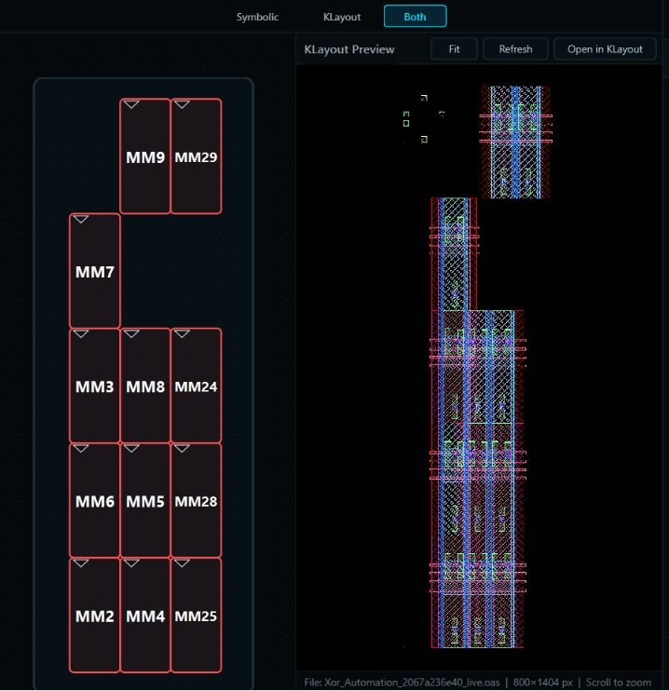
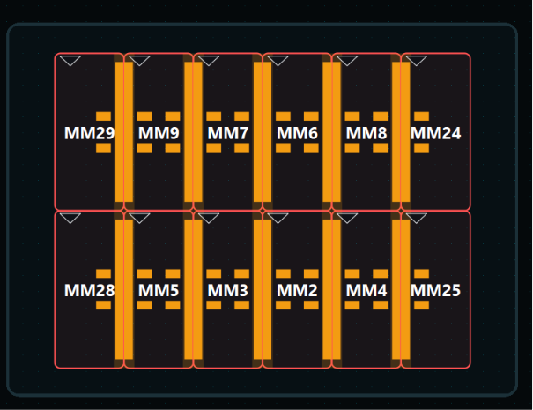
Evaluation: XOR Gate Layout - Symbolic Placements
(a) Initial unplaced symbolic grid.
(b) Symbolic placement with abutment.
AI-Based Analog Layout Automation | Ain Shams University & SI-Vision Collaboration
Slide 48

Slide 49
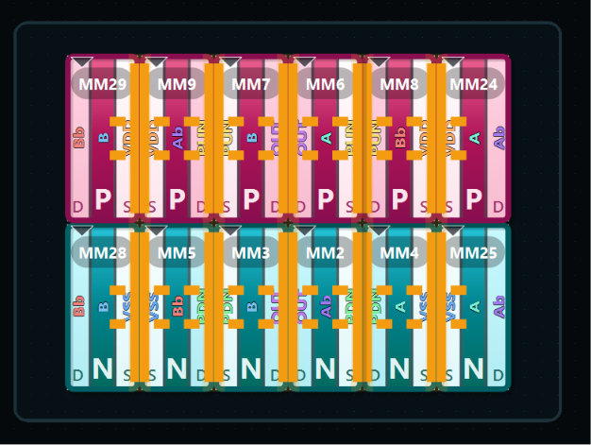
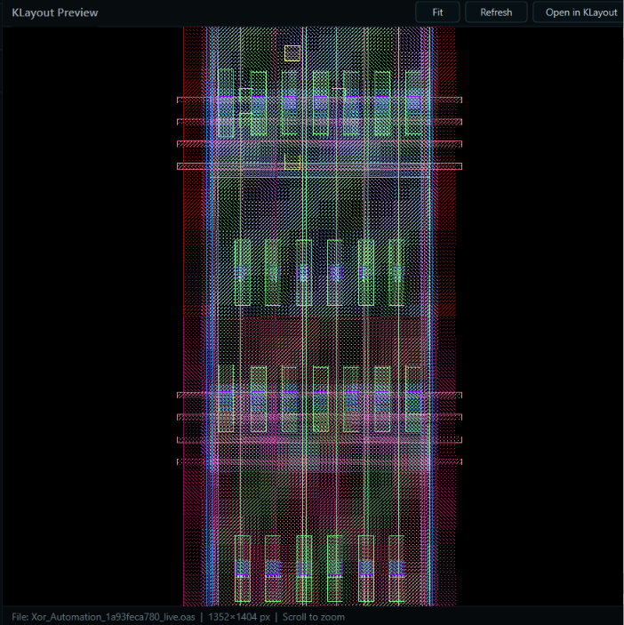
Evaluation: XOR Gate Layout - Schematic & Compacted
(c) Transistor schematic.
(d) Final compacted GDSII cell in KLayout.
AI-Based Analog Layout Automation | Ain Shams University & SI-Vision Collaboration
Slide 49

Slide 50
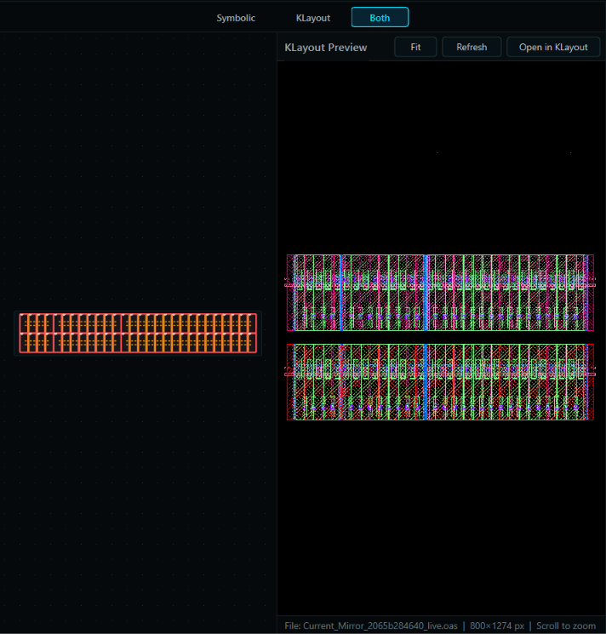
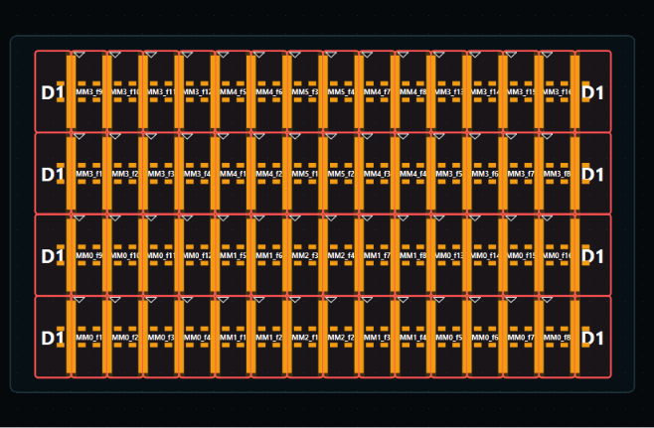
Evaluation: Current Mirror Layout - Symbolic Placements
(a) Initial uncompacted placement.
(b) Abutted symbolic placement.
AI-Based Analog Layout Automation | Ain Shams University & SI-Vision Collaboration
Slide 50

Slide 51
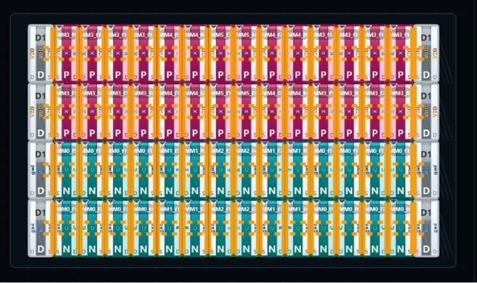
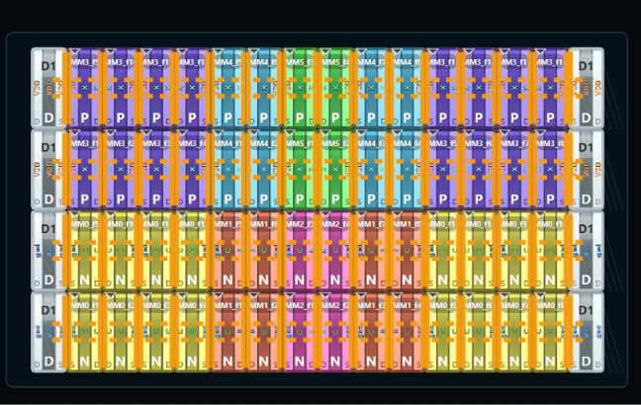
Evaluation: Current Mirror Layout - Schematic & centroid Matching
(c) Transistor schematic.
(d) Color-coded common-centroid plan.
AI-Based Analog Layout Automation | Ain Shams University & SI-Vision Collaboration
Slide 51

Slide 52
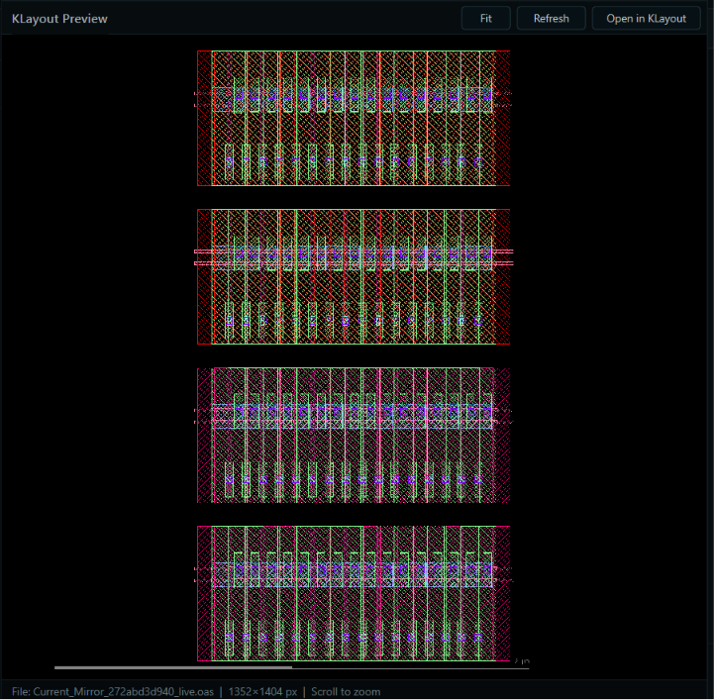
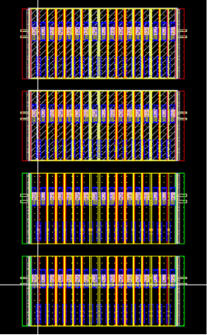
Evaluation: Current Mirror Layout - Compacted & EDA Ingestion
(e) Compacted GDSII in KLayout.
(f) Imported OpenAccess cell view.
AI-Based Analog Layout Automation | Ain Shams University & SI-Vision Collaboration
Slide 52

Slide 53
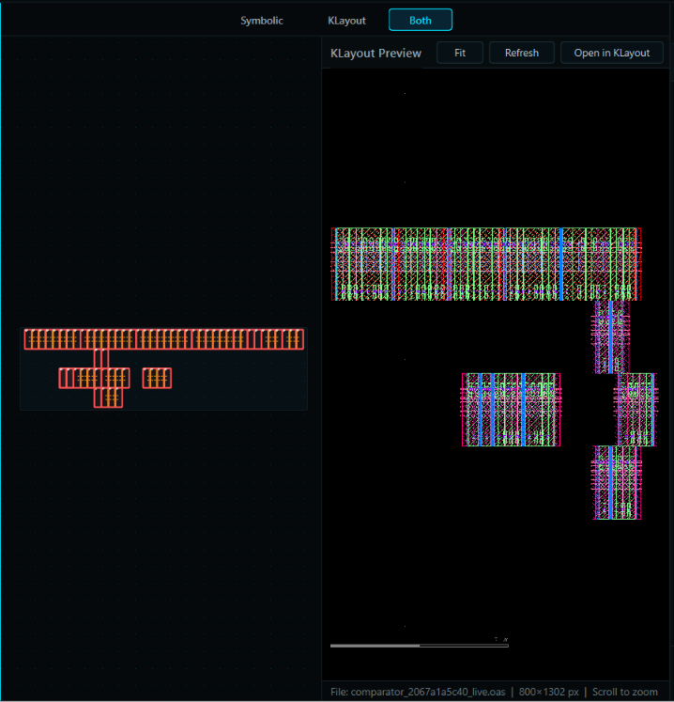
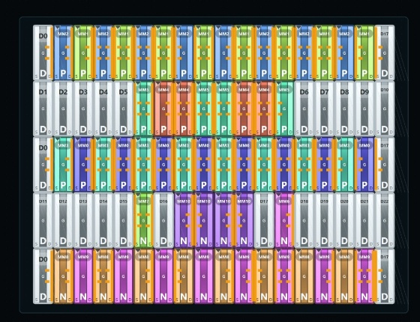
Evaluation: Dynamic Comparator Layout
(a) Initial unplaced schematic cells.
(b) Final physical layout with snapping in KLayout.
AI-Based Analog Layout Automation | Ain Shams University & SI-Vision Collaboration
Slide 53

Slide 54
Section 8: Conclusions & Future Work
Core Contributions, Technical Challenges, and AI Routing Roadmap
AI-Based Analog Layout Automation | Ain Shams University & SI-Vision Collaboration
Slide 54

Slide 55
Conclusions & Future Work: Technical Roadmap
1. AI-Guided Routing Agent
• PDK Metal Track Snapping: Develop an AI router specialist that routes net paths on discrete metal layers.
• Heuristic Routing: Uses A* search and maze routing guided by LLM-defined wire cost constraints.
• Obstacle Clearance: Calculates optimal via placements and avoids pre-existing well boundaries.
2. Thermal-Aware Layouts
• Thermal Mismatch Planning: Models silicon hot-spots and schedules symmetrical devices to cancel mismatch.
• 2D Centroid Architectures: Proposes 2D common-centroid cross-coupled placement arrays.
• Parasitic Balancing: Ensures identical trace lengths to balance active drain capacitances.
3. Nanosheet vertical stacking
• Nanosheet / CFET: Support vertical 3D transistor architectures where NMOS and PMOS gates stack vertically.
• Vertical track limits: Extends snapping grid coordinates to include vertical routing clearances.
• Automated Sub-5nm: Formulates compaction rules for sub-5nm restricted design rules.
AI-Based Analog Layout Automation | Ain Shams University & SI-Vision Collaboration
Slide 55

Slide 56
Thank You!
AI-Based Analog Layout Automation: A Conversational, Multi-Agent Framework
Ain Shams University & SI-VISION

